Slide 1
Low Temperature Sterilization
Chapter 16 7th Ed.
Rosemary Thurston RN

Slide 2
Ethylene Oxide – ETO/EO
History
  Used for items that can’t tolerate high heat of steam
  Penetrates well
  Compatible with many materials
Qualities
  Evaporates easily
    Maintains vapor state to fill and reach all areas in chamber
    Reaches all lumen spaces very well – no restrictions
  Reacts with genetic material or specific proteins
    Uses Alkylation targets organisms in MOISTURE
    Changes shape of organisms = death

Slide 3
Basic Requirements
Eight requirements for Low Temperature Sterilization
Effectiveness
  Must be tested against a broad range of organisms
  Must provide a required Sterility Assurance Level (SAL)
Safety
  No toxic residual
  Safe environment around the sterilizer
  Safe for staff if used properly – according to label

Slide 4
Monitoring
  OSHA – PEL (Permissible Exposure Limits)
    In an 8 hour Time Weighted Average (TWA)
      Maximum exposure allowed in 8 hours
      Hospitals must follow OSHA regulations
  NIOSH – National Institute for Occupational Safetya nd Health
    Established concentrations that are immediately dangerous to life or health (IDLH) see. P331

Slide 5
Quality Assurance
  Must be able to MONITOR effectiveness reliably
    Physical
    Chemical indicators
    Biological indicators
    Checked before releasing load
  Documentation
    Run
    Read
    Record
    Retain – for legal purposes

Slide 6
Penetration
  Instruments are much more complex today
  Agent must penetrate packaging AND all surfaces
    Lumens
    Tight surfaces
    Difficult to access areas
  Different processes
    Alkylation –seeks proteins in organisms to react with
    Oxidation – reacts easily – may be depleted before all organisms have been reached
      Reason to place monitoring indicators in hard to reach areas

Slide 7
Material Compatibility
  Packaging material must:
    Be permeable to agent
    Allow release of agent
    Be a barrier
    Resist tears and puncture
    Allow easy opening without contamination
    Have no toxic ingredients or dyes
    Have seal integrity

Slide 8


Adaptability
  Process should be
    Compatible with existing practices
    Easily modified to meet existing practices
Approval
  System must be cleared or registered with regulatory agencies
http://www.youtube.com/watch?v=rpuhIODxqiw

Slide 9
r
  Can penetrate through plastics
    Can reach areas that others can’t
    Requires RELEASE of AGENT
    Requires AERATION for long periods
      What remains after Sterilization is called RESIDUAL
        Warm air is circulated through chamber – Blown with fan
        Removes RESIDUAL from the material during this time
        The warmer the circulated air – the faster the AERATION
      Must be positioned same as penetration – loosely so agent can be released
  Not used with liquids
    May combine chemically with liquid and be harmful

Slide 10

Pe
Moisture is required part of process
  Small amounts of moisture should vaporize during preconditioning – during heating up and vacuum
  Wetter items may not allow ETO penetration through the water
  Don’t sterilize leather – may form toxin with tanning chemical

Slide 11
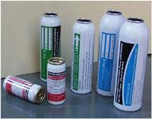
Fire safety
  In a large tank may be mixed with an inert gas to make it nonflammable and non-explosive
    More expensive
  Comes pure in small single load cartridge
    Better equipment
    Most used is 100%

Slide 12
Safety
  Must know hazards
  Procedures that reduce exposure to ETO
  Understand monitoring and be able to interpret results
  Use protective equipment
  Apply OSHA standards
  Have access to MSDS
    Know storage and handling procedures
  Know emergency plan
  Processing procedures

Slide 13
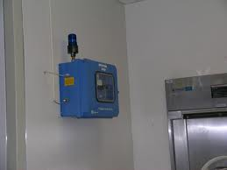
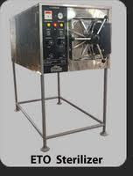
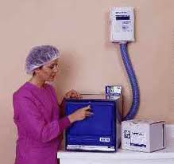
Toxicity
  Located in well ventilated area
    10 air exchanges per hour
    Has it’s own little area with an alarm
    Have emergency plan in case of spill / leak
  Residue on items
    Left after aeration is toxic
    Can burn patient skin
Aeration requirements
  8 hours at 140ºF
  12 hours at 122ºF

Slide 14
Loading
  Must have sufficient space to humidify, penetrate and evacuate (degassing)
  Use metal carts for loads when possible
    Doesn’t absorb ETO
    Reduces exposure to staff if load must be transferred to a separate AERATION chamber
  Place items on edge in basket
    DON’T STACK

Slide 15
Cycle time
  1 to 4 hours exposure to ETO
  8 to 12 hours evacuation / AERATION
    Warmer temperature shortens aeration time

Slide 16
Unloading
  Preference – to aerate before removal
  If there is a need to move to a separate aeration chamber:
    Open door 6” for 15 minutes before transfer
    Pull load (DON’T PUSH)
    Place immediately into AERATOR
    Once in the aerator – complete cycle before putting more items in it.
    If there is a PURGE CYCLE, remove items immediately after the cycle finishes, so ETO doesn’t build up again.
      If needed, repeat PURGE Cycle

Slide 17
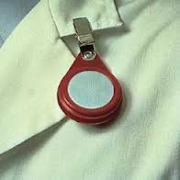
Personnel Monitoring
  Fixed to clothing in “breathing zone”
    Results determined after use
  OSHA requires keeping documentation
    For 30 years to protect employees
Area monitoring
  Real time monitoring
  Detect leaks, spills
    Failure of ventilation system
May have outside evaluation

Slide 18
Sterilizer Performance Monitors
  Physical monitors
    Guages
    Temperature control / measuring
    Timing recorders
    Humidity sensors
  Carefully examine data before removing items

Slide 19
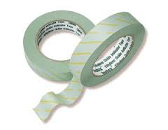
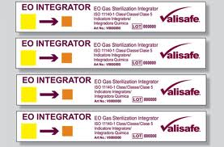
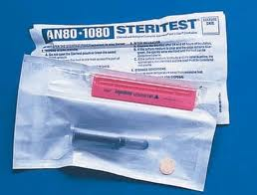
  Chemical Indicators
    Outside of packages
      Shows processing
    Inside of packages
      To show if ETO has penetrated
  Biologic Indicators
    Bacillus Atrophaeus
    Should be run in EVERY load

Slide 20
Penetration
  It is the BEST penetrator
  Easily maintained in vapor phase
  Stable – doesn’t break down

Slide 21
Material Compatibility
  Used on many types of materials
  Follow OEM recommendations
  Packaging Materials
    Plastic film
    Plastic and Paper-plastic pouches
    Nonwoven and paper wraps
    Textiles
    Don’t use:
      Aluminum, nylon films, cellophane

Slide 22
Hydrogen Peroxide - Plasma
Process
  Starts with deep vacuum
    Pulls moisture out
    Begins to warm
  Another deep vacuum
  H₂O₂ is added and fills all spaces of vacuum as vapor
  RadioFrequency energy enters
  Creates “plasma”
    Strong Oxidation kills organisms at this stage
  Process is repeated
  Then final vacuum occurs
    Takes out H₂O and O₂

Slide 23
Effectiveness
  Compatible with many materials
    Strong absorbers can’t be used in Plasma
      Powder, paper, linen, liquids
  Is more concentrated today – 95% vs. 58% previously
    Lessens lumen restrictions – diameter and length
      Must check length
      Size
      Number – how many?
      Type of material
      Number of instruments in load

Slide 24
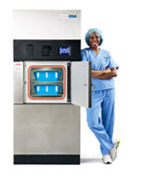
Safety
  Cassette of H₂O₂ is inserted into machine
    Has a leak indicator on the side
    Visible through clear protective wrap
    Chemical burns to the skin can occur
      With direct contact with agent
    Residual can occur if not working properly
      Residuals of active chemical can cause problems

Slide 25
  Safety practices for H₂O₂
    Training re hazards
    MSDS available
      Storage
      Handling
      Disposal
    OSHA PEL is 1ppm of H₂O₂
    Recommendations for changing vaporizer plates

Slide 26
  Safety Monitoring
    There are no personnel monitors
    Area monitoring systems are available
    Risks are possible when:
      Equipment fails
        Mechanical problems can lead to residue in items
      Procedures aren’t followed

Slide 27
Monitoring process
  Physical monitors
    Sterilizers operate on a fixed automatic cycle
      Controlled by microprocessor
    Printed record documents parameters of operation
      If process fails one parameter – Cycle is CANCELLED
      Printout will indicate the reason
    Must reprocess and repackage the load

Slide 28
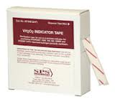
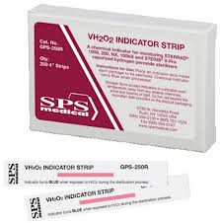
  Chemical Indicators - CI
    On outside
      To show processing
    Inside
      To show penetration
      There are penetration limits to H₂O₂
    Indicators may be light sensitive – store per OEM

Slide 29

  Biologic Indicators – BI
    Geobacillus Stearothermophilus
    Proves sterility
      Remember that items must be properly
        CLEANed
        PROCESSED
        PACKAGED
        LOADED

Slide 30
Penetration by H₂O₂
  Difficult to keep in a vapor / gas phase
    Molecules are fragile in gas phase
    Can break down easily to water and oxygen
  Increase penetration by
    Deep vacuums
    Multiple pulse additions of sterilant
    Increased concentrations

Slide 31
  Package penetration problems
    Some materials absorbe the H₂O₂
      Cellulose containing materials inhibit penetration
        Paper-plastic pouches
        Disposable wrappers
        Muslin wraps
    Should not be used with H₂O₂
    Chamber should not be crowded
      Allows agent to reach all areas

Slide 32
Material compatibility
  95% of medical devices are compatible
  Can be sterilized with H₂O₂
  May fade colored anodized components / plastics
  Brittleness of some adhesives
  Chemical changes in organic and polymers substances
  Follow OEM recommendations

Slide 33
  Manufacturers have device testing programs
    Questions???
    Contact the OEM
http://www.youtube.com/watch?v=inCeSWtw_-Q&playnext=1&list=PL242B1A4A8F45A128&feature=results_video

Slide 34
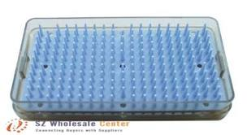
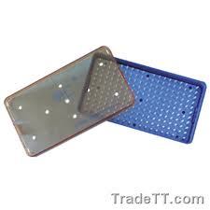
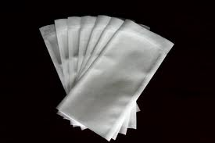
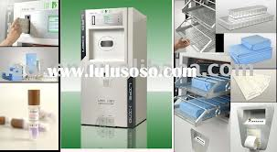
Packaging
  Special trays
    Tested for sterilization efficiency
  Standard non-woven polypropylene wrap
  Peel pouches without paper
    Tyvek pouches

Slide 35
Ozone
Strong Oxidizing agent
  Process similar to ETO and H₂O₂
  Deep vacuum
  Warmed and moisturized
  Ozone is generated in chamber
    Diffuses into load
    Kills by oxidation
  Process is repeated for better penetration

Slide 36
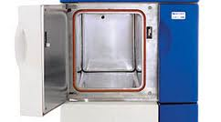
Effectiveness
  Penetrates similar to H₂O₂
  Restrictions on lumens
    Length and diameter
    Follow OEM recommendations
Safety
  Converts back to O₂ easily from O₃
    May be other risks
  No personnel monitors are available
  OSHA – PEL is 0.1 ppm

Slide 37
Monitoring
  Physical
    Based on physical measurements in system
    Review before load is released
  Chemical Indicators
    Outside
      Process identification
    Inside
      For penetration

Slide 38
  Biologic Indicators
    Geobacillus Stearothermophilus
    Negative result proves sterilization
Penetration
  Unstable agent – has difficulty penetrating
    Uses repeat cycle
  Must follow OEM instructions

Slide 39
Material compatibility
  There are restrictions
  Follow OEM
Packaging
  Tyvek packaging
  Follow OEM recommendations
Comparisons of all Low Temp Agents on p.341

