Slide 1
Inventory Management
Chapter 17 7th Ed.
Rosemary Thurston RN

Slide 2
Why?
Poorly managed inventory can:
  Create shortages and stock outs
  Impacts quality of care
  Increase costs

Slide 3
Inventory
What is inventory
  Consumable items
    Reusable
    Consumable
  Types
    Consumable
      Disposable wraps
      Detergents
      Sterility indicators
    Must purchase new to replace used

Slide 4
  Other consumable concerns
    Contamination of supplies
    Expiration
    Cost to discard unused supplies
  Must follow guidelines for consumables for:
    Purchasing
    Storing
    Handling
  Need to have safe adequate supplies

Slide 5
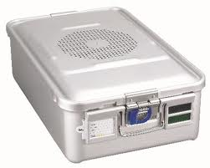
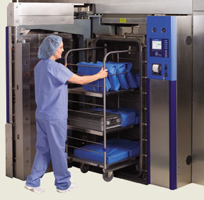
Types of Reusable supplies
  Less expensive
    Can be cleaned and reused many times
      Carts
      Rigid sterilizer containers
  More expensive
    Used many times
      Sterilizers
      Washers

Slide 6
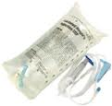


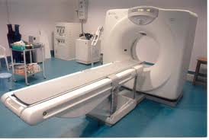
Assets
3 levels
  Consumable inventory
    Patient care equipment / supplies
    Office supplies – paper, pens, printer cartridges
  Reusable inventory
    Lower cost – wheel chairs, stretchers
  Capital equipment
    Higher cost – x-ray equipment, surgical robot systems
    Plans to purchase over time, money set aside

Slide 7
Inventory management and CST’s
Inventory management
  Provide supplies for entire hospital
    Inadequate supplies
      Can delay treatment of patients
      May cause hoarding in unapproved storage areas
  Provide supplies for surgery department
    Case cart techs
      Consumable Supplies used in surgery
    Decontamination techs
      Consumable supplies used in decontamination
        PPE – gloves, gowns, masks, goggles or face shields, etc.
        Detergents, enzymes, etc.
      Instrument techs
        Package materials, CIs, Bis, replacement screws, etc.
        Bowie Dick tests, other sterilizer supplies

Slide 8
Special concerns
Official Inventories
  Are found in:
    Storerooms
    Warehouses
    Satellite storerooms
Unofficial Inventories
  Kept in:
    Department storeroom, the lab
    At each lab station/workstation

Slide 9
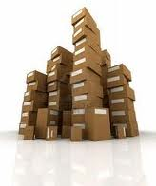
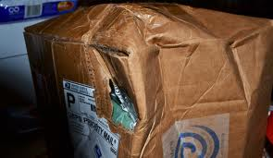

CS Responsibility
Challenge to maintain adequate inventories
  Too Much:
    Money tied up in excess inventory
    May have to borrow money to pay for received supplies
    More space required to store supplies
    Greater risk of supply loss through:
      Damage
      Obsolescence
      Pilfering or outright stealing

Slide 10


  Too little
    Shortages
    Emergency purchases
      Cost more
    Impact on patient care
    Hoarding in user department – inadequate storage
    Frequent handling to move inventories
$

Slide 11
Official Inventories
To run a hospital, Value of inventory includes:
  Equipment - $500,00 - $10, 000,000
  Reusable items - $250,000 - $2,000,000
  Consumable items - $500,000 - $1,000,000
Included in Hospital Balance Sheet as a
“Current Asset”
Includes these locations:
  CS, Pharmacy, Food Service Storeroom
  Nursing, Radiology, Surgery

Slide 12
Unofficial Inventories
Maintained at substantial levels
  Located in user departments for a long time before use

Slide 13
Considerations
Inventory levels usually exceed what is required
  Approximately 30% of budget is consumable
  Represent 50 days (7 weeks) of use requirements
  Usually there is more unofficial than official inventory

Slide 14
MUST MAINTAIN STERILITY of items
  Controls cost
  Assures patient safety
Dust control / cleaning
  Left on packages – become airborne when opened
  Fall on packages contaminating them
Clutter / overstocking
  Creates damage to packages
  May not be easily visible

Slide 15
Event Related Sterility
  May be labeled “Sterile Unless Damaged or Opened”
  All packages must be inspected before dispensing
    And before use
  If items are damaged
    Must be discarded
    Must be reported
  Costs associated with damage are TRACKED

Slide 16
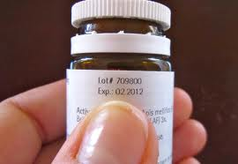
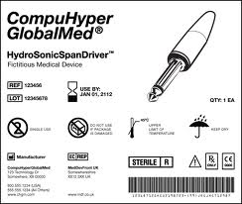
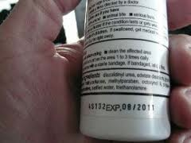
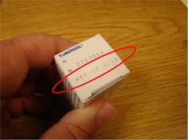
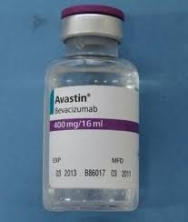
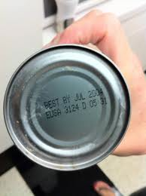
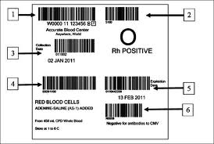

Expiration Dates
  Check each package for damage / expiration date
    No specific place for date

Slide 17
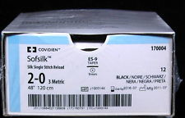
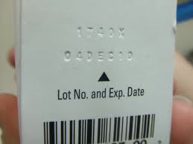
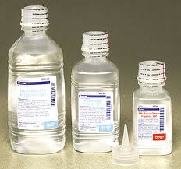
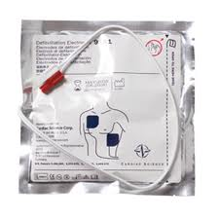
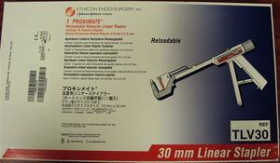

Slide 18
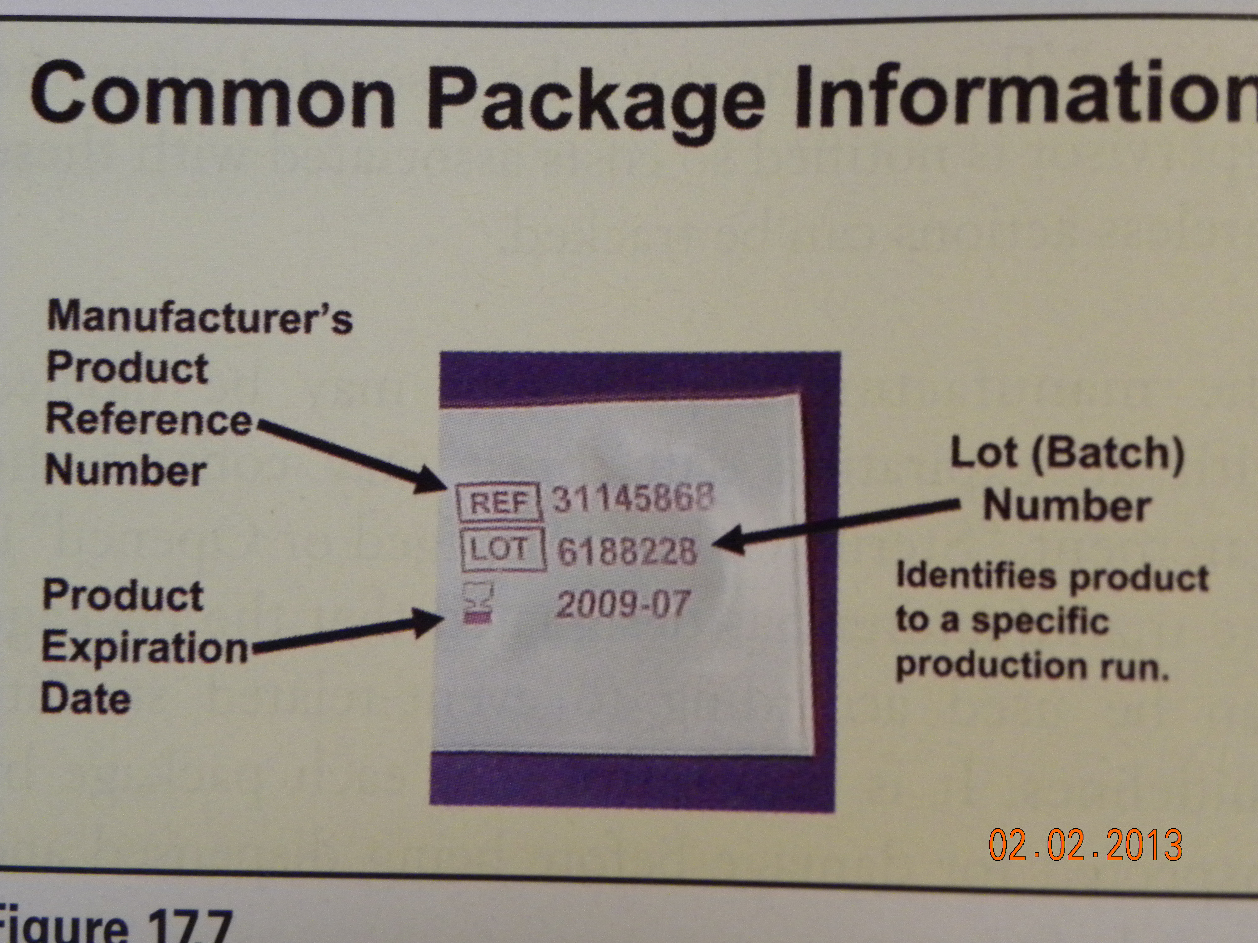
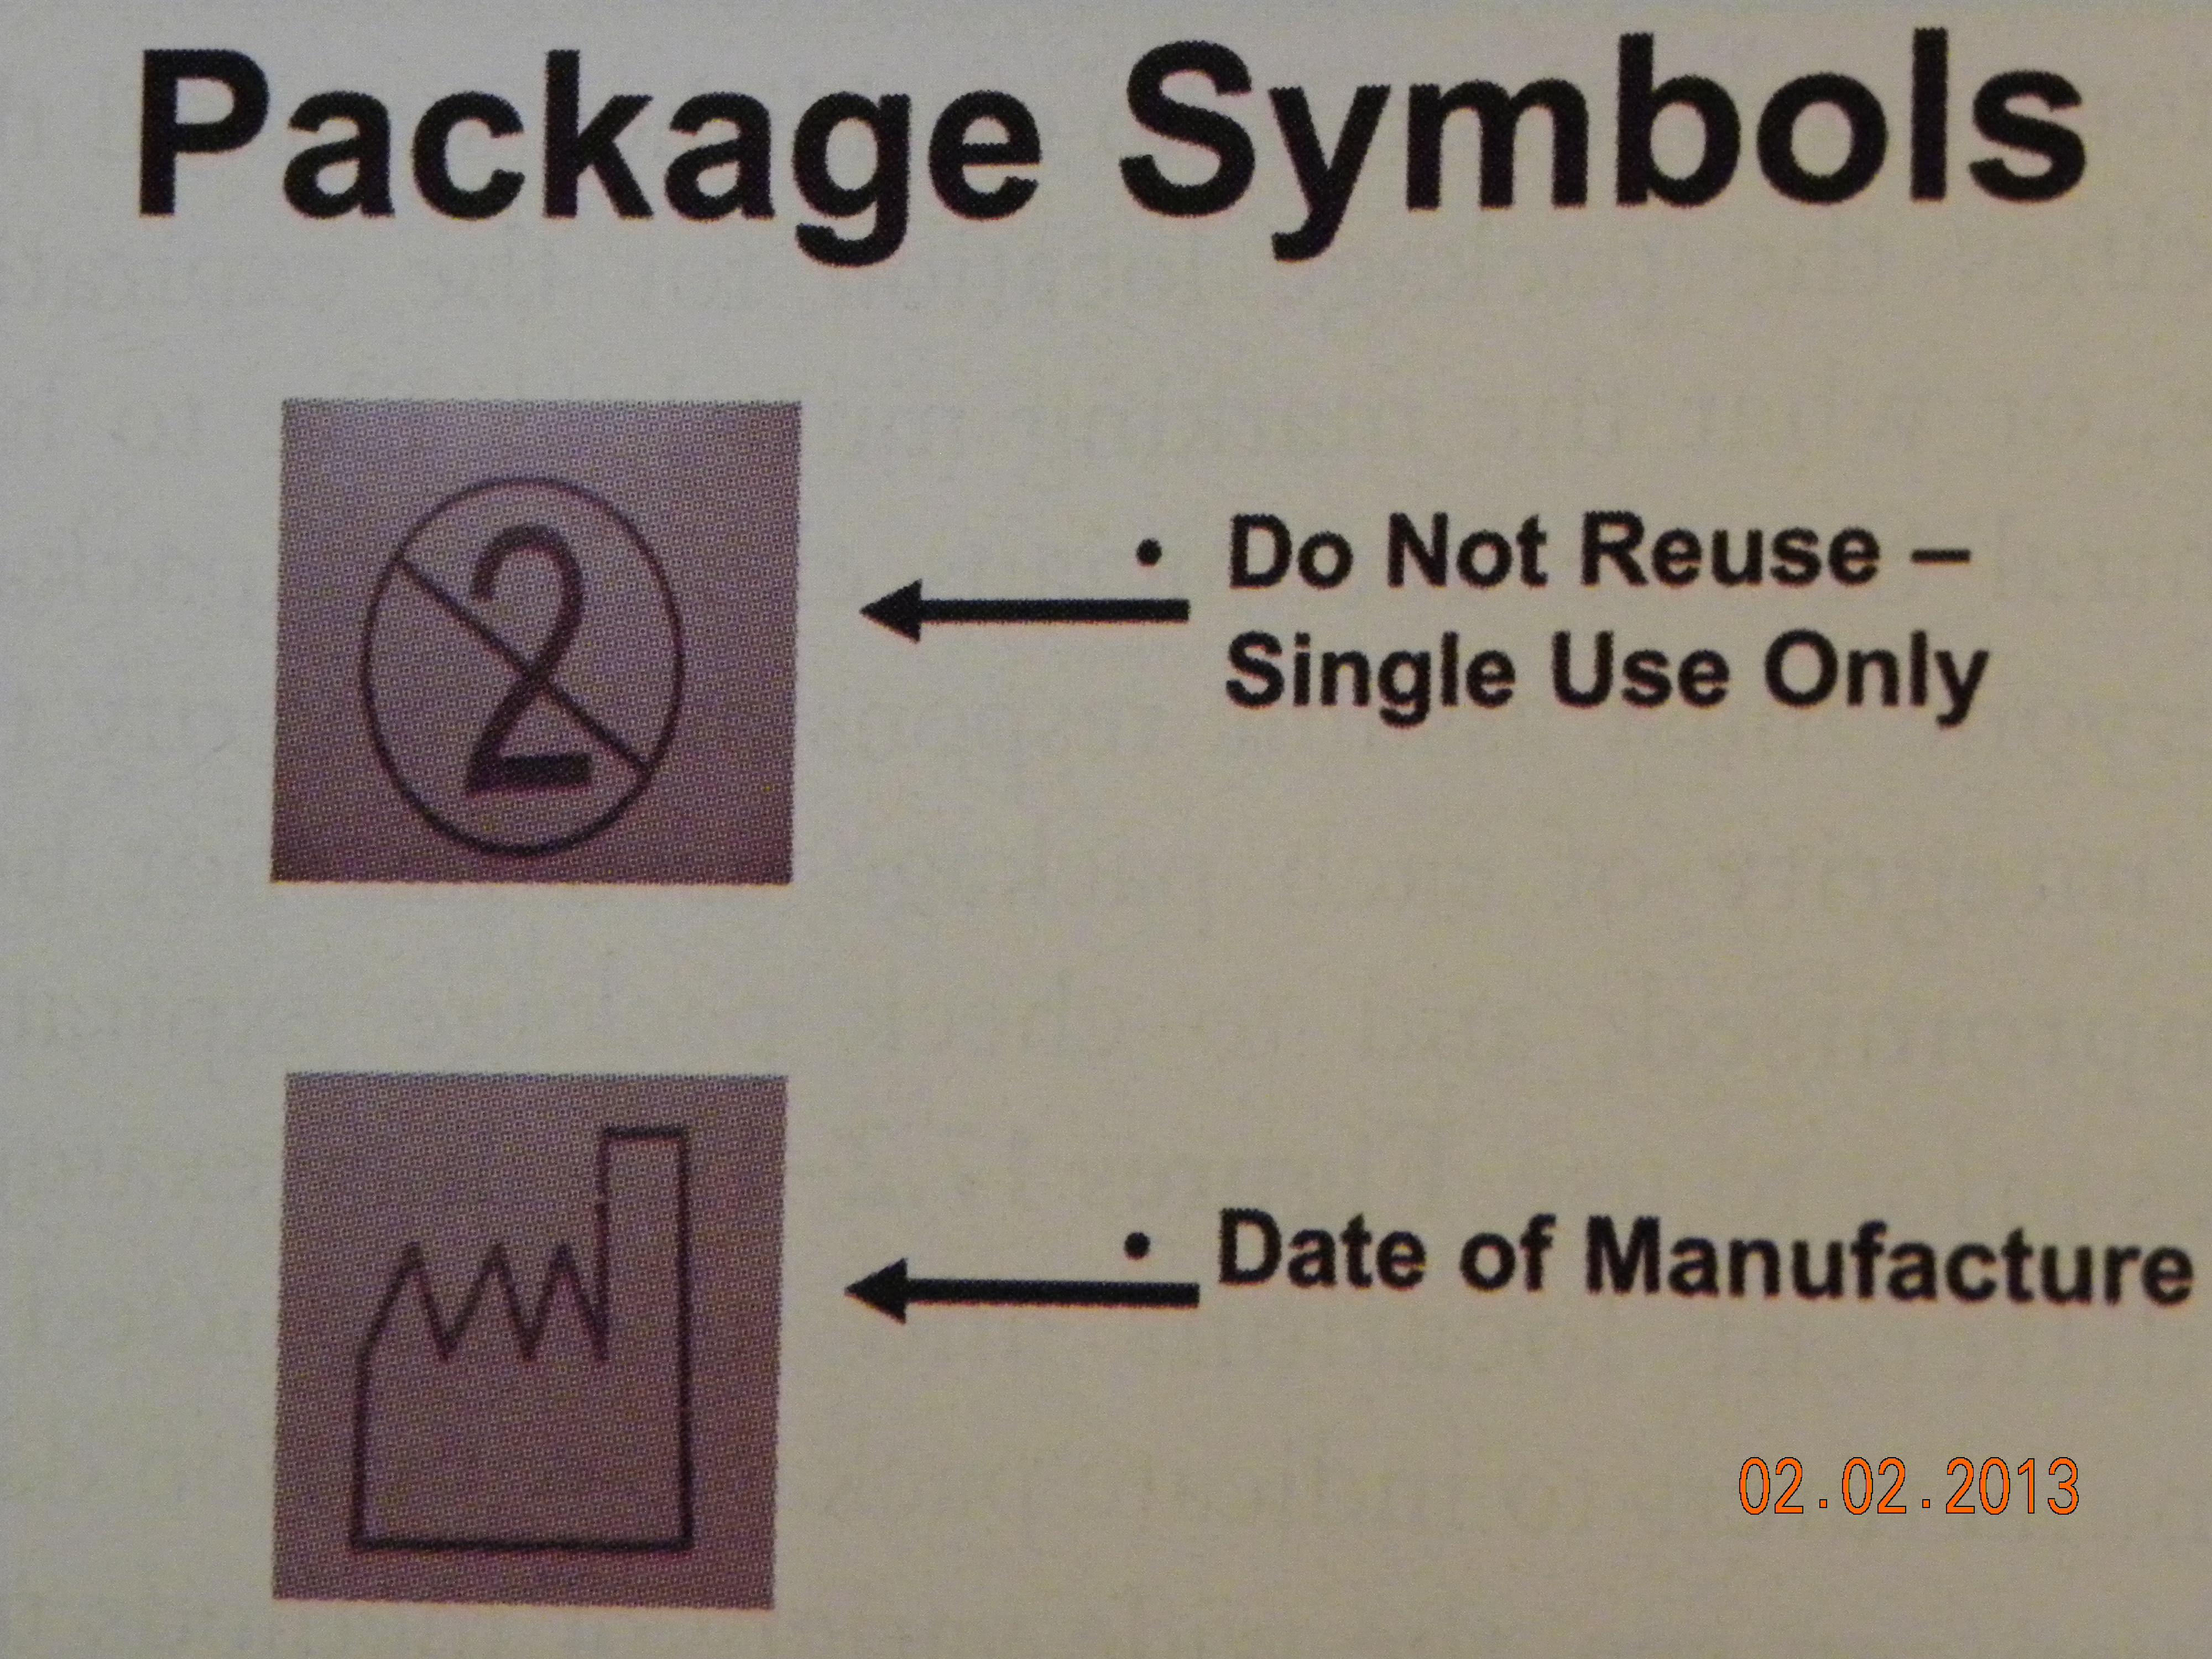

Slide 19
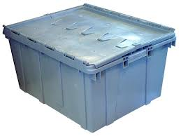
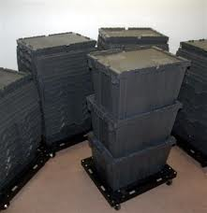
Transport
Equipment used to transport
  Outside the facility
    Must be enclosed in Cart / Totes
    Must be cleaned daily
  Inside the facility
    Enclosed carts

Slide 20
Inventory Replenishment
Methods Must
  Manage costs
  Have items available as needed
  Minimize work of supply staff
  Should be automatic – not need someone to reorder
PAR – Periodic Automated Replenishment
  Establish a standard for each item – user and MM
  CS/MM inventory each area on schedule
    Check items on hand – Count items there
    Figure what is needed to get to PAR standard – count to send
    Automatically? sent to unit

Slide 21
PAR – Level System
Item | PAR | On Hand | Needed / Send to Unit
Normal saline Irrigation 1500 ml | 40 | 15 | 25
4x4 Dressing Packages 12 / box | 26 | 13 | 13

Slide 22
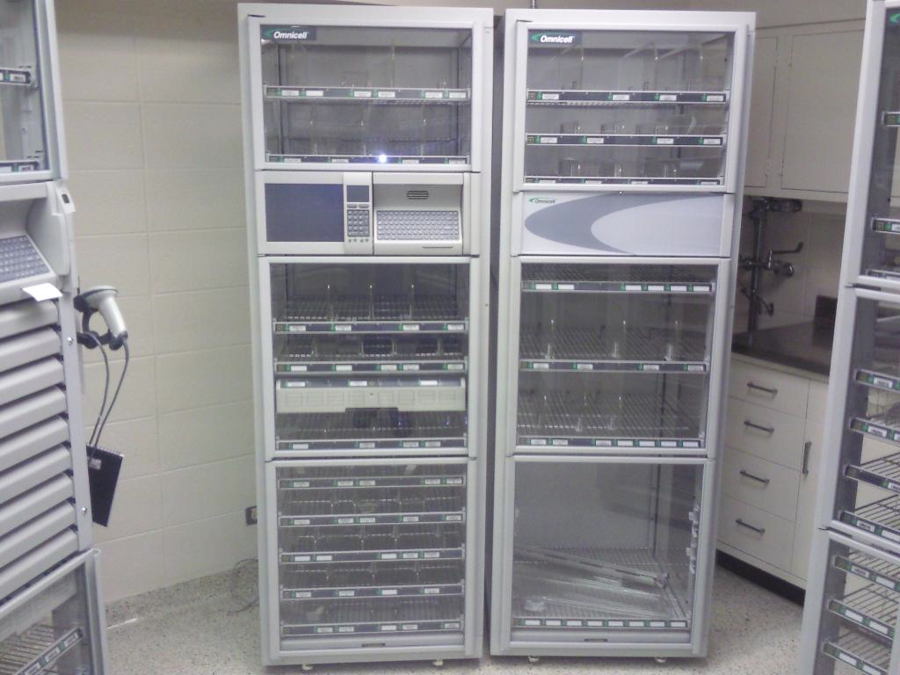
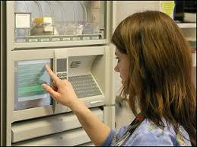
Automated Supply Replenishment Systems
  Computerized System
    Clinical users SCAN or PUSH BUTTON to indicate an item removed from inventory at that location
    Patient must be identified – if for unit use – unit identified
    Staff may have to sign in
  PAR levels and reorder points are established
    Order is generated for all items below order point
    Supply pick list is printed
    Used to retrieve needed items
  Delivered to unit / location

Slide 23
  Using information
    Can decrease / increase number of items stored in CS
    Can be used to bring items from Storage Warehouse
    Can be used to order from Suppliers
  Interfacing with other systems
    “communicating” with other unrelated systems in hospital
    ADT – Admissions, Discharge, Transfer of patients
      Knowledge of how many patients are in hospital currently
    Patient Billing System
      No one has to send information to Billing
      As it is used, it is being billing

Slide 24
Exchange Cart System
  Loaded Cart of specific items in specific area
  Exchanged for a used Cart with same items
  PAR is already decided
    Inventory is done to determine what is needed / consumed
  Cart is replenished - AUTOMATIC
    Items are charged to Unit
  Returned to unit on scheduled basis
  May have to change items or numbers at some time

Slide 25
Advantages
  Automatic – items and number already determined
    Clinical staff don’t order
    CS/MM staff don’t have to determine what is needed
  Works well for EMERGENCY carts
    Exchanged and restocked after each use see p.351
Disadvantages
  Double inventory and double carts
  Space for duplicate carts and place to restock them
  Movement of unused items many times

Slide 26
Requisition System
  Needed to:
    Order things that are not regular stock items
    Order additional items that have been used up
    CS delivers to unit
  System
    Manual – hand written on a piece of paper
    Computer – sent to department and printed
      Electronic – don’t need to re-enter for ordering into central system for MM
  Concerns
      No knowledge in CS of what unit needs are
      Difficult to manage inventory

Slide 27
Case Cart Systems
  Provides specific items for individual surgical procedures
    Assembled to meet needs of operating physician and the specific patient for a specific surgical procedure
      Providing disposable supplies
      Comprehensive systems providing
        Instruments
        Consumable Supplies
        Implants
    Meets needs of surgeons and maintains tracking system

Slide 28
Benefits
  Standardized infection control practices
    Instruments returned to decontam immediately after use
    Process begins immediately
    CS people do this all the time – do a better job of:
      Cleaning, inspecting, assembling, sterilizing complex items
  Cost reduction
    Shift responsibility to pick items from OR staff to CS staff
      CS staff are usually lower paid
  Better instrument / supply tracking
    Can better track used / unused items
    Can reduce items / reduce inventory
    Instruments being used / unused

Slide 29
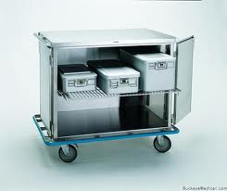
Effectiveness
  Users must decide what their needs are
    Must input into system
    Changed as practice changes
  Transferred to pick list for CS
    CS assembles carts with items
  Products should be standardized
    From same company used by hospital
      Not a special order
    Cost (acquisition, storing, etc.), quality
    Should not have different brands of same thing

Slide 30
  Delivered to user unit by assigned staff
    Must arrive on time
    Stays in contact with unit – COMMUNICATION
      OR staff must realize time to reprocess an instrument / set
      Must be aware of new items / instrument names / procedures
    Delivers additional items as needed
  After procedure is complete
    Cart is returned
    Reprocessable items go to Decontam
    Unused items go back into stock
    Charges for used items
    Replenishes inventory

Slide 31
  Standby Carts
    For EMERGENCIES
      Assembled
      on “Stand-By”
    Used for STAT situations (IMMEDIATE)
      For Cesarean Sections
      For Trauma
    For vaginal deliveries

Slide 32
STAT Orders
  Require IMMEDIATE ACTION
    For an item needed in patient care areas
  May be needed for the next day in surgery
    If item is not available
    May require
      Overnight air shipment
      Borrowing from another facility

Slide 33
Must be aware of
  Why they OCCUR
    Supplies too low – need to increase PAR
    Improper Planning - late notification of needs
  How they can be PREVENTED
    Routine reviews of usage on care units for PAR-levels
    Communication with and:
      Education of staff involved in use of items
      Preplanning for possible emergencies

Slide 34
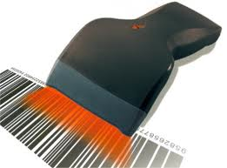
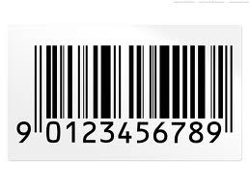
Automated Inventory Tracking Systems
  BAR CODES
    Bar code is scanned from item being used
    Tone that it has been read is heard
    Produce information goes to MM system

Slide 35
  RADIO FREQUENCY IDENTIFICATION (RFID)
    Tags on clothing in stores – removed before you leave
    Bars on items that are rubbed over a surface to deactivate them
    Being used currently for:
      Track expensive supply items
      Moveable patient equipment

Slide 36
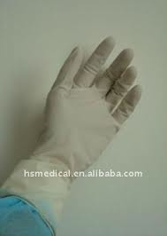
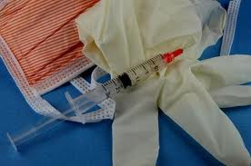
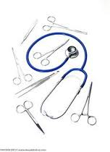

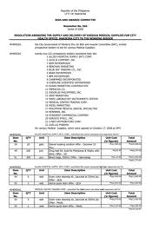

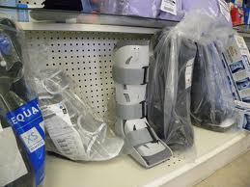
Distribution
Moving supplies from storage to user location
  Everything consumable usually
    Patient care items
    Paper supplies
    ETC.

Slide 37
Goal
  Move correct items
  In right quantities
  To right places
  At right times
  Being cost efficient
  By appropriate personnel

Slide 38
Considerations
  Routine in department
  Frequency
  Volume of use
  Peak activity times
  Amount of storage space in user areas

Slide 39
  Scheduled distribution
    Day of the week – what days or Daily?
    Category of supply –
      Medical /surgical – daily?
      Paper supplies – weekly?
    Type of User Area
      Medical – daily?
      Administration Office – weekly?
    Schedule of Patient Activities
      Operating Room Schedule – depending on schedule?
      Pulmonary unit – weekly?

Slide 40
  Physical Location
    Building A – daily?
    Building F – on Fridays?
  Quantity Required
    2x/ day = busy areas without enough storage
    Monthly = off-site building with lots of storage

Slide 41
Inventory Management Concepts
Perpetual Inventory System
  Manages and controls official inventories
  By maintaining a record about the balance on-hand
    Of each item at all times
Items are:
  Ordered
  Received
  Issued. . . . OR . . .
  Returned to suppliers

Slide 42
Allows MM to know exact quantity on hand
  Have a BALANCE at all times
Date | # Units Available | # Issued | # Ordered & Received | Balance
Day 1 | 8 |  | 10 | 18
Day 2 | 18 | 3 |  | 15
Day 3 | 15 | 5 | 8 | 18

Slide 43
Validated routinely
  Inventory count should match the BALANCE
  If there is a discrepancy (not the right number)
    It is called a VARIANCE
Counted Inventory # = Balance # on Paper
If they are not equal = VARIANCE

Slide 44
ABC Inventory Control
  Allows management and control priorities
  Each letter represents items with certain value
    Focuses on control of highest value first and then down the line
A = largest annual $ value – smallest number of items
  Hip and knee implants
B = medium $ value – mid number of items
  Procedure kits
C = smallest $ value – largest number of items
  Dressing and sponges

Slide 45
Alternative Inventory Control
  MM + CS + Department Units work together
    To Maintain the
      Lowest level. . . and . . .
      Most cost effective level
  Must select the method best suited for their facility
  Inventory Control Systems include:
    Min/Max system
      Minimum # needed before ordering – “Safety Stock Level”
      Maximum # in inventory – tells how much to order, like PAR

Slide 46
    Economic Order Quantity System
      Products are ordered in the most economical quantity
        By the Box, Case, Dozen, etc.
    Stockless Supplies
      SUPPLIER provides storage, inventory and distribution
        Delivers on pre-schedule basis
        There may be no on-hand supply
      Supplier does inventory and also delivers daily
    Just-in-Time (JIT) System
      Minimal stock on hand
      Orders are delivered when needed
      Reduces on hand inventory and costs

Slide 47
    Consignment System
      Items are owned by supplier and stored in hospital facility
      Items are only charged when used or lost
      Requires tight control – who pays in disaster, etc
    Pick-n-Pack System
      Items ordered from vendor
      Prepacked for a specific department
      (generally these are office supplies / forms)

Slide 48
Total Acquisition Costs
Analyzed by department working together
  Central Service, Materials Management, Purchasing
  Assure Quality with minimal Cost
Costs include:
  Requisitioning
  Authorizing
  Ordering
  Receiving
  Storing
  Picking
  Distributing
  Disposing

Slide 49
Other costs in addition:
  Storage costs – warehouse? Hospital space?
  Disposal of expired items
  Theft / pilferage
  Obsolescence – item is out of date / not wanted anymore
  Freight / delivery charges
  Stock outs – stock is not available

Slide 50
New Equipment evaluation
  Equipment +
  Additional items required for equipment +
  Education for staff
  Distribution of components – if any
Communication
  Between department considering equipment
  CS, MM, and Purchasing, Administration

Slide 51
Inventory Turnover Rates and Service Levels
Inventory Turnover Rate =
  Number of times per year
  Inventory is:
    Purchased
    Consumed
    Replaced
Concern:
  If they increase –may have a Stock out
  If they decrease –may have too much inventory

Slide 52
Inventory Service Levels
  % of items filled when order is placed
  8% Stock out must not include Medically-Necessary
  Medically-Necessary should be 100% always
    Inventory investment costs can be expensive
    Must balance service levels and cost
# Items Ordered | # Items Filled - delivered | % Inventory Service Level | % Stock out Level
100 | 92 | 92% | 8%

Slide 53
Inventory Information Systems
  Inventory = Cash
  Without Inventory = Cash in bank
  When Inventory is lost, expired, stolen
    Cash is used to replace it
Must have effective record keeping system
  Most use Perpetual Inventory System
  Some use a Manual Record System
    Maintain “on-hand’” quantities
    To note items on order

Slide 54
y
Uses Card System
  Item, vendor source and # of units
  Info on orders placed
  Receipt transactions
  Issue transactions
  Adjustments

Slide 55
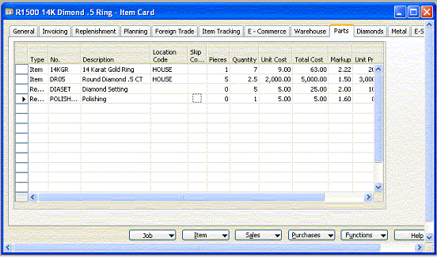

Slide 56
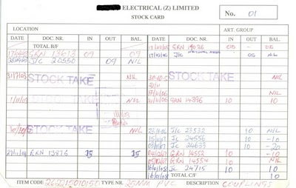

Slide 57
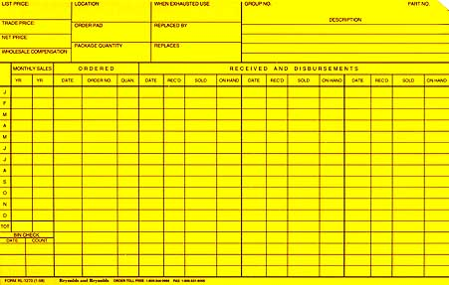

Slide 58
Manual System
  Difficult to maintain accurately
    To create inventory management reports
    To look at trends and service levels
Computerized Systems
  Are expensive
  Do not eliminate staff time
    Data transactions are associated with inventory management
  Provide useful information re:
    Use trends – turnover and service levels

Slide 59
Variations in Computer systems
  Inventory management only
  Connected to financial management systems
  Large and small
  Integrated with financial, patient car and other systems
  With Material Management and Purchasing
  Some are department specific or include all departments

Slide 60
Stock Locator Systems
  Items should have an assigned stock location (bin)
    May be computer or manual system
  Enables you to find any item in storage
    May allow location and picking order
  May also be connected with case cart system
    Creates path for staff to pull items for case cart in sequence

Slide 61
Space Utilization
  Concern
    When service have outgrown the space
    Storage space is in high demand
  Has impact on:
    Order picking process
    Inventory management activities
  When space tight
    Staff teamwork is important
      To increase output
      To develop new processes and work flows

Slide 62
Available space
  Square footage vs. cubic footage (volume)
  Store room capacity can be increased vertically
  Shelf storage locations assigned:
    From top shelf on the Left going to the Right
    Down to second shelf – left to right
    Leave space for future add-ons
    Fill the shelf – front to back, top to bottom
      Put like size and type together
      Move shelves to accommodate size

Slide 63
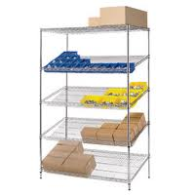
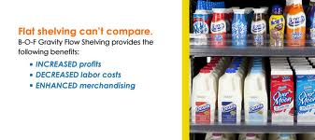
Gravity Flow Racks
  Pick up on front
  Stock from the back
  Uses gravity for ease
  Helps ensure stock rotation

