Slide 1
Management of Patient Care Equipment
Chapter 18 7th Ed.
Rosemary Thurston RN

Slide 2
Patient Care Equipment
Must be:
  Available when needed
  Safe
  Functional
  Ready-to-use
  Free from contamination / soil
Minimize costs
  Management program is necessary

Slide 3
Importance of Responsibility
Must have guidelines for:
  Cleaning
    Can pose infection potential
    Handled by many during decontamination, storage, distribution
  Preparing
    If not prepared appropriately – can cause delay in treatment
    Patient care staff may have to get additional components
  Tracking
    Can be lost in system
    Can cause delays or cost when replacing “lost” equipmt.

Slide 4
Responsibilities
Central Service
  Maintain flow of patient equipment
Biomedical /Clinical Engineering Dept. ( Bibomed )
  Perform inspections for:
    Safety
    Function
Each should keep to their own specialty / as trained

Slide 5
Equipment
  When entering the facility, Biomed must:
    Checked for safety
    Tested for function
  Periodic inspections and services – Preventive Maintenance
  Records are kept re
    Routine checks
    Repairs
    Other

Slide 6
The Joint Commission
  Requires Preventive Maintenance (PM) standards must be established for healthcare equipment
  General rules to follow:
    Assigned equipment location
    Ownership status - rented, leased, owned, borrowed
    Schedule for PM
    PM history
    Hospital-defined PM standards
    Repair history

Slide 7
Relation between CS and Biomed
When equipment is returned to CS
  Check PM sticker
  Reroute items needing PM to Biomed
  Check for and forward to Biomed:
    Damaged electrical cords
      Cracked, torn, frayed
    Damaged cases
    Loose knobs / switches
    Other signs of damage

Slide 8
Types of Patient Care Equip.
Purpose of basic types of equipment
  Improves customer service
  Reduces frustration
Must understand requirements for:
  Cleaning
  Inspecting
  Preparing
  Storing
  Dispensing
  Tracking

Slide 9
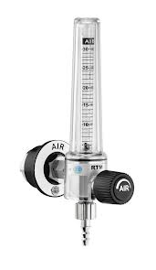
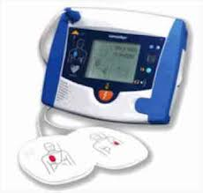
Types of Equipment
Airflow Regulator
  Gauge that control flow of gas
Defibrillator
  Delivers electroshock to restore heart rhythm

Slide 10
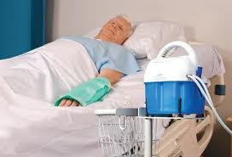
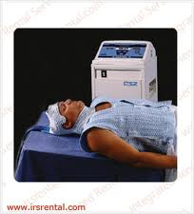
Hypothermia unit – Hot/cold therapy device
  Pumps heated/cooled water through coiled pad
  Heats or cools body or body part

Slide 11
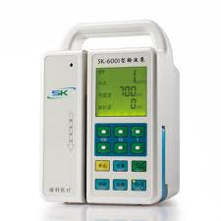
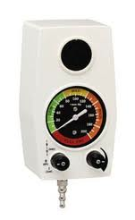
Infusion pump
  Controls administration of IV fluids
Intermittent Suction Device
  Suctions and stops at intervals

Slide 12
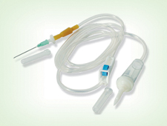
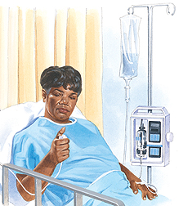
Microdrip
  IV line that delivers 60 drops/ml instead of 15/ml
PCA (patient controlled analgesia)
  Allows patient to control pain medication

Slide 13
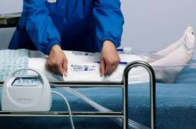
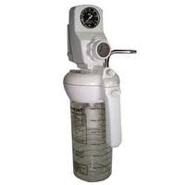
Sequential Compression Device –SCD
  Squeezes lower legs to prevent DVT (deep vein thrombosis)
Suction Unit
  Connected to vacuum to remove secretions
  Has a collection container

Slide 14
Handling soiled equipment
  ALL patient care equipment is “contaminated” once it is in use for a patient
  CS staff make ROUNDS to pick up soiled equipment
    Use gloves
    Transport back to decontamination in closed container p.127
  Disposable components
    Should be disconnected at POU and disarded

Slide 15
Cleaning
  Follow OEM recommendation
  Include healthcare facility infection control protocols
  Must have ATTENTION TO DETAIL
    All surfaces thoroughly cleaned to include:
    Cords
    Switches
    Crevices

Slide 16
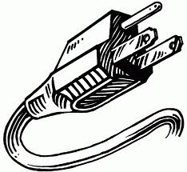
  Inspection
    Cords
      Frayed, cracked
    Plug
      Must have 3 prong plug
      Check for missing prong
    Case
      Dented or cracked – dropped???
    Concern – send to Biomedical for check

Slide 17
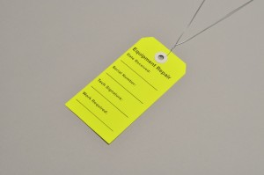
Nonfunctioning equipment
  Identify and TAG
  Return to Biomed
  If it has been in a patient room
    It needs to be decontaminated

Slide 18

Preparing Equipment for Use
  Should be ready-to-use and stored after processing
  Should be assembled
  Include new disposable supplies with equipment
  Check or send replacement batteries with unit
Preparing equipment with water
  Know OEM recommendation
  Water reservoirs, fill procedures and testing

Slide 19
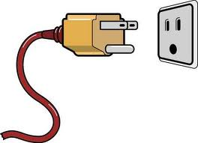
Storing Equipment
  After cleaning, inspection and assembly
  Usually occurs in CS or in User units
  Away from traffic in a secure area
    Prevents tampering, infection control breaches and damage
  Battery back up should be plugged in for Recharge
    May be needed for patient transport or power outages

Slide 20
Tracking
  Usually smaller – can be set aside and misplaced
  Can be difficult to locate
  Can create shortage - require rentals / replacement
Manually – on paper
  Uses equipment ID number
Computer
  Using Bar codes or RFID

Slide 21
Tracking information needed
  Current location
  Patient name to charge use
  Equipment usage and trends
  Track usage
Allows:
  Monitoring needs
  Availability when needed
  To justify additional equipment

Slide 22
Procuring Equipment
Procuring New Equipment
  Why
    Increased patient volume
    New technologies
  New equipment may be:
    Purchased
    Leased
    Rented
    Loaned by manufacturer

Slide 23
Purchase
  Personnel Identify need
  Determine type (model, style or brand
  Budget for purchase
  Purchase
  Incorporate into the system

Slide 24
Lease
  Determine need
  Contract with manufacturer / lease company
  Leased for specific time period – months / years
  Return at end of lease period or purchase it
  May then lease newer equipment

Slide 25
Rental
  Identifies immediate need
    May have high patient volume for existing equipment
    Or single patient need
  Done on a short term basis – one day or more

Slide 26
Manufacturer’s Loan
  May provide equipment if facility uses disposables
  May be provided when repairs are done on hospital equipment
Decisions
  Made by Administration
    What is most beneficial to facility
CS responsibility
  The same regardless of how equipment is acquired

Slide 27
Other Equipment Concerns
Maintenance and Repair
  Done by Biomedical Engineers ONLY
Preventive Maintenance ( PM )
  To identify potential problems
  Safety and function checks per OEM
    Routine and scheduled time line
Repair
  When equipment fails to function / is damaged

Slide 28
Outsourcing Equipment Systems
  Transfer control of equipment management system to outside entity
  Usually relates to
    Maintenance
    Repair
  Maintaining equipment daily
    Still CS responsibility
  Non-clinical functions
    Must be cost justified
    Want the most cost-beneficial option

Slide 29
Maintenance Insurance
  Hospital retains control of it’s equipment
  Hospital contracts with outside insurance group
    Manage and insure costs to maintain equipment
  Options
    Pay a flat fee – group manages equipment
    Risk-sharing - share cost or savings of maintaining equipment
    Management contracts – hospital incurs cost, insurance group manages equipment

Slide 30
Conclusion
CS Tech responsibilities
  Assure equipment is:
    Clean
    Assembled
    Ready for use
  Track equipment
  Insure patient’s needs are met
  Keep current re equipment and patient safety

