Slide 1
Tracking Systems
Chapter 19 7th Ed.
Rosemary Thurston RN

Slide 2
Need to Track
Why?
  Items are in constant movement between departments
    Dispensed
    Used
    Replaced / reprocessed
  Need to
    maintain order
    Insure availability

Slide 3
Tracking ensures:
Items can be quickly located
Know when to order consumable supplies
Measure item usage
Maintain adequate records of processes
  Sterilization
  Distribution
Assist with Quality processes
Obtain information for cost analysis

Slide 4
Financial tracking
  Man be done manually
  Usually done by automated information system
  Types of automated systems
    Instrument tracking
    Sterilization logging information
    Patient care equipment tracking
    Inventory management

Slide 5
Role of Computer Based Information Systems
Basic Function - to help decision making
  For Efficient use of hospital personnel
  To Centralize control and Information flow
Concerns re:
  Rising material costs
  Concerns about inventory
  Need to improve production and processing
Automated systems
  Provides opportunity for greater productivity /efficiency

Slide 6
  Automated systems combine
    Clinical needs
      Patient information
      Chart / medical records
    Information systems
      Data re supplies and equipment stock
      Must be managed and tracked
      Physician Preference Cards
      Case cart pick lists
      Instrument set lists
      OTHER- lab, radiology, administration NEEDS
    Financial administration
      Charging patients for items and use of equipment

Slide 7
  POU and Point of Care
    Computers are at the bedside
    In the work areas
      Wireless
      Hand held and portable computers
  Advantage
    Provides opportunity for
      greater productivity
      greater efficiency

Slide 8
Selection of Department Systems
  Define and evaluate requirements / needs
    Why is it needed?
    What do I want to do?
    Can it do what I want?
    Is it compatible with what I already have?
    Cost?
    Amount of work it must be able to do?
    Type of systems needed?
    How many users?
    Financial / patient information security?

Slide 9
Tracking Systems
Need
  Financial goal of reasonable instrument and equipment budgets
Tracking systems can:
  Forecast needs
  Give processing costs for trays / instruments

Slide 10
Manual systems are now computerized:
  Tags
  Log books
  Information on bulletin boards
Software
  Can buy or design your own systems
  Buy off of shelf with little support
  Buy product with support / upgrades

Slide 11
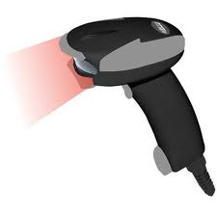
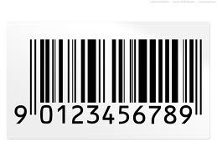
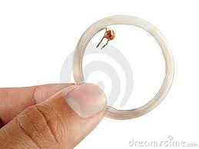
Tracking methods
  BAR CODE labels
    Scanned with reader
      For LOCATION
  Radio Frequency Identification – RFID
    Real time tracking – sends out signal continuously
      For LOCATION
  Purchase factors:
    Cost
    System compatibility

Slide 12
  Systems
    Usually a stand-alone hospital-based network
      Users include
        CS
        OR
    Subscription systems – pay for monthly
      Controls cost and have what they want
      Can change systems as needs change
    Depends on ability to upload or download files
      Instruments
      Equipment and location
      Instrument set lists
      Inventory costs
      Repair / purchase information
      Preference card and Case cart lists
      OR scheduling

Slide 13
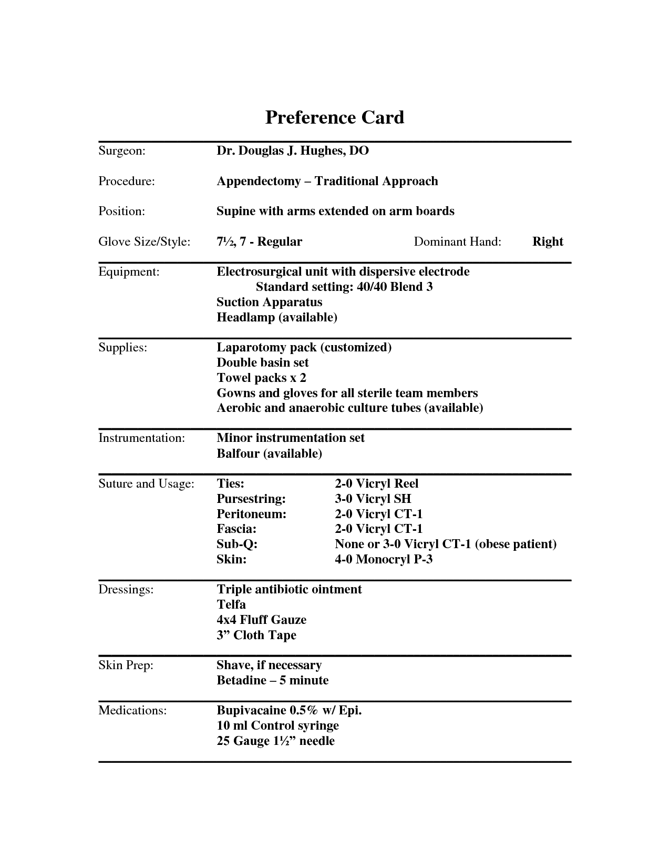

Slide 14
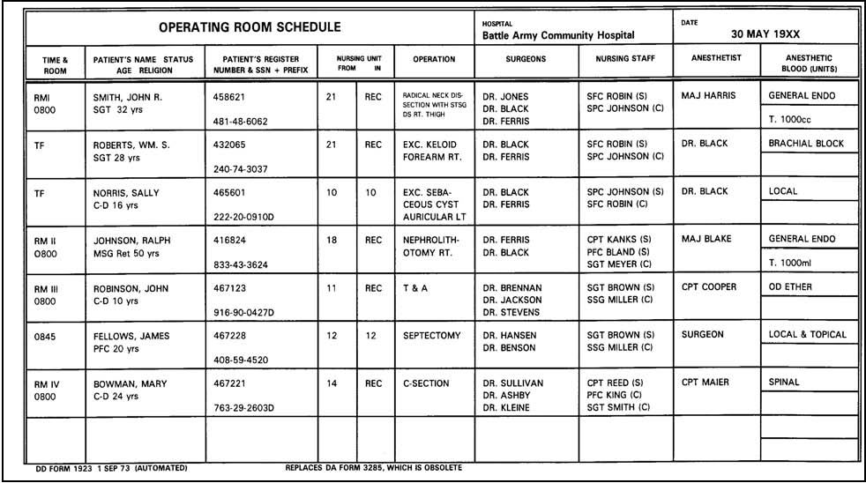

Slide 15
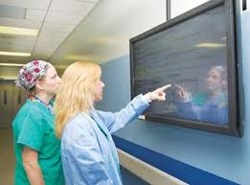

Slide 16
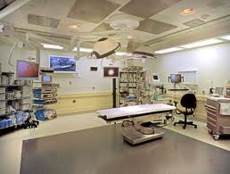

Slide 17
Tracking Needs
One area of facility may have special needs
  Different
    Procedures
    Equipment used / maintained
    Inventory
Advantage of computer tracking
  Quicker reports
  Wider scope of capabilities – can do more
  Store back up data

Slide 18
Sytems
  Must be able to update
  Capabilities
    To track one instrument in a set
      Dot etched on instrument
      RFID – know now
      Bar codes – know where last scanned location was
    Devices used
      Hand-held
      Wired to computer terminal
      Fixed radio receivers for RFID
      Manual input on keyboard / other device

Slide 19
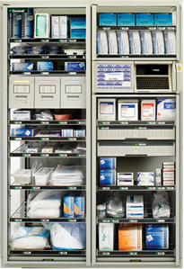
Omnicell in OR

Slide 20
Concerns
  Chemicals in decontamination
    Can damage markings
      Destroy laser etching
      Face barcode labels
  Heat in sterilization
    Can melt RFID transponder
    Can destroy batteyr in RFID
  Water, chemicals, heat to dry
    Can dissolve adhesive on Cart RFID transponders
    Can damage the RFID transponder itself

Slide 21
Features of systems
Basic systems
  Can track
    Instrument sets
    Pieces of equipment
    Last know location of an item
    Cost / value of equipment or instruments / sets
    Number of processing and use cycles for instruments / sets
    Use of specific equipment
    PM schedules and Repair histories for
      Specific equipment or instruments

Slide 22
  Can provide
    Instrument set lists
    Equipment set up procedures
      CS staff who assembled, inspected set or equipment
      Date processed
      Sterilization / cleaning process
      Catalog number / manufacturer’s name for ID
      Quantity of instruments in set
      Lists by category or instrument placement in set
      ID of instruments missing from set
        Can be put on outside for ID and tracking

Slide 23
  Productivity information
    Sets and instrument processed / completed in a shift
    Sets completed by a certain staff member in a shift
    Equipment distributed and processed
  Quality Assurance
    Sterilization load quarantines
    Education / in-service documentation
    BI monitoring standards and regulations

Slide 24
  Ability to Interface with:
    Sterilization equipment
    Washer-decontaminator equipment
  Financial data
    Instrument replacement / repair
    Equipment replacement / repair
    PM notification
    PM records for specific equipment / catagories
    Utilization of instrument sets and equipment
    Productivity and staffing requirements for peak times

Slide 25
  Interface to clinical areas
    Can link instrument sets / equipment to patient’s medical records

Slide 26
Advanced Systems
Tracking location through
  RFID tracking
  Bar Code labels
  Laser etched Bar Code
Facilities must look at all features to decide what is best for them

Slide 27
Conclusion
Technology
  Can improve processing in CS
  Can improve services from CS to facility
  Helps control costs
    Product and supplies
  Helps with tracking
  Can:
    Address administrative costs
    Help with quality patient care

