Slide 1
Introduction to Central Services
Chapter 1 7th Ed.
Rosemary Thurston RN

Slide 2
Central Service
Central
  One area
  Using one set of standards
Service
  Activity that helps others
  Provides for Patient Care
    Equipment
    Supplies / materials

Slide 3
Central Service Department
Depends on:
  The Right Policies
  Good Work Practices
  Well Trained People

Slide 4
Different Names – same service
Central Service
Central Sterile Supplies
Sterile Processing and Distribution
Central Supply

Slide 5
Services Provided
Can vary
  Use same standards
Each Provides
  Infection Control
  Material Support
    Integrated Delivery Network – IDN
      Provides coordinated range of REPROCESSING services
      To a specific Population –OR is the main user

Slide 6
Medical Procedures
Need:
  Instruments
  Supplies
  Equipment
May be
  Disposable
  Reusable
    Need to be safe to be reused
      Cleaned – inspected - disinfected /sterilized

Slide 7
Contamination
Soil – Dirt – Bioburden (biologic burden/soil)
  Blood
  Body fluids
  Tissue
  Microorganisms
Must be cleaned
  Items flow through CS in ONE WAY FLOW
    DIRTY to CLEAN ALWAYS

Slide 8
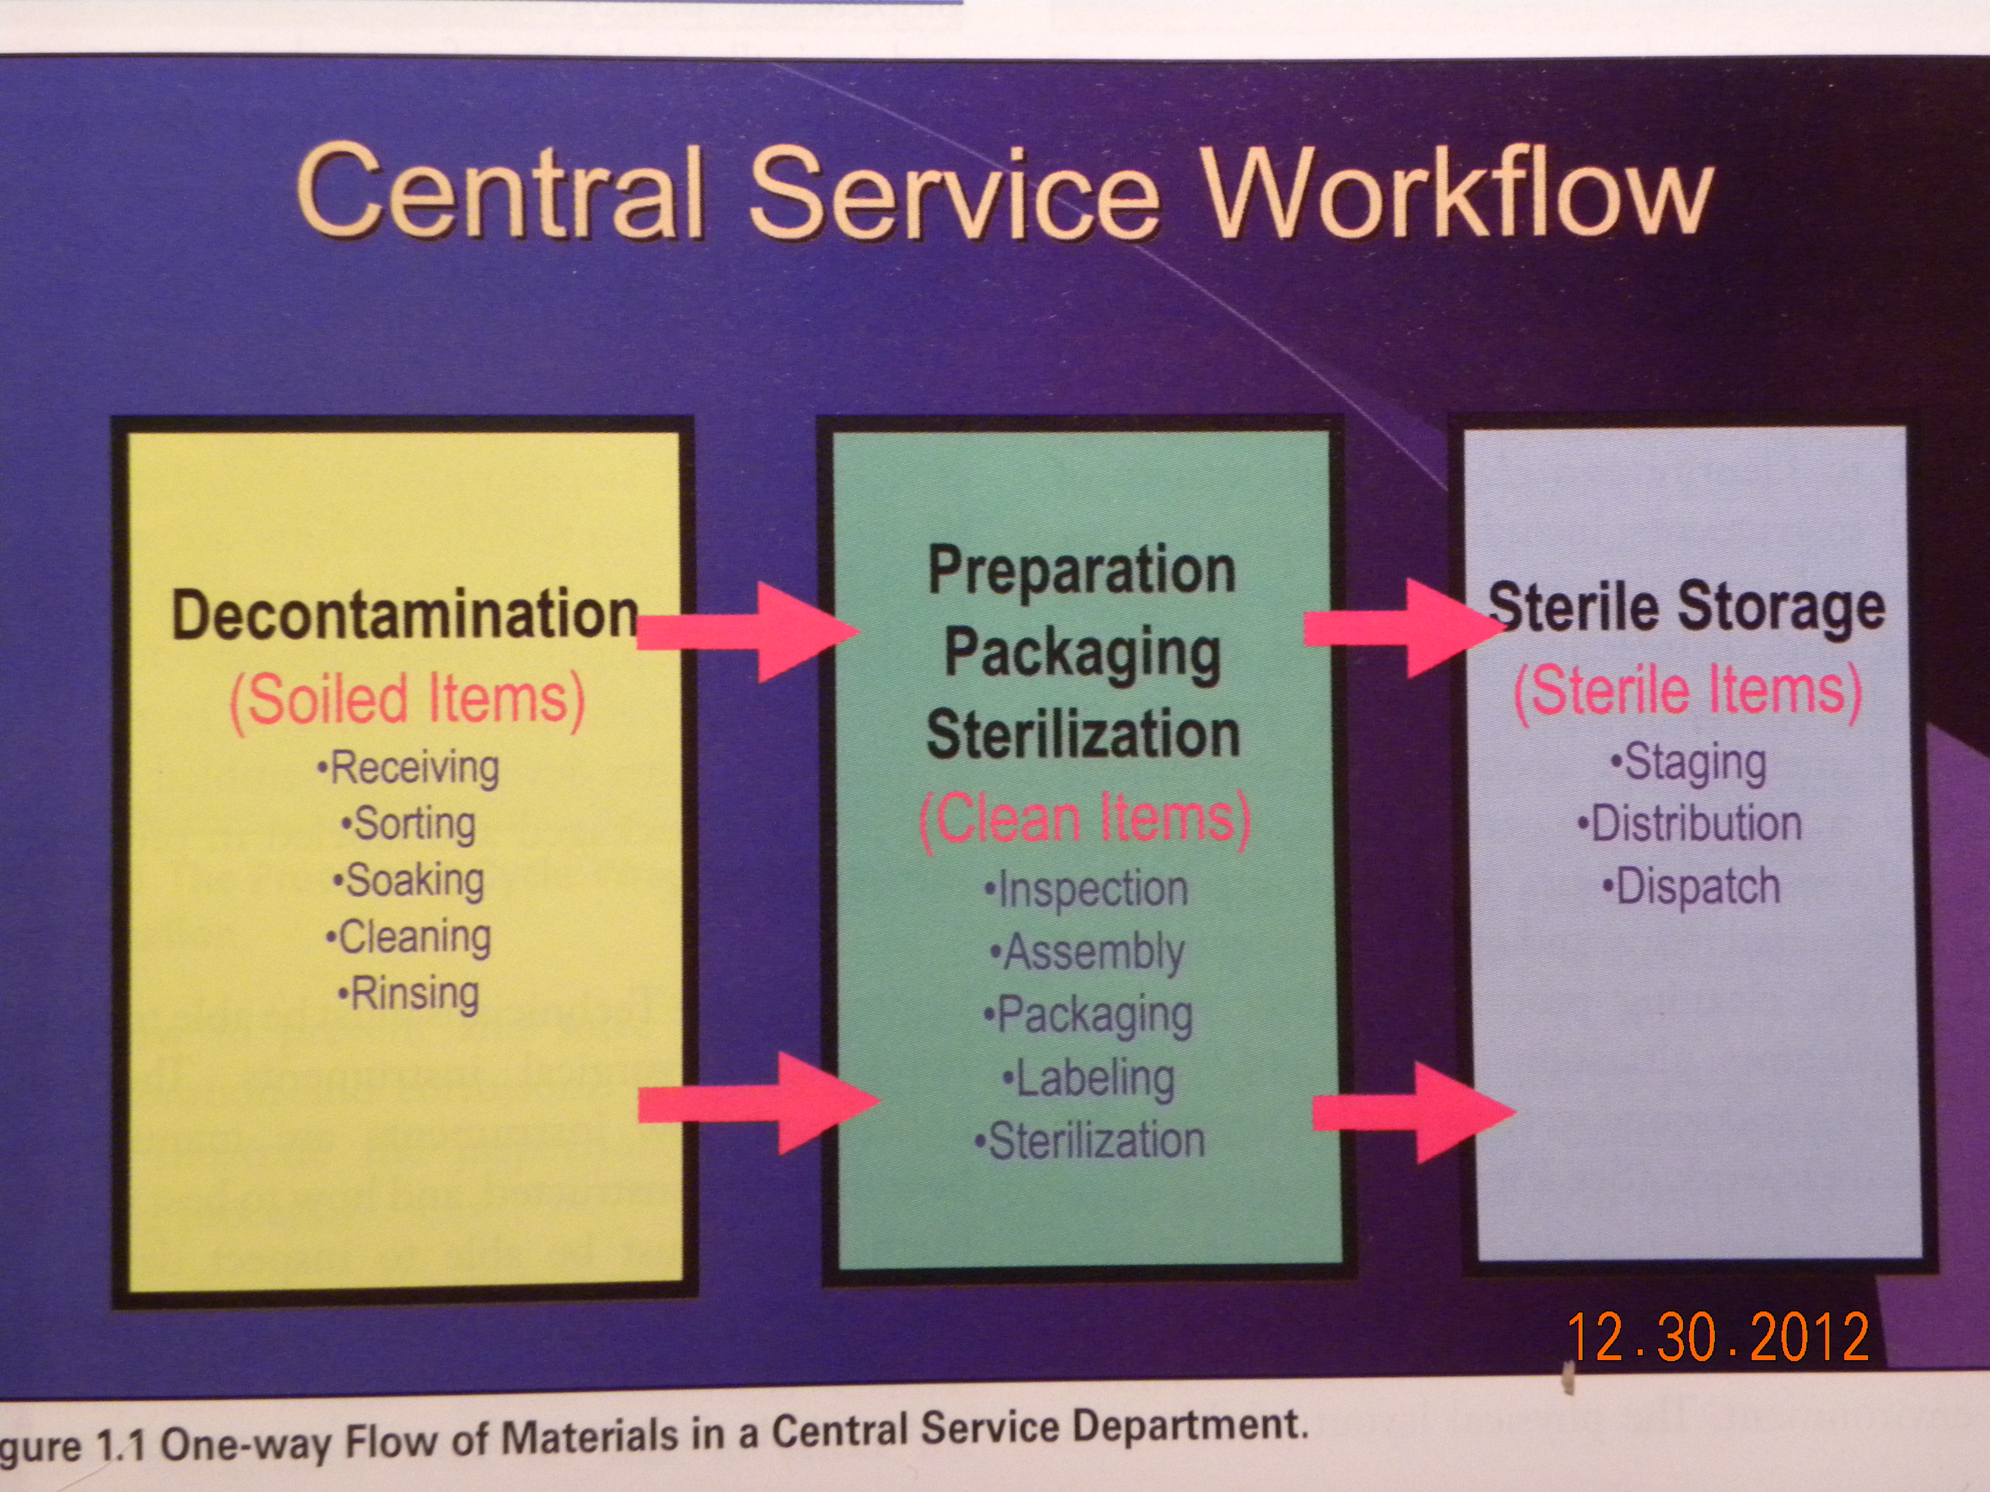

Slide 9
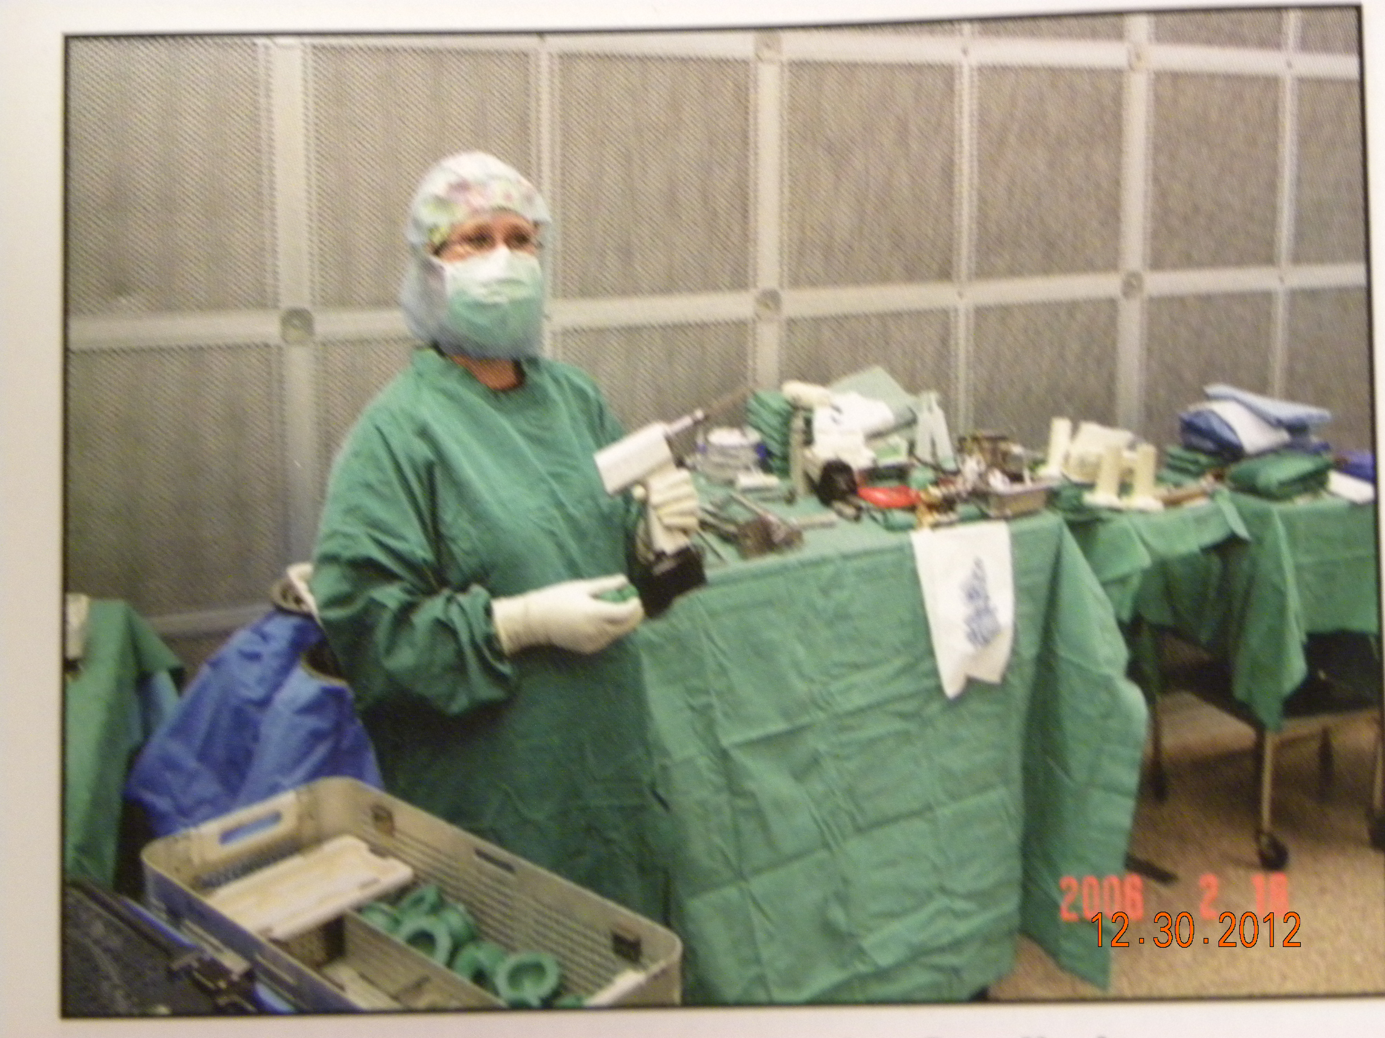
Using instruments in Surgery
Get contaminated items from Patient use areas / OR

Slide 10
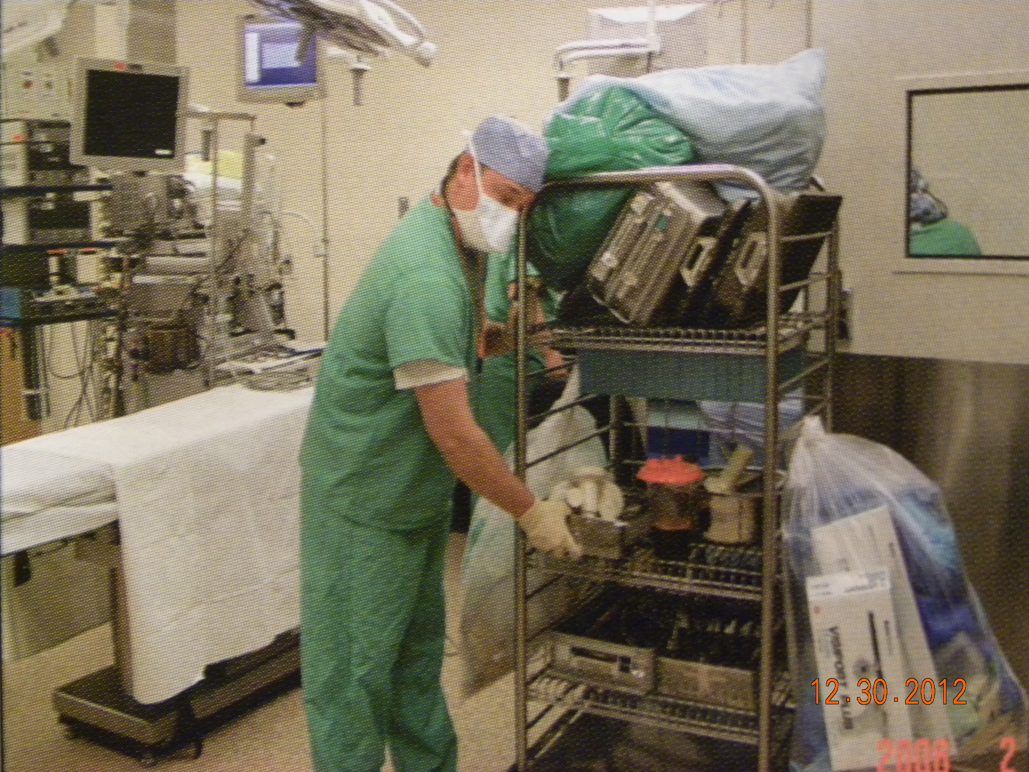
Separate Reusable items / Trash - Returned to Decontamination

Slide 11
Decontamination
Process
  Physical
    Manual – by hand
    Mechanical – by machine
  Chemical – using chemicals / enzymes
Makes an item safe for handling
  Removes contamination
    Blood
    Tissue
    Organisms – bacteria, viruses, etc.

Slide 12
Personal Protective Equipment
Worn to protect you from contamination – top down
  Head cover
  Eye protection
  Facemask
  Cover gown / apron
  Gloves
  Shoe covers / booties

Slide 13
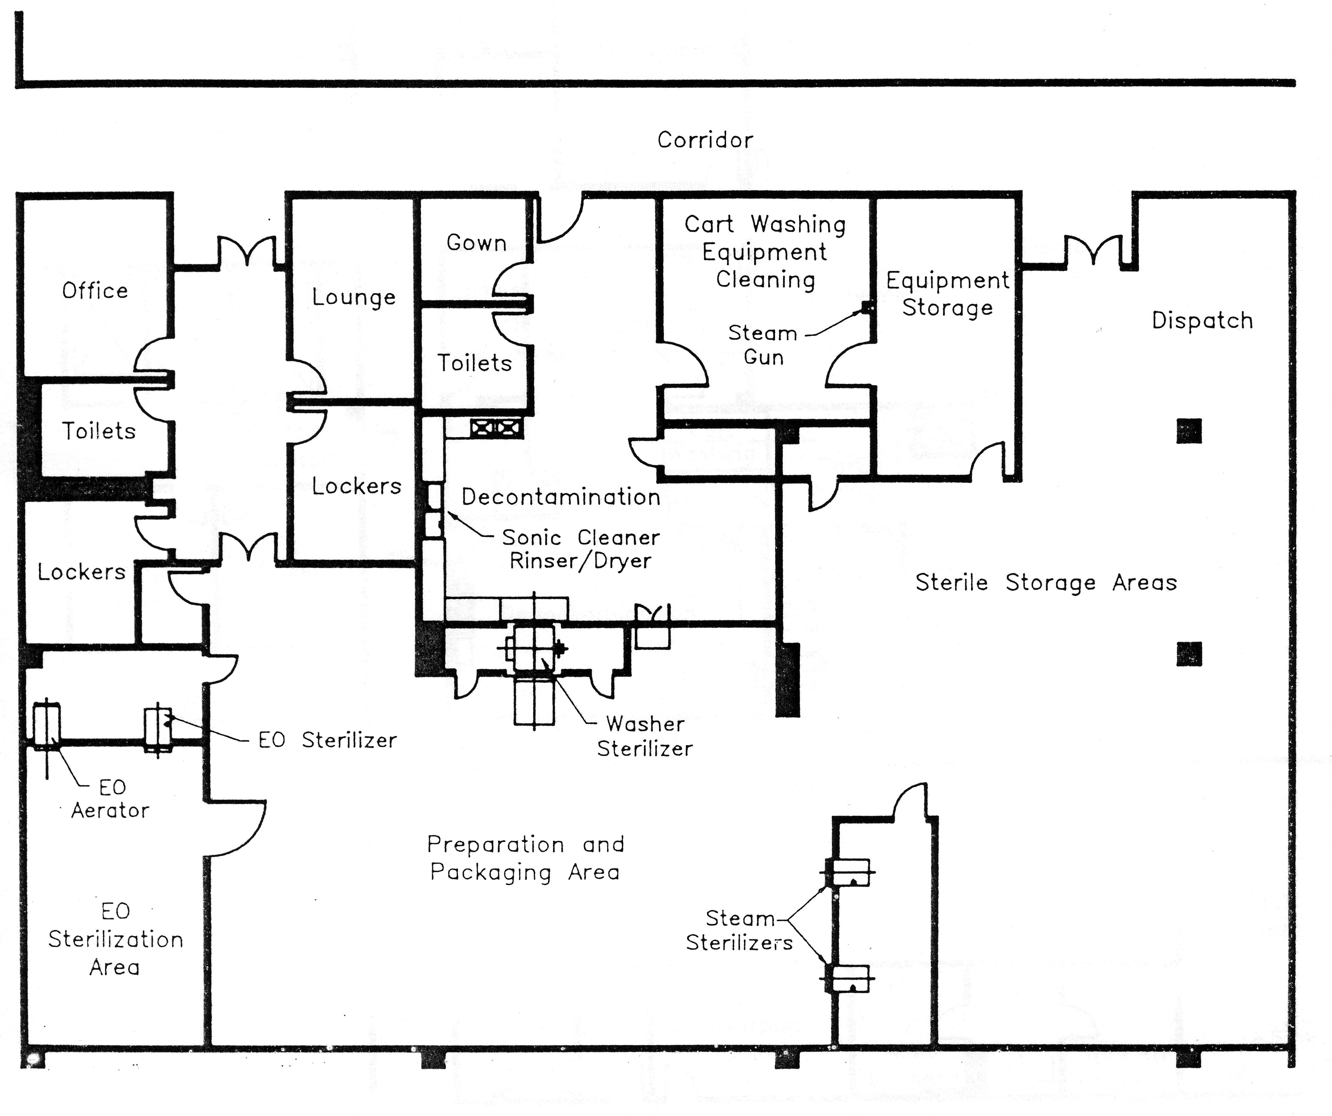

Slide 14
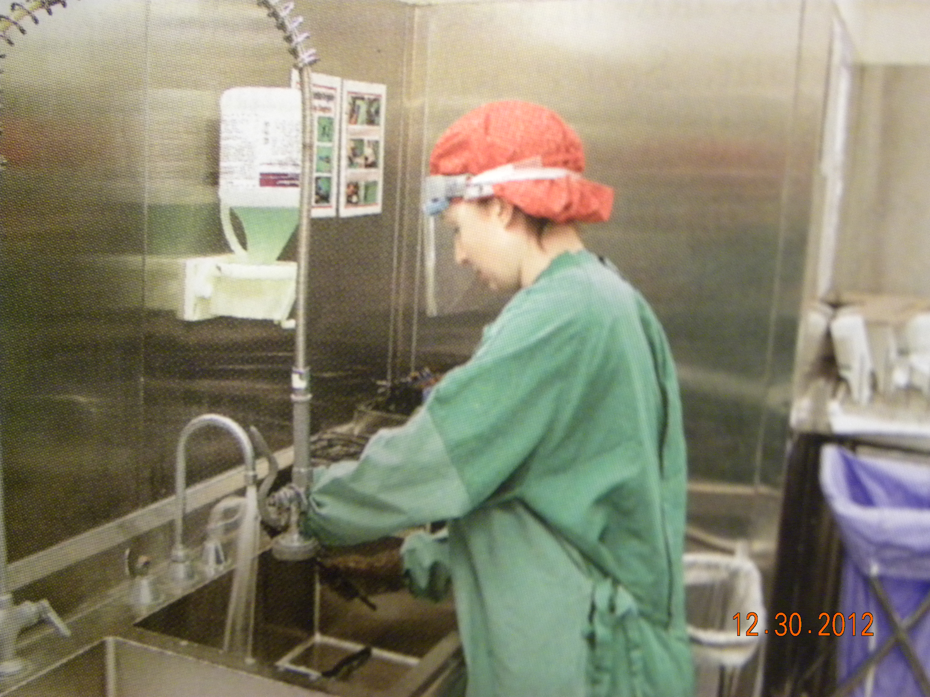
Manual Cleaning of surgical instruments
Like washing dishes Check first for appropriate cleaning process

Slide 15
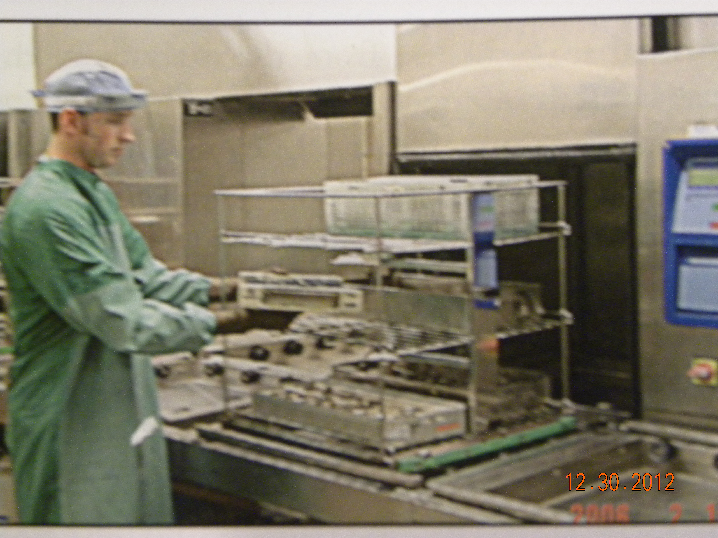
Mechanical Cleaning – like a dish washer

Slide 16
Duties
Identify instruments
Agents used
  Use – how to use it
  Effects on equipment / instruments
Lubrication
Maintenance
Hazardous waste disposal

Slide 17
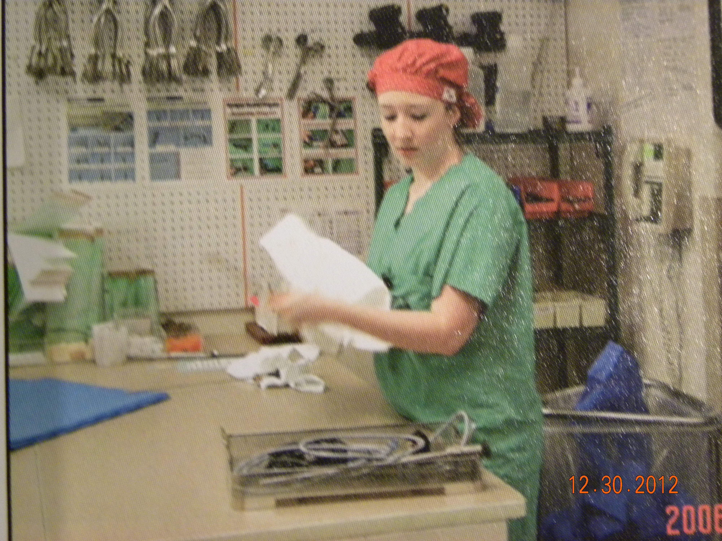
Inspecting- Is it Clean? Does it Work? Is it Broken?

Slide 18
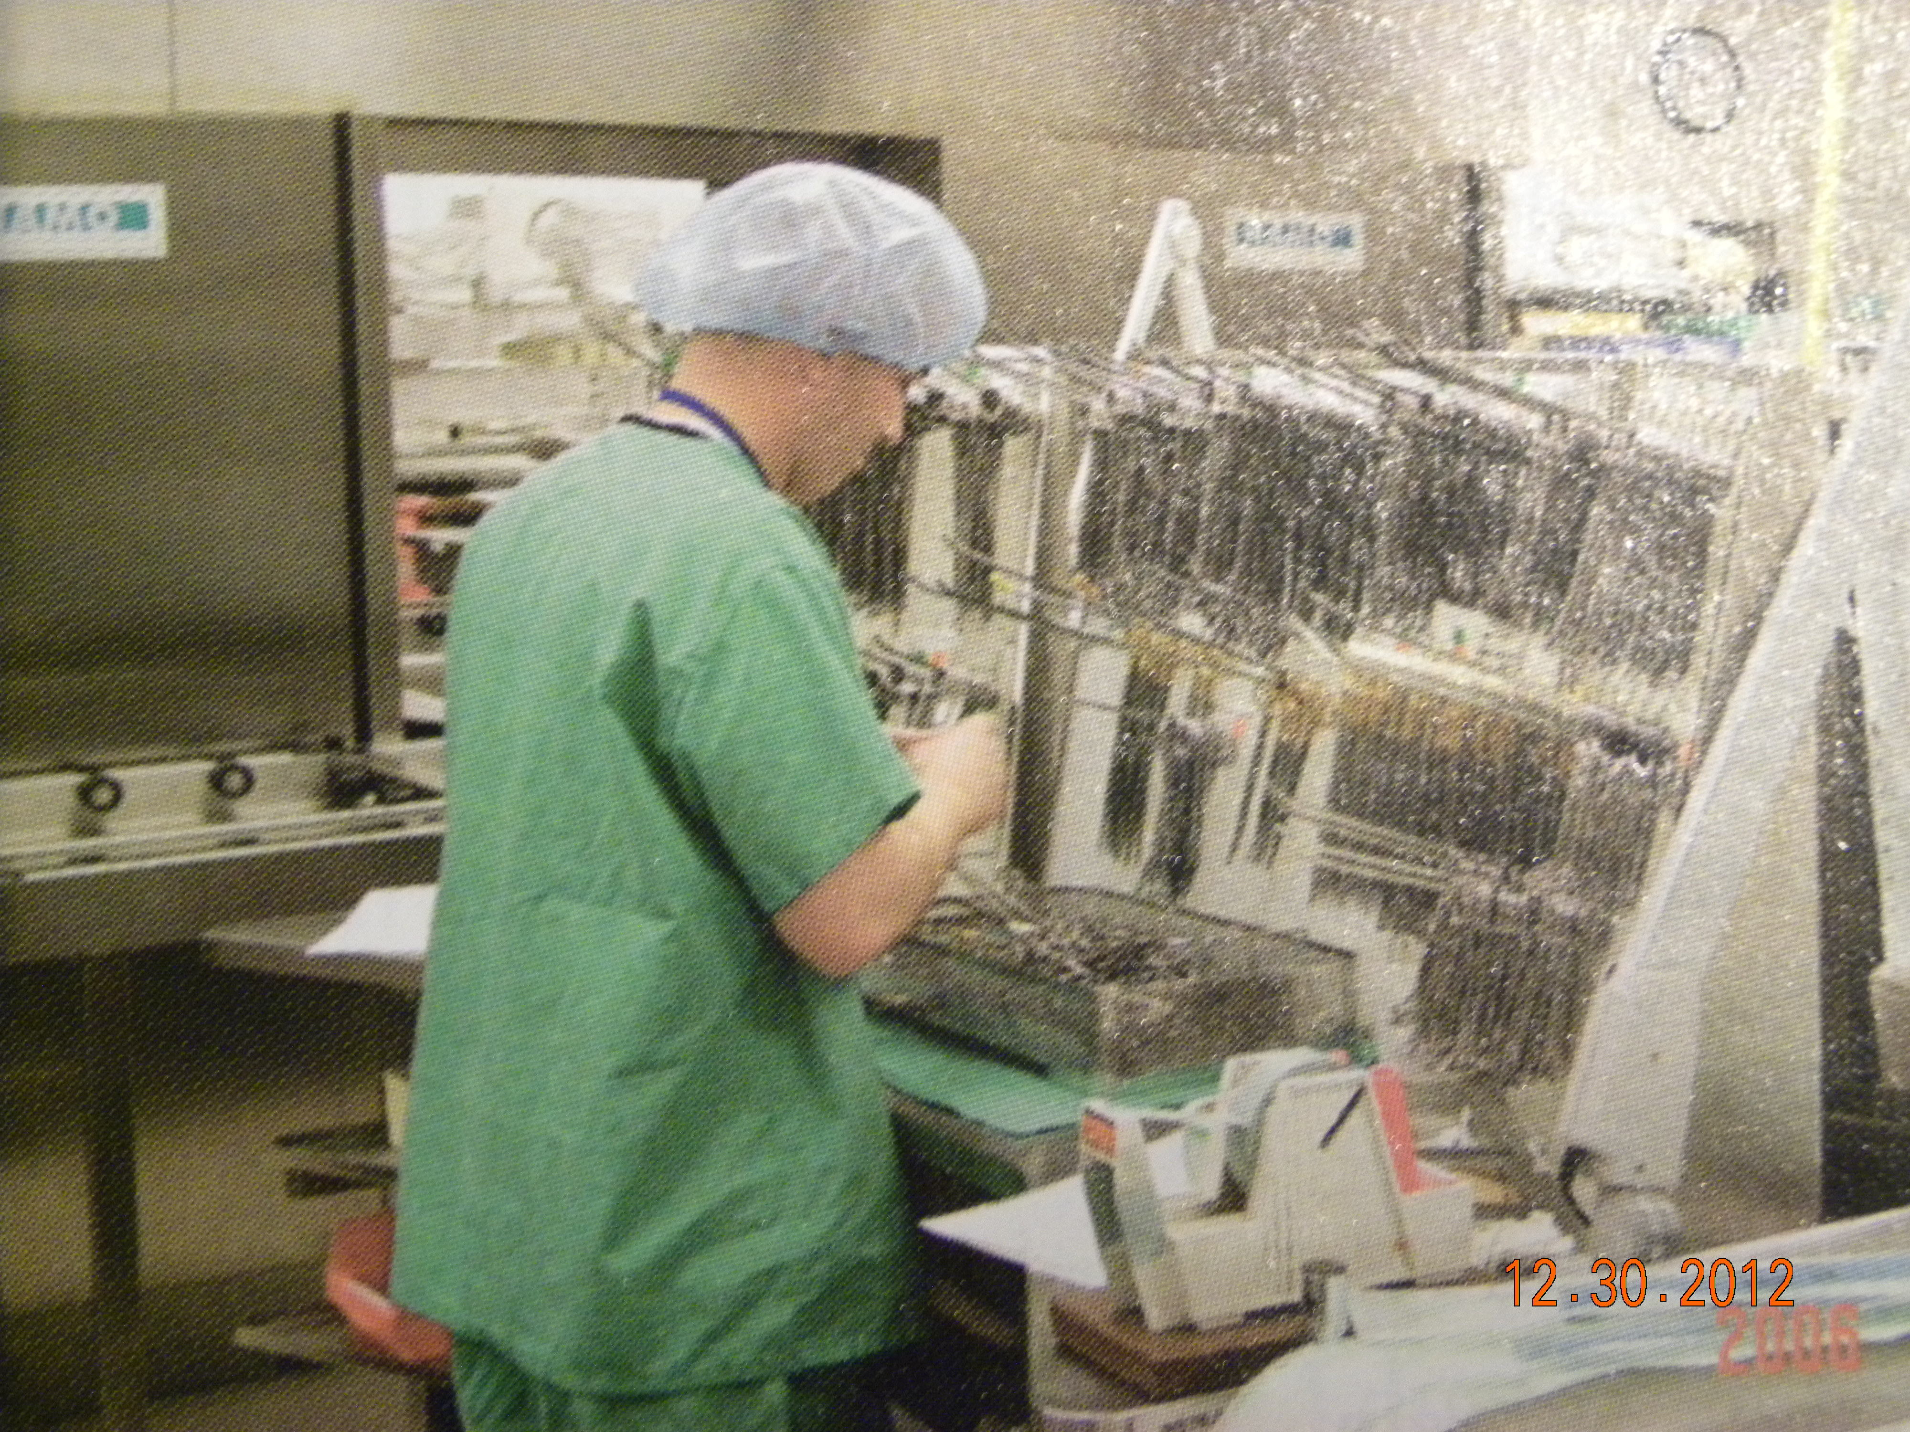
Assembling Instruments

Slide 19
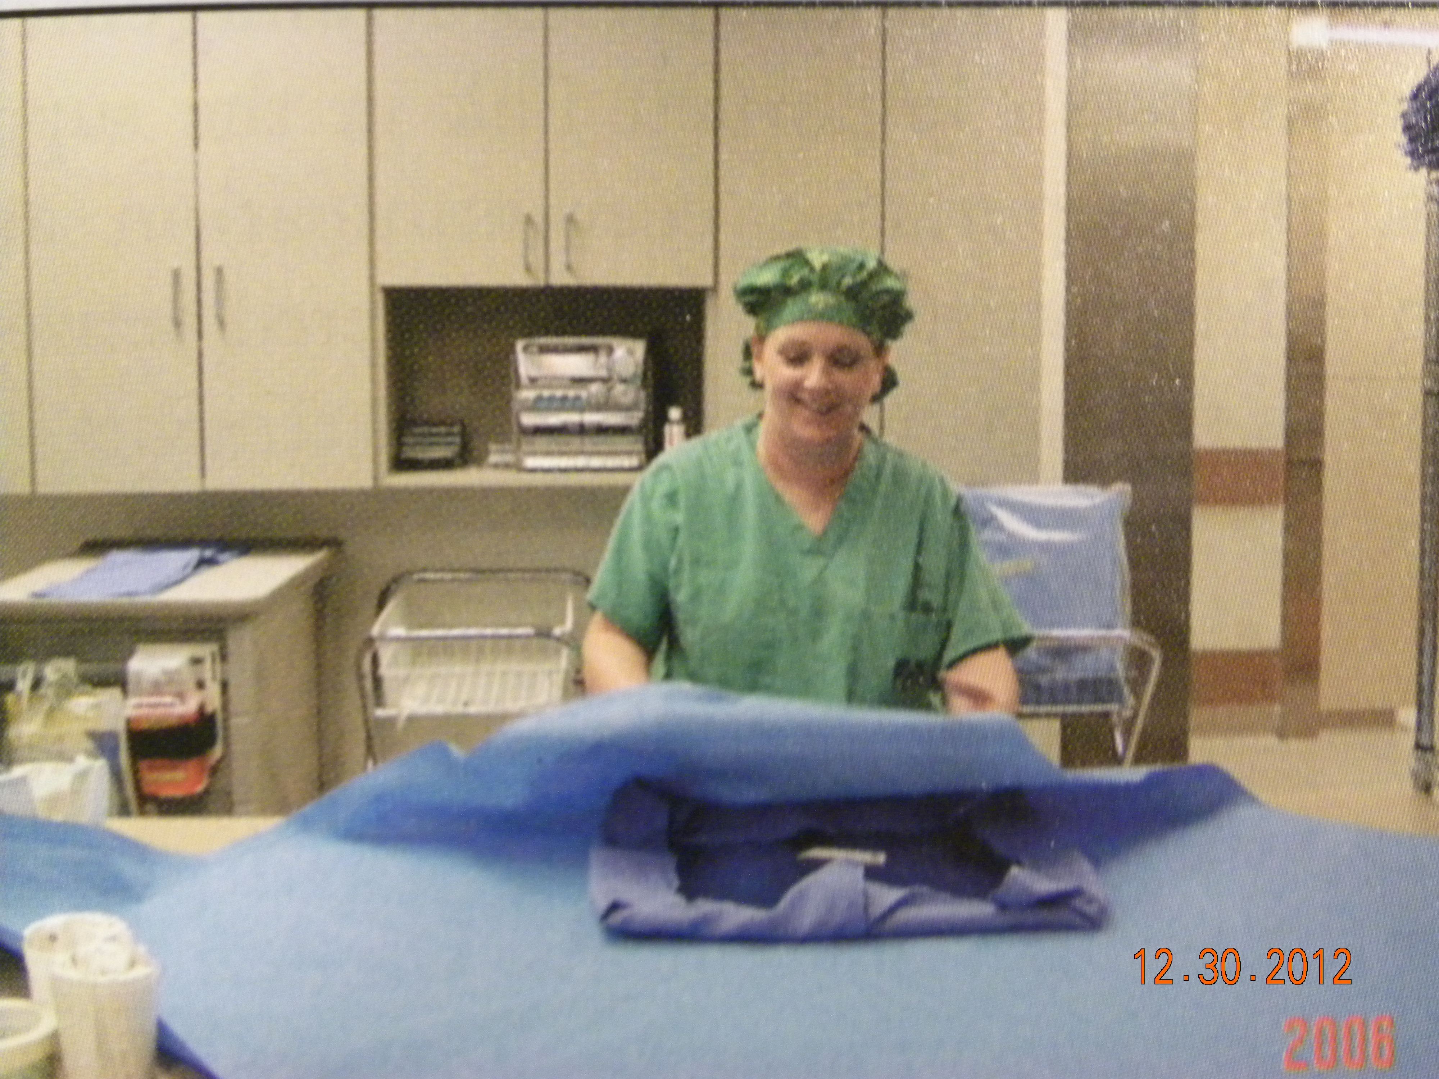
Wrapping

Slide 20
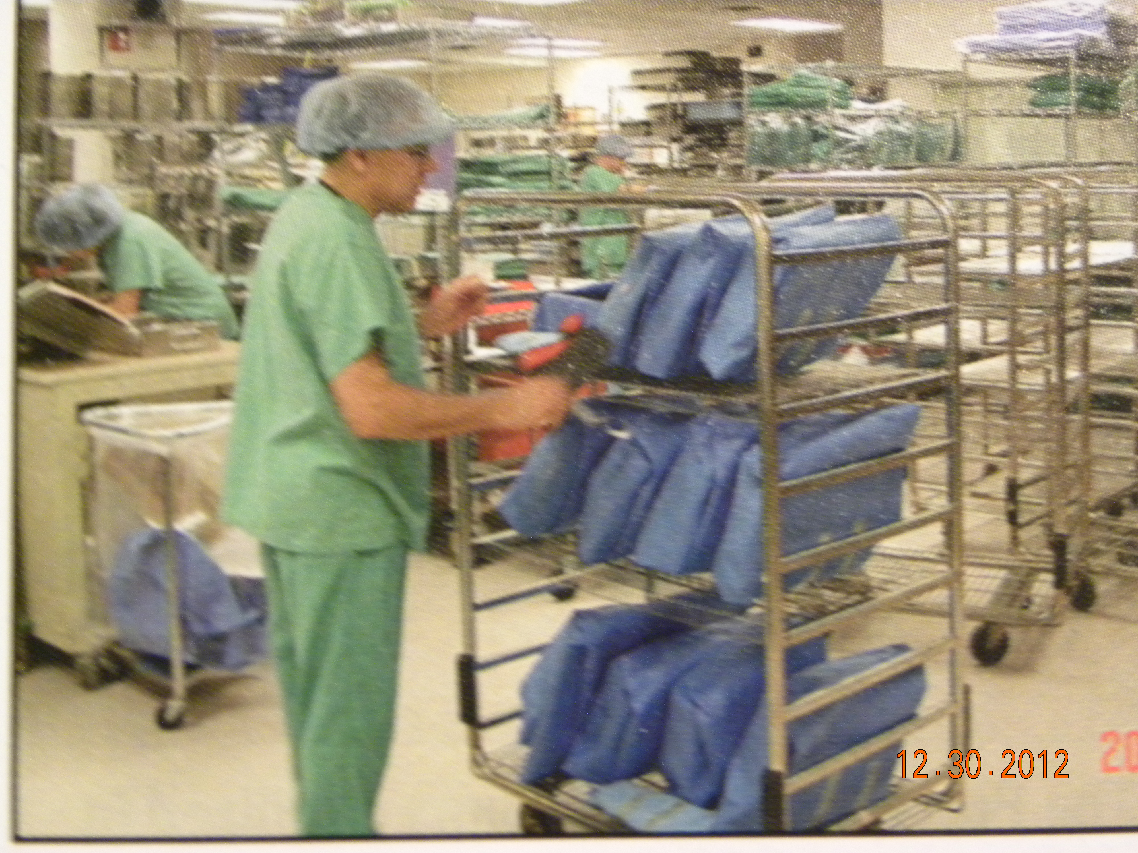
Loading Sterilizer Cart

Slide 21
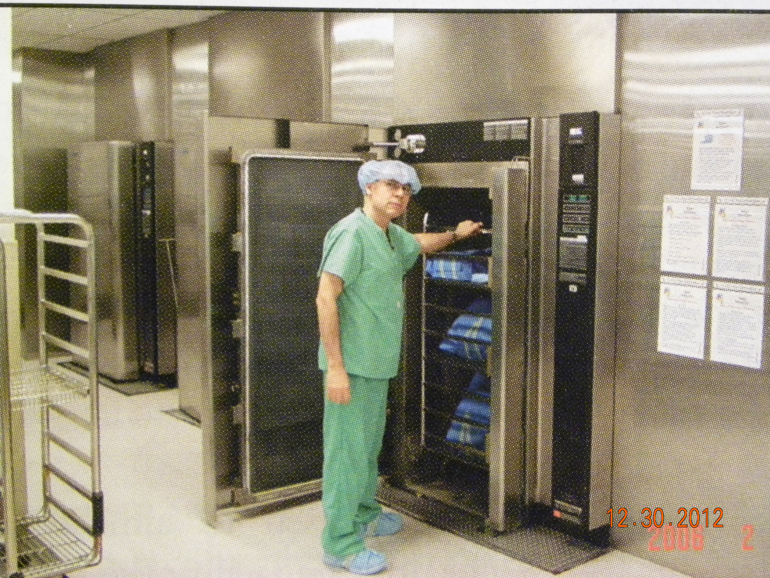
Into the Sterilizer

Slide 22
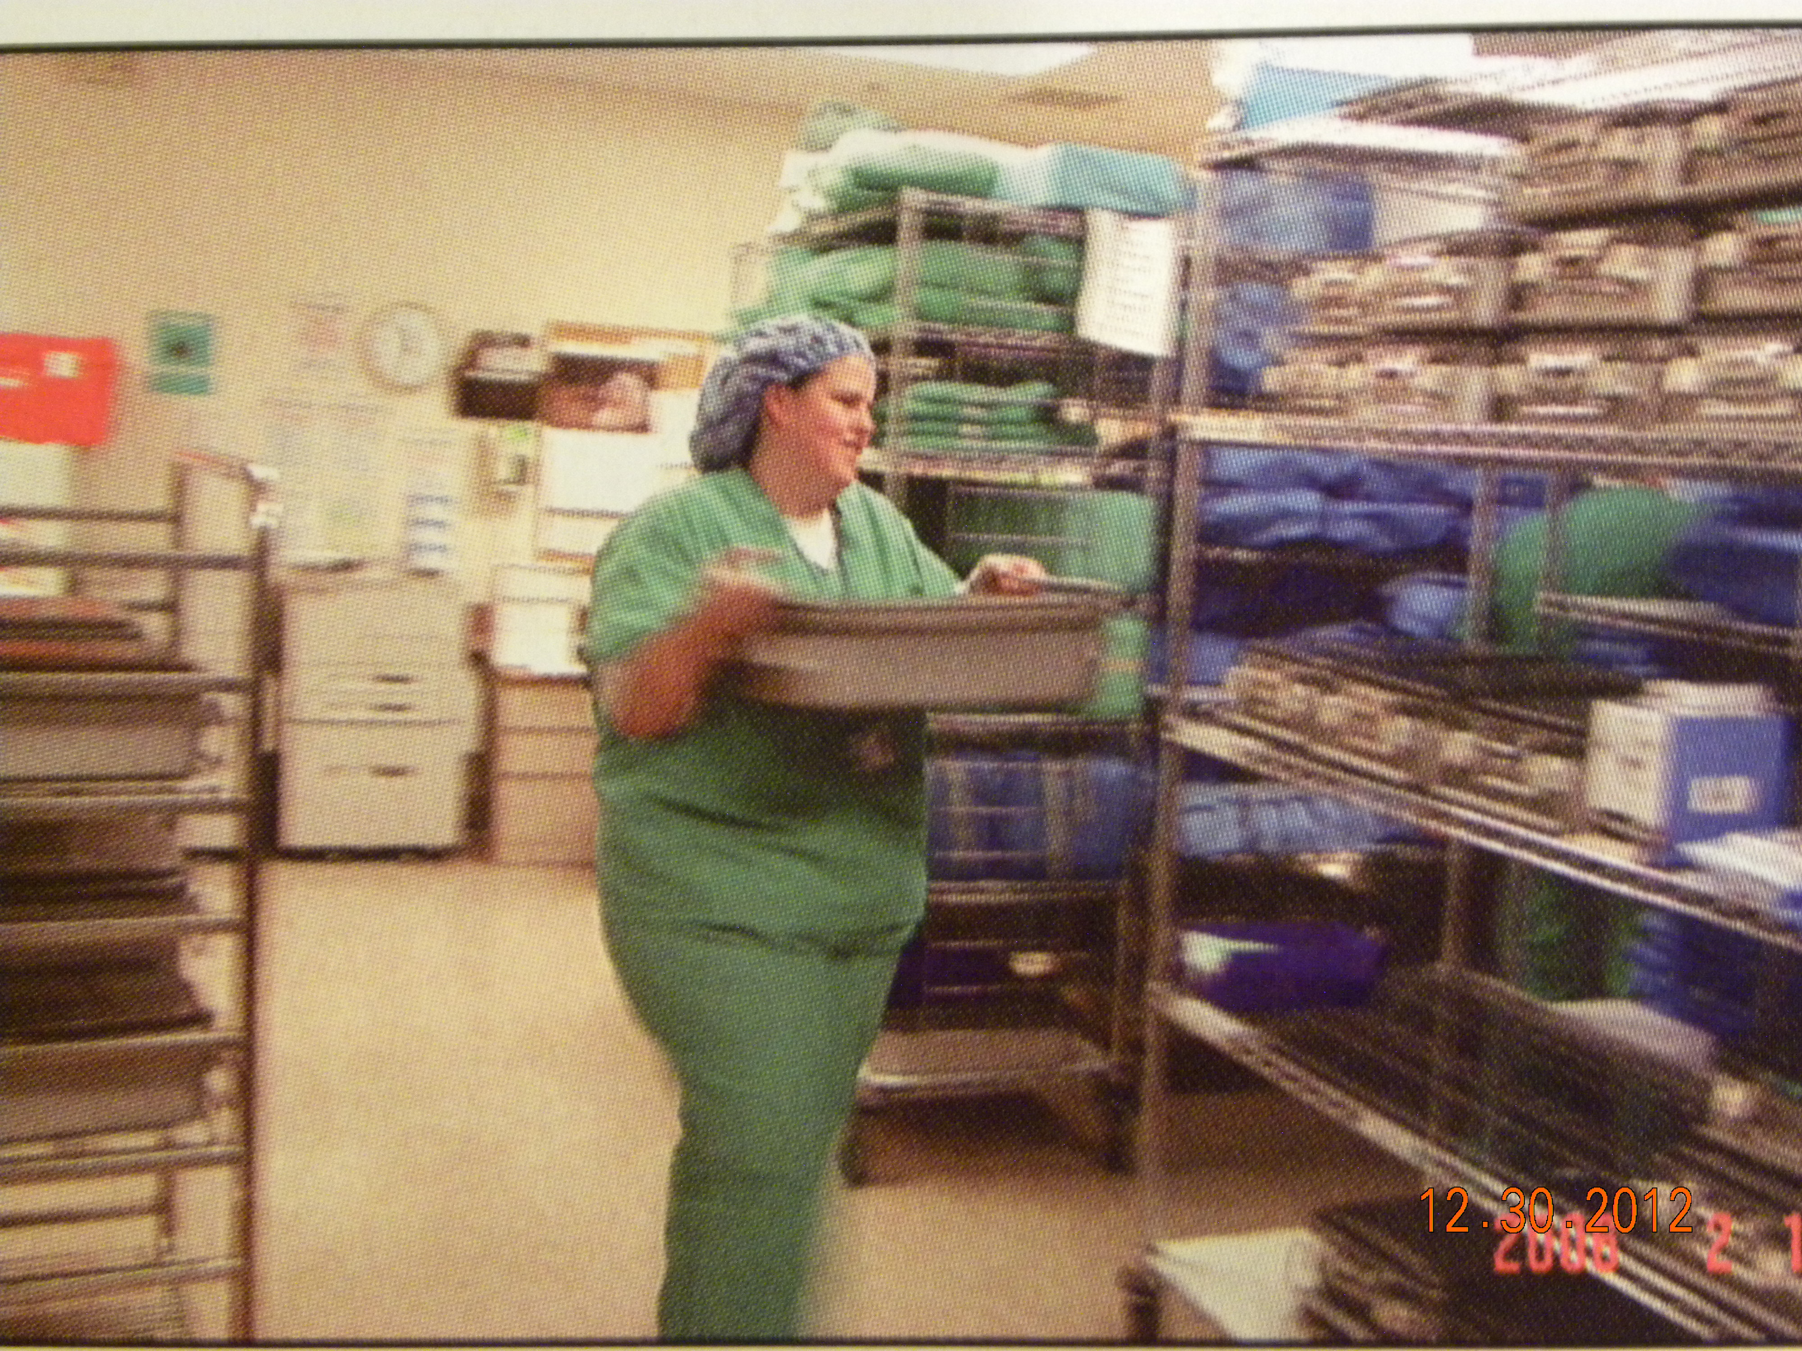
Then on to Sterile Storage

Slide 23
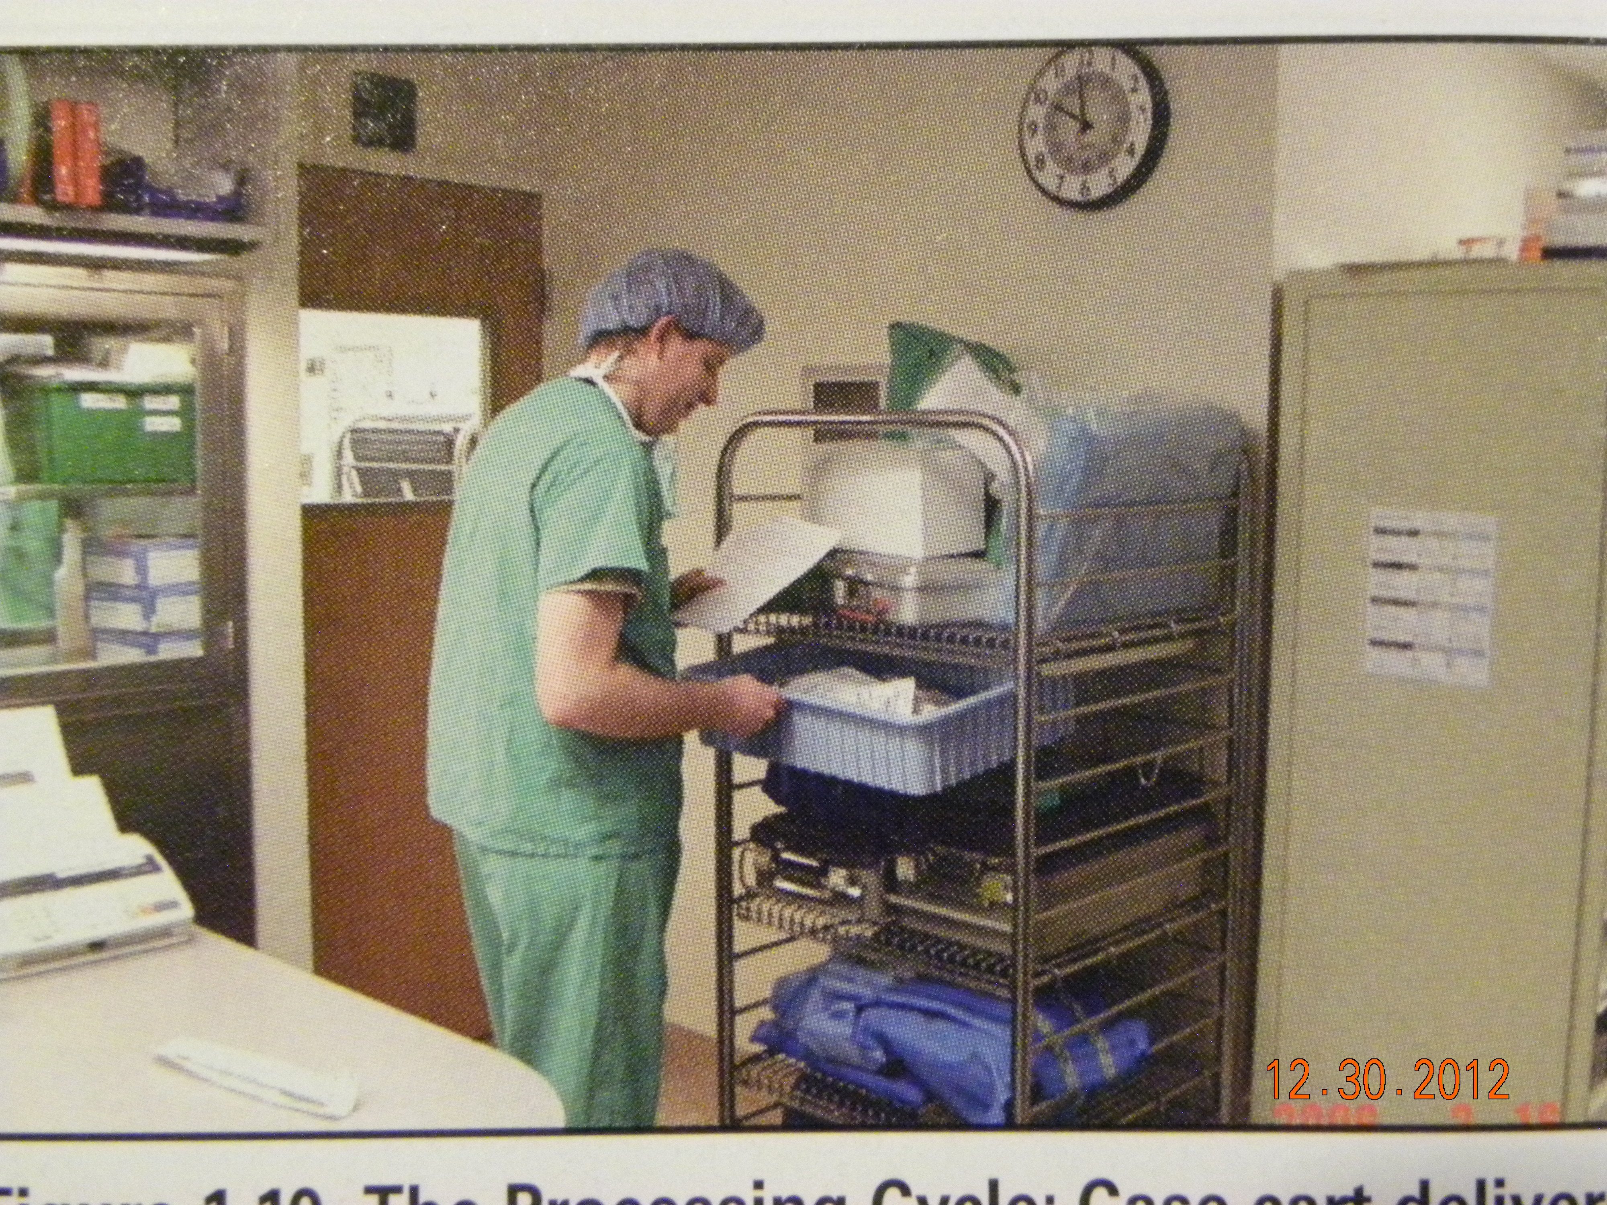
Ready to start all over . . . .
Case Cart to Surgery

Slide 24
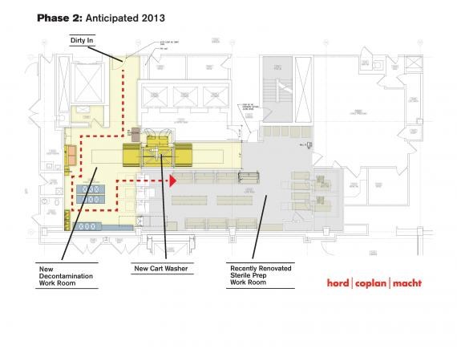

Slide 25
Case Cart
Surgery is scheduled
  Surgeons Preference Card
  Generates a Case Cart Pick List (Pull List)
    List of items needed for that surgery / surgeon
  Supplies are picked in the CS STORAGE AREA
  Assembled onto a closed cart
  Taken to the Operating Room for use

Slide 27
Work Flow
A day in the life of a Sterile Processing Tech (12:14) http://www.youtube.com/watch?v=GAOCDMbDvRQ

Slide 28
Must have knowledge of:
Instruments / equipment
Disinfection agents
Maintenance of instruments / equipment
Disposal of waste products
Handling of contaminated / sterile items
Safety rules/ exposure limits / PPE
  Minimizes exposure to substances

Slide 29
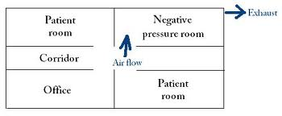
Environmental Conditions
Decontamination / dirty area
  Negative Air Pressure
    Lower air pressure in this area than surrounding areas
      Like a vacuum pulling air from the area
      Pulls organisms from area – air flows into the area
      Doesn’t let organisms in this area go out of the area

Slide 30
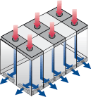
Clean Areas
  Positive Air Pressure
    Higher Air Pressure in this area than surrounding areas
      Like a blower in the area – air flows out of the area
      Doesn’t let outside organisms come into the area

Slide 31
Basic Job Skills
Communication
  Speaking, listening, written
    Understandable
    Accurate
    Timely
    Respectful
  Computer use

Slide 32
Employable
  Attendance
    There – on time
  Honesty
  Solve problems
    When you have knowledge
  Adaptable
  Respectful

Slide 33
Legal
  Follow procedures
  Work in your “scope of practice”
  Use safety practices / standards
  Document
  Avoid harassment and bullying

Slide 34
Ethics
  PATIENT’S NEEDS are FIRST
  Follow OSHA standards - Safety
  Equal treatment for everyone
  Report harmful activities
  Being professional

Slide 35
Safety
  Preventing injury to
    Patient
      Nosocomial Infections
    Self
      Standard Precautions
    Environment

Slide 36
Others
  Teamwork
    Work together
    Respecting each other
  Resource management
    Control costs
    Reduce waste - recycle
    Time management

Slide 37
Job description
  Page 18 in your text
  Certification
Career Growth
  Page 20 in your text
  Career Ladder

Slide 38
Department Organization
Department Head person
  Director
  Manager
  Supervisor
Section Heads
  Coordinator
See chart - p.24

Slide 39
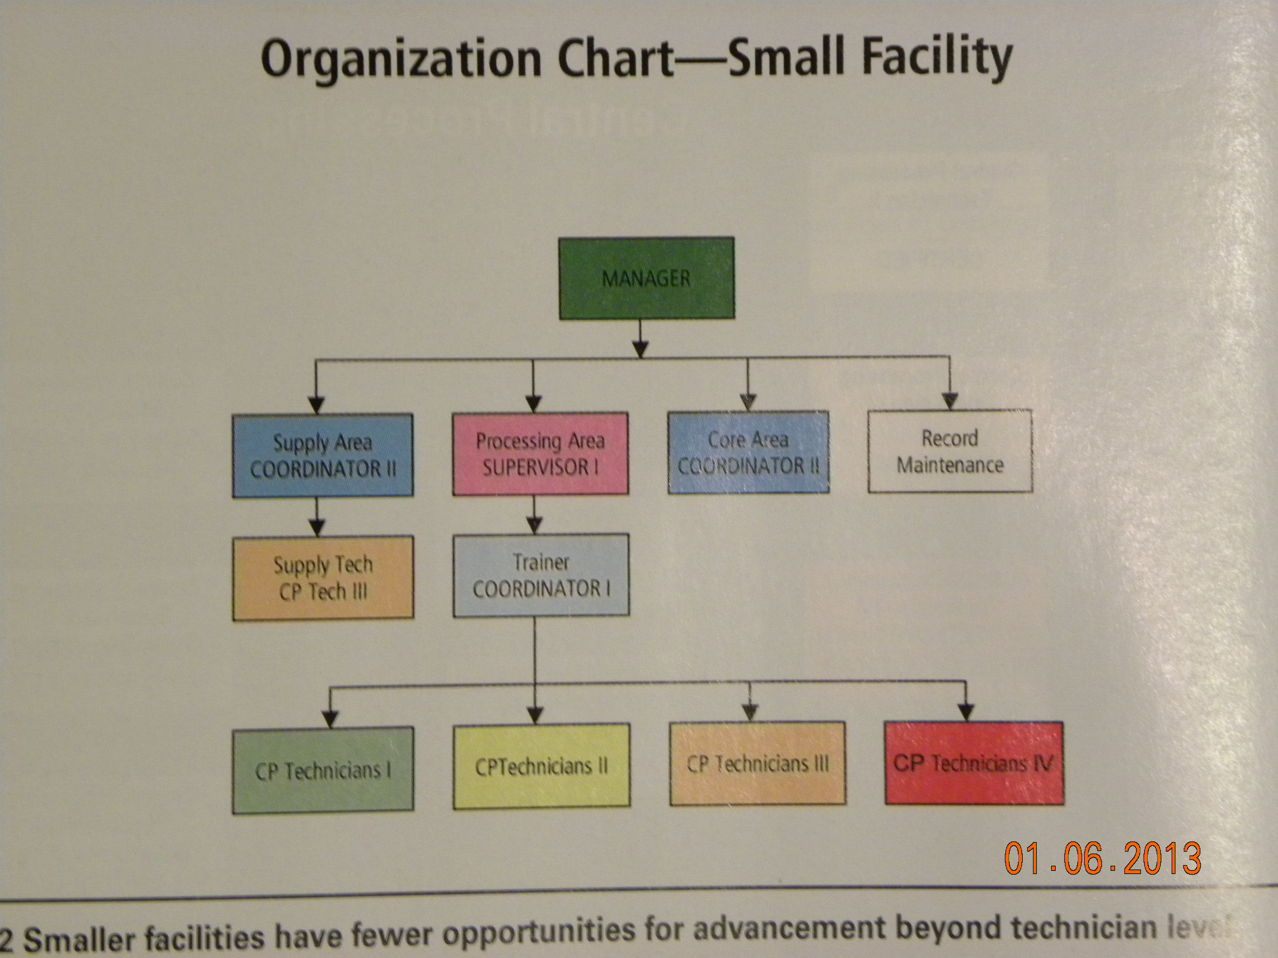

Slide 40
A day in the life of a Sterile Processing Tech http://www.youtube.com/watch?v=GAOCDMbDvRQ

