Slide 1
Quality Assurance
Chapter 20 7th Ed.
Rosemary Thurston RN

Slide 2
Quality
  Consistent delivery of products / services by established standards
    Patient care equipment
    Medical instruments
    Surgical instruments
  Combines concerns for customers with those of the department and facility
    Patients
    Internal customers
      Health care professionals

Slide 3
Quality
  Production is Only as Good as the Last Device Processed
    One imperfect tray will be noticed
    Harm to patients can be caused by the defect
    Harm to staff can be caused by mistake

Slide 4
What is quality?
Quality is
  The degree or grade of excellence of a product or service
    Measured through the eyes of the customers
    Patient must be the center of quality concerns
  Example:
    ER Crash Cart was delivered on time – good service
    Was missing an item on the supply list – poor product -
    OR Instrument set was delivered – good product
    No one was notified it was there – poor service

Slide 5
Things to remember
Quality if not the only way to improve
Some things critical to quality cannot be delegated
Quality takes time, effort and participation from every in the healthcare facility
Quality plan should be the department’s business plan

Slide 6
Identify Quality:
  Do they meet the needs?
    Do what they are supposed to do???
    Washer decontaminator properly used leaves items dirty
      Judged inferior = SUBJECTIVE
    Washer decontaminator leaves clean decontaminated items
      Judged “great” = SUBJECTIVE
  Branding
    One brand does well, would probably purchase again
      SUBJECTIVE

Slide 7
Established Standards
  Certain list of instruments for set
    One is missing – if not needed for procedure
      Judged OK by OR personnel
    Quality requires ALL instruments are in the set
      Meets CS standards
  Certain person assembled set / case cart
    ALWAYS right – becomes “Branding”
    ALL STAFF should meet STANDARD for QUALITY

Slide 8
Document meeting the standard = Quality
  Can validate statistics
  A system can identify inferior products before they leave the area
    Survey customers using:
      Count sheets
      Pick tickets for case carts
      Formal surveys
    Analyze statistics
    Study inferior areas
    Take corrective action

Slide 9
Components of Quality
Quality needs:
  Long term plan
    To get to IDEAL
  Must be supported by administration
    Changes must be supported by everyone
      Systems
      Procedures
    Need time to:
      Study and Develop
      Implement
      Monitor

Slide 10
empowerment
Granting authority to make decisions
  Within their area of responsibility
    Limited to well defined area – sterilization
  Must have level of knowledge / performance

Slide 11
Leadership
Leaders – Quality Committee
  Manage date
  Plan opportunities
  Establish priorities
  Empower people to implement new processes
  Define standards to be met
    Drive development of strategies to meet standard
    Must meet customer satisfaction and facility goals

Slide 12
Quality Committee
  Define Standards to be met
  Standards will
    drive development of strategies for customer satisfaction
    Attain facility goals
  Made up of department leaders
  Responsibilities:
    Create and put in place standards
      Coach employees
      Meetings on quality issues
      Daily quality message

Slide 13
    Set process priorities
      Evaluate suggest projects
      Difficulty implementing
      Costs – level of saving
      Savings worth the efforts
    Do quality planning and problem solving
    Responsible for “error-proofing”
      Addressing the people side of quality
        Human Resources training, etc.
    Address Human Errors
      Inadvertent
      Intentional
      incompetent

Slide 14
  First Line Guardians
    Include Supervisors and Lead Techs
      Ensure all personnel adhere to standards / priorities
    Employees should help teammates follow standards
      Interact
      Assist with training
      Participate with quality control checks

Slide 15
Standard Data
Data – Statistics
  Standards must be selected to implement and monitor the Quality Process
  Checking financial data
    Costs
    Turnover costs
  Satisfaction levels
  Number of defects
  Cycle times

Slide 16
  Setting Benchmarks (comparison to best standards)
    Want 50% cycle time reduction
    100% improvement in customer satisfaction
      Per customer satisfaction comment cards
  Implementing and monitoring
    Department leaders implemented
    Staff assisted in data collection and analysis

Slide 17
Planning tools & Procedures
Planning can reduce and prevent problems
  Identify what is important to customers
    Patients
      Must be patient centered
    Staff
      All levels of staff – top to bottom
  Issues
    What they like – dislike
    What is important
      Process is usually the problem – not people
      Manage the process, not the people
    Comparison to competition (Benchmarking)
      How do they do it?
      Doing better than the do

Slide 18
  Design features into processes to complete work assignments that people prefer
    Employees
    Patients
  Design dislikes out of the process
    Employees
    Patients

Slide 19
Steps for planning:
  1. ID needs and requests of department customer
    All instrument sets must be complete
  2. ID ideal process to address each need/request
    Check off list double checked by lead tech
  3. Compare actual steps and outcomes of each process to the ideal
    Double checking – did it make a difference
    what was the cost to do that
    were the sets complete 100% of the time
    Was the OR satisfied

Slide 20
    4. Plan process control activities to improve system
      Lead tech to oversee the final set
      Check off list for each set
    5. measure defects that result
      Should decrease
      Survey from the OR should let department know

Slide 21
Principles of Quality Management
Patient Focused
  Needs and wants drive changes
Process Focused
  Manage process rather than people
Fact Based Decisions
  Not on assumptions
Continuous Quality Improvement - CQI
    To continue to train and evaluate outcomes

Slide 22
Staff Members
Developing Staff
  Define traits of successful employees
  Provide staff with
    Knowledge
    Skills
    Tools to do work per standards
Empower staff to address solutions
  Work on projects
  Stop work to help someone else
  Ask for help to problem solve

Slide 23
Process management
Achieve goals with capable process
  Employees may be able to:
    Address ways to shorten cycle times
    Reduce errors in instrument sets
  Senior Leaders
    Can develop and improve quality processes
      Everyone should be a Quality Engineer
    Ensure that improvements become process
      Processes get better or weaker –never stay the same

Slide 24
  Process problems cause defects
    Identify DEFECTS
    Resolve them = fewer problems
  Delivering quality products and services
    Must meet quality standards
    MAKES GREAT SUCCESS
  Processes that could improve
    Turnaround times for instrument sets
    Instrument set accuracy
    Case cart accuracy
    Inventory fill rates

Slide 25
  Total Quality efforts include:
    Interactions with patients
    Interactions with other employees
      All levels of employees
  Attain quality standards
    That meet or exceed needs and desires of:
      Patients
      Facility
  Recognition of quality:
    Awards, Promotions, bonuses, or pay raises

Slide 26
  Costs spent on Quality
    Pay for prevention – doing it right the first time
    Appraisal – ensuring things are done right the first time
    Failure – not doing it right the first time
  Effective Quality Process
    Minimizes COST
    Maximizes
      CONSISTENCY
      EFFECTIVENESS
    For patients and facility

Slide 27
Quality is a sequential Process
Inputs to Quality come from
  Facility resources:
    People
    Material
    Time
  Resources are used to produce products/services required by patients and others
    Must be used efficiently
    In a well-defined process /series of processes

Slide 28
  Cross – functional Team
    Staff from various departments
    Perspective of each team member determine solutions
    Effective because they do the work
      Can address systems or procedures
      That may have been required by managers who don’t do the day to day work

Slide 29
Quality Indicators
Purpose
  To determine how the dept. is meeting objectives
    Producing quality goods
    Giving quality services

Slide 30
  Indicators to monitor periodically
    STAT orders are delivered within 5 minutes of request
    All sterile supplies have current dates on supply carts
    Sterilization is accepted based on :
      Mechanical, chemical and Biologic indicators
    Instrument sets are correct
    Customer surveys score 90 or greater on service satisfaction
    Pt. care equipment / supplies are in proper working condition

Slide 31
    Results of technical sterilization indicators
      Properly logged and reported for all sterilizers
      SEE NEXT SLIDE
    Flash Sterilization – done following protocols
      And DOCUMENTED
    BI’s are run with all required loads
    Case carts have correct items
    Instrument set errors must be below 0.6%
      Must be correct 99.4% or better

Slide 32
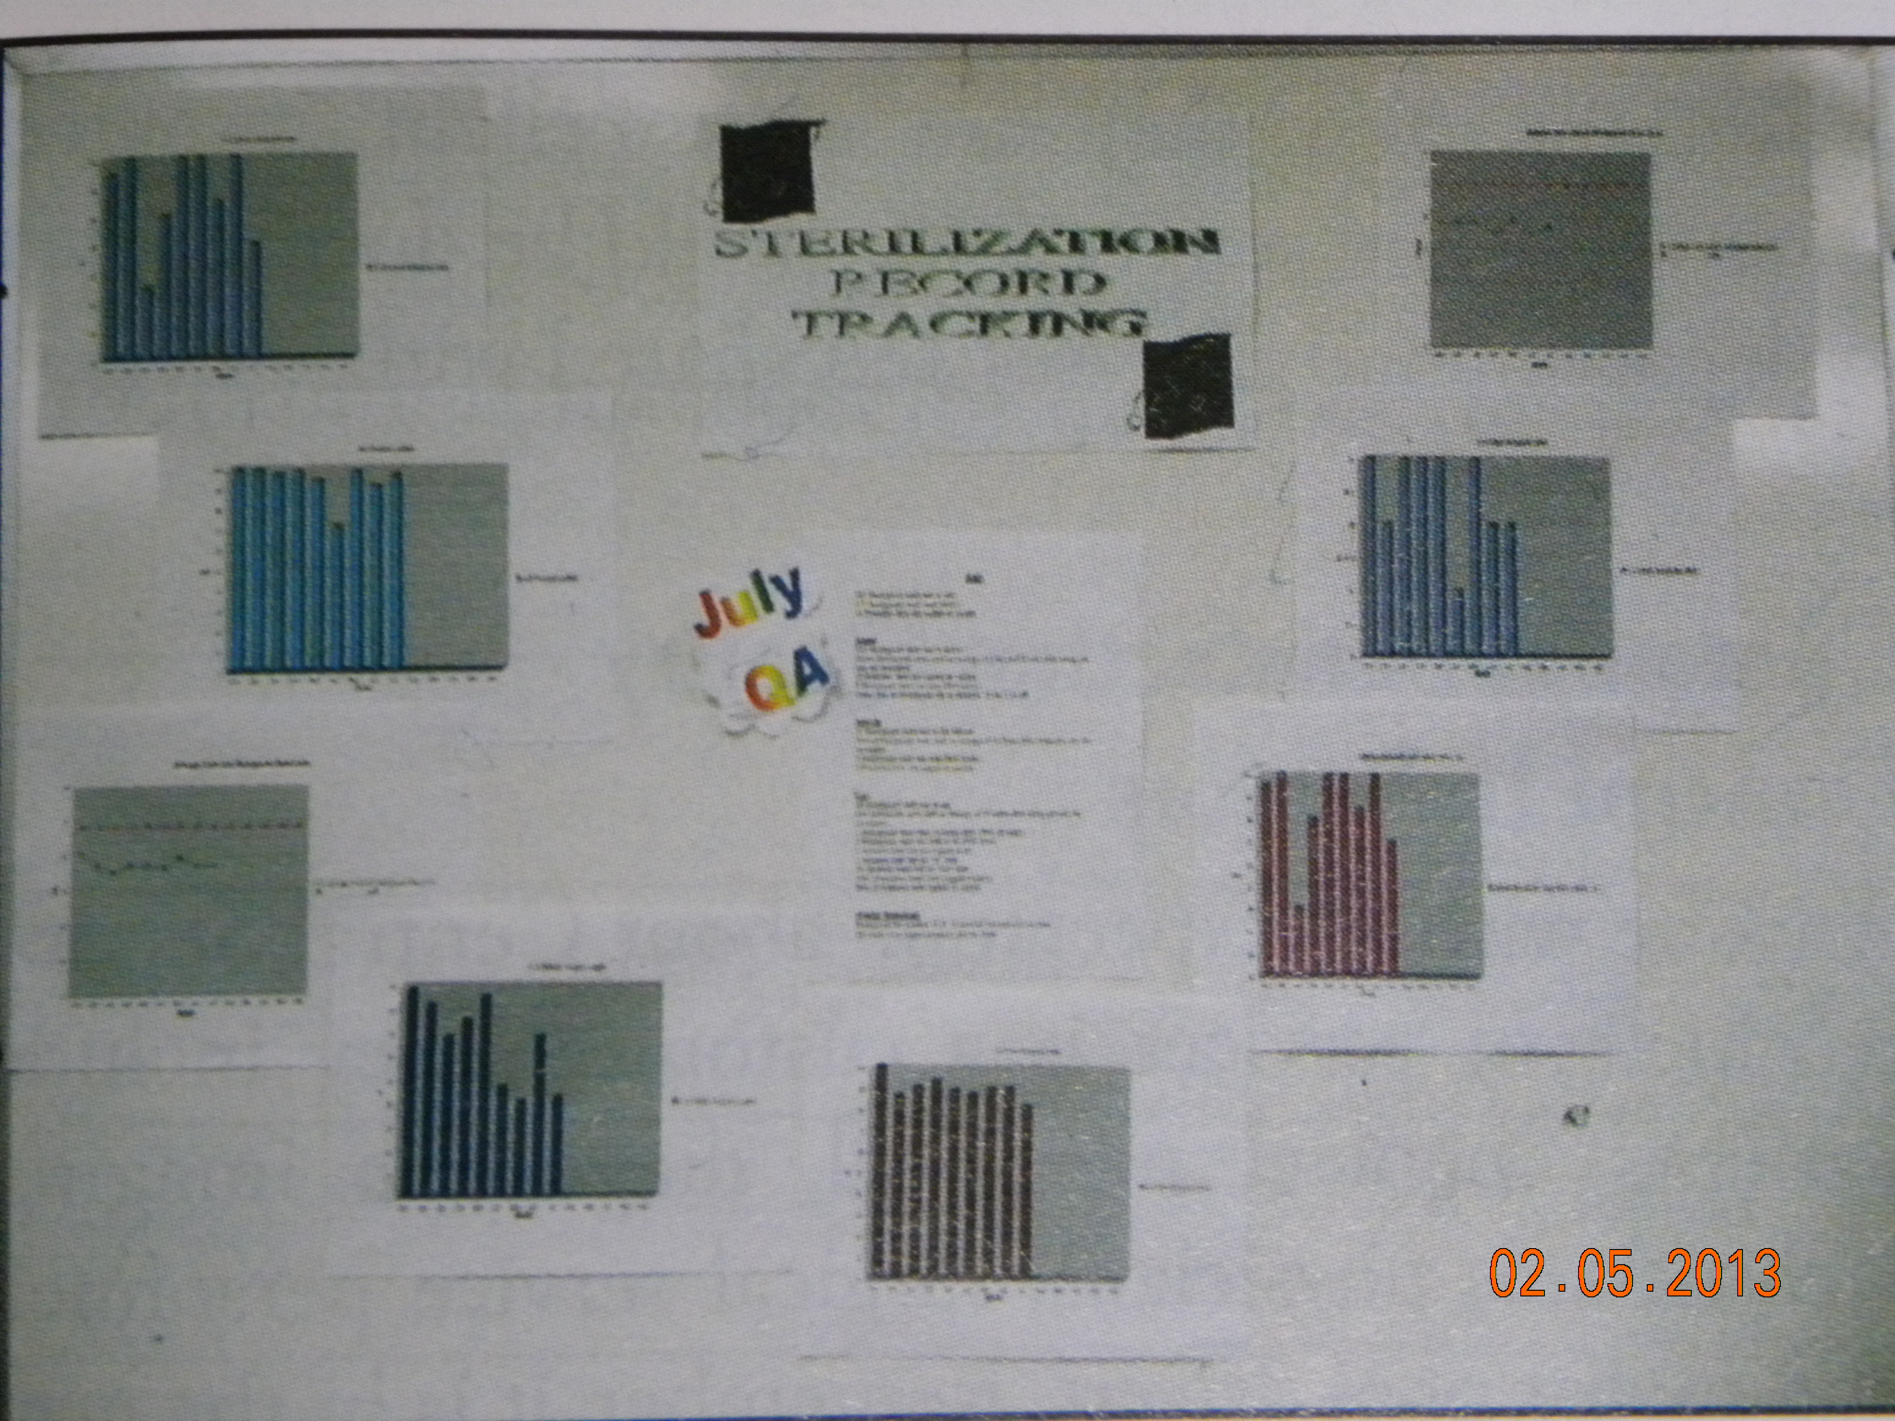

Slide 33
Categories of Quality control indicators
Administrative
  Management control Monitors
    Manager in the department
      Directors
      Managers
      Supervisors
      Lead techs
    Must be TRAINED
      Re CS principles
      Understand value of Human Resources

Slide 34
    Polices and Procedures and Work Assignment Lists
      Written procedures must be available to everyone
        Provides consistency
        Provides direction when needed
        Provides training for new personnel
      Need outcomes for Q control
    Quality control checks
      Measures how products / services meet standards
        Manufacturers may use acceptance sampling
          Assess completed items of a lot for quality
          Certain number of defective items will require rejection of LOT
        Requires lots of resources to do this

Slide 35
    Hospital Quality Control
      Performed on a regular basis
      Done randomly
      Checking everything is not inefficient
Instrument Set | Craniotomy | Case Cart | Craniotomy
Proper Cleaning | ✔ | Clean | ✔
Set up | ✔ | Supplies complete
Packaging | ✔ | Packed correctly | ✔
Labeling | ✔

Slide 36
  Inspection Control Numbers
    Cross Check system
      Infection Control coordinator
        Stays current with prevention principles
        Reviews patient infections
      Keeps staff informed about
        Disinfectants
        Isolation precautions
        Nosocomial infections

Slide 37
    Safety inspections
      Keep staff healthy and safe from injury
      Reports can use information to prevent accidents
      Injuries are costly
      Better to have regular staff than an unskilled person who needs training
    Regulatory Agency – The Joint Commission
      Check to see if departments are following their policies and procedures
      They are committed to Continuous Quality Improvement and are patient outcome oriented
      Usually give recommendations for improving quality of servicesn

Slide 38
  Facility Meeting Information
    Utilization Management Committee
      Meeting minutes may show some physician supply uses are not standard supplies
      Should discuss cost savings with standardization of supplies
    Infection Control Committee
      Meeting minutes report increased needle sticks by IV Team
      CS suggests new sharps containers that can be attached to IV poles
    Use committee minutes to identify problems
      CS personnel have experience and are good resources to solve problems, prevent problems

Slide 39
Customer Satisfaction
Quality Control Indicators
CS customers
  Patients
  Medical personnel
  Diagnostic imaging techs
  Physicians
  Surgical service personnel
  Motor pool drivers
Quality is in the eye of the beholder

Slide 40
Customer surveys
  Can indicate potential problems
    IV solutions stored in area difficult to access
    Opens communication to all people using this area
    Changes can occur
Incident Reports
  Can prevent problems
    Loaner ortho set is missing some important pieces
    Company Rep was unaware pieces were needed
    Documentation of communication with Rep can prevent similar problems

Slide 41
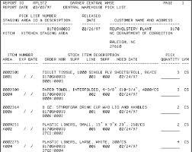
Tray Cards
  Sent with instrument sets
  Can obtain feedback re the dept. or the tech
    SEE P. 387
  Can generate quality comments
  Can be used with any service or products from the department

Slide 42

Customer complaints
  Express dissatisfaction
  Must be taken seriously
    Most are isolated, not systemic
  Should be addressed promptly and resolved
Staff complaints
  May be first indication of problem
  Input should be used to improve services or products

Slide 43
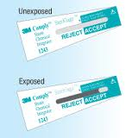
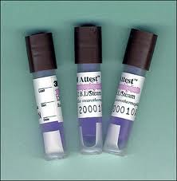
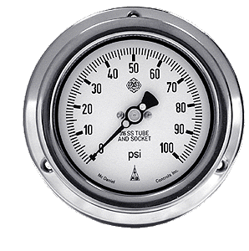


Technical Quality Control indicators
Process control measures utilized to assure conditions were met in sterile processing areas
  Met technical conditions for sterility to occur
  Technical Control Indicators
    Mechanical indicators – pressure gauges, thermometers, timers
    Chemical indicators / integrators
    Biological indicators

Slide 44
  Can measure other processes
    Decontam, cleaning, assembling, packaging and terminal sterilization
    Can use in areas outside of the CS for sterile processing
      Endoscopy
      Labor and Delivery

Slide 45
Analysis of Quality Concerns
Failure Mode and Effects Analysis – FMEA
  Proactive – to predict adverse outcomes of failures
    Human
    Machine
  “If this fails – what would follow?”
    After deciding that - they would redesign something to prevent failure
Not Used very much in Medicine
  There is a variation used in Healthcare

Slide 46
  Institute for Safe Medication Practices – ISMP
    Healthcare versiou of FMEA
    Analyzes potential medical errors
      Use of new products
      Design of new services
      Processes to determine points of potential failure . . . And what the effect would be . . . BEFORE any ERROR
      Done before purchase . . .
        If possible injury could occur

Slide 47
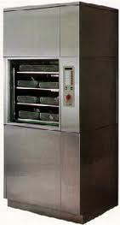
Root Cause Analysis – RCA
  Reactive - to analyze circumstances that lead to an unwanted event
    Uses historical analysis of adverse outcome . . . To prevent recurrence
      A pump on the washer decontaminator failed . . .
      Instrument were not cleaned . . .
      examine occurrences to discover what could have happened
      And what could be done to resolve it
    Examining contributing factors to adverse events

Slide 48
Root Cause
  Investigation to find initial cause of an event
  Ex. Sterilization failed
    Investigation to find what started a problem
      Without this thing – a problem would not have occurred

Slide 49
Quality Program alternatives
Total Quality Improvement – TQI
  Comprehensive
    Quality Assurance –
      For quality products over time
      Only does checks for quality
      Doesn’t research reason for defects
    Process improvement
      Finds solutions to eliminate root causes
  TQI
    Measuring current output of process / procedure
    Modify it to increase
      Output
      Efficiency
      effectiveness

Slide 50


  Applying TQI to performance –organization, team or individual
    CS produces 50 trays /day + meet requirements
      Change wrapping method
      Can produce 55 trays / day + quality
    Judy answers 10 calls /hour
      Give her a headset
      Judy can answer 15 calls / hour

Slide 51
  TQI areas of improvement
    Input – MATERIALS -
      reduce materials or reorder time for materials
    Throughput – TIME + RESOURCES
      Increase process efficiency
      While reducing waste and resource use
    Output – QUANTITY –
      increase quantities while not increasing cost
    Outcome – BETTER? –
      determine whether improvements make a difference

Slide 52
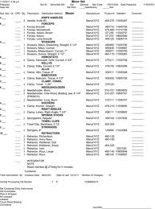
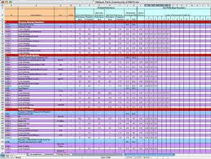
  Continuous Quality Improvement – CQI
    To improve PROCESS
      Instrument set list used for assembly
      Ensures quality of instrument set
      Goes with set to POU
      When returned – can figure the amount of quality to customer
    Database can determine performance by
      Case
      Department
      Physician
      Set
      Date
      Tech

Slide 53
    Quality control concerns about sterilization
      Check integrity and careful cleaning
      Correct sterilization procedure
      Routine random checking of instruments difficult to sterilize
        To be sure sterilization is adequate
      Staff feedback when there are issues/problems
    Audits - Validation
      Guidelines - Manufacturers instructions about cleaning and sterilizing
      CI and BI give information
      Hard to sterilize instruments need to be spot checked
        Use predefined factors to ensure proof of adequate sterilization

Slide 54
  Audits – ASSESS
    WHAT kind of sterilization method should be used
  Audit – TRAINING
    Where is training or education needed
  Audit – GET FEEDBACK
    From users to identify problems /possible improvements
  Audit – SINGLE USE ITEMS
    Reprocessing / resterilization of SUDs

Slide 55
  Total Quality Management – TQM
    Organization wide
    Customer satisfaction long term
    Uses:
      Maintain quality standards
      Tasks performed correctly first time
      Eliminate defects and waste
    How it works:
      Sample product or services for concerns of end users
      Causes of failure are identified and corrected
      Document findings

Slide 56
    Six Sigma
      Objective – To deliver to end customer
        High performance
        Reliability
        Value
      Focuses on developing and delivering near perfect products and services
      Only allows 3.4 defects per one million opportunities!

Slide 57

Other quality programs and standards
  The Joint Commission
    Ensure quality standards are:
      Set
      Monitored
      Maintained
    Uses recommended practices and standards from:
      AAMI and OSHA
    Has routine inspections
      Announced and unannounced
    Each facility if graded on performance

Slide 58

  Magnut Status
    From American Nurses Credentialing Center
    Measures nursing care and nurse satisfaction
    Surveys facilities regarding nurses
    Designation
      Recognizes quality nursing importance
      Very high achievement
      CS – looks at how CS service impact nursing / patient outcomes

Slide 59

International Standards Organization – ISO
  ISO 9000 – international standard
    Shows company delivers quality consistently

Slide 60
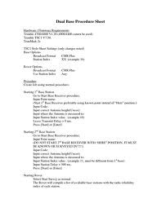

Quality CS procedures
CS Tech
  To attain quality standards while doing their work
    Follow procedures
    Work as a team

Slide 61
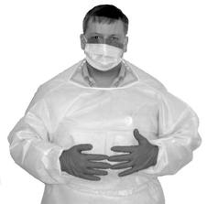
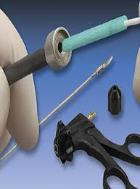
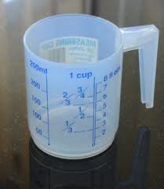
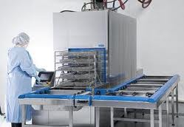
Quality in Processing
  Decontamination
    Wear PPE
    Disassemble all instruments as you can
    Measure properly
    Load and operate properly
    Follow written procedures
      Follow OEM recommendations
    No shortcuts
    Check equipment for proper working order

Slide 62


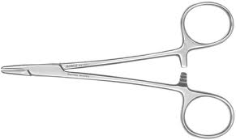
  Preparation and packing area
    Check linen for holes / lint
    Check wrappers / filters for holes, intactness
    Use nothing from the floor
      Instruments, wrappers
    Follow count sheets, pick lists
    Check / inspect all instruments
      Function
      Alignment
      Assembly
      sharpness

Slide 63
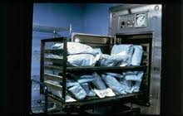
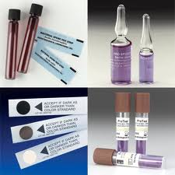
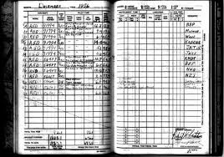
  Sterilization
    Load carts properly
    Verify mechanical and physical indicators post
    No touching until cool
    Complete documentation logs
      Load
      BI
      Implant

Slide 64
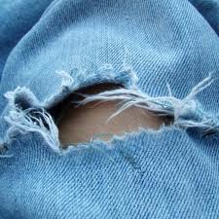
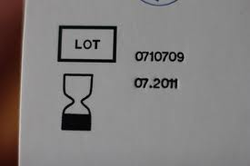

  Storage and Distribution
    Follow pick sheets
    Check packaging
      Holes
      Expiration
      Color changes
    Store / load items to ensure they stay intact

Slide 65



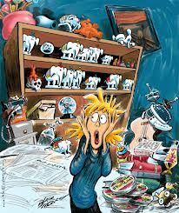
  CS / Distribution
    Don’t talk and work at the same time
      Causes distraction – mistakes
    Don’t do anything without training
    When unsure – ASK for someone to check /help
    When distracted – recheck to be sure it is right
    If not at 100% - don’t do it
      Don’t start if you can’t finish it
    Re-check all work
    Neatness counts

Slide 66



    Help others – even when they don’t think they need help
    Speak up if something seems wrong
    Report malfunctioning or damaged equipment
    Attend training, in-service
      All that you can
    Follow the rules
      There is a reason for the rules
    Question unsure things

