Slide 1
Safety
Chapter 21 7th Ed.
Rosemary Thurston RN

Slide 2
Common Safety Hazards
Maintaining heath and safety must be combined with day-to-day work
  CS Techs – must use information regarding hazards
    To make their work SAFE
    PREVENTS ACCIDENTS
    CS personnel considered high risk
  Thinking – “It won’t happen to me!”
    Not going to protect you
    MUST PRACTICE SAFETY

Slide 3
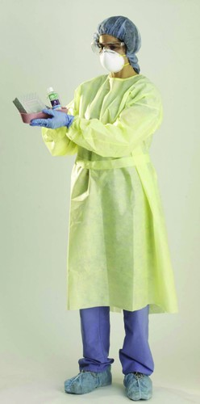
Decontamination
PPE
  Prevents exposure to blood / body fluids
    Exposure can cause:
      Injury, disease, death
  Includes
    Gloves
    Head and foot covers
    Fluid resistant gowns / suits
    Masks
    Goggles or face shields
  Provided by employer
  Must be USED by employees

Slide 4
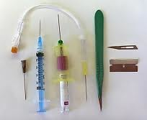


Sharps
  Needles
  Knife blades
  Pins
  Others
Cause
  Puncture wounds
  Lacerations
  Abrasions
Broken (nonintact skin) allows pathogens to center

Slide 5

IF exposed
  Notify supervisor IMMEDIATELY
  Obtain care per facility policy
If you don’t notify the employer . . .
  It didn’t happen!
  You are responsible for anything that happens as a result of not notifying your employer

Slide 6
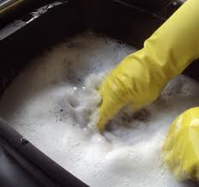
Safety Tips for Decontamination
Don’t put your hand into container of contaminated objects
  Unless you can CLEARLY see everything
  If you can’t see:
    Use sponge stick to grasp the object . . .or
    Pour out solution . . .
      Then remove items one at a time –ONLY
    Point sharps away from you or other people

Slide 7


Dispose of SHARPS in
  PUNCTURE PROOF SHARPS CONTAINER
NEVER put your hands in trash container
  If necessary –
    Pour contents onto surface
    Use instrument to sort through contents
    Use PPE

Slide 8
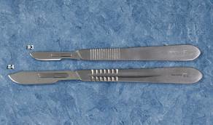
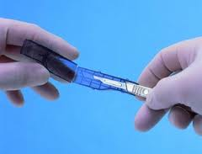
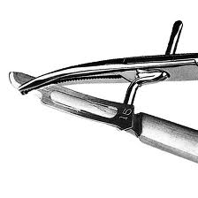
When necessary to remove blade from handle
  Use NEEDLE HOLDER to remove it
  Have your goggles and other PPE
Processing SHARPS
  Separate them from others
  Position them to avoid injury

Slide 9

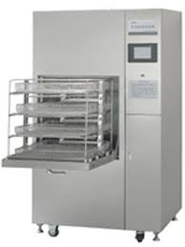
Follow OEM recommendation for SAFE use of Chemicals
  WEAR PPE to protect from chemical burns
Follow OEM instructions for SAFE operation of
  Cleaning equipment
  Testing equipment

Slide 10

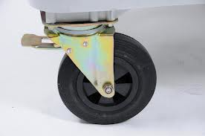
CAUTION in areas with WATER
  May be slippery
  Use mats or non-skid shoes
Moving CARTS
  Check for weight
    Unload items if too heavy
  Check for wheel alignment
    So they will roll over door spaces / uneven areas

Slide 11
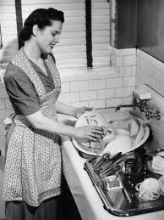

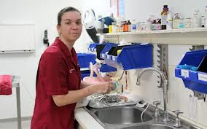
Sinks should:
  Be at working height
    Reduces back and arm strain
Cleaning instruments
  Scrub UNDER water surface
  Avoids formation of AEROSOLS

Slide 13


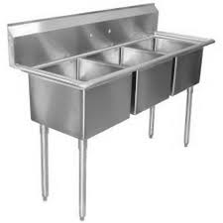
Use OEM’s recommendation for:
  Water
  Detergent concentration

Slide 14


Preparation and Sterilization
AAMI states:
  All those doing sterile processing
    SHOULD BE CERTIFIED
    AS A CONDITION OF EMPLOYMENT
    Only employees thoroughly trained in
      Sterilization
      Care and operation of sterilization equipment

Slide 15

AAMI also says:
  Safe environment results from:
      Monitoring Preventive Maintenance of equipment
      Employee education
      Employee orientation
    A SAFE ENVIRONMENT
      Ensures a safe and efficient sterile preparation and sterilization area
      BENEFITS PATIENTS

Slide 16
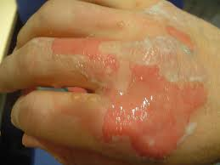
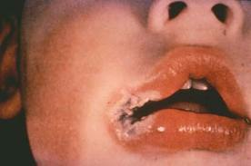
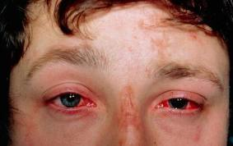
Possible CS injuries
  Burns
    Skin
    Mucous membranes
  Caused by
    Chemicals
      Splashing chemicals in eye – need for eye protection
    Nearness to heat source – sterilizer or hot cart
    Electrical burns – not following precautions

Slide 17


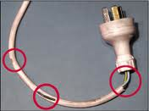
Safety tips for Sterilization Area
Use insulated gloves to handle
  sterilizer carts
  Washer baskets
  Other high temperature items
Move hot sterilize carts to low/no traffic areas
  decreases contact with hot carts
Inspect electrical equipment for damage
  Each time you have contact with them
  For frayed cords

Slide 18
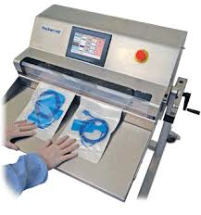

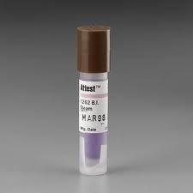
Caution with Heat Sealers
  NO FINGERS in the sealer for free materials
  Ask for help
Care with cutting edge for peel pouch preparation
Biologic indicators
  Procedures must be developed and followed by ALL
  Follow procedures for using, reading, recording, and disposing

Slide 19
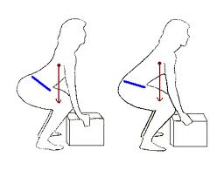

LIFTING
  Size up the load
  Use leg muscles
  Hold close to body
  Don’t twist
  Bend knees to put down
    DON’T BEND
Remember instruments may weight more on one end

Slide 20
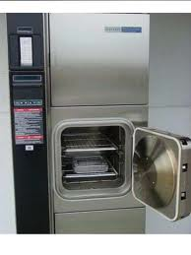
Check sterilizers continuously
  Check damage to
    DOORS
    DOOR SEALS
    HINGES
    OTHER PARTS
  If Damaged
    Don’t use
    Contact supervisor

Slide 21
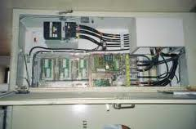
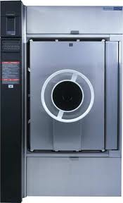
Control panels
  Only accessed by authorized, experienced service people
  Verify credentials of service person if there is a question
Operating Sterilizer
  Only by those trained and authorized
Entry to Sterilization Area
  Only to authorized hospital personnel
  No patients or visitors should enter

Slide 22



Signs and labels to warn
  “HAZARDS”
  “HOT”

Slide 23
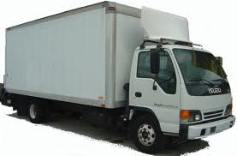
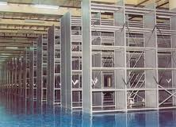
MM Receiving, Breakout, Storage
Supply Receiving requires
  TRAFFIC access
  Adequate STORAGE
    Sturdy shelves
    Arranged for efficient access and maximum space
    Heavy and bulky supplies on BOTTOM
    Lighter less used HIGHER
    Frequently used – MIDDLE

Slide 24



Access to shelves
  Appropriate equipment
    Ladders
    Steps
    Stands
    Training to safely use:
      dollies / hand trucks
      Fork lifts
      Carts
    Using tools for opening and sealing cases / crates safely

Slide 25
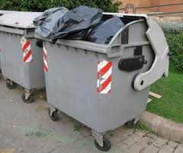


Containers
  CLOSED TRASH CONTAINERS
  Storage of HAZARDOUS FLAMMABLES
    100% Ethylene Oxide (ETO)
    Must follow Proper Procedures to handle materials
    MSDSs must be available for reference
  Other chemicals and solutions that are HAZARDOUS
  Concerns about fumes generated by trucks / fork lifts

Slide 26
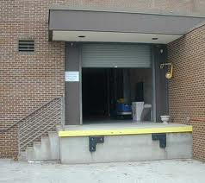

Loading Dock procedures
  Don’t get on truck until it is secured
  Don’t climb up and down or swing from the dock
    Can result in injuries, strains, sprains, broken bones
Use Good BODY MECHANICS

Slide 27


Safety Tips
Removing items from storage
  Examine the workspace
  Give yourself time to do the task
  Have adequate space to maneuver
Using a Box Cutter
  Be sure body part are not in the cutting path
    Fingers, leg
  Cut away from your body or to the side
  Retract the blade when finished

Slide 28




Scalpel Blades
    NOT used to open boxes
Paper
  Handle carefully
  Causes paper cuts
Broken Glass
  Don’t handle, use utensils
  Containerize them before placing in container

Slide 29



Moving items
  Avoid TWISTING and JERKING movements in tight spaces
Clear Aisles and Doorways
  Check for objects or equipment that protrudes
    MUST BE KEPT CLEAR
Small Areas
  Check traffic patterns and doors
  Check area and secure doors while working
  Use CAUTION sign for opening doors

Slide 30

Stretching before work
    Avoids injuries to back and other areas
    While lifting, pushing, pulling

Slide 31
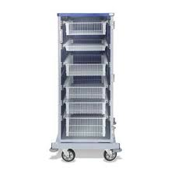
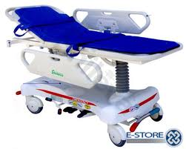

CS Equipment
Equipment in this area
  Storage carts
  Cabinets
  Gurneys
  Wheel chairs
  Equipment charging
Limited Space
  May have difficulty moving around

Slide 32
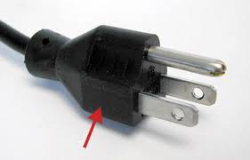

Electrical equipment
  Plug in to charge devices
  Check cords and plug prongs each time you touch the equipment on return, distribution
Storage
  Adequate shelving, with strength and enough capacity
  Provide ROTATION of supplies – FIFO
    Check for EXPIRATION DATES
    Continuous inspection for INTACT PACKAGES

Slide 33
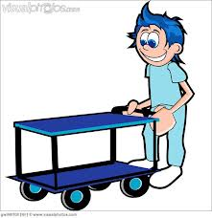
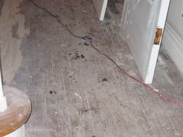


SAFETY TIPS
Moving carts in SUPPLY area
Ensure the path in front and each side is visible
Ensure path is clear on each side to avoid injury to hands and arms
Inspect floors for uneven areas that might cause items on cart to tip over

Slide 34
Push carts, don’t pull
Caution when approaching
  ELEVATOR
  CORNERS / INTERSECTIONS
    Use SAFETY MIRRORS to see oncoming traffic
  INCLINES
    Push up hill
    Pull down hill

Slide 35

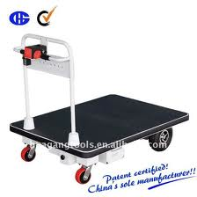
Don’t RIDE on equipment
Consider POWERED CARTS
  For heavy or awkward loads

Slide 36
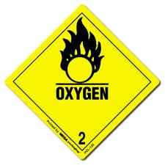
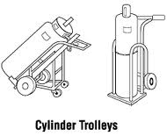
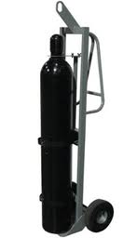
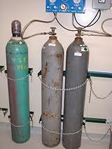
Compressed GAS CYLINDERS
  Be AWARE of requirements for each gas
SAFETY
  Don’t dispense without a label
  Secure at all times to prevent tipping
    In secured holder
    Strap or chain in upright position

Slide 37

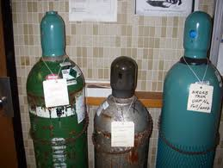
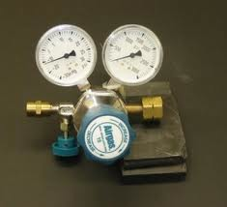
  Careful handling, don’t
    Roll
    Drag
    Drop
  Cover cap to protect cylinder valve
  Use regulator that works
  for the type of gas being used

Slide 38




Inspect threads
  on valves, regulators for damage before connection
Tag cylinder
  Full
  In USE
  Empty

Slide 39

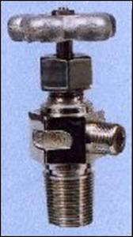
Gas Regulators
  Have a hand wheel or stem valve
  Stem vales require a key
  Should remain with regulator at all times
  See p. 404

Slide 40
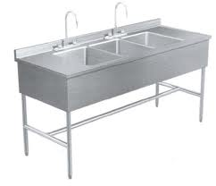
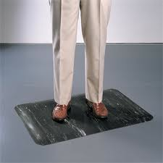
Clerical / Work Stations
Ergonomics
  Changing working conditions to reduce stress
  Repetitive activities can cause
  cause strains – bending over sink
SAFETY TIPS
  Assembly performed at level that will cause less fatigue and strain – higher sinks
  Floors should have fatigue mats

Slide 41
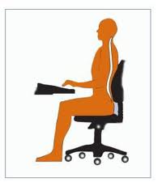

Supportive chairs at work stations
  To support back
Computer glare screen
  Reduce eye strain

Slide 42
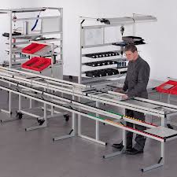
Store within easy reach
  Frequently used items
  Avoids strain to upper body
    from repetitive movements to retrieve them

Slide 43
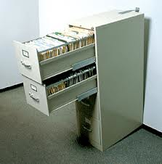
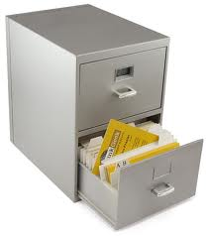
Filing Cabinets
  Opening more than one drawer at a time
  Can cause cabinet to tip forward
  Don’t leave drawers open when not in use
    Can cause someone to tip over them.

Slide 44

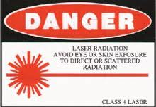
Surgical Services Area
  Observe SIGNAGE
  Same hazards as CS
  Specific hazards to OR
    Laser use
      Don’t enter a room without specific goggles ALWAYS
    X-ray use
      Don’t enter a room when it is in use
    Chemicals used
      Be aware of MSDS
  Follow OEM’s precautions

Slide 45
Ethylene Oxide Safety
Exposure expressed in TWA (8 hour time weighted average)
PEL 1ppm
AL 0.5ppm = Action Level
  Concentration at breathing level - “airborne”
  If exposures are below AL, employees don’t need:
    Routine monitoring of ETO exposure
    Routine medical exams
  If exposures are above AL
    Monitoring depends on level of exposure

Slide 46
STEL – Short Term Excursion Limit
  5 ppm over 15 minutes
  Doing tasks such as:
    Transferring non-aerated goods to aerator
    Sterilizer maintenance
    Changing gas cylinders
    Unloading sterilizer when there is a chance of exposure
  Monitoring
    Discontinued if exposures over 7 days are less than 5 ppm
    If exceeded, plan is developed to reduce exposure

Slide 47
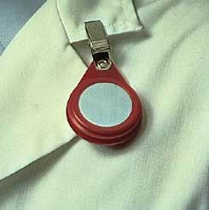
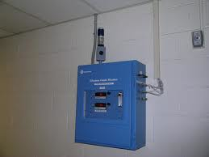
OSHA – hospital must determine exposure to ETO
  Using:
    Breathing zone air levels- environmental monitoring
    Personnel monitors
  OSHA mandates the accuracy of monitor used

Slide 48
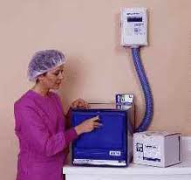
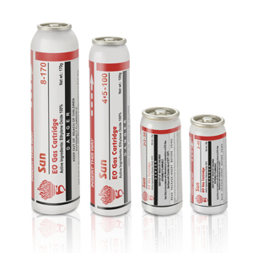
Areas of Exposure
  Front of sterilizer by the door
  Back of the sterilizer by the
    Drain
    Emission control device
    Tank changing area
  Through leaking of cylinder or the connection to it
Direct Contact can cause:
  Burning eyes, burning throat, red irritated skin

Slide 49
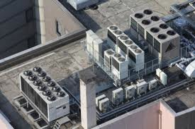
ETO exhaust
  Must be vented directly to the outside of the building
    Directed away from occupied spaces
    Must be labeled to warn people
  Exhaust should be vented through an emission control device
    Should capture any exhaust
    Can be changed into non hazardous products before entering the environment

Slide 50


ETO Safety Precautions
  Use neoprene gloves to transfer items to aeration cabinet
    Keep arms extended
    Do not inhale close to items
  If using cart – pull it instead of pushing into the fumes
  Separate ETO sterilizer area from general work areas
  Special ETO exhaust vent for the sterilizer
    Must be checked to ensure it is working correctly
  Auditory and visual alarms must activate if there is a malfunction

Slide 51
Some older sterilizers:
  Must leave door open 6” for 15 minutes after cycle is done.
  Sterilizer is turned off
  Leave contents in chamber
  No one should be around during this time
  These are being replaced with newer units
Hospitals must comply with all laws, regulations and record keeping in relation to:
  Worker safety
  Clean air

Slide 52
During aeration – leave door closed the entire cycle
  Do not remove items or add items
Don’t mix loads in aerator
Report immediately any exposure to ETO
Observe “Out of Order” signs to prevent exposure to electrical injury
P. 406 ETO Spill Response

Slide 53
Reporting on-the-job Accidents
Report accidents / injuries immediately
  Hospital must comply with OSHA regulations
  Investigation occurs:
    Cause
    Situation / behaviors involved
    Identify:
      Contributing factors
      Hazards
      Unsafe practices
    Corrective actions implements to address problems
      Prevent future accidents / injuries

Slide 54
Report directly to your supervisor (manager, etc.)
  Details needed
  Time
  Place
  Tasks being performed
  Description of what happened
Submitted to Risk Management
  Safety officer, personnel, employee health and others
  Must be aware of potential problems p. 409

Slide 55
Ergonomics
Effective program includes:
  Goal to reduce work related musculoskeletal disorders – WMSDs
    Adapting the work to fit the person
  Analysis of tools and equipment to fit job / person
    Should not contribute to an injury

Slide 56
Ergonomic Stressors
  FORCE – heavy lifting of manipulating
  REPETITION – using same motions continually /frequently
  AWKWARD POSITION – positions such as reaching/twisting while lifting
  VIBRATION – rapid oscillation of body or a part
  CONTACT STRESS – pressing body or part against hard /sharp edge

Slide 57



Stressors can cause:
  Sprains
  Joint / tendon inflammation
  Pinched nerves
  Herniated spinal discs
  Others
Occurrence
  Over time
  Single event

Slide 58

Result in :
  Pain
  Disability
  Loss of work
Reducing WMSDs
  Adjust work environment and practices
    Support from administration
    Staff must “buy in” to changes
    Requires sustained effort, allocations of resources and frequent follow-up

Slide 59
  Training Employees
    Recognize symptoms of WMSD to respond to them
    Report potential problems
    Recognize jobs with ergonomic stressors
    Know how to control them
  Evaluation
    Assess effectiveness
      Leading Indicators - ID events that prevent accidents / injuries
      Trailing Indicators – Measures historic results

Slide 60
Employees
  Need to maintain their health and fitness
  Personally and at work
Work Site
  Analyze to identify conditions / activities that are risky
  Implement actions to correct problems
  Compare your worksite to others
  Ask questions of employees
  P. 410 – Carts and lift systems to decrease heavy lifting
  P. 411 – Ergonomic Evaluation

Slide 61
Patient Injuries
CS must help PREVENT injuries
  Follow procedures to prevent infections
    Checks and Balances
      Monitor sterilization system while in use
      Monitor BI tests and other tests

Slide 62
Patient Care Equipment – Safety tips
  Test / document equipment before leaving department
    Using OEM guidelines & CS procedures
  Check ALL equipment:
    Decontamination
    Damage or defects
    Hazards – frayed cords, etc
  Track all equipment
    Use history is helpful in legal situations

Slide 63
  PM done on scheduled basis
    CS is accountable un TJC (Joint Commission)
    Records must be maintained
  Biomedical Engineering must:
    Check in all new equipment
    Do regular PM testing
  Safety Guards
    During transport, use them on heat lamps, heat cradles
    Prevents breakage

Slide 64


  Prevent Cross-Contamination
    Cover contaminated equipment during transport
    Cover clean equipment to reduce risk of contamination while awaiting distribution

Slide 65
Contaminated Supplies / Reusable Med Devices
  Safety Tips:
    All Items must be :
      Disassembled
      Thoroughly cleaned
      Inspected
      Reassembled??
      Prepared for sterilization
      Packaged appropriately
      Sterilized
      Aseptically handled
      Stored

Slide 66
  Sterile processing equipment must be tested to ensure proper operation
  Personnel must use appropriate techniques for equipment care and operation
  Instruments must be complete and functioning
  Monitor sterilization equipment:
    Visually during the cycle
    Mechanically with printout
    Indicators – chemical and biologic
      Air detection test

Slide 67
Chemical Residues
  Can cause Patient Burns
  Safety Tips:
    ETO items must be aerated fully
    Items for ETO must be DRY
      Ensures contact with surface
      Prevents possible acid formation
    Gluteraldehyde must be fully rinsed

Slide 68
Supply and Equipment Transport
  Safety Tips:
    CAUTION when approaching:
      Doorways
      Hallways
      Elevator
      High-traffic areas
    Don’t PUSH or PROP OPEN doors with transport carts
    Don’t BLOCK hallways with equipment
      Keep halls clean

Slide 69


Patient Accident Reporting
  Must be investigated and recorded
    Practices or conditions that contributed
  Everyone must report unsafe practices / conditions
    Minimizes problems

Slide 70

Sterilization Process Malfunction
  All items must be RECALLED
    Must be QUARANTINED until BI is read
    Take suspect Sterilizer out of service
  PROCEDURE should include:
    Get list of supplies know to be in the suspect load
    Verify sterilization controls
    Notify Supervisor
    Notify areas that may have questionable supplies
    Retrieve as many items as possible on list
    Notify Infection Control and Operating Room supervisor
    Notify MD’s if any suspect items were used in surgery

Slide 71
  Document ALL steps taken
  Notify Risk management about any possible suspect equipment used on patients
  Qualified Service people need to inspect equipment
    Comprehensive report must be written
    BI must be run before next use

Slide 72



Occupational Hazards
Categories
  PHYSICAL – including fire
  CHEMICAL – hazardous substances
  BIOLOGICAL – blood-borne and infectious waste

Slide 73

Fire Safety
    Fire Requires 3 elements –FIRE TRIANGLE
      COMBUSTIBLE FLAMMABLE substance
      OXYGEN
      IGNITION / HEAT source
    PREVENTION
      Eliminate one element

Slide 74
Fire
  Heat causes atoms to combine with oxygen (Oxidation)
  Energy is released - fire
    Solids burn on the surface – burn more slowly
    Volatile liquids (alcohol) vaporizes or gas (ETO)
      Flame passes quickly through substance
      May result as a EXPLOSION with heated gases
      Creates PRESSURE WAVE

Slide 75

Combustible Loading
    Weight / square foot of area where they are located
    DISPOSABLE materials contribute to HEAVY combustible loads
      Surgical drapes
      Gowns
      Caps
      Masks
      Shoe covers
      Tubing
      Bed pans
      Syringes

Slide 76
  Other areas of combustible loads
    Central storage
      Large volumes of single use items + wrappings
    Operating room
    Delivery suites
    Nursing units
    Trash handling facilities
  When these things burn, they produce toxic smoke
    Becomes a HIGH RISK situation close to in-patients

Slide 77
Fire Safety Programs
  Minimize Combustible Load
  Fire response plans
  Early detection
  Removal of persons in danger
  Containment of fire and combustible products
  Extinguishing
  Evacuation

Slide 78
Minimize Combustible Loads
  Reduce volume - Don’t give fire a place to start
  Reduce use of disposable items
  Store single-use items in proper temperature / humidity
    Higher temperature and low humidity increase risk
    Dedicated storage should be
      Compartmentalized away from rest of hospital
        Automatic doors – nothing to hold doors open
      Have fire detection, alarm and suppression systems

Slide 79


  Minimize volume by getting supplies when they are needed
  Minimize trash buildup
    Have covered containers that are non-combustible
    Regular pick up for transfer
    Disposal of environmental protection concerns

Slide 80
Fire Response Plan
  Facility has comprehensive plan
  CS has their part of the plan
  Each employee must know their role
    Orientation
    Annual training
    Participate in fire drills
      See P. 416

Slide 81
Using RACE
  Remove persons in danger
  Alarm – activate the alarm
  Contain the fire – close doors / windows
  Extinguish the fire OR Evacuate
    Put out the fire per hospital policy
    Horizontally or Vertically
      Move across fire door or up or down a floor

Slide 82
Early Detection
  Use ionization smoke detectors or per Local Code
    Connected to ALARM system
    Sprinklers connected to same system
  Patient care areas may require infrared smoke detectors
    Sprinklers should be activated as well
  Activate the ALARM
  Pull fire alarm – dial an emergency number
    Someone calls 911 or alarm goes directly to 911

Slide 83
Remove persons in immediate danger
  Everyone in the immediate fire / smoke area must be removed
  Patients are only moved in imminent danger
Containment
  Building is built with compartmentalization
      Allows a “defend-in –place” protection
  Fire doors close automatically
  Close all doors in your area
    Be sure all windows are closed

Slide 84

Extinguishment
  Fire extinguishers for specific hazard
    Must be used for specific kind of fire burning
    Should be placed according to what is in the area
  Follow Hospital POLICY
http://www.youtube.com/watch?v=BLjoWjCrDqg

Slide 85


Slide 86
Evacuation
  Usually a HORIZONTAL Evacuation
    Move from Threatened area to NON-Threatened Area
  Compartmentalization allows movement
    Fire doors / smoke doors
    Ventilation system prevents spreading smoke
  Keep hallways clear – must have clear exit - NO
    Equipment
    Supplies
    Other clutter

Slide 87

Moving patients – priorities
  Horizontally –
  Vertically – up or down
  Complete evacuation – only when unsafe to remain
  CS staff would transport Medical Supplies
    To a designated area
    Ensure critical supplies for longer duration evacuation

Slide 88
Hazardous substances
  Required Plan to ensure safety and health of employees
  OSHA requires “Employee Right to Know” communication program
    Container labeling requirements
    MSDS
    Employee information
    Training
    Procedures to manage hazardous substances
    Employee monitoring
    Hazardous Waste management

Slide 89

Container Labeling requires
  Contents
  Appropriate hazard warning
  Manufacturer’s name and address
  Secondary containers must be labeled with copy of original manufacturer’s label OR
  Generic label identifying hazard warning and use directions

Slide 90
MSDS – Material Safety Data Sheet
  Information to work safety with materials
  Developed and provided by manufacturer
  Specific for each material
  Must show:
    PRODUCT IDENTIFICATION– Name, ID number, Manufacturer’s address and phone number and synonym names
    List of HAZARDOUS INGREDIENTS
    PHYSICAL DATA - p419
    Fire/explosion information- flash point, extinguishing media, etc. N

Slide 91
    Reactivity – how stable is it, what it reacts with, etc.
    Health hazard data – effects of exposure/ over exposure
    Storage Recommendations – storage temperatures and incompatible materials
    Emergency and First Aid –
    Spill or leak procedures – spill management and disposal
    Protection – information and control measures
    SPECIAL PRECAUTIONS
http://www.thecloroxcompany.com/downloads/msds/bleach/cloroxregularbleach0809_.pdf

Slide 92
Employee Information and Training
  Attend Orientation and ongoing Training
  Be familiar with
    Hazards
    Safety practices
  Department Orientation
    Overview of Hazard Communication Regulations and employee rights
    Notification about hazardous substances in their work area
    Location of written hazard communication information

Slide 93
    Physical /health effects of Hazardous Substances they may encounter
    Methods to determine presence / release of hazardous substances
    Control and work practices, PPE to decrease exposure
    Department steps to decrease / prevent exposure
    Emergency / first aid procedures for exposure
    How to read labels/ review MSDS for information
    Emergency spill procedures for
      Gluteraldehyde
      EtO
      PA
      Hydrogen peroxide

Slide 94
Handling Hazardous Substances
  CS should have list of substances as hazardous
    See P 421
  Prior to performing tasks with hazardous chemicals:
    Get information about possible exposure
    PPE required
    Safety measures
    Emergency response procedures
  Other thing to minimize exposure
    Increase ventilation
    Respirators
    Assistance from other employees
    Rehearsing emergency procedures

Slide 95
Employee monitoring
  OSHA PELs
    Should not be exceeded
    Other organizations also have PELs
  Healthcare Facility are required by OSHA to:
    Have engineering controls – ventilation
    Have safe work operating procedures
    Other methods to keep exposure limits below PEL

Slide 96
Hazardous Waste Management
  Provides safety protocol for disposing of hazardous chemicals
    Waste will be disposed of properly
  May contract with waste management company
    Pick up on schedule
    Musts be LABELED with contents and beginning date
    Consult regional and local regulations

Slide 97
Bloodborne pathogens
  Significant health risk from occupational exposure
  Exposure to blood / other potentially infectious materials
    Hep B – liver disease
    HIV - AIDS organism
  Risk minimized through
    Engineering
    work practice controls
    PPE
    Training
    Medical surveillance
    Vaccination
    Other

Slide 98
Disaster Plans
Internal Disaster
  Situation inside facility with potential to cause harm or injury
  Loss of utilities would seriously impact department
    Hazardous chemical spill
    Loss of power
    Failure of Water or steam utility

Slide 99
External Disaster
  Situation outside of facility
    Flood
    Earthquake
    Hurricane
    Many injuries from one incident
  Whole facility in on alert

Slide 100
Disaster Plan
  Facility plan
  Department plan part of the whole
  Managed by ICS – Incident Command System
  Elements of CS plan include:
    Emergency call list –
      Lines of authority
      Who to call for specific disasters
    Protocols for supply replenishment

Slide 101
  Posted evacuation plans with practice drills
  Organizational structure - lines of authority
  Employee responsibility lists for certain tasks
  Alternate communication / transportation if out of order
  Location of utility / power shut off points
  Priorities for sterilization / distribution based on failing utilities / internal damage
  Risk assessment to help guide planning efforts
  How facility plan is integrated with community response organizations

Slide 102
New Concern
  Biologic Terrorism
    Potential of using biologic agents for terror
  Chemical Agents
  Must include these in Disaster Plans
    Preparedness and response protocols

Slide 103
Possible Alerts to possible terrorist attack
  Rapid increase of disease
  Epidemic that rises / falls in short period
  Endemic disease in an unusual time or pattern
  Lower exposure inside vs. outside area
  Cluster of people from one area
  Many rapidly fatal cases
  Uncommon disease that has terrorism potential – ie anthrax

Slide 104
CS special concerns:
  Isolation Precautions
  Standard Precautions
    Prevent direct contact with body fluids, droplets, and droplet nuelei
    Use of PPE
  Cleaning, disinfection, and sterilization of equipment
  Laundry isolation for some agents (small pox) in the room, in plastic bags and then linen bags
  Trash – may require special handling

