Slide 1
Anatomy and Physiology
Chapter 3 - 7th ed.
Rosemary Thurston RN

Slide 2
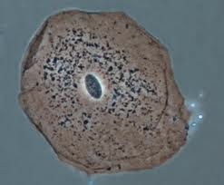
Structures of Body
Cells
  Basic unit
    Nucleus
      Contains DNA
      DNA tells the cell what kind of function
      it is supposed to do.

Slide 3
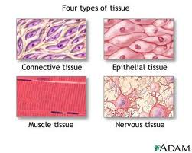
Tissue
  Group of similar cells with specific function

Slide 4
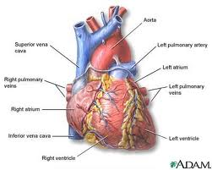
Organ
  Part that has 2 or more types of tissue
  Function together for specific function

Slide 5
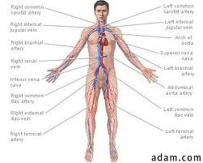
System
  2 or more organs functioning together

Slide 6
Activity
Get a partner and work together to:
  Pick one of the systems out of the basin
  Draw the system you have chosen
  Explain where it is in the body
  Point out the parts of the system
  Explain what it does
  Give common surgical procedures for that system

Slide 7
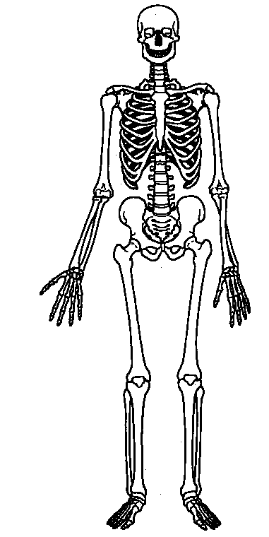
Systems
Skeletal
    Gives body shape
    Protects vital organs
  Cartilage – flexible connective tissue
    Forms structure of some body parts
      Ears, nose
    Connects bones together
    Cushions between joints
  Ossification
    Turns cartilage into bone

Slide 8
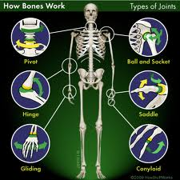
  Joints
    Gliding
      Slide back and forth – vertebrae
    Ball and Socket
      Head rotates in cup – hip and shoulder
    Pivot
      Bone rotates – lower arm
    Hinge
      One direction (door) – elbow and knee
http://www.youtube.com/watch?v=uxBe-BgmNTs

Slide 9
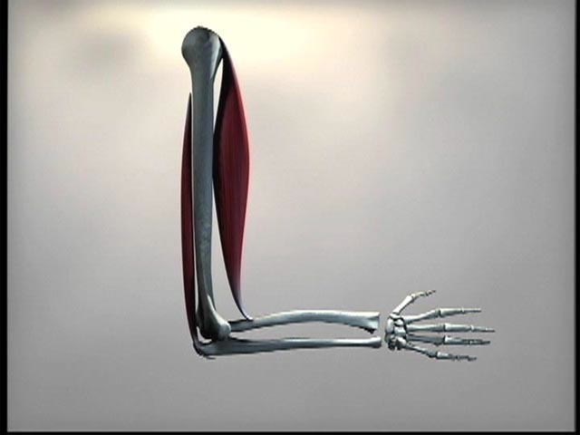
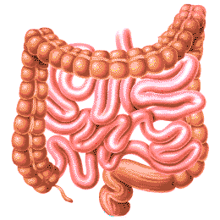
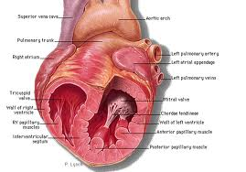
Muscles
  Kinds
    Skeletal – moves us –
    we control them (voluntary)
    Smooth – occur automatically
    (involuntary) – stomach,
    intestines, breathing,
    circulation, urinary
    Cardiac muscle – involuntary –
    heart beating

Slide 10
Nervous
  Sensory Stimuli
    Receives and allows response
  Movement of voluntary muscles
    Tells them how to move
  Information
    Learns
    Stores

Slide 11
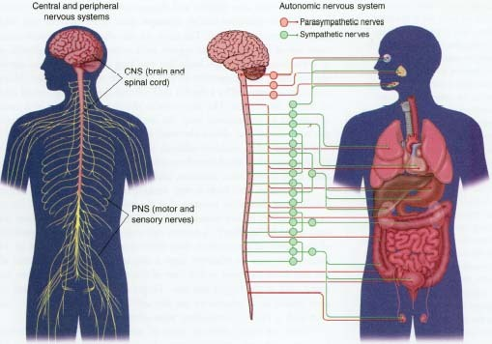
  Parts
    Central
      Brain and spinal cord
        Cerebrum is largest part of brain
    Peripheral
      All nerves outside of the
      brain / spinal cord
      http://www.youtube.com/watch?v=1en5saCESpA

Slide 12
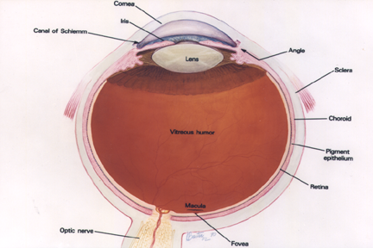
Sensory
  Eye
    Sclera – white outer covering
    Iris – colored part controls light entering the eye
    Pupil – hole in center of Iris
      Allows light to enter eye
      Enables you to see
      http://www.youtube.com/watch?v=RE1MvRmWg7I

Slide 13
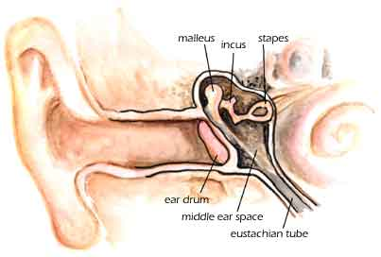
  Ear
    External ear
    Auditory canal
    Ear drum – tympanic membrane
      Sound waves vibrate membrane
    Middle ear and Ossicles –
      Little bones that transmit vibrations from ear drum
    Inner Ear – nerves pick up vibrations
      Transmitted to brain so you can understandhttp://www.youtube.com/watch?v=ahCbGjasm_E

Slide 14
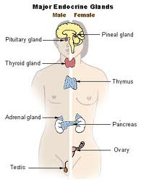
Endocrine glands
  Secrete Hormones
    Interact with Target cells or organs
    Influences function of that cell
  Pituitary
    Master Gland
      Secretes Growth Hormones
      Influences development of sexual organs

Slide 15
  Thyroid
    Controls metabolism
  Pancreas
    Controls glucose use
  Adrenal
    Responds to stresses
  These secrete hormones
  and Reproduction
    Testes
    Ovaries
  http://www.youtube.com/watch?v=Ry5fTZfZHIs

Slide 16
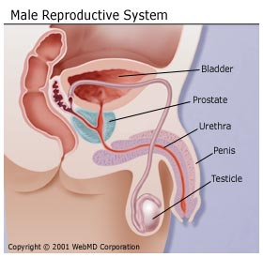
Reproductive system
  Male
    Scrotum
    Testes
    Prostate gland
    Urethra

Slide 17
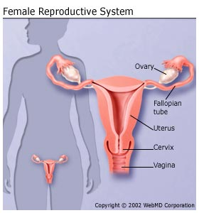
Female
  Ovaries
  Fallopian tubes
  Uterus
    Inside lining is the
    endometrium
  Vagina

Slide 18
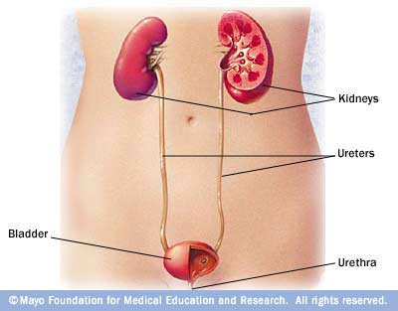
Urinary System
  Kidneys
    Filters blood
    Makes urine
  Ureters
    Transports urine
  Urinary Bladder
    Stores urine
  Urethra
http://www.youtube.com/watch?v=qxb2_d9ilEw

Slide 19
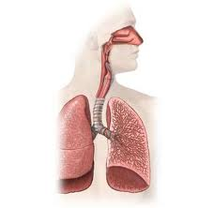
Respiratory
  Nose
  Pharynx
    Throat
  Larynx
    Voice box
  Trachea
  Bronchi
  Lungs
  http://www.youtube.com/watch?v=HiT621PrrO0

Slide 20
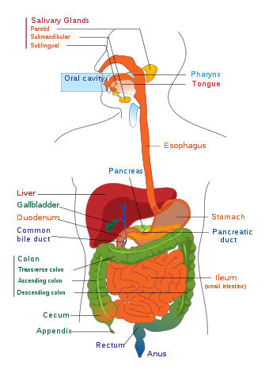
Digestive
  Mouth
  Esophagus
  Stomach
  Small intestines
  Colon
  Gall bladder
  Liver
  Pancreas
  http://www.youtube.com/watch?v=Z7xKYNz9AS0

Slide 21
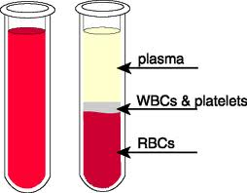
Circulatory
  Blood
    Plasma
    Blood Cells
      RBC’s
      WBC’s
    Platelets
    http://www.youtube.com/watch?v=Z7xKYNz9AS0

Slide 22
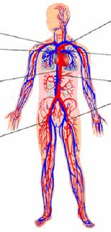
Heart
Arteries
  Aorta is largest
Veins
  Vena Cava largest
Capillaries
  Connect arteries
  to veins
  http://www.youtube.com/watch?v=57wrBvyp4jQ

