Slide 1
Microbiology
Chapter 4 7th Ed.
Rosemary Thurston RN

Slide 2
Microorganisms
Micro Organism
  Very Small Organism or living thing
Micro bio ology
  Very small living thing study of

Slide 3
Why ?
Duty to:
  Protect the patient from infection
  Protect yourself from infection
What causes infection?
  Microorganisms
  E-coli Story
Infection Control

Slide 4
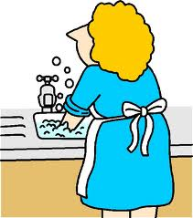
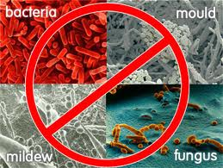
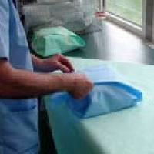
CS Infection Control
Cleaning
Disinfection
Sterilization
Sterility Maintenance

Slide 5
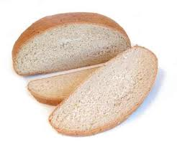
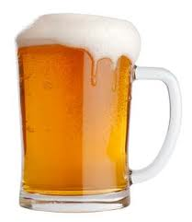

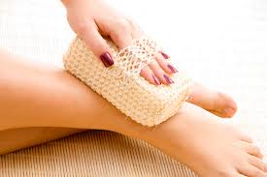
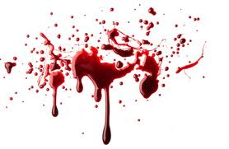
Microorganisms
Micro
  Very small
  Needs microscope
Classes
  Non pathogens – can be helpful
  Pathogens – causes disease
Found
  Everywhere
  In / on the body

Slide 6
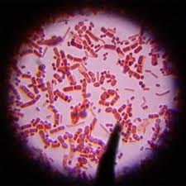
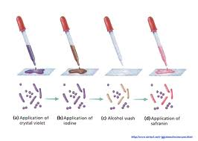
Identifying Bacteria
Shape
Color change
(gram stain)
Need for Oxygen

Slide 7

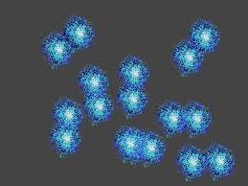
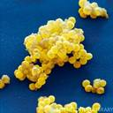

Identifying Bacteria
Shape
  Cocci – round balls
    Coccus – single cell
    In Pairs – Diplococci
    In Clusters - Staphylococci
    In Chairs – Streptococci
    http://www.youtube.com/watch?v=eoK3XcwChW4

Slide 8
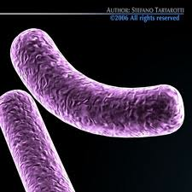
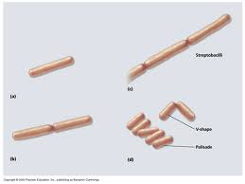
  Bacillus - Rods – (stick like)
    Bacillum
    Diplobacilli – a pair
    Streptobacilli – a chain

Slide 9
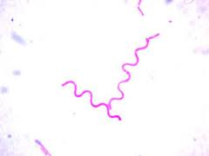
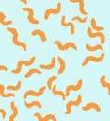
  Spirillum – spirals

Slide 10
Bacterial Growth
http://www.youtube.com/watch?v=J6akNYlkehY
Growth in body
http://www.youtube.com/watch?v=eoK3XcwChW4

Slide 11
Color Change – by staining
  Gram Stain
    Purple = Gram Positive
    Red = Gram Negative

Slide 12
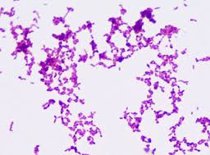
  Ziehl-Neilson stain (acid fast stain)
    It is like color fast materials
    Acid causes the bacteria to decolorize
    If they retain the red color – they are acid fast (color fast)
    TB – Mycobacterium
    Tuberculosis is one.

Slide 13
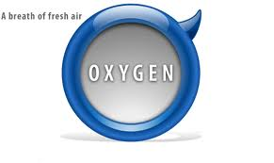
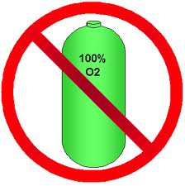
Need for Oxygen
  Aerobic – Needs air / oxygen
  Anaerobic – an aero (without air / oxygen)
    Tetanus
    Botulism

Slide 14
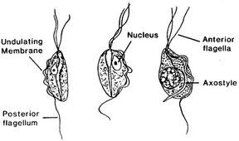
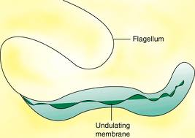
Another way to identify
  May have Flagella – (Tail)

Slide 15
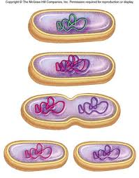
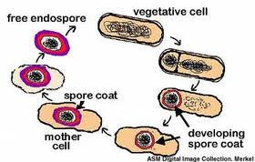
Conditions for Growth
Bacteria
  Vegetative State – actively growing
    Reproducing by binary fission
    http://www.youtube.com/watch?v=J6akNYlkehY
  Spore State – Resting state occurs
    In bad conditions for growth
    Not reproducing
    Very RESISTANT to being killed
http://www.youtube.com/watch?v=NAcowliknPs

Slide 16
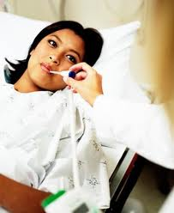
Temperature
  Most pathogenic bacteria like 68 to 113º F
    Considered Moderate Temperatures
      Mesophiles
        Meso = middle
    Grow well at body temperature – 98.6ºF
    Only 1% of organisms are pathogenic
  Some grow between 122 to 158º F
    Called
      Thermophiles
        Thermo = temperature

Slide 17
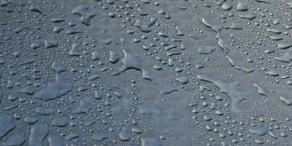
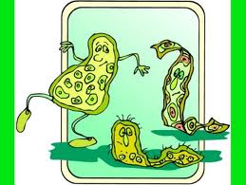
Moisture / humidity
  Needed by vegetative Bacteria
  Spore
    Can survive for a prolonged time without moisture

Slide 18

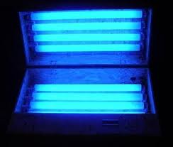
Light, especially Sunlight
  Able to kill organisms
  UV light
    Range of 2537 Angstrom – Unit of visible light
    Most lethal
    Used to disinfect air and purify the environment
      “Research presented at IDWeek 2012 showed that a specific spectrum of ultraviolet light killed certain drug-resistant bacteria on the door handles, bedside tables and other surfaces of hospital rooms,”
Organisms like darkness

Slide 19
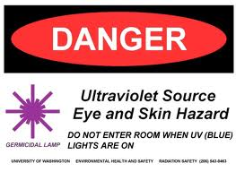
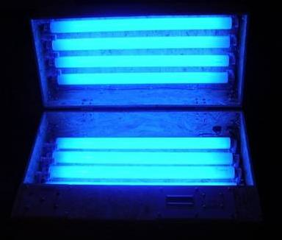
U.V. light

Slide 20
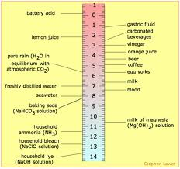
Acid Environment / pH
  Most will not grow in low pH / Acid
    4.4 pH or lower
      See chart
  Most like neutral pH –
    Similar to the human body
    7.0 to 7.8 pH

Slide 21

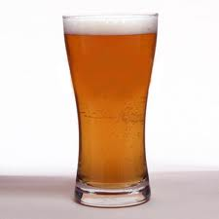
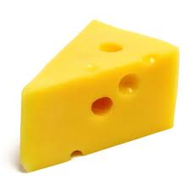
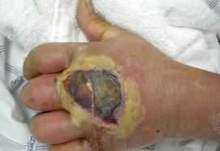
Human Body and Bacteria
Non Pathogenic
  Don’t cause disease
  Used in Bread, Beer, Cheese
Pathogenic
  Cause disease

Slide 22
Normal Flora
  Organisms that grow on and in the body Normally
  Specific organisms in specific areas
    Skin
    Digestive tract
    Respiratory tract
    Reproductive tract
  Pathogenic in other areas of the body
    E-coli from bowel in Bladder – causes bladder infection

Slide 23
Resistant Organisms
  May adapt and change
  Do not respond to usual antibiotics
  Examples:
    MRSA – Methicillin Resistant Staphylococcus Aureus
    VRE – Vancomycin Resistant Entercocci
    http://www.youtube.com/watch?v=ZuybyjV_3Ko&feature=related
    http://www.youtube.com/watch?v=tqOVYpkZ0qs&feature=related

Slide 24
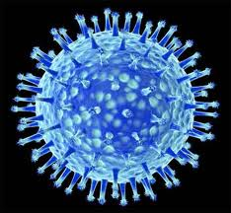
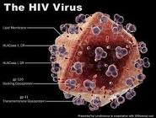
Other Organisms
Viruses
  Much smaller than bacteria
    Needs special microscope
  Is carried from place to place
    Air, Water, Human HOST
  Enters cell
    Uses the cells genetic materials to reproduce
  Some can survive outside of the cell / body
      On surfaces
http://www.youtube.com/watch?v=TVLo2CtB3GA&feature=related
Bacteriophage
http://www.youtube.com/watch?v=9hzUjx_oD8E

Slide 25
Diseases
  Measles, mumps, polio, cold sores, warts, hepatitis, AIDS, influenza and others
Hepatitis
  A – from food
  B
  C All the rest can be in Body Fluids
  D
  E – oral intake – usually contaminated water

Slide 26
  Hepatitis B
    Caused by Hepatitis B Virus - HBV
      Transmitted by blood / body fluids / STD / perinatal / IV drug abusers
      Results in Hepatitis – inflammation of the liver
    Can be resolved
      Causes production of Hepatitis B Antibodies – HBsAb
    10% become chronic
      Can cause cirrhosis or liver cancer over time
    Vaccination is available – provides protection
      Requires 3 injections over 6 months
      Should produce Hepatitis B Antibodies
    Very difficult to kill
      Can live on surfaces for 24+ hours

Slide 27
  AIDS – Acquired Immune Deficiency Syndrome
    Caused by Human Immunodeficiency Virus – HIV
      Transmitted by blood / body fluids / STD / IV drug abusers
        May have initial symptoms of flu infection
      Obligate parasite –
        must live in human cells
      Damages immune response
        Leaves people open to opportunistic infections / cancers
      Symptoms may not occur for years
        Will be for whatever opportunistic disease occurs

Slide 28
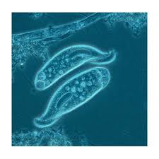
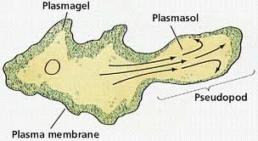
Protozoa
  One Celled Animal Organism
    Can change shape
    Can move in environment with Pseudopods
      Called AMEBOID MOVEMENT
      Can use Phagocytosis
  http://www.youtube.com/watch?v=fpOxgAU5fFQ
  Diseases
    Malaria
    Trichomonas

Slide 29
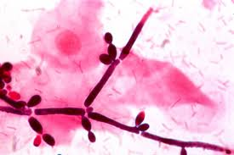

Fungus, fungi (pleural)
    Plant like organism
    Are parasites ( live off of living material)
      Ringworm, lung disease
        histoplamosis
  Yeasts
  Molds

Slide 30
Microorganism Transmission
Mode of transmission
  How does it get to someone else
    Person to person contact
      Direct – touching someone
        You shake hands
      Indirect – you touch something and then they touch it
        You use the phone and then they do
    Airborne spread
      Through the air
    Vectors
      You get bit by a bat infected with rabies
      You get bit by a deer fly and get Lyme disease

Slide 31
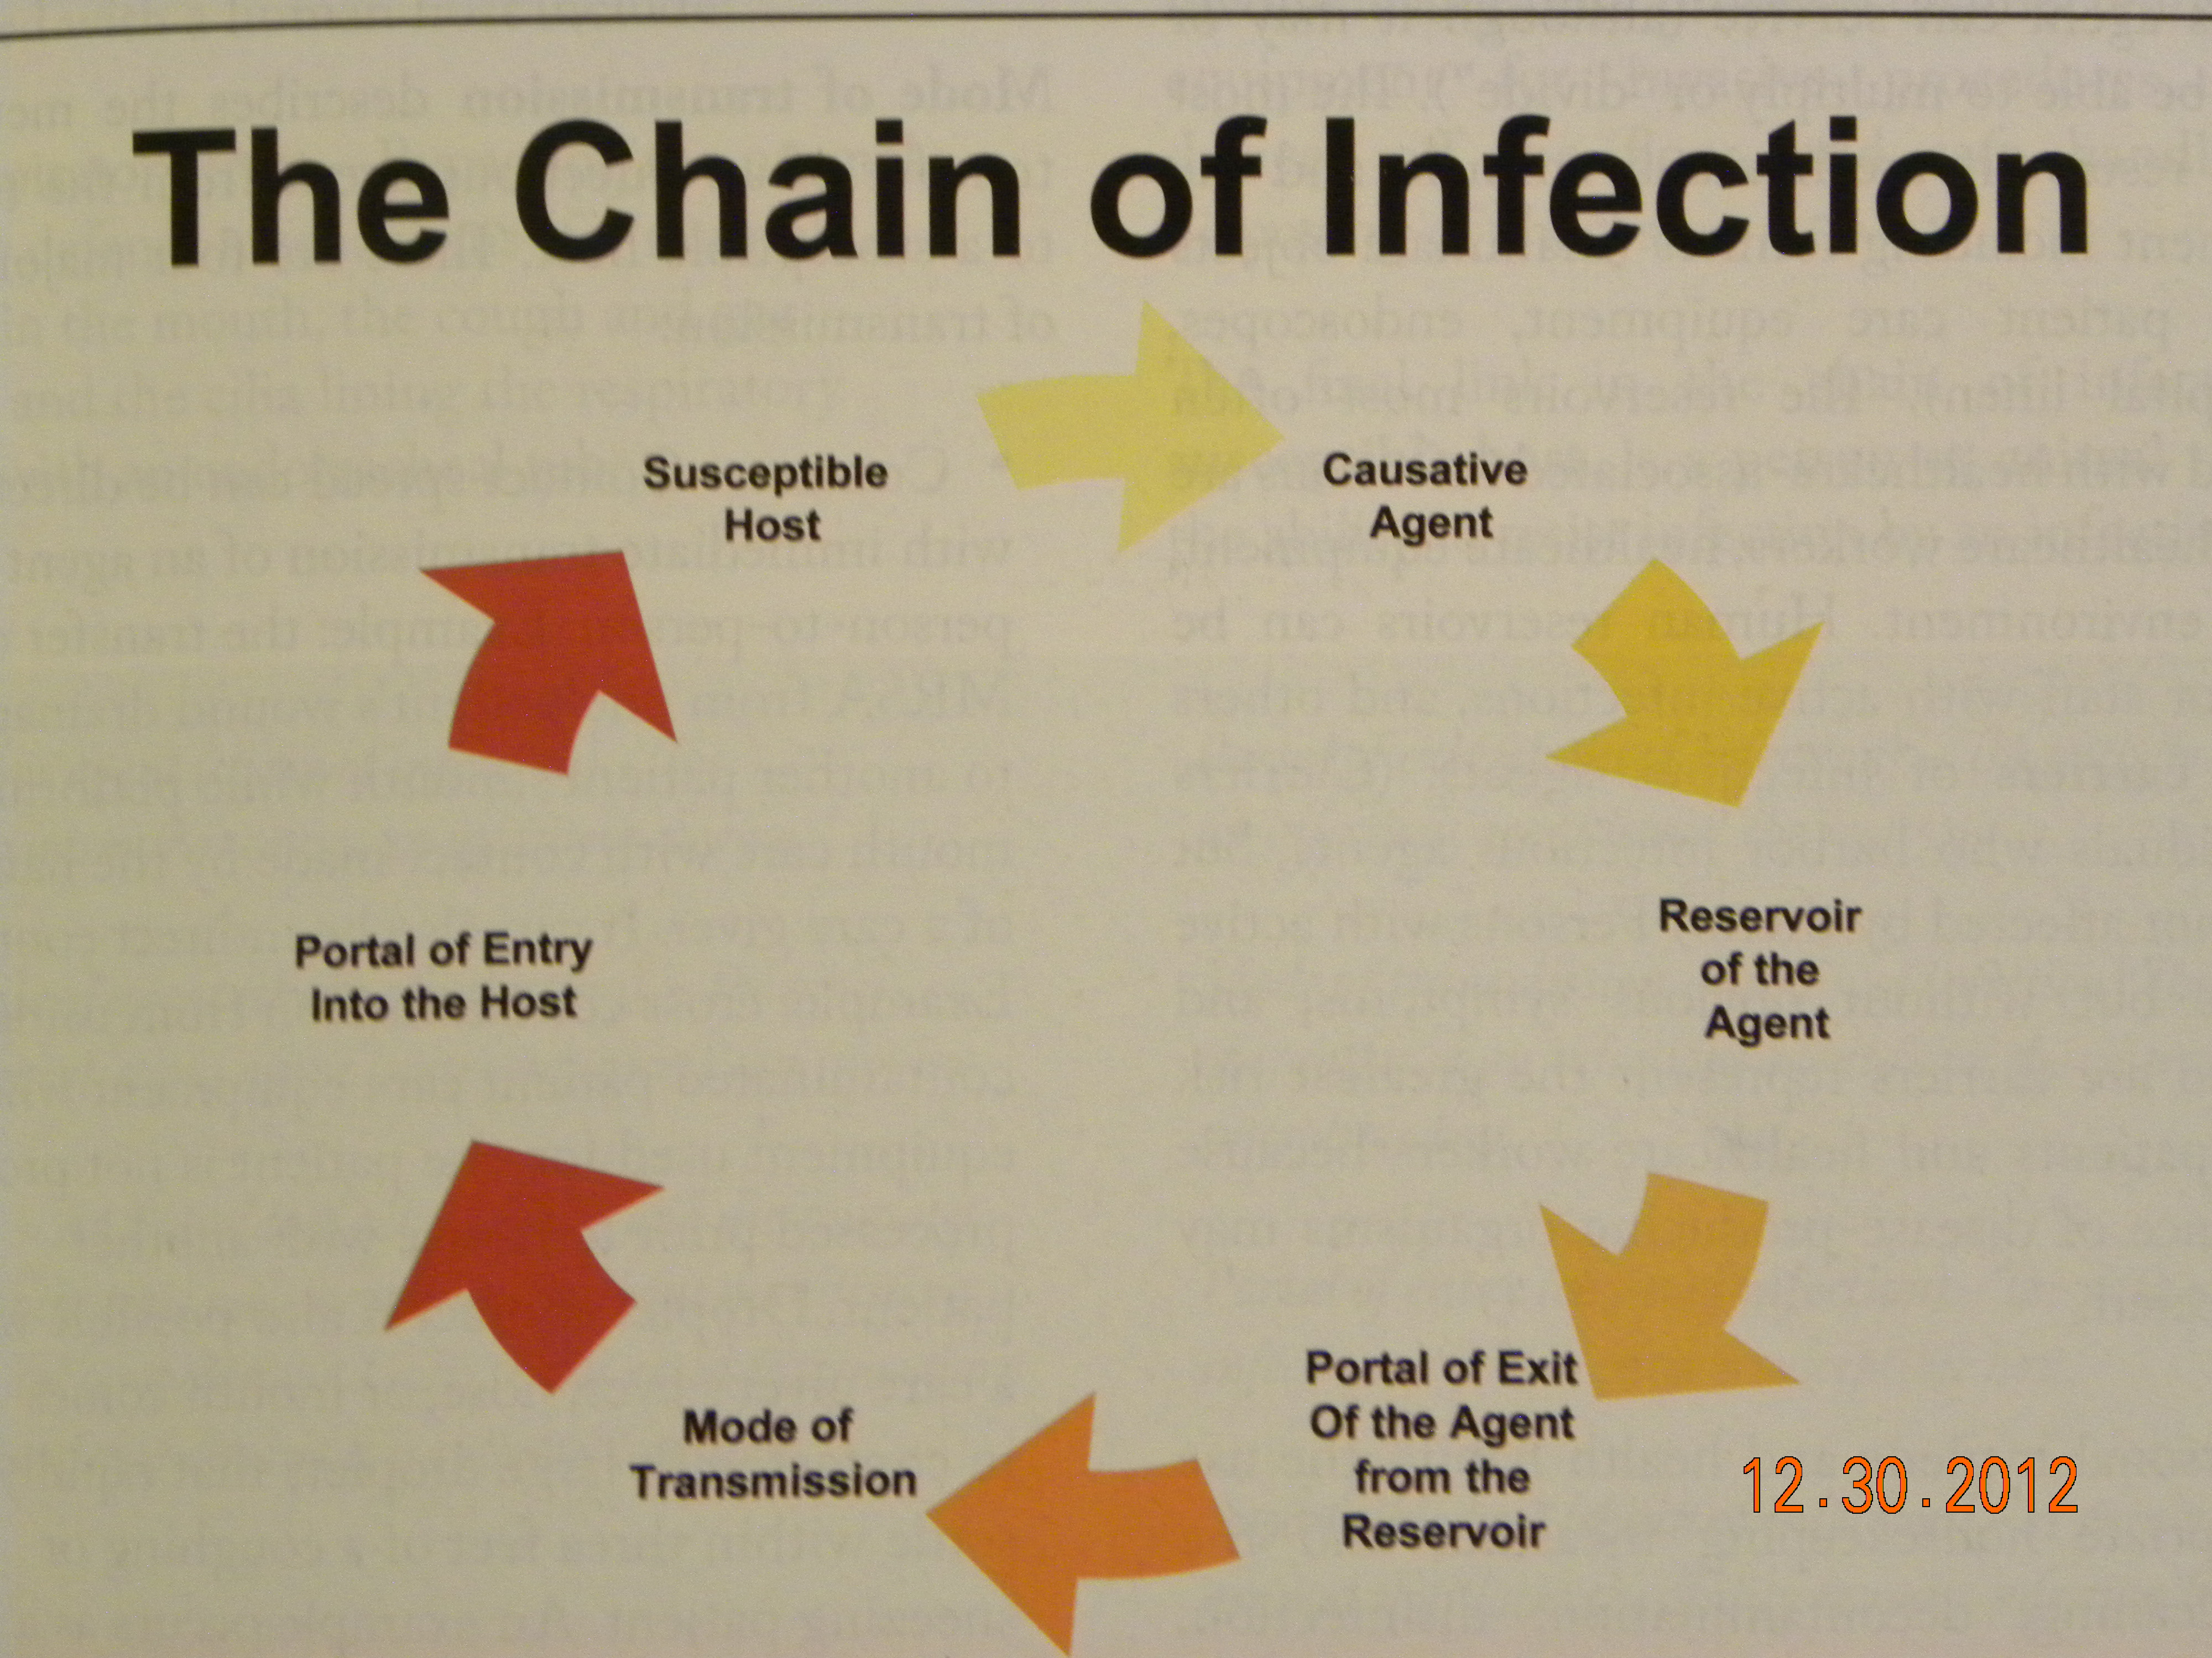

Slide 32
Breaking the Chain
Causative agent
  Invasiveness
  Pathogenicity
  Virulence –
    Very capable to cause disease
  Infectious Dose
  Viability –
    Survives well outside of host
  Ability to have resistance to antimicrobials

Slide 33
Reservoir
  Where it can survive
    People
      Patient and healthcare workers
      Carriers – have organism but not sick
        Can pass it on to others
    Equipment
      Fomites – inanimate objects
    Environment
    Animals
  Cleanliness can eliminate
    To include disinfection and sterilization

Slide 34
Portal of exit
  Respiratory tract
  Genitourinary tract
  Gastrointestinal tract
  Skin / mucous membranes
  Blood
  Placenta

Slide 35



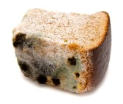
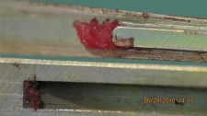
Mode of Transmission
  Contact – person to person
    Direct – hands are the most common
    Indirect – from objects that have been touched
  Common vehicle – Fomite
    Item, food or blood with infectious agents in them

Slide 36
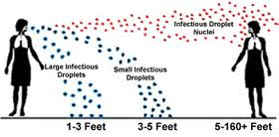
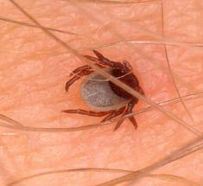
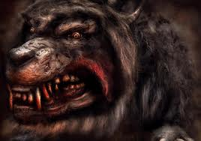
  Airborne
    Droplet
      Heavy
      Go short distance
    Droplet nuclei
      Lighter
      Float through the air
  Vector – can move organisms by them selves
    Tick
    Mosquitoe
    Flea

Slide 37
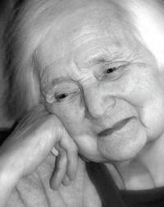
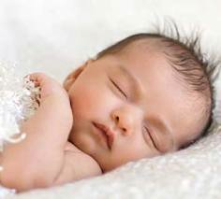
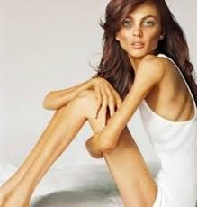
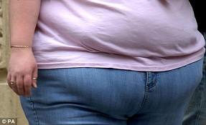
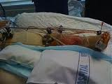
  Must enter a susceptible host
    Age
      Older and very young
    Diseases
      Diabetes, cancer, respiratory disease
    Nutritional state
    Compromised immunity
      AIDS, chemotherapy, on steroids, other infections
    Trauma

Slide 38
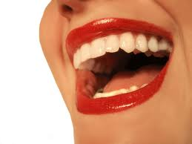
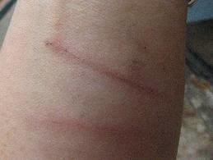

Have a Portal of Entry
  Respiratory tract
  Skin / mucous membrane
    In not intact (broken)
  Parenteral
    Needle puncture
  Urinary / reproductive

Slide 39


Slide 40
Break the Chain
Microorganisms from one patient
  Must not be passed on to another
  Go back to slide 32 and discuss how to prevent
Using
  Cleaning
  Disinfection
  Sterilization
  HAND washing

Slide 41


Slide 42
Goal of C.S.T.
Control spread of microorganisms
Prevent INFECTION
  Clean
  Disinfection
  Sterilization
  Maintaining Sterile / clean items

