Slide 1
Cleaning and Decontamination
Chapter 9 7th Ed.
Rosemary Thurston RN

Slide 2
Basic Factors
Decontamination Area
  Design
    Should be centralized
      Expensive process
      Don’t want to duplicate
    Must consider transport
      Transportation from point of use
      Containment during transport

Slide 3
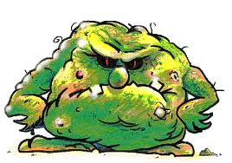
Cleaning is Fundamental
Cleaning- removal of all visible and non-visible soil or other foreign material from the device
  Improperly cleaned devices can cause:
    Disease transmission
      Between patients
      From the environment to patients
    Device malfunction or failure
      From debris or rust

Slide 4
Cleaning – first step of reprocessing
  Must remove foreign material on the outside and inside
      Soil
      Organic materials
      Microorganisms
      Inorganic materials
  May hinder ability to sterilize or disinfect
“You can clean without sterilizing / disinfecting –
you can’t sterilize / disinfect without cleaning!”

Slide 5
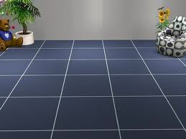
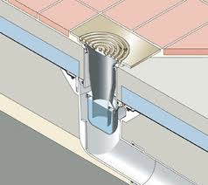
Environmental Design
Floors and Walls
  Made of materials – tolerate harsh chemicals
    Need frequent cleaning / disinfecting
Floor drains
  Provide adequate drainage

Slide 6

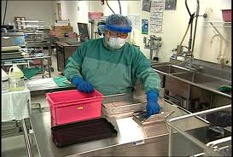
Ventilation system
  Must provide 10 air exchanges / hour
  Negative Air Pressure in Decon.
Temperature
  60 – 65º F
    Helps inhibit growth of miroorganisms
    Provides comfort for person wearing PPE
      Gets hot after an extended period of time

Slide 7
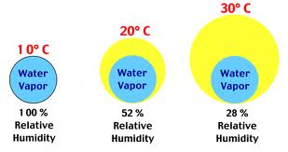
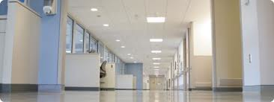
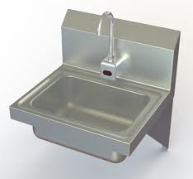
  Relative Humidity
    30 – 60%
      Reduces static electricity
  Lighting
    Adequate for detailed cleaning / inspection
  Traffic
    Restricted to personnel in the area
    Emergency eyewash / shower
      Within 10 seconds / 30 meters of potential exposure
    Hand washing stations should be hands
    free

Slide 8
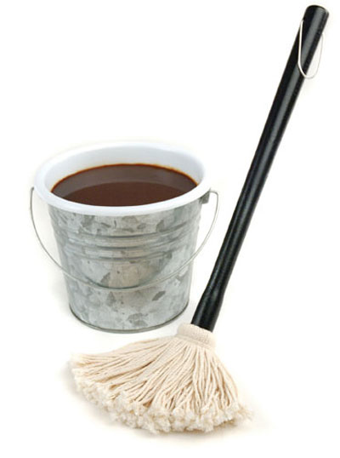
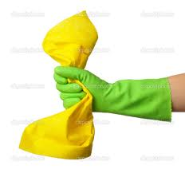
Housekeeping Concerns
High microbial count in decontamination
  Central point for handling contaminated devices
  Cleaning
    Reduces contamination
    Requires special attention
    Tools – mops, etc
      Not used anywhere else
      Cleaned after use

Slide 9
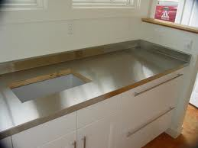
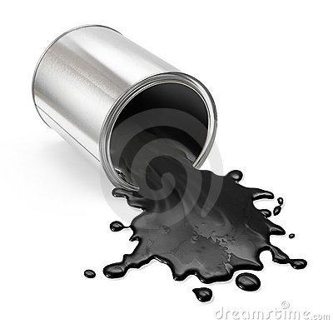
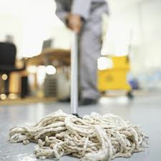
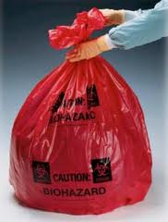
  Horizontal surfaces
    Cleaned at beginning and end of each shift
  Spills
    Spot – cleaned immediately
  Floors
    Cleaned and disinfected daily
  Biohazardous waste
    Removed frequently

Slide 10
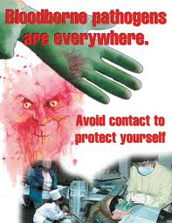
Staff Safety - Attire
Contaminated items
  Pose infection risk to staff
  OSHA requires
    Bloodborne Precautions must be followed
      Procedures and effective work practices
      Training of personnel

Slide 11
Personal Protective Equipment – PPE
  Protect against
    Splashes
    Contact
    spills
    Other contamination of yourself
  Provided by the employer
  Damaged / contaminated
    Should be discarded
    Blood soaked
    Torn barrier

Slide 12

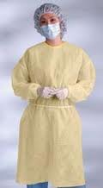
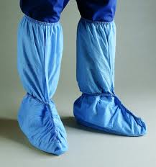
PPE’s
Hair covering
Eye protection
  Goggles
  Faceshield
Mask
  Fluid-resistant
Gown
  Reinforced sleeves
  Fluid barrier in front
Gloves
  General purpose
Shoe covers
  Skid resistance
Scrubs
  Clean for each shift

Slide 13
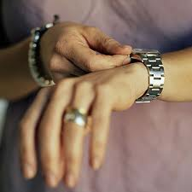
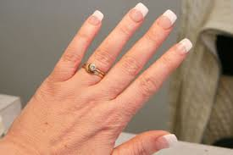

Personal
  Jewelry
    Harbor organisms
  Acrylic nails
    Harbor organisms between nail and natural nail
    Can cause fungal growth of natural nails
    Can’t be sealed to prevent organisms
  Food and Drink
    Can become contaminated
    Can’t be handled without contamination
    Can invite insect infestation

Slide 14
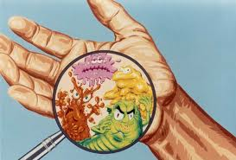
Washing hands
  After completing tasks
  After removing gloves
  When soiled
  Should have hand washing only
  sink in decontamination area

Slide 15
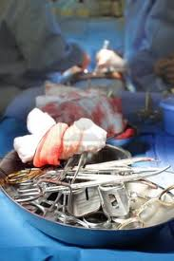
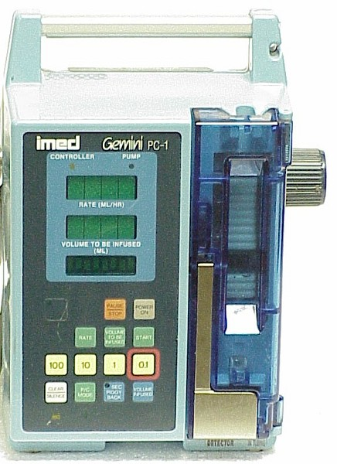
Standard Precautions
  ALL BODY FLUIDS
  ALL ITEMS contacted with BODILY FLUIDS
  ARE POTENTIALLY INFECTIOUS
All ITEMS coming into
Decontamination
  Are CONTAMINATED

Slide 16

Staff Education / Training
  Before being assigned to decontamination
    Must receive thorough orientation to include:
      Use of PPE
      General safety
      Hand washing
      Proper handling of contaminated items
  Regular updates for current staff

Slide 17
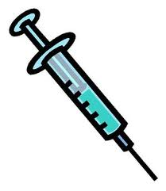
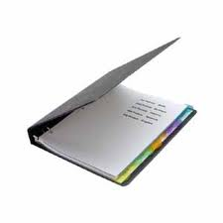
Hepatitis B Immunization
  Require immunization
    If denied – waiver must be signed
Policies for injuries
  Reporting
  Treatment
  Follow-up

Slide 18
Cleaning Agents and Lubricants
Manufacturer (OEM –Original Equipment Manufacturer)
  Provides written cleaning recommendations
    Can damage equipment if not followed
      Wrong detergent
      Improper usage
    Equipment is VERY EXPENSIVE
      Can be costly to hospital
Techs require training with new equipment

Slide 19
Qualities of effective cleaning agents
  Non-abrasive
  Low-foaming
  Free-rinsing – removal of any residue of cleaning agents
  Biodegradable
  Give rapid soil dispersion
  Non-toxic
  Effective on all soils
  Long shelf-life
  Cost-effective
  Can monitor effectiveness

Slide 20
Water
Wetting Agent
  Primary agent for cleaning
  Water quality should be check periodically
Characteristics
  Temp – Chapter 7
  Purity – Chapter 7
  pH - acid or alkaline
    Influence effectiveness of enzymes and detergents
    Extreme levels can inactivate cleaners

Slide 21
  Hardness – minerals in the water
    Chelating (sequestering) agents
      Minimize formation of insoluble deposits
      Prevents
        instrument spotting
        Equipment scaling
    Softeners
      Removes minerals – reduces scale
      For wash water

Slide 22
    Steam Line Filters
      For washer equipment
    Distilled or De-Ionized water
      Minerals removed
      Prevents mineral deposits

Slide 23
Detergents
Solid /liquid soils
  Are dislodged, removed and dispersed from surface
  By:
    Lowering surface tension
      Liquid can penetrate the soil on surface
    Deflocculate (break up and disperse)
      Separate clumps of dirt
      Dissolve or suspend particles in water / fluid
    Keep solids in suspension
      Until they can be rinsed away
  Also
    Low foaming
      Can hinder washer disinfector high-pressure jets

Slide 24
  pH
    Low 0 – 6 is acidic
      Vinegar and lemon
    High 8 – 14 is alkaline
      Soap
    Mild alkaline detergents are preferred

Slide 25
Enzymes
Break down “digest” large organic molecules
  Facilitates removal
    Finds them, locks on, breaks apart – gone!
  Used to clean heavily soiled items
    Must be moist to work (May have to re-hydrate)
  Use in CS
    Protease enzymes –
      Break down Blood, Mucus, Feces, Albumin (blood protein)
    Lipase –
      Breaks down fats – bone marrow and adipose
    Amylase –
      Breaks down starch

Slide 26
Enzymatic Detergents
  Neutral pH detergent
  Enzymes
  Surfactant
  Are
    Biodegradeable
      Will be broken down and decompose
    Temperature
      Too high – inactivates enzyme
      Too low – may not activate the enzyme

Slide 27
Selecting enzymatic detergents- Consider:
  Water temp in decontam
  Room temp
  Useful life and stability
  Expiration date
  Material of the item being cleaned
  Approved by EPA
  http://www.youtube.com/watch?v=6u_MRTv3awQ 1:32

Slide 28
Ultrasonic detergents
Specific for ultrasonic cleaners
  Low – foaming to prevent interfering with ultrasonic action
  Contain
    Surfactants
    Chelating agents
  Prevent
    Re-deposit of solids on items

Slide 29
Lubricants
Called “Instrument Milk”
Maintain integrity of instruments
  Prolongs life of instrument
    Protects finish on surface
  Prevents abrasion on scissor blades
    Increases cutting action
  Action
    Water soluble – so steam sterilization can occur through it
    Sprayed on instruments
      Contact time and proper dilution is needed
    Must be compatible with sterilization process being used

Slide 30
Cleaning/ Decontamination Processes
Cleaning – removal of soil
  From:
    Surfaces
    Crevices
    Serrations
    Joints
    Lumens
    Devices
    Equipment

Slide 31
Remove Gross Soil “asap”
  Reduce number of org. on item
  Reduce nutrients that support org. growth
  Reduce environmental contamination through:
    Spillage
    Aerosolization
  Minimize damage to items
“You can clean without sterilizing/disinfecting – You can’t sterilize/disinfect without cleaning.”

Slide 32
Without clean items, this can happen
  Growth of organisms
    Cause infection
  Patient foreign body reaction
  Patient pyrogenic reaction
  Debris can cause device to not function

Slide 33

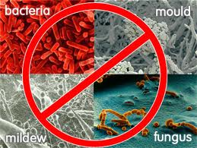
Decontamination
Purpose
  Make items safe to handle without gloves
  Reduce bioburden for next steps
Process
  Uses physical or chemical procedures
  To remove, inactivate, or destroy pathogens on an item’s surface

Slide 34
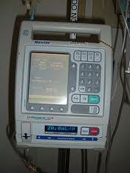
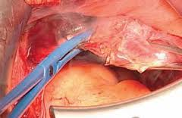
  May involve:
    Cleaning
      Items not exposed to broken skin
        IV pump
        Heating pad
    clean plus biocidal agent
      Items exposed to blood / body fluids / tissue
        Surgical instruments

Slide 35
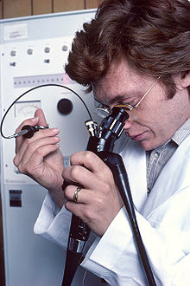
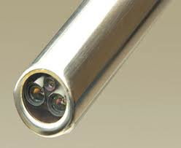
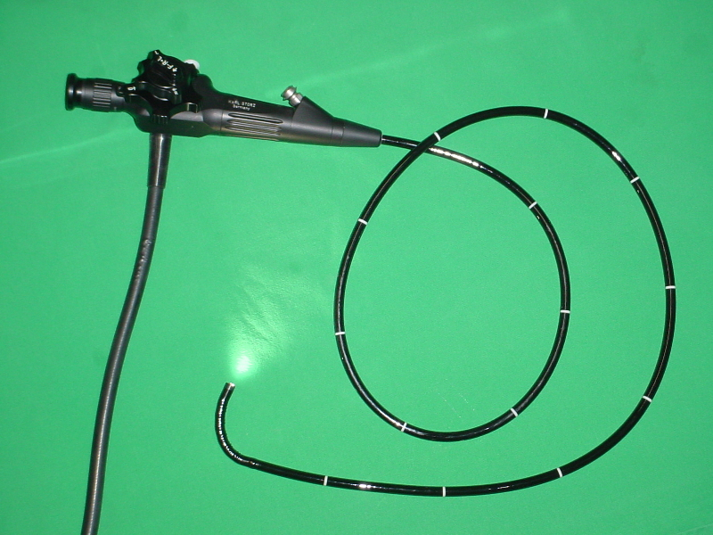
New Challenges
Long narrow lumens and channels
  Single or multiple channels – endoscopes

Slide 36
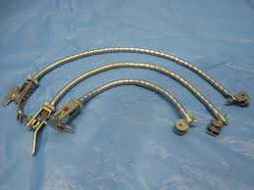
Valves
Crevices, joints or surface pores
  Flexible neuro retractor

Slide 37
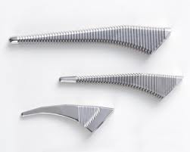
Parts that can’t be disassembled
  Rule: Anything that can be taken apart – must be taken apart.
  Clamps that can’t be opened
Rough irregular surfaces
that retain bioburden

Slide 38
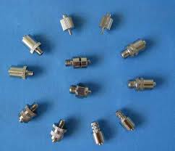
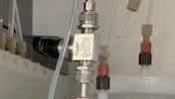
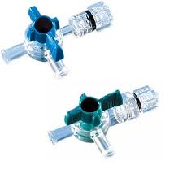
Porous material
Luer-locks
3 way adaptors

Slide 39
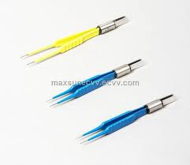
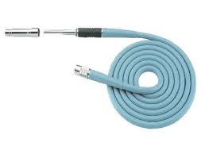
Junction between insulating sheaths and activating mechanism
Electrical components

Slide 40
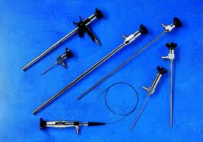
Heat sensitive materials

Slide 41

Manual Cleaning
Purpose:
  Physically remove debris after pre-clean
How:
  Friction (elbow grease)
Used:
  Before mechanical cleaning
  If there is no ultrasonic or washer-sterilizer/decontaminator (Mechanical cleaning)

Slide 42
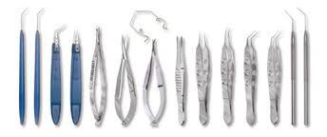
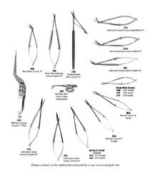
For delicate or complex instruments
  Can’t be washed mechanically – would be damaged

Slide 43
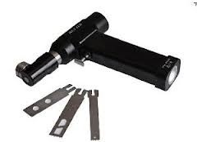
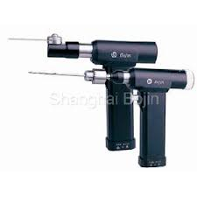
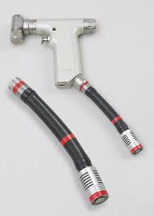
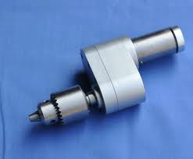
For power instruments that can’t be immersed
  Electric / battery / pneumatic devices

Slide 44
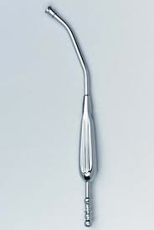
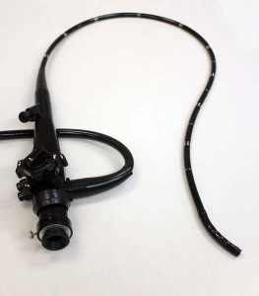
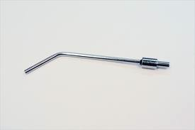
For instruments with lumens

Slide 45
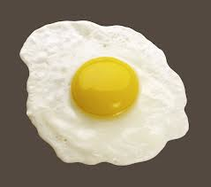
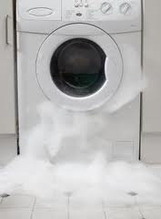
Process:
  Water must be below 110º F / 43ºC
    Prevents coagulation (denaturing) of Proteins
  Excessive detergent may be hard to rinse
    Will deteriorate instruments

Slide 46
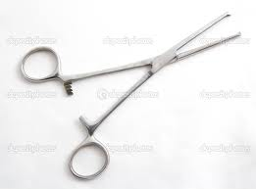
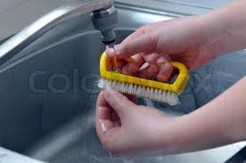
  All instruments should be open to clean box-lock/hinge
  Brush instruments under water
    Prevents aerosolization of contaminants

Slide 47

3 sink arrangements
  Wash sink – water and detergent
  Intermediate rinse
    Plain or softened (deionized) water
  Final rinse
    Distilled / deionized water
      Prevents spotting on instruments
      Prevents debris redepositing on instruments

Slide 48
Instruments with lumens
  Vertical soaking cylinders are used
    Allow agent to contact all surfaces
    If soaked horizontally – air bubbles are trapped
      Doesn’t allow all surfaces to contact cleaning solution

Slide 49

Mechanical Cleaning
Ultrasonic Cleaners
  Pass Sound waves through liquid
    Creates vibrations
    http://www.youtube.com/watch?v=PwTfXduC7F8&feature=fvsr
    Cavitation
      Small gas bubbles are created
      Get larger and unstable
      Until they Implode (collapse on themselves)
      Creates vacuum in the area
      Pulls in particles on the instruments
    Able to thoroughly clean all hard to reach areas

Slide 50


Slide 51

Before ultrasonic cleaning
  Remove gross soil / blood on instruments
    Keeps solution cleaner longer
    Coagulated protein absorbs sound
      Reduce cleaning action
  Degas new water
    Remove excess bubbles after filling
      Will decrease energy of vacuum
    Run for 5-10 minutes

Slide 52
During
  Use specific ultrasonic detergent
  Temperature between 80ºF/27ºC to 109ºF/43ºC
    Above 140ºF / 60ºC will coagulate protein
    Like cooked on food in a pan
  Keep lid on at all times
    Prevents aerosols dispersing into area
    http://www.youtube.com/watch?v=ryBVlIoLULk&feature=related 1:31

Slide 53

Items in ultrasonic
  Trays should have small wire and 8 opening / inch
    Allows transmission of waves
    Don’t overload trays –more than 3” high
    Only one tray at a time
  Process all instruments – even if they look clean

Slide 54
  All lumens must be filled
  All instruments open and completely submerged
  Orthopedic instruments
    May have fatty deposits
    Soil the water more quickly – change more frequently
  Don’t mix metals
    May plate off onto another

Slide 55
  Don’t PUT IN ULTRASONIC
    Chrome-plated, ebonized, plastic, cork, glass, wood, rubber and needles
  Check with manufacturer’s recommendations re:
    Delicate instruments
      May loosen tiny screws
    Flexible Endoscopes
      May have their own specific ultrasonic cleaner
    Rigid scopes will have fiberoptics damaged
    Aluminum devices

Slide 56
After ultrasonic cleaning
  Instruments must be rinsed
    Particles and detergent that might be on surface
    Sediment remains in the cleaner
    http://www.youtube.com/watch?v=5GdTFwmnoDY 1:40
  Must be cleaned as needed / by schedule
    Clean tank after emptying
    Check for debris in drain

Slide 57
Automated Mechanical Washers
Impingement – Principle
  Spray force action of pressurized water
  Against instruments to remove bioburden
Uses – Like a dish washer
  Spray action - Impingement
  Temperature
  Detergent
    Specifically for automated washers

Slide 58
Steps of wash cycle – (Like a Dishwasher)
  Pre-rinse to wet instruments
  Detergent cycle
  Lubrication cycle
  Rinse cycle
  Dry cycle

Slide 59
Use
  Must be properly loaded
  Trays
    Never overloaded
    Each tray placed separately
    Washer arm should be able to move freely
  Instruments
    Disassembled
    Box-locks open
    http://www.youtube.com/watch?v=Ya6ganI2SIA

Slide 60
  Delicate instruments
    Placed in small perforated baskets with lids
    Prevents damage and loss from racks
  Washer traps
    Inspect daily for debris
    Clear any obstructions

Slide 61
Cycles
  Instruments
    Usually the longest
    Must be set to meet needs of items processed
  Basins
    Run on utensil cycle
    Shorter because needs are not as complex
  Mixed loads
    Used the instrument setting for max. effectiveness

Slide 62
Automated Cart Washer
Used for
  Rigid containers
  Basins
  Surgical stainless steel tables
Quick and efficient
  Work like washer sterilizer / decontaminator
  Or car wash
http://www.youtube.com/watch?v=0lQJ9t5md4Y
Safety
  Uses very hot water – inside walls may be hot
  Door could close while inside – need emergency shutoff

Slide 63
  Carts
    Sold that are meant to go through cart washer
      Wheels that tolerate high temperature
      Design to drain off water
  Manually washing
    Over floor drain
    Use a spray gun

Slide 64


Basic Instrument Cleaning
  Time to begin cleaning process
    Should be
      Covered with moist towel OR
      Placed in soak basin with water and enzyme
    15 – 60 min after being used
    Longer can lead to stains, pits, rust and dullness
    Precleaning errors must be
      Identified
      Communicated
      Addressed
      Become part of Quality Control

Slide 65



Instrument
  Must be disassembled
  Open jaws and inspect for bioburden
    Clean with brushes, pipe cleaners, forced air/water
  Lumens
    Place under water and clean with brush
    Force water and enzymatic detergent through with syringe

Slide 66



  Curettes / orthopedic instruments
    May have bone / other tissue
    Clean out with brush
  Instruments tagged for repair
    May be marked with a tag or wrapped pipecleaner
    Must be decontaminated
    After repair – must go through decontamination process again

Slide 67
Delicate Hard-to-clean Instruments
Instruments
  Lightweight
  Fine points and tips
End of procedure
  Separated from other instruments
    Prevents damage and misalignment
    May be placed in a basket with fine holes
  Ophthalmic
    Use saline extensively
    Must be rinsed and lubricated often

Slide 68


  Instruments with cabeling
    Clean according to OEM recommendations
    http://www.youtube.com/watch?v=4NPo-zagUFk
  Joint replacement instruments
    Miscellaneous cutters contain gross blood, bone, tissue
      Are cleaned at POU
    Pre-soaking with enzymatic detergent
    Still require extensive hand cleaning

Slide 69

Containers and Basins
Rigid containers
  Usually made of aluminum
    Need a neutral pH detergent to prevent etching
  Inspect for cracks, missing pieces
    Handles
    Locking mechanisms
    Basin rims

Slide 70


Basins
  May be cleaned on rack specific for them

Slide 71


Power Equipment
Powered by
  Batteries
  Pneumatic air
  Electric cords
Manually cleaned /decontaminated
  Follow OEM’s written guidelines for
    Cleaning / Disinfection and sterilization

Slide 72
  General manual cleaning
    Surface-wiped
      Clean
      Soft cloth
      Water
      Neutral pH enzymatic detergent
    Care at connection points and battery contacts
      Can cause loss of electrical contact

Slide 73


Cannulated Drills
  Lumens cleaned with rap water
  Chucks brushed with pipe cleaners, soft brush
  Syringe can delivery agents to hard to reach areas
  Then flushed with distilled /deionized water to remove any residual

Slide 74

Mobile Pt. Care Equipment
Made of many different materials
  Require agents that won’t damage surfaces
  Follow OEM’s instructions
Devices with access doors and hatches
  Cleaned with soft materials and applicator
  Clean around switches and cords
    Cloth should not be too wet

Slide 75

Specialty carts
  Isolation, special procedure and others
  On return to Central Service
    Remove clean contents from cart
      Place in plastic bags
    Take empty cart to decontamination area
      Clean all surfaces inside and out

Slide 76

Infectious Waste
Categorized:
  General trash –
    Garbage that goes to local solid waste facility
  Regulated Medical Waste
    May transmit infectious disease
    Red Bag – Biohazardous

Slide 77






Regulated waste includes:
  Sharps
    Needles
    Syringes with needles
    Trocars
    Pipettes
    Scapel blades
    Broken glass

Slide 78





Selected isolation waste:
  Materials contaminated with
    Blood
    Excretion
    Exudates
    Secretions
  Isolation protects others from infectious diseases
Pathology
Blood products
.

Slide 79


