Slide 1
Progress Test 5
Review Part A

Slide 2
What does “inventory” refer to?

Slide 3
Reusable and consumable items
What is a “stock out”?

Slide 4
Stock out = out of stock
Items are not available
Is it better to have a high stock out rate or a low stock out rate?
True or False? High stock out rates increases patient/customers satisfaction.

Slide 5
It is better to have a LOW stock out rate, this means that you rarely run out of stock.
FALSE! High Stock Out rates DECREASE patient satisfaction, as running out of stock may postpone/delay procedures.
What is an asset?

Slide 6

Accounting Items:
Asset – items of value owned by the organization
Consumable inventory – items that are consumed(used up) as services are provided ---wrapping supplies, chemicals, etc.
Reusable Inventory –items that can be reused--medical devices, sterilization containers, etc.
Capital Equipment – Expensive items, advance planning need to purchase them—sterilizers, washers., etc.

Slide 7
Accounting cont
Official Inventory - found in warehouses, CS areas and storerooms, and satellite storage areas
Unofficial inventory – found in user areas, surgical locations, labs. These items have already been expensed/charged to the department.
Current Asset – expected to be used within a year.

Slide 8
What is the problem with having too much inventory?

Slide 9
Too much cash invested in stock
May need to borrow money to pay suppliers
Need more space to store supplies
Greater risks of damage, loss, obscelence (no longer used/needed), theft.
More time to manage inventory
What happens with too little inventory?

Slide 10

Supply shortages, emergency purchases (more expensive), negative impacts on patient care, hoarding, frequent handling.
+ = ?

Slide 11
Single Use Only (p. 348)
What is a PAR System?

Slide 12
Periodic Automatic Replenishment System
Desired amount of products which should be on hand is established. Personnel inventory each area , check the current supply on hand, and note the quantity available. The amount needed to bring the quantity of supplies the desired level is determined and automatically replenished.
What is automated replenishment?

Slide 13
When an item is removed from inventory, it is automatically identified and tracked, when a reorder point is reached, a supply pick list is generated, and items are issued and transferred to the appropriate area.

Slide 14
In this system, desired inventory items are placed on a cart which is assigned to a specific location and quantity. A second, duplicate cart is maintained in another location and exchanged once daily to ensure that sufficient supplies are available at all times. Commonly used to provide products for surgical procedures.

Slide 15
Exchange Cart System
Similar to the Exchange Cart System, but is generally used for one special surgical case in the OR, not general supply replenishment.

Slide 16
Case cart system
This term means immediately, or at once.

Slide 17
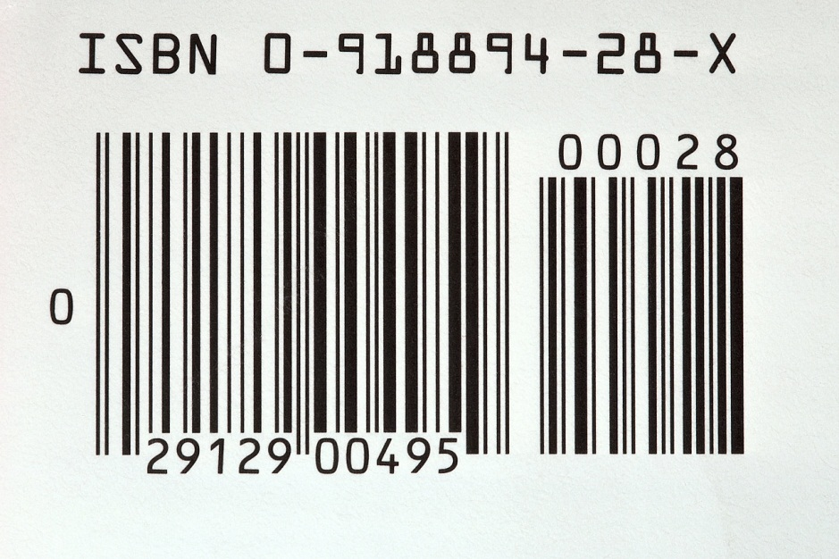
STAT (from Latin word “statim”)
What is this? Which type of inventory system is it used in?

Slide 18
Bar code – automated systems
This tracking system uses radio waves to track items.

Slide 19
RFID – Radio Frequency Identification
Where have you seen this used?
The department responsible for moving supplies throughout the facility.

Slide 20
DISTRIBUTION
In this system, all incoming and issued supplies are tracked so that the quantity of supplies is known on an on-going basis.

Slide 21

Perpetual Inventory System
True or False: In ABC Analysis, the “A” Items represent the lowest number and percentage of the total inventory items, but the largest dollar value.

Slide 22
True! What does the “C” represent?
In this system, items are stored a the facility but the supplier owns them and does not charge unless it is used or lost.

Slide 23
Consignment System
The _________________________________ represents the number of times per year that inventory is purchased, consumed, and replaced.

Slide 24
Inventory turnover rate
If 100 items are ordered, and 92 are available, what is the Inventory Stock Out Rate?

Slide 25
8% (100% - 92%)
What is the Inventory Service Level – 100 items ordered and 92 available.

Slide 26
92% - you have available
In an ABC analysis system, which items receive the most attention?

Slide 27
The “A” items because they are the most expensive, then “B”, then “C”.
In this system, the minimum and the maximum amount of inventory that must be kept on hand is agreed upon. When the minimum point is reached, one must reorder.

Slide 28
MIN/MAX
In this system, the minimal stock is kept on site, and delivered when needed.

Slide 29
JUST-IN-TIME
What are some advantages to tracking patient care equipment?

Slide 30
Can prevent equipment shortages
Faster than manual tracking systems.
More effective for tracking data
Which organization requires that Preventative Maintenance Standards be established for patient care equipment?

Slide 31
Joint Commission
Items due for Preventative Maintenance and those needing repair should be returned to:

Slide 32
The Biomed Department
What is the name of the patient care equipment that pumps heated or cooled water to raise or lower body temperature?

Slide 33
Hypothermia Unit
What is a PCA? What does it do?

Slide 34
Patient Controlled Analgesia Pump
Provides for automatic (self) administration of pain medication.
All patient care equipment dispensed for use must be considered _______________, and handled as such.

Slide 35
CONTAMINATED
After a piece of patient care equipment is used with a patient, and is no longer needed, what is the procedure?

Slide 36
CSTs make rounds to pick up soiled equipment and transport to CS to be decontaminated
How do you process patient care equipment?

Slide 37
1. Throw away all disposable items at point-of-use.
2. Transport according to soiled item transport guidelines.
2. Follow the manufacturers recommendations.
3. Clean all surfaces – cords, switches, crevices
4. Inspect for hazards – cracked or frayed cords, missing electrical prongs, damaged switches, cracks or dents.
5. Prepare unit for patient use.

Slide 38
If a unit is nonfunctioning, it should be ______________________________ and routed to the ________ Department.

Slide 39
Tagged for repair
The Biomed Department
Patient care equipment should be stored in a ________________________ state.

Slide 40
Ready-to-use
What may be needed to be done to prepare patient care equipment for patient use?

Slide 41
Assembly, new disposables (tubing, pads), check/replace batteries, fill with water
The___________________________________requires that the healthcare facility report malfunctions of medical devices that have contributed to patient injury, illness, and/or death to the manufacturer and the FDA.

Slide 42
The Safe Medical Devices Act of 1990
What is Preventative Maintenance?

Slide 43
Identify potential problems before they occur.
What is outsourcing?

Slide 44
Hospital equipment managed by an external entity

