Slide 1
Infection Prevention and Control
Chapter 6 7th Ed.
Rosemary Thurston RN

Slide 2

Infection Prevention / Control
CS Goals are
  Eliminate / destroy all potentially infectious contaminants
    on reusable instruments and equipment
  Safely distribute to patient care areas
    Reusable and single-use items
  Establish and enforce standards for:
    Decontamination
    Disinfection
    Sterilization

Slide 3
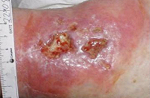
Nosocomial infections
  10% of hospitalized patients develop infections
  Of 2 million infections, 90,000 die
  Increase health care costs by
    $2,000,000,000 (2 billion)
  Most result from
    Invasive devices
    Surgical procedures

Slide 4
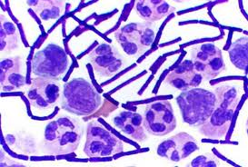
Primary purpose of CS
  To STOP spread of pathogenic microorganisms

Slide 5


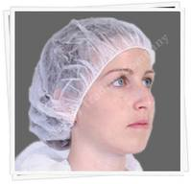
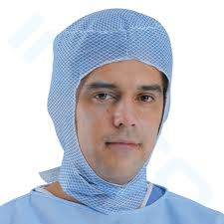
Infection Prevention
Before work:
  Bathing and shampooing
    Washes off the normal flora picked up in environment
Arrival at work:
  Change into facility issued SCRUBS
    Removing clothes that have picked up organisms from the environment
    Keeps organisms at work at end of day
  Don HAIR COVER
    Should cover all head and facial hair

Slide 6

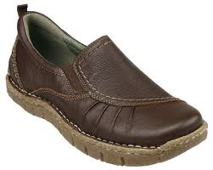

  Remove watches and jewelry
    Harbor organisms
    Can’t be washed off
  Shoes
    Non skid soles
    Comfortable to stand in for long periods

Slide 7

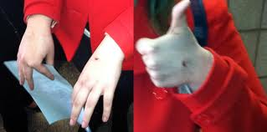
Hand Hygiene – prevents transmission of microorganisms
  When entering or leaving work area
  When soiled
  Nails – keep ¼” or less, may:
    Harbor organisms
    Tear gloves
    Artificial nails harbor organisms
  Skin should be intact
    Refrain from handling patient care items with:
      Open or weeping wound
      Skin irritations

Slide 8
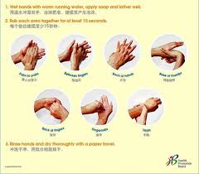
  Wash with soap and water
    Remove jewelry
    Turn on sink with paper towel – throw away
    Wet hands with water before getting soap
    Wash at least 15 seconds with friction –
    hands down – to prevent contamination running up your arm
    between fingers – to get all areas
    dry – with clean paper towel
    Use towel to turn off sink see P. 100
  Use alcohol-based hand rub
    Has gel base to have longer contact
    Longer contact is needed to kill microorganisms
    Rub hands – don’t dry them with towel

Slide 9
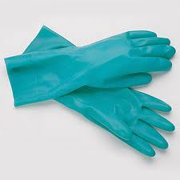
PPE’s
Personal Protective Equipment
  Provide a BARRIER to organisms in Decontamination
  Required by OSHA
Gen Utility Gloves
  Prevent contamination when handling items
    May have imperfections
    Still need HAND HYGIENE
    Wash hands after removing all gloves
  Should be durable enough to prevent tears

Slide 10

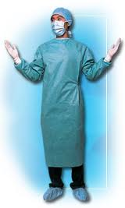


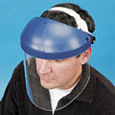
Fluid Resistant Covering
  Protects clothing and skin –
    Should cover arms
    Gown
    Jumpsuit
    Apron See p. 102
Full face protection
  To prevent skin / mucous membrane exposure
    Splashes, sprays, aerosolized contaminated fluids
    Full length face shield or
    Goggles and mask

Slide 11

Shoe covers
  Protect shoes from getting wet / contaminated

Slide 12

STANDARD PRECAUTIONS
Concern re ALL PATIENTS
  Blood and body fluids
  Treat ALL patient care items as CONTAMINATED
Ms. Spence will cover Blood Borne Precautions
  STANDARD PRECAUTIONS

Slide 13

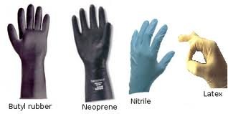
A short review:
  Employer must:
    Have a written Exposure Control Plan
      Must be reviewed annually
      Must be updated when new tasks / procedures are introduced
    Train new employees and then annually
      Any changes require training
    Hepatitis B vaccination at no cost
      Any refusal requires a signed declination form
    Providing PPE at no cost to include:
      Gowns, masks / face shields, eye protection, gloves

Slide 14

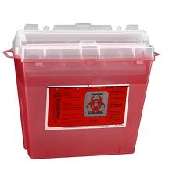
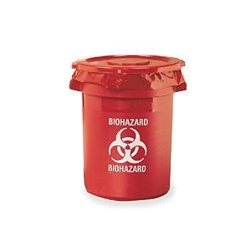
    A clean and sanitary working environment
      Scheduled cleaning with hospital disinfectants
    Use of orange/red “BIOHAZARD” labels or bags
      On waste/trash
      Contaminated items stored in refrigerators/freezers, or containers
    Providing rigid, puncture-proof containers that can be sealed for sharps
    Contaminated items must be transported in covered, rigid, puncture-proof containers identified as “BIOHAZARD”

Slide 15
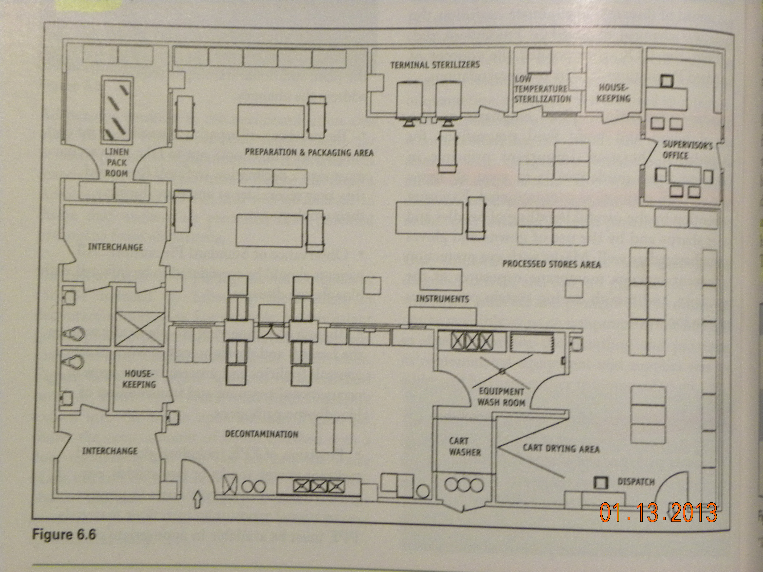
CS Design

Slide 16
Environmental Concerns
Physical Design
  Clean and dirty are always separated
    Decontamination must have solid barrier between it and the Sterile Storage area
      Dirty areas?
      Clean areas?

Slide 17
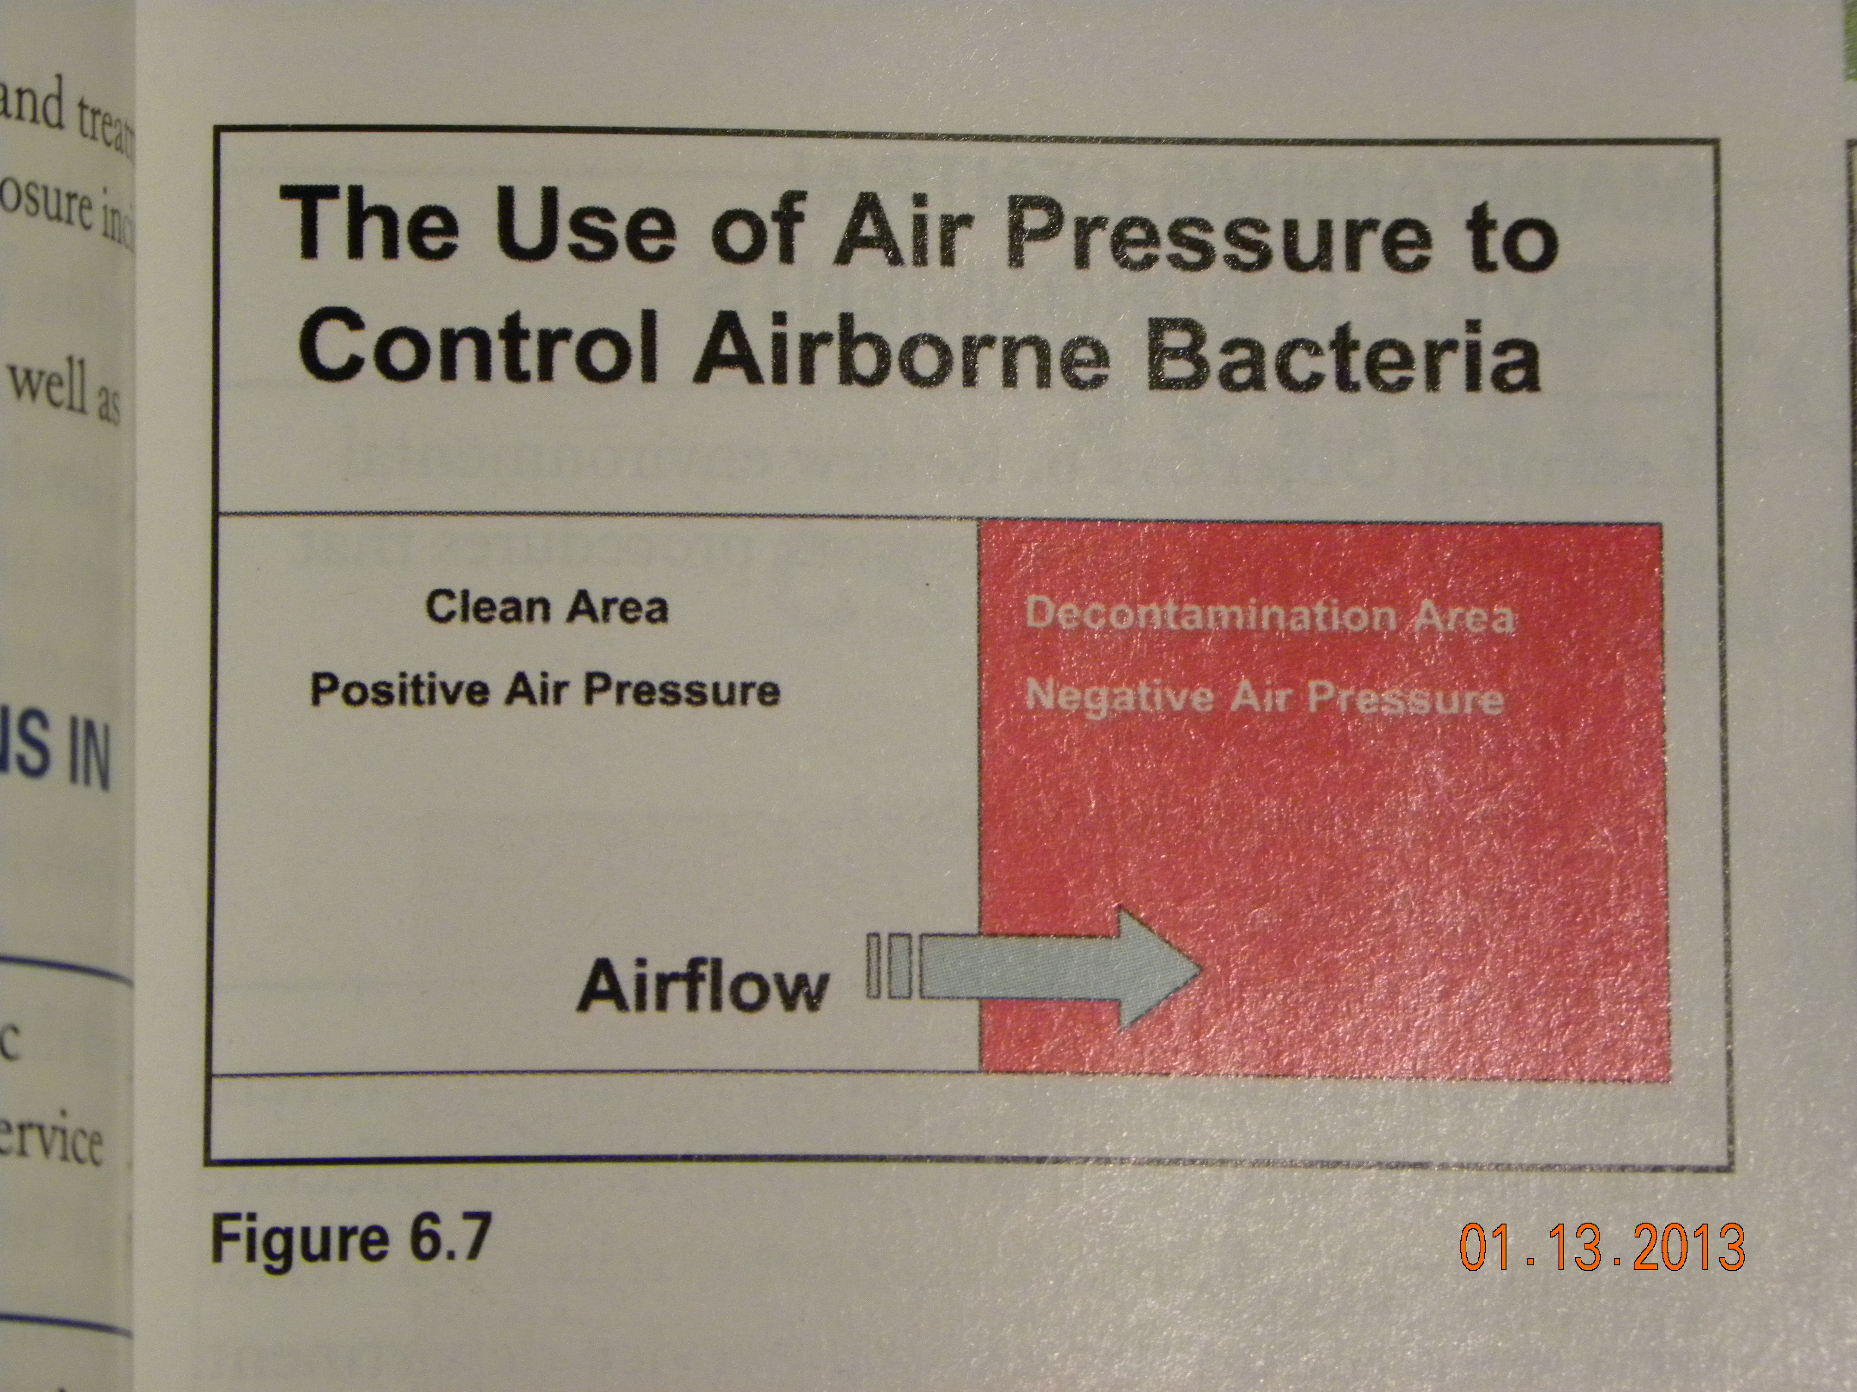
  Air pressure – prevents movement of organisms
    from DIRTY to CLEAN
    Negative air pressure in Decontamination
    Positive air pressure in the Clean Areas
      Doors / openings between must be closed

Slide 18
Specific Area Requirements

Slide 19
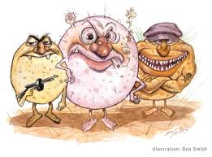


Temperature
  Less likely for bacteria to grow
  Comfort range for staff
Humidity
  Lower than 60% decreases bacterial growth
  Decreases chance of static electricity
Air Exchanges
  All air is filtered
  More than 20 exchanges / hour increases movement of dust /bacteria around the room

Slide 20
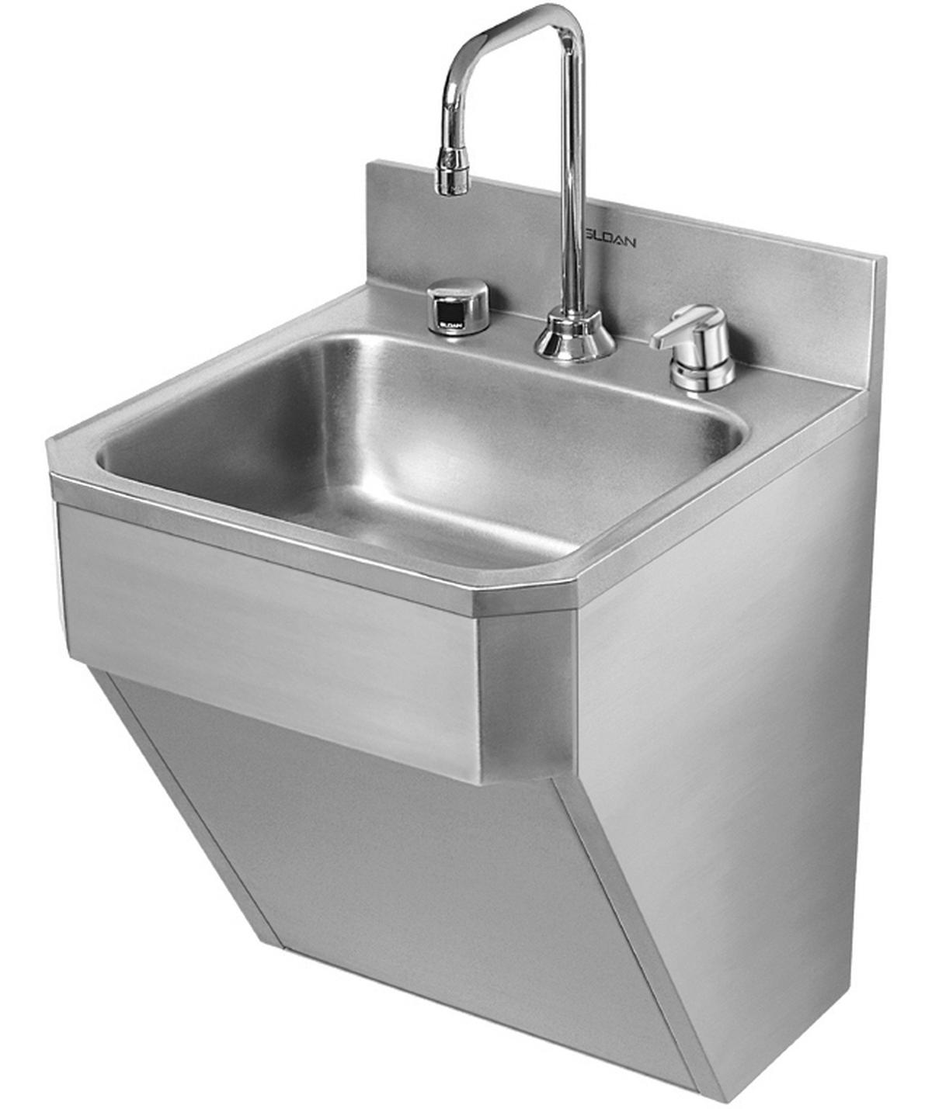
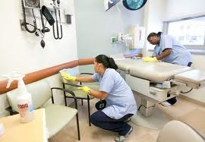
Other Requirements
Hand washing sinks
  Located for easy access
  Only place to wash hands
    – not in decontamination sinks
Cleaning
  Fixtures / furniture –
    Materials must be washable
    Cleaned on a regular schedule

Slide 21
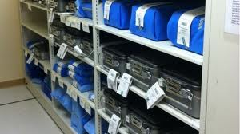
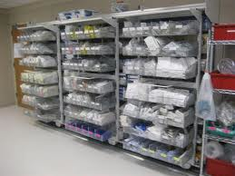
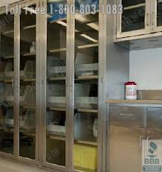
Sterile Storage
  Based
    Items stored
    Traffic in the area
  Types
    Open
      Rack units – dust can accumulate
      Bottom shelf should be solid
        Provides protection when cleaning
    Closed
      Cabinet units –limit dust
      Better in areas of high traffic

Slide 22
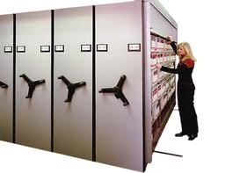
Space saving systems

Slide 23

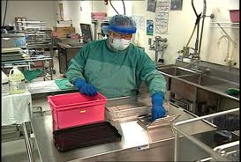
Maintaining the Environment
Traffic Control
  Anyone entering
    Controlled access
      To get into the department
        By code or card access
        Door Bell
    Must follow department dress standards
      Visitors must wear:
        Scrubs and hair cover
        Coveralls over street clothing
      Changes depending on area entered

Slide 24
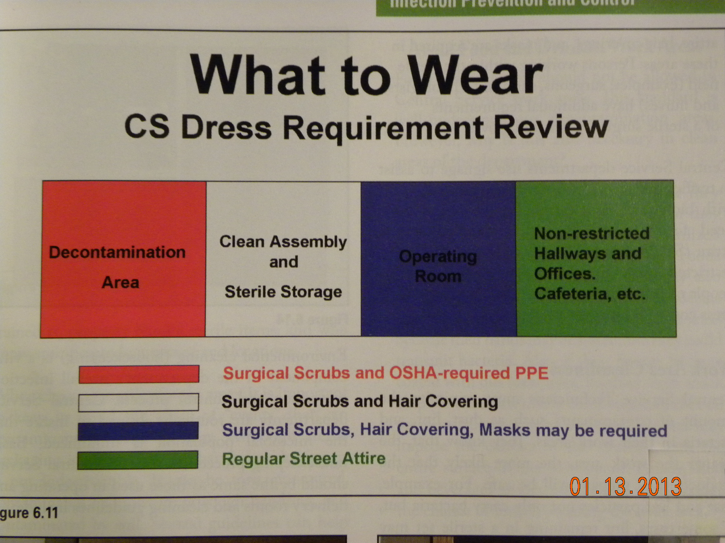

Slide 25
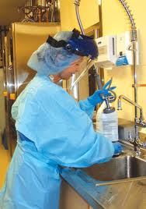
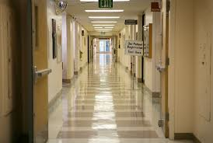
Area / Dress Requirements
Biohazard
  Contaminated from used materials
  Wear PPE (OSHA) - Decontamination
Unrestricted
  Normal traffic areas ie. hospital corridor
    Most offices
    Locker / dressing rooms
    General public areas - cafeteria

Slide 26
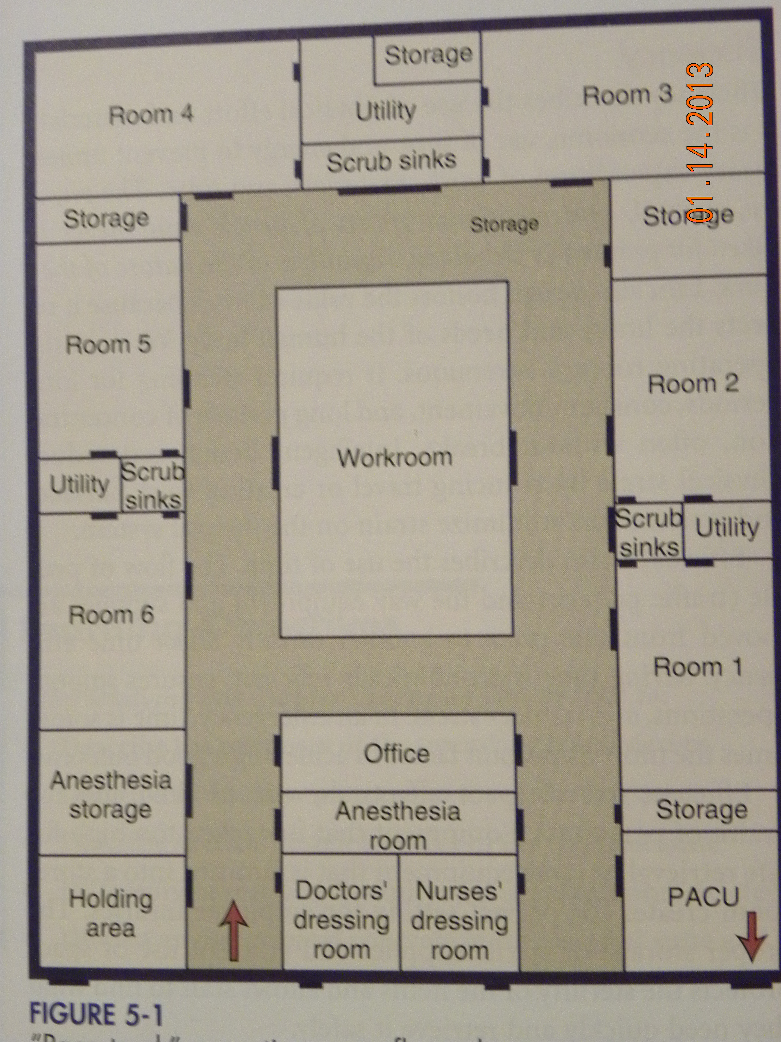
http://pedsanesthesia.stanford.edu/education/OR_layout.pdf
Operating Room Areas
  Unrestricted –
    Hallways
    Dressing rooms
3. SemiRestricted
    OR halls
    Offices in OR
    Scrub areas
    Equipment /supply rooms
    Workrooms
    Clean processing room
    Anesthesia wk rm
    PACU - recovery

Slide 27
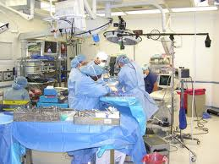
4. Restricted
  Operating room
    Always keep organisms to the lowest number possible
  Substerile Room
    Connected directly
    to operating room
  Sterile Core
    May have open
    sterile supplies

Slide 28



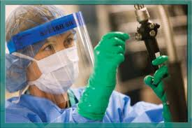
What to Wear
Unrestricted
  Regular street clothing
Semirestricted
  Scrubs, hair covering
Restricted
  Scrubs, hair covering, mask (maybe booties)
Biohazard
  Scrubs, hair covering, PPE (depending on task)

Slide 29
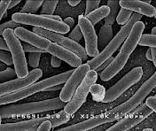
Work Area Cleanliness
Minimize contaminants
  Dust
    Carries organisms
  Lint
    Carries organisms
    On instruments – can cause wound problems
  Bacteria
    Cause infections

Slide 30

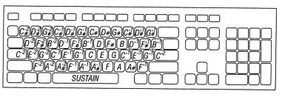

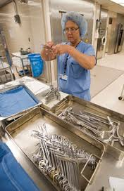
Organism transmission
  Direct contact
    Person to person
  Indirect contact
    Fomite – inanimate object that can transmit organisms
      Door handles
      Computer keyboard / pads
      Telephones
      Work station and items there
    Clean on regular basis

Slide 31




CS Housekeeping
Floors
  Wet mopped daily
    No dry dusting – spreads dust /organisms
    Used specifically for CS – washed after use
  Horizontal surfaces
    cleaned daily
    Hospital germicide
  Light fixtures / covers
    Every 6 moths
  Other – walls, cabinets, racks
    Regularly scheduled cleaning
    Done by techs who know how to handle sterile supplies

Slide 32
Cleaning Sterile Storage
Remove sterile items from unit
  Place on dry clean surface
  Avoid rough handling
Clean unit per hospital recommendations
  Use gloves and PPE as needed
Allow to dry completely
  Avoid strike through on packages
Return sterile items
  With clean dry hands
  To same place

Slide 33
Receiving shipping containers
  Harbor microorganisms
Boxes
  Discarded before items enter CS
Plastic totes
  Cleaned before entering

Slide 34
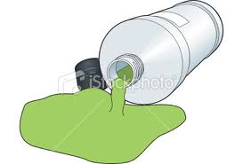

Food
Beverages
  Can spill
    Contaminate sterile items
Foods
  Can attract insects – carry organisms
  Are hands clean to eat?
  Can transmit oils to hands to instruments
    Can prevent sterilization of instrument
    Steam must penetrate oils – it doesn’tn

Slide 35
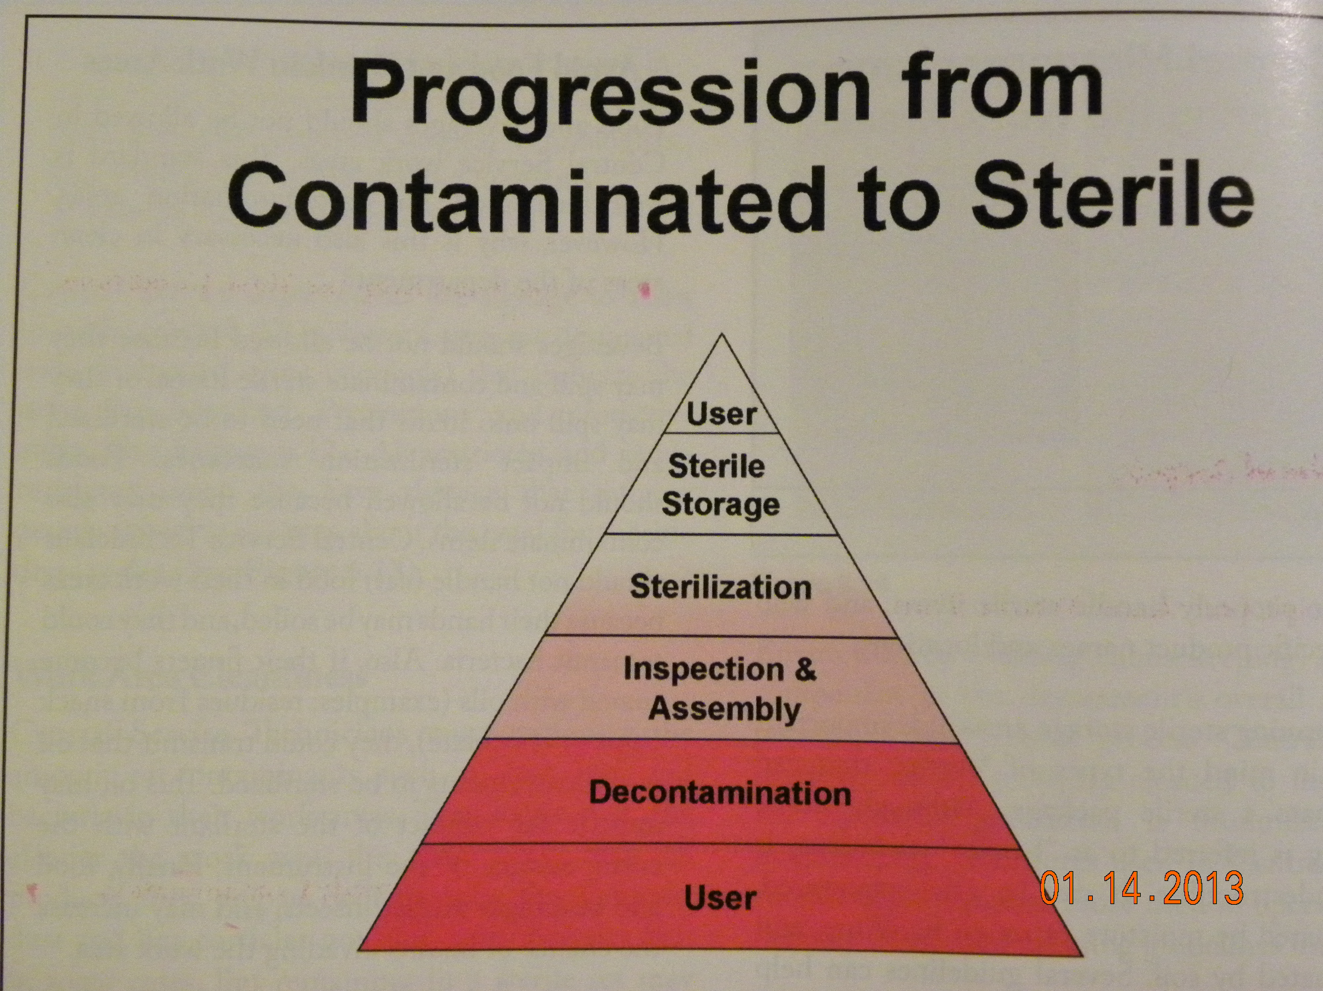
Workflow

Slide 36
Must avoid cross-contamination
  Flow from decontamination to storage
    Decontamination
      Safe to handle
    To preparation area
      Instrument sets put together
    Sterilized
      Kills organisms left
    Sterile storage
      Must maintain sterility
    Back to patient

Slide 37
Principles of Asepsis
Asepsis – absence of microorganisms that cause disease
  Know what is Dirty
    Used for patient care = contaminated
    Visibly soiled = contaminated
    Is or isn’t ? = contaminated
    If in Doubt – Throw it out!
  Know what is clean
    Mechanically cleaning – removes soil and most microorganisms = considered clean
    Cleaned with detergent disinfectant = decontaminated = safe to handle

Slide 38
  Know what is Sterile
    Sterility is – the absence of all microbes, including spores.
    Only STERILIZATION achieves sterility
  Keep the 3 Conditions Separate
    Dirty
      Can contaminate clean / sterile items
      Keep in dirty area
      Moisture allows org. to pass through – STRIKE THROUGH
    Clean
      If soiled must return to decontamination
    Sterile
      Not stored where they can become wet or soiled

Slide 39
  Remedy Contamination
    If contamination occurs – must be corrected immediately
    If you suspect contamination – take action to protect patient
      IS CONTAMINATED!
Sterile Conscience
  Careless attitude can lead to increased risk of infection
  You must provide safe items for use
  Follow 5 Principles of Asepsis

