Slide 1
Tools for Cleaning
Chapter 7 7th Ed.
Rosemary Thurston RN

Slide 2
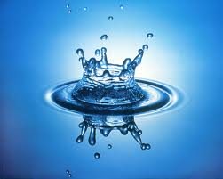
Water
Quality
  Impurities
    Minerals
    Dissolved solids
    Particles
    Gases
    Organic and non-organic chemicals
    Bacteria
    Algae
    Parasites

Slide 3
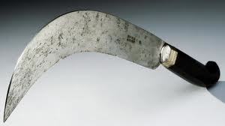
Concerns:
  Can harm finish on instruments
    Purify water for final rinse
  Can impede cleaning and biocidal processes
    May inactivate detergent germicide
  Must test water in CS for use in:
    Manual or mechanical processes
    Instruments or cart washers

Slide 4
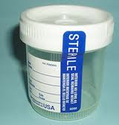
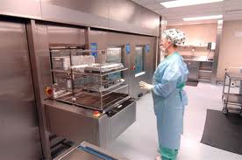
Procedure to do water sample test
  Collect sample
    in sterile plastic container
    Sterile urine container can be used
  Locate
    where water enters sink or cleaning equipment
  Let water flow first
    Then collect
  Send for testing quickly

Slide 5
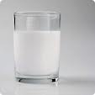
Quality factors
  Conductivity
    Checks ionic charge
  Total dissolved Solids
    Minerals – calcium, iron, etc
    Can leave hard water stains/spots
    Buildup in washing equipment and plumbing
  pH - Acidity / Alkalinity
    Should be at 6.5 – 7.5 pH = NEUTRAL

Slide 6
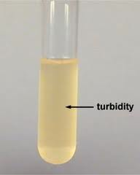
  Chlorides - like salt on the roads NaCl
    Allows corrosion to occur on instruments
  Other particles – cause Turbidity
    Can make water look dirty
      Rust
      Filter particles
      Sand
      Gases – will degas over time - clear

Slide 7
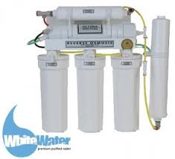
Water purification systems
  Filters
    Usually a cartridge inside of a housing
      Various materials
    Replacement
      Checked by measuring water pressure before and after filter
      Lower pressure after filter means it is clogged
    Filtering size measured in microns
      Vary from 1 – 25 microns or lower
      Trap particles, chemicals, organisms
    May be several filters in a row

Slide 8
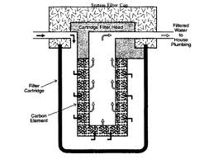
  Granular Activated Charcoal
    Removes chlorides (salts)
  Softeners
    Removes “hardeners” in the “hard” water
      Calcium and magnesium
http://www.youtube.com/watch?v=9s01qSwK-nM

Slide 9
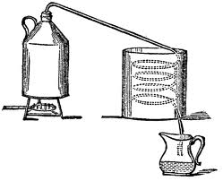
Distilling, Deionizing and Reverse Osmosis
  Distillation
    Removes impurities by making water into steam
    Steam is collected and condensed back into water
    Not used today because distilled water is purchased

Slide 10
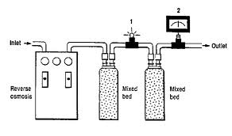
  Deionization
    Used for
      Heating and cooling units for patient therapy
      Final rinse water
        Manual and automatic cleaning of instruments
    Uses multiple filters in line

Slide 11
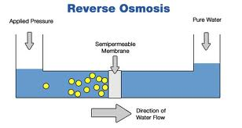
  Reverse Osmosis
    Remoives dissolved solids / organics
      To include bacteria, pyrogens, endotoxins

Slide 12
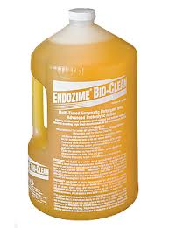
Cleaning Chemicals
Enzymatic products
  Point of use: (in the OR)
    Loosen soil on instruments
  In the washing process
    Remove proteins – blood and tissue
      PROTEINS
      FATS
      STARCHES
  Concerns
    Temperature should not exceed 140º F
      Inactivates the enzyme
    Soils can decrease effectiveness
    Must be moist

Slide 13
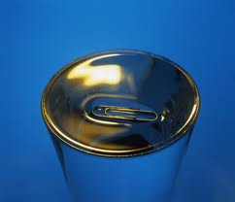
Detergents
  Action
    Decrease surface tension of water
      Allows it to get under the soil
      http://www.youtube.com/watch?v=Hm52rkh68JA&feature=related
  May contain:
    Chelating agents (ion)
      Attracts opposite ions (in soil) – breaks it away from item
      Emulsifier surrounds to prevent reattaching
      Can break up oils holding soil

Slide 14
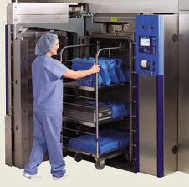
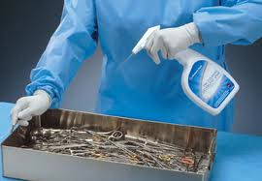
  Descalers
    (acidic detergent)
    Cleans up scale on equipment
  Pre-soaking chemicals
    First part of decontamination
      Water
      Detergent solution
      Enzymatic detergents
      Enzyme-germicide detergent
    If left very long
      Can damage the instrument finish

Slide 15
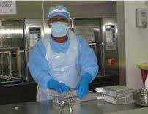
  Manual cleaners
    Break up surface tension
      Make water “wetter”
      Penetrate under the soil – breaks the bond
      http://www.youtube.com/watch?v=Obbw7D-DYXc&feature=related
    Low foaming – free rinsing
    Use the manufacturer’s instructions

Slide 16
Mechanical Cleaning
  Equipment
    Washer decontaminators
    Washer sterilizers
    Ultrasonic cleaners
    Cart washers
    Automatic scope reprocessors
  See manufacturer’s instructions
    For kind of chemicals to use
    Then follow chemical manufacturer’s instructions

Slide 17
Safety Precautions
  PPE
    Around biohazardous materials
    Around chemicals used to clean
  Forearm length gloves
  Fluid impervious gown
  Face shield
  Shoe covers

Slide 18

  Never mix chemicals
    Unless mixing is required by manufacturer
    Some can create toxic gases
      Bleach and ammonia mixed together – can be lethal
    Follow recommend dilution
    Read precaution on label / MSDS
    Cold water for removing blood
    Water and chemical mixture
      Follow temperature recommended by manufacturer

Slide 19
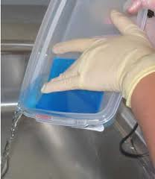
Product Disposal
  Follow labels and MSDS
  Know regulations, federal, state, local
    Know where to dispose of chemicals
    Don’t put down sewer unless regulations say you can

Slide 20
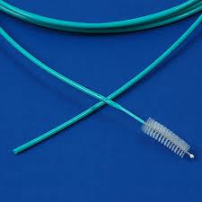

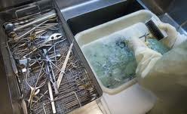
Cleaning Tools
Brushes
  Nylon bristles
    Usually disposable
      Otherwise must be
        Cleaned
        Sterilized daily
    Rigid or flexible
  Abrasive brushes
    NEVER USED
    Damage surface finish
  Buffers can be used safely

Slide 21
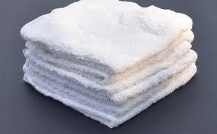
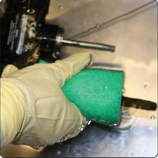
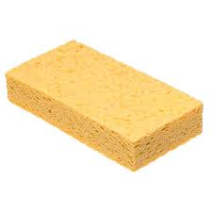
Process
  Use Brush under water
    Prevents aerosolization “splatter” off of brush
Lint free wash clothes
  Don’t want lint on instruments
Sponges
  Replaced daily

