Slide 1
Decontamination: Point of Use Preparation and Transport
Chapter 8 7th Ed.
Rosemary Thurston RN

Slide 2
Transporting Soiled Items
Priorities
  Prepare items so they won’t be damaged
  Don’t cross-contaminate the environment
    Between point-of-use and decontamination
  Assure safety of everyone who might contact items

Slide 3
Sources of Contamination
  Surgery – the majority of items
    Central Service may be close to the Surgery Department
  Other Departments
    Labor and Delivery
    Emergency Department
    Endoscopy
    Cardiac Catheterization

Slide 4
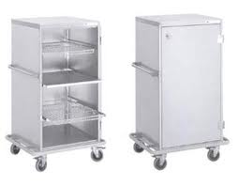

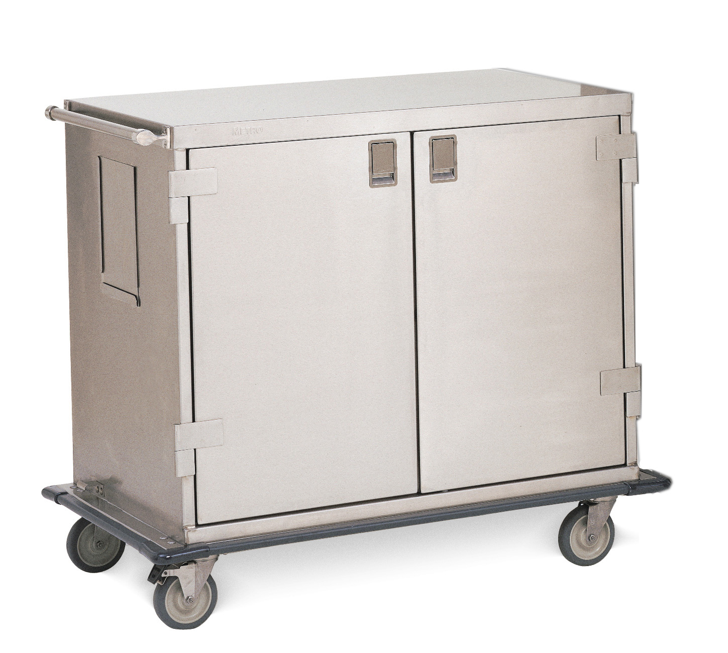
  Enclosed Carts
    Contain contaminated / soiled items
      Instruments
      Equipment
    Placed in designated area
      Waiting to be returned to decontamination
      Designated Biohazardous area
      Soiled Utility in pat. Care area
    Return to Decontamination
      Via direct connection (for contaminated items only)
        Hallway
        Elevator
        Dumb waiter
      By CS staff or user staff

Slide 5

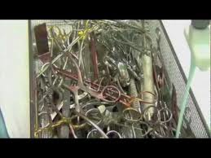
Point-of-use Preparation
  Why?
    Helps prolong life of instruments
      Blood / saline damage finish
    Dried on debris harder to remove
      Keep moist
      Takes more time in decontamination
        Can delay return to surgery
      Everyone’s responsibility

Slide 6

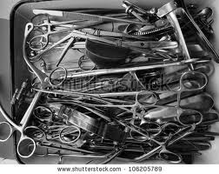
Guidelines
  Remove gross soil
    Immediately after use
    Follow manufacturer’s instructions
      Ie. Endoscope needs fluid suctions through channels
  Keep them moist
    Enzyme spray
    Moist towel covering

Slide 7

    Soaking in enzyme solution or water
      Only for short periods of time
      Solution removed before transport
        Reduces risk of spilling / splashing
    Instruments
      Should be open – hinges / box locks
  Remove disposable components
    Remove blades
      Put in sharps container
      Reduces injury from “sharps”
    Discard disposable components
      Reduces items transported
      Care to protect reusables –
        Towel clamps on drapes

Slide 8
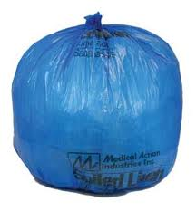
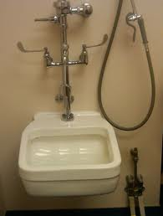
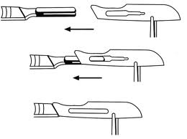
  Separate reusable linen
    Placed into linen bag
  Empty fluid from containers
    Ie. suction cannister with blood
    Should go down flushed hopper
  Separate reusable sharps
    Put in separate container
      Reduces risk of injury

Slide 9
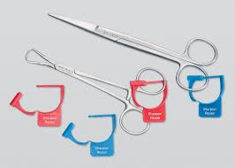
  Keep items together
    Separating sets or parts increases risk of loss
    Increases time to reassemble
  Alert re. repair needs
    Tag instruments for repair

Slide 10
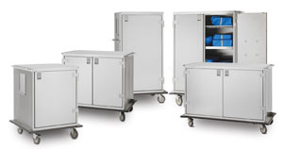
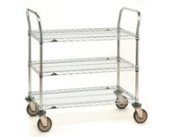
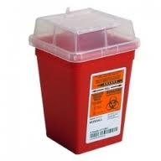
Transport of Soiled Items
Procedures
  Contaminated items should be contained
    Decreases airborne organisms
    Decreases chance of direct contact
    Reduces cross-contamination
  Using
    Closed cart
    Open cart with solid bottom and covered
    Dedicated transport container for other departments
      Using biohazardous containers
      Must not have contamination on exterior

Slide 11

Transport via vehicle
  US DOT (Dept of Transportation) guidelines
    There may be State or Local requirements as well
      May need to go from building to building
      Safely load transport devices to prevent spillage
      Assure items are securely contained

Slide 12
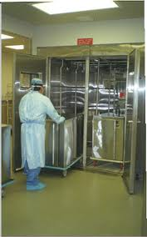
Contaminated item movement - Surgery
  Separate from clean / sterile
    Elevator
    Hall / corridor
    Dumb waiter
  Carts used for soiled items
    Must be decontaminated in cart washer
    Then can be used as case cart for
    Clean / sterile

Slide 13
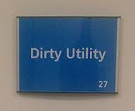
Contaminated items – hospital departments
  Placed in holding area – Soiled Utility
    CS Tech assigned to go on scheduled “ROUNDS”
      Must be timely to prevent items sitting and shortages

Slide 14
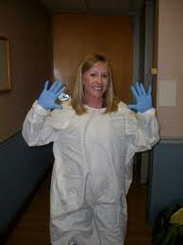
Safety
All used equipment is contaminated
  Handle as contaminated
  Transport requires protective
    Gown or coat
    Gloves
      Place on transport cart
      Remove gloves after handling
      Wash hands after removing gloves

Slide 15



  If there is possible splashes, spills, aerosols
    Wear mask / goggles or face shield / mask
    Always use PPE according to OSHA
  Maintain control of cart when moving
    Use care at corners
      Use corner mirrors if available
    Yield to
      Patients and visitors
      Patient stretchers and wheel chairs
      Not like this!

Slide 16
Education and Training
  YOU help keep infections down in patient care
  Policies and Procedures
    Developed with other specialties
      Infection Control
      Hazardous Material
    Recommended Practices from:
      AAMI
      OSHA
      AORN
  Everyone who comes in contact with contamination must be knowledgeable –
  Continuing Education is important for everyone in healthcare

