Slide 1
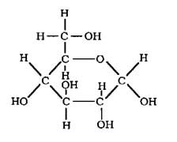
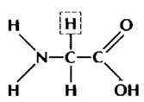
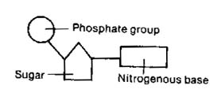
Biology
March 12th
Objective:
  Students will review for a cumulative test in genetics.
Study tables Tuesday after school 3:15.
Homework: Test review packet using ELMO (25 min)
2 New Vocabulary terms Ch. 17
Sex-linked inheritance
  As a class with worksheet
Chapter test 1-5 review (20 min)
Analysis Questions Chapters 17, 16, 12-14, 10, 8
What will be on the test?
Vocabulary review using smart. (20 min)
front legs, just

Slide 2
Pedigree interpretation
Punnett squares
Mitosis-phases, purpose and result
Meiosis-phases, purpose and result
Steps in protein synthesis (transcription, translation)
DNA replication
Sex chromosomes
DNA, compare and contrast with DNA as to structure, bases, purpose
Genotypes (heterozygous, homozygous, dominant, recessive)
How do nucleotides, DNA, RNA, genes, chromosomes, nucleus and cells relate to each other?
Vocabulary for all chapters on test (1-5, 8, 10, 12-14, 16, 17)

