Slide 1
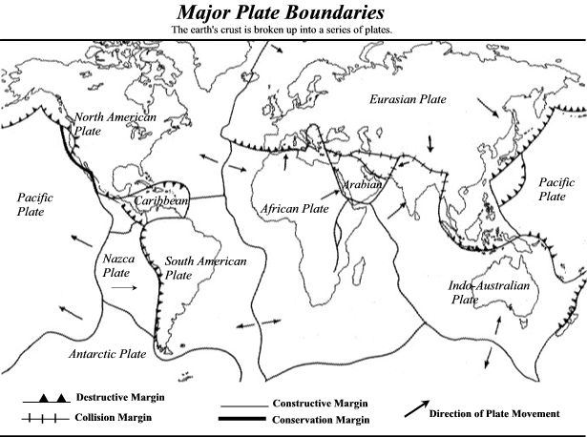

Slide 2
Convergent Plate Boundaries

Slide 3
Convergent Boundary between oceanic and continental plates

Slide 4
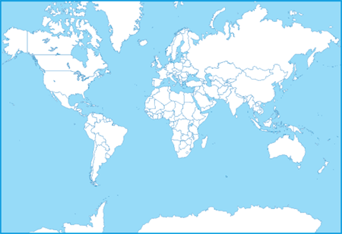
Plate Tectonics Examples Worldwide

Slide 5
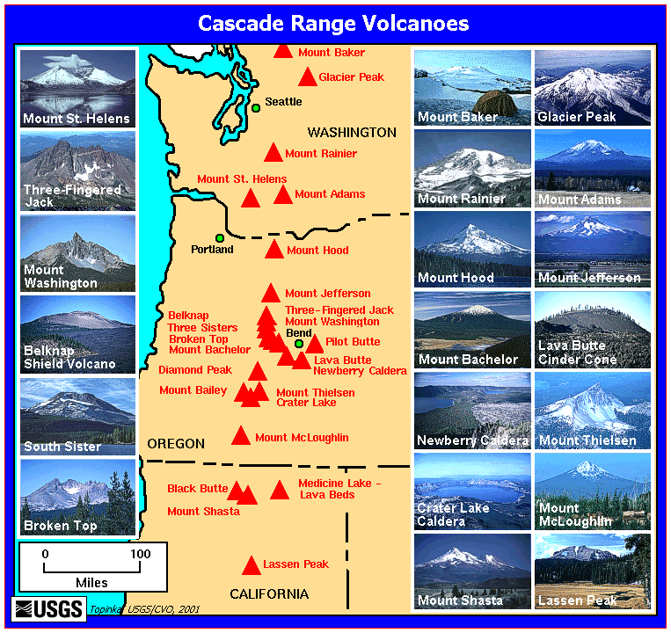
Cascade Mountains

Slide 6
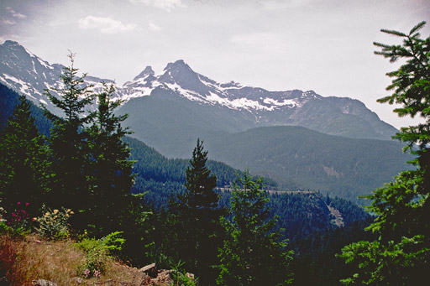
Cascade Mountains

Slide 7
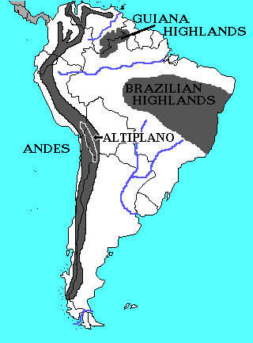
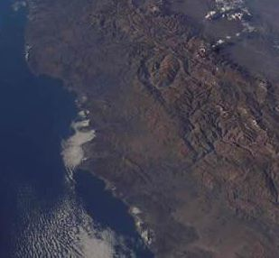
South American Andes Mountains

Slide 8
Convergent Oceanic-Oceanic

Slide 9
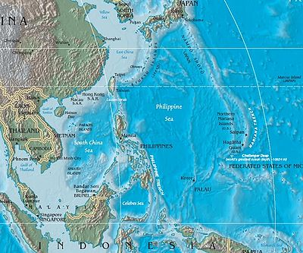
Marianas Trench
Marianas Trench

Slide 10
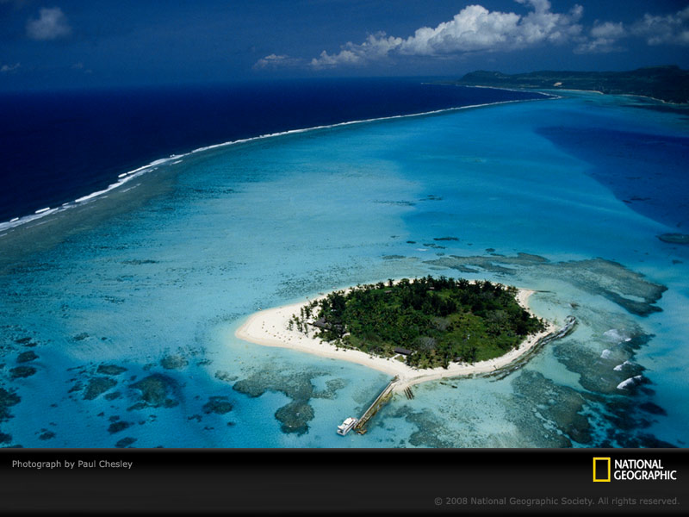
Marianas Island
Marianas Island

Slide 11
Convergent Oceanic-Oceanic

Slide 12
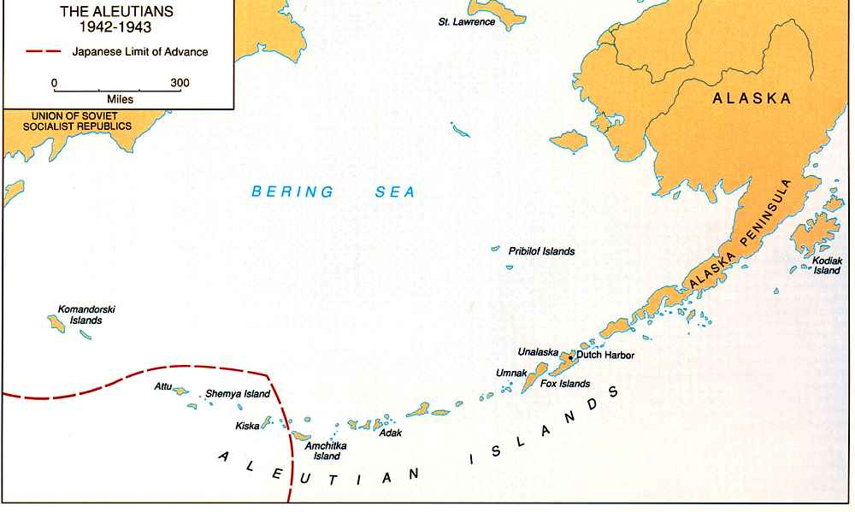
Aleutian Islands

Slide 13
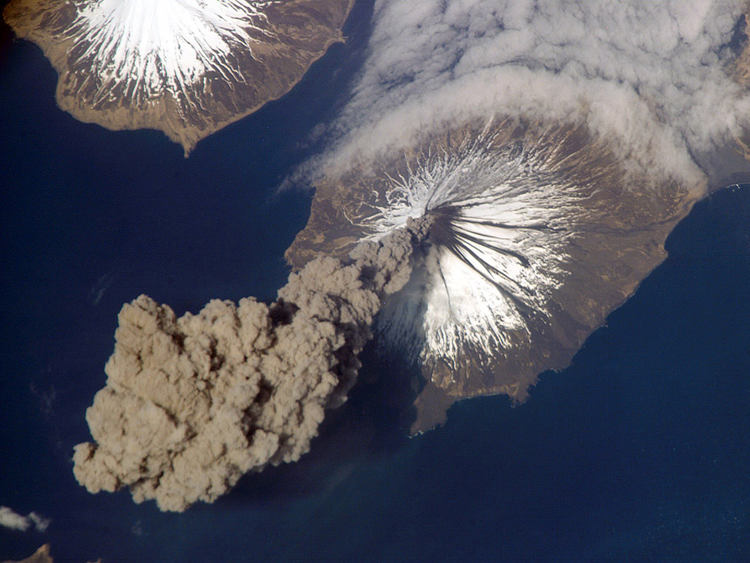
Cleveland Volcano Aleutian Islands

Slide 14
Convergent Continental-Continental

Slide 15
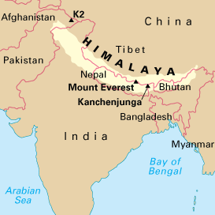
Himalayan Mountain Range

Slide 16
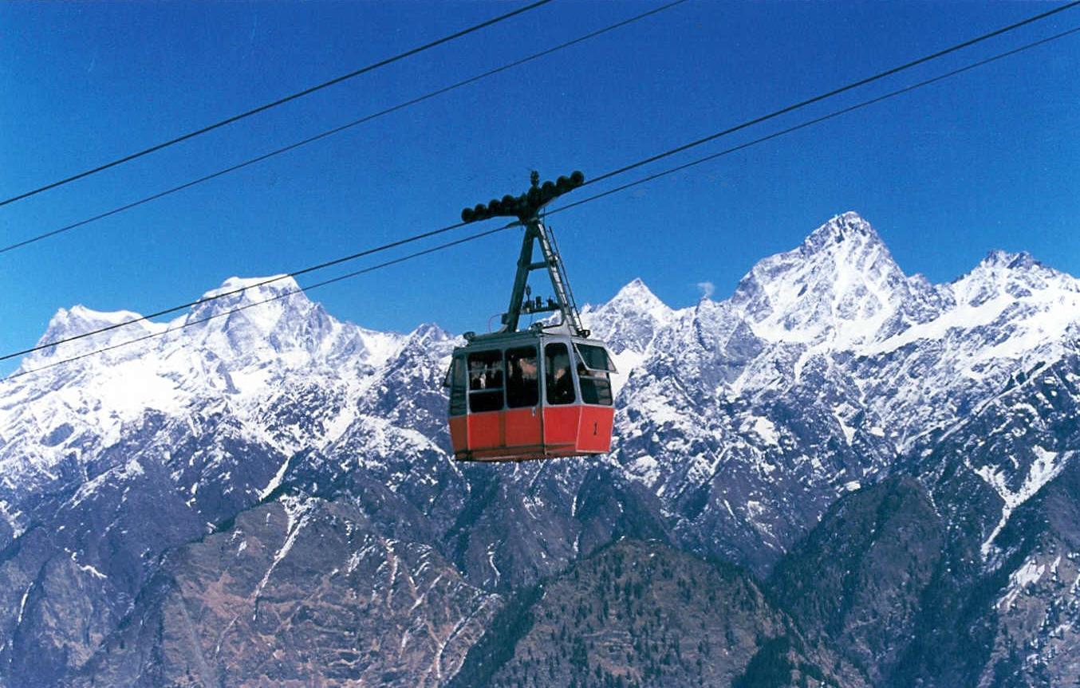

Slide 17
Divergent Plate Boundaries

Slide 18
Divergent Oceanic-Oceanic

Slide 19
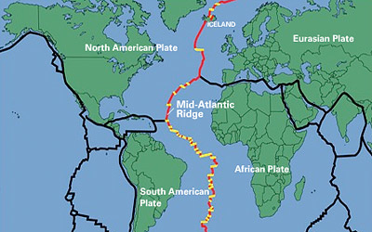
The Mid-Atlantic Ridge

Slide 20
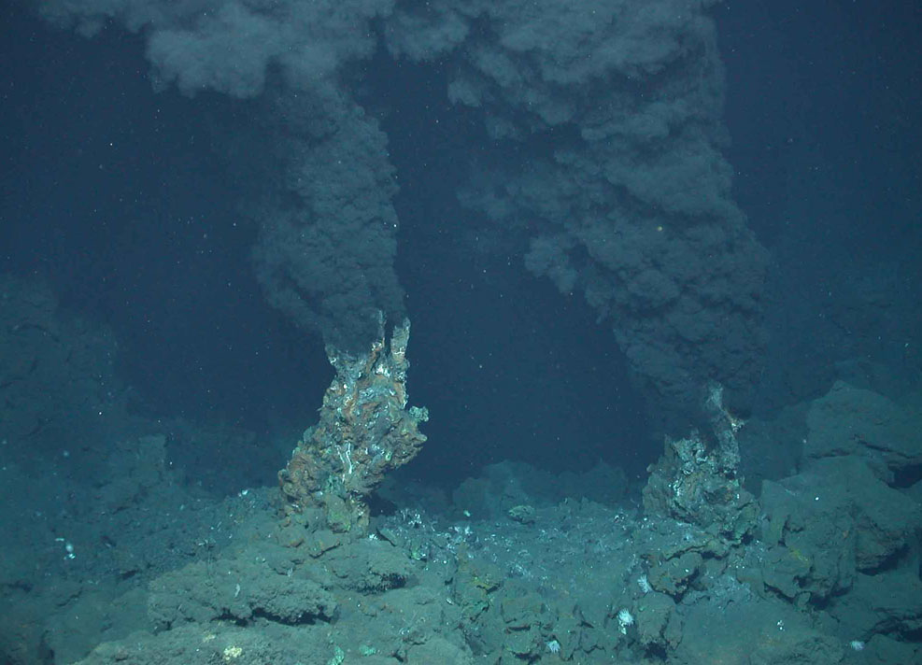
Mid-Atlantic Ridge

Slide 21
Divergent Continental-Continental

Slide 22
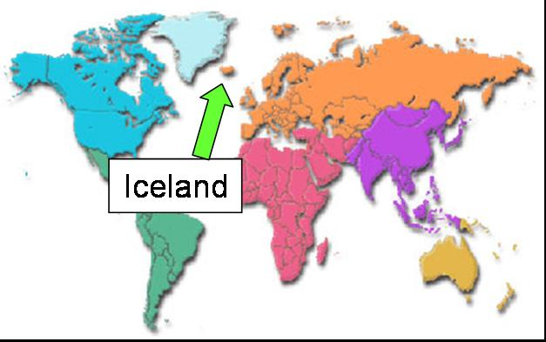
Divergent continental-continental

Slide 23
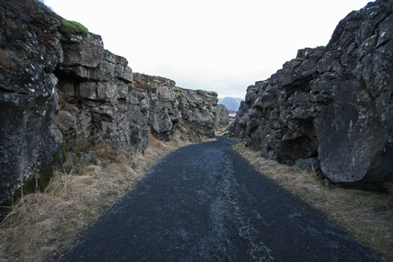
North American and Eurasian Plates Moving Apart

Slide 24
Transform Boundaries
Most are in the ocean
One famous one is on the land……….

Slide 25
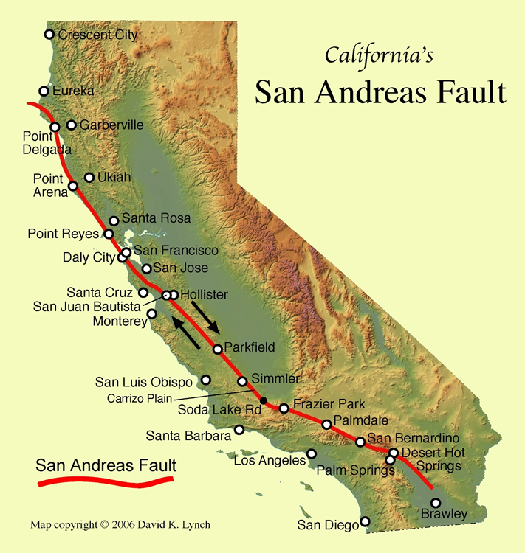
San Andreas Fault

Slide 26
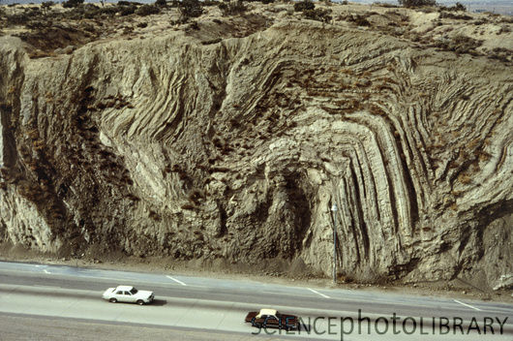
Folds in Rock Strata of San Andreas Fault

