Slide 1
Stars and Their Spectrums

Slide 2

Stars are the Element Factories of the Universe

Slide 3
Stars fuse _________ into _________most of their lives.
Stars fuse hydrogen into helium most of their lives.

Slide 4
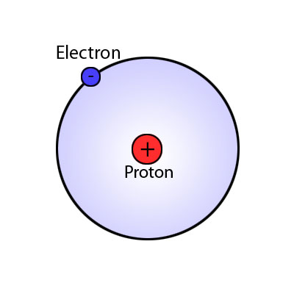
Younger stars are rich in hydrogen

Slide 5
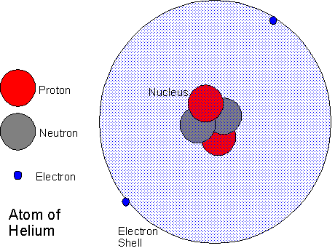
Older stars are rich in helium

Slide 6

Massive stars are able to fuse elements heavier than helium, and these heavier elements show up in a stars spectra

Slide 7
How can a star’s spectra tell astronomers a star’s….
age?
mass?
density?

