Slide 1
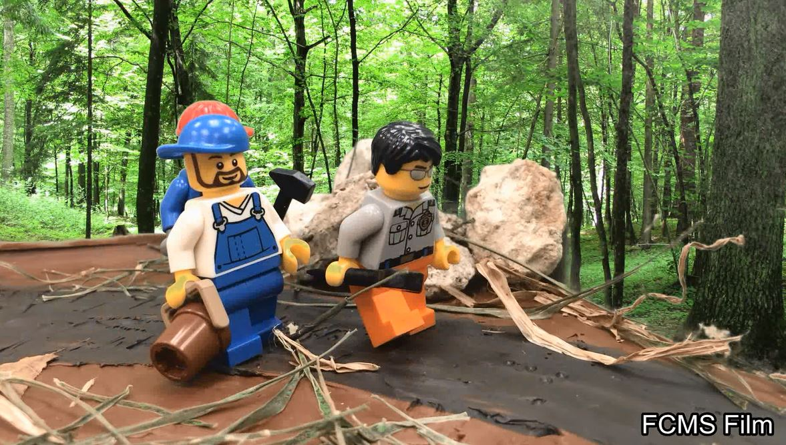
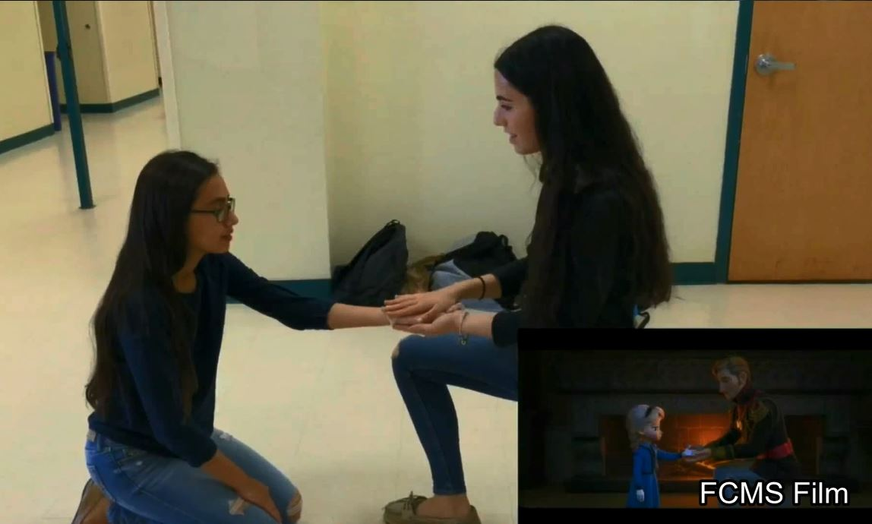
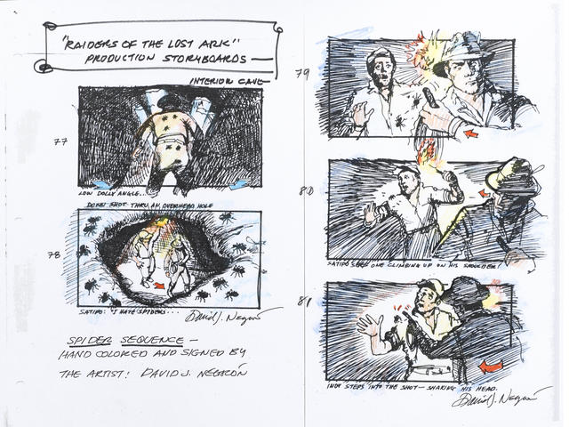
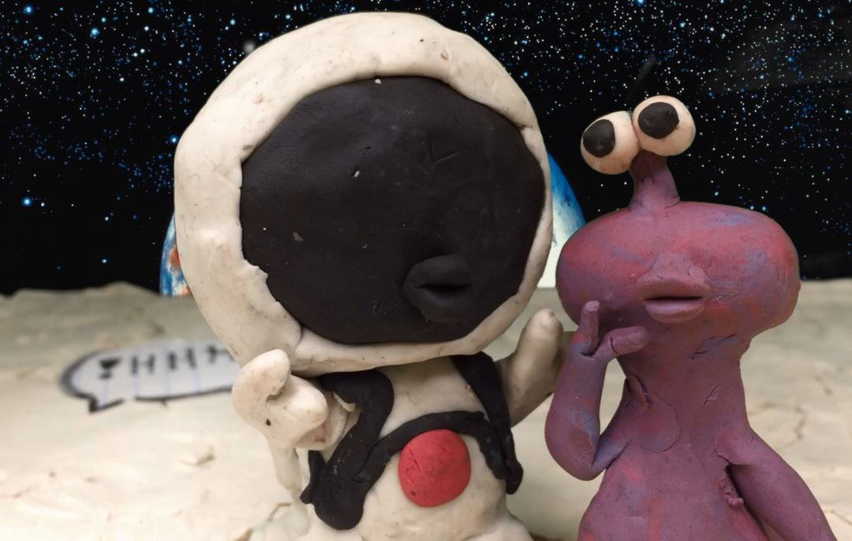
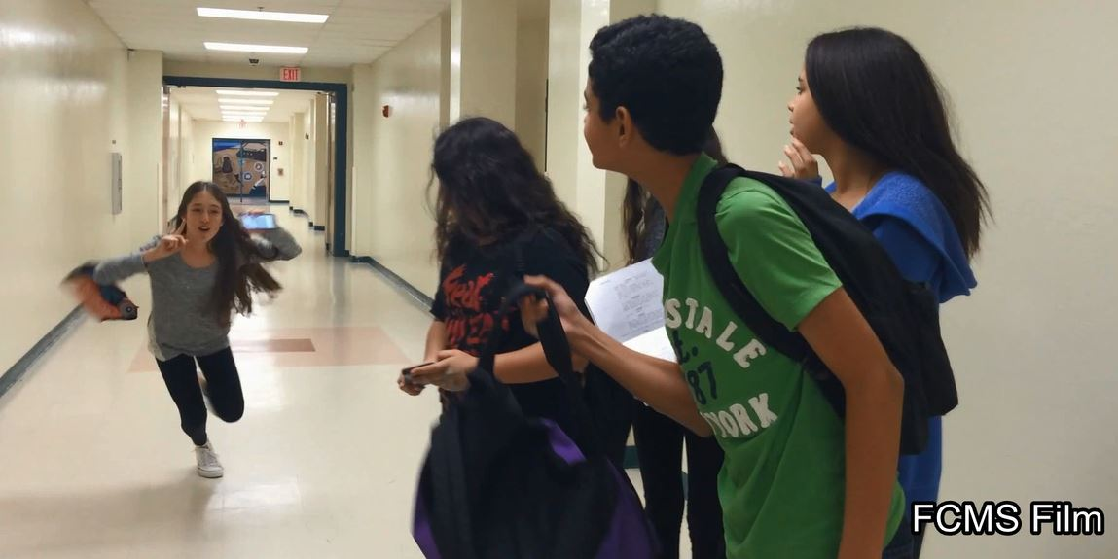
FILM 1
2018-2019
Mr. Hengge /
Mrs. Schrager

Slide 2
Film 1 – High School Credit Course Description
Students explore the fundamental concepts, terminology, techniques, and applications of digital imaging to create original work. The instructional focus will be on film. Students produce digital animated images through the single or combined use of computers, digital cameras, digital video cameras, scanners, photo editing software, drawing and painting software, graphic tablets, printers, new media, and emerging technologies. Through the critique process, students evaluate and respond to their own work and that of their peers to measure artistic growth. The course incorporates hands-on activities, the use of technology, and consumption of art materials. This course will meet graduation requirement for Performing Fine Arts graduation credit

Slide 3
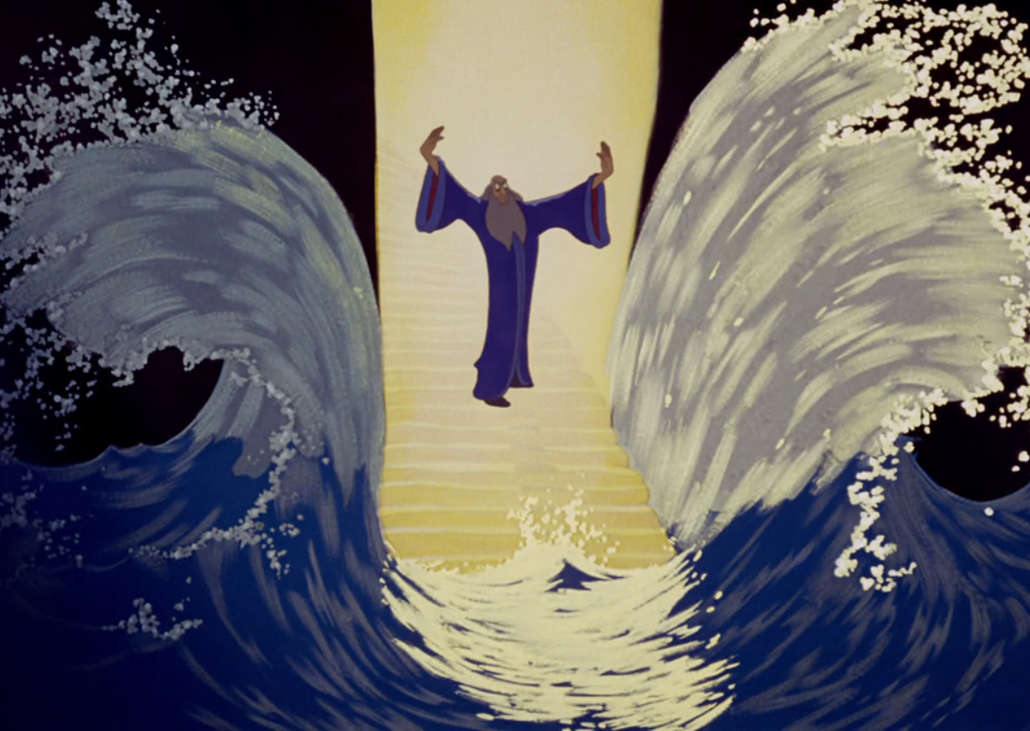
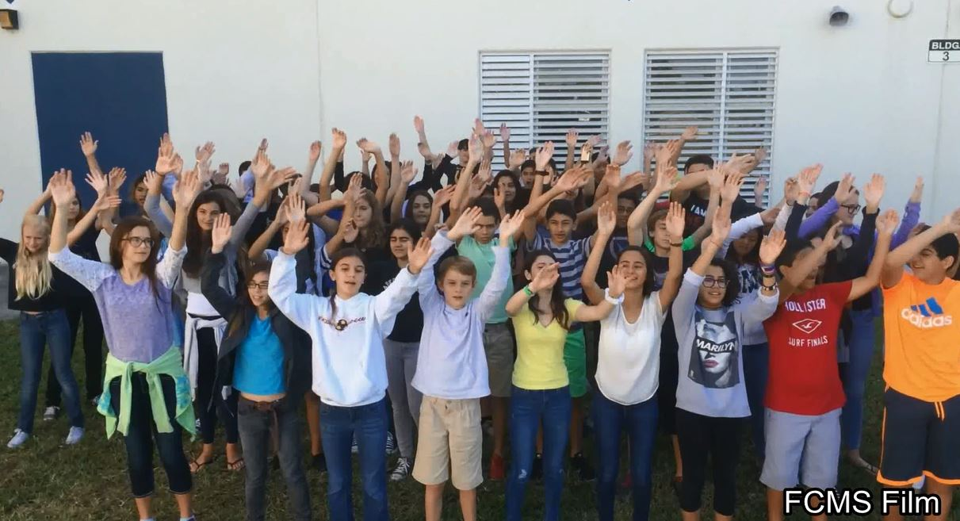
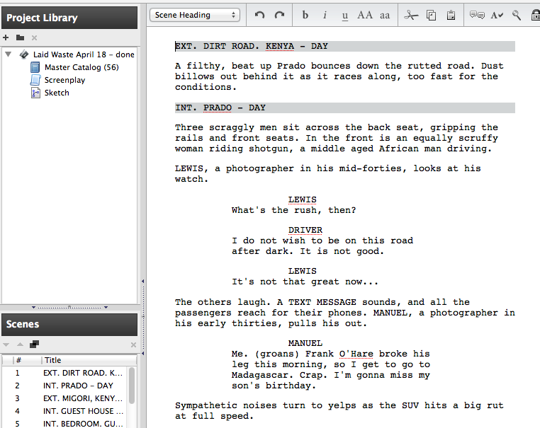
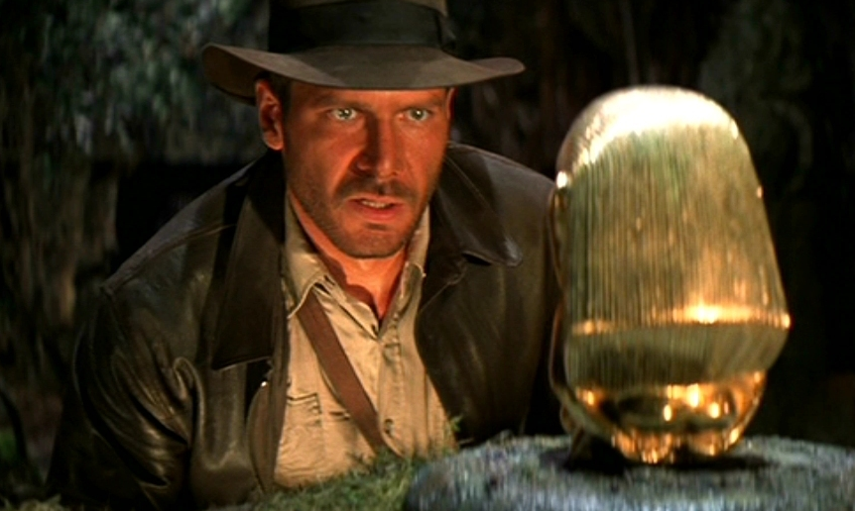
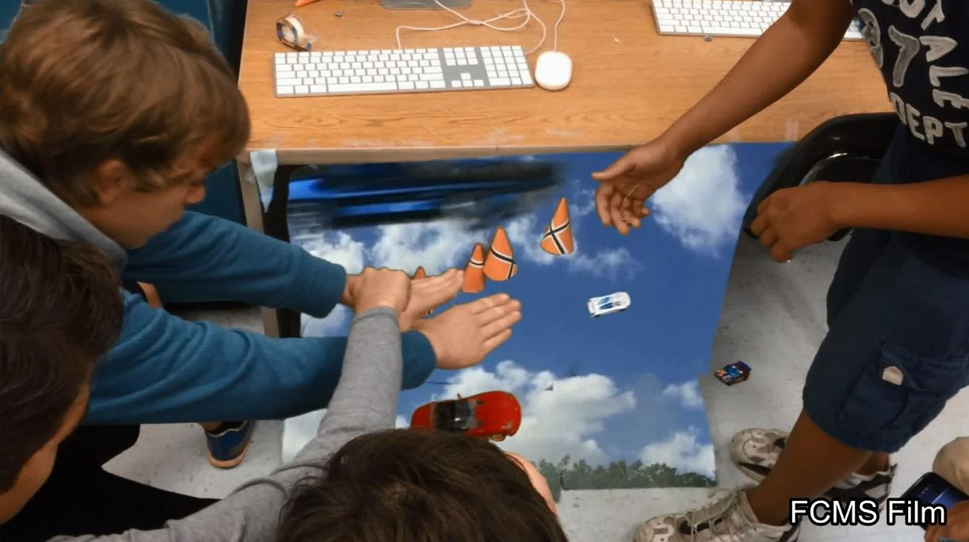
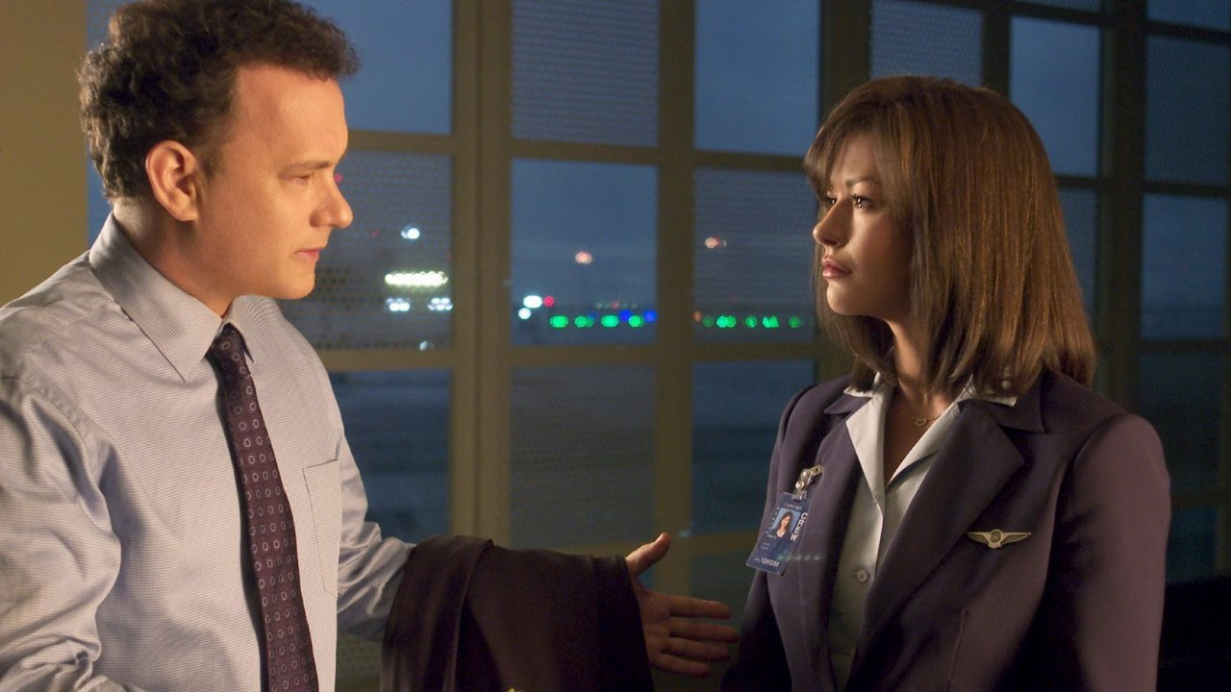
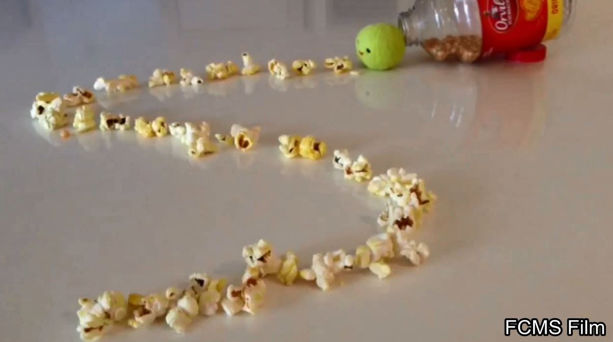
Q: What are the Components of
Film 1?
A: This course is equal parts Film appreciation, and Project Based learning assignments.

Slide 4

Q: What is the selection process for the films chosen for review in this class?
A: Movies are chosen based on the following criteria (as taken from the American Film Institute )
“Honorees are selected based on works which:
* Best advance the art of the moving image
* Enhance the rich cultural heritage of America's
art form
* Inspire audiences and artists alike
* And/or make a mark on American society”

Slide 5
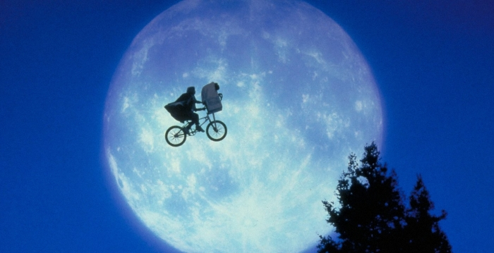
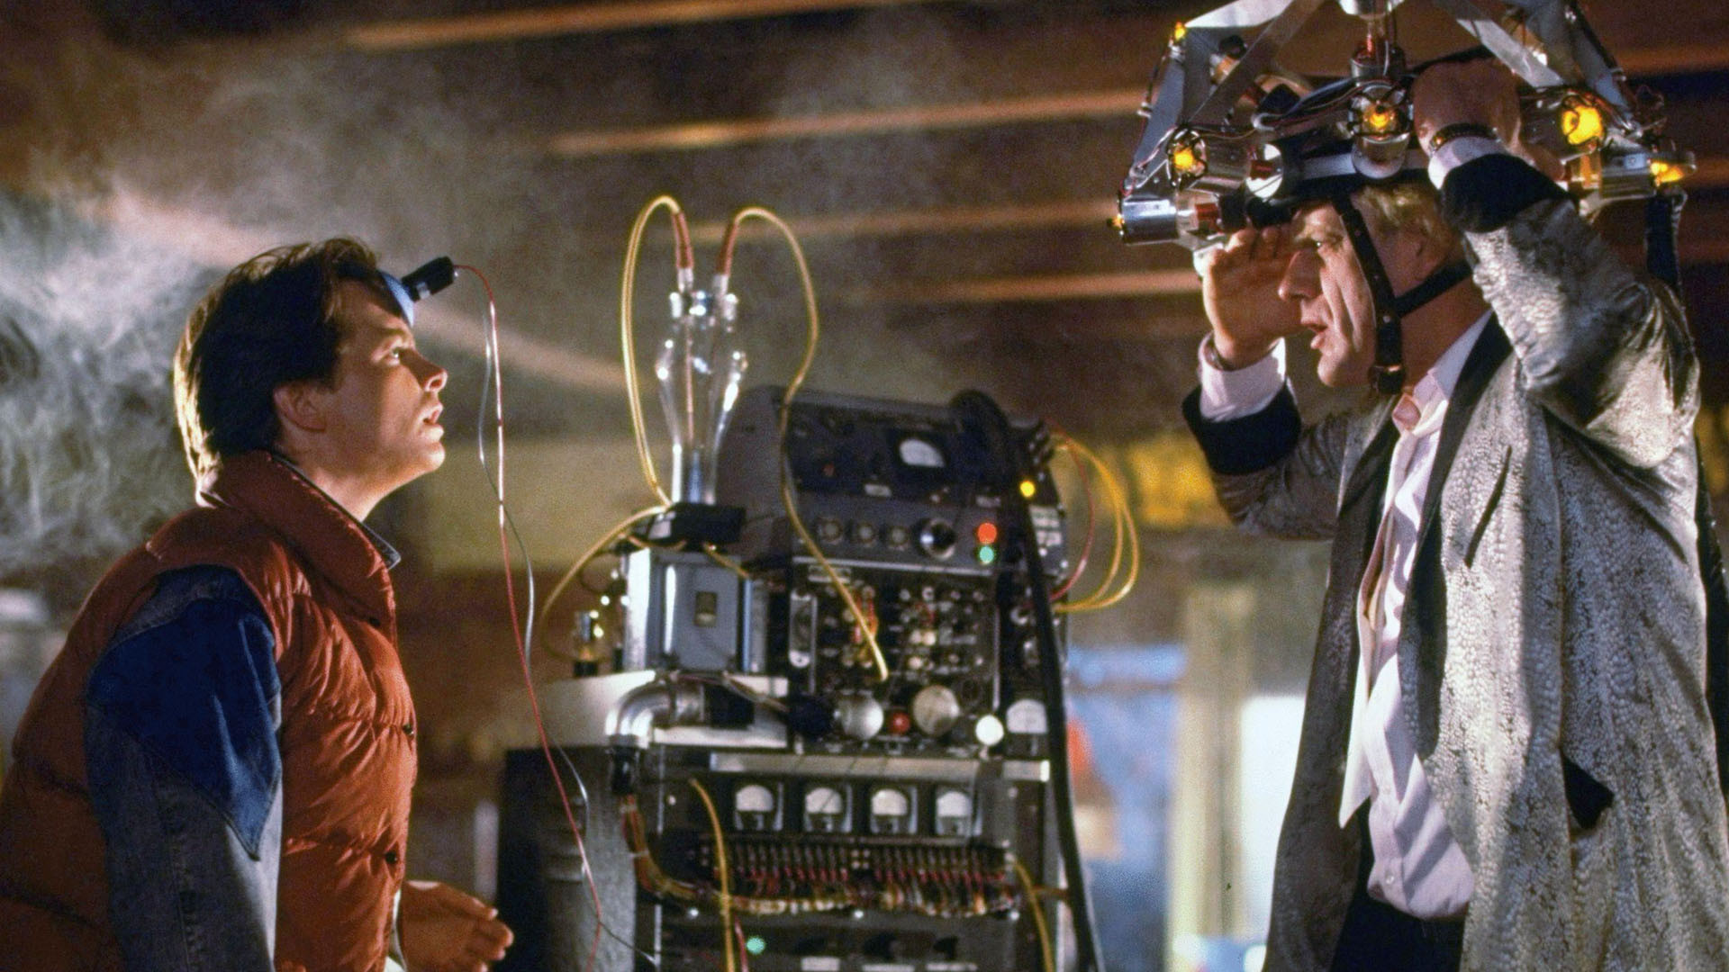
Contd…
Q: What films can we expect to see in Film 1?
A: Films that keep with the criteria described previously. Examples will possibly include:
E.T. (1983)
La La Land (2017)
Beetlejuice (1988)
The Birds (1963)
Beauty and the Beast (1991)
Singin’ In the Rain (1952)
Back to the Future Trilogy (1985 – 1989)
Jaws (1975)
Fantasia (1940)
…and many more.
Q: What about Film ratings?
With the exception of the Matrix, which has an “R” rating (for violence), all movies shown last year were rated anywhere between G, PG and PG-13. We will let students know beforehand what movies have been chosen. Remember that this is a High School Credit course and we will do our best to show important cinema while at the same time, being mindful of our students ages in our classes.

Slide 6
Q: How will students analyze films shown?
A: Here are some examples. Students will provide verbal /and or written feedback to:
Identify turning points in films ( plot analysis ).
Learn many different camera shots commonly used- and why they are used.
Imagine other actors playing title roles and what effect positive or negative, it would have on the picture.
Describe processes and techniques used to record visual imagery.

Slide 7
FILM 1 PROJECTS
Examples of Film 1 projects:
Create a personal slideshow about yourself using editing software.
Make a stop motion/time lapse video.
Recreate a scene from a film shot for shot.
Write an original screenplay using proper formatting.
Film a scene from original screenplay. Include Foley effects and original audio.
A large portion of this class is project based learning. Students will be expected to work with each other in teams to reach their filmmaking goals.

Slide 8
Student Expectations
A certain level of maturity and trust is needed to be successful in this class. At times, you the student will be given opportunities to work in groups on campus outside of this classroom.
Here are some tips…

Slide 9
When working in groups, everybody must do their part.
Stay focused and be mindful of the due dates. Stay on task and do not abuse the privileges afforded to you.
Plan ahead. Ask yourself: “What materials, costumes, props equipment, etc. is necessary for me to complete the task?”
Working outside the school may sometimes be necessary

Slide 10
FILM 1 SUPPLIES LIST
The following supplies are required:
A dedicated notebook for Film 1 – preferably 3-prong with plenty of
loose-leaf paper for notes and pockets.
Pen/ pencil
Google Drive and/or USB drive with adequate storage (16GB minimum recommended)

Slide 11
The following supplies are required as of 2018-2019:
Smartphone or digital camera (iPhone / Samsung Galaxy)
Always have you Smart phone charging cable at ALL TIMES!!!
Tripod
http://www.amazon.com/s/ref=nb_sb_noss_2?url=search-alias%3Daps&field-keywords=smartphone+tripod
Personal headphones (1/8 in. stereo jack for input)
ALL PROPERTY MUST BE LABLED WITH THE STUDENT’S NAME AND PERIOD!! WE WILL STORE THE ITEMS, BUT YOU ARE RESPONSIBLE FOR PUTTING THE ITEMS IN THE PROPER PLACE!!! ANY LOST ITEMS ARE THE OWNERS RESPONSIBILITY!!

Slide 12
Class Wishlist
Magic erasers
Facial tissue
Hand sanitizer
Swiffer refills
We accept donated items to help build our program. Technology materials such as USB drives, cables, cords, tripods, CD-ROMS, etc., are always in demand. Items submitted can be used, but in good working condition.
We will graciously accept
previously used and new movies
on DVD and Blu-ray to add to our
library. Every little bit helps!

Slide 13
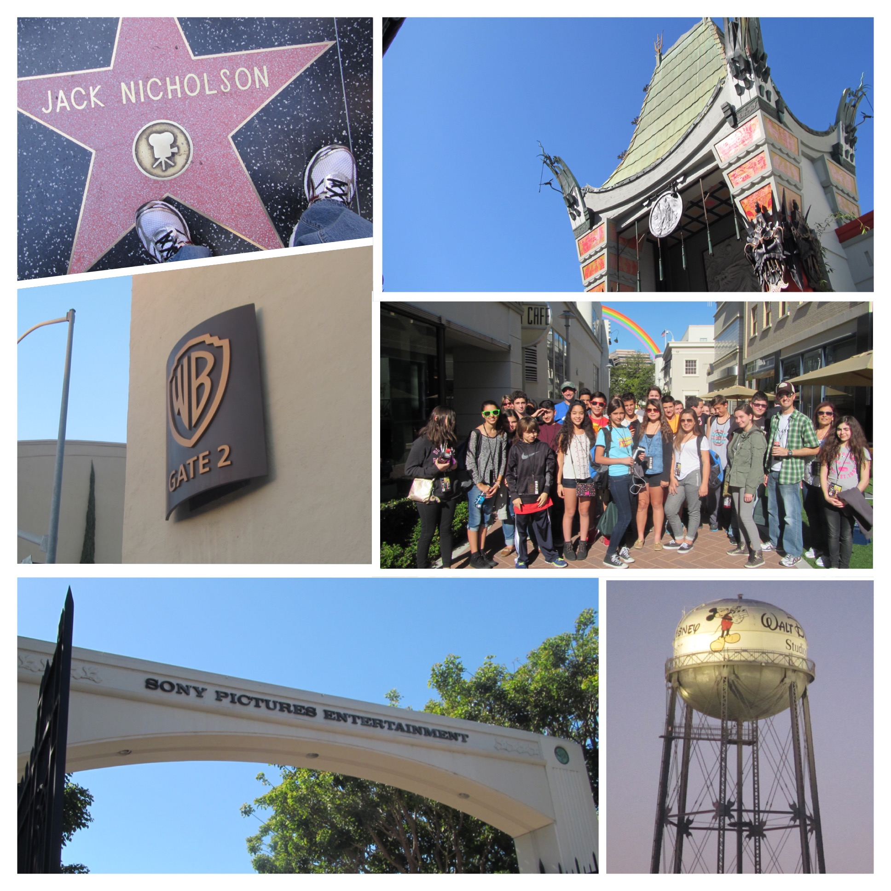

THANK YOU!
We can’t do this without you, the parents and students.
When we work together,
we’ll make movie magic to last a lifetime, to infinity and beyond.

