Slide 1

English Literature
The Medieval Period
400-1500
(Old English and Middle English)
*Write the slide or bullet point into your notes when you see an asterisk.*

Slide 2
Where does your language come from?

Slide 3
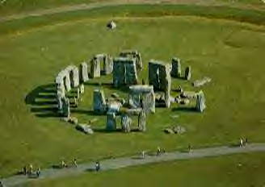
*England before the English
Roman legions arrived, found land inhabited by “Britons” a.k.a “Celts”
    Stonehenge
    no written language
Britons absorbed into Roman society
  Latin spoken
    Romans withdrew as Roman Empire crumbled, left Britons behind

Slide 4
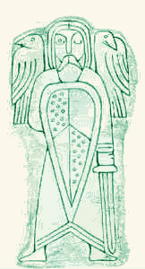
*Britons + Pagans = English
Pagan invasions from Northern Europe
  Anglo-Saxons (Angles, Saxons, Jutes)
  bring Germanic languages
  We still use their language
    Wednesday…day of Woden, father of the gods
    Thursday…day of Thor, god of war
Woden--father of the gods

Slide 5
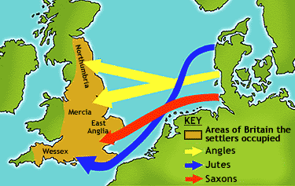

Slide 6
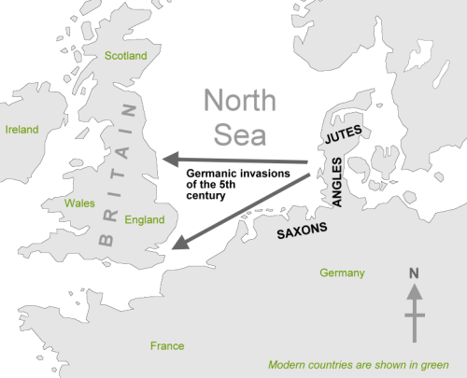

Slide 7
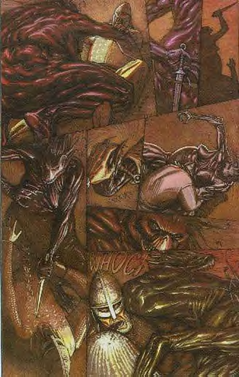
*Britons + Pagans = English
By 600, Anglo-Saxons conquer Britons
  language becomes more Germanic
    still retains some Latin
Anglo-Saxons’ two urgings--war and wandering are part of oral story tradition
  Beowulf --Anglo-Saxon hero tale
Beowulf battles Grendel’s mother

Slide 8
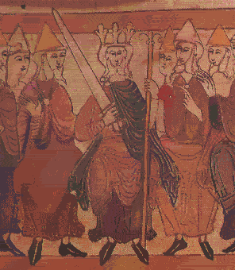
*Britons + Pagans = English
By 700, Christian missionaries arrived, converted the pagans
  Latin (the language of the Church) returns
King Alfred
  the Britons become organized
  first true king of the Britons
  period of prosperity
King Alfred brings an age of prosperity

Slide 9
*Britons + Anglo-Saxons + French = English
In 1066, the Normans (French speaking people from Normandy), led by William the Conqueror attack and defeat the Britains (Britons and Anglo-Saxons) at the Battle of Hastings
3rd language is introduced--French
  French culture literature arrives

Slide 10
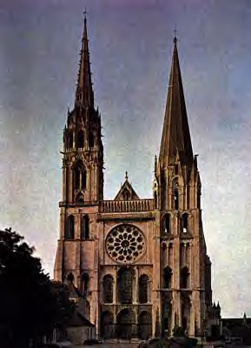
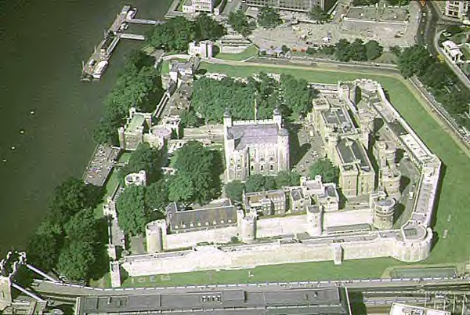
Welcome to England and the English… an island of peoples, languages, and divisions...
The White Tower in London…
part of William’s legacy
Chartres Cathedral
Latin -- church, schools
French -- court, castle
English -- commoners

Slide 11
What was it like to live in the Middle Ages?

Slide 12
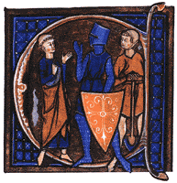
*The 3 Estates in the Middle Ages
The idea of estates, or orders, was encouraged during the Age, but this ordering was breaking down.
  Clergy
    Spoke Latin—purpose was to save everyone’s soul—those who pray
  Nobles
    Spoke French—purpose was to protect, keep peace, provide justice, those who fight
  Commoners
    Spoke English—purpose was to feed and clothe all above them—those who work

Slide 13
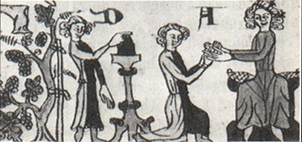
feudalism
*The economic system of much of the Middle Ages (800-1100)
Commoners (peasants) lived on a feudal manor. The lord of the manor gave his vassals (the peasants) land to farm.
In return, the vassals received protection from roving bandits. Yet they were taxed and had to surrender a portion of their crops to the lord.
  it was better to be a lord than a vassal!
*Feudalism—created ties of obedience and fostered a sense of loyalty between the vassals and lords.
A tenant (vassal) renews his oath of fealty to his lord

Slide 14
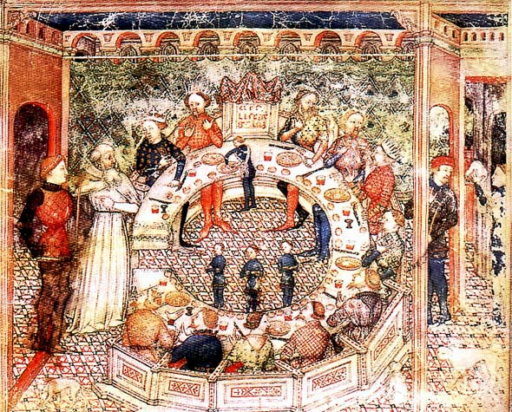
*Chivalry
An idealized system of manners and morals
  Restricted to nobility
Medieval knights were bound to chivalric code—loyalty to…
  God
  his lord
  his lady
Chivalric ideals include...
  benevolence
  brotherly love
  politeness
    Sir Gawain is an example

Slide 15
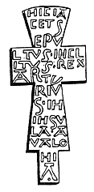
The Church
*The Church Provided guidance through well known precepts..
  Seven Deadly Sins
    Pride
    Greed
    Wrath
    Envy
    Gluttony
    Sloth
    Lust

Slide 16
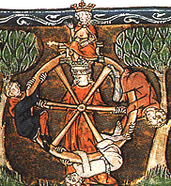
The Wheel of Fortune
*The idea of Fortune and her wheel was one of the most pervasive ideas throughout the Middle Ages.
On the wheel are depicted four figures: one at the top, one at the bottom, one rising, and one falling.

Slide 17
It served to remind of the temporality of earthly things.
The Wheel helps understand the medieval mind, reminds us that the important things in life come from within, and that hard work has its own merits. An award, an office, a title--these are not the things that make for greatness.

Slide 18
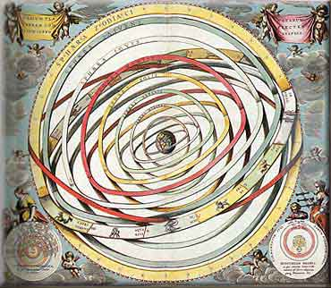
the Ptolemaic
Universe
Imagine a sphere that encloses another that holds another that holds yet another…and continues into heaven…
It is a commonly held myth that people of the Medieval period thought the Earth was flat…FALSE!
  It was round, but earth was at the center of the universe!
So what! Well, the people of the Medieval period loved order! Remember the Three Estates, the Seven Deadly Sins—a place for everyone and everyone in that place.
  Watch for this order to begin to be displaced…

Slide 21
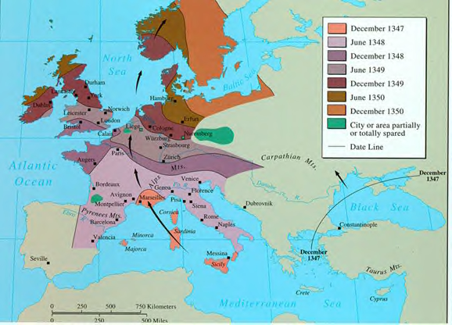
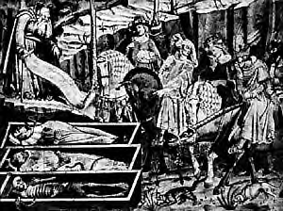
With the Crusades comes
The Black Death
spreads along trade routes
kills much of the population
the plague outbreaks occur through the Middle Ages and into the Renaissance
Paradoxically, the Plague provides for continued growth in cities
  Afterwards, hundreds of new jobs available
  Many debts “died off” with creditors
also contributed to society’s culture

Slide 22
Enough already!
I thought this was an English class!

Slide 23
Literature During the Medieval Period

Slide 24
Languages
Latin was the language of the Roman Catholic Church, which dominated Europe
The Church was the only source of education
Thus, Latin was a common language for Medieval writings.

Slide 25
*Much of medieval literature is anonymous.
*Medieval authors tended to re-tell and embellish old stories rather than invent new stories.

Slide 26
Writings
Catholic clerics were the intellectual center of society in the Middle Ages, and it is their literature that was produced in the greatest quantity.

Slide 27
*Characteristics of Medieval Literature
Heroism
  from both Germanic and Christian traditions, sometimes mingled
    Beowulf
    Sir Gawain and the Green Knight
Presentations of idealized behavior
  literature as moral lesson
    loyalty to king
    chivalry
use of kennings (especially in Beowulf)
  A figurative, usually compound expression used in place of a name or noun. Example, storm of swords is a kenning for battle.

Slide 28
*Characteristics of Medieval Literature
Romance
  Sir Gawain and the Green Knight
  A narrative in prose or verse that tells of the adventures and heroic exploits of chivalric heroes
    exploits of knights
    often a supernatural element involved
Christian message
  concern with salvation and the world to come
  no interest in social change
    until the late 14th century
    Chaucer signals new thinking, up-ending social order

Slide 29
Use of Allegory
*Allegory—a figurative mode of representation conveying a meaning other than the literal.
Much of medieval literature relied on allegory to convey the morals the author had in mind while writing--representations of abstract qualities, events, and institutions are thick in much of the literature of this time.

Slide 30
*The Ideal of Courtly Love
A relationship modeled on the feudal relationship between knights and lords.
The knight serves his courtly lady with the same obedience and loyalty which he owes to his liege lord.
She is in complete control; he owes her obedience and submission

Slide 31
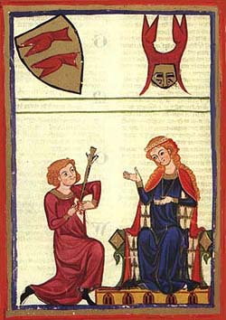
The knight's love for the lady inspires him to do great deeds, in order to be worthy of her love or to win her favor.

Slide 32
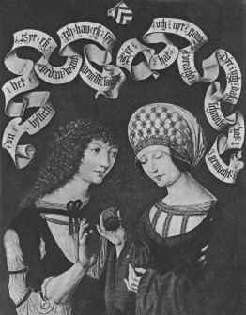
“Courtly love" was not between husband and wife because it was an idealized sort of relationship that could not exist within the context of "real life" medieval marriages.
In the middle ages, marriages amongst the nobility were typically based on practical and dynastic concerns rather than on love.

Slide 33
“Courtly love" provided a model of behavior for a class of unmarried young men who might otherwise have threatened social stability.
Knights were typically younger brothers without land of their own (hence unable to support a wife).
They became members of the household of the feudal lords whom they served.

Slide 34
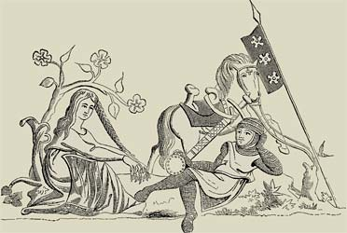
The lady is typically older, married, and of higher social status than the knight because she was modeled on the wife of the feudal lord, who might naturally become the focus of the young, unmarried knights' desire.

Slide 35
The literary model of courtly love may have been invented to provide young men with a model for appropriate behavior.
It taught them to sublimate their desires and to channel their energy into socially useful behavior (love service rather than wandering around the countryside, stealing or raping women).

Slide 36
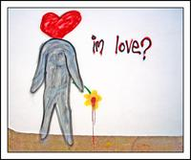
The "symptoms" of love were described as as if it were a sickness.
The "lovesick" knight’s typical symptoms: sighing, turning pale, turning red, fever, inability to sleep, eat or drink.

Slide 37
The Quest
In addition to the theme of Courtly Love, the Quest was highly important:
the code of conduct observed by a knight errant who is wandering in search of deeds of chivalry. This knight is bound by a code of behavior - a set of conventional principles and expectations

Slide 38
*A quest is a hero’s journey towards a goal. The objects of quests require great exertion on the part of the hero, and the overcoming of many obstacles.
The hero's must obtain something, or someone, by the quest and with this object return home.

Slide 39
Usually, an inner and outer problem for the character is set.
The hero is introduced; audience identifies with them
The hero lacks something, has a tragic flaw, or a deep wound
The call often produces disorientation and discomfort for the hero
The call is often in the form of a dire warning

Slide 40
Excuses are used to avoid the call
This hesitation illustrates the formidability of the challenge ahead
Resistance creates change and strength, allowing the hero to grow
A physical or metaphorical crossing is made
The crossing is an irrevocable leap of faith, from which there’s no turning back

Slide 41
The hero faces his greatest fear
The hero “dies,” so he can be reborn
The hero gains new perception
This new perception may create a moment of clarity
The moment may be of great self-realization for the hero
It may also be an epiphany for the hero’s companions

Slide 42
The Hero
Is often of divine descent endowed with great strength and ability" or "a man admired for his achievements and noble qualities"

