Slide 1

The Paston Letters
Life in 1400’s England
*Write the slide or bullet point into your notes when you see an asterisk.*

Slide 2
*Why read 600 year old letters?
Non-fiction (“real”), primary source
Insight into daily life of the past.
Comparison with current day life:
  Legal system (especially property ownership)
  Police, fire, ambulance, military
  Communication (internet, phones, twitter, texting, etc.)
  Social and economic mobility

Slide 3
Who were the Pastons?
Clement Paston – Granddad of John Paston
  Yeoman (commoner, farmer)
  Took advantage of black plague – acquired cheap land
  Borrowed money – sent son (William) to law school
  Died 1419

Slide 4
Who were the Pastons?
William Paston – Father of John Paston
  Survived plagues
  Went to law school
  Became a judge
  Married Agnes Berry, acquired more land
  Lived at Oxnead

Slide 5
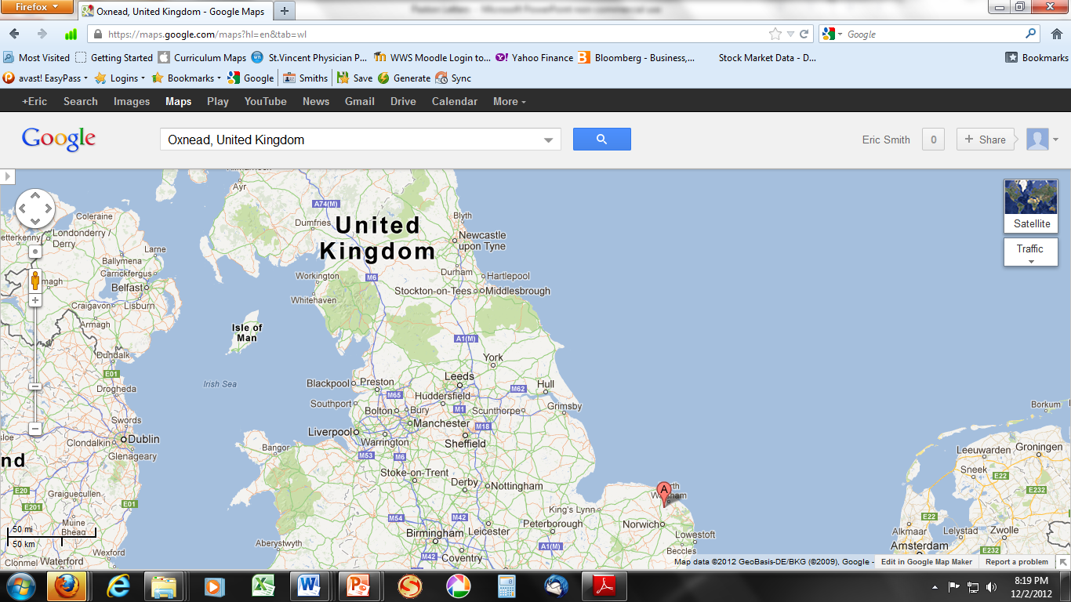

Slide 6
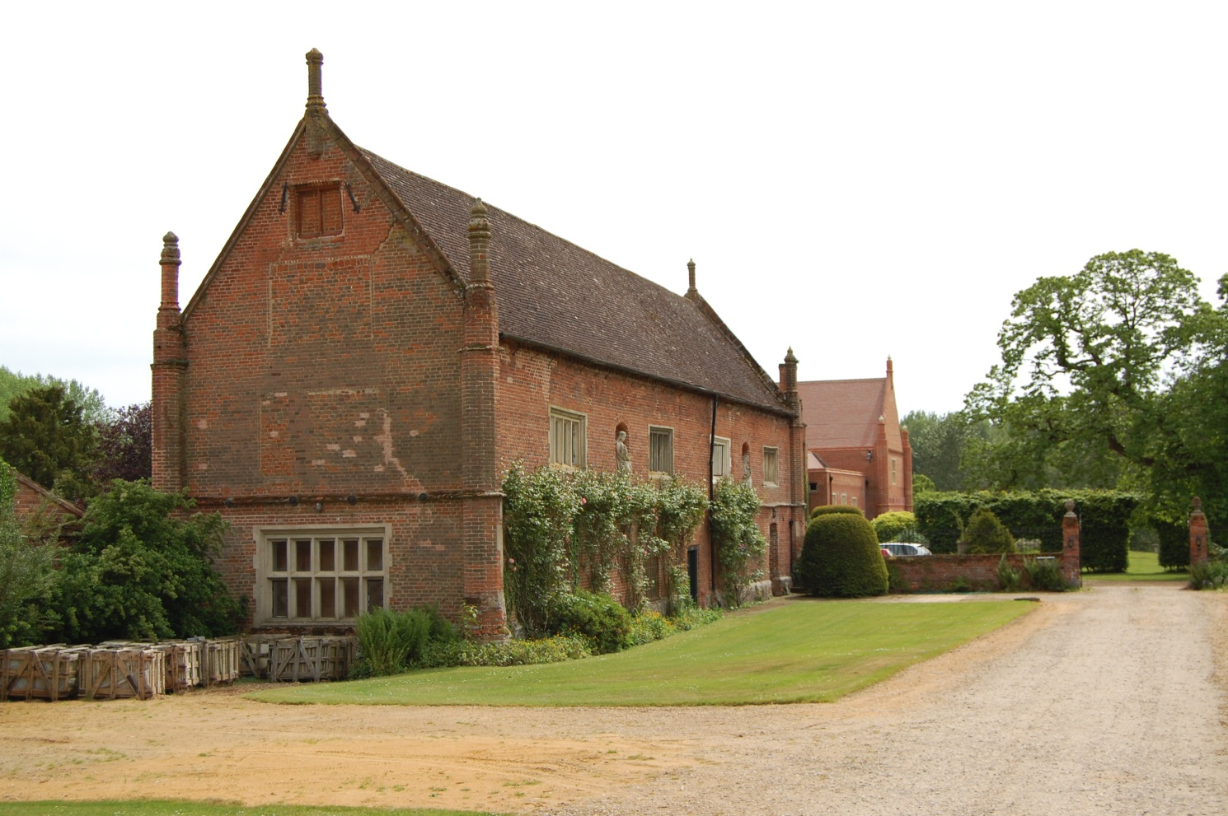
Onxnead, Near Norwitch

Slide 7
*Who were the Pastons?
John Paston I and Margaret Paston
  Law school at Cambridge
  Became a judge
  Married Margaret Mauteby – acquired two manors
  Befriended and became lawyer to Sir John Fastolff
    Main beneficiary of Falstoff’s will
    Falstoff’s heirs contest will for decades (forcible, legal)
    John to London often, defending property claims
  Survived by John eldest, John younger, Margery

Slide 8
Works Cited
Self, Cameron. "Oxnead." Literary Norfolk. Cameron Self, n.d. Web. 2 Dec. 2012.
Ibeji, Mike. "Paston Family Letters." BBC History. BBC, 17 Feb. 2011. Web. 2 Dec. 2012. <http://www.bbc.co.uk>.

