Slide 1
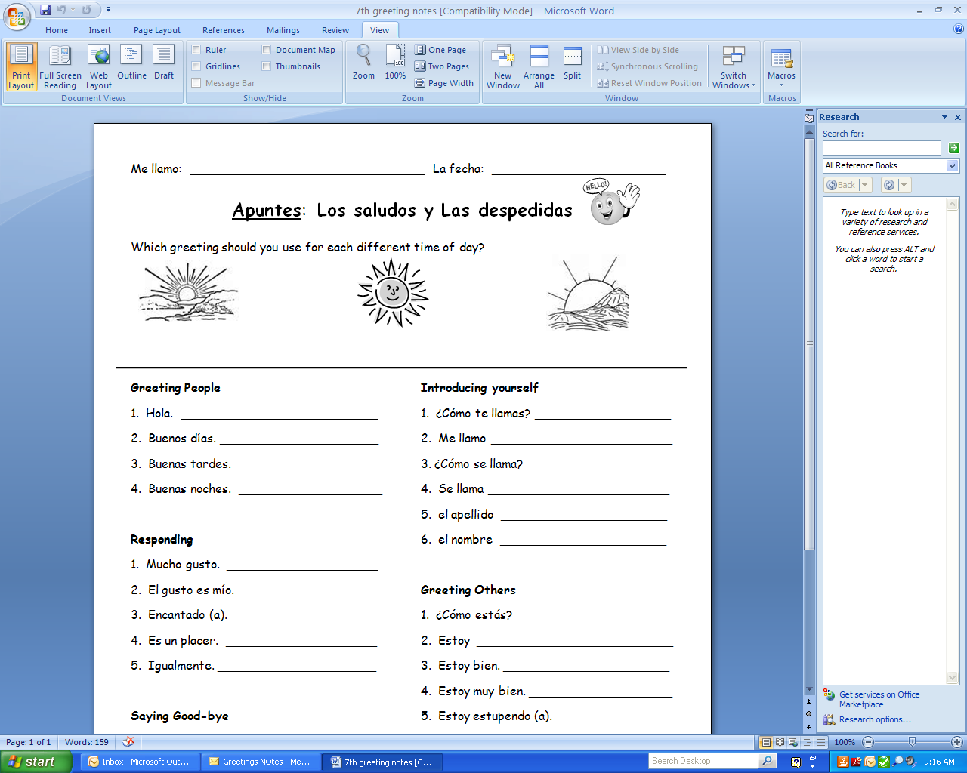
Buenos días
Buenas tardes
Buenas noches
Hello.
What is your name?
Good morning.
My name is… (I call myself…)
Good afternoon.
What is his/her name?
Good evening.
His or her name is…
last name
name

Slide 2
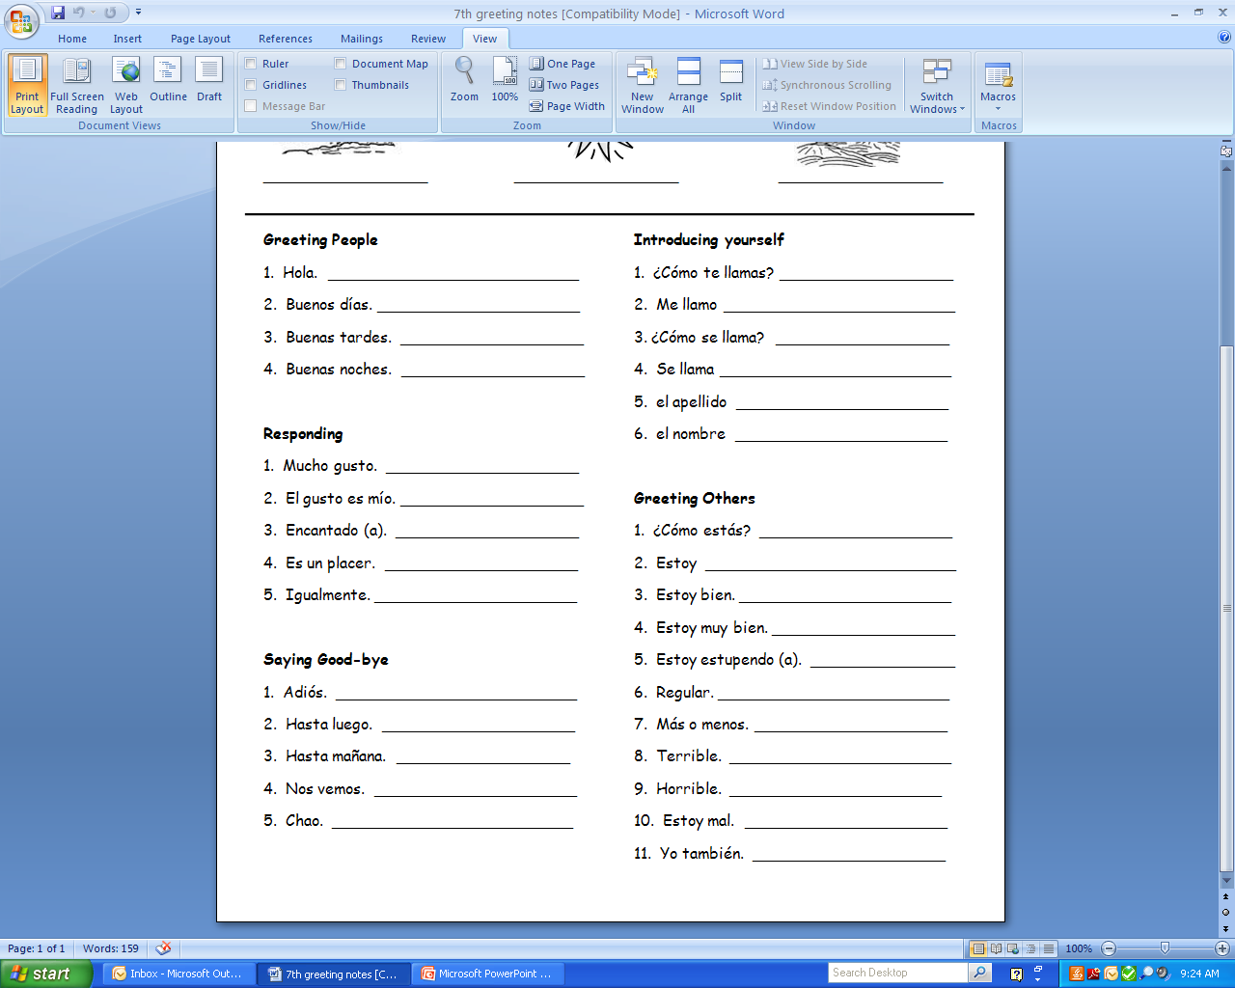
Responding
Nice to meet you.
The pleasure is mine.
Delighted to meet you.
How are you?
It’s a pleasure.
I am …
Same here. (Equally)
I am fine/well (good).
I am very well (good).
I’m great.
Goodbye.
So-so.
See you later.
So-so. (more or less)
See you tomorrow.
Terrible.
See you soon.
Horrible.
Bye.
I’m bad.
Me too.

