Slide 1
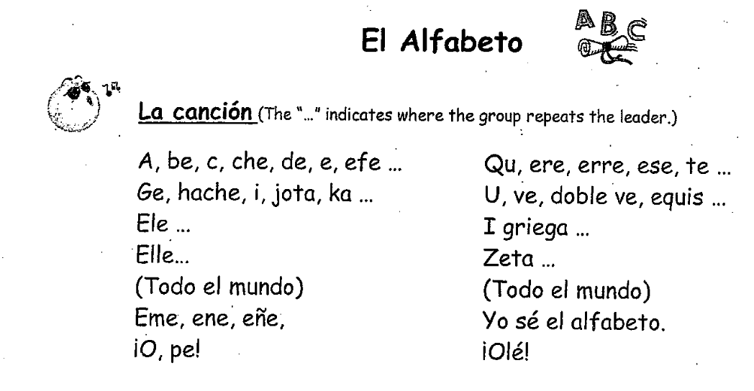

Slide 2
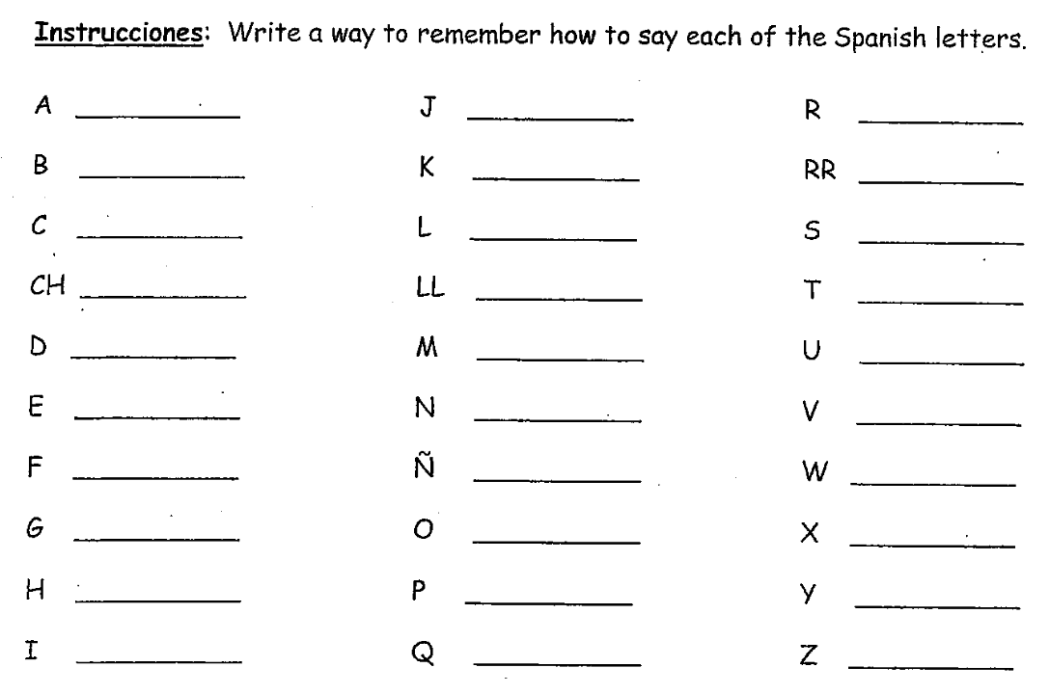
ahh
ho-tah
air-ay
bay (larga)
kah
airr-ay
say
“l”-ay
essay
chay
“ay”-yay
tay
day
“m”-ay
oo
ay
“n”-ay
bay (corta)
“f”-ay
“n”-yay
doblay-bay
hay
oh
ec-kees
ah-chay
pay
ee-gree-ay-gah
ee
koo
say-tah

Slide 3
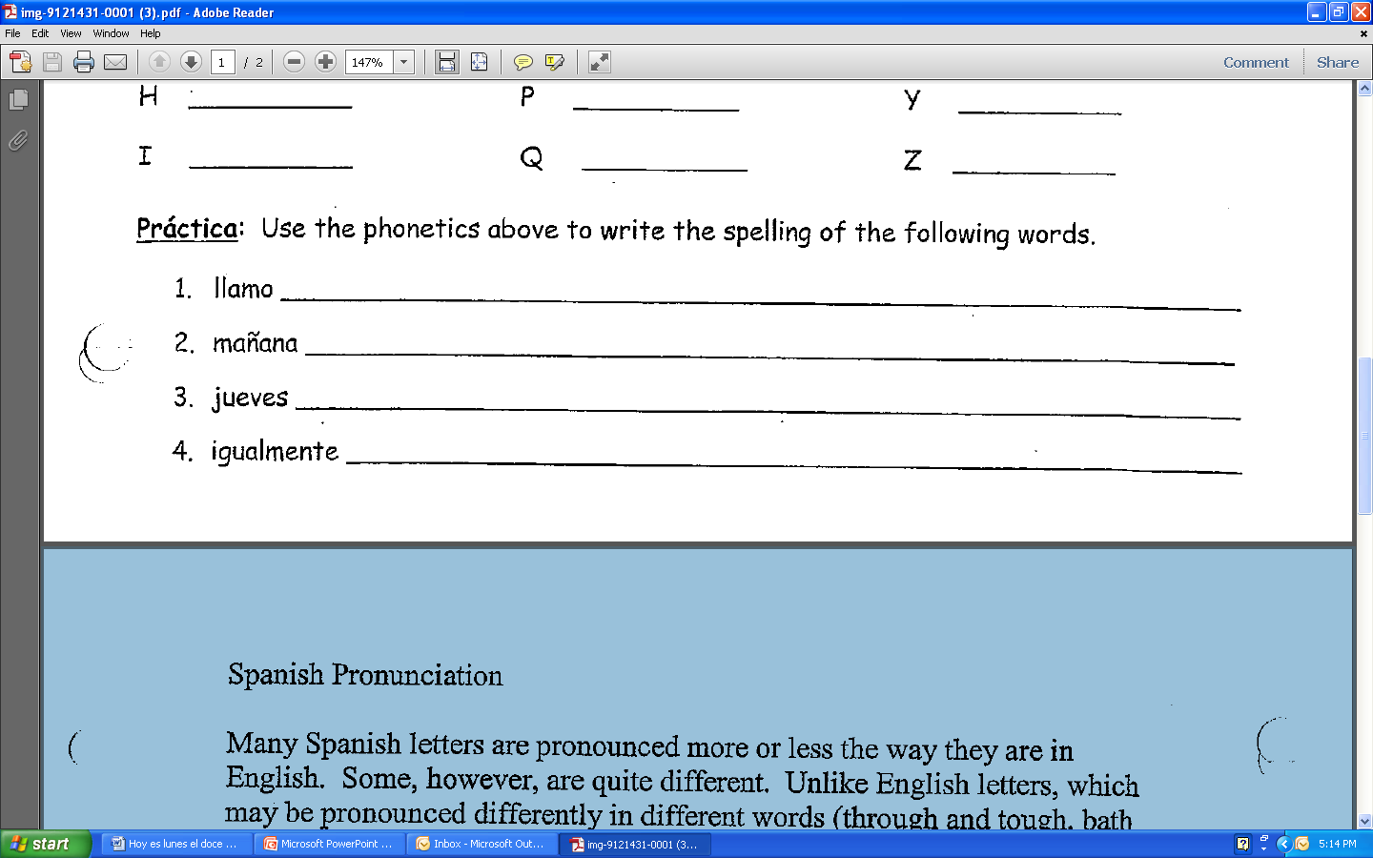
“ay”-yay –ahh- “m”-ay - oh
“m”-ay- ahh- “n”-yay- ahh- “n”-ay- ahh
ho-tah- oo- ay- bay corta- ay- essay
ee- hay- oo- ahh- “l”-ay- “m”-ay- ay-
“n”-ay- tay- ay

