Slide 1
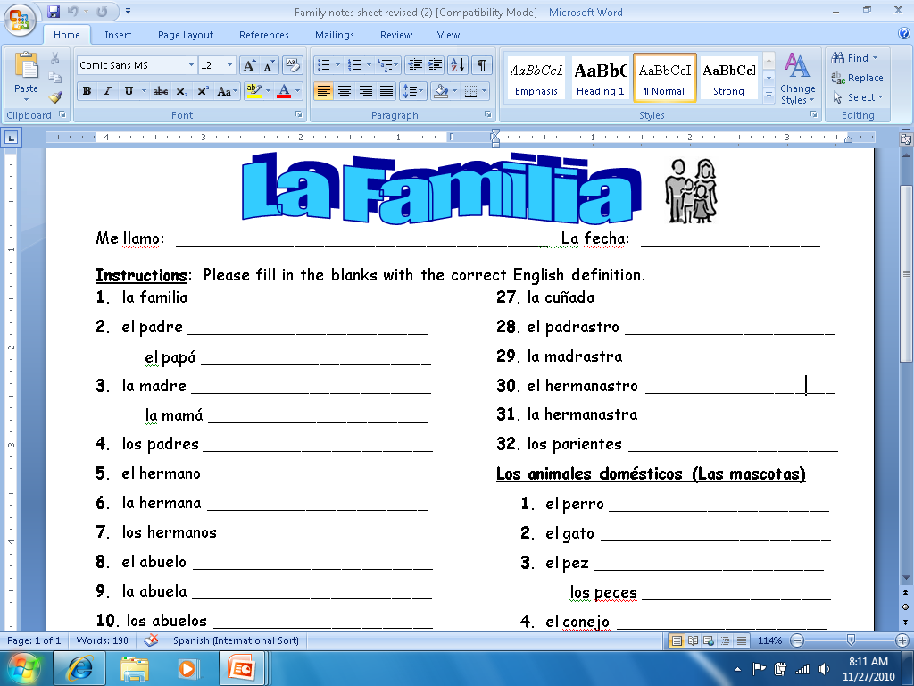
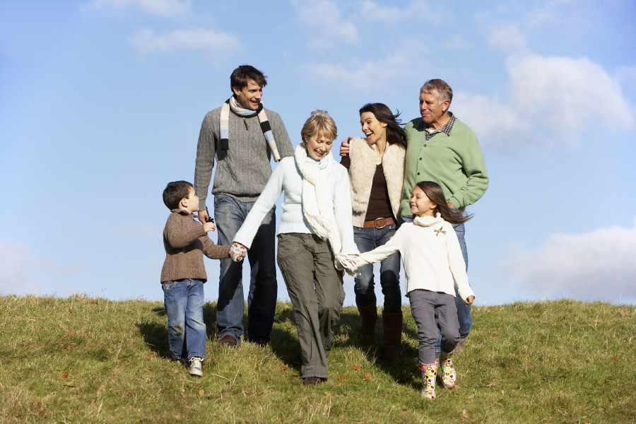

Slide 2
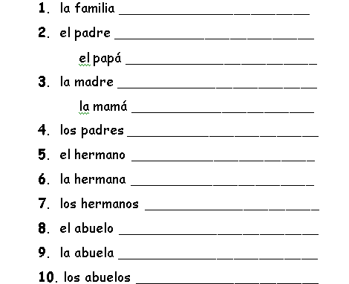
The Family
The Father
The Dad
The Mother
The Mom
The Parents
The Brother
The Sister
The siblings (Brothers and Sisters)
The Grandfather
The Grandmother
The Grandparents

Slide 3
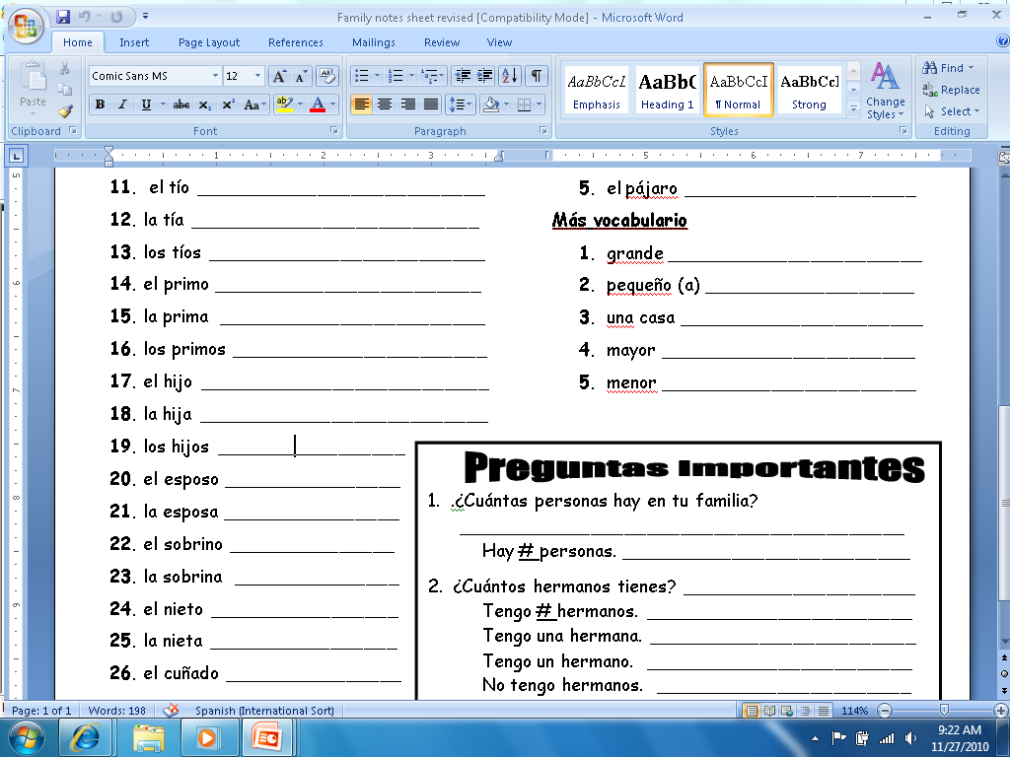
The Sons and Daughters
The Uncle
The Aunt
The Husband
The Aunts &Uncles
The Wife
The (boy) Cousin
The Nephew
The (girl) Cousin
The Niece
The Cousins
The Grandson
The Son
The Granddaughter
The Daughter
The brother-
in-law

Slide 4
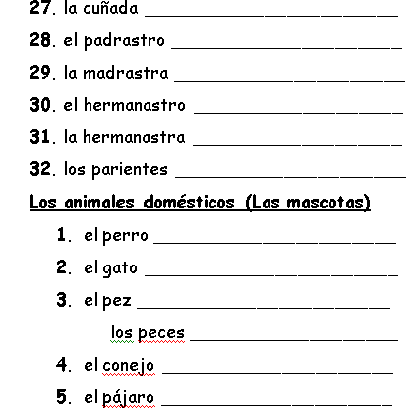
The sister-in-law
The Step-father
The Step-mother
The Step-brother
The Step-sister
The Relatives
The Dog
The Cat
The Fish (0ne)
The Fish-ies
The Rabbit
The Bird

Slide 5
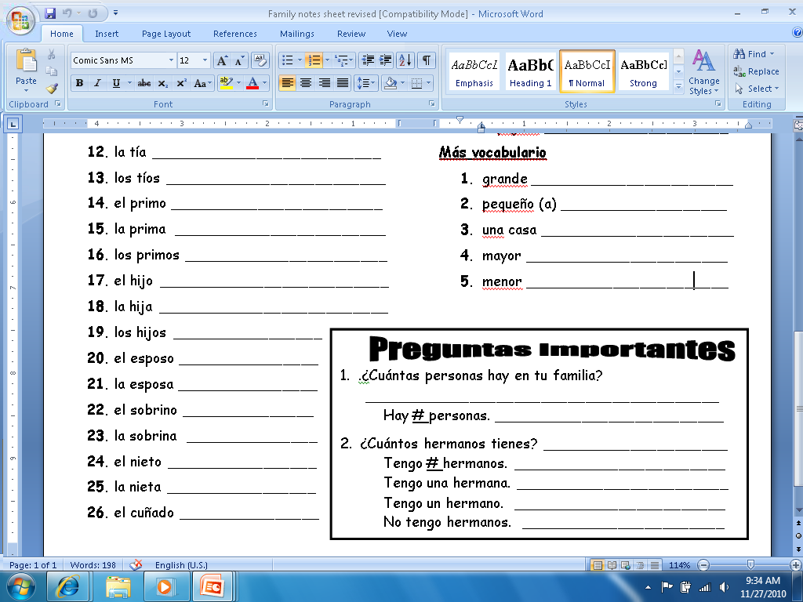
Big
Small
A house
Older
Younger

Slide 6
How many people are in your family?
There are # people.
How many Siblings do you have?
I have # siblings.
I have one (a) sister.
I have one (a) brother.
I don’t have siblings.

Slide 7
http://www.youtube.com/watch?v=s9iUXEhEMh8&NR=1

Slide 8
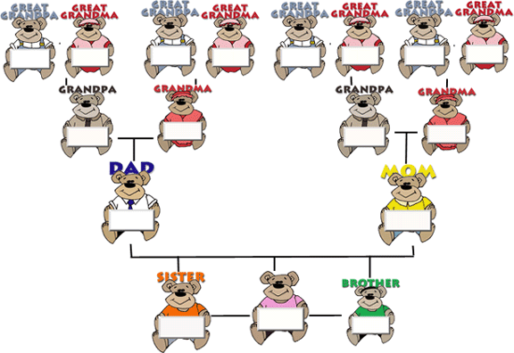
Bisabuelo
Bisabuela
Bisabuelo
Bisabuela
Bisabuelo
Bisabuela
Bisabuelo
Bisabuela
Abuelo
Abuela
Abuelo
Abuela
Padre
oMadre
Yo
Hermana
Hermano

