Slide 1
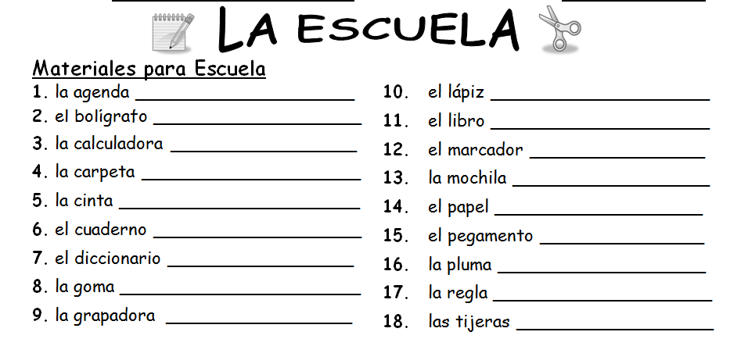
the agenda
the pencil
the (ballpoint) pen
the book
the calculator
the marker
the folder
the backpack
the tape
the paper
the workbook/notebook
the glue
the dictionary
the (fountain) pen
the pencil eraser
the ruler
the stapler
the scissors

Slide 2
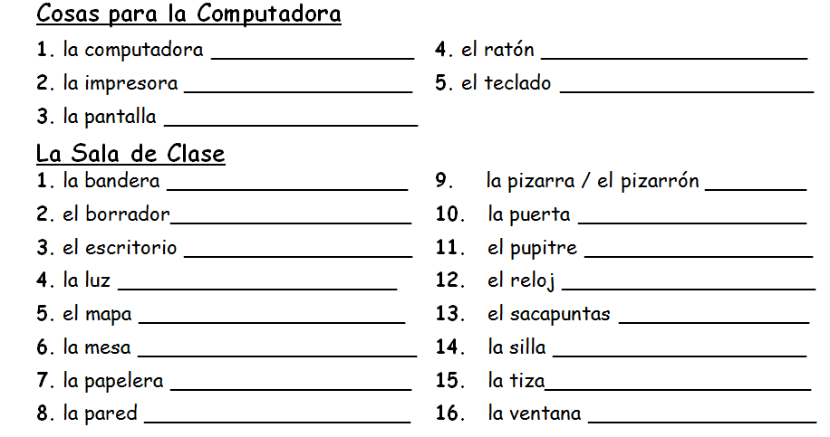
the computer
the mouse
the printer
the keyboard
the screen
the flag
the chalkboard
the chalkboard eraser
the door
the teacher’s desk
the student’s desk
the light
the clock
the map
the pencil sharpener
the table
the chair
the wastebasket
the chalk
the wall
the window

Slide 3
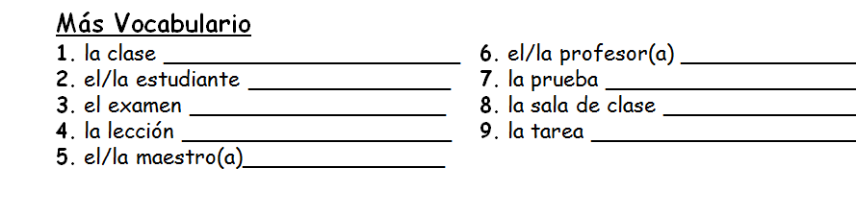

the class
the professor
the student
the quiz
the test/exam
the classroom
the lesson
the homework
the teacher
Práctica Cómo se dice en español:
el teclado y el ratón
la bandera
el borrador y la tiza
la cinta

