Slide 1
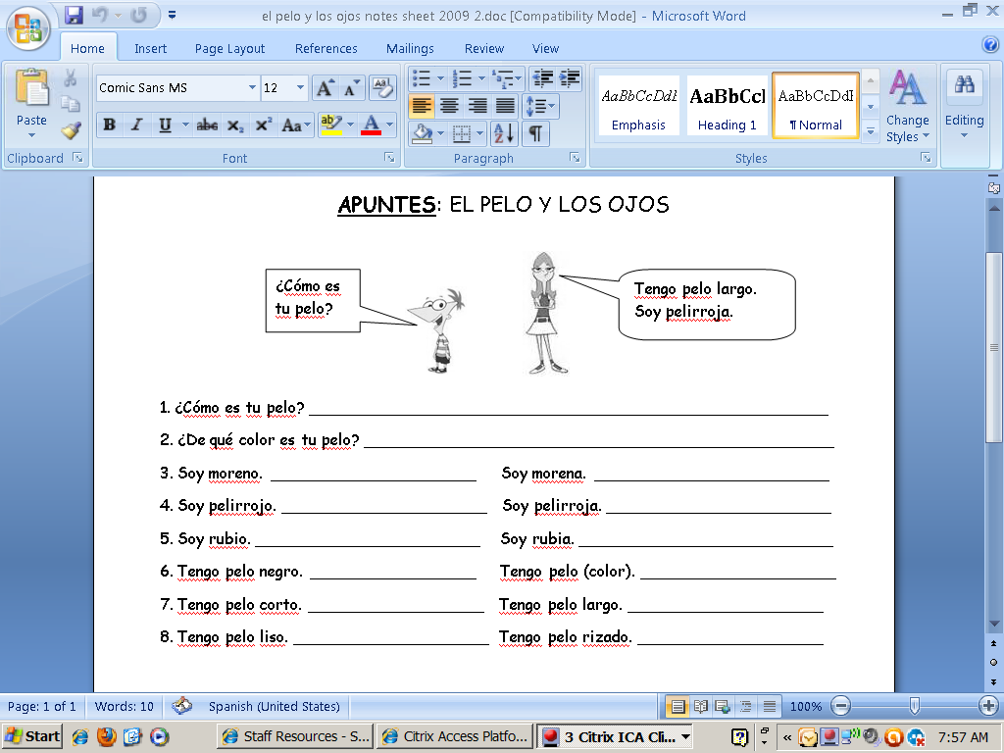
What is your hair like?
What color is your hair?
I am dark haired. (boy)
I am dark haired. (girl)
I am (a) redhead. (boy)
I am(a) redhead. (girl)
I am blonde. (boy)
I am blonde. (girl)
I have black hair.
I have (color) hair.
I have short hair.
I have l o n g hair.
I have straight hair.
I have curly hair.

Slide 2
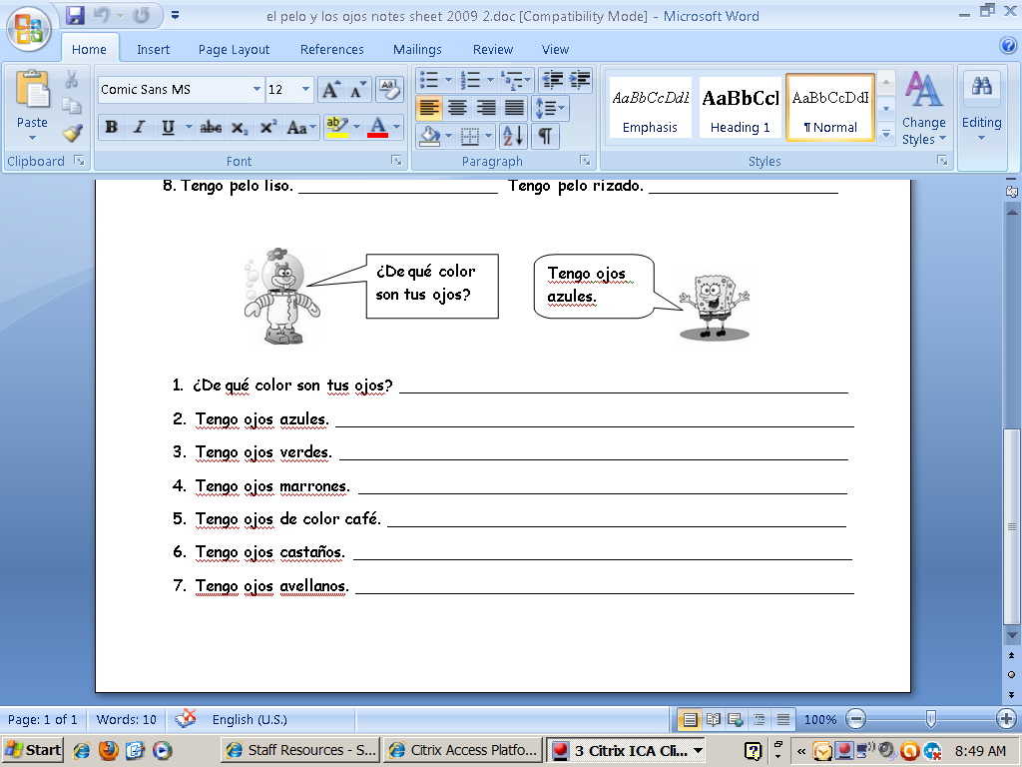
What color are your eyes?
I have blue eyes.
I have green eyes.
I have dark brown eyes.
I have brown eyes.
I have light brown eyes.
I have hazel eyes.

