Slide 1
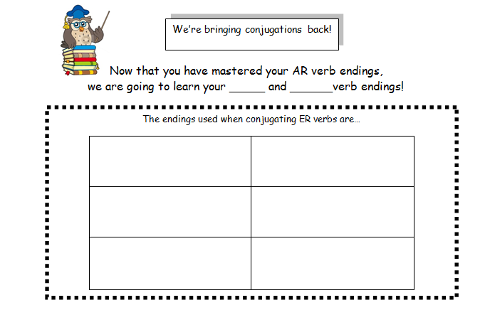

-ER
-IR
Nosotros(as)
Yo
o
emos
☺
Tú
es
Él/Ella/Usted
Ellos/Ellas/Uds.
e
en

Slide 2
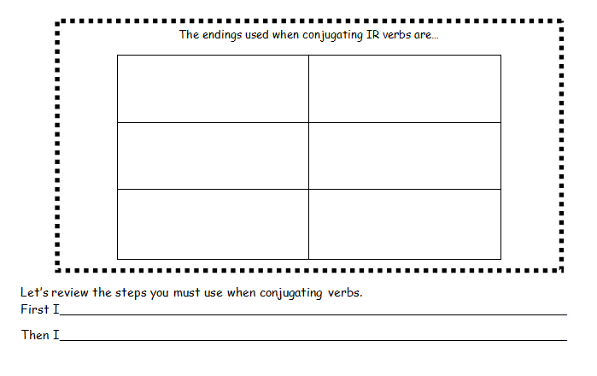
Yo
Nosotros(as)
o
imos
Tú
es
☺
Él/Ella/Usted
Ellos/Ellas/Uds.
e
en
Drop the ending (ar/er/ir) from the infinitive (basic form of a verb).
Look for the subject and add the appropriate ending.

Slide 3
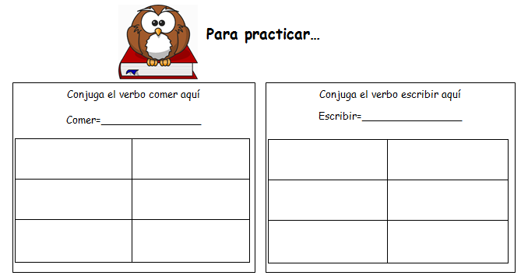



See the boot?
To eat
To write
como
comemos
escribo
escribimos
☺
☺
comes
escribes
(coméis)
(escribís)
come
comen
escribe
escriben

Slide 4
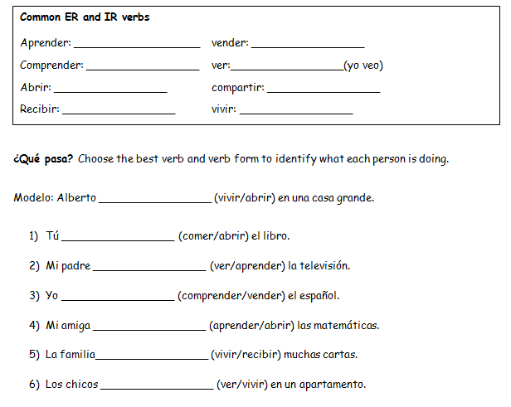
To learn
To sell
To understand
To see
To open
To share
To receive
To live
vive
abres
ve
comprendo
aprende
recibe
viven

