Slide 1
Writing Formulas and
Naming Compounds

Slide 2
First, Let’s review polar and nonpolar covalent molecules!

Slide 3
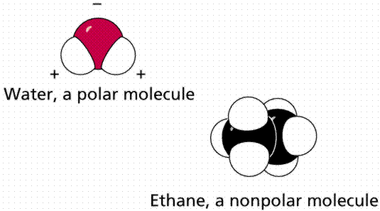
Water is polar:
Oxygen has a slight negative charge
Hydrogen has a slight positive charge

Slide 4
Hydrogen bonds
the (-) end of one water is attracted to the (+) end of another water molecule
This attractive force creates a hydrogen bond
It is a weak force, but essential to explaining the many functions of water

Slide 5
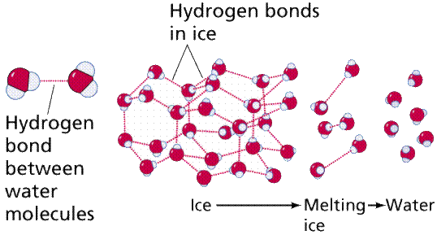
Hydrogen Bonding

Slide 6
Why does this make water so special?
It is a great solvent: will dissolve anything with charged particles.
Has a high specific heat (takes a lot of energy to raise the temp 1 degree)
Becomes less dense as it freezes (great for fish!)
Is adhesive and cohesive (good for plants)

Slide 7
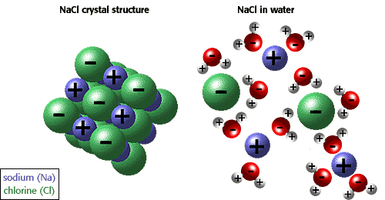
Ionic Compounds dissolve in Water

Slide 8
Writing Formulas
Binary compounds: a compound composed of only 2 elements

Slide 9
But first,
Before you can write the formula for a binary compound you must know
  What elements are involved
  How many electrons they gain, lose or share

Slide 10
Oxidation Numbers
How many electrons an atom can gain, lose or share in order to become stable.

Slide 11
For Ionic compounds
The oxidation number is the same as the charge on the ions

Slide 12
Oxidation numbers follow the group numbers on the periodic table

Slide 13
Some elements can have more than one oxidation number, typically these are transition metals

Slide 14
For rules to determine and write Oxidation Numbers see handout!

Slide 15
** Polyatomic ions
Ions containing more than one atom
Most end in –ate or –ite
See table in handout
Ex: OH- (hydroxide)

Slide 16
Writing formulas for
Ionic compounds
Must be metal (+ ion) and a nonmetal (- ion)
Can have polyatomic ions in place of either part of the compound
Most polyatomic ions are (-) except for the amonium ion, NH₄⁺
Hydrogen is the only nonmetal with a (+) ox number

Slide 17
Writing Formulas
Write the symbol of the element or Polyatomic ion that has the positive ox number.
Lithium nitride
Li ⁺¹
** ending –ide indicates a single element not a polyatomic ion

Slide 18
Write the symbol of the element or polyatomic ion that has the negative ox number
    Li⁺¹ N ⁻³

Slide 19
3. The charge of one ion becomes the subscript for the other ion.
    Li₃N
    Remember the absence of a subscripts means “1”

Slide 20
4. Reduce subscripts to the smallest whole number
**See other rules in handout!

Slide 21
Write Formulas for the following compounds
Lead (IV) Phosphide
Iron (III) oxide
3. Lithium sulfate

