Slide 1
Annual Flowers

Slide 2
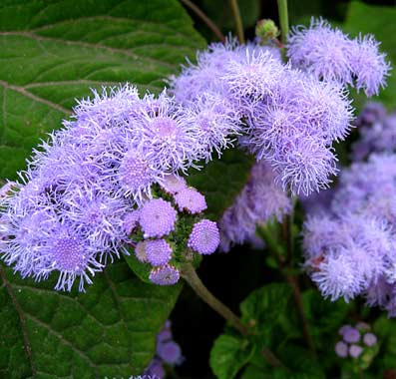
Ageratum
Scientific name- Ageratum houstonianum
Requires full – partial sun
Soil should be well drained but not dry
Can be up to 24”
Annual
Flowers in the summer

Slide 3
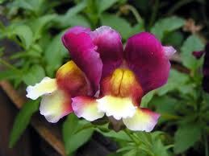
Snap Dragons
Antirrhinum majus
Snap Dragons
Sun to partial shade
fast growth rate
6 to 36 inches
Low drought tolerance

Slide 4
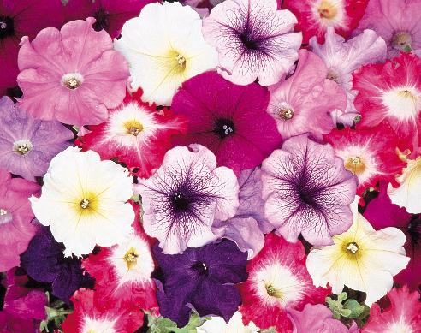
Petunias
Scientific name: Petuniax hybrida
Annual plants
Light: sun to partial shade
Growth rate: medium
Mature plant size: 6 to 18 inches
Moderate drought tolerance

Slide 5
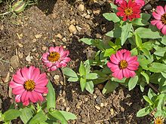
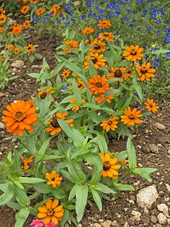
Zinnia
Zinnia angustifolia
Zinnia angustifolia native to the SW US
popular garden plant.
It is an annual flower.
Height of 6 to 12 inches.
Light requirements sun/partial shade.
Flowers in late spring through early fall
Needs well drained soil
Attracts butterflies

Slide 6
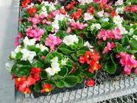
Wax Begonia
Begonia semperflorens
Also know as a fibrous begonia
It is an annual
They should be in full or full but bright shade(trees pruned high).
Wax Begonias grow from 6 to 12 inches tall with a spread of 6 to 12 inches
They have pink, white, or red flowers.
Blooms may be single or double
Two kinds of flowers: male and female
  Males have a bright tuft or yellow pollen in the center and females have a three sided ovary behind the petals.
Leaves are heart shaped and can be bright green, bronzy green, maroon, or variegated with green and white.

Slide 7
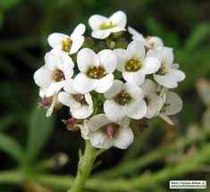
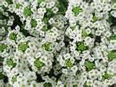
Sweet Alyssum
AlyssumweetAlyssum
Lobularia maritima
Sweet Alyssum
Annual
Light- sun/partial shade
Rapid growing
8-12 inches tall at maturity
Blooms year round in frost free climates
Emits a sweet aroma when in full bloom
Requires very little attention

Slide 8
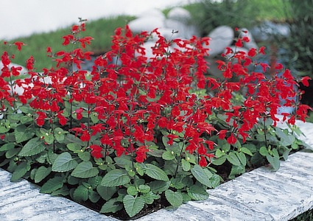
Salvia
Scientific Name: Salvia coccinea
Common Name: sag
Annual flower
Growth rate: Fast
Plant size: 1-3 feet.
Light requirements: full sun
Drought and disease resistant
Pull off spent blooms for continuous summer blooming
Attract hummingbirds

Slide 9
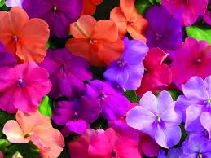
Impatiens
Impatiens is an annual flower.
Scientific Name: Impatiens wallerana
Common Name: Impatiens
Light Requirements: Partial shade to shade
No growth rate is given.
Mature plant size: Height: 8 to 24 inches
Spacing: 10 to 12 inches
Special requirements or facts: Low drought tolerance

Slide 10
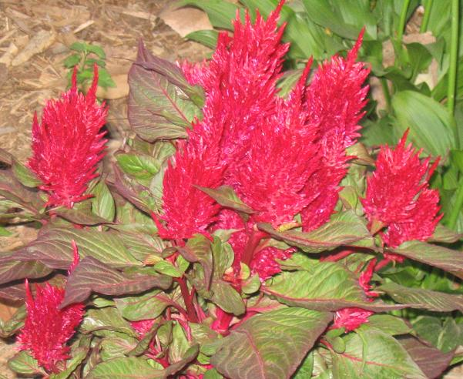
Celosia
Scientific name- Celosia argentea
Height/Mature Size- 10 inches- 1foot
Light Requirements- Full Sun
Growth Rate- Moderate
-Annual
-Can be eaten
Moisture - Very drought resistant

Slide 11
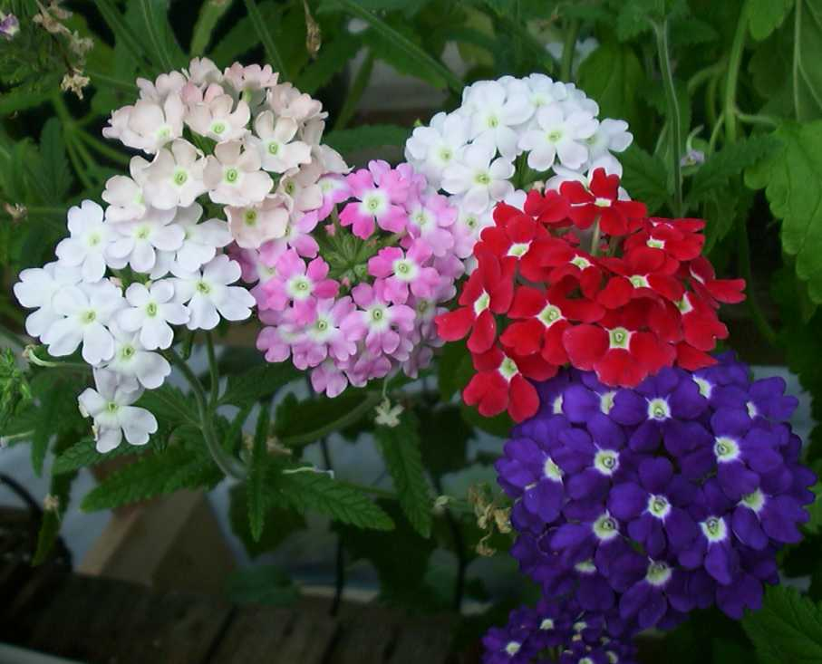
Verbena
Annual plant…
Scientific name:
Verbena x hybrida…
Light requirements: sun to partial shade…
Growth rate: moderate
Mature plant size: 6 to 12 inches
Flower color: apricot, blue, pink, salmon, red, & white

Slide 12
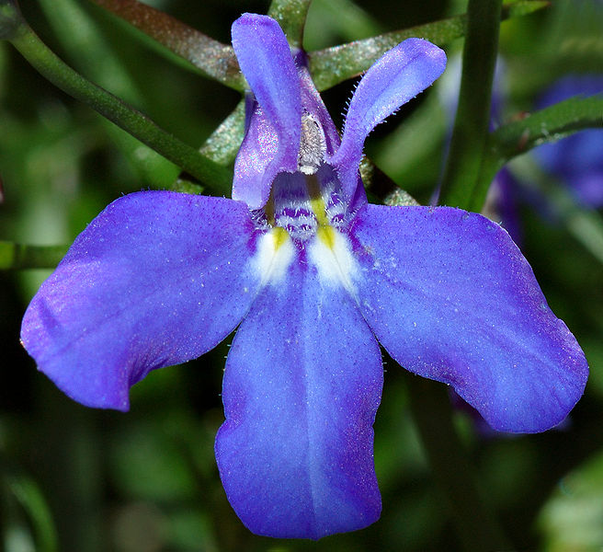
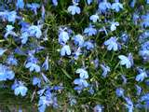
Lobelia
Lobelia erinus
Lobelia erinus is a very popular ornamental plants in gardens.
Herbaceous annual plant.
It is perennial in subtropical climates, but often grown as an annual plant in colder areas.
Height 1 ft Width 1 ft
grown for its long flowering period, from mid spring to early autumn.
Zone: 2 to 11 .
Bloom Time: April - June .
Sun: Full sun to shade
Water: Medium.
Maintenance: Medium.

