Slide 1
Reference Books and Periodicals
Communication Skills 1

Slide 2
Reference Books
Dictionaries
Encyclopedias
Atlases
Yearbooks/Almanacs
Indexes
Biographies
Books of Quotations
Abstracts International

Slide 3
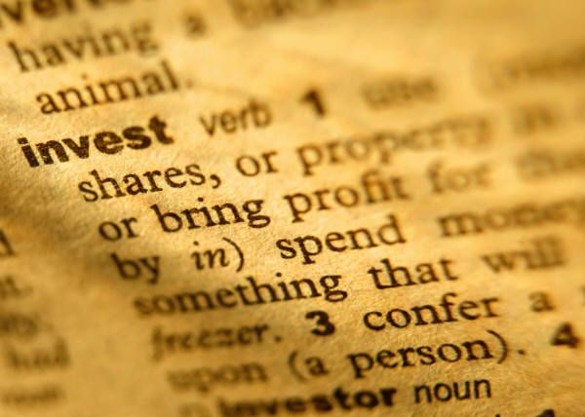
Dictionaries
Provide spelling, pronunciation, diacritical marks, parts of speech, etymology, meaning, level of usage, syllabication, inflection, synonym and abbreviation of a word.

Slide 4
Encyclopaedias
a book or set of books containing articles on various topics, usually in alphabetical arrangement, covering all branches of knowledge or, less commonly, all aspects of one subject.

Slide 5
Atlases
An atlas is a collection of maps, typically of Earth or a region of Earth, presenting geographic features and political boundaries.
Many atlases often feature geopolitical, social, religious and economic statistics.

Slide 6
Almanac
It is an annual reference book of useful and interesting facts relating to countries of the world, sports, entertainment, etc.
TIME Almanac with Information Please
World Almanac and Book of Facts
The Farmer's Almanac
The Old Farmer's Almanac.

Slide 7
Index
It is a detailed list, usually arranged alphabetically, of the specific information in a publication.

Slide 8
Biography
It is a description or account of someone's life, which is usually published in the form of a book or essay, or in some other form, such as a film.

Slide 9
Books of Quotations
Famous quotations are frequently collected in books that are sometimes called quotation dictionaries or treasuries.
Bartlett's Familiar Quotations,
The Oxford Dictionary of Quotations,
The Columbia Dictionary of Quotations,
The Yale Book of Quotations
The MacMillan Book of Proverbs, Maxims, and Famous Phrases

Slide 10
Abstracts International
It is a listing that provides:
bibliographic citations that include title, author name, degree- granting university, year awarded, number of pages, and ProQuest order number, the name of the dissertation adviser, committee chair, etc.

Slide 11
Dictionary Entries
Abbreviation
Synonym
Inflection
Syllabication
Level of usage
Meaning
Etymology
Part of speech
Pronunciation
Spelling

Slide 12
Abbreviation
a shortened or contracted form of a word or phrase, used to represent the whole, as Dr. for Doctor, U.S. for United States, lb. for pound.

Slide 13
Synonym
a word having the same or nearly the same meaning as another in the language, as joyful, elated, glad.

Slide 14
Inflection
the change in the shape of a word, generally by affixation, by means of which a change of meaning or relationship to some other word or group of words is indicated.
-ed
-tion
-ness
a-
il-

Slide 15
Syllabication
Word division; To form or divide into syllables

Slide 16
Level of Usage
Intimate
Casual
Impromptu
Planned
Oratorical
Informal,
Semiformal,
Formal

Slide 17
Meaning/Definition
the formal statement of the meaning or significance of a word, phrase, etc.

Slide 18
Etymology
an account of the history of a particular word or element of a word.
L. Latin
O.E. Old English
Fr. French
Ger. Germanic

Slide 19
Part of Speech
Noun
Pronoun
Adjective
Adverb
Verb
Conjunction
preposition
Article
Interjection
n.
Pro.
Adj.
Adv
v.i.
v.t.
Conj.
Prep.
a.
Int.

Slide 20
Pronunciation
Diacritical mark is a mark, point, or sign added or attached to a letter or character to distinguish it from another of similar form, to give it a particular phonetic value, to indicate stress, etc., as a cedilla, tilde, circumflex, or macron.
[dahy-uh-krit-ik]

Slide 21
Spelling/Alternative Spelling
the manner in which words are spelled; orthography.
Liter – Litre
Color- Colour
Critic-Critique
Offense-Offence

Slide 22
Parts of a Book (main parts)
Title Page
Copyright Page
Preface
Table of Contents
Body
Bibliography

Slide 23
Title Page
Primary Title
Secondary title
Author/s
Place/Year of Publication

Slide 24
© Copyright Page
It contains the statement of the exclusive right to make copies, license, and otherwise exploit a literary, musical, or artistic work, whether printed, audio, video, etc.: works granted such right by law on or after January 1, 1978, are protected for the lifetime of the author or creator and for a period of 50 years after his or her death.

Slide 25
Preface
The author/s’ message to the readers about the content of the book, the objetives of the writers, and the arrangement of topics within the text.

Slide 26
Table of Contents
It is the outline of the major topics in the book with their corresponding page numbers.

Slide 27
Body
Contains the main bulk of the text. Includes textual and graphical explanations of the concepts in the book.

Slide 28
Bibliography
a list of source materials that are used or consulted in the preparation of a work or that are referred to in the text.

Slide 29
Parts of Book (additional parts)
Dedication
Acknowledgment
Introduction
List of Illustrations, Maps, Charts
Appendix
Glossary
Index

Slide 30
Dedication
Mentions the name/s of person/s and/or institutions to whom the book is dedicated

Slide 31
Acknowledgment
Expresses the author/s gratitude to person/s and/or institution for their contribution to the publication of the book.

Slide 32
Introduction
Presents a bird’s eye view of the topic before it is thoroughly explained. It mentions whether prior knowledge is required before reading the text.

Slide 33
List of Illustrations, Maps, Charts
Like a table of contents, but only shows where graphic representations are located in the book

Slide 34
Appendix
It refers to a supplementary material at the end of a book, article, document, or other text, usually of an explanatory, statistical, or bibliographic nature

Slide 35
Glossary
It is like a mini- dictionary; a list at the back of a book, explaining or defining difficult or unusual words and expressions used in the text

Slide 36
Index
(in a nonfiction book, monograph, etc.) a more or less detailed alphabetical listing of names, places, and topics along with the numbers of the pages on which they are mentioned or discussed, usually included in or constituting the back matter.

Slide 37
Sections of Newspaper
Front Page
World News
Local News
Editorial
Entertainment
Business
Classified Ads
Obituaries
Lifestyle
Sports

