Slide 1

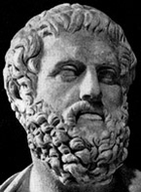
Sophocles
and

Slide 2
SOPHOCLES
(496-406 BC)
Concentrated on timeless problems of men and women striving against fate for happiness
Gave a sympathetic vision of the plight of mankind

Slide 3
Sophocles
Introduced a 3rd actor
Included more plot and action
Crafted plays to build to skillful climax
Wrote at least 120 plays of which only 7 survive

Slide 4
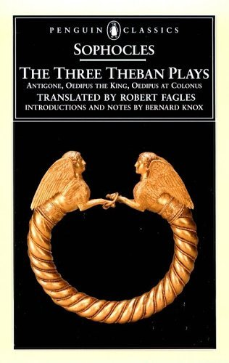
Sophocles wrote of the history of the house of Laius, King of Thebes, in three plays:
Oedipus Rex *
Oedipus at Colonnus
Antigone *
*high points of ancient Greek theatre

Slide 5
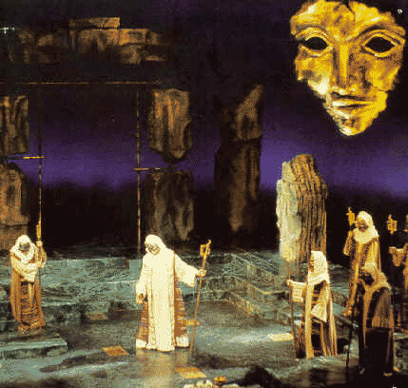
Oedipus Rex

Slide 6
PLOT
Identify types of conflict that occur:
  Person vs. Person
  Person vs. God
  Person vs. Self
  Person vs. Nature

Slide 7
Plot: Sequence of Events
Exposition:
  Readers are assumed to know the background of Oedipus’s birth and the story of the riddle of the Sphinx
  The play begins with Oedipus addressing the plague-ridden Thebans and demonstrating his leadership skills
Complication
  Kreon comes back from Delphi
  Things escalate from there

Slide 8
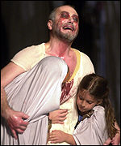
Sequence of Events
Climax
  The truth is fully revealed
  Oedipus blinds himself
  Jocasta kills herself
Denouement
  Oedipus bids farewell to Antigone and Ismene
  The chorus offers a closing reflection
Oedipus Rex at the Roman Coliseum, July 2000, BBC News

Slide 9
Follows Aristotle’s Classical Unities
Unity of time
  The play occurs within 24 hours.
Unity of place
  The setting is in one locale
Unity of action
  There are no sub-plots going on simultaneously

Slide 10
Setting
Where is the action set?
What other settings from Oedipus’s past influence the present action?
Is the setting man-made or natural? Hostile or friendly?

Slide 11
Characterization
Protagonist = Oedipus
Antagonist = fate

Slide 12
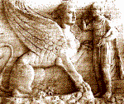
Oedipus’ Character
Find evidence of these traits in the text
Wise and courageous
Virtuous and conscientious
Loving husband, father, and son
Pious and proud
Quick tempered
Insistent upon truth
Suspicious
Strong in the face of disaster
Just

Slide 13
Oedipus’ Character
Two Flaws in Oedipus’ Character:
Impatience and erroneous judgment
  Regarding his father Laius
  Regarding Teiresias
  Regarding Kreon

Slide 14
Oedipus is a developing character
The tragedy lies in his knowledge of guilt rather than in the guilt itself
He pushes on to find the truth
Is he a better man at the end of the play?

Slide 15
Oedipus at the end of the play
Has shown strength of character
Has shown courage
Has gained insight into his own nature
Has learned who he is

Slide 16
Oedipus’ Tragic Flaw
He insists on knowing the truth
He presses on in spite of characters who try to dissuade him: Teiresias, Iokaste, the shepherd, Choragos

Slide 17
Symbols
Blindness
  Spiritual
  Physical
Oedipus himself
Others?

Slide 18
Symbol:
Oedipus’s Blinding of Himself
He once believed his insight to be superior to that of the priest Teiresias
He “Has nothing beautiful left to see in this world.”

Slide 19
Symbol: Dramatic Irony
The author implies a different meaning from that intended by speaker:
  ll. 141-143
    Whoever killed King Laios might—who knows—Lay violent hands on me—and soon.
  ll. 213-214
    If any man knows by whose hand Laios, son of Labdakos, Met his death, I direct that man to tell me everything, No matter what he fears…

Slide 20
Dramatic Irony
  ll. 223-231
    I solemnly forbid the people of this country, Where power and throne are mine, ever to receive that man Or speak to him, no matter who he is…

Slide 21
Dramatic Irony
  ll. 244-253
    Now I, Having the power that he held before me, Having his bed, begetting children there Upon his wife, as he would have, had he lived—Their son would have been my children’s brother, If Laios had had luck in fatherhood!...I say I take the son’s part, just as though I were his son.

Slide 22
Theme: Can be any or a combination of these:
No one can escape fate
The gods are in control
Even the best humans are ruled by fate
Do not count yourself happy until you know the end of your story
True happiness is rooted in virtue rather than circumstances
What you don’t know can’t hurt you
Other ideas?

