Slide 1
Protein Synthesis
PART 2
TRANSLATION

Slide 2
mRNA Codons
THE BASICS
Beginning with the three nucleotide bases AUG, each group of three nucleotides comprises a codon
AUG is referred to as the START codon because it is the signal to begin the process of protein synthesis known as TRANSLATION
Each codon is the code for an amino acid or for a STOP signal

Slide 3
TRANSLATION
Translation is the second stage of gene expression (protein synthesis)
Translation occurs in the cytoplasm on a ribosome
The agent of translation is tRNA

Slide 4
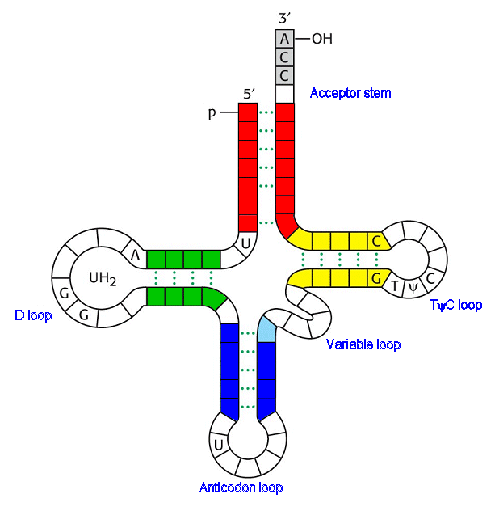
tRNA
tRNA loops around in a cloverleaf shape
The 3’ end at the top of the strand is where the amino acid attaches
At the bottom of the loop are three bases that form the anticodon
Amino Acid Attachment Site

Slide 5
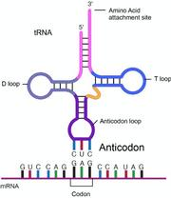
tRNA
The anticodon on the bottom of the tRNA will temporarily bond to the codon on the mRNA
This locks the amino acid into its place along the ribosome

Slide 6
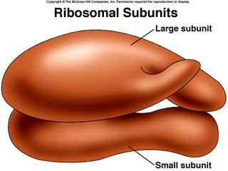
Ribosomes
Ribosomes consist of a small subunit and a large subunit
The mRNA first attaches to the small subunit

Slide 7
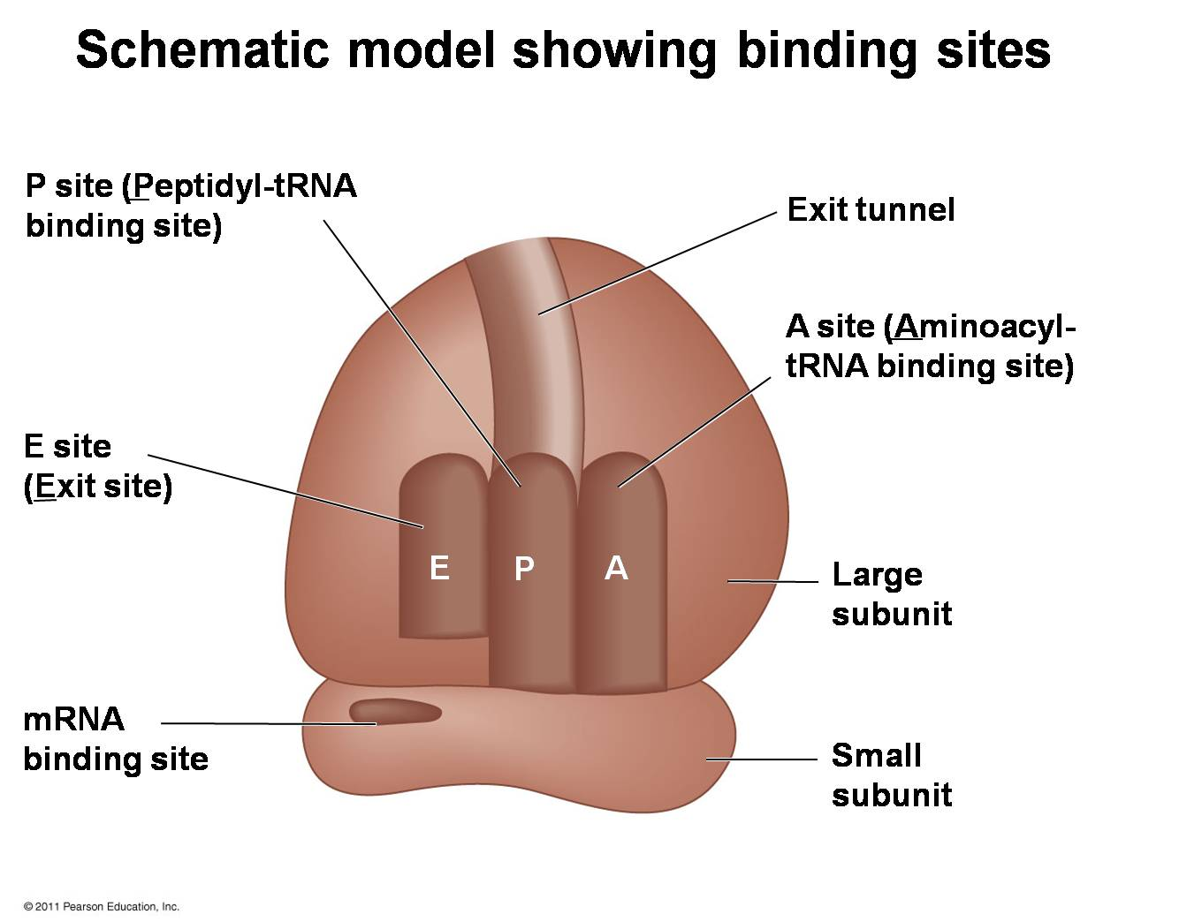
Ribosome Structure: The Large Subunit
The large subunit has three action sites
E = Exit site
P = Polypeptide growth site
A = Arriving Amino Acid site

Slide 8
Translation Begins…

Slide 9
INITIATION
  The mRNA transcript leaves the nucleus
  The mRNA, the tRNA carrying methionine, and the two subunits of the ribosome come together
    This forms a functional ribosome

Slide 10
INITIATION
The START codon of the mRNA is located in the P-site of the ribosome
The anticodon (UAC) of the tRNA carrying methionine bonds to the START codon (AUG)
The first amino acid of the protein is now locked in place
This is called INITIATION

Slide 11
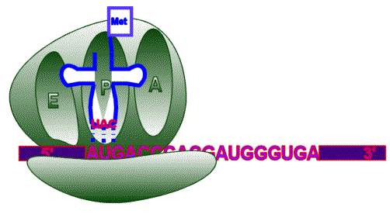
INITIATION

Slide 12
ELONGATION
The second mRNA codon is located in the A-site of the ribosome
  Remember, the A-site is where the next arriving amino acid will be delivered by tRNA
The two amino acids (one in the P-site and one in the A-site) will be peptide bonded together by the enzymes in the rRNA
This is called ELONGATION.

Slide 13
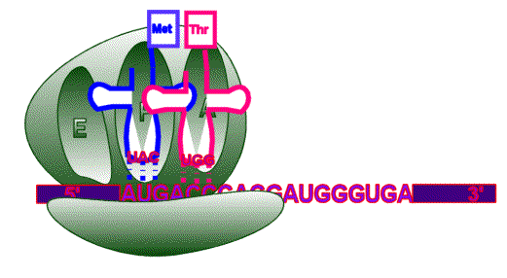
ELONGATION

Slide 14
ELONGATION
Once the peptide bond is formed, the first tRNA is no longer needed
Notice that it is no longer attached to the amino acid that it delivered

Slide 15
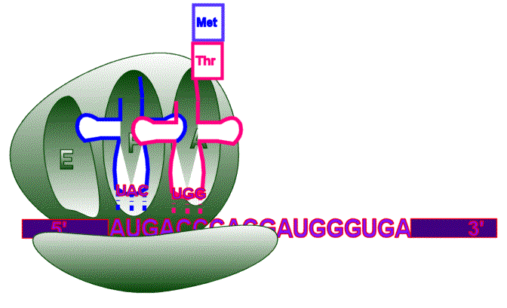
ELONGATION

Slide 16
ELONGATION
The ribosome slides one codon toward the 3’ end of the mRNA
The empty tRNA is now in the E-site, the exit position
The tRNA that carried methionine is released and will recycle

Slide 17
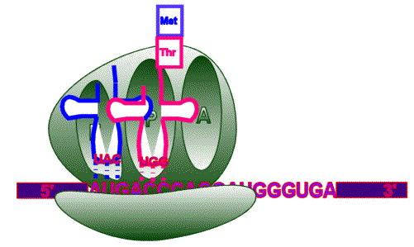
ELONGATION

Slide 18
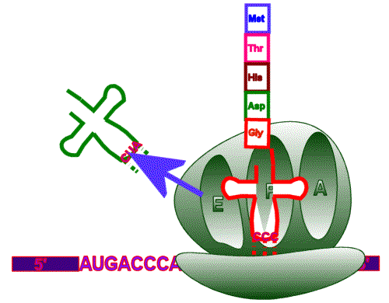
ELONGATION

Slide 19
TERMINATION
This process repeats itself until a STOP codon is located in the A-site

Slide 20
TERMINATION
When a STOP codon enters the A-site, a release factor enters the ribosome instead of a tRNA

Slide 21
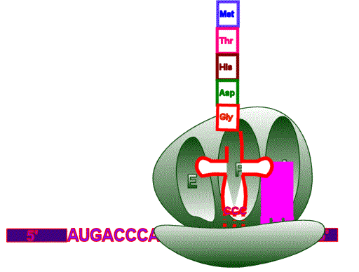
TERMINATION

Slide 22
Termination
When the release factor enters the ribosome,
  the ribosome subunits dissociate,
  the polypeptide chain is released and
  the mRNA breaks into nucleotides and
  is recycled.

Slide 23
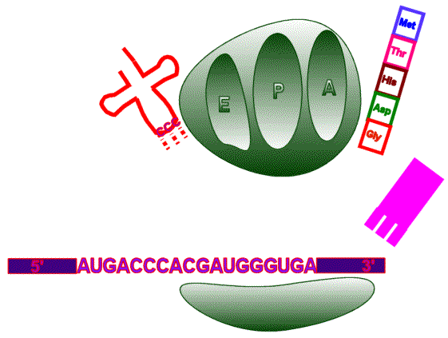
Click to see animation

