Slide 1
Discovering the Structure of DNA

Slide 2
DNA or Proteins?
Scientists knew that all cells contain nucleic acids (DNA and/or RNA) and proteins
The question was which one passes on hereditary information?

Slide 3
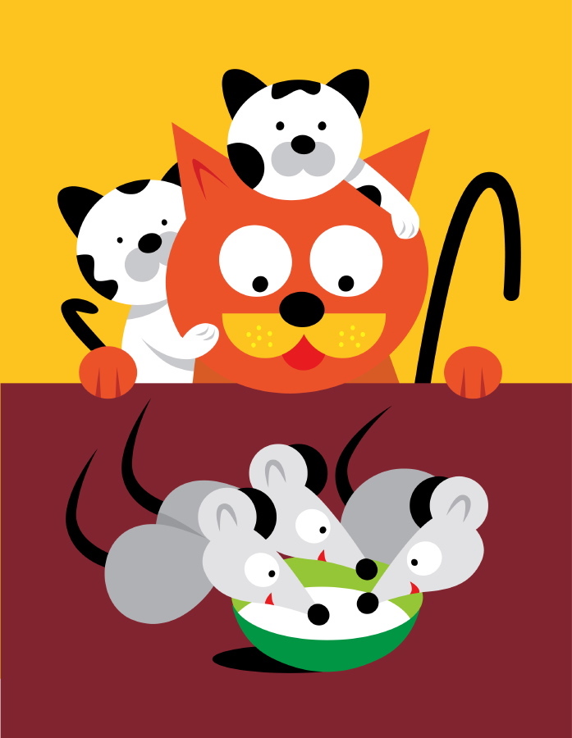
Griffith Experiment

Slide 4
Hershey-Chase Experiment

Slide 5
Reviewing Organic Compounds
Carbohydrates are made of
monosaccharides.
Lipids are made of
fatty acids and glycerol
Proteins are made of
amino acids
Nucleic acids are made of
nucleotides

Slide 6
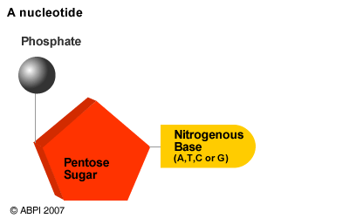
Nucleotides are made of
1 phosphate group
1 five-carbon sugar molecule
1 of four nitrogenous bases
  Adenine (A)
  Guanine (G)
  Cytosine (C)
  Thymine (T)

Slide 7
The Structure of DNA
The five-carbon sugar in DNA is called DEOXYRIBOSE sugar
DNA is named after the name of the sugar it contains
The five-carbon sugar in RNA is called RIBOSE sugar

Slide 8
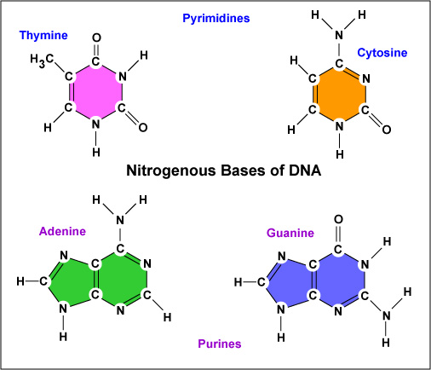
Pyrimidines have a single ring and Purines have a double ring
Which bases belong to each category?

Slide 9
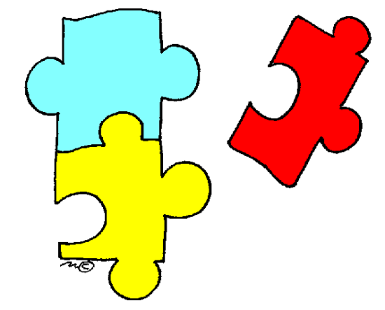
The Race for the Prize
Many scientists were working toward determining the structure of DNA.
A lot of people had part of the puzzle, but no one had the entire picture.

Slide 10
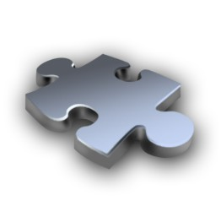
Chargaff’s Rule
Erwin Chargaff discovered that in all organisms
  The amount of adenine always equaled the amount of thymine
    A = T
  The amount of cytosine always equaled the amount of guanine
    C = G

Slide 11
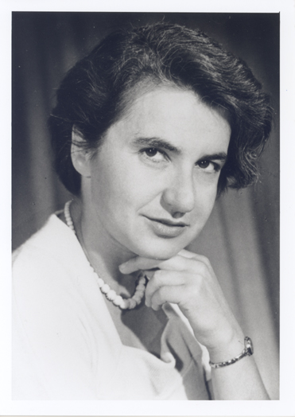
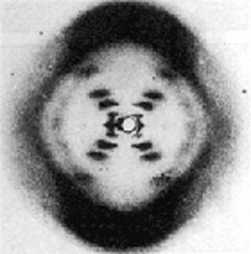
Rosalind Franklin
Rosalind Franklin & Maurice Wilkins took x-ray crystallography pictures of the DNA molecule.
The picture indicated a spiral structure.

Slide 12
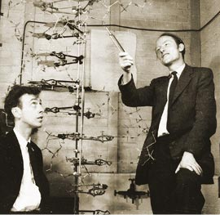
Watson & Crick
Using their own research and data from others, James Watson and Francis Crick finally figured out how to put the pieces together.
Their model is the famous double helix.

Slide 13
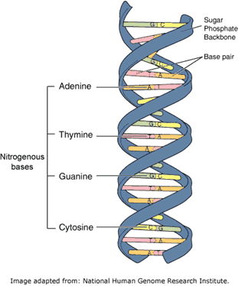
Watson & Crick’s Model of DNA
Shaped like a double helix (spiral staircase)
Base-pairing rules (from Chargaff) that adenine always bonds to thymine and cytosine always bonds to guanine
Anti-parallel construction

Slide 14
Base-pairing Rule
The nitrogenous bases that always bond to one another (adenine with thymine and cytosine with guanine) are referred to as complementary base pairs
Nitrogenous bases are held together by hydrogen bonds

Slide 15
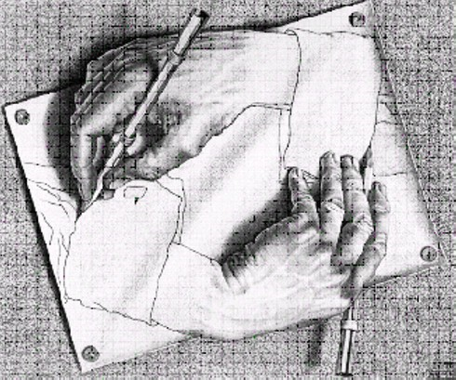
Antiparallel Construction

Slide 16
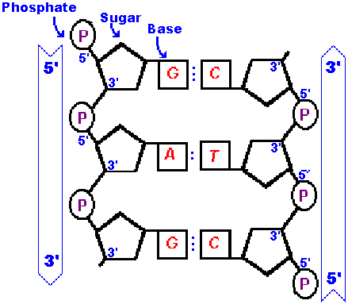
Antiparallel Construction
Antiparallel construction means that one side of the DNA molecule appears to be upside-down when compared to the other side of the strand.

Slide 17
DNA Direction
The end of each side of the DNA molecule that has the “free” phosphate is labeled 5’ and the other end is labeled 3’.
These designations are based on the carbon atom within the ring to which the phosphate is bonded.
DNA can only be constructed in a 5’ to 3’ direction

