Slide 1

“Working Smart” Module 1: Self-Awareness
Lesson 3:
Cognitive Cycle
“Working Smart: Soft Skills for Workplace Success”
A product of Charlotte Mecklenburg Workforce Development Partners by Steve Parese, Ed.D.

Slide 2
COGNITIVE CYCLE
“Working Smart” Program
Lesson 3 Objectives
In this lesson, we will:
√ Learn how the “Cognitive Cycle” works
√ Understand how beliefs and behaviors are connected
√ Separate helpful beliefs from harmful beliefs

Slide 3
COGNITIVE CYCLE
“Working Smart” Program
Overview of Cognitive Cycle:
The Cognitive Cycle shows how what goes on inside of us drives our choices, and these influence our outcomes. Deeply held BELIEFS may be triggered by stressful situations, leading to strong feelings and impulsive behaviors.
Thus our beliefs, our values, impact our reaction to things. By changing our values or beliefs, we can best manage our reaction to things.

Slide 4
Overview of Cognitive Cycle
Beliefs
Stressful Situation
Internal Reactions
Outcomes
Behavior

Slide 5
Overview of Cognitive Cycle
Beliefs-how we see the world
Stressful Situation – What is happening
Internal Reactions – our emotional response
Outcomes – the results of our actions/response
Behavior – how we react, words/actions

Slide 6
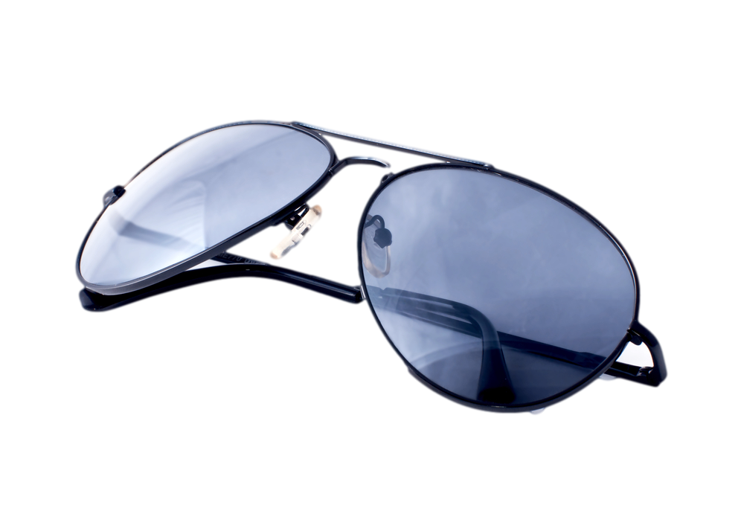
Helpful vs. Harmful Beliefs
Imagine that each of us is wearing a pair of “belief sunglasses,” created by our life experiences.

Slide 7

Helpful Beliefs
A helpful belief is like a compass.
Helpful beliefs guide us toward our goals, helping us live according to our values.

Slide 8

Harmful Beliefs
A harmful or unhealthy belief is like an explosive volcano.
Harmful beliefs justify choices that hurt others, and keeping us from our goals.

Slide 9

“Watch Your Thoughts”
Watch your thoughts for they become your WORDS...

Slide 10

“Watch Your Thoughts”
Watch your words for they become your ACTIONS...

Slide 11

“Watch Your Thoughts”
Watch your actions for they become your HABITS...

Slide 12

“Watch Your Thoughts”
Watch your habits for they become your CHARACTER...

Slide 13

“Watch Your Thoughts”
Watch your character
for it becomes your DESTINY.

Slide 14

Key Points for this Lesson
1. The Cognitive Cycle shows how our perceptions (especially our attitudes and beliefs) influence the way we react to stressful situations.
Helpful beliefs are like compasses, guiding us toward our goals. Harmful beliefs are like volcanoes, leading us to make poor choices that may harm us and others.

Slide 15
Key Points for this Lesson
2. Our internal reactions to a problem (thoughts, feelings and physical signs) will sometimes escalate us, making stressful situations worse.
As we gain greater self-awareness, we can deliberately choose to clear our minds, calm our emotions, and relax our bodies during tough problems.

Slide 16
Overview of Cognitive Cycle
Beliefs
Stressful Situation
Internal Reactions
Outcomes
Behavior

