Slide 1
Essential Question | How do you determine what time it is based on a location? 7.3.spi.17. read and interpret a time zone map. (Bloom’s Taxonomy level 6) Estimated Lesson Length: 1 day
Activating Strategy | Students will discuss with a partner why we see the Olympics at a different time then they do in London?
Teaching Strategies | Show students the images of sunlight going across the globe. Discuss how this can affect the flow day, “What would happen if every place on the earth was at 1:00 pm at the same time?” AP#1- Pair/Share: Each pair will come up with 2 answers to the following question, “Why would it be important to be aware of the differences in time?” Students will discuss how many degrees are in a sphere/circle and how many hours are in the day. Lead the students to realize that in order to equally divide up the day and the degrees on the globe we can determine divide ̊the amount of degrees by days. 360̊/24= 15̊ Each time zone will be 15̊. Compare time zones to a number line. Moving to the right adds to the time and moving to the left decreases it. Graphic/Organizer: Time Zone Chart . AP#2 –What time is it? Ask individual students to pick a time and place on the map. On their dry erase board, have them write down what time it is in one of the stared location. Show students the maps where the lines are not straight. Have them brainstorm ideas about why the lines bend. AP#3 – In groups, students will write a computation problem using time zones and share with the class. The class will solve their problem.
Summary | Students will finish the statement, “The reason we use time zones is…..”
Homework Options | Complete Time Zone worksheet/What Time Is It?

Slide 2
Earth rotates west to east
Solar time is based on the position of the sun
NIGHT IS FALLING ON EARTH
Look at the East Coast of the United States. The lights are already lit.
California the sun is still visible.

Slide 3
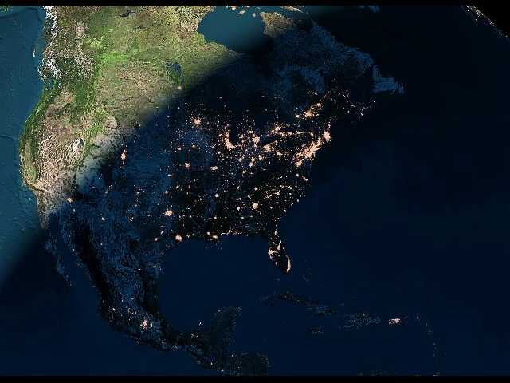
This pictures shows AMERICAN CITIES at night.
Notes:
3

Slide 4
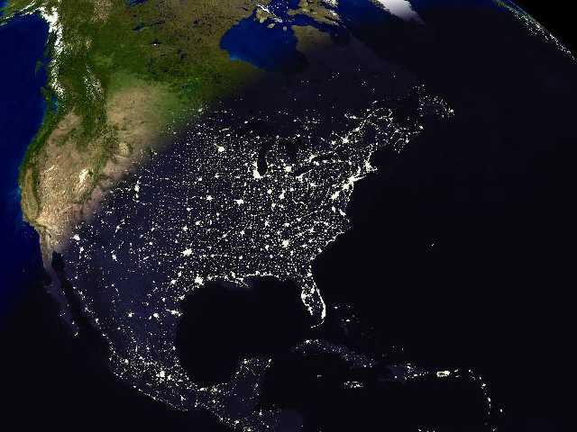
Saguenay
Sept-Iles
Thunder Bay
Toronto
St.John
Ottawa
It’s still daylight in California
Québec
Montréal
Those light are Boston, New York, Philadelphia and Washington.
Detroit
Dallas
Puerto Rico
Houston
Miami
Mexico City
Havana
Port-au-Prince
Notes:
4

Slide 5
NIGHT IS FALLING ON EARTH.
Look at Paris and Barcelona, the lights are already lit, meanwhile in London, Lisbon and Madrid the sun is still visible.
Looking south, we can see the islands in the middle of the ocean.
We have a perfect view of the British Islands, Iceland and Canada.
Notes:
5

Slide 6
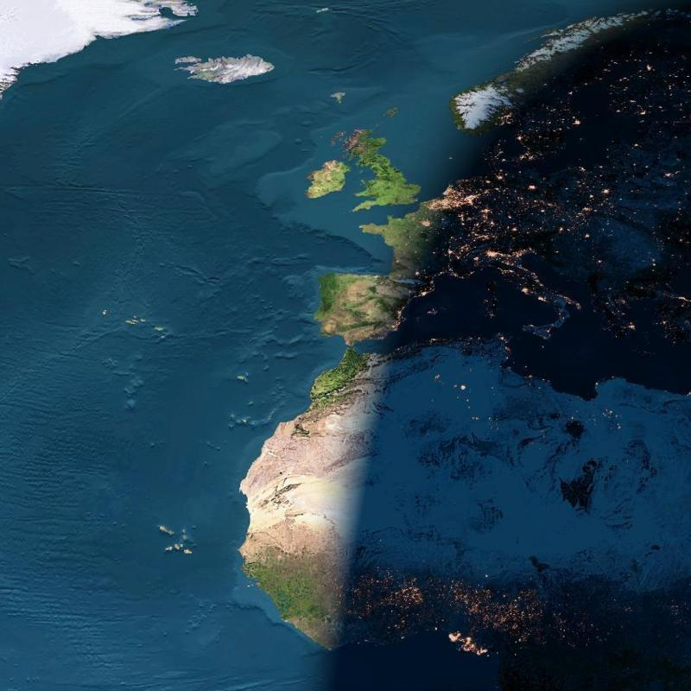
Iceland
England
Atlantic
Ocean
France
Spain
Italy
AFRICA
Notes:
6

Slide 7
Imagine that it is 1:00 pm in New York, New York at the same time as Sydney, Australia.

Slide 8
Pair/Share
Come up with 2 answers to the following question,
Why would it be important to be aware of the differences in time between different locations?

Slide 9
LONGITUDE AND TIME
The world rotates (spins) _____° in ___ hours.
How many degrees per hour does the earth spin?
360° / 24 hours = 15° per hour
The world has 24 time zones, each l5° apart.
THERE IS A 1 HOUR TIME DIFFERENCE FOR EVERY 15° OF LONGITUDE

Slide 10
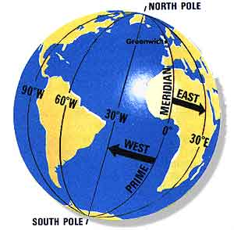
Greenwich, England is the logical starting point for time zones
The world rotates west to east (counterclockwise), time zones to the east are ahead of the those time zones to the west

Slide 11
Think of it as a giant number line.
Greenwich, England is at 0 on the number line. As you move to the left you add, as you move to the right you subtract.
-2
Sandwich Islands
-1
Dakar
0
Greenwich
+1
Paris
+2
Cape Town

Slide 12
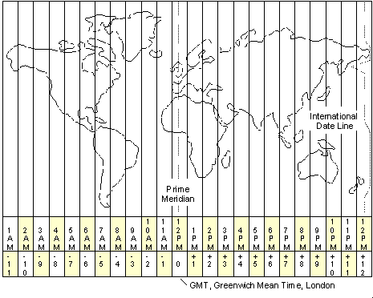
Graphic Organizer

Slide 13
What time is it in the locations below

Slide 14
ANOTHER CHEESY SAYING
EAST INCREASE
Time is forward to all places to the east
WEST LESS
Time is backward to all places to the west

Slide 15
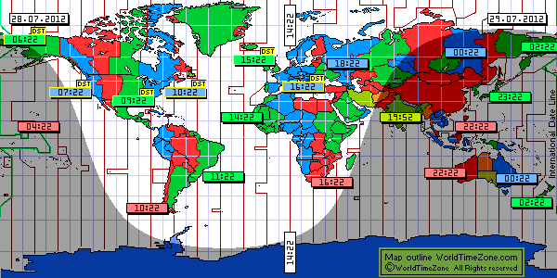

Slide 16
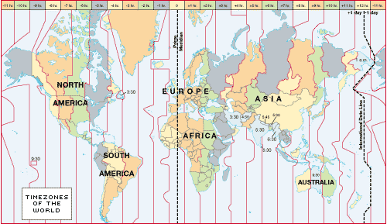

Slide 17
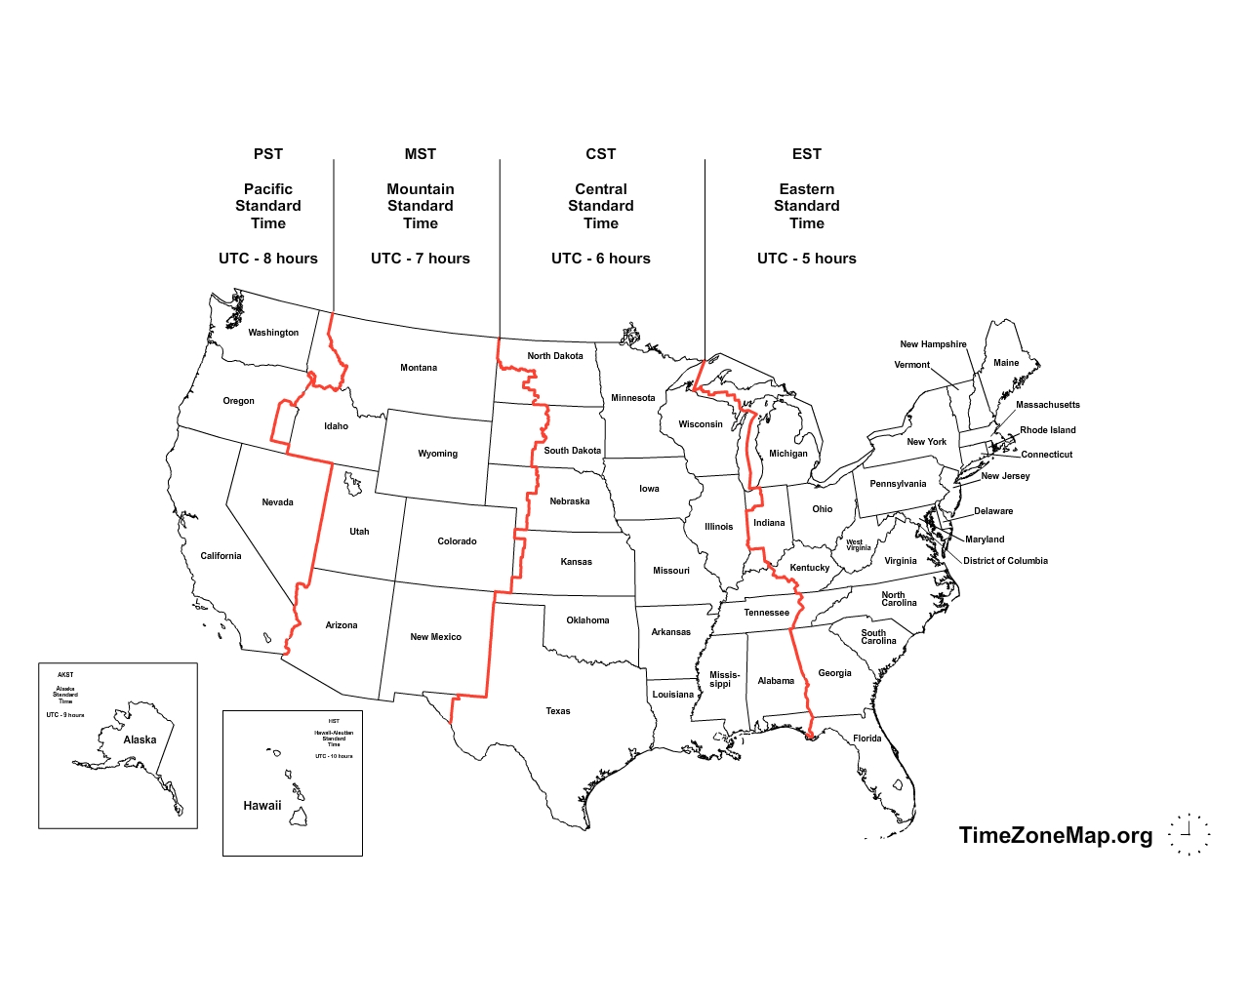
4:00 PM
If it is 4:00 PM in New York What time will it be in Iowa, Utah, and Oregon?

Slide 18
East Increase – West Less
(1 hr per l5°)
If it 9 p.m. at Position D, what time is it at position C? Position B?
If it is 1 p.m. at Position X, at which location is the time 5 p.m.

Slide 19
Graphic Organizer

