Slide 1
Nervous System
Human Anatomy Chapter 9

Slide 2
Nervous System
The Nervous system is the major controlling, regulatory, and communicating system in the body.
Responsible for regulating and maintaining homeostasis.
Keeps us in touch with our environment, both external and internal.
Primary organs are the brain, spinal cord, nerves and ganglia.

Slide 3
Nervous system function
3 major functions
  Sensory- receptors detect stimuli or changes that occur inside and outside the body. All the gathered information is called sensory input.
  Integrative – Sensory input is converted into electrical signals called nerve impulses. In the brain, signals are brought together. This is called integration.
  Motor – Based on sensory input and integration, the nervous system responds by sending signals to muscles or glands. The response is called motor output or motor function.

Slide 4
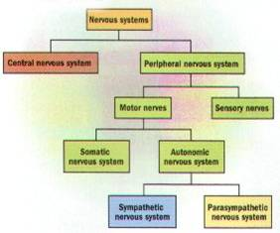
Organization of system

Slide 5
Nervous System
Central NS
Peripheral NS
Made up of brain and spinal cord.
Are encased in bone for protection
They are 2 separate but continuous organs.
Nerves and ganglia
Nerves are bundles of nerve fibers
Cranial nerves and spinal nerves extend from the CNS to other organs.
Ganglia are collections of nerve cell bodies outside the CNS.

Slide 6
Peripheral Nervous Sys.
Afferent (sensory)
Efferent (Motor)
Transmits impulses from organs TO the CNS.
Transmits impulses from CNS OUT to the peripheral organs or muscles.

Slide 7
Efferent (Motor) Division
Somatic
Autonomic
Supplies motor impulses to the skeletal muscles.
Sometimes called the voluntary nervous system.
These nerves permit conscious control of the skeletal muscles
Supplies motor impulses to cardiac muscle, to smooth muscle and to glandular epithelium.
Sometimes called the involuntary nervous system.
These impulses are NOT under conscious control.

Slide 8
Autonomic Division
Sympathetic
Parasympathetic
Primary involved with expenditure of energy.
“Fight or flight” response.
Primary involved with conservation and restoration.
“Rest and repose” division.

Slide 9
Nerve Tissue
Two main types of cells in nerve tissue.
  Neurons – nerve cells. These are the conducting cells that transmit impulses. It is the structural unit of the nervous system.
  Neuroglial cells. These cells do NOT conduct impulses. They provide a support system for the neurons. They are a special type of connective tissue for nervous system.

Slide 10
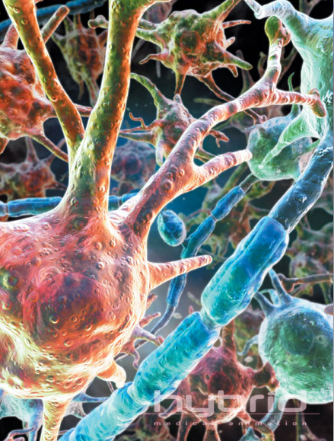
Neuroglia types

Slide 11
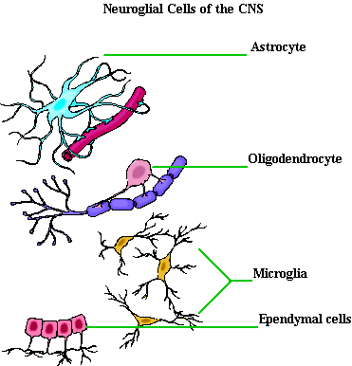
Neuroglia CNS

Slide 12
CNS Neuroglia
Astrocytes – star shaped- provide structural support. Help regulate concentrations of nutrients. Form scar tissue after injury to the CNS.
Oligodendrocyte – Small cells with few long processes – provide myelin to axons in the CNS.

Slide 13
Microglia – small cells with long processes. Support neurons and phagocytize bacteria and cellular debris.
Ependymal – Columnar cells with cilia. – Form a membrane that covers specialized brain parts and forms linings that enclose spaces within the brain and the spinal cord.

Slide 14
CNS Neuroglia
Neuroglia do NOT conduct nerve impulses. They support, nourish, and protect the neurons.
More numerous than neurons.
Are capable of mitosis
Primary malignant brain tumors are tumors of the glial cells because neurons do not undergo mitosis.
Gliomas have extensive roots, and are difficult to remove.

Slide 15
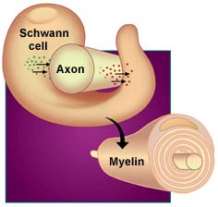
Neuroglia of Peripheral NS
Schwann cells – make the myelin that surrounds many axons.
Flat cells with long flat processes that wrap around cells.

Slide 16
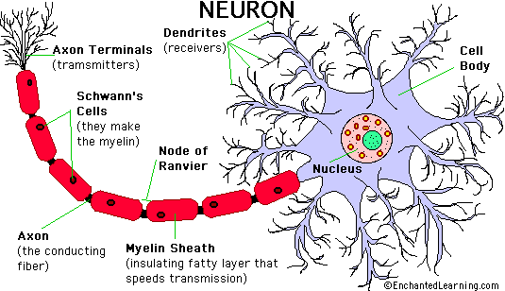
Neurons

Slide 17
Neurons
Neurons carry out functions of nervous system by conducting impulses.
THEY ARE AMITOTIC – they do not undergo mitosis. If a neuron is destroyed, it cannot be replaced.
Peripheral neurons can regenerate axons if they are damaged. CNS neurons generally cannot.
Each neuron has 3 basic parts
  Cell body (soma)
  Axon (only one)
  Dendrites (one or more)

Slide 18
Cell body – has granular cytoplasm, organelles, and a network of neurofibrils. Many membranous sacs called Nissl bodies – act like ER in other cells. Has a large nucleus and a prominent nucleolus.
Dendrites – usually short and branching to receive signals. Transmit impulses TO the neuron cell body.
Axon – usually long and carries impulses AWAY from the cell body. Many mitochondria and neurofibrils.

Slide 19
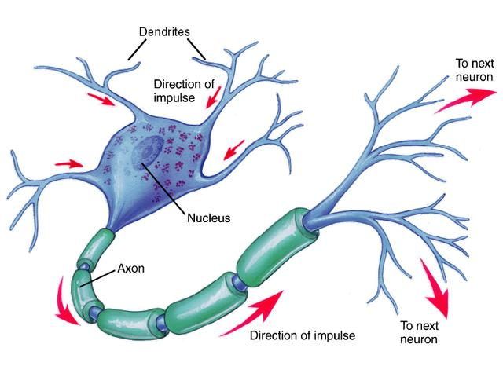

Slide 20
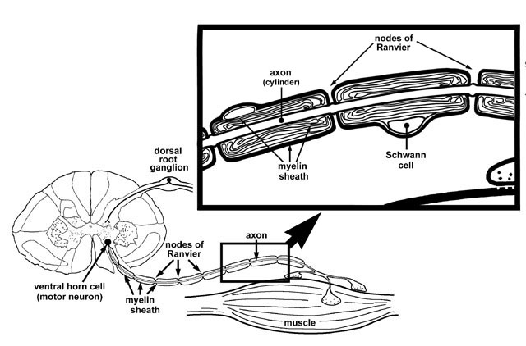
Axons
Many axons surrounded by myelin- a white fatty material.
Schwann cells make myelin. They surround the axon.
Some axons have no myelin.

Slide 21
Regions between the myelin segments are called nodes of Ranvier.

Slide 22
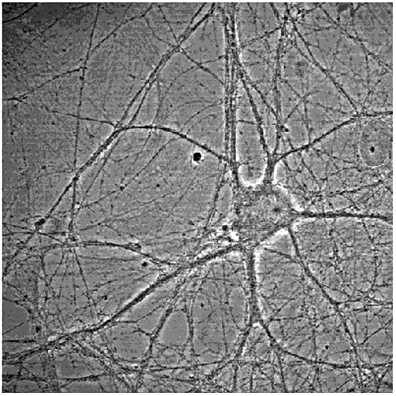

Slide 23
Neuron Classification
Neurons can be classified by structure.
  Multipolar neurons – have many processes arising from the cell body. Must neurons in the brain and spinal cord are multipolar.
  Bipolar neurons – have only 2 processes – 1 axon and 1 dendrite. Specialized cells in parts of the eyes, nose, and ears.
  Pseudounipolar neurons – have a single process extending from the cell body. A short distance from the cell body this process divides into 2 branches. The cell bodies of some unipolar neurons grow together in specialized masses of nervous tissue called ganglia.

Slide 24
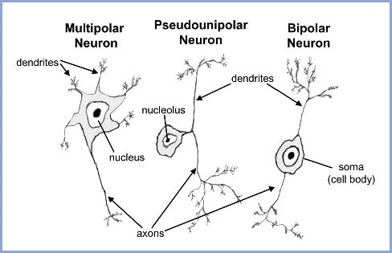

Slide 25
Neuron classification
Neurons can also be classified by function
Afferent neurons – also called sensory neurons – carry impulses from the peripheral nerves to the CNS.
Efferent neurons –also called motor neurons- transmit impulses from the CNS to organs such as muscles and glands.
Inter-neurons or association neurons – are located entirely in CNS – a connecting link between afferent and efferent neurons.

Slide 26
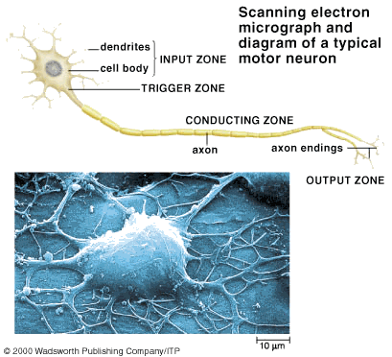

Slide 27
Nerve Impulses and Physiology

Slide 28
Nerve Impulses
Neurons have 2 major functional characteristics: excitability and conductivity.
  Excitability is the ability to respond to a stimulus
  Conductivity is the ability to transmit an impulse from one point to another.
  ALL functions of the nervous system, including thought, learning, and memory are based on these 2 characteristics.
  These 2 characteristics are based on the structure of the cell membrane.

Slide 29
Resting membrane
Resting membrane - the cell membrane of a non-conducting or resting neuron.
There are more sodium ions outside the cell and more potassium ions inside the cell. Because a cell membrane is more permeable to potassium, more potassium diffuses out. More positive charges leave the cell than can enter it.
The difference in charges on the 2 sides of the resting membrane is called the resting membrane potential.
The electrical measurement of this potential is about -70mV.

Slide 30
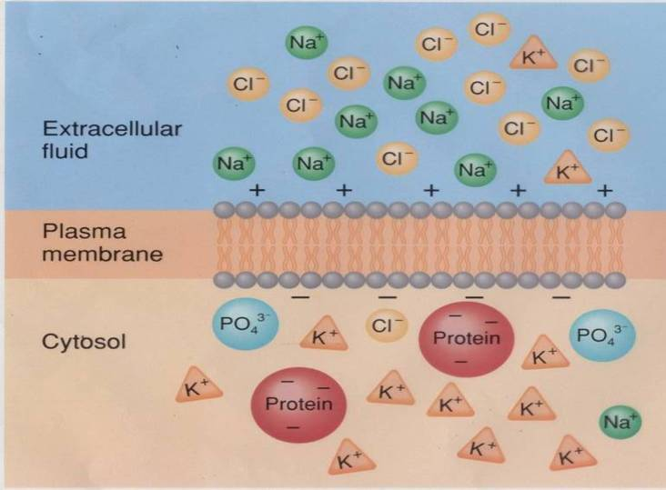
Resting membrane pot.

Slide 31
Neuron Stimulus
A stimulus is a physical, chemical, or electrical event that alters the neuron cell membrane and reduces its polarization for a short time.
The membrane becomes permeable to sodium ions, which diffuse into the cell.
As these positive ions enter the cell, the inside becomes more positively charged, reducing the polarization.
This is called depolarization

Slide 32
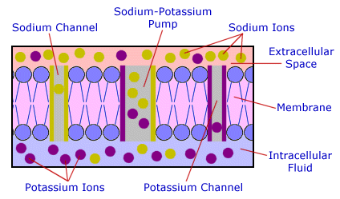

Slide 33
Very quickly, the membrane channels close, trapping the sodium inside the cell.
Then the potassium channels will reopen, allowing potassium to diffuse back out of the cell.
This is called repolarization.
During repolarization, the resting membrane potential is restored.

Slide 34
For just a second, the influx of sodium ions reverses the membrane polarity, with more positive charges inside than outside.
This is reverse polarization.

Slide 35
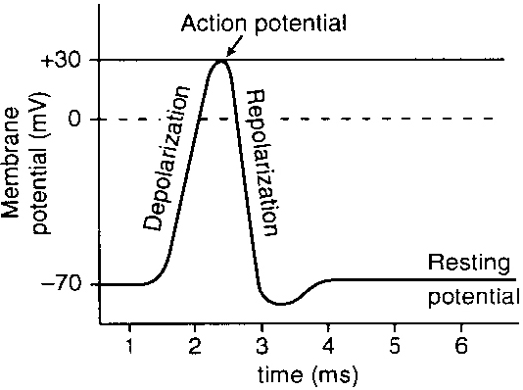
Electrical impulses

Slide 36
Action potential
This sequence – depolarization and repolarization- is called the action potential.
This sequence only takes about 1 msec.
The polarity changes from about -70 mV to +30 mV during an action potential.
At the end, resting conditions are restored.
The minimal stimulus necessary is called a threshold stimulus.

Slide 37
Conduction sequence
The sequence is:
  Resting potential
  Depolarization
  Reverse polarization
  Repolarization
  Resting potential

Slide 38
Conduction
Once the threshold stimulus has been applied, and an action potential started, it must be conducted along the entire length of a neuron to the next neuron or to the effector.
This process is called propagation.
The other name for this process is a nerve impulse.
This is the process that occurs in unmyelinated axons.

Slide 39
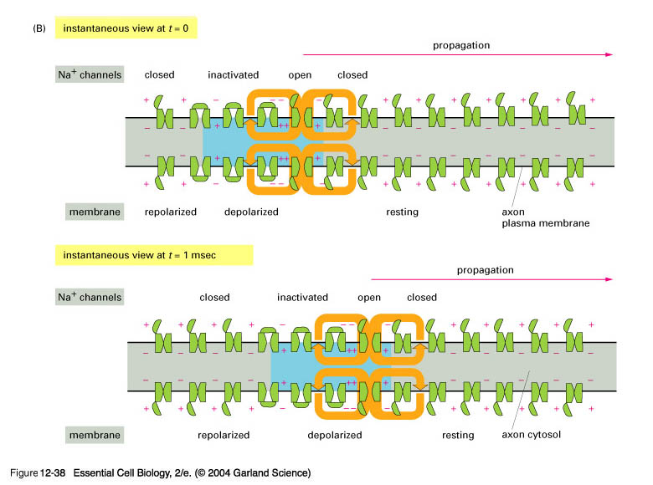
Conduction

Slide 40
Saltatory conduction
Saltatory conduction – occurs in myelinated nerve fibers.
Myelin is an insulator and inhibits flow of current.
In myelinated fibers, depolarization only occurs at spots where there is no myelin – at the nodes of Ranvier.
The action potential “jumps” from node to node.
This is a much faster conduction time.

Slide 41
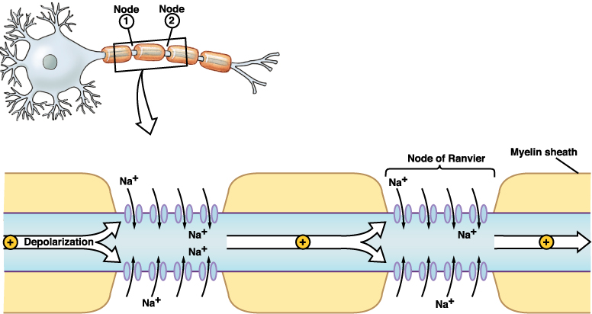
Saltatory conduction

Slide 42
When the point on the cell is recovering from depolariztion, this is called the refractory period.
The neuron at this point cannot respond to a second stimulus, no matter how strong.
Nerve fibers, like muscle fibers, obey the all or none principle.

Slide 43
Synaptic conduction
A nerve impulse travels along a nerve fiber until in reaches the end of the axon – then it must be transmitted to the next neuron.
The region of communication between two neurons is called a synapse.
A synapse has 3 main parts
  Synaptic knob
  Synaptic cleft
  Postsynaptic membrane

Slide 44
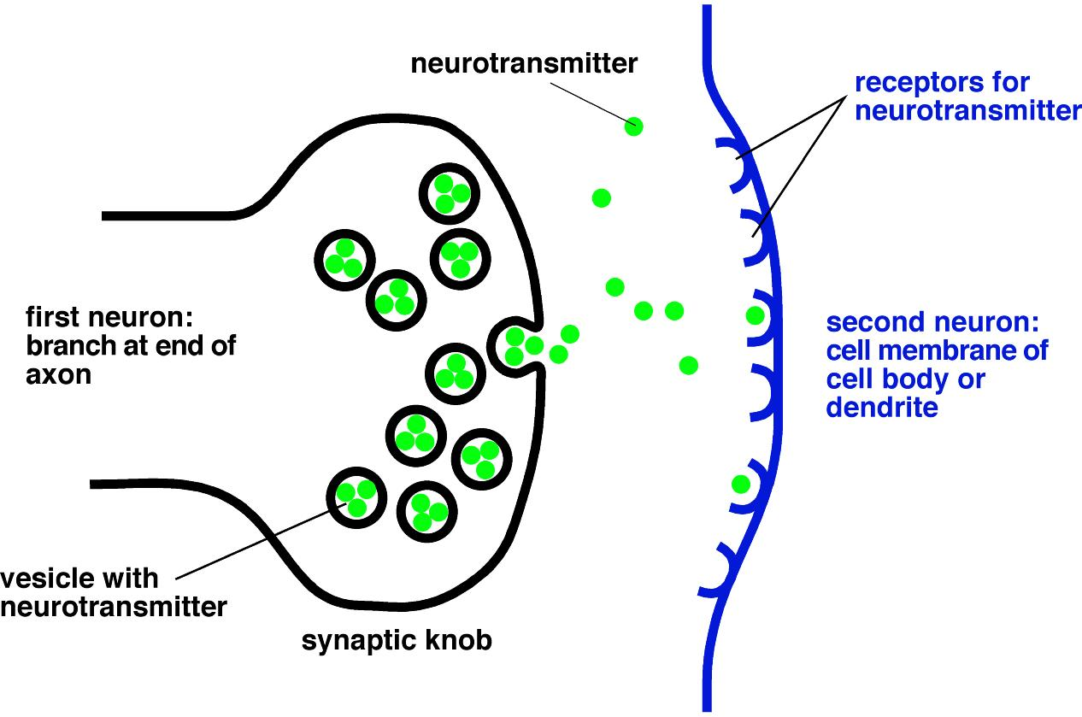
Synaptic conduction

Slide 45
Neurotransmitters
Neurotransmitters are the chemicals which are released by the synaptic knob.
They diffuse across the synaptic cleft and react with receptors on the next neuron’s membrane.
One of the best understood neurotransmitters is acetylcholine.
ACH is then quickly inactivated by an enzyme to prevent prolonged reactions. This enzyme is cholinesterase
Each neurotransmitter has its own enzyme deactivator.

Slide 46
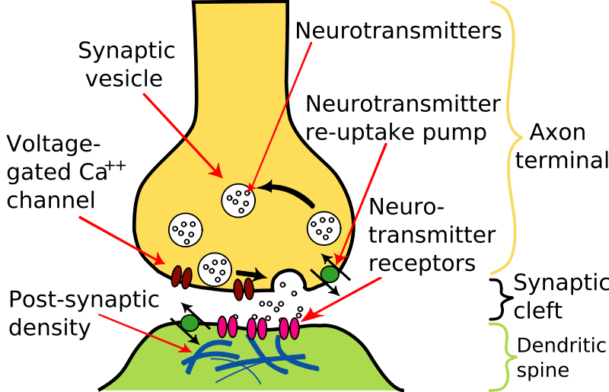
Synaptic transmission

Slide 47
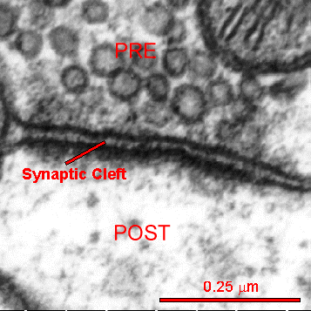

Slide 48
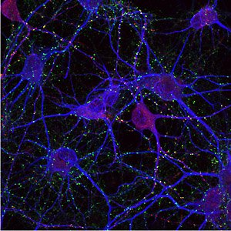
Synapse mapping
Three different proteins - GluR1, SYP and MAP2 - are labelled with a red, green or blue tag, respectively. Active synapses are shown where the red signal of GluR1 and the green of SYP coincide, giving a yellow signal. The blue signal shows the nerve fibers

Slide 49
Synaptic transmission
Transmission across a synapse may be:
  Excitatory – result in stimulation of next neuron.
  Inhibitory – results in making the membrane less able to respond to stimulus.

Slide 50
The organization of neurons affects how the nervous system responds and processes information.
  Neurons within the CNS are organized into neuronal pools. These are groups that make hundreds of synaptic connections with each other and perform a common function.
  Any single neuron in a neuronal pool may get impulses from 2 or more incoming axons. This is convergence.
  Impulses leaving a neuron often exhibit divergence – or pass into several output neurons.

Slide 51
Types of neuron circuits
Divergence
Convergence
Neuron
Impulse
Impulse
Impulse
Impulse
Neuron
Impulse
Impulse
Impulse

Slide 52
Reflex arcs
A reflex arc is a type of conduction pathway. It is a one-way street – impulses pass in only one direction.
A reflex is an automatic, involuntary response to a change inside or outside the body
There are 5 basic parts in a reflex arc are:
  Receptor
  Sensory neuron
  Center
  Motor neuron
  Effector

Slide 53
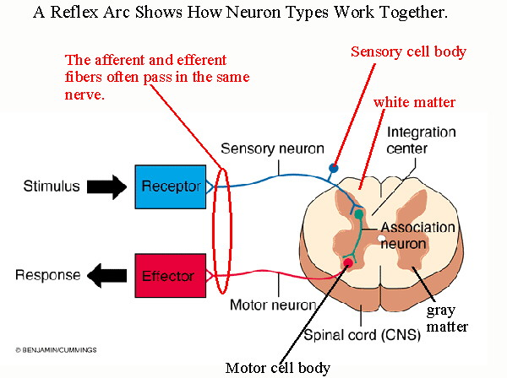
Reflex arcs

Slide 54
Reflexes
Common reflexes are:
  Coughing
  Sneezing
  Reactions to pain (hot stove, tack)
  Babinski – toes curl down when stimulus is placed on sole of foot.

Slide 55
Central Nervous System

Slide 56
CNS
CNS consists of brain and spinal cord.
They are enclosed in bone for protection
The brain is continuous with the spinal cord at the foramen magnum, even though the 2 are separate organs.
CNS is surrounded by connective tissue called meninges and by cerebrospinal fluid.

Slide 57
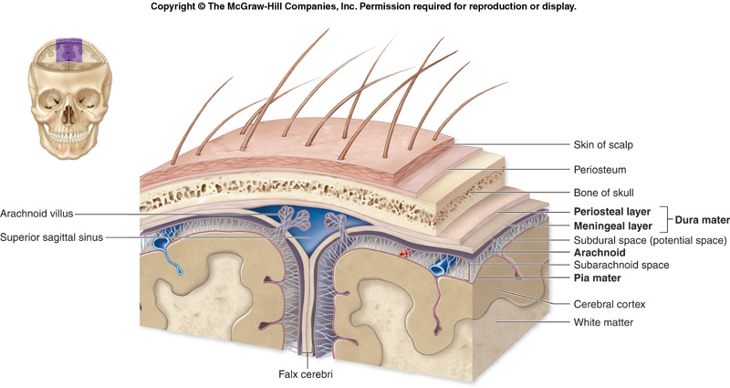
CNS - meninges

Slide 58
Meninges
3 layers of meninges:
Outer layer is called the dura mater – it is tough, white connective tissue. It is just inside the cranial bones. The dura mater contains channels that collect venous blood to return it to the heart.
Middle layer is arachnoid. It resembles a cobweb in appearance. Thin with numerous threadlike strands. Space under the arachnoid is the subarachnoid space, filled with CSF>
Inner layer is the pia mater. It is thin and delicate and tightly bound to the surface of the brain.

Slide 59
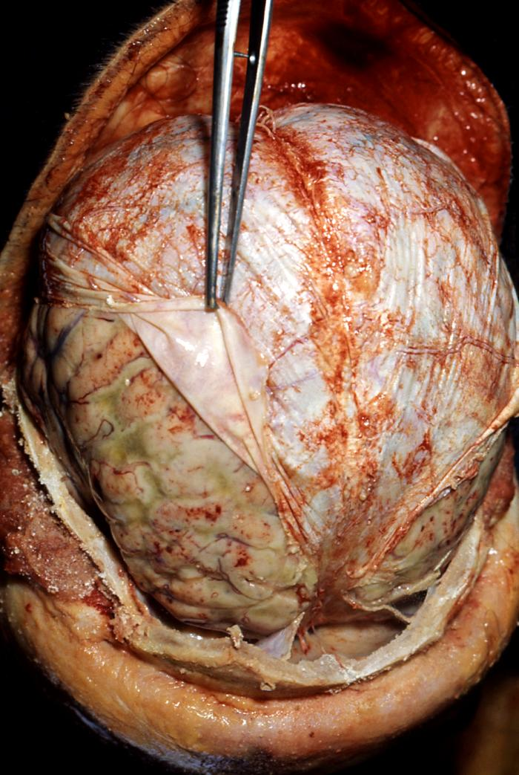
Meningitis
Meningitis – is an acute inflammation of meninges.
Can be caused by bacteria, fungi, viruses, or tumors.
May be mild or can progress to a fatal disease.

Slide 60
CNS - Brain
Brain parts
  Cerebrum
  Diencephalon
  Brain stem
  Cerebellum

Slide 61
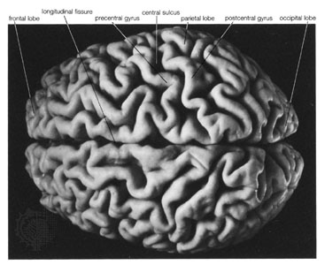
Cerebrum
Cerebrum is the largest and most obvious portion of the brain.
It is divided into 2 hemispheres by a deep longitudinal fissure.
The hemispheres are 2 separate entities connected by the corpus callosum.

Slide 62
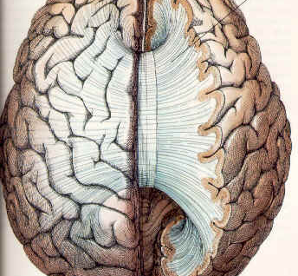
Corpus callosum
Corpus callosum provides a communication pathway between the two halves of the brain.

Slide 63
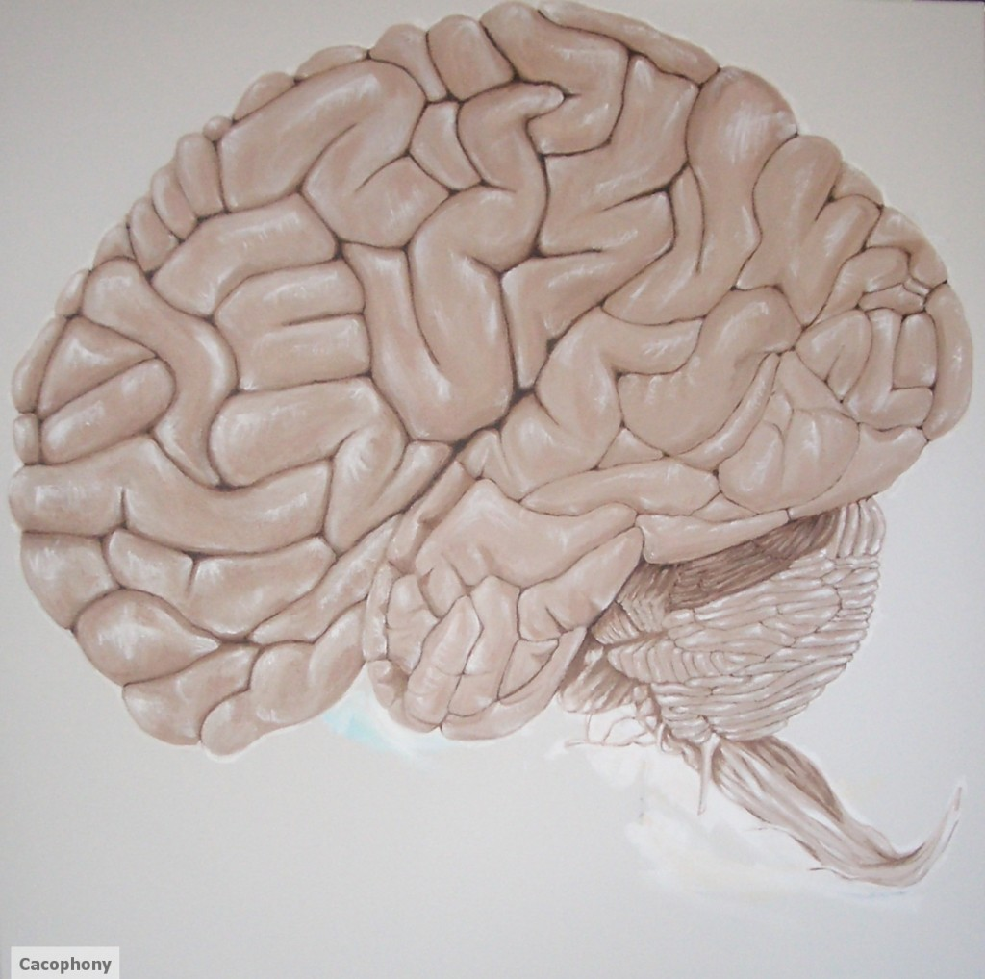
Brain surface - cerebrum
Gyri – the obvious convolutions on the surface of the cerebrum.
Sulci – the shallow grooves that separate the gyri.
Fissure – the deep grooves – usually separate parts of the brain

Slide 64
Cerebral lobes
Cerebrum is divided into lobes – 4 of these are easily visible on the slide following
  Frontal lobe – under the frontal bone
  Parietal lobe – Under the parietal bone
  Occipital lobe – most posterior portion, under the occipital bone
  Temporal lobe – under the temporal bones.

Slide 65
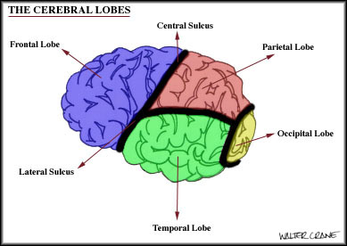
Cerebral lobes

Slide 66
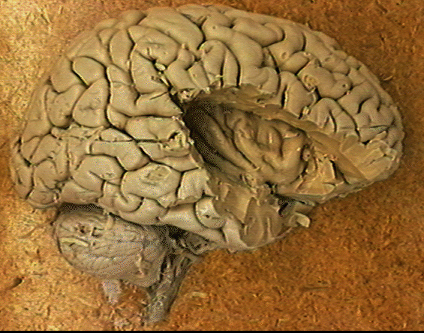
Insula
The fifth lobe is the insula – deep within the lateral sulcus. It is covered by parts of the frontal, parietal, and temporal lobes.

Slide 67
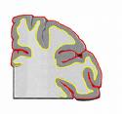
Cerebral hemispheres
Cerebrum consists of gray matter, white matter and basal ganglia.
  Gray matter, also called the cerebral cortex, is the outermost portion. Consists of neuron cell bodies and unmyelinated fibers.
  White matter – just below the gray matter. Makes up most of the cerebrum. Made of myelinated fibers.
  Basal ganglia – additional areas of gray matter scattered throughout the white matter.

Slide 68
Cerebral cortex areas
There are regions of the cerebral cortex that have specific jobs.
Primary sensory area is in the post central gyrus of the parietal lobe.
Primary motor areas are in the frontal lobe.
Association areas – involved in the process of recognition. Analyze and interpret data.
Basal ganglia – Function as relay stations or areas of synapse. Have an important role in posture and coordination.
Also there are specific areas for major sense interpretation.

Slide 69
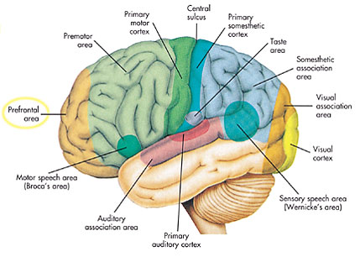
Functional cerebral areas

Slide 70
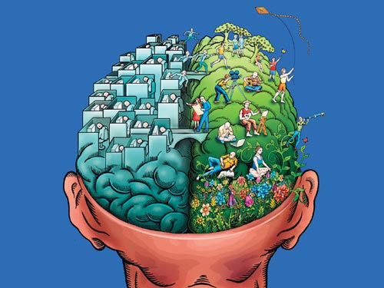
Hemisphere dominance

Slide 71
In most people, one side of the cerebrum is dominant – controlling the ability to use and understand language.
Again, in MOST people, the left hemisphere is dominant for language, speech, writing and complex intellectual functions.
The non-dominant hemisphere specializes in nonverbal functions like motor tasks that require concentration, interpreting musical patterns, and usually controls emotional thinking.

Slide 72
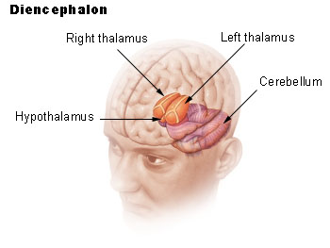
Diencephalon
The diencephalon is centrally located and nearly surrounded by cerebrum.
The diencephalon includes
  The thalamus
  The hypothalamus
  Epithalamus
  It is mostly gray matter.

Slide 73
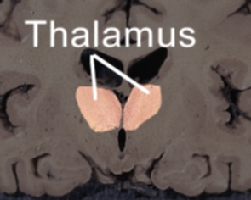
Thalamus – 2 oval masses of gray matter that act as relay stations for sensory impulses.
Channels impulses to the appropriate region of the cortex.

Slide 74
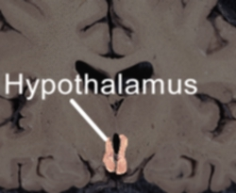
Hypothalamus – helps to maintain homeostasis by regulating visceral activities.
Also serves as a link to the endocrine system by regulating the pituitary gland.

Slide 75
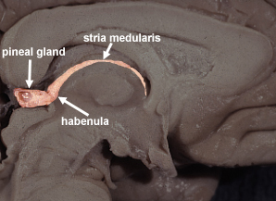
Epithalamus – consists of the pineal gland which is involved with the onset of puberty and rhythmic cycles in the body.
Similar to a biological clock.

Slide 76
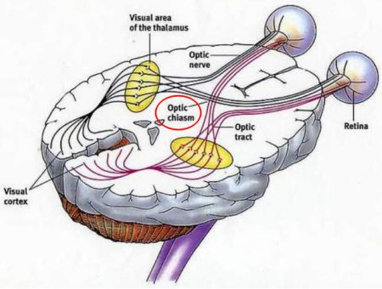
Optic chiasm
The optic chiasm is formed by the crossing of the optic nerves over each other in the diencephalon.

Slide 77
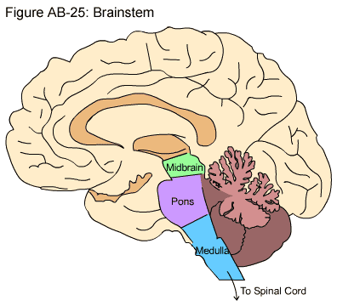
Brain Stem
The region between the diencephalon and the spinal cord.
It consists of three regions
  Midbrain
  Pons
  Medulla oblongata

Slide 78
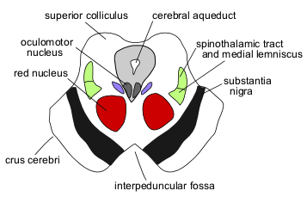
Midbrain
Midbrain – uppermost portion of the brain stem.
Has several features that act as visual reflex centers and auditory reflex centers.
It also has a channel that allows CSF to flow down.
Voluntary motor tracts as well.

Slide 79
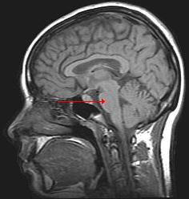
Pons
Below the midbrain
Forms conduction tracts between higher brain centers and spinal cord.
Also contains areas that help regulate breathing.

Slide 80
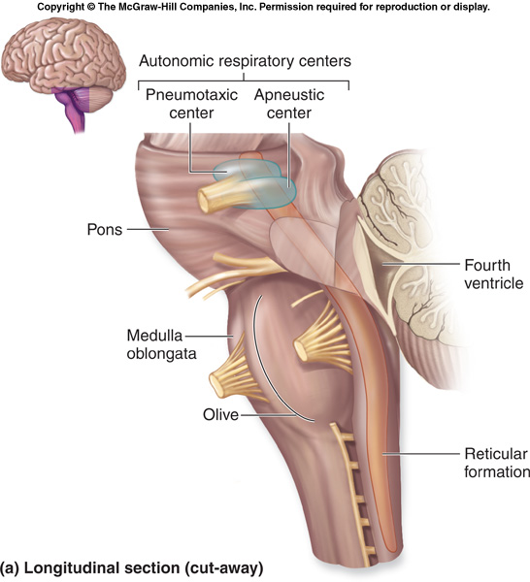
Pons –breathing centers

Slide 81
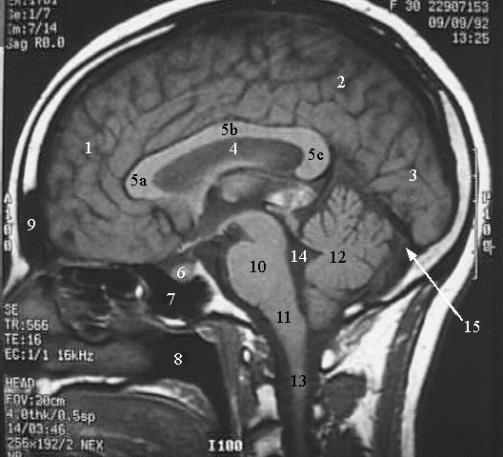
Medulla oblongata
Medulla – is continuous with the spinal cord.
All ascending and descending nerves pass through the medulla.
Three vital centers
  Cardiac center controls heart rate
  Vasomotor center controls blood pressure
  Respiratory center regulates rate, rhythm and depth of breathing.

Slide 82
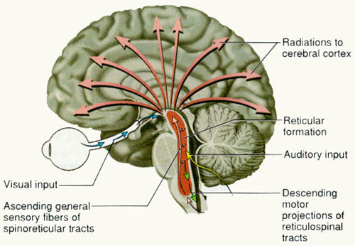
Reticular formation – scattered throughout the medulla, pons, and midbrain.
A complex network of nerve fibers
When sensory impulses reach the RF, it “wakes” the cerebral cortex.
Decreased activity here results in sleep.
Destruction of the RF results in a permanent comatose state.

Slide 83
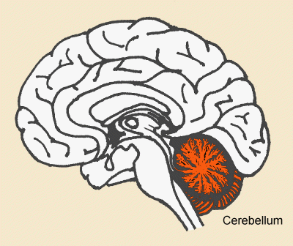
Cerebellum
Cerebellum – the 2nd largest portion of the brain.
Located below the occipital lobes.
Consists of two cerebellar hemispheres.
Consists of white matter surrounded by a thin layer of gray matter.
The gray matter is the cerebellar cortex
Responsible for coordination, posture, and balance.

Slide 84
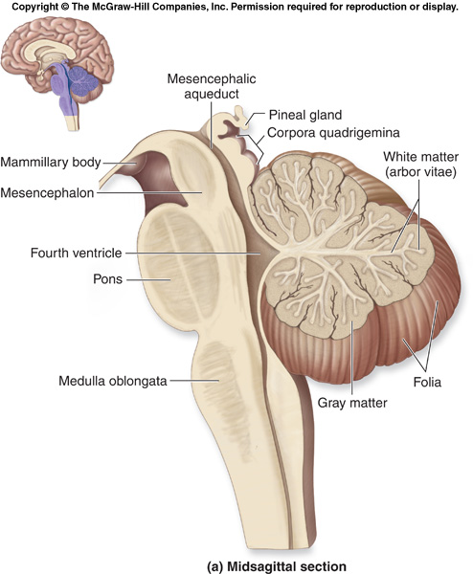
Cerebellum
Cerebellar white matter is called arbor vitae because it branches like a tree.
There are pathways of communication called peduncles between the cerebellum and other parts of the cns.

Slide 85
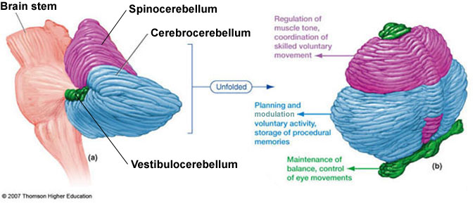

Slide 86
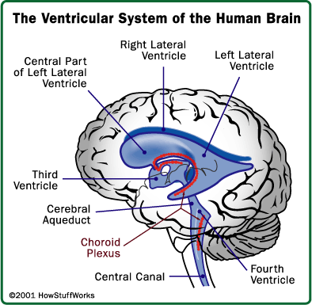
Ventricles and CSF
The brain has 4 ventricles. These are fluid-filled cavities.
Fluid produced in the brain (cerebrospinal fluid or CSF) circulates through the ventricles and around the spinal cord.
CSF provides support, protection and helps to nourish the brain and remove waste products.

Slide 87
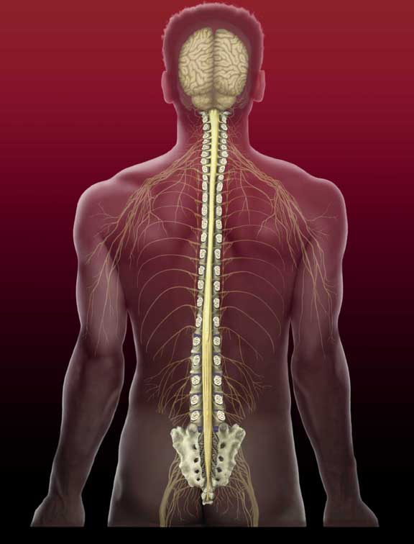
Spinal Cord
The spinal cord is part of the CNS.
Extends from the foramen magnum to the level of L1.
It is surrounded by bone, meninges, and CSF.
It is separated from the bones by the epidural space.
There is a collection of nerves at the end of the spinal cord that resembles a horse’s tail called the cauda equina.

Slide 88
Each segment of the spinal cord gives rise to a pair of spinal nerves. These nerves branch out to the various body parts.
There are 2 enlargements of the spinal cord, one in the neck called the cervical enlargement, and one in the lower back called the lumbar enlargement.
The cervical enlargement gives rise to the nerves that supply the upper extremity.
The lumbar enlargement gives rise to the nerves that supply the lower extremity.

Slide 89
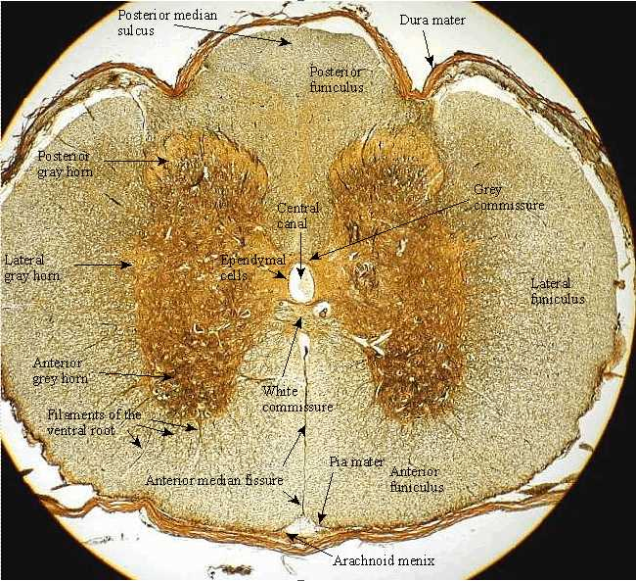
Spinal cord

Slide 90
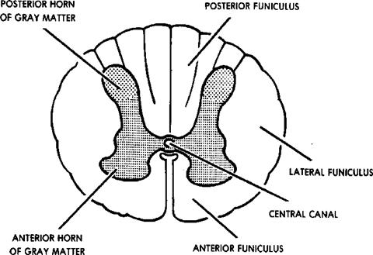
Spinal cord
The cord is basically divided into two halves.
White matter surrounds gray matter.
The white matter contains bundles of myelinated nerve fibers.
The gray matter contains sensory neuron axons, interneurons, and dendrites and cell bodies of motor neurons.

Slide 91
Spinal cord
Two main functions of spinal cord are conduction of impulses going to and from the brain, and serving as a reflex center.
Conduction pathways that carry impulses from body parts TO the brain are ascending tracts.
Conduction pathways that carry motor impulses from brain to muscles and glands are descending tracts.
Tracts are named for the pathway they take – for example – spinothalamic tracts.
Reflexes do not require conscious thought.

Slide 93
Peripheral nervous system

Slide 94
Nerve contain bundles of fibers surrounded by connective tissue.
Sensory nerves – only sensory neurons.
Motor nerves – only motor neurons.
Mixed nerves – both types of fibers.
Peripheral nervous system is divided into somatic (voluntary) and autonomic (involuntary).

Slide 95
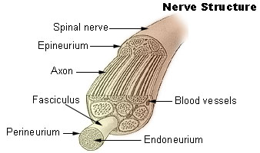
Nerve structure
Every nerve surrounded by a connective tissue sheath called epineurium.
Each bundle of nerve fibers is a fasciculus.
Each fasciculus surrounded by perineurium.
Each individual nerve is covered by endoneurium.

Slide 96
Cranial Nerves
There are 12 pairs of cranial nerves.
All innervate head, neck, and facial structures.
Most cranial nerves have both sensory and motor functions.
Many of the cranial nerves are associated with special senses.

Slide 97
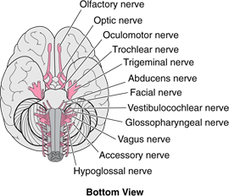
Cranial Nerves
Oh, Oh, Oh! To Take A Family Vacation! Go Vegas After Hours!

Slide 98

Spinal Nerves
Each pair of spinal nerves corresponds to a segment of the spinal cords.
There are
  8 cervical nerves
  12 thoracic nerves
  5 lumbar nerves
  5 sacral nerves
  1 coccygeal nerve

Slide 99

Spinal Nerves
Each spinal nerve is connected to the spinal cord by 2 roots, the dorsal and ventral.
Dorsal root is sensory, ventral root is motor.
These roots join together to form the spinal nerves.
After leaving the vertebral column, the nerves divide into branches.

Slide 100
Autonomic Nervous Sys.
The autonomic nervous system sends motor impulses to visceral organs.
It functions automatically and continuously, without conscious effort.
It maintains heart rate, breathing rate, blood pressure, body temperature, and other activities to maintain homeostasis.
The ANS has 2 parts:
  Sympathetic
  Parasympathetic
  Many organs have fibers from both divisions.

Slide 101


Slide 102
Sympathetic system – generally most concerned with preparing the body for active, emergency or stressful situations.
It stimulates responses necessary to meet the emergency.
Acetylcholine is the neurotransmitter at the preganglionic fibers. They are called cholinergic fibers.
At the postganglionic fibers, norepinephrine is released and they are called adrenergic fibers.

Slide 103
Parasympathetic system – most active under ordinary and relaxed conditions.
It acts to bring the body back to normal after an emergency or stressful response.
Both preganglionic and postganglionic fibers are cholinergic.
The parasympathetic effect is short term because ACH is readily inactivated.

Slide 104
Nervous System Disorders
Trauma concussion, herniated disc
Inflammation meningitis
Degenerative Parkinson’s disease Alzheimer’s disease
Toxins Botulism, tetanus
Malformations Hydrocephalus, spina bifida
Cardiovascular Stroke, hemorrhage

Slide 105

Trauma

Slide 106

Trauma
New studies are definitely linking a concussion with tissue injury in the brain itself.
Orange areas in this brain are a result of concussion.

Slide 107


Trauma
Herniated lumbar disc
Herniated cervical disc

Slide 108

Inflammation
Meningitis
Encephalitis

Slide 109

Degenerative diseases
Parkinson’s disease – a result of gradual degeneration of nerve cells in the midbrain that control body movement.

Slide 110

Symptoms of Parkinson’s disease include :
  Tremor
  Lack of facial movement
  Difficulty with gross motor movements.

Slide 111

Degenerative diseases
In the Alzheimer brain:
The cortex shrivels up, damaging areas involved in thinking, planning and remembering.
Shrinkage is especially severe in the hippocampus, an area of the cortex that plays a key role in formation of new memories.
Ventricles (fluid-filled spaces within the brain) grow larger.

Slide 112

Toxins

Slide 113

Toxins
Tetanus – caused by bacteria getting into untreated wounds.
The toxin produced by the bacteria causes muscle spasm because of nerve irritation.
Also known as lockjaw.

Slide 114
Malformations
These are diseases present at birth which are malformations of a part of the nervous system.
Included are
  Spina bifida
  Hydrocephalus

Slide 115


Malformations
Hydrocephalus
Spina bifida

Slide 116

Cardiovascular disorder

Slide 117

Symptoms of stroke are related to the area in the brain which has lost blood flow.
Some patients lose speech and motion, others lose only 1 or the other.
Stroke can be fatal.

