Slide 1
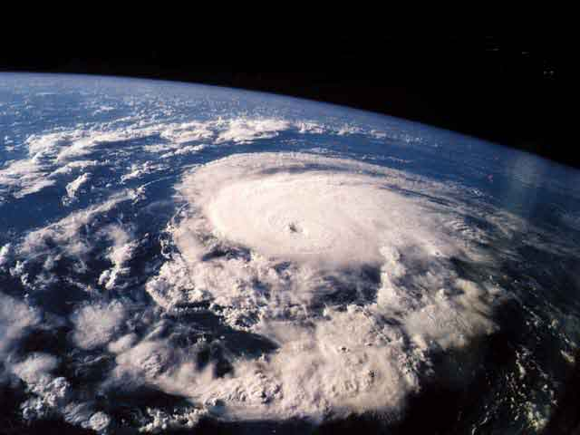
Chapter 25 Weather

Slide 2
25.1 Air Masses
Section Objectives
Explain how an air mass forms
List and describe the types of air masses that usually affect the weather of North America

Slide 3
What is an air mass?
Definition: a large body of air that has a uniform temperature and moisture content
When a body of air moves slowly or remains stationary over a uniform surface it takes on the characteristic temperature and humidity of that region – this happens in areas where air pressure differences are small and the air remains relatively stationary.
Remember – air moves due to pressure differences which are due to uneven heating of the earth
(equator, convection cells, Coriolis effect)

Slide 4
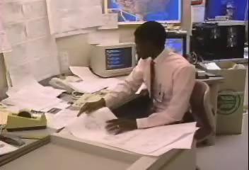
Air Masses

Slide 5
Where do air masses form?
A source region where air masses form must have a uniform temperature and moisture content such as occurs over frozen polar regions (cold and dry) or tropical oceans (warm and moist)

Slide 6
Types of Air Masses
Air masses are classified according to their source regions
cold air masses = polar regions = P
warm air masses = tropical areas = T
ocean = maritime = m (moist)
land = continental = c (dry)
Four main types of air masses
maritime polar (mP) maritime tropical (mT)
continental polar (cP) continental tropical (cT)

Slide 7
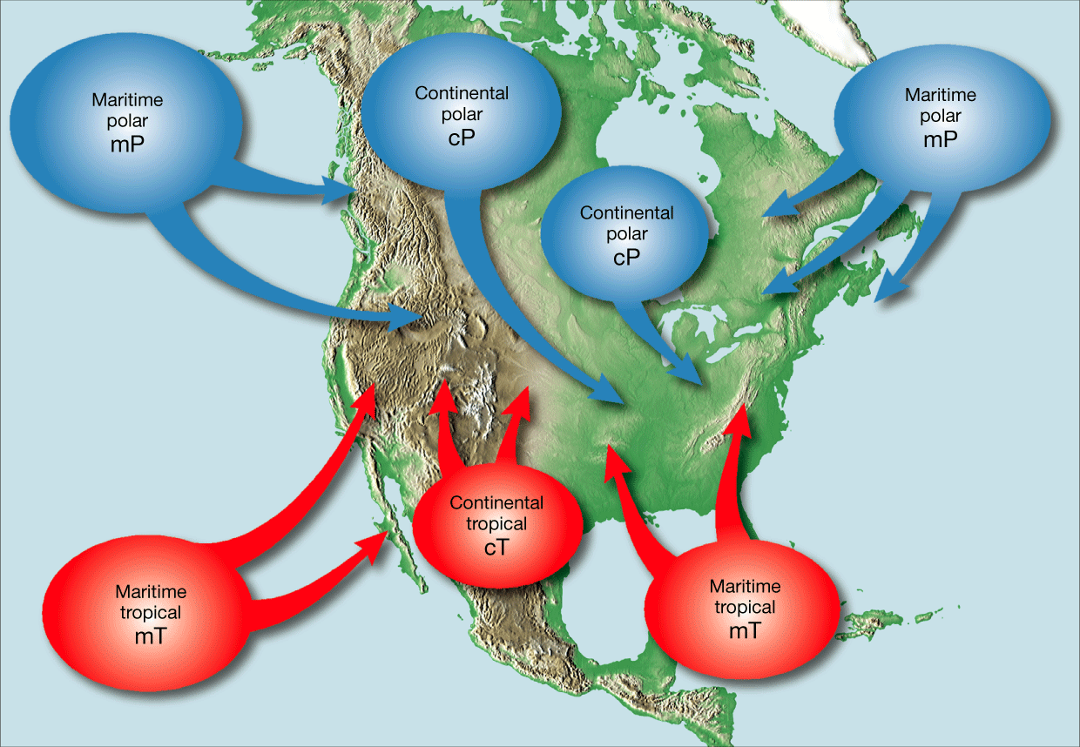
North American Air Masses

Slide 8
Polar Air Masses
Three Polar air masses influence weather in North America
Continental polar Canadian (cP)
- form in northern Canada over land covered by ice
and snow
- move southeastward across Canada and into
northern United States
- summer = cool, dry weather
winter = very cold weather

Slide 9
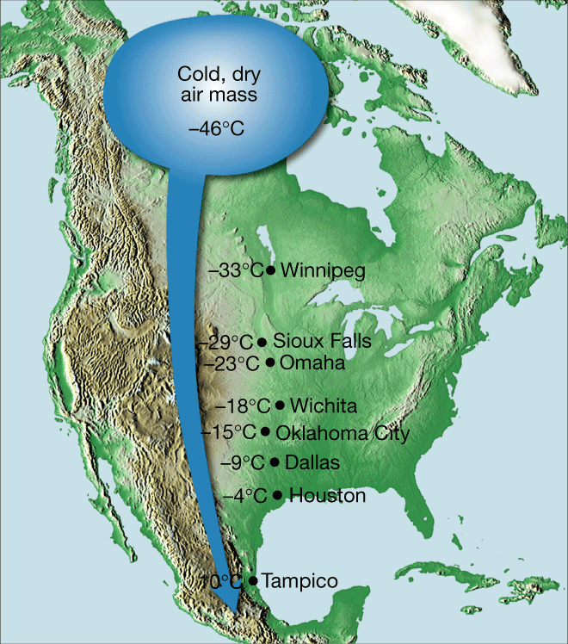
Frigid Canadian Air Mass moves Southward

Slide 10
Polar Air Masses
Maritime polar Pacific (mP)
- form over cool waters near Alaska’s Aleutian
Islands
- very moist but not extremely cold
- affect the Pacific coast mostly
- summer = cool foggy weather
winter = rain and snow
- lose their moisture as they pass over the Cascades
and bring cool, dry weather to mid- US

Slide 11
Polar Air Masses
Maritime polar Atlantic (mP)
- form over the North Atlantic Ocean (cool waters
between Greenland and Iceland)
- move generally eastward toward Europe but may
pass over New England and eastern Canada
- winter = cold, cloudy weather and precipitation
summer = cool weather with low clouds and fog

Slide 12
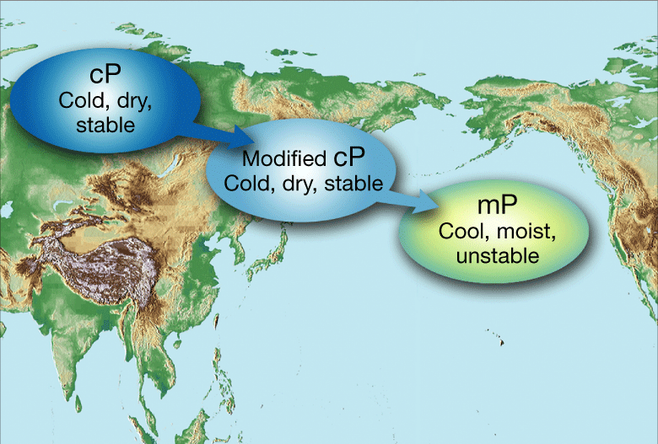
Maritime Polar Air Masses

Slide 13
Tropical Air Masses
Four tropical air masses influence the weather in North America
Continental tropical (cT)
- form over the deserts of northern Mexico and
southwestern US
- move northeastward
- bring clear dry and very hot weather

Slide 14
Tropical Air Masses
Maritime tropical gulf and Maritime tropical Atlantic (mT)
- form over the warm water of the Gulf of Mexico and
tropical North Atlantic Ocean
- move northward across the eastern US
- winter = mild cloudy weather
summer = hot, humid weather, thunderstorms,
hurricanes

Slide 15
Tropical Air Masses
Maritime tropical Pacific (mT)
- form over the warm areas of the North Pacific
Ocean
- rarely reach the Pacific Coast
- winter = heavy precipitation and thunderstorms to
the coast and southwest deserts

Slide 16
North American Air Masses

Slide 17
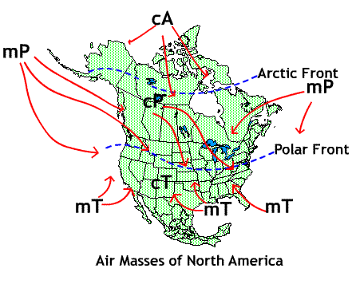
North American Air Masses

Slide 18
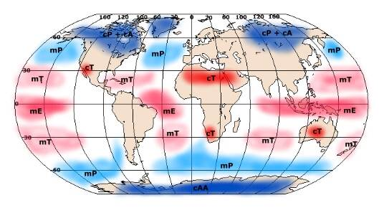
Global Air Masses

Slide 19

Air Masses an Introduction

Slide 20
Questions
1.Define Air Mass
a large body of air with uniform temperature and moisture content
2. What is the name of the air mass that forms over the warm water of the Gulf of Mexico?
maritime tropical gulf
What letters designate the source region of this air mass?
mT
3. Suppose that the snow is falling on the Pacific Coast area.
What type of air mass is probably responsible for this weather?
Maritime polar Pacific
What letters designate the source region of this air mass?
mP

Slide 21
25.2 Fronts
Section Objectives
Compare the characteristic weather patterns of cold fronts with those of warm fronts
Describe how a wave cyclone forms
Describe the stages in the development of hurricanes, thunderstorms, and tornadoes

Slide 22
What is a front?
When two air masses meet, density differences usually keep the air masses separate and a boundary forms between the air masses which is called a front

Slide 23
Types of Fronts
Cold front
Warm front
Occluded front
Stationary front

Slide 24
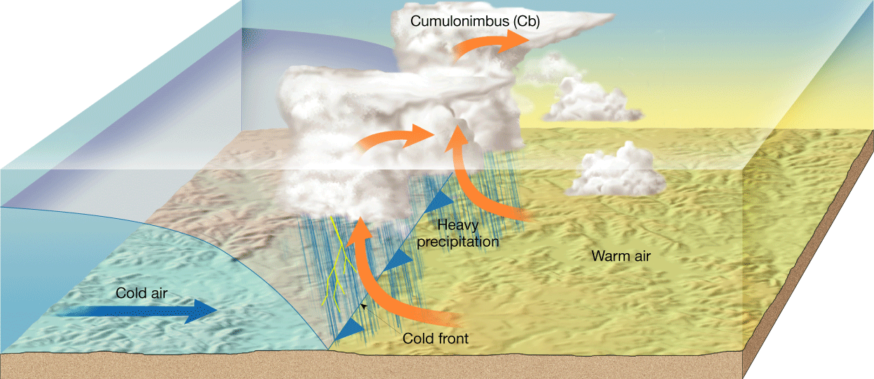
Cold Front
forms when a cold air mass overtakes a warm air mass (moving cold air lifts the warm air)

Slide 25
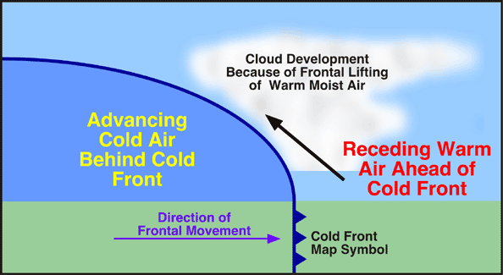
Cold Front

Slide 26
Cold Front

Slide 27
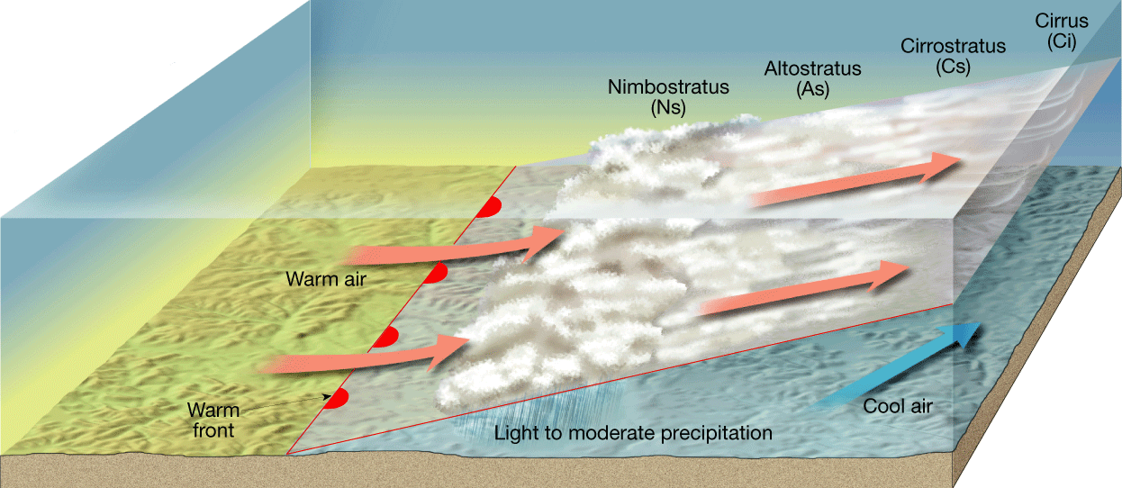
Warm Front
forms when a warm air mass overtakes a cooler air mass ( less dense warm air rises over the cooler air)

Slide 28
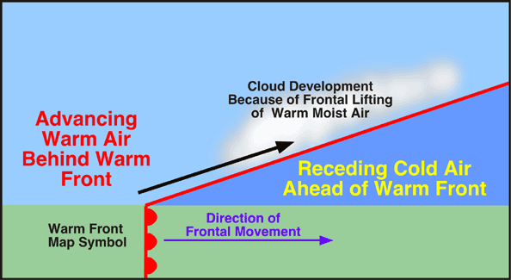
Warm Front

Slide 29
Warm Front

Slide 30
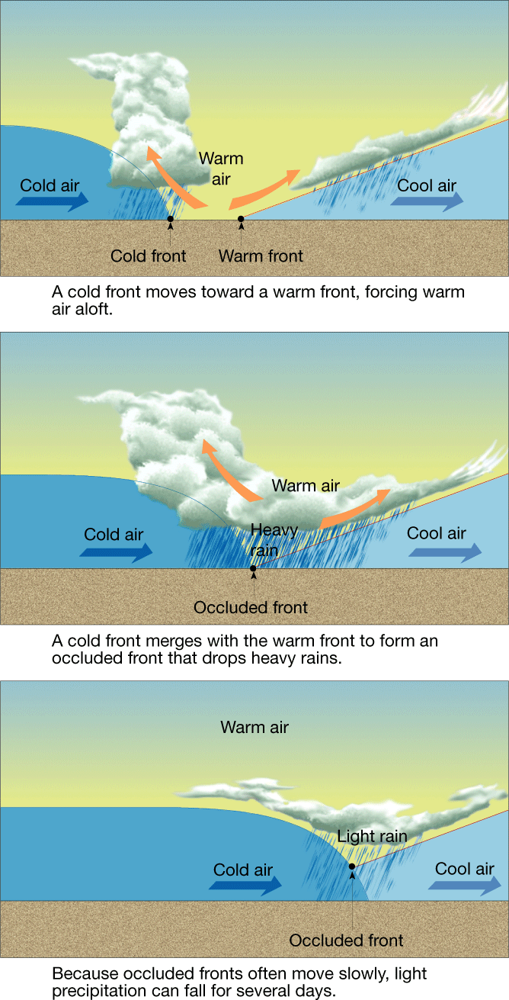
Occluded Front
Forms when a fast-moving cold front overtakes a warm front, lifting the warm air completely off the ground

Slide 31
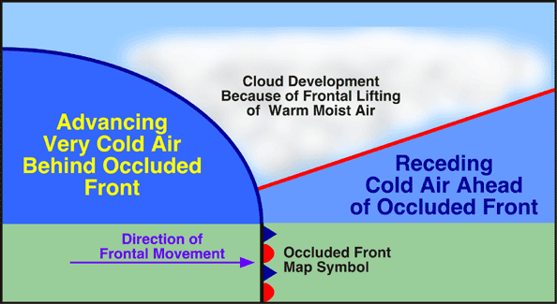
Occluded Front

Slide 32
Occluded Front

Slide 33
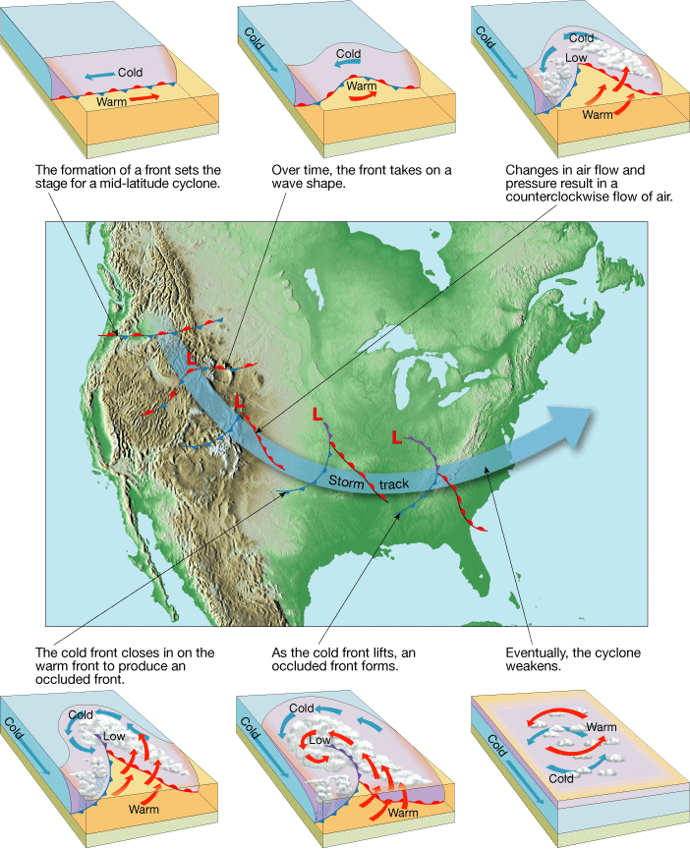
Polar Fronts and Wave Cyclones

Slide 34
What are waves?
They form along polar fronts and are often developed by the high speed jet-stream winds
These waves are the beginnings of low-pressure storm centers called wave cyclones…large storms up to 2,500 km in diameter (mid latitude cyclones)

Slide 35
Stages of a wave cyclone
Wave cyclones occur along a cold or a stationary front
A wave cyclone begins when a bulge of cold air develops and advances slightly ahead of the rest of the front.
As the fast moving cold front overtakes the slow moving warm front, an occlusion forms and the storm reaches its highest intensity.
Generally within 24 hours after the occlusion, the system loses all its energy and the wave cyclone disappears

Slide 37
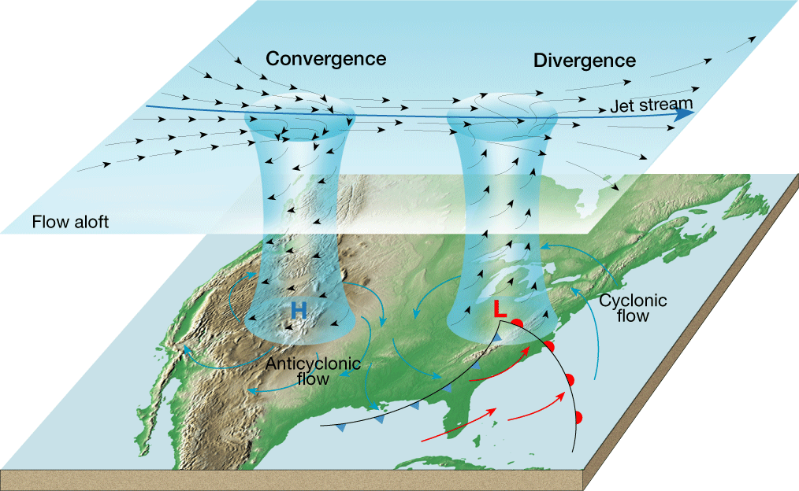
Cyclonic flow and anti-cyclonic air flow

Slide 38
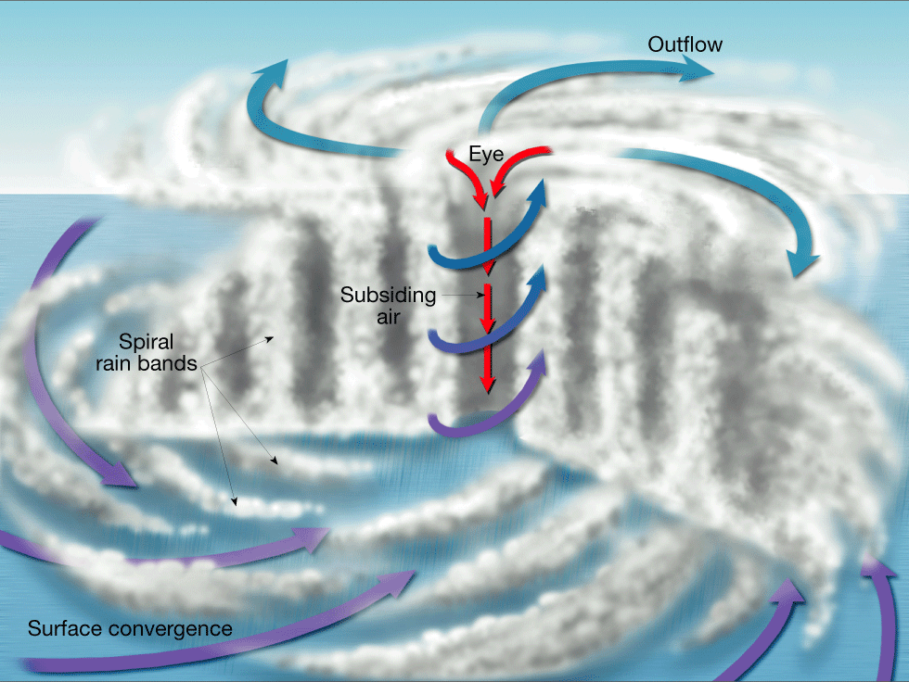
Hurricanes

Slide 39
What is a hurricane?
Severe tropical storm with wind-speeds over 120 km per hour
Develop over warm tropical waters
Winds spiral rapidly in toward a low pressure storm center
Greatest number of hurricanes (20 per year) occur in the western North Pacific ocean (typhoons)
Consists of a series of thick cumulonimbus cloud bands spiraling upward around the center (eye)

Slide 40
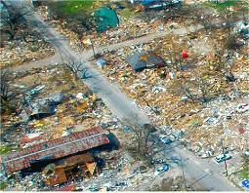
Hurricane Statistics
Winds may reach 275 km along the eyewall
Most deaths during hurricanes are due to drowning

Slide 41
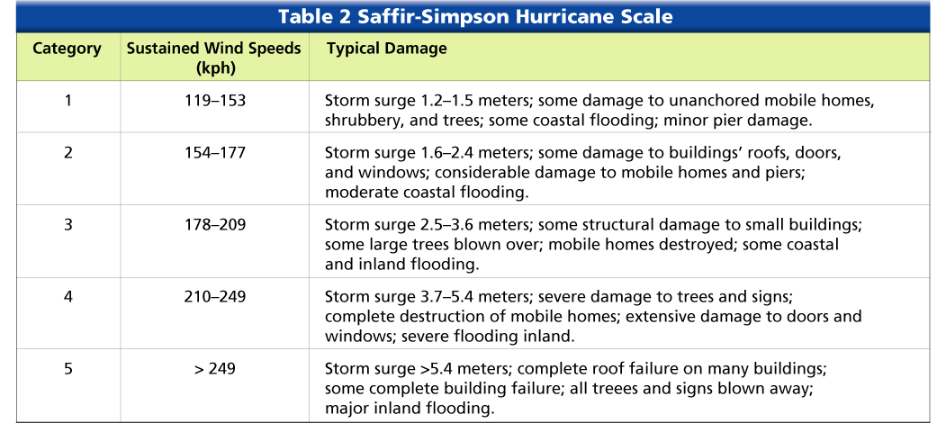
Hurricanes

Slide 42
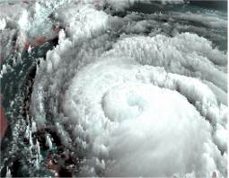
Hurricane Andrew

Slide 43
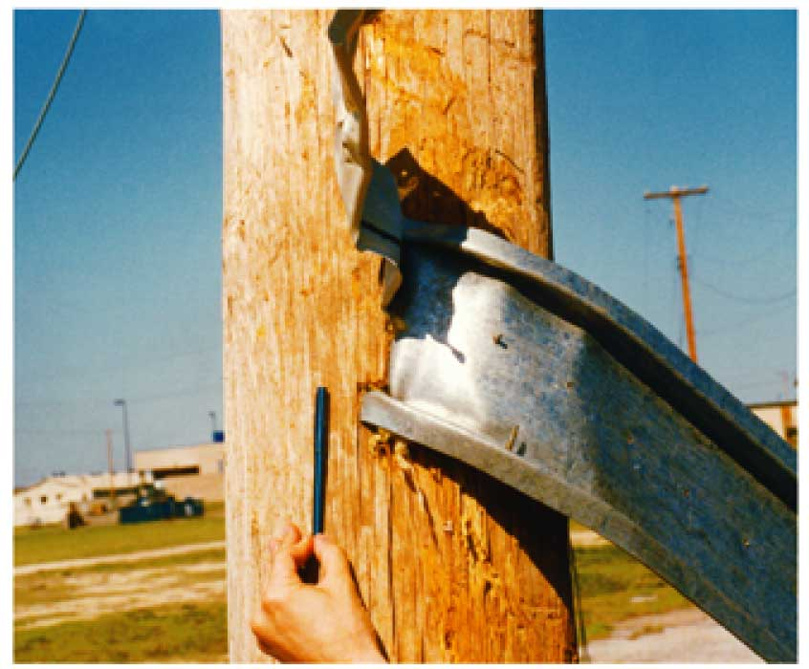
Hurricane Damage

Slide 44
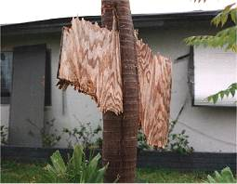
Hurricane Damage

Slide 45
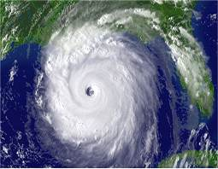
Hurricane Katrina

Slide 46
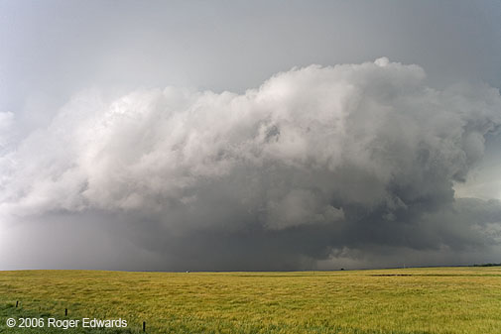
Thunderstorms

Slide 47
What is a thunderstorm?
Storm accompanied by thunder, lightning and strong winds
Portion of air in a warm, moist mT (maritime tropical) air mass is heated and rises
Commonly occur in the late afternoon or early evening
Air rising over mountains or in a cold front also form severe thunderstorms

Slide 48
Stages of a thunderstorm
cumulus stage – warm moist air rises until the water vapor within the air condenses and forms a cumulus cloud
mature stage – violently rising warm moist air swells higher and higher forming a cumulonimbus cloud – may be 15 km tall and form an anvil shape at the top –characterized by strong updrafts and downdrafts
Dissipating stage – downdrafts stop upward air currents

Slide 49
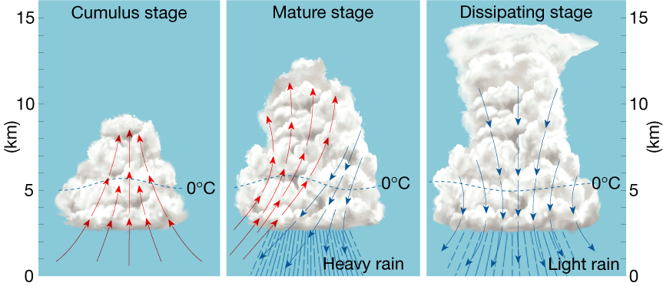

Slide 50
Thunder and Lightning
What is thunder?
the rapid expansion and collapse of air heated by lightning discharge
What is lightning?
discharge of electrical energy due to distinct differences in electrical charges throughout the cloud (negative in the bottom and positive in the top)

Slide 51
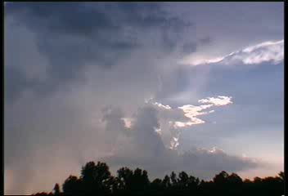
How do thunderstorms form

Slide 52
If you see lightening…
Only 10-20% of lightening take place between the clouds and the ground
Avoid bodies of water and metal objects
Lightening takes the shortest path between the cloud and the ground
Avoid high locations in open land

Slide 53
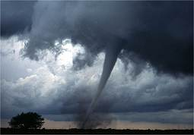
Tornadoes

Slide 54
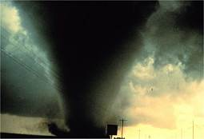
What Is a tornado?
Smallest, most violent and shortest lived severe storm
Forms when a thunderstorm meets high-altitude, horizontal winds which make the rising air in the thunderstorm rotate and create the familiar funnel

Slide 55
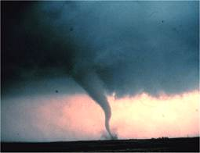
Where do they occur?
Most common in “Tornado Alley” in the south-central and mid-western United States during the late spring and early summer

Slide 56
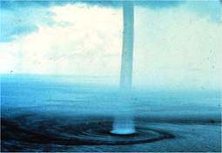
What are waterspouts?
Tornadoes over the ocean – less powerful and usually smaller than tornadoes

Slide 57
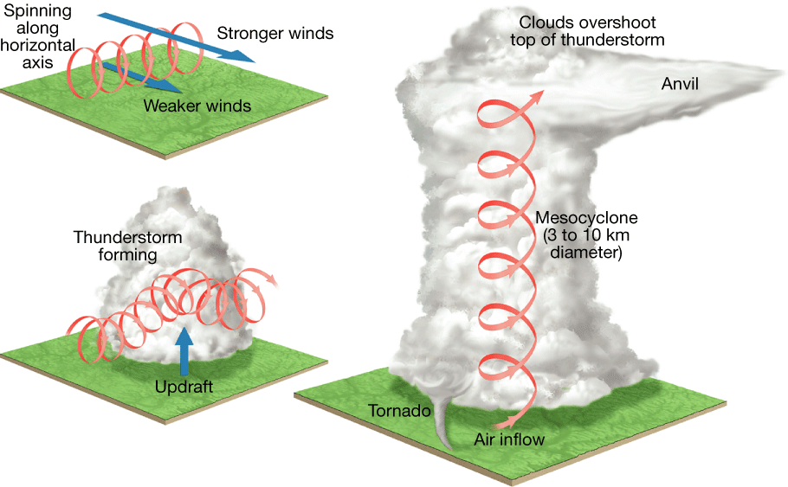
Mesocyclone

Slide 58
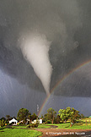
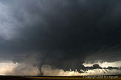
Tornadoes

Slide 59
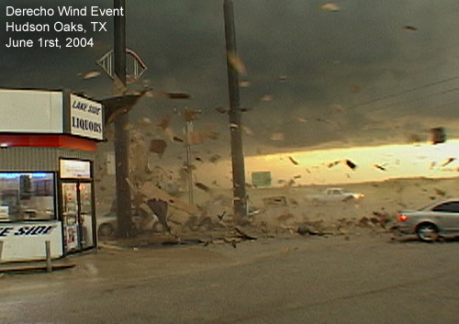
Tornado Damage

Slide 60
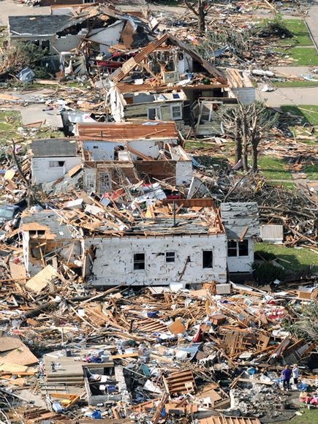
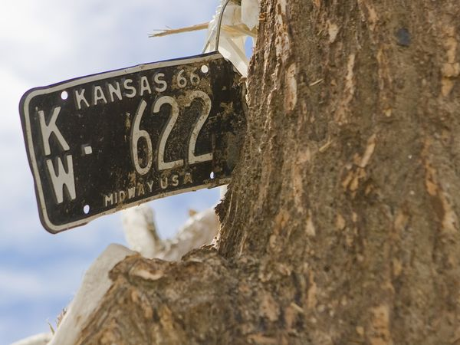
Tornado damage

Slide 61
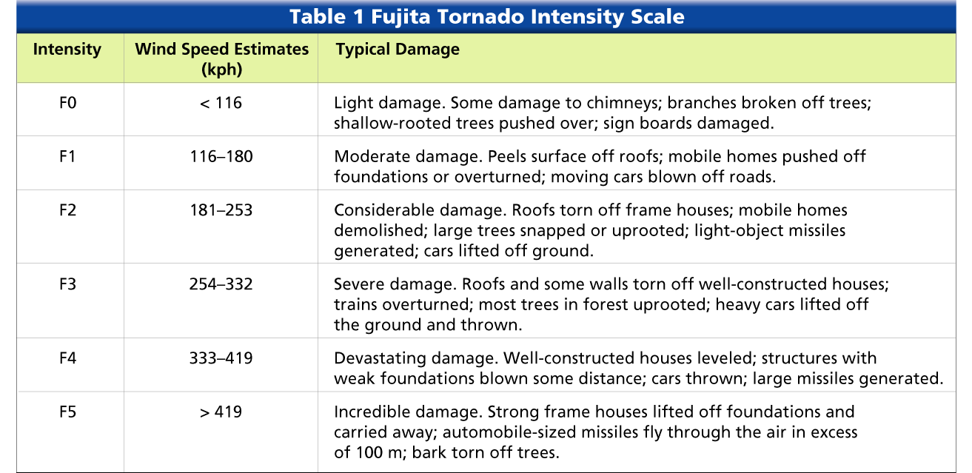
Fujita Scale

Slide 62
Questions
What kind of front forms when a cold air mass overtakes a warm air mass?
a cold front
What is the general storm track commonly traveled by wave cyclones in North America?
west to east
If you are canoeing on a lake when a thunderstorm breaks out, are you in danger of being struck by lightning?
Yes bodies of water are likely targets

Slide 63
25.3 Weather Instruments
Section Objectives
Describe the types of instruments used to measure air temperature and wind speed
Describe the instruments used to measure upper-atmospheric weather conditions

Slide 64
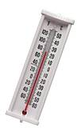
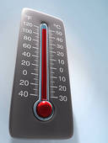
Measuring Air Temperature
Mercury or alcohol thermometer – rise in temperature causes the liquid to expand and move up the tube or a drop in temperature cases the liquid to contract and move down the tube.

Slide 65
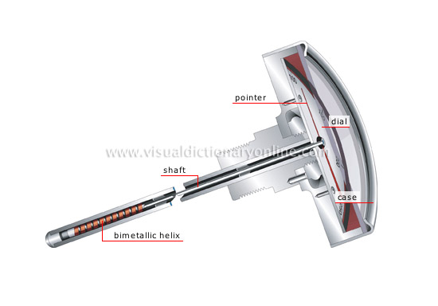
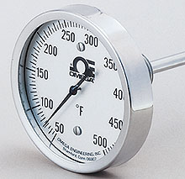
Bimetal thermometer – two strips of different metals such as brass and iron which expand different amounts when heated and contract when cooled- recorded by a thermograph

Slide 66

Electrical thermometer – electric current flowing through certain materials increases as temperature rises

Slide 67
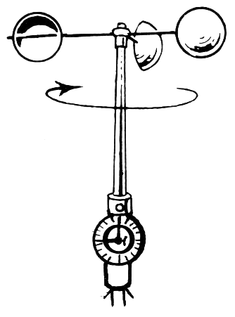
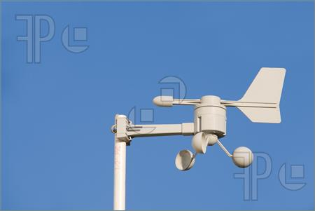
Measuring wind speed
Anemometer - measures wind speed

Slide 68
Beaufort Wind Scale
(kmPH)– Term Description
0-5 Calm Smoke goes straight up
6-20 Light Wind is felt on face;
leaves rustle
21-39 Moderate Raises dust; flags flap
40-61 Strong Large branches move;
umbrellas turn inside out
62 + Gale / Whole Gale

Slide 69


Measuring wind direction
Wind vane – measures direction …wind is described according to the direction from which it comes….westerly describes a wind that blows from the west

Slide 70
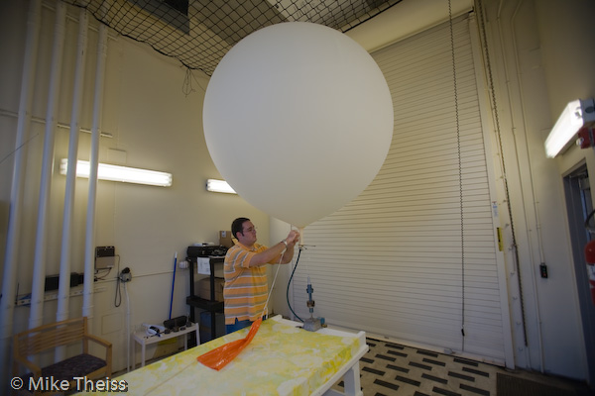
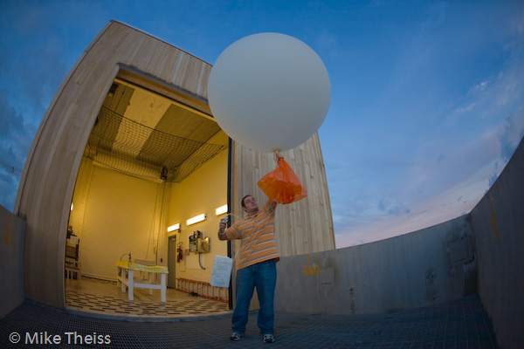
Measuring Upper atmospheric conditions
Radiosonde – instrument that measures relative humidity, air pressure and air temperature ….carried by helium filled weather balloons….measurements sent back by radiowaves

Slide 71
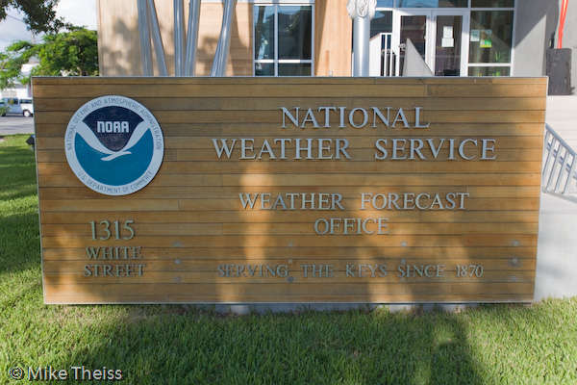
Weather balloon launch site

Slide 72
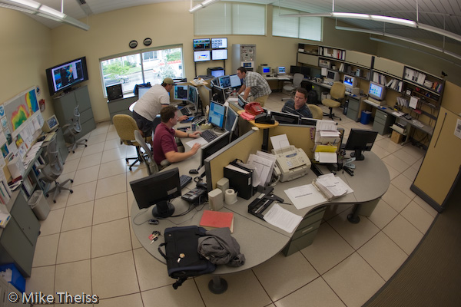
Weather balloon data

Slide 73
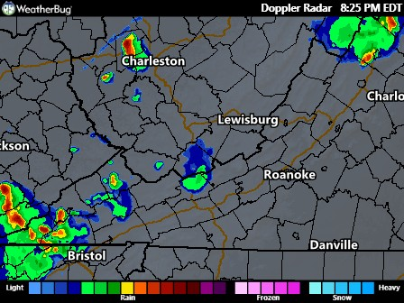
Doppler Radar
Electronic device that transmits pulses of radio waves in the form of a beam
Can indicate the precise location ,movement and extent of a storm as well as the intensity of precipitation and wind patterns

Slide 74

Radar to track thunderstorms

Slide 75
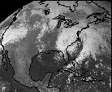
Weather satellites
Satellite images and instruments can give data on atmospheric conditions all over the globe and feed this information to computers for instant processing…giving meteorologists greater forecasting power

Slide 76
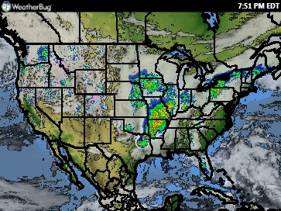
Weather Underground

Slide 77
Questions
1. How does a bimetal thermometer work?
the different rates of expansion of the two metals in a bar cause it to curve when heated and straighten when cooled
2. What does a radiosonde measure?
relative humidity, temperature, and air pressure in the upper atmosphere
If a wind vane is pointing toward the west, from what direction is the wind blowing?
from the west it is constructed to point into the wind

Slide 78
25.4 Forecasting the Weather
Section objectives
Explain how a weather map is made
Describe the steps involved in preparing a weather forecast

Slide 79
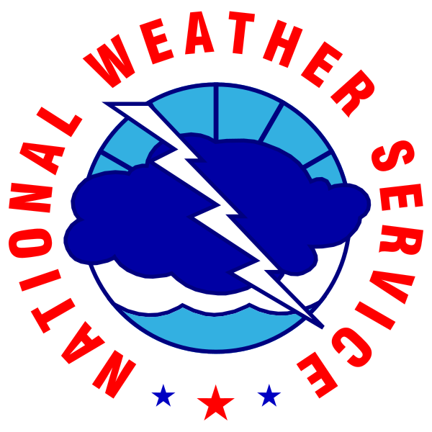

Weather information gathering

Slide 80

Making a weather map
Station model – clusters of symbols plotted around a reporting station showing the conditions at that station

Slide 81

Weather maps

Slide 82

Sky Coverage

Slide 83

Clouds

Slide 84

Wind
Each barb equals 10 mph

Slide 85

Present Weather

Slide 86
Atmospheric pressure
On a weather map, lines are drawn to connect points of equal atmospheric pressure….these lines are called Isobars
Closely spaced = high wind
Widely spaced = low wind
speed

Slide 87

Front lines
Indicated by sharp changes in winds, temperature or humidity

Slide 88
Types of forecasts
Daily and Long –term forecasts
Using radar, satellite images, recent weather maps, computer predictions, personal experience using temperature, wind direction, wind speed, cloudiness and precipitation forecasts can be made for three to five days.
Expended forecasts of 6-10 days by computer analysis of slowly changing large-scale movements of air are less accurate

Slide 89
Controlling the weather
Project Stormfury (1962-1983) four hurricanes were seeded with mixed results
Project VORTEX (1994 and 1995) scientists chased tornado producing storms that helped to verify which radar signatures led to tornado formation….this led to the formation of NEXRAD (next generation weather radars) which extended tornado warnings by as much as half an hour.

Slide 90
Questions
1. What is a station model?
clusters of weather symbols and numbers around a weather-reporting station on a map
2. Why are new and 24 hour old weather maps compared?
to compare the progress of large weather systems
3. Explain which region on a weather map- one with widely spaced isobars or one with closely spaced isobars- has stronger winds?
the one with closely spaced isobars, because closely spaced isobars indicate a rapid change in pressure and high wind speeds

Slide 91

Tornado Alley

Slide 92
Raging Planet
VIDEO QUESTIONS
Raging Planet: Tornado Alley
1. Does a tornado have to be associated with lightning and thunder? (A tornado does not have to be associated with lightning and thunder. A tornado only needs warm air and cool air to collide for it to form.)
2. Where is “Tornado Alley.” (Tornado Alley stretches from West Texas to the Dakotas.)
3. Where might you find daily dust devils? (The superheated plains of West Africa have daily dust devils.)
4. Where does the Storm Prediction Center get its data? (The Storm Prediction Center gets its data from satellite images and a complex network of radar stations across the U.S.)
5. What is the difference between hail produced in regular thunderstorms and hail produced by supercells? (Hail from thunderstorms is generally less abundant and smaller than supercell hail, because the updrafts in supercell clouds recycle the hailstones a number of times, making them larger and larger.)
6. By how long has tornado warning time increased since 1972? (Tornado warning time has increased from one minute in 1972 to 20-30 minutes today.)
7. What do the purple and green areas on Doppler Radar indicate? (Purple means wind (or rain) is moving away from the observer. Green indicates wind moving toward the observer.)
8. If a Doppler Radar image has purple touching green, what is indicated? (Purple touching green on a Doppler Radar screen indicates a tornado.)

