Slide 1
World War I, Chapter 22 Notes

Slide 2
Roosevelt and Foreign Policy
Roosevelt left a strong imprint on America’s foreign policy
  Took for granted the superiority of Protestant Anglo-American culture
  Believed that America must be militarily strong
  Roosevelt orchestrated the independence of Panama so that a canal could be built through the country

Slide 3
Roosevelt Corollary to the Monroe Doctrine
If countries in the Americas cannot keep order, America would act as an international police power to restore order
Roosevelt mediated a settlement of the Russo-Japanese War at Portsmouth, New Hampshire in 1905 and won the Nobel Peace prize in 1906

Slide 4
Taft and Wilson
Taft—replaced Roosevelt’s “big stick” with the weapon of business investment—”dollar diplomacy”
Wilson—In 1913, Wilson observed that it “would be the irony of fate if my administration had to deal chiefly with foreign affairs
Wilson emphasized capitalist development, democracy, and free trade

Slide 5
WWI
Triple Alliance
  Germany
  Austria-Hungary
  Italy
Triple Entente
  Great Britain
  France
  Russia

Slide 6
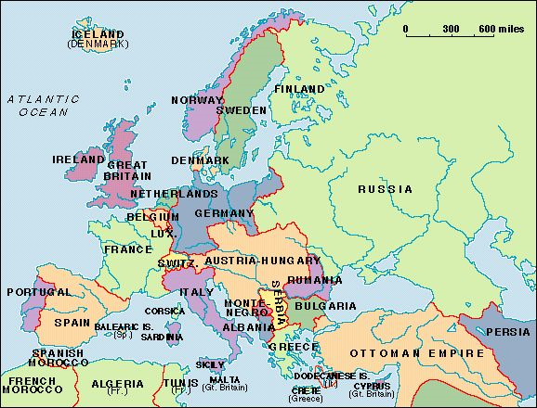

Slide 7
Guns of August
Alliance system between nations in Europe threatened to trap the continent in war if two countries went to war
June 28, 1914—Archduke Franz Ferdinand, heir to the throne of the Austro-Hungarian Empire, was assassinated in Sarajevo, Bosnia
Killer?—a Serbian nationalist who believed the Austro-Hungarian province of Bosnia should be annexed to Serbia
Germany pushed Austria-Hungary to retaliate against Serbia and the Serbians asked Russia for help

Slide 8
WWI
German forces were stopped at the River Marne in September of 1914
Fighting in northern France killed 5 million over the next two and a half years

Slide 9
American Neutrality
President Wilson issued a formal proclamation of neutrality and urged Americans to be “impartial”
This was impossible—
  8 million German Americans and 4 million Irish Americans supported the Central powers
  Britain and France bought a lot of war supplies from the United States—bringing about an economic boom in the US

Slide 10
Preparedness
Germany declared the waters around the British Isles to be a war zone
Began unrestricted submarine warfare—with no warning
May 7, 1915—a German U-boat sank the British liner Lusitania off the coast of Ireland
128 Americans died on board
Wilson protested

Slide 11
March of 1916—German U-boat torpedoed the Sussex, an unarmed French passenger ship, injuring four Americans
German promised Wilson that all vessels would be visited prior to attack
Wilson began preparing for war
Wilson’s slogan in 1916: “He Kept Us Out of War” reveals the deep interest by Americans in staying out of the conflict

Slide 12
War
In February of 1917, Germany began unlimited submarine warfare, with no warnings
Wilson still hoped for peace, but prepared for war
March 1—Wilson publicized an intercepted message from German foreign secretary Arthur Zimmermann to the German Ambassador in Mexico

Slide 13
The Zimmermann telegram proposed an alliance between Germany and Mexico if the US entered the war—Mexico would get back territory in New Mexico, Texas, and Arizona
After the Germans sunk 7 US merchant ships, Wilson asked Congress for a declaration of war

Slide 14
Mobilization
Committee on Public Information (CPI) was created to organize public opinion
  Led by George Creel
  Literature
  Posters
  Celebrities
    Mary Pickford
    Douglas Fairbanks
    Ida Tarbell
  Campaigned against Germans

Slide 15
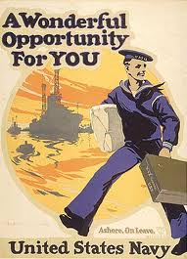

Slide 16
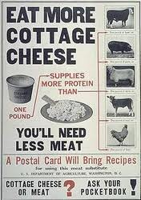

Slide 17
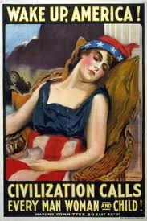

Slide 18
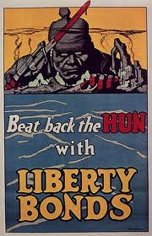

Slide 19
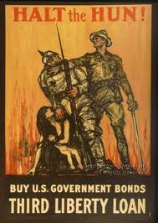

Slide 20
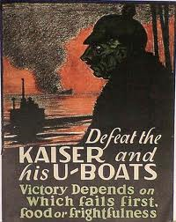

Slide 21
The Army
Not enough volunteers had responded to join the army
A draft was introduced
Selective Service Act
  Registration of all men between 21 and 35 years of age
  New draft did not allow for substitutes

Slide 22
Racism in the Military
Organized into segregated units
Barred from the Marines and Coast Guard
More than 200,000 African Americans eventually served in France, but only one in five saw combat

Slide 23
Americans in Battle
American Expeditionary Force
  Led by General John J. Pershing
  Western Front: 1918
    Spring of 1918—Germans launched a major offensive
    Germans were stopped at the battles of Chateau-Thierry and Belleau Wood
    Late Sept. 1918—AEF took over the southern part of a 200 mile front in the Meuse-Argonne offensive

Slide 24
    In 7 weeks of fighting, US soldiers used more ammunition than the entire Union army had in the four years of the Civil War
    Germans were outnumbered and looked for a cease fire
    Armistice was signed on November 11, 1918

Slide 25
Over Here
Organizing the Economy
  War Industries Board (WIB) oversaw the war effort
  Food and Fuel Act 1917—allowed the president to regulate the production and distribution of food and fuel necessary for the war effort
  Food Administration—led by Herbert Hoover
    Imposed price controls on commodities
    Hoover stopped short of mandatory rationing
      “Wheatless Mondays, Meatless Tuesdays, and Porkless Thursdays”

Slide 26
Business of War
War meant expansion and high profits for American business
Organized labor’s power grew during the war—working people had higher wages and a better standard of living during the war
IWW had denounced capitalism—Espionage Act was used by the Justice Dept. to crack down on the IWW

Slide 27
Women Suffrage
Western states led the way in allowing woman suffrage
WWI gave an opportunity for suffrage groups to seek a constitutional amendment
  NAWSA—National American Woman Suffrage Association pursued a policy of lobbying Congress
  In 1917, Wilson urged Congress to pass a woman suffrage amendment
  19th Amendment was ratified in 1920

Slide 28
Prohibition
1917—coalition of progressives and rural fundamentalists in Congress banned alcoholic drinks nationwide
18th Amendment was ratified in January of 1919 and became law one year later

Slide 29
Muzzling Dissent
Espionage Act of June 1917—
  Government used it to suppress anti-war sentiment
  It set severe penalties
  Postmaster general could exclude any newspapers or magazines he thought “treasonous”
  Bureau of Investigation enforced the act (later became the FBI)
  1918—Sedition Act outlawed any disloyal, profane, abusive language causing contempt for the government, Constitution, or flag
Acts were used to strike out at socialists, pacifists, and radicals

