Slide 1
The Twenties, Chapter 23 Notes

Slide 2
Postwar Prosperity and its Price
  Republican Warren G. Harding won the presidency in 1920 with the campaign slogan: “Return to Normalcy”
  However, the 1920s saw economic and cultural changes that guaranteed that things would not return to “normal”

Slide 3
Second Industrial Revolution
Prosperity of the 1920s rested on what historians have called the “second industrial revolution” in American manufacturing
Technology increased industrial output without expanding the labor force

Slide 4
Electricity:
  In 1914, only 30% of US factories had electricity
  By 1929, 70% relied on electric motors instead of steam
Mass-production techniques were applied to heavy industries and makers of consumer-durable goods:
  Cars, radios, washing machines, etc.
Building boom and demand for new housing

Slide 5
Modern Corporation
Management was separated from ownership interests
Management of business became more “scientific” and used theories of behavioral psychology
Oligopoly—control of the market by a few large producers—became the norm

Slide 6
Welfare Capitalism
Large employers promoted new programs designed to improve worker well-being and morale
  The goal? To challenge the power of trade unions
Examples:
  Stock purchase plans
  Offering insurance policies

Slide 7
The Auto Age
No other single development matched the impact of the postwar increase in car ownership on the American way of life
During the 1920s, America made 85% of all of the world’s passenger cars

Slide 8
Henry Ford
His continuous assembly line reduced the number of workers required to produce a car
Mass-production reduced the cost of cars—the Model T cost just under $300 in 1924: about 3 months’ factory wages
By 1927, Ford had produced 15 million Model Ts.

Slide 9
Impact of Cars
Traveling out of town was easier
Getting away from routines was easier
Teenagers could get away from their parents
Cars shaped urban communities
  Suburban communities grew at twice the rate of their core cities

Slide 10
Economic Exceptions
Agriculture
  Post WWI surpluses of cotton, hogs, and corn made prices drop sharply in 1920
  By 1921, farm income was down more than 50% from 1920
  The South was still dependent on cotton, and had not changed much since the 1890s

Slide 11
Coal became less important
Railroads began to lose out to cars and trucks
Textiles moved to the south, where non-union shops and lower wages allowed for more profits

Slide 12
Movie-Made America
By 1914, there were 18,000 movie houses showing motion pictures
The industry shifted to Hollywood and large studios such as Paramount, Fox, Metro-Goldwyn-Mayer (MGM), Universal, and Warner Brothers produced longer movies
These companies were founded and controlled by immigrants

Slide 13
Movie stars became important
Young Americans looked to movies to learn how to dress, wear their hair, talk, etc.
Many Americans worried about how Hollywood impacted traditional morality
Censorship by government was avoided, but was voluntarily managed by the Motion Pictures Producers and Distributors of America

Slide 14
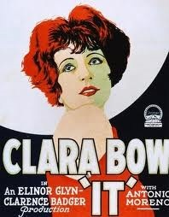

Slide 15
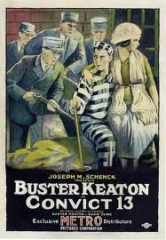

Slide 16
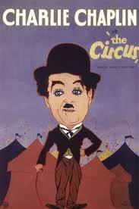

Slide 17
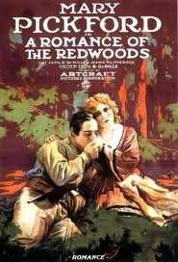

Slide 18
Radio
Before KDKA in Pittsburgh, radio was of interest only to the military and hobbyists
By 1923, nearly 600 stations had been licensed by the Department of Commerce and about 600,000 Americans had bought radios
Who would pay for radio?
  By the end of the 1920s, it had been determined that advertising would pay for it

Slide 19
Journalism
Tabloids
  A smaller, more convenient size than newspapers
  New York Daily News—circulation reached 400,000 in 1922 and 1.3 million by 1929
  Featured the gossip column

Slide 20
Advertising Modernity
Previously, advertising was confined mostly to newspapers and magazines
Advertising now took a more scientific approach
Advertisers focused on the needs, desires, and anxieties of the consumer, rather than on the qualities of the product
Ad campaigns created national brands

Slide 21
Sports and Celebrity
Spectator sports enjoyed an unprecedented growth in popularity and profitability
Major league baseball was the most popular sport
  George Herman “Babe” Ruth was the best example of the sports hero
  Baseball attendance reached 10 million/year in 1929
  African Americans were excluded and were limited to their own leagues
College football was also a popular sport

Slide 22
New Morality?
There was a new cult of celebrity which was defined by mass media
Flappers
  An enduring image of the “Roaring Twenties”
  Portrayed as a young woman with short, bobbed hair, risqué clothing, who smoked, drank, and danced to jazz music
  The flapper did exist, but was not as widespread as image would suggest

Slide 23
Increased sexual openness in the 1920s
  Reasons?
    Troops in the armed forces had received sex education
    Freud and other psychologists talked about sexuality
    Margaret Sanger’s birth control information placed the topic in the public mind

Slide 24
Resistance to Modernity
Prohibition:
  18th Amendment, banning the manufacture, sale, and transportation of alcoholic beverages, took effect in January 1920
  Volstead Act of 1919 established a Federal Prohibition bureau to enforce the amendment
  The law was widely broken and organized crime provided alcohol
  Per capita consumption did go down: 2.6 gallons per person in 1910 versus less than 1 gallon in 1934

Slide 25
Immigration Restriction
Between 1891 and 1920, roughly 10.5 million immigrants arrived from southern and eastern Europe—nearly twice as many as arrived during the same years from northern and western Europe
Many Americans were biased against these immigrants
In 1921, Congress passed the Immigration Act, setting a maximum of 357,000 new immigrants each year, and barred Japanese immigrants

Slide 26
Ku Klux Klan
The original KKK died out in the 1870s
The new KKK started in Georgia in 1915
The new Klan presented itself as a defender of tradition
By 1924, the Klan counted more than 3 million members across the country
The Klan lost influence in 1925 when the leader, David C. Stephenson (Grand Dragon) was involved in an affair

Slide 27
Religious Fundamentalism
Fundamentalism was a counter to the focus on social and reform activities in some Protestant churches rather than spiritual matters
Evolution was a target of fundamentalists
  Example: Scopes Monkey Trial

Slide 28
President Warren Harding
Harding looked presidential, but was not a good president
His close circle of friends was the “Ohio Gang”
They were involved in many scandals for which his administration is known:
  Teapot Dome scandal
    Albert Fall, Sec. of the Interior, received hundreds of thousands of dollars in payoffs when he secretly leased navy oil reserves to private developers

Slide 29
Harding died in office, and Calvin Coolidge took over
“Silent Cal” believed in the least amount of government possible: “The business of America is business.” captured his philosophy
Herbert Hoover believed that reform should come from individuals and private groups, not the government

Slide 30
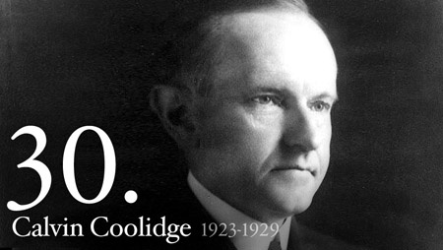

Slide 31
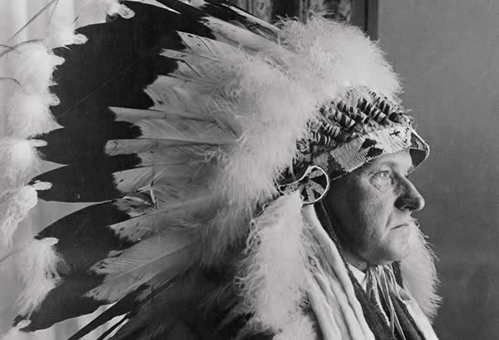

Slide 32
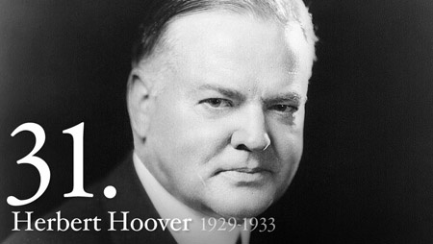
Herbert Hoover

Slide 33
Hoover as President
Hoover was Secretary of Commerce during the Harding and Coolidge administrations before becoming president in 1929
Hoover combined a faith in old-fashioned individualism with a strong commitment to the progressive possibilities offered by efficiency and rationality
Hoover wanted to actively assist the business community
Hoover promoted trade associations
Anti-trust prosecutions decreased

Slide 34
War Debts
America was the strongest economic power in the world after WWI
  European governments owed the US about $10 billion in 1919
During the 1920s, war debt and reparations were the single most divisive issue in international economics
In 1924, Herbert Hoover and Chicago banker Charles Dawes worked out a plan to aid the German economy (Germans owed $33 billion in reparations):
  Reduced Germany’s debt
  Stretched out the repayment period
  Arranged for American bankers to lend funds to Germany
Germany’s currency was stabilized—and could pay France and Britain (which could then pay the US)
Kellogg-Briand Pact—1928—US and 62 other nations renounced war

Slide 35
Commerce and Foreign Policy
Secretary of State Charles Evans Hughes pursued policies to expand American economic activity abroad
  Focused growth and investment into friendly countries, not the Soviet Union and not on munitions or weapons
Strategy was maximum freedom for private enterprise, backed by limited government advice and assistance
  Results?
    Increased power and profits of American investors
    Dependence on underdeveloped economies on a few staple crops for export (sugar, coffee, cocoa, bananas, etc.)

Slide 36
Feminism in Transition
19th Amendment resolved the central issue holding female reform movements together
Conflict—should the women’s movement:
  Seek protective legislation to deal with the differences between men and women?
Or….
  Seek full legal and civil equality?

Slide 37
National American Woman Suffrage Association became the League of Women Voters in 1920
  The league represented the historical mainstream of the suffrage movement—the vote would bring a nurturing sensibility and a reform vision to American politics
National Woman’s Party (NWP) was founded in 1916 by militant suffragist Alice Paul
  NWP argued that women were still subordinate to men and opposed protective legislation for women, claiming that such laws reinforced stereotypes
  Supported an Equal Rights Amendment to the Constitution

Slide 38
1921 Sheppard-Towner Act
Established the first federally funded health-care program, providing matching funds for states to set up prenatal and child health care centers
  NWP thought it stereotyped all women as mothers
  Birth control advocates complained that contraception was not part of the program
  American Medical Association objected to government-sponsored health care
By 1929, Congress cut off funds for the program

Slide 39
Mexican Immigration
Mexican immigration was not included in the immigration laws of 1921 and 1924
Political instability and economic hardships provided incentives to cross the border
Approx. 459,000 Mexicans entered the United States between 1921 and 1930
Primary incentive was the agricultural expansion in the American Southwest

Slide 40
Boarder crossing became more difficult, and Mexicans decided it was easier to stay in the US
Racism and local patterns of residential segregation confined most Mexicans to barrios—rude shacks without running water or electricity
Immigration was not limited because agribusiness interests wanted to keep the borders open

Slide 41
The “New Negro”
The Great Migration continued throughout the 1920s
Largest and most influential African American community in the North was Harlem in New York City
Between 1920 and 1930, 120,000 African Americans moved to Harlem
Harlem had crowded apartments but also boasted a large middle-class population
Harlem became the political and intellectual center for the “New Negro”—an optimistic faith in and celebration of, African American culture

Slide 42
Harlem Renaissance
Poetry of Langston Hughes and Claude McKay
Novels of Zora Neale Hurston
Essays, Acting and music
Jazz
  Duke Ellington
  Cab Calloway
  Louis Armstrong

Slide 43
Earnest Hemingway, F. Scott Fitzgerald, and Sinclair Lewis
  Most influential novelists of the 1920s
  Hemingway—depicted the search for personal moral codes that would allow one to endure life with dignity and authenticity
    The Sun Also Rises (1926)
    Farewell to Arms (1929)
  Fitzgerald—celebrated the vitality of the “Jazz Age”
    This Side of Paradise (1920)
    The Great Gatsby (1925)
  Lewis—satirized small-town life
    Main Street (1920)
    Babbitt (1922)

Slide 44
Election of 1928
Herbert Hoover (R)
Al Smith (D)
Smith was Catholic, and this fact split the Democratic party, especially in the South
Prohibition also divided the Democrats
Hoover won 444 to 87 in the electoral college (including Smith’s home state—NY)

