Slide 1
Business Strategy
Strategy formation

Slide 2
Readings
Generic strategies
http://www.quickmba.com/strategy/generic.shtml
Generic strategies
http://www.quickmba.com/strategy/generic.shtml

Slide 3
Strategy Formation
Functional strategy
Business unit strategy
Corporate level strategy

Slide 4
Functional Strategy
Marketing
Finance
Production
Human resources
IT
Research and development

Slide 5
Business Unit Strategy
Generic strategies
Low cost
Differentiation
Focus

Slide 6
Corporate Level Strategy
Stability
Growth
Retrenchment
“What businesses should we be in?”

Slide 7
Corporate Level Strategy: Growth
Vertical integration
Horizontal integration
Horizontal diversification
Conglomerate diversification
Mergers and acquisitions
Internationalization

Slide 8
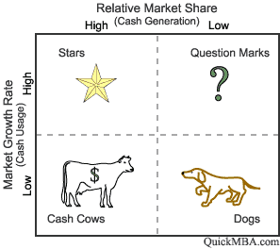
BCG Matrix

Slide 9
Corporate Level Strategy: Retrenchment
Turnaround
Divestment
Liquidation

