Slide 1
Session 2 - Ethics: Define and apply three major approaches to moral reasoning Discuss influential moral theories

Slide 2
Different Philosophical Approaches to Business Ethics
Key Perspectives:
Deontology
Utilitarianism
Virtue Ethics
Basic Personal Rights / Rights Based Approach
Notes:
A SUMMARY:
Deontology:
Underlying rules
Utilitarianism:
Ethical behaviour in terms of desired outcomes
Virtue Ethics:
Founded on philosophies of the ancient world, e.g. Plato and Aristotle
Basic Personal Rights / Rights Based Approach:
Personal viewpoint of what is acceptable/what is felt our “right” to expect
Post Modernism:
Progress and advancement at the expense of human cost – “enlightenment” era
More details in the slides that follow.
Mellahi et al, page 13, 2010

Slide 3
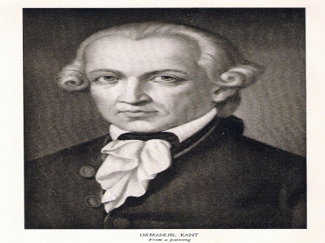
Deontology
The founder was Immanuel Kant 1724 – 1804
This approach says that there are rules for morality. There are rules that say actions are ’right’ or ‘wrong’
Act ethically “because it is one’s duty, regardless of the consequences”
You must make the right decisions for the right reasons
Therefore Deontologists are anti-relativists
Ethics can be universalized. This means it can be a moral law followed by all.
Notes:
Discussion on implications: get students own experiences and feedback.
Book notes – for support and reinforcement
Solves the problem of “free-riding”
Encourages cooperative action
Uncertainty – what really is collectively right and wrong? E.g. downsizing workforce – good for company, bad for people affected.
Human nature does not encourage this type of ethics
Lamsa says rely on customs, but this brings us back to relativist standpoint – goes against the universal Kantist standpoint.
Conflict: good for profit or good for goodness sake.
Consider MOTIVES of those acting.
Summary: Rules for all, no matter what the end result is.

Slide 4
Deontology
Not just the “golden rule” of do to others what you want done to you – Kant takes this further.
He says that we should act as though the whole world is watching us and from that moment on, the whole world will act they way we did
.
The end result is not as important as the action itself.
Notes:
Discussion on implications: get students own experiences and feedback.
Book notes – for support and reinforcement
Solves the problem of “free-riding”
Encourages cooperative action
Uncertainty – what really is collectively right and wrong? E.g. downsizing workforce – good for company, bad for people affected.
Human nature does not encourage this type of ethics
Lamsa says rely on customs, but this brings us back to relativist standpoint – goes against the universal Kantist standpoint.
Conflict: good for profit or good for goodness sake.
Consider MOTIVES of those acting.
Summary: Rules for all, no matter what the end result is.

Slide 5
Deontology
This approach says: Do the right thing, no matter what the consequences are…
This is also known as non-consequentialism
(This approach says:
“Do not be concerned about the consequences”)
Implications?
Notes:
Discussion on implications: get students own experiences and feedback.
Book notes – for support and reinforcement
Solves the problem of “free-riding”
Encourages cooperative action
Uncertainty – what really is collectively right and wrong? E.g. downsizing workforce – good for company, bad for people affected.
Human nature does not encourage this type of ethics
Lamsa says rely on customs, but this brings us back to relativist standpoint – goes against the universal Kantist standpoint.
Conflict: good for profit or good for goodness sake.
Consider MOTIVES of those acting.
Summary: Rules for all, no matter what the end result is.

Slide 6
Deontology
What is good about this approach?
It encourages cooperative action (action where everybody works together)
What are possible problems of this approach?
There may be uncertainty about what really is collectively right and wrong?
For example, downsizing a workforce may be good for company, but is bad for people affected.
Summary: There are rules for all, no matter what the end result is
Notes:
Discussion on implications: get students own experiences and feedback.
Book notes – for support and reinforcement
Solves the problem of “free-riding”
Encourages cooperative action
Uncertainty – what really is collectively right and wrong? E.g. downsizing workforce – good for company, bad for people affected.
Human nature does not encourage this type of ethics
Lamsa says rely on customs, but this brings us back to relativist standpoint – goes against the universal Kantist standpoint.
Conflict: good for profit or good for goodness sake.
Consider MOTIVES of those acting.
Summary: Rules for all, no matter what the end result is.

Slide 7
Question
Deontological ethics
Does Human nature does not encourage this type of ethics?
Discuss

Slide 8
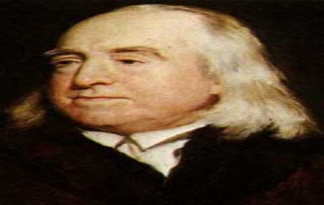
Utilitarianism
A number of philosophers consider this approach, including Jeremy Bentham 1748 – 1832
This approach says that ethics are determined by Moral principles, but not rules.
The approach is Goals orientated – the end result is important.
The people who follow this approach say that you have to consider the consequences of an action
For example: If I do this….. What happens?
Notes:
Discussion on implications: get students own experiences and feedback.
Book notes:
Not trying to follow set rules, but adjustment based on the end result. E.g. “do not lie” is a rule that would be broken if more people were made happy by the lie than people being hurt by it. Refuse to tell a mother where her baby is if she is very abusive to the child and you know the child will be hurt.
Jeremy Bentham – happiness as the avoidance of pain. Bentham strongly supported welfare reform at a time when large numbers of people were poor, starving and in deep poverty and his ideas were brand new – radical.
JS Mill – degrees of happiness
Book Examples: Cost Benefit Analysis Green energy – what do we give up to get this type of energy source? Environmental Pollution in return for huge profits?
Other theorists: Adam Smith – cooperation and trust are most important; invisible hand that forces market equilibrium comes from this (note economics last year); self interest to be good citizens. J S Mill – happiness calculus; working out be best possible social good from a particular action. John Rawls – exploit the poor to the benefit of the rich = utalitarianism

Slide 9
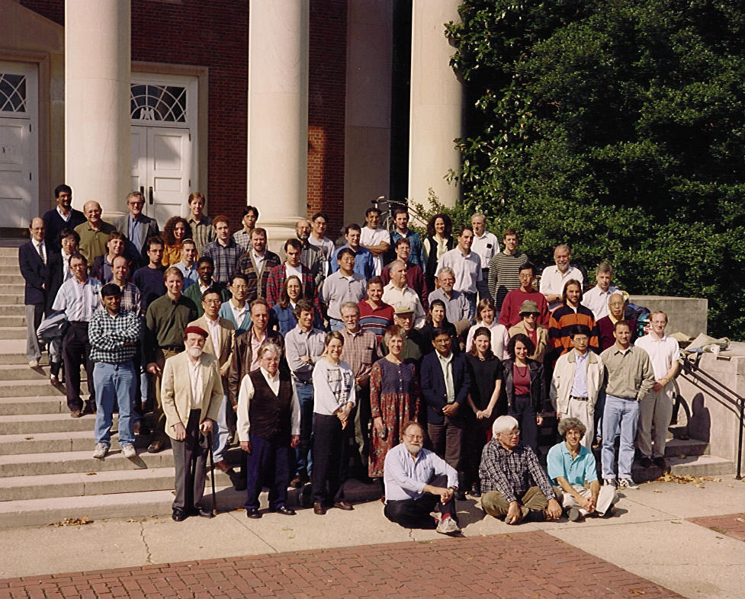
Utilitarianism
The action is right if the result is the greatest net utility or happiness for the most people possible.
They would say that you have to make the ethical decision that creates the most ‘value’ or ‘happiness for the most people
(Maximize happiness, minimize pain).
Notes:
Discussion on implications: get students own experiences and feedback.
Book notes:
Not trying to follow set rules, but adjustment based on the end result. E.g. “do not lie” is a rule that would be broken if more people were made happy by the lie than people being hurt by it. Refuse to tell a mother where her baby is if she is very abusive to the child and you know the child will be hurt.
Jeremy Bentham – happiness as the avoidance of pain. Bentham strongly supported welfare reform at a time when large numbers of people were poor, starving and in deep poverty and his ideas were brand new – radical.
JS Mill – degrees of happiness
Book Examples: Cost Benefit Analysis Green energy – what do we give up to get this type of energy source? Environmental Pollution in return for huge profits?
Other theorists: Adam Smith – cooperation and trust are most important; invisible hand that forces market equilibrium comes from this (note economics last year); self interest to be good citizens. J S Mill – happiness calculus; working out be best possible social good from a particular action. John Rawls – exploit the poor to the benefit of the rich = utalitarianism

Slide 10
Utilitarianism
Following this approach, you are not trying to follow set rules, but adjustment based on the end result.
For example, “Do not lie” is a rule that would be broken if more people were made happy by the lie than people being hurt by it. Refuse to tell a mother where her baby is if she is very abusive to the child and you know the child will be hurt.
This approach says: Before you take an action or make a decision, you have to consider the consequences of your action. Therefore this approach is often called consequentialism
It also called the happiness principle
Notes:
Discussion on implications: get students own experiences and feedback.
Book notes:
Not trying to follow set rules, but adjustment based on the end result. E.g. “do not lie” is a rule that would be broken if more people were made happy by the lie than people being hurt by it. Refuse to tell a mother where her baby is if she is very abusive to the child and you know the child will be hurt.
Jeremy Bentham – happiness as the avoidance of pain. Bentham strongly supported welfare reform at a time when large numbers of people were poor, starving and in deep poverty and his ideas were brand new – radical.
JS Mill – degrees of happiness
Book Examples: Cost Benefit Analysis Green energy – what do we give up to get this type of energy source?
Other theorists: Adam Smith – cooperation and trust are most important; invisible hand that forces market equilibrium comes from this (note economics last year); self interest to be good citizens. J S Mill – happiness calculus; working out be best possible social good from a particular action. John Rawls – exploit the poor to the benefit of the rich = utalitarianism

Slide 11
Utilitarianism
What is positive about this approach?
Decisions made when following this approach are positive and provide the greatest happiness for greatest number of people, maximizing benefits and minimizing harm
What are possible problems with this approach?
It may justify some actions such as Environmental Pollution in return for huge profits (because more people will benefit from the profits than there will be people suffering from the pollution)
Notes:
Discussion on implications: get students own experiences and feedback.
Book notes:
Not trying to follow set rules, but adjustment based on the end result. E.g. “do not lie” is a rule that would be broken if more people were made happy by the lie than people being hurt by it. Refuse to tell a mother where her baby is if she is very abusive to the child and you know the child will be hurt.
Jeremy Bentham – happiness as the avoidance of pain. Bentham strongly supported welfare reform at a time when large numbers of people were poor, starving and in deep poverty and his ideas were brand new – radical.
JS Mill – degrees of happiness
Book Examples: Cost Benefit Analysis Green energy – what do we give up to get this type of energy source?
Other theorists: Adam Smith – cooperation and trust are most important; invisible hand that forces market equilibrium comes from this (note economics last year); self interest to be good citizens. J S Mill – happiness calculus; working out be best possible social good from a particular action. John Rawls – exploit the poor to the benefit of the rich = utalitarianism

Slide 12
Virtue Ethics
Virtue ethics describes the character of a person as a driving force for ethical behavior
The character of the person determines behavior, NOT rules
Can you see how this approach is different from Deontology?
Deontologists say that rules determine a person’s behavior
Can you see how this approach is different from Consequentialism?
Consequentialism says that rightness or wrongness is determined from the outcome of the act itself rather than from the character, or social context
Source:http://en.wikipedia.org/wiki/Virtue_ethics
Notes:
Discussion on implications: get students own experiences and feedback.
Discussion of what makes and excellent manager and how these ancient virtues fit modern business (green, fair trade, human resources, human rights etc)
Aristotle’s Virtues: required to “live well”
Courage
Liberality
Sense of self worth
Gentleness
Modesty
Justice
Wisdom
Plato and Aristotle stated need to cultivate these virtues in order to represent primary function of morality
Book notes:
Students to read the Whetstone framework pages 21-22 and then further discuss above: key points
Excellent manager overcomes pressures through experience
Can overtake habitual behaviour
Most admired manager = flexible and adjustable, leaving behind “ingrained” values
Learning and sensitivity

Slide 13
Virtue Ethics
Therefore, you have to consider the nature of the person making the decision and his/her cultural context; as well as the learnt and acquired virtues (positive character traits)[Aristotle = sense of context]
You have to know yourself and reflect on your own actions and character; [Socrates = personal responsibility]
Virtue ethics is grounded in a social, temporal context
Therefore, it is not determined by just one moment, but through a lifetime as a whole
Notes:
Discussion on implications: get students own experiences and feedback.
Discussion of what makes and excellent manager and how these ancient virtues fit modern business (green, fair trade, human resources, human rights etc)
Aristotle’s Virtues: required to “live well”
Courage
Liberality
Sense of self worth
Gentleness
Modesty
Justice
Wisdom
Plato and Aristotle stated need to cultivate these virtues in order to represent primary function of morality
Book notes:
Students to read the Whetstone framework pages 21-22 and then further discuss above: key points
Excellent manager overcomes pressures through experience
Can overtake habitual behaviour
Most admired manager = flexible and adjustable, leaving behind “ingrained” values
Learning and sensitivity

Slide 14
Rights-Based Approaches
According to this approach, people (or individuals) have certain basic rights (or entitlements), for example freedom of speech (to say anything), right to associations, etc.
Rights based approaches include free market systems and consumer rights
There are some problems with this approach.
There may be a difference between universal rights and society or community based rights. Also- these rights may not extend to everyone in a community
These rights may therefore vary (or be different from country to country). For example, all countries do not have the same level of freedom in voting rights.
Page 22
Notes:
Discussion on implications: get students own experiences and feedback.
Book notes:
Universal rights vs. elite or special community
Ethical relativism and anti-relativism – REVIEW
Are certain rights inalienable? If so, you cannot be an ethical relativist
Can you be a utilitarian AND rights based ethicist? Killing is ok if it saves 100 people?
Theorist: John Rawls
liberties of individuals, not utalitarian. Utilty is maximised, but minority groups are marginalized – Rawls was against this and pushed rights – based approaches.
Equal opportunities a right?
Fair distribution of wealth a right?
Rights based approach should call for the protection of the interests of individuals against the powers of corporations.
STORY OF STUFF VIDEO

Slide 15
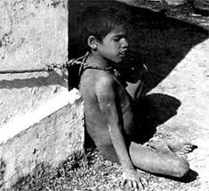
Rights Theories- example
A moral theory based on the concept that all people have human rights that form the justifying basis of obligations because they best express the purpose of morality, which is the securing of liberties or other benefits for a right-holder.

Slide 16

Exercise -
With your group make a list of what you think should be classified as Human Rights (rights that should apply to everyone in society) put those rights in order of importance to you
Be prepared to share your findings with the rest of the class
16

Slide 17
“Moral Rights” Considerations
The right of free consent
The right to privacy
The right of freedom of conscience
The right of free speech
The right to due process
The right to life & safety
17
PHolt/S.Farrell
01/18/17

Slide 18
There are some problems with this approach.
There may be a difference between universal rights and society or community based rights. Also- these rights may not extend to everyone in a community
These rights may therefore vary (or be different from country to country). For example, all countries do not have the same level of freedom in voting rights.

Slide 19
Question:
Which ethical perspective, do you think, is the most relevant to the world of business?
Give reasons for your answer.

