Slide 1
Situational Leadership
Objective:
To consider the adaptation of leadership styles to the circumstances – with emphasis on people & task.

Slide 2
Overview
The Situational Approach
Hershey & Blanchard’s model
Applying the Situational approach
Strengths and weaknesses of the approach

Slide 3
Leadership…
a
Leader
Power
Trait theory
Skills approach
Situation
Followers
Leadership Style
Goal
Leadership Style
Foundations of Leadership
LSH 2113
So far the focus has been on the leader as an individual, their skills, their traits and how they lead… which is best?
Michael Anthonisz
26 March 2017

Slide 4
Leadership in context
a
Leader
Situation
Foundations of Leadership
LSH 2113
Followers
Results/ Goal
The situation a leader is in and success will be determined by the task in hand and the followers available.
Michael Anthonisz
26 March 2017

Slide 5
Situational Leadership
  Assumptions:
  A certain leadership style should be most effective in different types of situations.
  Leaders do not readily change leadership styles.
  Matching the leader to the situation or changing the situation to make it favorable to the leader is required

Slide 6
Hersey and Blanchard’s Situational Leadership Theory (SLT)
  Argues that successful leadership is achieved by selecting the right leadership style which is contingent on the level of the followers’ readiness.
    Acceptance: leadership effectiveness depends on whether followers accept or reject a leader.
    Readiness: the extent to which followers have the ability and willingness to accomplish a specific task.
  Leaders must relinquish control over and contact with followers as they become more competent.

Slide 7
Hersey and Blanchard’s Situational Leadership Theory (SLT)
  Creates four specific leadership styles :
    Telling: high task–low relationship leadership
    Selling: high task–high relationship leadership
    Participating: low task–high relationship leadership
    Delegating: low task–low relationship leadership

Slide 8
Hersey and Blanchard’s Situational Leadership Theory (SLT)
  Posits four stages for follower readiness:
    R1: followers are unable and unwilling
    Followers not confident or competent
    R2: followers are unable but willing
    Followers are motivated but lack appropriate skills
    R3: followers are able but unwilling
    Followers are able but unwilling to do something
    R4: followers are able and willing
    Followers are both able and willing to do what is required

Slide 9
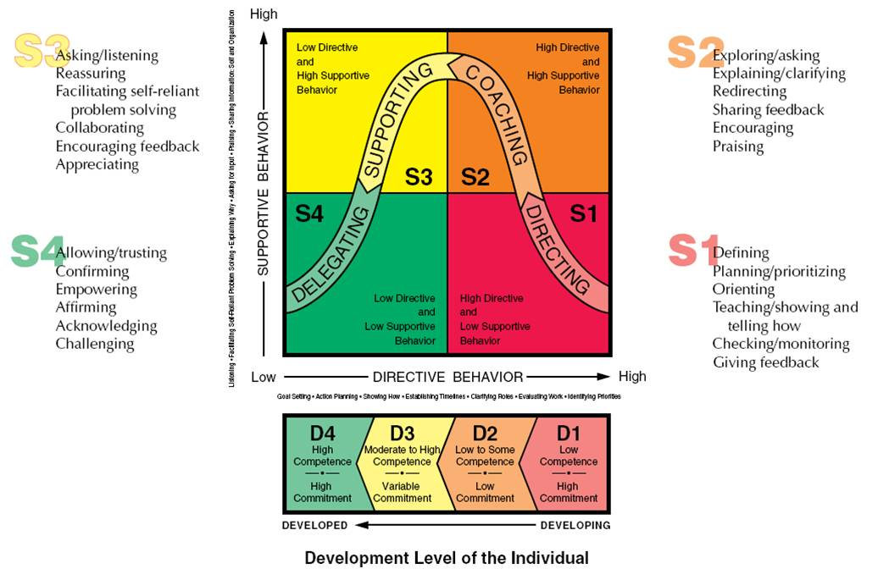
Applying The Situational Approach

Slide 10
Strengths Weaknesses
+ Stresses the importance of adapting style to followers
There is no one right way to lead in a given situation or a given person you can/should move backwards & forwards between S1 & S4.
+ Provides answers…what you should do in given situations
Does not take into account the power of the manager or the complexity of the task

Slide 11
Trends in Leadership Development
Charismatic Leader
  develops special leader–follower relationships and inspires followers in extraordinary ways.
Transactional Leader
  directs the efforts of others through tasks, rewards, and structures.
Transformational Leader
  Inspires Enthusiasm and Extraordinary Performance

Slide 12
Trends in Leadership Development
Moral Leadership
  Builds trust from a foundation of personal integrity
Ethical Leadership
  Has integrity and appears to others as “good” and “right” by moral standards
Integrity
  In leadership is honesty, credibility and consistency in putting values into action
Servant Leadership
  Means serving others, helping them use their talents to help organizations best serve society
Empowerment
  Gives employees job freedom and power to influence affairs in the organization

Slide 13
Peter Drucker
Why Peter Drucker’s leadership advice l matters
When Peter Drucker died at the age of 95 in the year 2005, the former CEO of GE, Jack Welch, said: “The world knows he was the greatest management thinker of the last century." That could be an understatement. Drucker was renowned worldwide for his many books, consultancies, newspaper columns, and sage advice on matters of management, organizations, business and society, and executive leadership. Here’s a sampler of his enduring advice:

Slide 14
Trends in Leadership development
Peter Drucker’s “Good Old-Fashioned Leadership”
Good leaders have integrity; they mean what they say, earning
and keeping the trust of followers.
Good leaders define and establish a sense of mission; they set
goals, priorities and standards.
Good leaders accept leadership as responsibility, not a
rank; they surround themselves with talented people.

Slide 15
More Drucker
    • Management is about human beings.
    • Don’t ever think or say “I.” Think and say “We.”
    • Attracting and holding talent have become two of the central tasks of management.
    • Every decision is risky.
    • Levels of management should be kept to the minimum.
    • Effective organizations exist not to satisfy themselves but to fill a customer need.
    • I’m not going to give you any answers. . . . I’m going to give you the questions you should ask.

