Slide 1
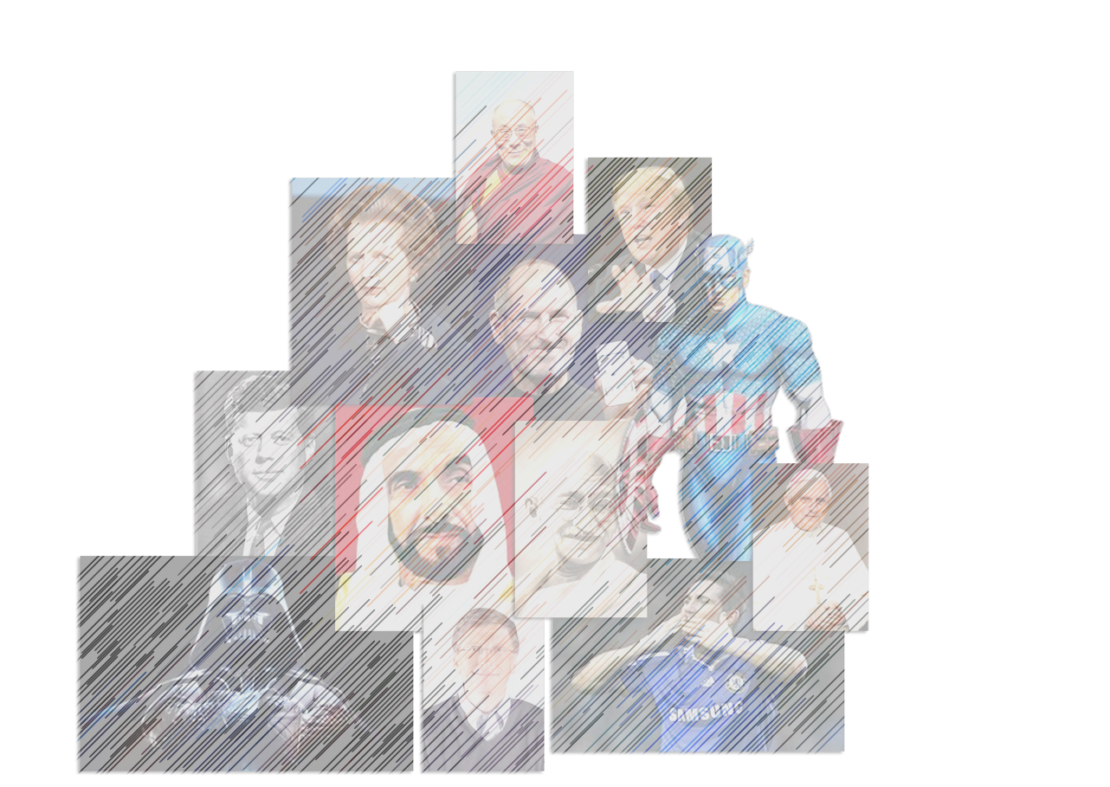
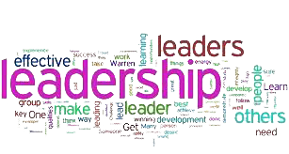
Leadership Style
a
Objective: To consider the aspects of style approach to leadership and the link between leader, task & followers.
Michael Anthonisz
22 March 2017
1

Slide 2
Overview
a
The Style Approach
Ibn Khaldun
John Adair
Blake & Mouton’s Leadership grid
Strengths and weaknesses of the approach
Foundations of Leadership
Michael Anthonisz
22 March 2017

Slide 3
Style Approach
Emphasizes the behavior of the leader
Trait Approach – personality of the leader
Skills Approach – Leaders capabilities

Slide 4
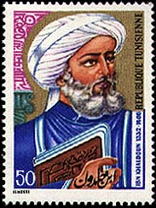
Ibn-Khaldun Conception of Leadership
a
a
He was born in Tunis in the year 1332.
He was mainly interested in political leadership, but his conceptualization is important for understanding leadership in any context, business or non-business.
Ibn Khaldun emphasizes the personal qualities of the leader. He calls those qualities “perfecting details”.

Slide 5
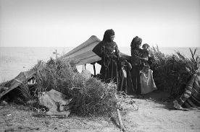
Perfecting Details Include:
Generosity
2. Forgiveness of error
3. Patience and perseverance
4. Hospitality toward guests
5. Maintenance of the indigent
(poor or needy people)
6. Execution of commitments
7. Respect for the religious law

Slide 6
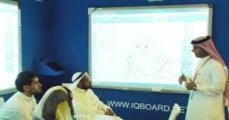
Perfecting Details Include:
8. Reverence for old men and teachers
9. Fairness
10. Meekness
11. Consideration to the needs of followers
12. Avoidance of deception and fraud
13. Kindness to, and protection of, subjects.

Slide 7
Leadership…
a
Leader
Situation
Followers
Results/ Goal
Foundations of Leadership
Leaders are determined by the results that they achieve and this in turn is impacted by how they are viewed by their followers.
Michael Anthonisz
22 March 2017

Slide 8
Leadership Styles
a
Telling “you will…”
Asking
“how should we?”
Autocratic
Democratic
Laissez Faire
Foundations of Leadership
LSH 2113
Michael Anthonisz
22 March 2017
Dependent on a number of factors including the situation, the task, the people their education/ knowledge/experience…

Slide 9
The Style Approach
a
Developed from the work of Stodgill (1963). Comprised of Two Kinds of Behaviours:
Task behaviors - Facilitate goal accomplishment
Relationship behaviors - Help subordinates feel comfortable with themselves, each other, and the situation
Foundations of Leadership
LSH 2113
Michael Anthonisz
22 March 2017

Slide 10
Active Leadership Model (John Adair)
Task needs
Individual needs
Team needs

Slide 11
Activity – in groups
Identify 4 needs from each of the following areas – share your information with the group
Task needs
Individual needs
Team needs

Slide 12
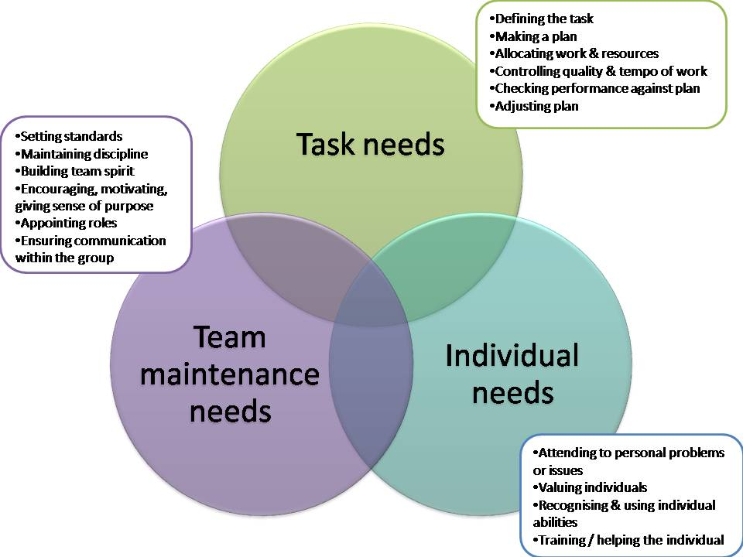
Active Leadership Model (John Adair)

Slide 13
Managerial (Leadership) Grid
a
Involves a hands on activity within an organization.
Blake & Mouton (1964, 1978, 1985).
Concern for production – whatever the organization is seeking to accomplish:
Attention to policy decisions; new product development; process issues; workload; sales volume...
Concern for people – how a leader attends to the people:
Building commitment & trust; promoting self worth; providing good working conditions; fair salaries; promoting social relations…
Leader usually has a dominant grid style and a backup style that is reverted to under pressure
Foundations of Leadership
LSH 2113
Michael Anthonisz
22 March 2017

Slide 14
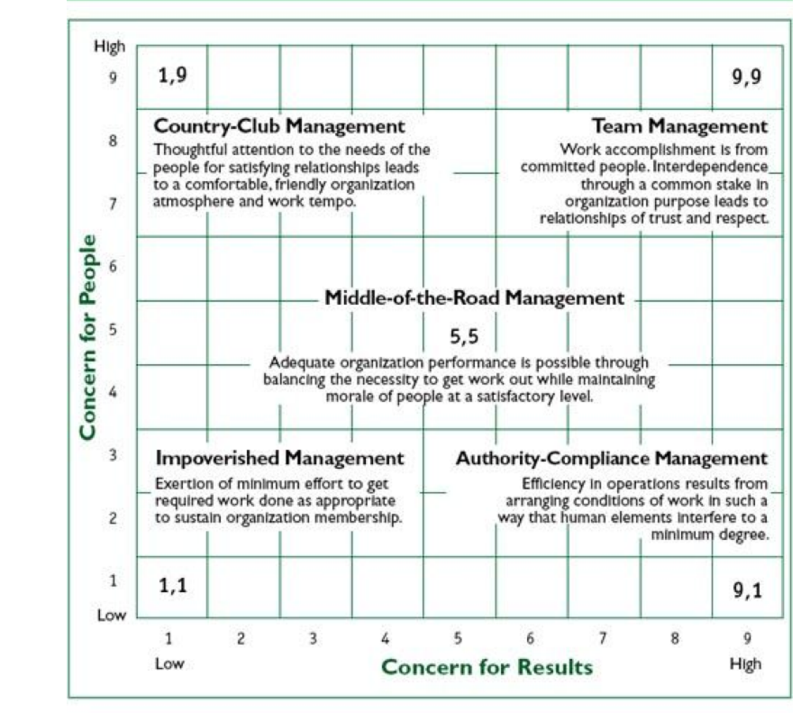
Managerial (Leadership) Grid
a
Involves a hands on activity within an organization.
Foundations of Leadership
LSH 2113
Michael Anthonisz
22 March 2017

Slide 15

Authority Compliance (9,1)
a
Efficiency in operations results from arranging conditions of work such that human interference is minimal
More emphasis on task and job requirements and less emphasis on people
Communicating with subordinates outside task instructions not emphasized
Results driven; People regarded as tools to that end
Foundations of Leadership
LSH 2113
Michael Anthonisz
22 March 2017

Slide 16
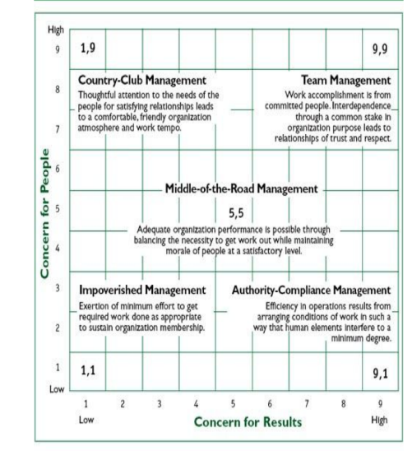
Country Club (1, 9)
a
Thoughtful attention to the needs of people leads to a comfortable, friendly organization atmosphere and work tempo
Low concern for task accomplishment coupled with high concern for
interpersonal relationships
De-emphasizes production; leaders stress the attitudes and feelings of people
Positive climate fostered by being agreeable, eager to help, comforting, noncontroversial
Foundations of Leadership
LSH 2113
Michael Anthonisz
22 March 2017

Slide 17

Impoverished (1,1)
a
Minimal effort exerted to get work done is appropriate to sustain organizational membership
Leader unconcerned with both task and interpersonal relationships
Going through the motions, but uninvolved and withdrawn
Have little contact with followers and are described as indifferent, noncommittal, resigned, and apathetic
Foundations of Leadership
LSH 2113
Michael Anthonisz
22 March 2017

Slide 18

Middle-of-the-Road (5,5)
a
Adequate organizational performance possible through balancing the necessity of getting work done while maintaining satisfactory morale
Leaders who are compromisers; have intermediate concern for task and people
To achieve equilibrium, leader avoids conflict while emphasizing moderate levels of production and interpersonal relationships
Described as expedient; prefers the middle ground, soft-pedals disagreement
Foundations of Leadership
LSH 2113
Michael Anthonisz
22 March 2017

Slide 19

Team (9,9)
a
Work accomplished through committed people; interdependence via a “common stake” in the organization’s purpose, which leads to relationships of trust and respect
Strong emphasis on both tasks and interpersonal relationships
Promotes high degree of participation and teamwork
Leader stimulates participation, acts determined, makes priorities clear, follows through, etc.
Foundations of Leadership
LSH 2113
Michael Anthonisz
22 March 2017

Slide 20

Paternalism Maternalism 9,1,1,9
a
Reward and approval are bestowed on people in return for loyalty and obedience; failure to comply leads to punishment
Leaders who use both 1,9 and 9,1 without integrating the two
The benevolent dictator; acts gracious for purpose of goal accomplishment
Makes decisions and rewards loyalty/obedience, whilst punishing non compliance
Foundations of Leadership
LSH 2113
Michael Anthonisz
22 March 2017

Slide 21

Opportunism
a
People adapt and shift to any grid style needed to gain maximum personal advancement
Performance occurs according to a system of selfish gain
Leader uses any combination of the basic five styles for the purpose of personal advancement (ruthless, cunning, self motivated or adaptable & strategic)
Foundations of Leadership
LSH 2113
Michael Anthonisz
22 March 2017

Slide 22
Strengths and weaknesses
a
Considers leaders behavior in relation to followers and goals
No relation to performance outcomes
No ‘best’ style
No consideration of situation
Foundations of Leadership
LSH 2113
Michael Anthonisz
22 March 2017

Slide 23
Strengths and weaknesses
a
Considers leaders behavior in relation to followers and goals
No relation to performance outcomes
No ‘best’ style
No consideration of situation
Foundations of Leadership
LSH 2113
Michael Anthonisz
22 March 2017

Slide 24
References
a
Blake & Mouton (1964) The managerial grid. Houston. TX: Gulf Publishing
Dale Carnegie () How to win friends and influence people
Foundations of Leadership
LSH 2113
Michael Anthonisz
22 March 2017

