Slide 1
Trait and Skills Theories of Leadership
Objective: To consider the aspects of trait theory in more depth and how they relate to the ‘leader
The Skills approach
Categorising Skills
The Skills Model
Strengths and weaknesses of the approach

Slide 2
Leadership…
a
Leader
Situation
Followers
Results/ Goal
Foundations of Leadership
LSH 2113
Who they are – characteristics
What they know - capabilities
What they do - behaviours
Micael Anthonisz
25 March 2017

Slide 3
Great Person Theories
Trait Approach: one of the first systematic attempts to study leadership
“Great Man” Theories (early 1900s)
Focused on identifying intrinsic qualities and characteristics possessed by great social, political, & military leaders
Clearly Traits are associated with the ‘leader’ however they may also depend on the followers and the situation they find themselves in.

Slide 4
Trait Theory
Activity:
Consider ‘great people’…what traits do you suppose they would have? Which of these are synonymous with being a leader? Are there any additional traits that you consider important?

Slide 5
Leadership Traits
a
Stogdill
(1948)
Mann
(1959)
Stogdill
(1974)
Lord, DeVader, & Alliger
(1986)
Kirkpatrick & Locke
(1991)
Masculinity
Dominance
Intelligence Intelligence Achievement Intelligence Drive
Masculinity
Adjustment
Dominance
Extroversion
Conservatism
Motivation
Integrity
Confidence
Cognitive Ability
Task Knowledge
Alertness
Insight
Responsibility
Initiative
Persistence
Self-Confidence
Sociability
Persistence
Insight
Initiative
Self-Confidence
Responsibility
Cooperativeness
Tolerance
Influence
Sociability
Note: If you are unclear as to the meaning of any of these words, ask or look them up

Slide 6
Major Leadership Traits
Intelligence - Intellectual ability including verbal, perceptual, and reasoning capabilities
Self-Confidence - Ability to be certain about one’s competencies and skills
Determination - The desire to get the job done (i.e., initiative, persistence, dominance, drive)
Integrity - The quality of honesty and trustworthiness
Sociability - Leader’s inclination to seek out pleasant social relationships

Slide 7

Personal Qualities
Emotional Intelligence
Self Awareness
Self regulation
Empathy
Motivation
Social Skills
Knowing and controlling yourself
Personality
i
Traits
Intelligence
Self-Confidence
Determination
Integrity
Sociability

Slide 8
Strengths and weakness of trait theory
Strengths
Focusses on the differences of leaders
Well researched (over 100 years)
Highlights the role of an individual in the leading of others
Identifies qualities to improve for potential leaders
Weaknesses
No definitive list of traits
Ignores situation and followers in leadership
Extremely subjective
Ignores the attainment of goals and outcomes (good vs poor leadership)
Teaching new traits is inherently difficult – what’s the point if we don’t have leadership qualities we never will…

Slide 9
The Skills Approach
Katz (1955) published “Skills of an effective researcher” in HBR.
Skills can be learned
Leadership effectiveness depends on leader’s ability to solve complex organizational problems.
He contended that there are 3 types of Skill: Technical; Human; Conceptual.

Slide 10

Technical Skills (things)
Involves a hands on activity within an organization.
Proficiency in a specific type of work and/or activity. It includes:
Competences in a specialized area
Analytical ability
Ability to use appropriate tools and techniques
Foundations of Leadership
LSH 2113
Involves a hands on activity within an organization.
Michael Anthonisz
25 March 2017

Slide 11
Human Skills (people)
a
The knowledge and ability to work with subordinates, peers and superiors.
Appreciate own perspective and other’s perspective. This stimulates:
Trust
Comfortable & Secure environment
Engaged employees
Motivated behavior
Consider Emotional Intelligence…
Foundations of Leadership
LSH 2113
Michael Anthonisz
25 March 2017

Slide 12

Conceptual Skills (ideas)
a
The ability to work with ideas, concepts and hypothetical notions.
Great for creating plans and strategic visions
Which of the three skills is
most important? Discuss.
Foundations of Leadership
LSH 2113
Michael Anthonisz
25 March 2017

Slide 13
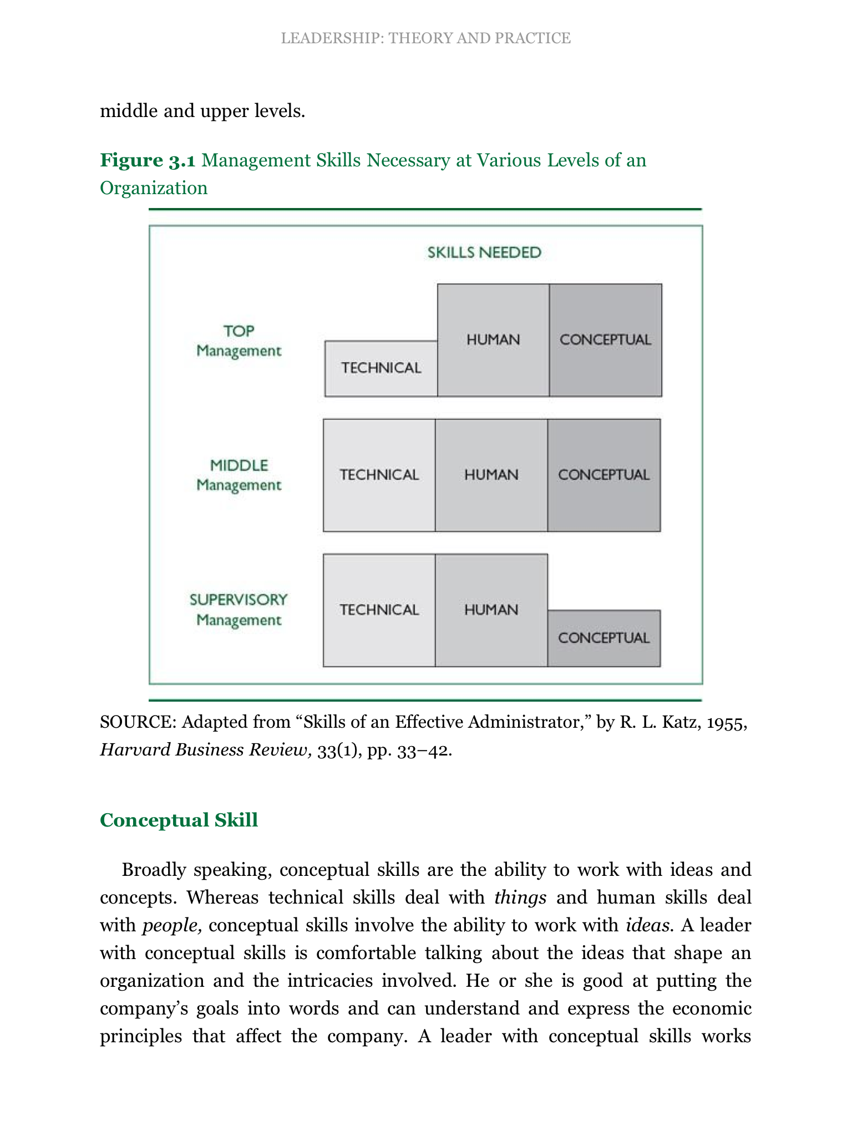
Managers and Skills
a
Foundations of Leadership
LSH 2113
Michael Anthonisz
25 March 2017

Slide 14
Strengths and weaknesses
a
Skills can be taught, learned & developed.
Starts to consider external impacts on the leader.
Integrates ‘traits’ at odds with the notion that skills can be taught.
Does not prescribe what should be taught & learned.
Does not outline the extent to which performance is affected.
Foundations of Leadership
LSH 2113
Michael Anthonisz
25 March 2017

