Slide 1
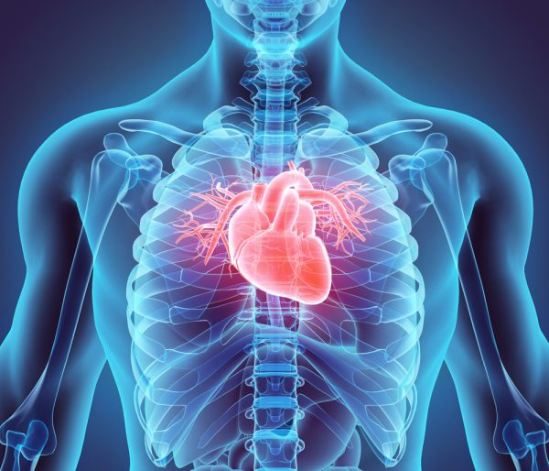
CHAPTER 2
THE CARDIOVASCULAR SYSTEM

Slide 2
Learning Outcome 2.1 Circulation and the E C G
Functions of the heart.
Pumps blood to and from all body tissues.
Supplies tissues with nutrients and oxygen.
Removes carbon dioxide and wastes.
Notes:
LO 2.1: Explain how circulation occurs in relation to the ECG.
-----

Slide 3
Circulation
Process of transporting blood throughout the body.
Depends on:
Electrical activity of heart.
Ability of heart to contract.
E C G records the heart’s electrical activity.
Notes:
LO 2.1: Explain how circulation occurs in relation to the ECG.
-----
Circulation depends on the heart’s pumping ability.
The electrical activity of the heart causes the heart to contract.
A knowledge of heart function is an important aspect of understanding the ECG.

Slide 4
Learning Outcome 2.1 Apply Your Knowledge 1
What is the function of the heart?
Notes:
LO 2.1: Explain how circulation occurs in relation to the ECG.

Slide 5
Learning Outcome 2.1 Apply Your Knowledge 2
What is the function of the heart?
Answer:
To pump blood to and from body tissues.
Notes:
LO 2.1: Explain how circulation occurs in relation to the ECG.

Slide 6
Learning Outcome 2.2 Anatomy of the Heart 1
Key Terms
Aorta.
Aortic semilunar valve.
Atrium (pl. atria).
Chordae tendineae.
Deoxygenated blood.
Interventricular septum.
Left atrium.
Left ventricle.
Mitral (bicuspid) valve.
Oxygenated blood.
Papillary muscles.
Pericardium.
Pulmonary artery.
Pulmonary semilunar valve.
Notes:
LO 2.2: Recall the structures of the heart including valves, chambers, and vessels.
-----
Aorta: The largest artery of the body, which transports oxygenated blood from the left ventricle of the heart to the entire body.
Aortic semilunar valve: Valve located in the aorta that prevents backflow of blood into the left ventricle.
Atrium (pl. atria): Top two chambers of the heart.
Chordae tendineae: Structures that connect the atrioventricular valves to the papillary muscles and prevent them from opening in the wrong direction.
Deoxygenated blood: Blood that has little or minimal oxygen (oxygen-poor blood).
Interventricular septum: A partition or wall (septum) that divides the right and left ventricles.
Left atrium: The left upper chamber of the heart, which receives blood from the lungs.
Left ventricle: The left lower chamber of the heart, which pumps oxygenated blood through the body. It is the biggest and strongest chamber, known as the workhorse of the heart.
Mitral (bicuspid) valve: Valve with two cusps or leaflets located between the left atrium and left ventricle; it prevents backflow of blood into the left atrium.
Oxygenated blood: Blood having oxygen (oxygen-rich blood).
Papillary muscles: Muscles in the ventricles that anchor the chordae tendineae and atrioventricular valves.
Pericardium: A two-layered sac of tissue enclosing the heart.
Pulmonary artery: Large artery that transports deoxygenated blood from the right ventricle to the lungs; only artery in the body that carries deoxygenated blood.
Pulmonary semilunar valve: Valve found in the pulmonary artery that prevents backflow of blood into the right ventricle.

Slide 7
Learning Outcome 2.2 Anatomy of the Heart 2
Key Terms
Pulmonary veins.
Right atrium.
Right ventricle.
Semilunar valve.
Tricuspid valve.
Vena cava.
Notes:
LO 2.2: Recall the structures of the heart including valves, chambers, and vessels.
-----
Pulmonary veins: Transport oxygenated blood back into the left atrium of the heart. These are the only veins that carry oxygenated blood .
Right atrium: The right upper chamber of the heart; receives blood from the body.
Right ventricle: The right lower chamber of the heart, which pumps deoxygenated blood to the lungs.
Semilunar valve: A valve with half-moon-shaped cusps that open and close, allowing blood to travel only one way; located in the pulmonary artery and the aorta.
Tricuspid valve: Valve located between the right atrium and right ventricle; it prevents backflow of blood into the right atrium.
Vena cava: Largest vein in the body, which provides a pathway for deoxygenated blood to return to the heart; its upper portion, the superior vena cava, transports blood from the head, arms, and upper body; and its lower portion, the inferior vena cava, transports blood from the lower body and legs.

Slide 8
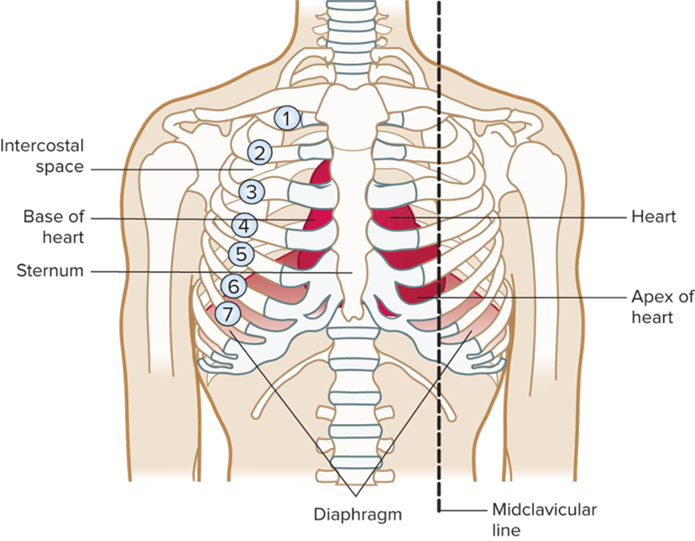
Anatomy of the Heart
Lies in center of chest.
Under sternum.
Between the lungs.
The size of your fist.
Weighs 10.6 ounces or 300 grams.
Access the text alternative for slide images.
Notes:
LO 2.2: Recall the structures of the heart including valves, chambers, and vessels.
-----
The heart lies behind your sternum and in front of your thoracic spine (these are two important structures when performing CPR)
The heart varies in size and weight depending on a person’s weight, physical condition, and gender.
In most people, two-thirds of the heart lies to the left of the sternum.

Slide 9
Heart Statistics
Average beats.
Per minute: 72.
Per day: 100,000.
Per lifetime: 22.5 billion.
Average output (stroke volume): 70 mL of blood per beat.
Total cardiac output = 5 L per minute
Notes:
LO 2.2: Recall the structures of the heart including valves, chambers, and vessels.
-----
Each day, the heart pumps approximately 1,800 gallons or 7,250 liters of blood.

Slide 10
Heart Anatomy
Pericardium -Sack of tissue surrounding the heart.
Two layers.
Parietal layer is the tough outer layer.
Visceral or epicardium layer is the inner layer and adheres closely to the heart.
Purpose is to protect the heart from infection and trauma.
Notes:
LO 2.2: Recall the structures of the heart including valves, chambers, and vessels.
-----
Pericardium -Sack of tissue surrounding the heart
Two layers
Parietal layer is the tough outer layer
Visceral or epicardium layer is the inner layer and adheres closely to the heart
Purpose is to protect the heart from infection and trauma
Pericardial space
Between parietal and visceral layers of the pericardium
Contains approximately 10 to 20 mL of fluid
Serves to cushion the heart against trauma
Epicardium – outer layer
Also known as the visceral pericardium
Thin and contains the coronary arteries
Myocardium – middle, muscular layer
Endocardium – inner layer
Lines the inner surfaces of the heart chambers and valves

Slide 11
Heart Anatomy
Pericardial space.
Between parietal and visceral layers of the pericardium.
Contains approximately 10 to 20 mL of fluid.
Serves to cushion the heart against trauma.

Slide 12
Heart Anatomy
Myocardium – middle, muscular layer (mechanical contracting layer).
Endocardium – inner layer.
Lines the inner surfaces of the heart chambers and valves.

Slide 13
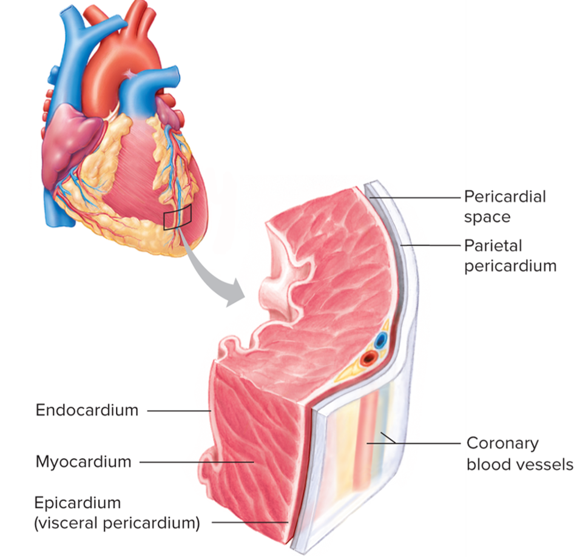
Heart Layers
Access the text alternative for slide images.
Notes:
LO 2.2: Recall the structures of the heart including valves, chambers, and vessels.
-----

Slide 14
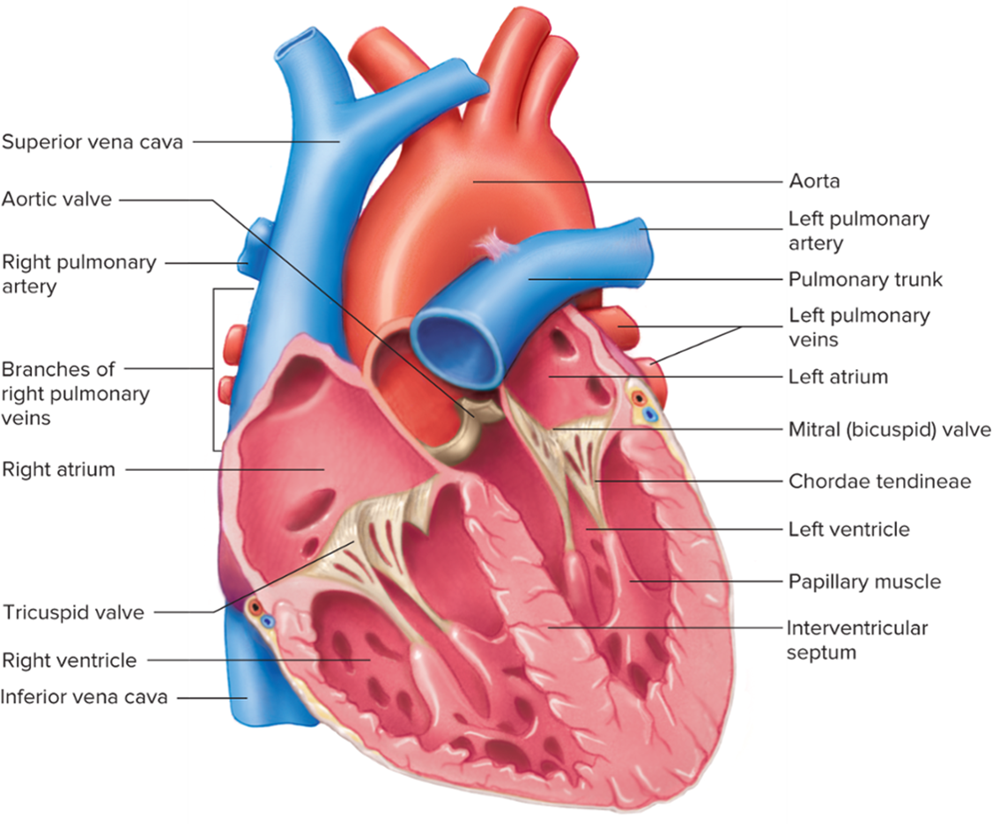
Heart Chambers, Vessels, and Valves
Access the text alternative for slide images.
Notes:
LO 2.2: Recall the structures of the heart including valves, chambers, and vessels.
-----

Slide 15
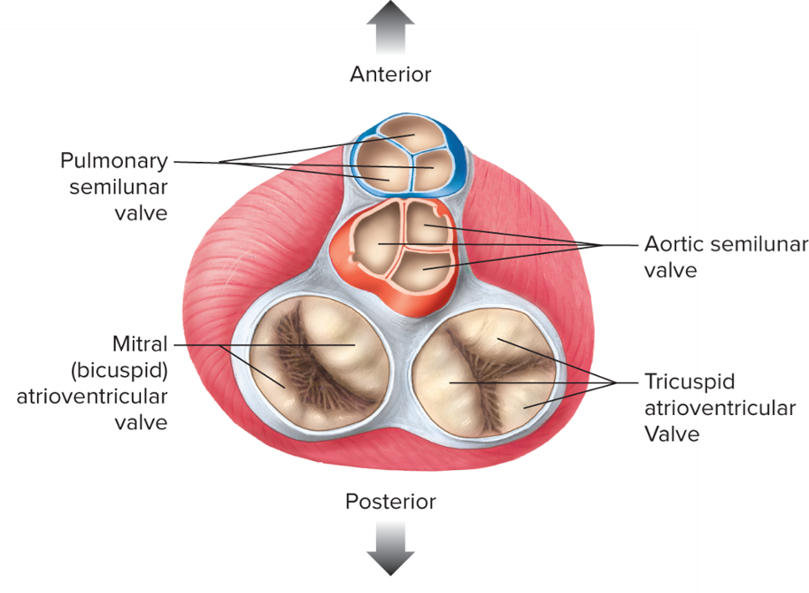
Heart Valves
Tricuspid valve.
Mitral (bicuspid) valve.
Semilunar valves.
Aortic.
Pulmonary.
Access the text alternative for slide images.
Notes:
LO 2.2: Recall the structures of the heart including valves, chambers, and vessels.
-----
Tricuspid valve – located between the right atrium and right ventricle
Mitral (bicuspid) valve – located between left atrium and left ventricle
Semilunar valves – located in the pulmonary artery and aorta; prevent blood from backing up into the right ventricle and left ventricle, respectively.

Slide 16
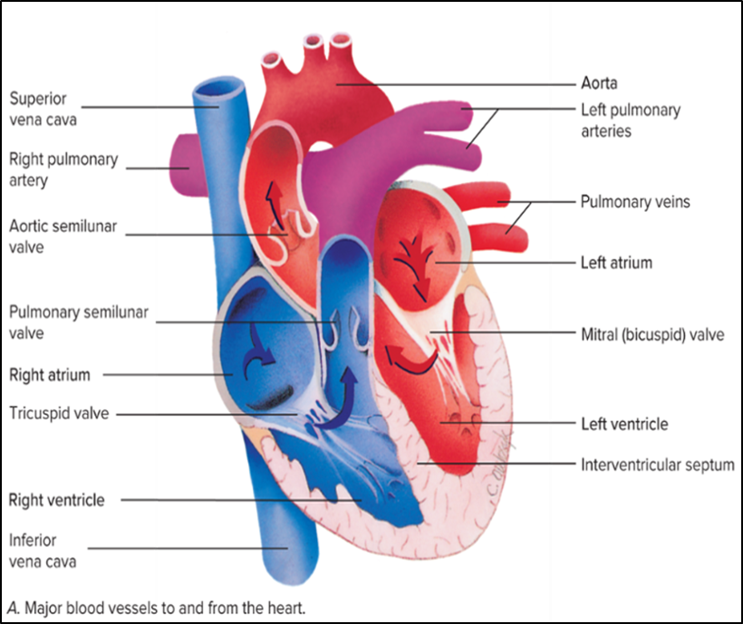
Major Vessels to and from the Heart
Vena cava
Superior vena cava returns blood from upper body to the heart Inferior vena cava returns blood from lower body to the heart
Pulmonary artery
Carries deoxygenated blood from the right ventricle to the lungs
Pulmonary vein
Carries oxygenated blood from the lungs to the left atrium
Aorta
Carries blood from the left ventricle to the body
First branches from aorta are the coronary arteries
Coronary arteries (not pictured)
Supply blood to the heart muscle
Access the text alternative for slide images.

Slide 17
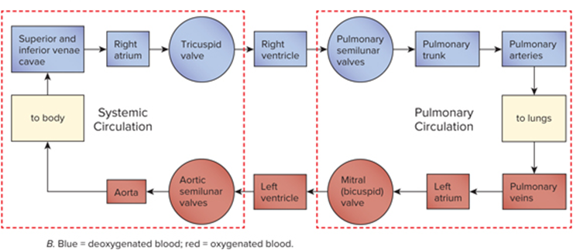
Oxygenated and Deoxygenated Blood
Access the text alternative for slide images.
Notes:
LO 2.2: Recall the structures of the heart including valves, chambers, and vessels.
-----

Slide 18
Learning Outcome 2.2 Apply Your Knowledge #1 1
Which valve of the heart lies between the left atrium and the left ventricle?
Notes:
LO 2.2: Recall the structures of the heart including valves, chambers, and vessels.
-----

Slide 19
Learning Outcome 2.2 Apply Your Knowledge #1 2
Which valve of the heart lies between the left atrium and the left ventricle?
Answer:
The mitral or bicuspid valve
Notes:
LO 2.2: Recall the structures of the heart including valves, chambers, and vessels.
-----

Slide 20
Learning Outcome 2.2 Apply Your Knowledge #2 1
Name the three layers of the heart.
Notes:
LO 2.2: Recall the structures of the heart including valves, chambers, and vessels.
-----

Slide 21
Learning Outcome 2.2 Apply Your Knowledge #2 2
Name the three layers of the heart (innermost to outermost layer).
Answer:
The endocardium, myocardium, and epicardium
Notes:
LO 2.2: Recall the structures of the heart including valves, chambers, and vessels.
-----

Slide 22
Learning Outcome 2.3 Principles of Circulation
Key Terms
Coronary circulation.
Pulmonary circulation.
Systemic circulation.
Notes:
LO 2.3: Differentiate among pulmonary, systemic, and coronary circulation.
-----
Coronary circulation: The circulation of blood to and from the heart muscle.
Pulmonary circulation: The transportation of blood to and from the lungs; blood is oxygenated in the lungs during pulmonary circulation.
Systemic circulation: The pathways for pumping blood throughout the body and back to the heart.

Slide 23
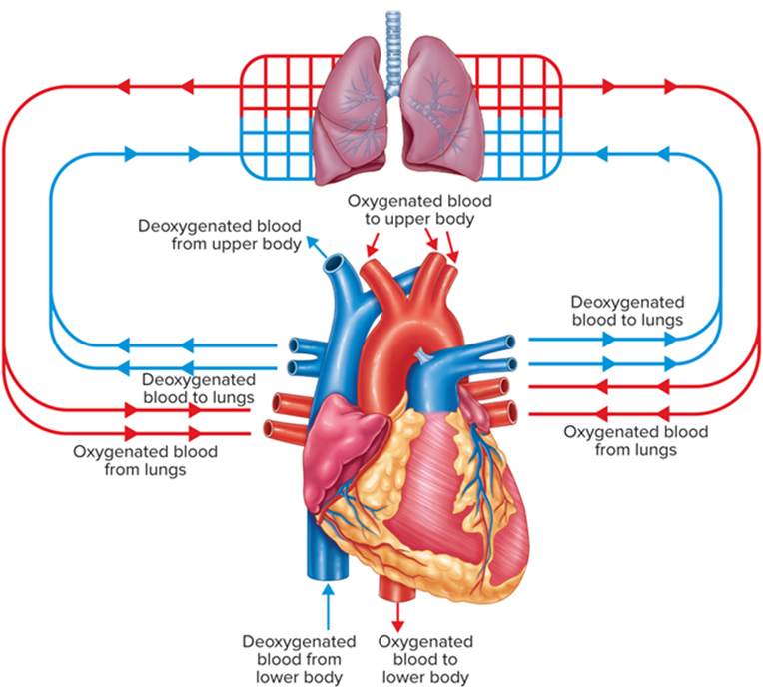
Pulmonary and Systemic Circulation
Access the text alternative for slide images.
Notes:
LO 2.3: Differentiate among pulmonary, systemic, and coronary circulation.
-----

Slide 24
Pulmonary Circulation
Blood enters right atrium.
Blood passes through the tricuspid valve to the right ventricle.
Right ventricle pumps blood through the pulmonary semilunar valve into the pulmonary artery, then into the lungs.
Blood returns to the heart through the pulmonary veins into the left atrium.
Notes:
LO 2.3: Differentiate among pulmonary, systemic, and coronary circulation.
-----
Pulmonary Circulation:
Deoxygenated blood enters the right atrium from the superior and inferior venae cavae.
Blood travels through the tricuspid valve into the right ventricle.
The right ventricle pumps the blood through the pulmonary semilunar valve into the pulmonary artery, then into the lungs. In the lungs, the blood is oxygenated.
The blood returns to the heart through the pulmonary veins into the left atrium. The left atrium is the last step of pulmonary circulation.

Slide 25
Systemic Circulation
Blood enters the left atrium and passes through into the left ventricle.
The left ventricle pumps the blood through the aortic semilunar valve into the aorta.
From the aorta, blood circulates throughout the body.
Deoxygenated blood returns to the right atrium of the heart through the superior and inferior venae cavae.
Notes:
LO 2.3: Differentiate among pulmonary, systemic, and coronary circulation.
-----
Systemic circulation:
Oxygenated blood enters the left atrium and travels through the mitral valve into the left ventricle.
The left ventricle pumps the blood through the aortic semilunar valve into the aorta.
After traveling through the body, the deoxygenated blood returns to the right atrium of the heart through the superior and inferior venae cavae.

Slide 26
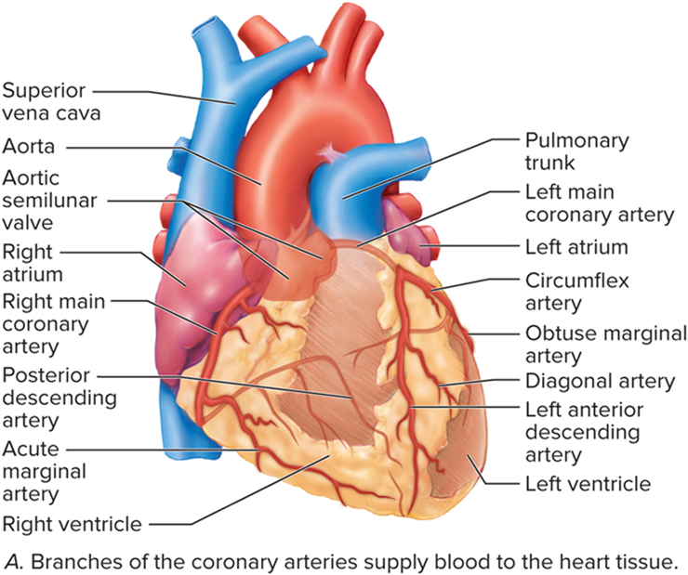
Coronary Circulation: Coronary Arteries
Access the text alternative for slide images.
Notes:
LO 6.1 Describe circulation and the purpose of the vascular system.

Slide 27
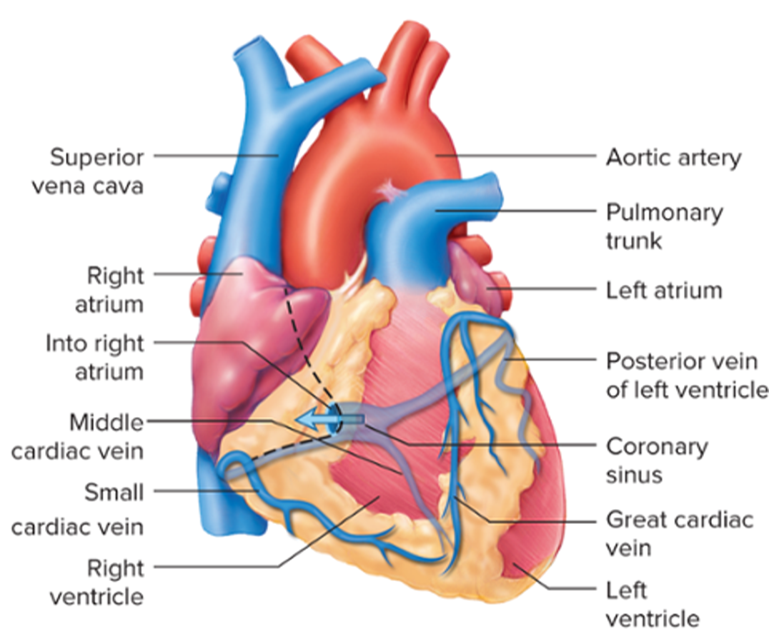
Coronary Circulation: Coronary Veins
Access the text alternative for slide images.
Notes:
LO 6.1 Describe circulation and the purpose of the vascular system.

Slide 28
The Heart as a Pump
Stroke volume.
Amount of blood ejected with each contraction.
Varies with gender, size, physical fitness, disease, and genetics.
Cardiac output.
Volume of blood pumped per minute.
Estimated by multiplying heart rate by stroke volume
Heart Rate × Stroke Volume = Cardiac Output.
Notes:
LO 2.3: Differentiate among pulmonary, systemic, and coronary circulation.
-----
When blood volume decreases, heart rate increases in an effort to maintain homeostasis (physiologic “balance.”) and
When contractile force decreases, stroke volume decreases.
Signs of low cardiac output:
Pallor
Confusion
Low blood pressure
Nausea
Dizziness

Slide 29
Learning Outcome 2.3 Apply Your Knowledge #1 1
Which side of the heart pumps deoxygenated blood?
Notes:
LO 2.3: Differentiate among pulmonary, systemic, and coronary circulation.
-----

Slide 30
Learning Outcome 2.3 Apply Your Knowledge #1 2
Which side of the heart pumps deoxygenated blood?
Answer:
The right side
Notes:
LO 2.3: Differentiate among pulmonary, systemic, and coronary circulation.
-----

Slide 31
Learning Outcome 2.3 Apply Your Knowledge #2 1
How is cardiac output estimated?
Notes:
LO 2.3: Differentiate among pulmonary, systemic, and coronary circulation.
-----

Slide 32
Learning Outcome 2.3 Apply Your Knowledge #2 2
How is cardiac output estimated?
Answer:
By multiplying the heart rate by the stroke volume.
Notes:
LO 2.3: Differentiate among pulmonary, systemic, and coronary circulation.
-----

Slide 33
Learning Outcome 2.4 The Cardiac Cycle
Key Terms
Cardiac cycle.
Diastole.
Systole.
Notes:
LO 2.4: Explain the cardiac cycle including the difference between systole and diastole.
-----
Cardiac cycle: The contraction and relaxation of the heart.
Diastole: The phase of the cardiac cycle when the heart is expanding and refilling; also known as the relaxation phase.
Systole: The contraction phase of the cardiac cycle, during which the heart is pumping blood out to the pulmonary (lungs) and systemic (body) circulation.

Slide 34
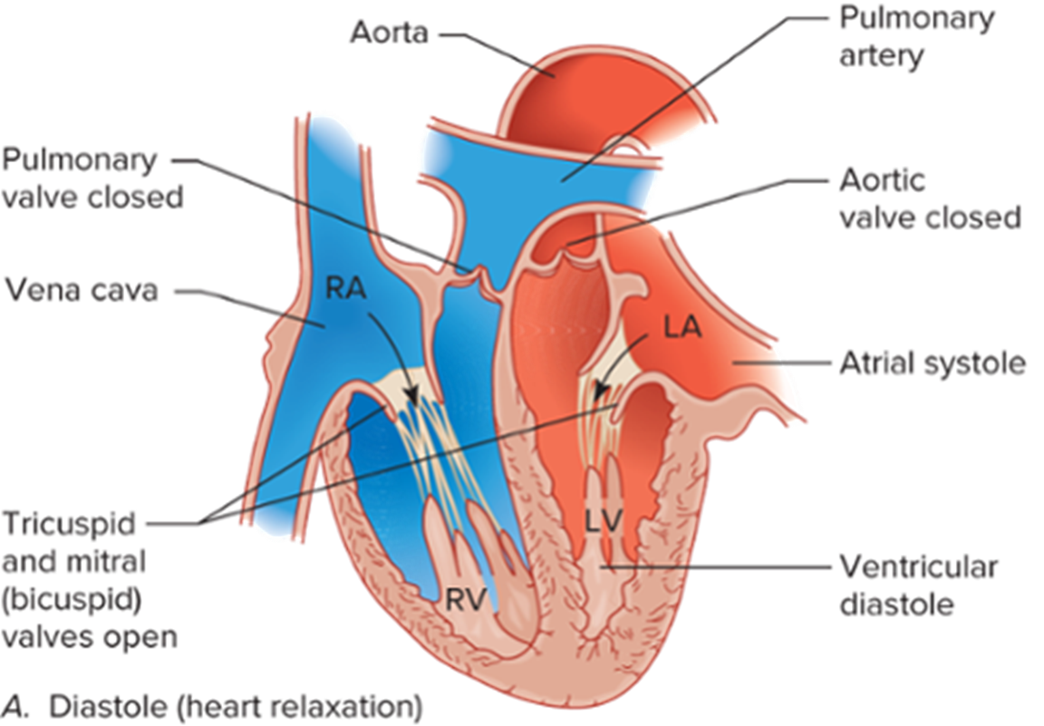
The Cardiac Cycle: Diastole
Access the text alternative for slide images.
Notes:
LO 2.4: Explain the cardiac cycle including the difference between systole and diastole.
-----

Slide 35
Diastole: Relaxation Phase
Blood returns to the heart via the superior and inferior vena cava.
Blood flows from the right atrium into the right ventricle.
Blood from the pulmonary veins flows from the left atrium into the left ventricle.
Notes:
LO 2.4: Explain the cardiac cycle including the difference between systole and diastole.
-----
Blood from the upper body returns via the superior vena cava.
Blood from the lower body returns via the inferior vena cava.
The right atrium fills with blood, pushes open the tricuspid valve, and enters the right ventricle.
Blood returns from the lungs via the pulmonary veins to the left atrium, then forces the mitral valve open to allow blood flow to the left ventricle.

Slide 36
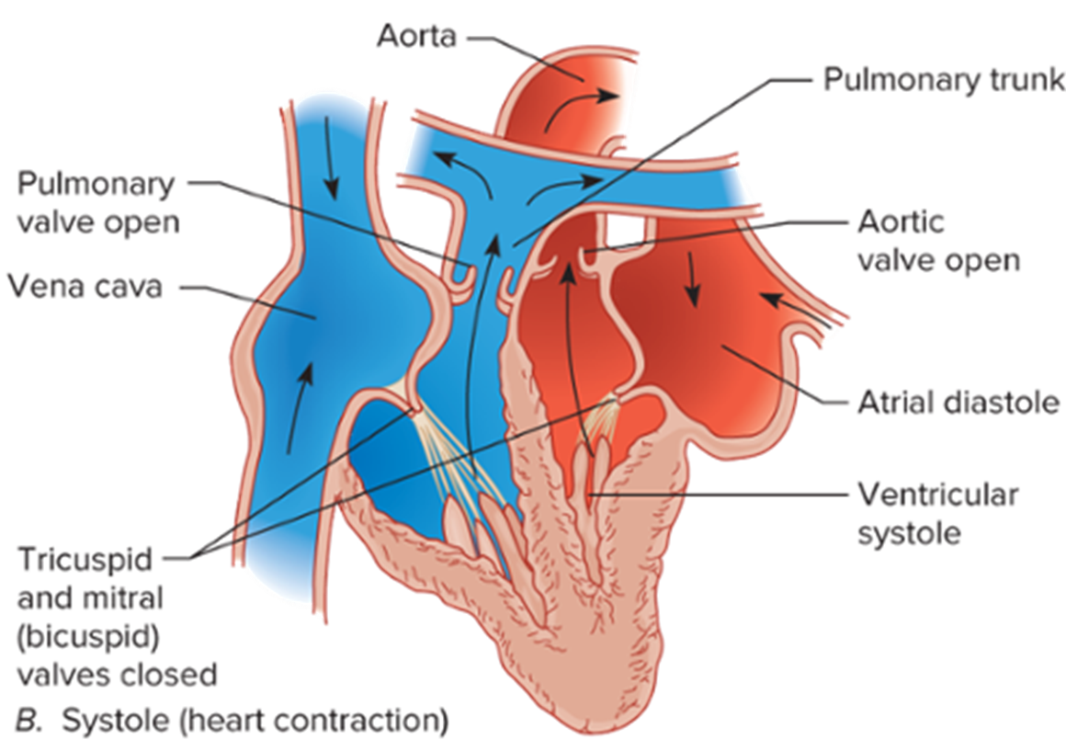
The Cardiac Cycle: Systole
Access the text alternative for slide images.
Notes:
LO 2.4: Explain the cardiac cycle including the difference between systole and diastole.
-----

Slide 37
Systole: Contraction Phase
Contraction creates pressure, opening the pulmonary and aortic valves.
Blood from the right ventricle flows to the lungs.
Blood from the left ventricle flows through the aorta to the body.
Notes:
LO 2.4: Explain the cardiac cycle including the difference between systole and diastole.
-----
Contraction of the right ventricle pushes blood into the lungs to exchange oxygen and carbon dioxide.
Contraction of the left ventricle pushes blood through the aorta to be distributed through the body to provide oxygen for tissues and to remove carbon dioxide.
Lubb-dupp sounds:
Lubb is the closing of the mitral and tricuspid valves during systole.
Dupp is the closing of the pulmonary and aortic valves during diastole.

Slide 38
Learning Outcome 2.4 Apply Your Knowledge 1
The relaxation phase of the cardiac cycle is known as:
Notes:
LO 2.4: Explain the cardiac cycle including the difference between systole and diastole.

Slide 39
Learning Outcome 2.4 Apply Your Knowledge 2
The relaxation phase of the cardiac cycle is known as:
Answer:
Diastole
Notes:
LO 2.4: Explain the cardiac cycle including the difference between systole and diastole.

Slide 40
Learning Outcome 2.5 Conduction System of the Heart
Key Terms
Atrioventricular (A V) node.
Automaticity.
Bachmann’s bundle.
Bundle branches.
Bundle of His (A V bundle).
Conductivity.
Contractility.
Excitability.
Myocardial.
Parasympathetic.
Purkinje fibers.
Purkinje network.
Sinoatrial (S A) node.
Sympathetic.
Notes:
LO 2.5: Describe the parts and function of the heart and conduction system and how they relate to the ECG.
-----
Atrioventricular (AV) node: Delays the electrical impulse to allow the atria to complete their contraction.
Automaticity: The ability of the heart to initiate an electrical impulse without being stimulated by another or independent source.
Bachmann’s bundle: The structure that relays the electrical impulse from the SA node to the left atrium in a normal heart.
Bundle branches: Left and right branches of the bundle of His that conduct impulses down either side of the interventricular septum to the left and right ventricles.
Bundle of His (AV bundle): Located next to the AV node; provides the transfer of the electrical impulse from the atria to the ventricles.
Conductivity: The ability of the heart cells to receive and transmit an electrical impulse.
Contractility: The ability of the heart muscle cells to shorten in response to an electrical stimulus.
Excitability: The ability of the heart muscle cells to respond to an impulse or stimulus; also called irritability.
Myocardial: Pertaining to the heart (cardi) muscle (myo).
Parasympathetic: The part of the autonomic nervous system (ANS) that helps slow the heart rate.
Purkinje fibers: The fibers within the heart that distribute electrical impulses from cell to cell throughout the ventricles.
Purkinje network: Spreads the electrical impulse throughout the ventricles by means of the Purkinje fibers.
Sinoatrial (SA) node: An area of specialized cells in the upper right atrium that initiates the heartbeat.
Sympathetic: The part of the autonomic nervous system that causes an increase in the heart rate.

Slide 41
Unique Qualities of the Heart
Qualities that initiate and control the beating of the heart:
Automaticity.
Conductivity.
Contractility.
Excitability.
Notes:
LO 2.5: Describe the parts and function of the heart and conduction system and how they relate to the ECG.
-----
Automaticity – heart’s ability to initiate an electrical impulse
Conductivity – ability of myocardial cells to receive and conduct electrical impulses
Contractility – ability of the heart muscle to shorten in response to an electrical impulse
Excitability – ability of the heart to respond to an impulse or stimulus

Slide 42
Regulation of the Heart 1
Autonomic nervous system (A N S): Sympathetic branch.
Secretes norepinephrine.
Increases heart rate and contractility.
Parasympathetic branch.
Secretes acetylcholine.
Decreases heart rate by stimulating vagus nerve.
Notes:
LO 2.5: Describe the parts and function of the heart and conduction system and how they relate to the ECG.
-----
The ANS is involuntary – you have no control over it. It secretes norepinephrine automatically when you are under stress or become frightened.
The vagus nerve is the major nerve of the parasympathetic system.

Slide 43
Regulation of the Heart 2
Other factors that affect heart rate.
Exercise.
Stress.
Body temperature.
Blood pressure.
Electrolyte levels.
Notes:
LO 2.5: Describe the parts and function of the heart and conduction system and how they relate to the ECG.
-----
Potassium
Low concentration causes decrease in heart rate
High concentration causes dysrhythmias
Calcium
Low concentration depresses heart activity
High concentration causes longer-than-normal heart contractions

Slide 44
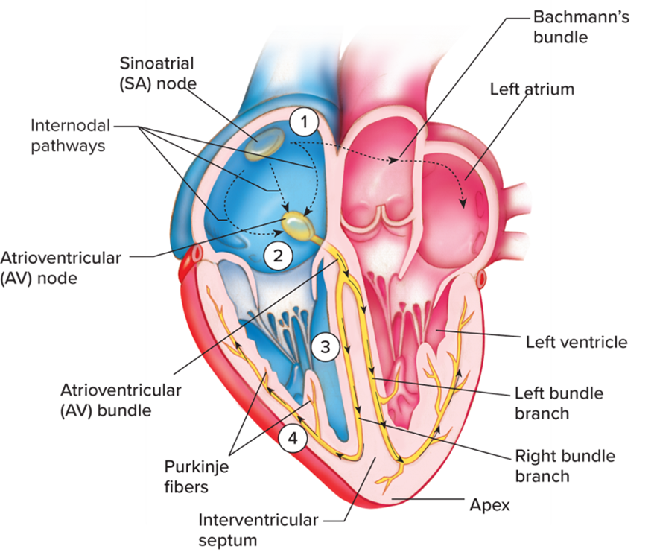
Conduction Pathway
S A node.
Bachmann’s bundle.
A V node.
Bundle of His.
Bundle branches.
Purkinje fibers.
Access the text alternative for slide images.
Notes:
LO 2.5: Describe the parts and function of the heart and conduction system and how they relate to the ECG.
-----

Slide 45
Sinoatrial (S A) Node and Bachmann’s Bundle
S A node.
Located in upper portion of right atrium.
Initiates the heartbeat.
Pacemaker of the heart (60 to 100 beats per minute).
Normal conduction begins in S A node.
Bachmann’s bundle.
Relays the impulse from S A node to the rest of the left atrium.
Notes:
LO 2.5: Describe the parts and function of the heart and conduction system and how they relate to the ECG.
-----

Slide 46
Atrioventricular (A V) Node
Located on the floor of the right atrium.
Causes delay in the electrical impulse.
Can act as pacemaker if S A node is not working.
Inherent rate: (40 to 60 bpm).
Notes:
LO 2.5: Describe the parts and function of the heart and conduction system and how they relate to the ECG.
-----
The AV node slows the electrical impulse, providing three benefits:
Provides for atrial kick
Prevents excessive rate of impulses from reaching the ventricles
Allows ventricles to contract from the bottom up
Atrial kick: Additional blood that travels from the atria to the ventricles before they contract, as a result of the electrical delay caused by the AV node.

Slide 47
Bundle of His (A V bundle) and Bundle Branches
Bundle of His.
Located next to the A V node.
Transfers electrical impulses from the atria to the ventricles.
Bundle branches.
Split the electrical impulse down the right and left side.
Stimulate left and right ventricles to contract.
Stimulate intraventricular septum to contract in left-to-right pattern.
Notes:
LO 2.5: Describe the parts and function of the heart and conduction system and how they relate to the ECG.
-----
The bundle branches are the two branches of the bundle of His that carry the electrical impulse to both sides of the heart.

Slide 48
Purkinje Fibers
Form the Purkinje network.
Electrical pathway for each cardiac cell.
Impulse activates left and right ventricles simultaneously.
Produce an electrical wave that results in contraction.
Notes:
LO 2.5: Describe the parts and function of the heart and conduction system and how they relate to the ECG.
-----

Slide 49
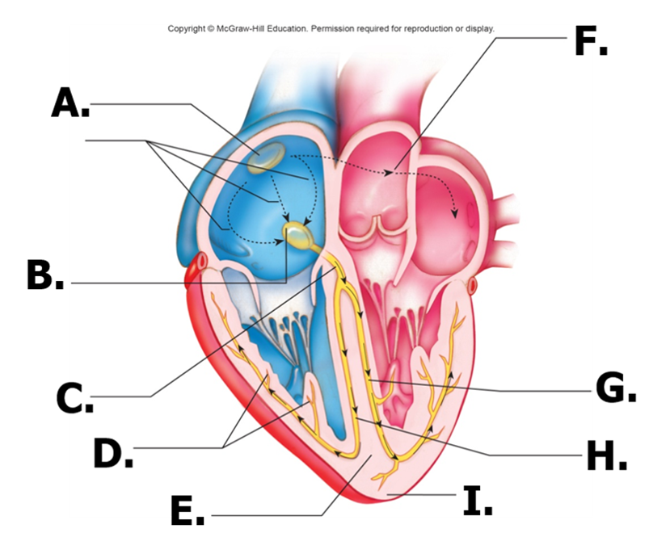
Learning Outcome 2.5 Apply Your Knowledge #1 1
Identify each part of the conduction system (A to I).
Access the text alternative for slide images.
Notes:
LO 2.5: Describe the parts and function of the heart and conduction system and how they relate to the ECG.
-----

Slide 50
Learning Outcome 2.5 Apply Your Knowledge #1 2
Answer
S A node
A V node
A V bundle
Purkinje fibers
Interventricular septum
Bachmann’s bundle
Left bundle branch
Right bundle branch
Apex
Access the text alternative for slide images.
Notes:
LO 2.5: Describe the parts and function of the heart and conduction system and how they relate to the ECG.
-----

Slide 51
Learning Outcome 2.5 Apply Your Knowledge #2 1
What is the ability of the heart to generate an electrical impulse called?
Notes:
LO 2.5: Describe the parts and function of the heart and conduction system and how they relate to the ECG.
-----

Slide 52
Learning Outcome 2.5 Apply Your Knowledge #2 2
What is the ability of the heart to generate an electrical impulse called?
Answer:
Automaticity
Notes:
LO 2.5: Describe the parts and function of the heart and conduction system and how they relate to the ECG.
-----

Slide 53
Learning Outcome 2.5 Apply Your Knowledge #3 1
Which part of the conduction system is known as the pacemaker of the heart?
Notes:
LO 2.5: Describe the parts and function of the heart and conduction system and how they relate to the ECG.
-----

Slide 54
Learning Outcome 2.5 Apply Your Knowledge #3 2
Which part of the conduction system is known as the pacemaker of the heart?
Answer:
The sinoatrial or S A node
Notes:
LO 2.5: Describe the parts and function of the heart and conduction system and how they relate to the ECG.
-----

Slide 55
Chapter Summary 1
The function of the heart is to pump blood to and from all body tissues.
The heart has three layers and is covered by the pericardium.
The heart consists of four chambers and four valves.
The coronary arteries supply oxygenated blood to the heart.
The coronary veins remove carbon dioxide and wastes.
Blood travels, or circulates, through three pathways: pulmonary, systemic, and coronary.
The cardiac cycle consists of a contraction phase (systole) and a relaxation phase (diastole).
Notes:
LO 2.1: Explain how circulation occurs in relation to the ECG.
LO 2.2: Recall the structures of the heart including valves, chambers, and vessels.
LO 2.3: Differentiate among pulmonary, systemic, and coronary circulation.
LO 2.4: Explain the cardiac cycle including the difference between systole and diastole.

Slide 56
Chapter Summary 2
The conduction system of the heart generates and maintains electrical activity.
Unique qualities of heart cells include automaticity, conductivity, contractility, and excitability.
The sympathetic and parasympathetic branches of the autonomic nervous system regulate the heart.
The heart’s conduction system includes the S A node, A V node, bundle of His, bundle branches, and Purkinje fibers.
Notes:
LO 2.5: Describe the parts and function of the heart and conduction system and how they relate to the ECG.

