Slide 1
Chapter 1
Phlebotomy and Healthcare
© McGraw Hill LLC. All rights reserved. No reproduction or distribution without the prior written consent of McGraw Hill LLC.

Slide 2
Learning Outcomes 1
1.1 Summarize the definition and history of phlebotomy.
1.2 Explain the role of the phlebotomist in the various healthcare facilities where he or she may be employed.
1.3 Describe inpatient and outpatient healthcare facilities and their relationship to the practice of phlebotomy.
1.4 Identify the healthcare providers and other members of the healthcare team with whom the phlebotomist will interact in inpatient and outpatient facilities.
1.5 Summarize the organization of the medical laboratory.

Slide 3
Learning Outcomes 2
1.6 Recognize the agencies that regulate hospitals and medical laboratories.
1.7 List the qualities and characteristics of a phlebotomist.

Slide 4
N A A C L S Competencies 1
1.1 Demonstrate knowledge of the healthcare delivery system and medical terminology.
1.2 Identify the healthcare providers in hospitals and clinics and the phlebotomist’s role as a member of this healthcare team.
1.3 Describe the various hospital departments and their major functions in which the phlebotomist may interact in his/her role.
1.4 Describe the organizational structure of the clinical laboratory department.

Slide 5
N A A C L S Competencies 2
1.5 Discuss the roles of the clinical laboratory personnel and their qualifications for these professional positions.
1.6 List the types of laboratory procedures performed in the various sections of the clinical laboratory department.
7.3 Instruct patients in the proper collection and preservation for non–blood specimens.
9.1 Communicate (verbally and nonverbally) effectively and appropriately in the workplace.
9.4 Interact appropriately and professionally with other individuals.
9.7 Model professional appearance and appropriate behavior.

Slide 6
Key Terms 1
Aseptic.
Capillary/dermal puncture.
Centers for Disease Control and Prevention (C D C).
Centers for Medicare & Medicaid Services (C M S).
Clinical and Laboratory Standards Institute (C L S I).
Clinical chemistry.
Clinical Laboratory Improvement Amendments (C L I A ’88).
College of American Pathologists (C A P).
Commission on Office Laboratory Accreditation (C O L A).
Cytology.
Department of Health and Human Services (H H S).
Environmental Protection Agency (E P A).
Food and Drug Administration (F D A).

Slide 7
Key Terms 2
Hematology.
Histology.
Immunohematology (blood bank).
Immunology.
Medical microbiology.
Microsurgery.
Molecular diagnostics.
National Accrediting Agency for Clinical Laboratory Sciences (N A A C L S).
Occupational Safety and Health Administration (O S H A).
Pathology.
Phlebotomist.
Phlebotomy.
Physician office laboratory (P O L).
Point–of–care testing (P O C T).
Pre–examination.
Professionalism.

Slide 8
Key Terms 3
Reference laboratory.
Serology.
The Joint Commission (T J C).
Toxicology.
Urinalysis.
Venipuncture.

Slide 9
Phlebotomy
Learning Outcome 1.1

Slide 10
Phlebotomy 1
Phlebotomy means to cut into a vein.
Phlebotomy is performed by a phlebotomist.
The primary role of a phlebotomist is to obtain blood specimens for testing.
Notes:
LO 1.1 Summarize the definition and history of phlebotomy.
Notes:
Phlebotomists follow the principles and techniques established by the Clinical and Laboratory Standards Institute (CLSI), a nonprofit organization that sets recommendations, guidelines, and standards for all areas of the laboratory to improve the quality of medical care.

Slide 11
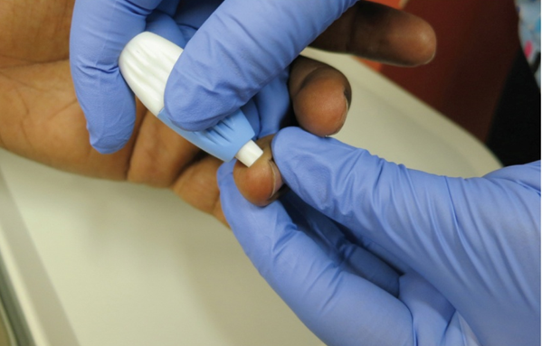
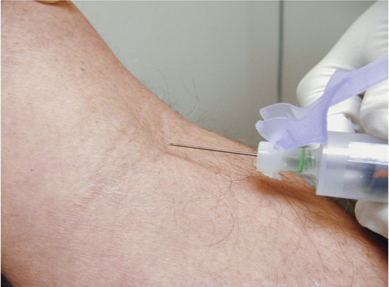
Common Methods of Obtaining Blood Specimens
Dermal (capillary) puncture
Venipuncture
© Total Care Programming, Inc./© Lillian Mundt
Notes:
LO 1.1 Summarize the definition and history of phlebotomy.
Notes:
The physician specifies the tests to be performed, the type of specimen to be collected, and for some tests, the time at which the specimen should be collected.
Although the phlebotomist may or may not perform the actual laboratory tests, he or she must be familiar with the tests to know which type of specimen to collect. Some tests must also be performed at certain times or with certain preparations. For example, the specimen for a fasting blood glucose test must be collected after the patient has fasted for 8 to 12 hours.
Venipuncture is the insertion of a needle into a vein to remove blood.
Capillary (dermal) puncture is the use of a puncture device to obtain capillary blood by pricking the skin.

Slide 12
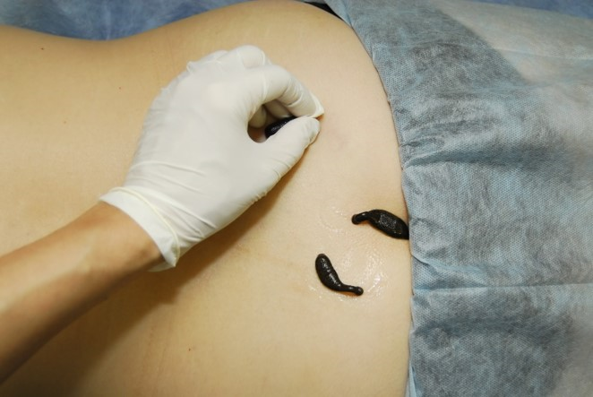
History of Phlebotomy 1
Bloodletting dates back to about 1400 B C.
In the early 1800s, medicinal leeches were used to remove toxins from the blood.
Bloodletting was typically performed by barbers or anyone claiming medical training.
The use of leeches has made a recent comeback.
©Mikhail Malyshev/Shutterstock.com R F
Notes:
LO 1.1 Summarize the definition and history of phlebotomy.
Notes:
Bloodletting was thought to remove toxins from the blood.
Venesection, another method of bloodletting, was performed by piercing the skin with a lancet. These procedures were often performed by barbers but could be performed by anyone claiming medical training. Aseptic practices were not known, so the same lancet was used for several patients without cleaning.
The use of leeches has recently made a comeback for certain purposes. Leeches have both anticoagulant and vasodilatation properties, so they are used following microsurgery to decrease swelling.
Microsurgery: Surgery involving reconstruction of small tissue structures

Slide 13
History of Phlebotomy 2
Then
Now
Performed by a cut into a vein with a sharp instrument to drain blood.
The lancet was the most popularly used instrument.
Aseptic practices were not known, so the lancet was reused for several patients.
Profession emerged as a result of technology and expansions in laboratory function.
Performed by trained professionals.
Standards of practice set by the Clinical and Laboratory Standards Institute (C L S I).
Notes:
LO 1.1 Summarize the definition and history of phlebotomy.
Notes:
In the late 1980s and early 1990s, phlebotomy emerged as a profession, and licensed phlebotomists became responsible for obtaining blood for testing.
Lancet: Small cutting instrument that controls the depth of the cutting blade
Aseptic: Pertaining to a condition that is free of disease-producing microorganisms (germs)

Slide 14
Learning Outcome 1.2
Roles of the Phlebotomist

Slide 15
Pre-Examination Phase of Testing
Patient identification and preparation.
Specimen collection (venous and dermal).
Specimen handling (appropriate specimen containers).
Labeling, processing, and transport of specimens.
Performance of quality control for point-of-care testing.
Patient advocacy.
Notes:
LO 1.2 Explain the role of the phlebotomist in the various healthcare facilities where he or she may be employed.
Notes:
Pre-examination phase: The phase of phlebotomy in which blood is collected, processed, and transported to the laboratory for testing
The phlebotomist is responsible for collecting, processing, and transporting blood specimens to the laboratory during the pre-examination phase of laboratory testing. This includes:
Correctly identifying the patient
Preparing the patient
Collecting the blood specimen using venipuncture or capillary/dermal puncture
Using the appropriate containers for the specimens
Labeling, processing, and transporting the specimens safely
Phlebotomists also perform other tasks. They collect blood from donors for blood transfusions. They remove blood from patients who have polycythemia. They are often responsible for instructing patients on how to collect urine or fecal specimens. Phlebotomists may also perform point-of-care testing (POCT), such as blood glucose monitoring. While performing these tasks, they may also be involved in patient advocacy.
Point-of-care testing (POCT): Tests performed at the patient’s bedside or work area, using a portable instrument
Patient advocate: Someone who helps guide patients through the healthcare system.
Quality control testing is an important part of the phlebotomist’s duties. The quality of the specimens sent to the laboratory determines the accuracy of the test results. The phlebotomist must therefore ensure that all specimens are obtained and handled properly.

Slide 16
Phlebotomist Duties and Responsibilities 1
Demonstrate professional attire.
Observe all safety regulations.
Know and follow facility policies and procedures.
Properly identify patients.
Collect both venous and capillary blood specimens.
Select the correct specimen containers for the specified tests.
Properly label, handle, and transport specimens.
Notes:
LO 1.2 Explain the role of the phlebotomist in the various healthcare facilities where he or she may be employed.
Notes:
One of the most important responsibilities of a phlebotomist is maintaining the safety of patients. To maintain patient safety, it is important to be familiar with the processes, equipment, and variables involved in obtaining blood specimens.
The phlebotomist is responsible for maintaining a professional attitude at all times. The phlebotomist must behave and dress according to facility policies and must be able to communicate courteously and effectively with patients, physicians, and co-workers.
Phlebotomists are required to respect patient confidentiality. This includes not talking about a patient with co-workers who are not involved with that patient, as well as making sure computerized information is secure.

Slide 17
Phlebotomist Duties and Responsibilities 2
Sort specimens received and process them for delivery to laboratory departments.
Perform computer operations and/or update log sheets where required.
Perform point–of–care testing and quality control checks.
Notes:
LO 1.2 Explain the role of the phlebotomist in the various healthcare facilities where he or she may be employed.

Slide 18
Phlebotomy Training
Various agencies approve phlebotomy programs.
College or hospital programs available.
Several different certifications are available.
Must be high school graduate.
Notes:
LO 1.2 Explain the role of the phlebotomist in the various healthcare facilities where he or she may be employed.
Notes:
Most phlebotomy training courses require students to have a high school diploma or GED.
Agencies such as the National Accrediting Agency for Clinical Laboratory Sciences (NAACLS) have established standards for phlebotomy training programs. Programs that meet these standards are said to be “accredited.” Attending an accredited program helps ensure that students are qualified to take a certification exam.
National Accrediting Agency for Clinical Laboratory Sciences (NAACLS): organization that provides accreditation to phlebotomy training programs and offers certification for structured educational programs
Not all states require phlebotomists to be certified. However, some states require phlebotomists to be both licensed and certified. Even in states where this is not required, attending an accredited program and becoming certified shows potential employers that the phlebotomist has the training and skills to become a valuable employee.

Slide 19
Learning Outcome 1.3
Healthcare Facilities

Slide 20
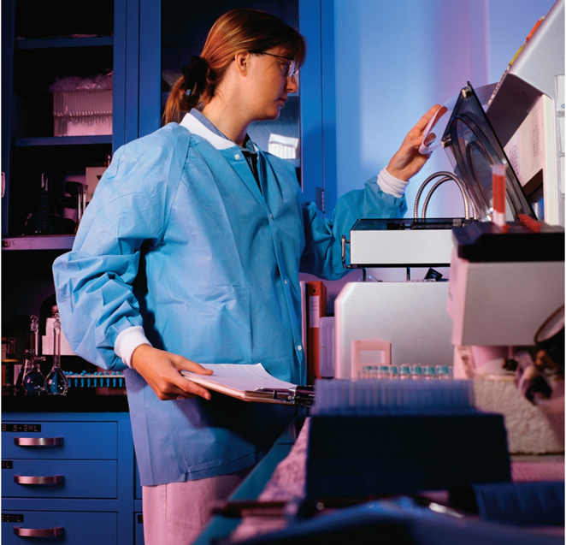
Inpatient Facilities
Patients stay for one night or long–term.
Examples include:
Hospitals.
Nursing homes.
Rehabilitation centers.
©David Buffington/Getty Images R F
Notes:
LO 1.3 Describe inpatient and outpatient healthcare facilities and their relationship to the practice of phlebotomy.
Notes:
Inpatient facilities are facilities in which patients stay for one or more nights. They include hospitals, nursing homes, and rehabilitation centers.

Slide 21
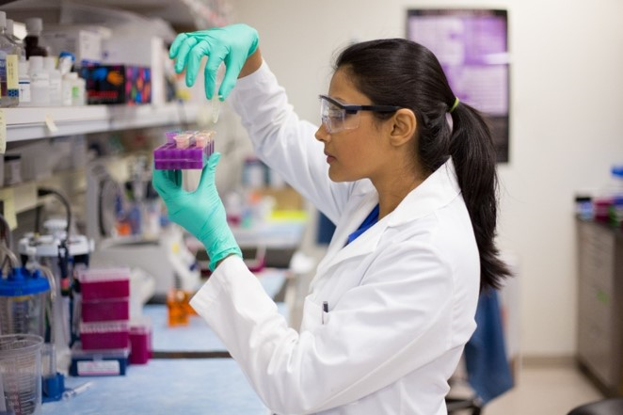
Outpatient Facilities
Patients visit for a short time and leave the same day.
Examples include:
Physician offices.
Ambulatory care centers.
Blood collection centers.
©nandyphotos/iStock/Getty Images R F
Notes:
LO 1.3 Describe inpatient and outpatient healthcare facilities and their relationship to the practice of phlebotomy.
Notes:
Outpatient facilities are those that patients visit for a short time and leave the same day. These include blood collection centers, ambulatory care centers, and physician offices.
Ambulatory care centers are the fastest-growing outpatient settings.

Slide 22
Patient Home Visits
The phlebotomist goes to the patient’s home.
Examples include:
Home healthcare agencies.
Insurance companies.
Notes:
LO 1.3 Describe inpatient and outpatient healthcare facilities and their relationship to the practice of phlebotomy.
Notes:
In addition to inpatient and outpatient facilities, phlebotomists who work for home healthcare agencies or insurance companies may work in a patient’s home. They may also work in complementary and alternative medicine (CAM) settings, such as chiropractor offices.

Slide 23
Learning Outcome 1.4
The Healthcare Team

Slide 24
Members of the Healthcare Team 1
The phlebotomist is a member of a diverse healthcare team that must work together to achieve positive patient outcomes.
Anesthesiology.
Cardiology.
Diagnostic Imaging (Radiology).
Electrocardiography.
Electroencephalography.
Emergency Department.
Endocrinology.
General Medicine (Family Practice).
Geriatrics.
Internal Medicine.
Neonatology.
Nephrology.
Neurology.
Notes:
LO 1.4 Identify healthcare providers and other members of the healthcare team with which the phlebotomist will interact in inpatient and outpatient facilities.
Notes:
Anesthesiology is the management of pain before, during, and after surgery.
Cardiology is the study, diagnosis, and treatment of conditions pertaining to the heart and circulatory system.
Diagnostic imaging (radiology) involves the use of ionizing radiation, X-rays, and specialized procedures such as computed tomography (CT) scans, positron emission tomography (PET), magnetic resonance imaging (MRI), and ultrasound to produce diagnostic images.
Electrocardiography is the study of the heart’s electrical patterns.
Electroencephalography is the study of electrical activity of the brain.
Emergency department doctors and nursing staff specialize in the delivery of acute care for initial treatment of life-threatening or otherwise unplanned medical events.
Endocrinology is the study, diagnosis, and treatment of hormone disorders.
General medicine (family practice) is the general care of patients of all ages.
Geriatrics is the diagnosis and treatment of disorders associated with elderly patients.
Internal medicine is the diagnosis and treatment of disorders related to the internal organs.
Neonatology is the study, diagnosis, and treatment of disorders associated with newborns.
Nephrology is the study, diagnosis, and treatment of disorders of the kidneys.
Neurology is the study, diagnosis, and treatment of disorders of the brain and nervous system.

Slide 25
Members of the Healthcare Team 2
Nuclear Medicine.
Nutrition and Dietetics.
Obstetrics/Gynecology.
Occupational Therapy.
Oncology.
Orthopedics.
Pathology.
Pediatrics.
Pharmacy.
Physical Therapy.
Psychiatry.
Respiratory Therapy.
Surgery.
Urology.
and many more…
Notes:
LO 1.4 Identify healthcare providers and other members of the healthcare team with which the phlebotomist will interact in inpatient and outpatient facilities.
Notes:
Nuclear medicine is the use of injectable radionuclides to diagnose and treat diseases, such as tumors.
Nutrition and dietetics is responsible for ensuring that patients receive proper nutritional intervention during and after their hospital stay.
Obstetrics/gynecology is the study, diagnosis, and treatment of the female reproductive system.
Occupational therapy enables people to perform meaningful and purposeful activities within the limits of a disability.
Oncology is the study, diagnosis, and treatment of malignant tumors.
Orthopedics is the diagnosis and treatment of bone and joint disorders.
Pathology is the study and diagnosis of disease.
Pediatrics is the diagnosis and treatment of disorders associated with children.
Pharmacy ensures the safe and effective use of therapeutic drugs.
Physical therapy is a rehabilitative science that focuses on the development, maintenance, and restoration of maximum movement and functional ability.
Psychiatry is the study and treatment of mental disorders.
Respiratory therapy is the assessment and treatment of breathing disorders.
Surgery uses operative techniques to investigate and treat pathological conditions or to improve bodily function or appearance.
Urology is the study, diagnosis, and treatment of male and female urinary tract disorders and disorders of the male reproductive system.

Slide 26
Learning Outcome 1.5
The Medical Laboratory

Slide 27
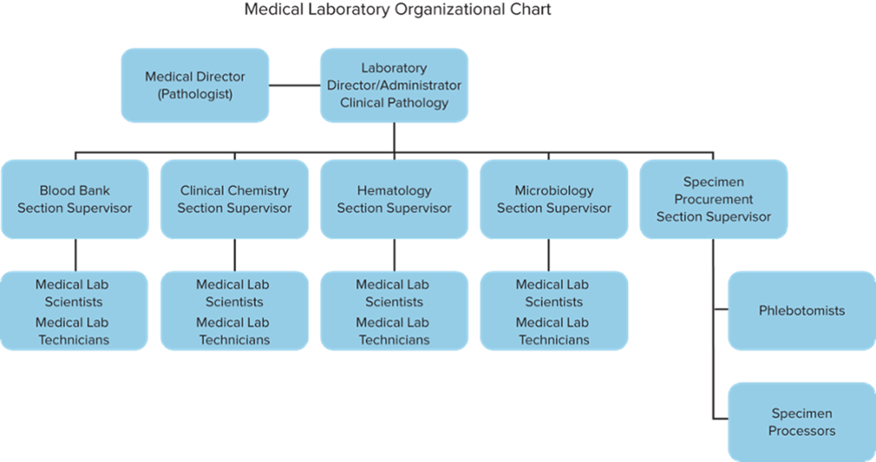
Hierarchy in the Medical Laboratory
Access the text alternative for these images
Notes:
LO 1.5 Summarize the organization of the medical laboratory.
Notes:
The structural hierarchy of a medical laboratory determines its chain of accountability. This hierarchy is shown in an organizational chart.

Slide 28
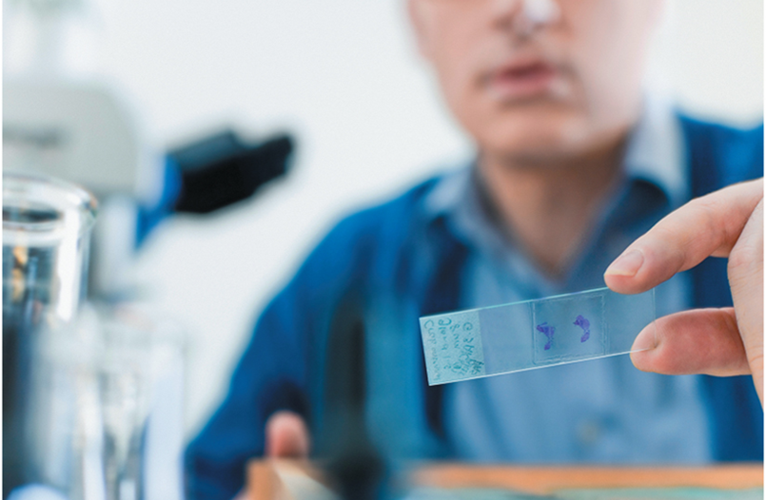
Laboratory Specialties: Cytology
P A P smears.
Tissue preparations.
©Ingram Publishing R F
Notes:
LO 1.5 Summarize the organization of the medical laboratory.
Notes:
Cytology is the investigation of cells for signs of cancer. The cytologist examines the cells under a microscope to determine whether abnormalities are present.

Slide 29
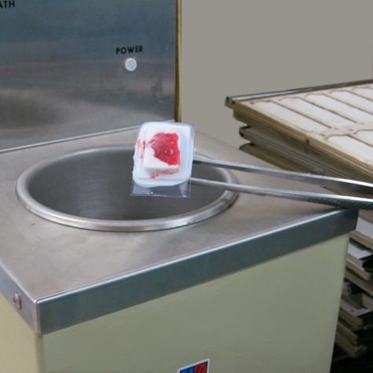
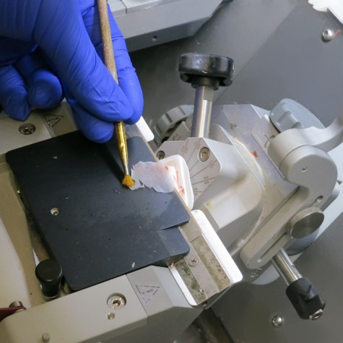
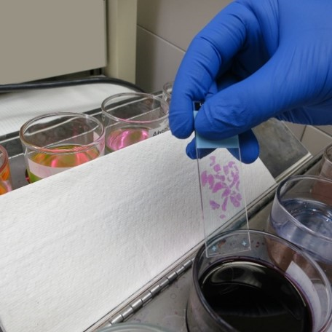
Laboratory Specialties: Histology
Embed
Slice
Stain
©Lillian Mundt
Notes:
LO 1.5 Summarize the organization of the medical laboratory.
Notes:
Histology is the study of body tissues and cells. Histology technicians (HTs) prepare surgical specimens by embedding the tissues in paraffin, cutting ultra-thin slices of the embedded tissue, affixing them to slides, and applying various stains. Histologists oversee the technical aspects of the histology lab and evaluate new procedures. Pathologists view the slides and interpret the results.

Slide 30
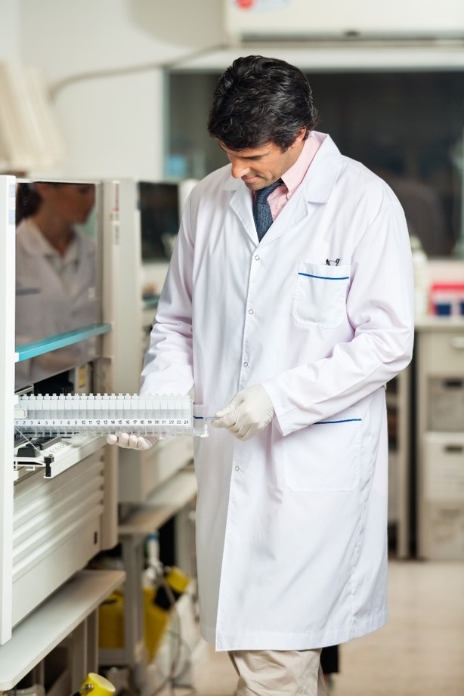
Laboratory Specialties: Clinical Chemistry
Serum and plasma.
Carbohydrates.
Enzymes.
Hormones.
Lipids.
Proteins.
Therapeutic drugs.
©Montgomery Martin/Alamy Stock Photo R F
Notes:
LO 1.5 Summarize the organization of the medical laboratory.
Notes:
Clinical chemistry is the evaluation of the chemical constituents of the human body. Medical laboratory technicians and medical laboratory scientists work with blood serum and plasma to determine levels of various components, such as carbohydrates, lipids, and proteins. They also test levels of enzymes and hormones.
When a physician is titrating a medication level for a specific patient, the clinical chemistry department may be asked to determine the level of a therapeutic drug. Laboratories who serve government and some non-government agencies may do routine tests for drugs of abuse on potential employees.

Slide 31
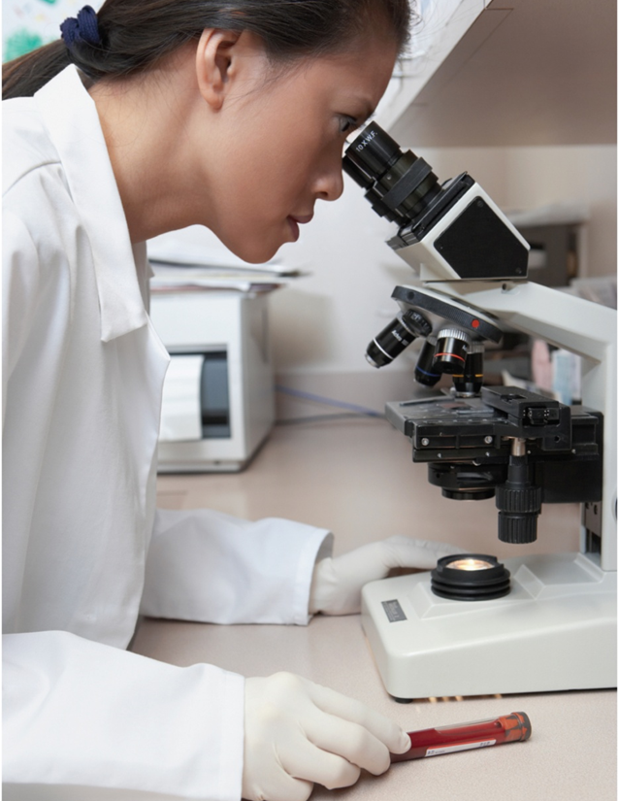
Laboratory Specialties: Hematology
Cell counts.
Coagulation tests.
©Blend Images R F
Notes:
LO 1.5 Summarize the organization of the medical laboratory.
Notes:
Hematology is the study of blood and blood-forming tissues, including coagulation studies. Medical laboratory technicians and medical laboratory scientists perform complete blood counts (CBCs), red cell counts (RBCs), white cell counts (WBCs), coagulation tests, bone marrow analysis, and body fluid cell counts.

Slide 32
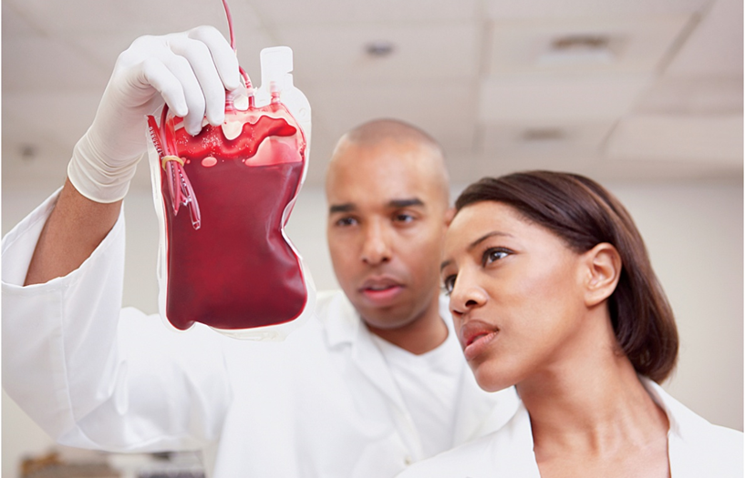
Laboratory Specialties: Immunohematology/Blood Bank
Donor screening.
Cross–matching.
Blood product preparation.
Transfusion reaction investigations.
©Blend Images R F
Notes:
LO 1.5 Summarize the organization of the medical laboratory.
Notes:
Immunohematology (blood bank) is a subspecialty that involves the collection and preparation of blood for transfusion. The MLTs and MLSs screen donors, collect the blood, type and cross-match it, and prepare it for transport to the recipient. When a recipient has a reaction to a blood transfusion, they also perform investigations into the causes for the reaction.

Slide 33
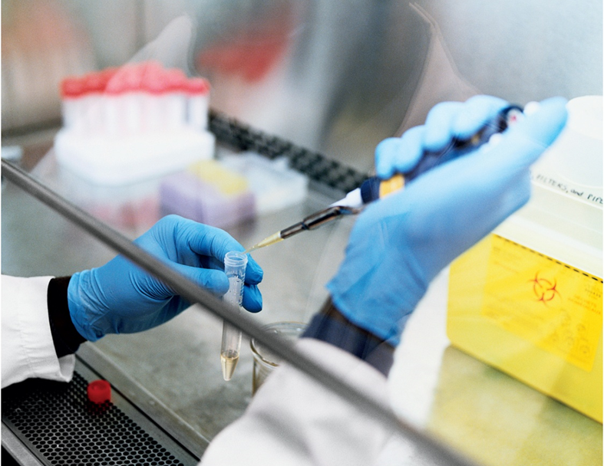
Laboratory Specialties: Immunology and Serology
Body’s resistance to disease.
Body’s defense against foreign substances.
©Blend Images R F
Notes:
LO 1.5 Summarize the organization of the medical laboratory.
Notes:
Immunology and serology are the study of the body’s resistance to disease. When a person is attacked by a disease or is exposed to a harmful foreign substance, the body produces an immunologic response to help fight the disease or substance. Some diseases, including mononucleosis and strep throat, are diagnosed by testing for the presence of the body’s immune response.

Slide 34
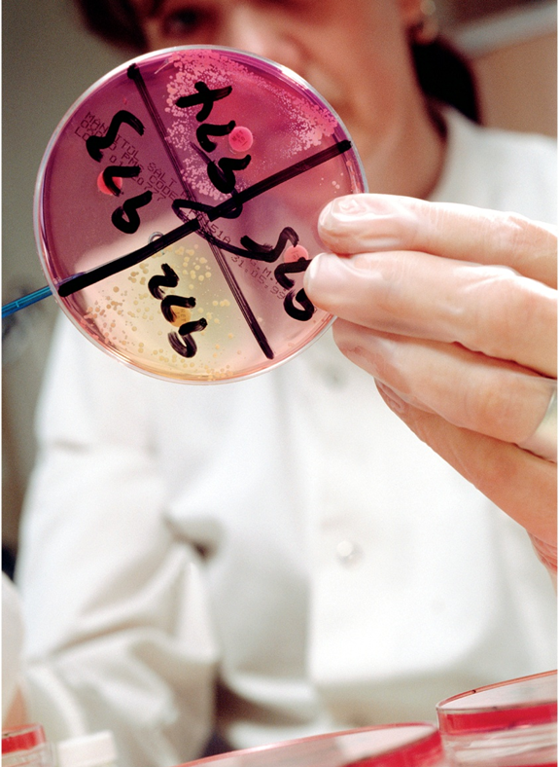
Laboratory Specialties: Medical Microbiology
Cultures.
Antibiotic sensitivity.
Pathogen identification.
©Corbis/VCG/Getty Images R F
Notes:
LO 1.5 Summarize the organization of the medical laboratory.
Notes:
The medical microbiology department performs tests to identify pathogenic microorganisms, including bacteria, fungi, parasites, and viruses. When pathogenic bacteria are found, they perform further tests to determine the most effective antibiotic to combat infection.

Slide 35
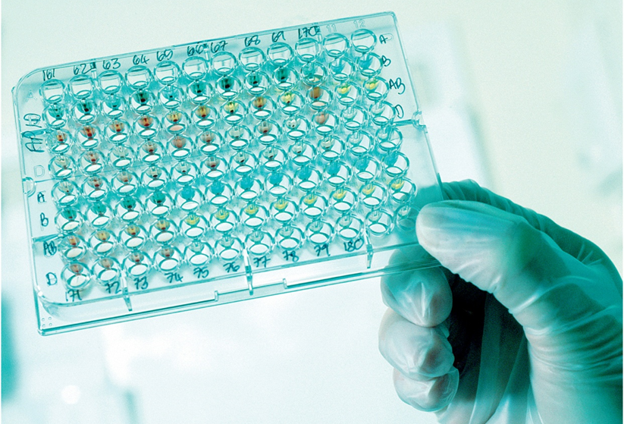
Laboratory Specialties: Molecular Biology
Molecular tests.
Flow cytometry procedures.
D N A–based tests.
©Corbis/VCG/Getty Images R F
Notes:
LO 1.5 Summarize the organization of the medical laboratory.
Notes:
The molecular diagnostics department detects and classifies diseases using molecular and DNA-based testing. The medical laboratory technicians and scientists test for infectious diseases. They use protein markers on body cells and DNA probes to determine the presence of leukemia and lymphoma and to analyze gene mutations and tumor cells.

Slide 36
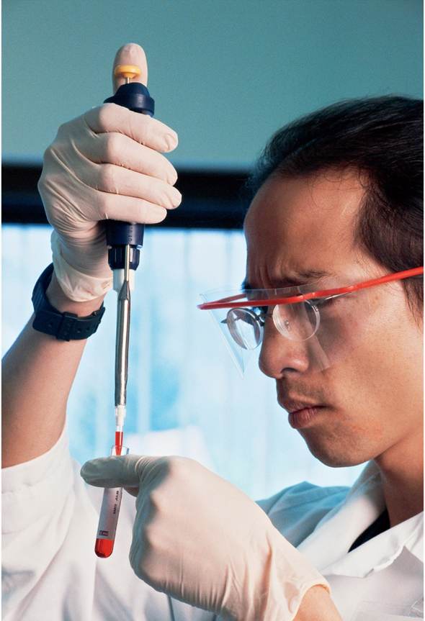
Laboratory Specialties: Toxicology
Abused drugs.
Heavy metals.
Trace elements.
Other toxins.
©Corbis/VCG/Getty Images R F
Notes:
LO 1.5 Summarize the organization of the medical laboratory.
Notes:
Toxicology is the study of adverse effects of chemicals on living organisms. Levels of heavy metals, such as lead, as well as other toxins and drugs of abuse are determined by people working in toxicology. Many of the tests involve chemical reactions, so toxicology is sometimes included in the chemistry department.

Slide 37

Laboratory Specialties: Urinalysis
Urine chemical screening.
Urine sediment analysis.
Pregnancy testing.
©Corbis/VCG/Getty Images R F
Notes:
LO 1.5 Summarize the organization of the medical laboratory.
Notes:
The urinalysis department tests the physical, chemical, and microscopic characteristics of urine. The abnormal presence of certain items may indicate disease. For example, glucose in the urine may be a sign of uncontrolled or inadequately controlled diabetes.
Pregnancy testing is also done in the urinalysis department because most pregnancy tests are performed on urine.

Slide 38
Medical Laboratory Personnel
Medical office staff.
Medical transcriptionists.
Medical laboratory assistants.
Histologic technicians.
Histologists.
Cytologists.
Pathologists.
Pathologists’ assistants.
Medical laboratory technicians.
Medical laboratory scientists.
Notes:
LO 1.5 Summarize the organization of the medical laboratory.
Notes:
Medical office staff greet and assist outpatients needing laboratory services.
Medical transcriptionists prepare pathologist-dictated reports.
Medical laboratory assistants (MLAs) are phlebotomists trained to perform low-complexity testing or assist laboratory staff in other ways.
Histologic technicians (HTs) prepare small sections of surgical specimens for microscopic examination by pathologists.
Histologists (HTLs) perform more complex functions of the histology laboratory and are responsible for the technical aspects of the histology laboratory as well as new procedure evaluation.
Cytologists (CTs) perform microscopic examination of human cells in order to detect cancer and other diseases.
Pathologists are medical doctors who specialize in the study of disease, which includes anatomic and clinical pathology.
Pathologists’ assistants (PAs) examine surgically removed tissue samples and collect and examine autopsy specimens. They assist pathologists in the identification of disease states.
Medical laboratory technicians (MLTs), formerly called clinical laboratory technicians by some agencies, have a minimum of an associate’s degree and can perform low-complexity and some moderately complex laboratory testing other than cytology and histology. In some states, MLTs may perform some procedures (those requiring interpretation) under direct supervision of medical laboratory scientists.
Medical laboratory scientists (MLSs), formerly called medical technologists or clinical laboratory scientists, have a minimum of a bachelor’s degree and can perform high-complexity testing other than cytology and histology.

Slide 39
Learning Outcome 1.6
Regulatory Agencies

Slide 40
Clinical Laboratory Improvement Amendment (C L I A)
Established in 19 88 to ensure that all laboratories receiving federal funds, regardless of size, would meet the same standards.
As of 19 92, this legislation made the Centers for Medicare & Medicaid Services (C M S) the regulatory body for all laboratories.
Establishes qualifications for phlebotomists.
Notes:
LO 1.6 Recognize the agencies that regulate hospitals and medical laboratories.
Notes:
The 1988 Clinical Laboratory Improvement Amendments (CLIA ’88) requires all laboratories that receive federal funding to be certified and meet the same standards. CLIA classifies laboratories according to the complexity of tests performed and patient risk if the tests are not performed properly.

Slide 41
Regulatory Agencies Impacting Phlebotomy
The Joint Commission (T J C).
College of American Pathologists (C A P).
Department of Health and Human Services (H H S).
Centers for Medicare & Medicaid Services (C M S).
Commission on Office Laboratory Accreditation (C O L A).
Centers for Disease Control and Prevention (C D C).
Occupational Safety and Health Administration (O S H A).
Environmental Protection Agency (E P A).
Food and Drug Administration (F D A).
Notes:
LO 1.6 Recognize the agencies that regulate hospitals and medical laboratories.
Notes:
Accrediting agencies such as The Joint Commission and the College of American Pathologists also help ensure a high standard of care for patients. TJC is the main accrediting agency for hospitals, and CAP accredits medical laboratories.
The Department of Health and Human Services oversees the Centers for Medicare & Medicaid Services, which is the federal agency that established regulations to implement CLIA and the Commission on Office Laboratory Accreditation (COLA). COLA accredits physician office laboratories (POLs).
The Centers for Disease Control and Prevention (CDC) implements public health regulations and reporting requirements.
The Occupational Safety and Health Administration (OSHA) regulates concerns over worker safety for the clinical laboratory.
The Environmental Protection Agency (EPA) defines and regulates medical waste.
The Department of Transportation regulates the packaging and transport of biological specimens and other potentially hazardous materials.
The Food and Drug Administration (FDA) provides additional regulation of blood banks, medical and diagnostic equipment, pharmaceuticals, reagents, and diagnostic tests.

Slide 42
C L S I Testing Phases
Pre–Examination
Examination
Post–Examination
Test ordering.
Patient identification.
Specimen collection, handling, and transport.
Specimen integrity.
Quality assurance.
Adherence to standards.
Quality control.
Test analysis and interpretation.
Resolution of result discrepancies.
Result reporting.
Handling of critical results.
Follow-up on reflex testing.
Documentation of errors, variances, and corrective action.
Specimen storage.
Notes:
LO 1.6 Recognize the agencies that regulate hospitals and medical laboratories.
Notes:
The Clinical Laboratory Standards Institute (CLSI) is a private, nonprofit organization that develops and publishes both national and international standards for clinical laboratory testing. These standards are designed to help laboratories meet federal regulations. The three types of standards published by CLSI are as follows:
Pre-examination (steps that occur before the actual test is performed)
Examination (the steps of the laboratory test itself)
Post-examination (steps that occur after the laboratory test has been performed)

Slide 43
Learning Outcome 1.7
Qualities of a Phlebotomist

Slide 44
Professionalism
Be professional.
Apply good interpersonal skills.
Dress professionally.
Many institutions require that phlebotomists wear lab jackets and specified shoes to meet O S H A guidelines.
Become certified or licensed.
Notes:
LO 1.7 List the qualities and characteristics of a phlebotomist.
Notes:
Professionalism: Group of characteristics or qualities that display a positive image or code of ethics; behavior that exhibits the traits or features that correspond to the models and standards of a profession
Professionalism and good interpersonal skills go hand-in-hand. Many of the patients a phlebotomist sees do not like having their blood drawn or are actually afraid of having their blood drawn. A professional attitude and calm demeanor can help quiet patient misgivings.

Slide 45
Public Image
Clean and well–groomed.
Appropriate dress.
Posture.
Pleasant odor.
Hair under control.
Keep tattoos hidden.
No display of piercings.
Notes:
LO 1.7 List the qualities and characteristics of a phlebotomist.
Notes:
Many institutions require that phlebotomists wear lab jackets and specified shoes to meet OSHA guidelines.

Slide 46
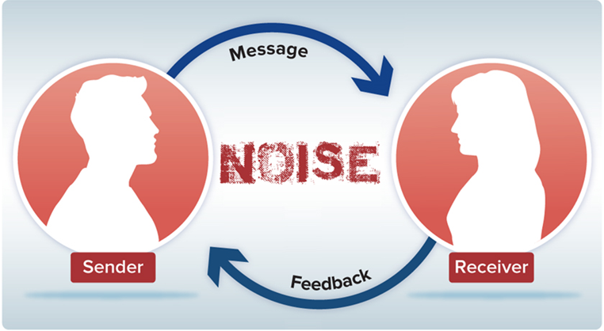
Communication
Nonverbal Communication: Positive versus. Negative Gestures.
Positive | Negative
Good body posture | Drooping shoulders with head held low
Eye contact | Looking down or away from patient
Neat, well-groomed appearance | Dingy, wrinkled lab coat; too much jewelry
Respecting personal space | Immediately approaching patient’s space before greeting and explaining procedures
Notes:
LO 1.7 List the qualities and characteristics of a phlebotomist.
Notes:
The four elements of the communication process are the sender, message, receiver, and feedback. Noise includes any barrier to effective communication, including pain, fear, and distractions such as visitors or a television.
The two types of communication are verbal and nonverbal. Nonverbal communication includes mannerisms and behaviors, as well as attire.
Positive communication techniques:
Speak in a calm, clear voice
Use nonmedical terminology when appropriate so the patient can understand
Maintain appropriate eye contact
Respect personal space
Things to avoid:
Using pet names such as “sweetie” or “honey”
Telling the patient it won’t hurt
Using slang
Talking excessively

Slide 47
Customer Service
Positive communication.
Patient identification.
Common courtesy.
Sympathy.
Situations addressed promptly.
Notes:
LO 1.7 List the qualities and characteristics of a phlebotomist.
Notes:
Customer service requires common courtesy.
Active listening techniques such as mirroring the patient’s statements and maintaining appropriate eye contact can help the patient understand that the phlebotomist is willing to help address any concerns the patient has. The phlebotomist should take steps promptly to address any problem or concern the patient describes.

Slide 48
Learn How 1–1: Communication and Customer Service 1
Ensure that you are neat and well–groomed before approaching a patient.
Approach the patient with an upright and open posture and a smile.
Address the patient with respect using the patient’s name and verify his or her identity by asking the date of birth.
Maintain eye contact with the patient during your introduction.
Respectfully request to draw the blood.
Notes:
LO 1.7 List the qualities and characteristics of a phlebotomist.

Slide 49
Learn How 1–1: Communication and Customer Service 2
Do not enter the patient’s personal space to draw the blood until you have verbal or nonverbal approval.
Thank the patient for his or her cooperation when you have finished the procedure.
Notes:
LO 1.7 List the qualities and characteristics of a phlebotomist.

Slide 50
Chapter Summary 1
The art of phlebotomy has evolved from the use of leeches to modern–day certified phlebotomists.
Phlebotomists are responsible for collecting, processing, and transporting blood specimens.
Phlebotomists are employed at hospitals, rehabilitation centers, nursing homes, clinics, physician offices, ambulatory care centers, blood banks, and reference labs.
Phlebotomists interact with healthcare professionals from many different medical specialties.
Notes:
LO 1.1 Summarize the definition and history of phlebotomy.
LO 1.2 Explain the role of the phlebotomist in the various healthcare facilities where he or she may be employed.
LO 1.3 Describe inpatient and outpatient facilities and their relationship to the practice of phlebotomy.
LO 1.4 Identify healthcare providers and other members of the healthcare team with whom the phlebotomist will interact in inpatient and outpatient facilities.

Slide 51
Chapter Summary 2
Roles of various medical laboratory personnel correspond to their specialty areas and levels of education.
There are many regulating agencies for phlebotomy including C L S I, T J C, H H S, C D C, C M S, C O L A, F D A, and O S H A, among others.
Professionalism involves a positive attitude and appearance, proper communication to the patient, and providing quality customer service.
Notes:
LO 1.5 Summarize the organization of the medical laboratory.
LO 1.6 Recognize the agencies that regulate hospitals and medical laboratories.
LO 1.7 List the qualities and characteristics of a phlebotomist.

Slide 52
End of Main Content
© McGraw Hill LLC. All rights reserved. No reproduction or distribution without the prior written consent of McGraw Hill LLC.

Slide 53
Accessibility Content: Text Alternatives for Images

Slide 54
Hierarchy in the Medical Laboratory – Text Alternative
Return to parent-slide containing images.
Top tier in the hierarchy: Medical Director (Pathologist) is linked to Laboratory Director/Administrator Clinical Pathology which is linked to the following on Second tier: Section supervisors for blood bank, clinical chemistry, hematology, microbiology, and specimen procurement. Third tier: Medical lab scientists medical lab technicians, are connected to the tier 2 sections. Phlebotomists connects to specimen procurement. Fourth tier: Specimen processors connects to Phlebotomists.
Return to parent-slide containing images.

