Slide 1
Chapter 10
Dermal (Capillary) Puncture

Slide 2
Learning Outcomes
10.1 Explain why dermal (capillary) puncture is used instead of routine venipuncture for some patients.
10.2 Select an appropriate site for dermal (capillary) puncture and identify the equipment needed.
10.3 Carry out the procedure for performing a dermal (capillary) puncture.
10.4 Apply the procedure for collecting a dermal (capillary) specimen.
Notes:
Introduction
Dermal (capillary) puncture is used to collect blood samples from infants and small children. It may also be used as an alternative method of blood collection for adult patients with whom venipuncture procedures are too difficult. Dermal (capillary) puncture procedures consist of detailed steps that must be performed safely and accurately.

Slide 3
N A A C L S Competencies 1
5.1 Demonstrate knowledge of collection equipment, various types of additives used, special precautions necessary, and substances that can interfere in clinical analysis of blood constituents.
5.6 List and select the types of equipment needed to collect blood by venipuncture and capillary (dermal) puncture.
5.7 Identify special precautions necessary during blood collections by venipuncture and capillary (dermal) puncture.
6.1 Follow standard operating procedures to collect specimens.
6.2 Identify potential sites for venipuncture and capillary (dermal) puncture.

Slide 4
N A A C L S Competencies 2
6.3 Differentiate between sterile and antiseptic techniques.
6.4 Describe and demonstrate the steps in the preparation of a puncture site.
6.5 List the effects of tourniquet, hand squeezing, and heating pads on specimens collected by venipuncture and capillary (dermal) puncture.
6.6 Describe and perform correct procedure for capillary (dermal) collection methods.
6.8 Describe the limitations and precautions of alternate collection sites for venipuncture and capillary (dermal) puncture.

Slide 5
N A A C L S Competencies 3
6.9 Explain the causes of phlebotomy complications.
6.10 Describe signs and symptoms of physical problems that may occur during blood collection.
6.11 List the steps necessary to perform a venipuncture and a capillary (dermal) puncture in order.
6.13 Demonstrate a successful capillary (dermal) puncture following standard operating procedures.
9.11 Demonstrate basic understanding of age specific or psycho-social considerations involved in the performance of phlebotomy procedures on various age groups of patients.

Slide 6
Key Terms
Calcaneus.
Interstitial fluid.
Osteomyelitis.
Palmar.
Plantar.

Slide 7
Learning Outcome 10.1
Dermal (Capillary) Puncture

Slide 8
Introduction to Dermal (Capillary) Puncture
Preferred method for young patients.
Infants.
Very small children.
May also be used for other patients.
Obese.
Elderly.
Severely burned.
Notes:
LO 10.1 Explain why dermal (capillary) puncture is used instead of routine venipuncture for some patients.
Notes:
Dermal or capillary puncture is the preferred specimen collection method for infants and very young children. In these patients, the veins are very small, and it is difficult to find a vein large enough to withstand the vacuum in evacuated collection tubes. Also, dermal puncture takes less time, so it is more often successful. Dermal puncture is easy to perform and is often less traumatic for children.
The blood specimen obtained using dermal puncture is not entirely venous blood. Instead, it is a mixture:
Capillary blood
Venous blood
Arterial blood
Interstitial fluid (fluid between cells and tissues)

Slide 9
Learning Outcome 10.2
Preparing for Dermal (Capillary) Puncture

Slide 10
Learn How 10-1: Dermal (Capillary) Puncture Preparation
Acquire and examine the requisition slip.
Greet and identify the patient.
Explain the procedure.
Verify any dietary restrictions.
Wash your hands.
Put on gloves.
Notes:
LO 10.2 Select an appropriate site for dermal (capillary) puncture and identify the equipment needed.
Notes:
The main differences between venipuncture and dermal puncture are:
Site selection
Equipment assembled

Slide 11
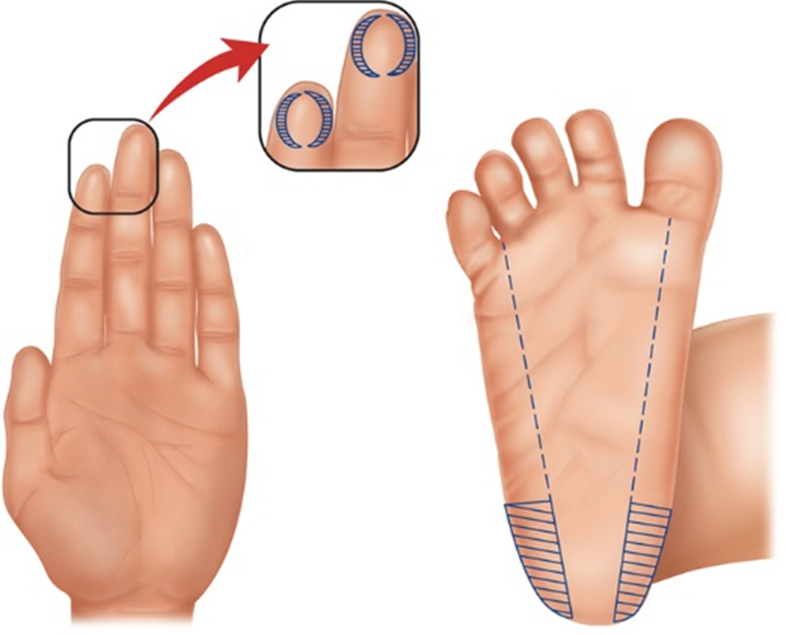
Selecting a Dermal (Capillary) Puncture Site
Notes:
LO 10.2 Select an appropriate site for dermal (capillary) puncture and identify the equipment needed.
Notes:
For children and adults, use the third or fourth finger of the hand.
Use the palmar surface of the finger.
Use the sides of the fingertip instead of the middle of the finger.
Warm the finger slightly to increase blood flow.
For infants, use the plantar surface of the heel.
Never perform a dermal puncture on the heel of an infant who has begun to walk.
Use the lateral surface of the heel, well away from the calcaneus (heel bone). If the calcaneus is punctured, it can cause osteomyelitis (bone infection).
For infants less than 1 year old, sides of the plantar surface of the heel are the sites of choice. Do not use the fingers because they are too small to maintain a safe distance from the bone during puncture.
Do not use:
Arch of the foot
Back of the heel
Plantar area (bottom surface, or sole) of foot

Slide 12
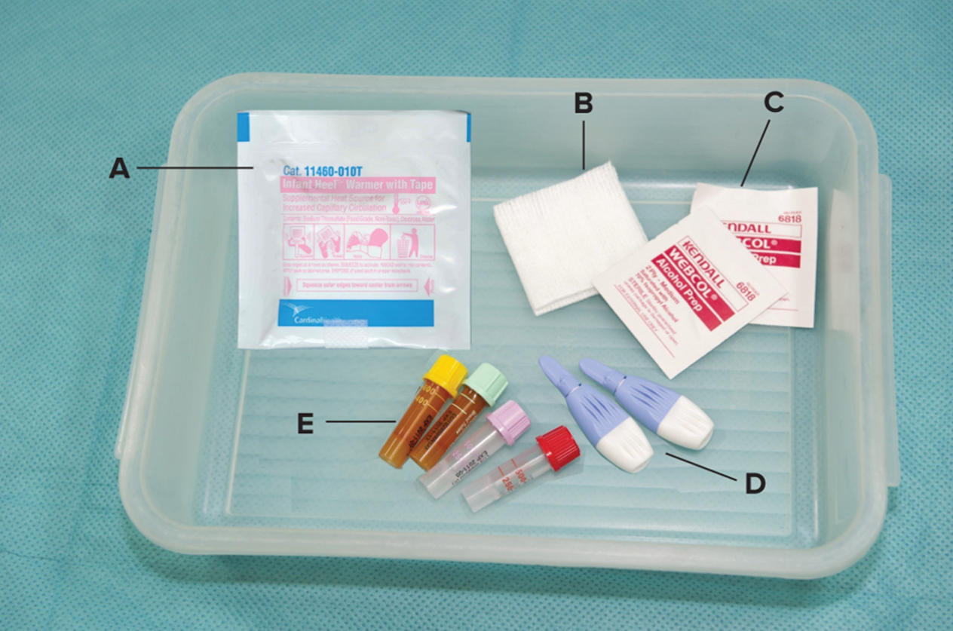
Assembling Dermal (Capillary) Puncture Equipment
©McGraw-Hill Education/Sandra Mesrine, photographer
Notes:
LO 10.2 Select an appropriate site for dermal (capillary) puncture and identify the equipment needed.
Notes:
Chapter 8 described the equipment needed for dermal puncture. Review the items before continuing with this section.
Requisition slip
Alcohol prep pad
Gauze pad
Gloves
Adhesive bandage or tape
Sharps container
Computer label
Permanent marker or pen
Lancet
Microspecimen containers

Slide 13
Learning Outcome 10.3
Performing a Dermal (Capillary) Puncture

Slide 14
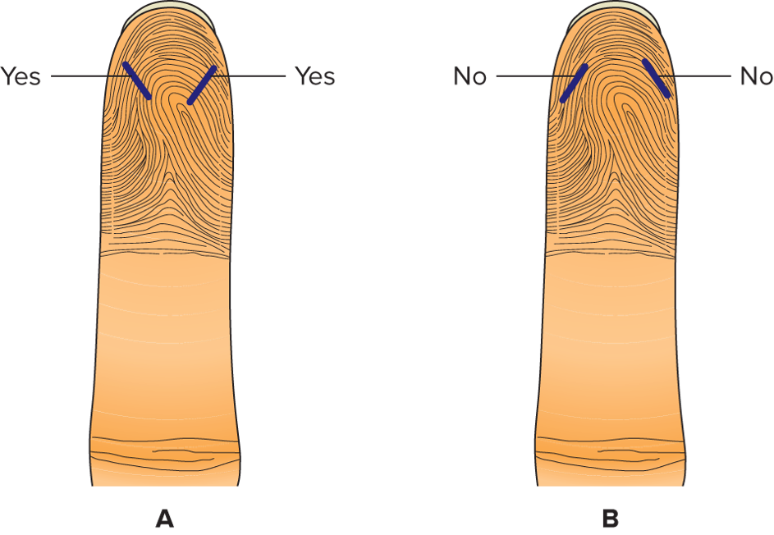
Planning the Puncture
Examine the fingers.
Choose a finger for the puncture.
Plan to cut across the fingerprint.
Notes:
LO 10.3 Carry out the procedure for performing a dermal (capillary) puncture.
Notes:
Select a site that is warm and free from scars, cuts, rashes, or bruises.
Plan to cut across the fingerprint. Do not cut in the same direction as the fingerprint because blood tends to run in the prints or ridges instead of forming a rounded drop.

Slide 15
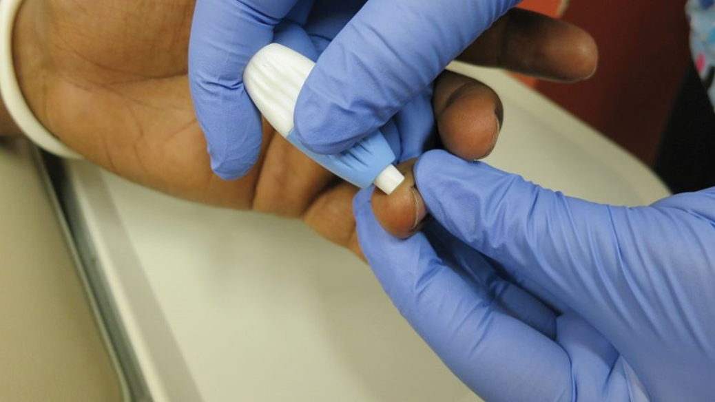
Performing the Puncture
Clean the site with alcohol.
Allow to dry completely.
Hold the finger to stretch skin tightly.
Puncture the finger.
©Lillian Mundt
Notes:
LO 10.3 Carry out the procedure for performing a dermal (capillary) puncture.
Notes:
Hold the finger in the proper position and stretch the skin tightly. Position the lancet to cut across the fingerprint, rather than in the same direction as the fingerprint.
Be sure to make the puncture deep enough to collect the amount of blood needed.
Note that improper technique during dermal puncture can cause bone infection, especially in infants. Puncture depth should never be greater than 2 mm and should never be performed at the center of the heel, where the calcaneus is most likely to be punctured.
Additional guidelines:
Do not use spring-loaded devices designed for glucose monitoring.
Use the device correctly. Check the directions before using an unfamiliar device.
Apply a steady amount of pressure to the site before and during the puncture.
View the video, “Skin Puncture Methods,” for more information about dermal (capillary) puncture.

Slide 16
Learn How 10-2: Performing a Dermal (Capillary) Puncture
Assemble the equipment, considering the patient and puncture depth.
Clean the site with an alcohol pad and allow the site to dry thoroughly.
Hold the finger (or heel) with the skin stretched tightly.
Use the lancet or puncture device according to the manufacturer’s directions to create the puncture.
Notes:
LO 10.3 Carry out the procedure for performing a dermal (capillary) puncture.

Slide 17
Learning Outcome 10.4
Collecting the Dermal (Capillary) Specimen

Slide 18
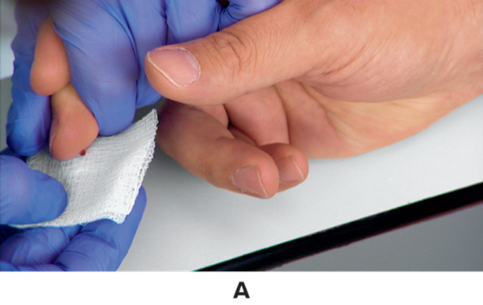
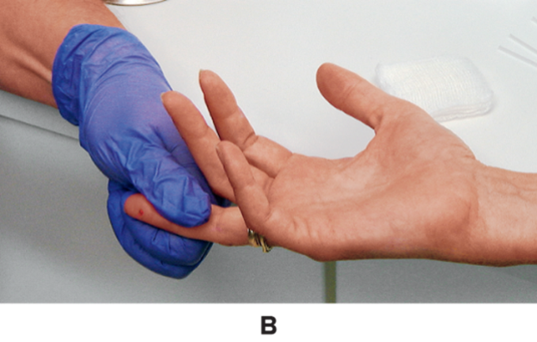
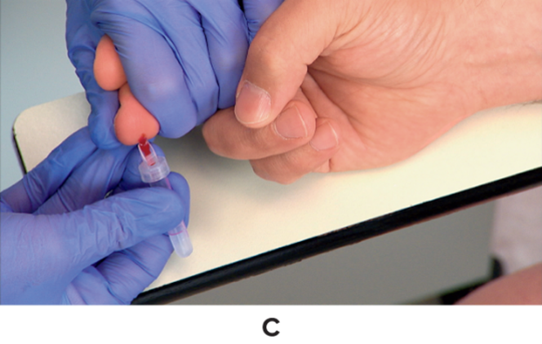
Collection Procedure
Wipe away first drop
Apply steady pressure
Collect specimen
©McGraw-Hill Education/Take One Digital Media, photographer
Notes:
LO 10.4 Apply the procedure for collecting a dermal (capillary) specimen.
Notes:
Wipe away the first drop to avoid contaminating the specimen with tissue fluid.
Apply a steady amount of pressure to the site and hold the finger so that drops of blood form and fall away from the site.
Additional guidelines:
Touch the open end of an appropriate microcollection container to the drop of blood to collect it.
Gently tap the container after each drop to ensure mixing with the anticoagulant, if present.
Do not “milk” the finger because this will contaminate the specimen with interstitial fluid.
Do not scrape the container against the skin because this may cause the blood to hemolyze or clot before it mixes with the anticoagulant in the collection container.
When collection is finished, apply gauze until the bleeding has stopped. (The patient may be able to do this.)

Slide 19
Order of Draw
E D T A (lavender or pink).
Heparin (green or light green).
Sodium fluoride (gray).
Nonadditive (red) or serum separator (gold).

Slide 20
Learn How 10-3: Collecting the Dermal (Capillary) Specimen 1
After performing the dermal puncture, wipe away the first drop of blood.
If using capillary tubes, hold the tube horizontally and touch the end of the tube to the next drop of blood to fill the tube by capillary action.
If using microcollection containers, follow the correct order of draw. Allow free-flowing drops of blood to enter the collection device, without milking the finger.
If the microcollection container includes an anticoagulant additive, tap the container gently on a hard surface after each drop to mix the blood with the additive.
Notes:
LO 10.4 Apply the procedure for collecting a dermal (capillary) specimen.

Slide 21
Check Your Competency 10-3: Collecting the Dermal (Capillary) Specimen 2
Collect blood to the fill line on the container. Collect a capillary tube to 2/3 to 3/4 full. Do not overfill or underfill.
Cap the microcollection container or seal the capillary tube.
If the container contains an additive, mix by inverting the container according to the manufacturer’s directions. Seal the capillary tube ends.
Dispose of the puncture device in the sharps container.
Label the microcontainers.
Check the puncture site and apply a bandage if appropriate.
Notes:
LO 10.4 Apply the procedure for collecting a dermal (capillary) specimen.

Slide 22
Complications of Dermal Puncture
Infection.
Osteochondritis.
Osteomyelitis.
Notes:
LO 10.4 Apply the procedure for collecting a dermal (capillary) specimen.
Notes:
Do not puncture through a previous puncture site; doing so may cause the site to become infected. Also take care not to puncture the bone, which may cause osteochondritis (inflammation of bone and cartilage) or osteomyelitis (inflammation of bone marrow and adjacent bone).

Slide 23
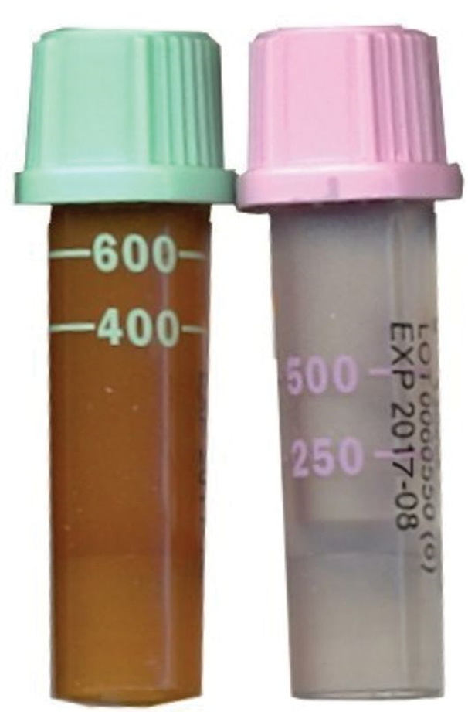
Minimum and Maximum Blood Volumes
Collecting the correct volume is important.
Enough for tests to be performed.
Do not exceed maximum allowed for day or over short time.
Most containers are marked with acceptable minimum and maximum fill levels.
©Lillian Mundt
Notes:
LO 10.4 Apply the procedure for collecting a dermal (capillary) specimen.
Notes:
Not collecting enough blood may cause an additional blood collection that would otherwise be unnecessary. However, collecting too much blood can result in iatrogenic anemia and exsanguination, as described in Chapter 9. Many facilities have guidelines for maximum blood volumes. Follow the protocol at your facility.
Another reason for drawing just the right amount of blood is that the amount of additives in the microcollection containers are based on a specific quantity of blood. If too little or too much blood is drawn, the ratio of blood to additive is affected, which may cause the blood to clot or otherwise affect test results.

Slide 24
Example Guidelines for Blood Collection Volumes
Body weight (kilogram) | Body weight (lb) | Maximum allowable volume (miliLitre) in one blood draw (2.5% of total blood volume) | Total maximum allowable volume (miliLitre) drawn over 30 days
1 | 2.2 | 2.5 | 5
2 | 4.4 | 5 | 10
3 | 6.3 | 6 | 12
4 | 8.8 | 8 | 16
5 | 11 | 10 | 20
6 | 13.2 | 12 | 24
7 | 15.4 | 14 | 28
8 | 17.6 | 16 | 32
9 | 19.8 | 18 | 36
10 | 22 | 20 | 40
Notes:
LO 10.4 Apply the procedure for collecting a dermal (capillary) specimen.
Notes:
Not collecting enough blood may cause an additional blood collection that would otherwise be unnecessary. However, collecting too much blood can result in iatrogenic anemia and exsanguination, as described in Chapter 9. Many facilities have guidelines for maximum blood volumes. Follow the protocol at your facility.
Another reason for drawing just the right amount of blood is that the amount of additives in the microcollection containers are based on a specific quantity of blood. If too little or too much blood is drawn, the ratio of blood to additive is affected, which may cause the blood to clot or otherwise affect test results.

Slide 25
After the Dermal (Capillary) Puncture
Place used lancet in sharps container.
Label the microcontainers.
Check patient’s finger and apply bandage if necessary.
Collect and dispose of supplies appropriately.
Thank and dismiss the patient.
Remove gloves.
Transport specimen to the laboratory.
Notes:
LO 10.4 Apply the procedure for collecting a dermal (capillary) specimen.
Notes:
Not all patients should have a bandage applied. Small children tend to put their fingers in their mouths. This puts them at risk for swallowing or choking on the bandage.

Slide 26
Chapter Summary 1
Dermal (capillary) puncture is used for blood collection from infants, small children, and adults in whom veins may be difficult to find, such as elderly patients, obese patients, or severely burned patients.
Dermal puncture procedures include a series of detailed steps that must be performed safely and accurately.
Properly identify patients and prepare them for blood collection by explaining the procedure and positioning them in a supported seated or lying position.
Select an age-appropriate site on the fingers or the heel of the foot.
Notes:
10.1 Explain why dermal (capillary) puncture is used instead of routine venipuncture for some patients.
10.2 Select an appropriate site for dermal puncture and identify the equipment needed.

Slide 27
Chapter Summary 2
Equipment needed for dermal puncture is the same as that used for venipuncture with the exception of the puncture device and the collection containers.
Properly cleanse the puncture site using an alcohol prep pad or other appropriate antiseptic; wipe in a circular motion from the center outward. Be sure the site is dry before collecting blood.
It is essential to follow aseptic technique and standard precautions and to collect the specimen in the appropriate microcontainers.
Notes:
10.2 Select an appropriate site for dermal puncture and identify the equipment needed.
10.3 Carry out the procedure for performing a dermal puncture.
10.4 Apply the procedure for collecting a capillary specimen.

Slide 28
Chapter Summary 3
Complications of dermal puncture include infection, osteochondritis, and osteomyelitis.
It is important to draw the correct amount of blood—no less than the minimum and no more than the maximum amount. Drawing less than needed for tests requires an additional puncture; drawing too much may result in exsanguination, especially in infants and small children.
After the puncture is complete, dispose of the contaminated safety lancet, label the microcontainers, check the puncture site, apply a bandage if indicated and appropriate, dispose of used supplies, clean the area, and thank and dismiss the patient.
Notes:
10.4 Apply the procedure for collecting a capillary specimen.

Slide 29
End of Main Content
© McGraw Hill LLC. All rights reserved. No reproduction or distribution without the prior written consent of McGraw Hill LLC.

