Slide 1
Blood Specimen Handling
Chapter 11
©McGraw-Hill Education. All rights reserved. Authorized only for instructor use in the classroom. No reproduction or further distribution permitted without the prior written consent of McGraw-Hill Education.

Slide 2
Learning Outcomes
11.1 Explain methods for transporting and processing blood specimens for routine and special testing and to reference laboratories.
11.2 Recognize the types of specimens that require special handling and the criteria for handling each specimen.
11.3 List the circumstances that would lead to re-collection or rejection of a patient sample.
Notes:
Introduction
The way in which blood specimens are handled during and after collection is of crucial importance. Minor mistakes may result in large errors. All specimen requirements must be followed, and specimens must be transported to the laboratory in a timely manner, whether the laboratory is in-house or a reference laboratory.

Slide 3
NAACLS Competencies 1
4.3 Define the phlebotomist's role in collecting and/or transporting these specimens to the laboratory.
4.4 List the general criteria for suitability of a specimen for analysis, and reasons for specimen rejection or recollection.
5.4 Describe the substances that can interfere in clinical analysis of blood constituents and ways in which the phlebotomist can help to avoid these occurrences.
7.00 Demonstrate understanding of requisitioning, specimen transport, and specimen processing.
7.3 Explain methods for transporting and processing blood specimens for routine and special testing.

Slide 4
NAACLS Competencies 2
7.4 Explain methods for processing and transporting blood specimens for testing at reference laboratories.
7.5 Identify and report potential pre-analytical errors that may occur during specimen collection, labeling, transporting, and processing.
7.6 Describe and follow the criteria for specimens and test results that will be used as legal evidence, i.e., paternity testing, chain of custody, blood alcohol levels, etc.

Slide 5
Key Terms
Additive-to-blood ratio
Aerosol
Aliquoting
Autoantibodies
Centrifuging
Chain of custody
Cold agglutinins
Delta check
Glycolysis
Icteric
Light-sensitive
Lipemia
Pneumatic tube system
Pre-examination error
Real-time tracking
Reference laboratory
STAT (ST)

Slide 6
Specimen Transport
Learning Outcome 11.1

Slide 7
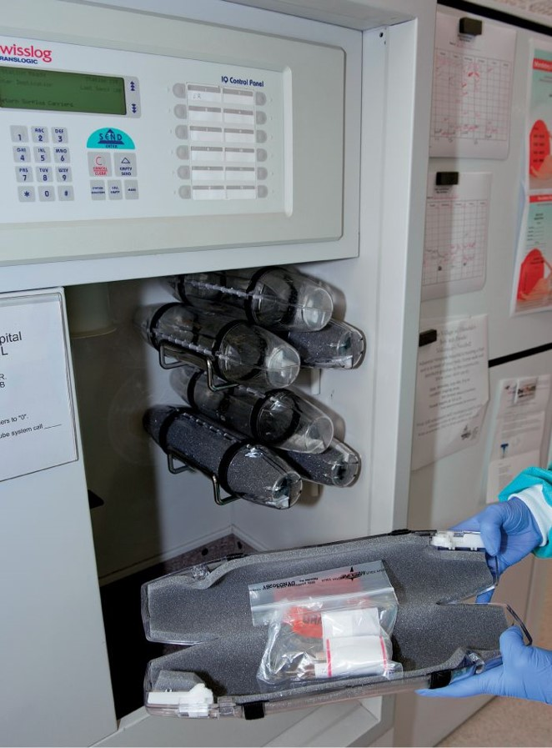
Specimen Transport within the Facility
Pneumatic tube system
Dumbwaiter
Automated tracks
Robotics
Conveyor belts
©McGraw-Hill Education/Sandra Mesrine, photographer
Notes:
LO 11.1 Explain methods for transporting and processing blood specimens for routine and special testing and reference laboratories.
Notes:
The simplest way to transport specimens within a facility is to walk to the laboratory. However, many facilities have other devices that simplify or speed up the process of transporting specimens.
Pneumatic tube systems have vacuum tubes like those used at bank drive-through windows. The specimen is properly labeled and enclosed in a biohazard bag for transport and is then put into a capsule. The capsule is loaded into the pneumatic tube and sent to the laboratory.
Use of a pneumatic tube system for specimen transport must be validated to establish a policy that allows for alternate delivery methods for specimens that would be hemolyzed or suffer other harmful effects if delivered using the pneumatic tubes.
Dumbwaiters are small elevators dedicated to transporting specimens to the laboratory.

Slide 8
Specimens for STAT Tests
Must be collected and processed immediately
Results are expected within 1 hour of order
Some tests require centrifugation within specified time
Take to lab within 45 minutes
Centrifuge within 1 hour
CLSI standard: 2 hours between collection and centrifugation
Notes:
LO 11.1 Explain methods for transporting and processing blood specimens for routine and special testing and reference laboratories.
Notes:
STAT tests are tests that are to be collected and processed immediately.
Specimens must be transported to the laboratory in a timely manner, especially if the phlebotomy area is in a different part of the building than the laboratory.
Tests on STAT specimens must be performed within one hour of collection.
Specimens that require centrifugation should be taken to the lab within 45 minutes and centrifuged within one hour.
Standards recommend a limit of two hours between collection and serum or plasma separation by centrifuge.
If you are unsure of specimen requirements, look them up in the procedure manual. Test results will be inaccurate if the specimen handling and processing guidelines are not met.

Slide 9
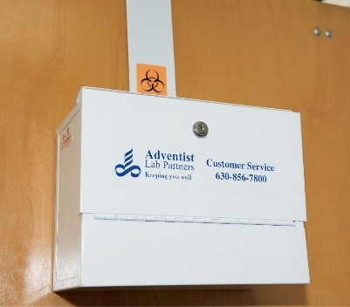
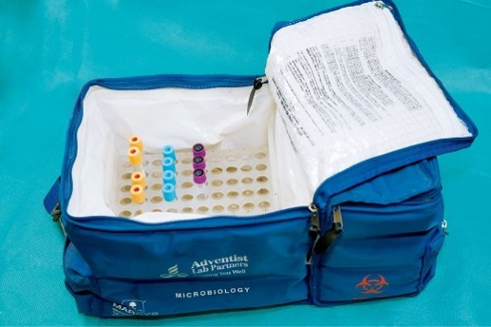
Courier Service
Transport specimens outside the facility
Specimens placed in locked box
May need to be processed before transport
Policy needed for time and temperature
©McGraw-Hill Education/Sandra Mesrine, photographer
Notes:
LO 11.1 Explain methods for transporting and processing blood specimens for routine and special testing and reference laboratories.
Notes:
Outpatient facilities often need to send specimens to a reference laboratory for processing.
Medical courier services are usually employed to transport specimens.
Some specimens require special handling procedures, such as keeping the specimens warm or cold.
Laboratories may provide clients such as doctors’ offices with a laboratory courier service for ease of delivering specimens collected in the office.
Specimens are placed in a courier pickup lock box. Laboratory policy dictates how long the specimens can stay in the box and how specimens are protected from extreme temperatures. Couriers follow a predetermined pickup schedule and help ensure specimen integrity by maintaining specific specimen requirements, such as using proper insulated transport containers.

Slide 10
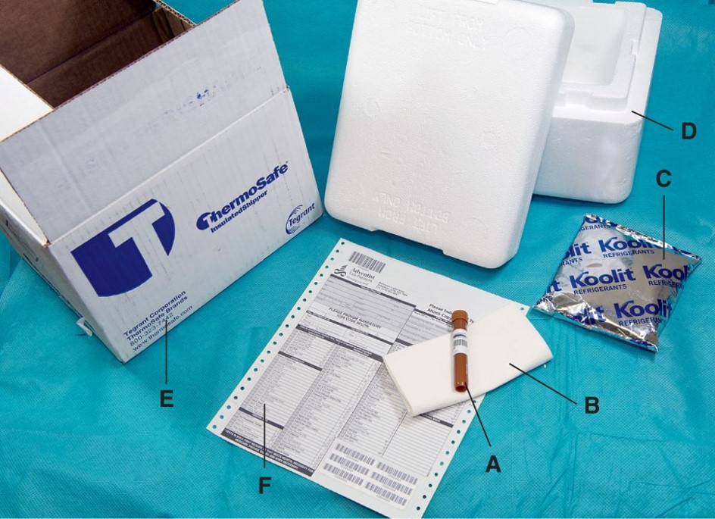
Reference Labs
Courier service
Shipping
©McGraw-Hill Education/Sandra Mesrine, photographer
Notes:
LO 11.1 Explain methods for transporting and processing blood specimens for routine and special testing and reference laboratories.
Notes:
Even hospitals sometimes need to send specimens to a reference laboratory. Reference laboratories offer a larger variety of tests than most community hospital laboratories.
Some reference labs provide their own courier service. However, specimens being sent to reference laboratories often have to travel longer distances, so extra attention must be paid to specimen preparation.
Specimens sent through the mail or by an express delivery service (such as FedEx) must comply with local, state, and federal laws governing packaging and biohazard identification.

Slide 11
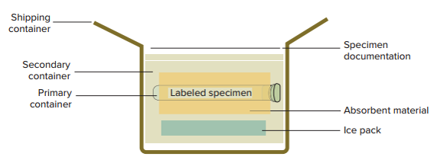
Packaging Requirements for Shipping Specimens
Packaging Requirements for Shipping Specimens Appendix
©Lillian Mundt
Notes:
LO 11.1 Explain methods for transporting and processing blood specimens for routine and special testing and reference laboratories.
Notes:
Packaging requirements for clinical specimens include:
Watertight primary container, labeled the same as the original specimen
Original specimen tube or plastic screw-cap transfer tube
Absorbent material
Watertight secondary container (Ziploc® bag, plastic canister, or Styrofoam box), with specimen identification and appropriate biohazard labels
Sturdy outer packaging (fiberboard, wooden box, or rigid plastic container), also displaying biohazard warning labels
Paperwork, including patient, specimen, and test information, placed inside the shipping container but outside the secondary container so that it does not get wet

Slide 12
Protecting Personnel
Place specimen tubes in biohazard bags
For shipping
When transporting by pneumatic tube
To open packaging or pneumatic tube:
Wear appropriate PPE
If specimen has spilled in a pneumatic tube, follow facility policy to decontaminate the tube
Notes:
LO 11.1 Explain methods for transporting and processing blood specimens for routine and special testing and reference laboratories.
Notes:
Appropriate PPE for opening a pneumatic tube that contains laboratory specimens includes gloves, a lab coat, and face protection.

Slide 13
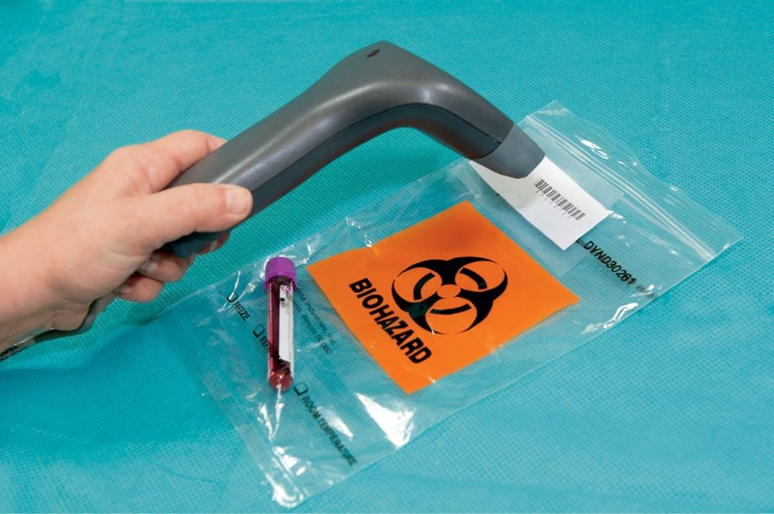
Tracking Specimen Transit
Enter transit information into LIS
Manual entry
Bar code reader
©McGraw-Hill Education/Sandra Mesrine, photographer
Notes:
LO 11.1 Explain methods for transporting and processing blood specimens for routine and special testing and reference laboratories.
Notes:
Documentation of specimen collection and transit are essential.
Enables proper recordkeeping
Allows follow-up on problem specimens
The phlebotomist enters the following data into the laboratory information system (LIS):
All collection information, including date and time of collection
Phlebotomist identification code
Any comments pertaining to the specimen or collection
The courier enters pickup and drop-off information for the specimens. Some facilities use bar code scanners to provide real-time tracking so that a glance at the records in the LIS shows the latest information about the specimen and its location.

Slide 14
Special Specimen Handling
Learning Outcome 11.2

Slide 15
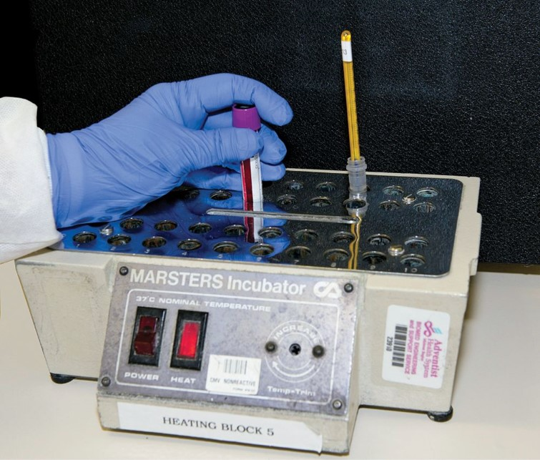
Specimens Requiring Warmth
Tests
Cold agglutinins
Clot retraction
Must be kept at 37° C
©McGraw-Hill Education/Sandra Mesrine, photographer
Notes:
LO 11.2 Recognize criteria for special specimen handling.
Notes:
Cold agglutinins are antibodies that react at cooler temperatures. They are tested when a patient is suspected of having atypical pneumonia, which can cause the person to produce autoantibodies (antibodies against oneself).
Requirements for specimens that require warmth during transit:
Tubes must be pre-warmed to 37° C and kept warm throughout the collection process.
Tubes must be delivered directly to the laboratory section responsible for performing the test and placed in an incubator or water bath in the laboratory, set at 37°C.
Specimen must be kept at body temperature until the serum or plasma has been separated from the cells.
Separation of serum or plasma must be done within one hour.

Slide 16
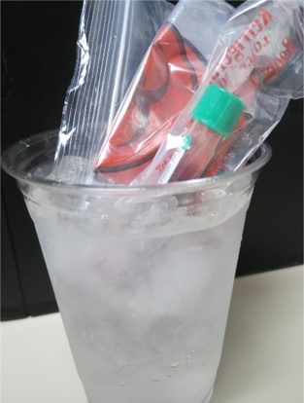
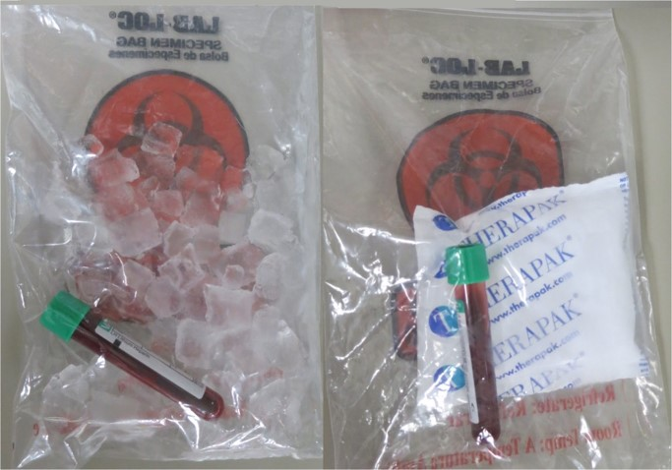
Specimens Requiring Cooling
Slows metabolic process
Placed in a slurry of crushed ice and water
Placed in a bag with cool pack
Must NOT be allowed to freeze.
©Lillian Mundt
Notes:
LO 11.2 Recognize criteria for special specimen handling.
Notes:
When placing specimens in an ice bath, be sure to protect the specimen label from moisture. Place the specimen in a plastic bag or in a double-compartment specimen transport bag with ice or a cold pack in a separate compartment.

Slide 17
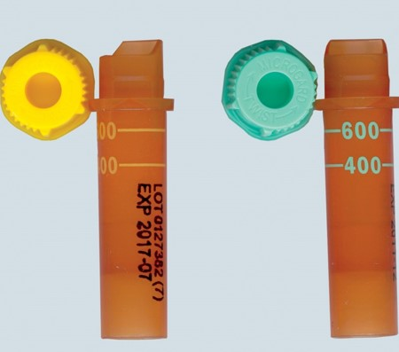
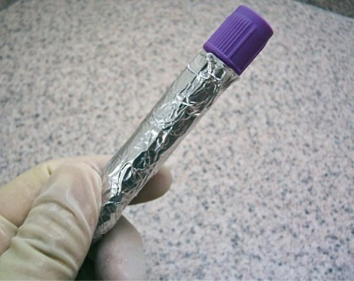
Light-Sensitive Specimens
Tests
Bilirubin
Beta-carotene
Use amber tube
Wrap in foil
Top: ©Lillian Mundt; bottom: ©Total Care Programming, Inc.
Notes:
LO 11.2 Recognize criteria for special specimen handling.
Notes:
Substances such as bilirubin and beta-carotene are light-sensitive: they break down when exposed to light. Therefore, if the specimen will be tested for these substances, it must be protected from light immediately upon collection.
Bilirubin levels are commonly performed on newborn infants. An infant who is known to have excess bilirubin is commonly placed under an ultraviolet light to help break down the bilirubin. If the patient is under an ultraviolet light, it is very important to turn off the light before collecting the blood because the UV light will destroy some of the bilirubin in the specimen as you collect it, yielding false results.
If you turn off a UV light to collect a specimen, be sure to turn it back on before you leave.

Slide 18
Specimens for Legal Matters
Results may be used in court of law
Blood alcohol levels
Forensic specimens
Toxicology specimens
Chain of custody
Uninterrupted control of authorized personnel
If broken, specimen and tests are invalid
Chain of custody form must be completed
Notes:
LO 11.2 Recognize criteria for special specimen handling.
Notes:
Specimens pertaining to any legal matter must be handled very carefully. These specimens include:
Blood alcohol
Forensic testing
Toxicology specimens
Chain of custody accounts for the specimen from the time of collection to the final disposition of the specimen.
To ensure that there are no breaks in the chain of custody:
Each person who handles the specimen must sign and date the chain-of-custody form.
The specimen is kept in a locked container or the tube must be sealed with a tamper-proof label or wax at all times.

Slide 19
Blood Alcohol Testing
Proceeding without patient consent or court order is considered assault and battery
Requires chain of custody
Do not use alcohol to cleanse site
No alcohol prep pads
No iodine swabs
Use disinfectant to cleanse site
Green surgical soap
Hydrogen peroxide
Notes:
LO 11.2 Recognize criteria for special specimen handling.
Notes:
It is important not to use an alcohol prep pad to cleanse the puncture site when you are collecting blood for a blood alcohol test. The alcohol from the prep pad will affect the test result. Iodine swabs also contain alcohol. Use a disinfectant such as green surgical soap or hydrogen peroxide instead.

Slide 20
Forensic Testing
Usually for legal cases
Requires chain of custody
Check specific guidelines at your facility
Special evidence kits
Proper training
Notes:
LO 11.2 Recognize criteria for special specimen handling.
Notes:
General guidelines for collecting forensic specimens:
Wear gloves at all times.
Collect the specimen as soon as possible.
Ensure that the specimen is packed, stored, and transported correctly.
Label each specimen with the patient’s name and date of birth, the name of the person collecting the specimen, the type of specimen, and the date and time of the collection.
Pack the specimen securely in tamper-proof packaging.
Record all handling of the specimen, usually on a chain-of-custody form.

Slide 21
Check Your Competency 11-1: Forensic Testing Guidelines 1
Avoid contamination by wearing gloves at all times.
Collect the specimen as soon as possible.
Ensure that the specimen is packed, stored, and transported correctly. In general, fluids are refrigerated and other specimens are kept dry and at room temperature.
Label each specimen with the patient’s name and date of birth, the name of the person collecting the specimen, the type of specimen, and the date and time of the collection.
Notes:
LO 11.2 Recognize criteria for special specimen handling.
Notes:
Perform forensic testing specimen collection only if you have had the proper training.

Slide 22
Check Your Competency 11-1: Forensic Testing Guidelines 2
Make sure the specimen is packed securely and is tamper-proof. Only authorized people should touch the specimen.
Record all handling of the specimen, most commonly on a chain-of-custody form.
Notes:
LO 11.2 Recognize criteria for special specimen handling.
Notes:
Perform forensic testing specimen collection only if you have had the proper training.

Slide 23
Toxicology Specimens
Reasons for toxicology specimens
Detect poisons or medications
Detect trace elements
Follow facility protocol for collection, type of specimen, and equipment usage
Notes:
LO 11.2 Recognize criteria for special specimen handling.
Notes:
Following the laboratory facility’s policy for toxicology specimens is critical because many things can contaminate or react with some of the analytes, including:
Oil or bacteria from hands
Glass
Plastic materials

Slide 24
Samples Collected for Forensic Purposes
Blood
Bones
Hair
Nails
Saliva
Skin
Sperm
Sweat
Teeth
Vaginal
Mud
Vegetation
Notes:
LO 11.2 Recognize criteria for special specimen handling.

Slide 25
Lactic Acid Blood Collection
Tourniquet may be applied briefly to locate vein
Remove tourniquet before collection
Arm must be at rest for 2 minutes before collection
Place specimen on ice
Deliver to laboratory STAT
Notes:
LO 11.2 Recognize criteria for special specimen handling.
Notes:
Lactic acid forms during carbohydrate metabolism in the muscles. Its blood level can be affected by:
Exercise
Vigorous hand pumping prior to blood collection
Application of a tourniquet during blood collection
Procedure for collecting a specimen for a lactic acid test:
Apply tourniquet for less than one minute if necessary to locate the vein.
Allow the arm to rest for at least two minutes.
Use a gray-topped (sodium fluoride) tube to collect the blood to minimize the effects of glycolysis (a process that changes glucose into lactic acid).
Place the specimen on ice for transport.
Deliver the specimen to the laboratory STAT.

Slide 26
Special Coagulation Studies
Types of studies
Factor assay
Platelet function studies
Coagulation inhibitor assays
Follow strict order of draw with large-bore needle
Perform procedure quickly
Invert tubes gently to mix
Deliver to laboratory immediately
Notes:
LO 11.2 Recognize criteria for special specimen handling.
Notes:
The trauma of venipuncture activates the clotting system at the site of puncture. A large-bore needle (21-gauge or larger) must be used.
If you are obtaining specimens for multiple tests, always draw the coagulation studies (light blue-topped tube) first. If you are using a butterfly needle assembly, use a discard tube first before drawing the specimen for the coagulation studies.
Perform the procedure quickly to minimize the amount of time that the tourniquet is applied.
Invert each tube the specified number of times while the next tube is filling.
If you are collecting blood through a venous access device:
Flush the line with saline.
Draw at least 10–20 mL of fluid and blood by syringe and discard.
Use a new syringe to collect the required amount of blood for the coagulation studies.
Transfer immediately to light-blue-topped evacuation tubes.
Invert the tubes the required number of times.
Deliver all specimens to the laboratory immediately.

Slide 27
Separated Specimens
Separation procedures
Centrifuging
Aliquoting
For most tests, separation should be completed within 2 hours of collection
Notes:
LO 11.2 Recognize criteria for special specimen handling.
Notes:
Some facilities expect phlebotomists to process samples by:
Centrifuging: spinning to separate the cells from the liquid portion of the blood
Aliquoting: Dividing or separating specimens into separate containers

Slide 28
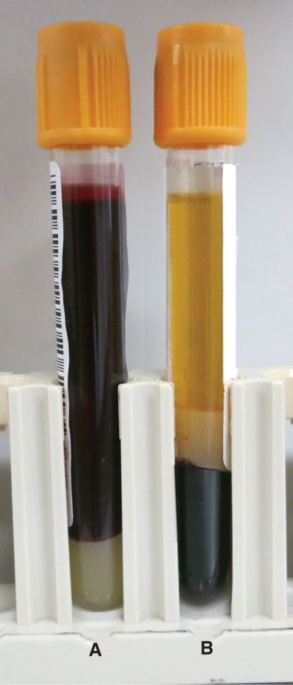
Centrifuging Specimens
Separates blood cells from liquid components
Speed and time depend on specimen
Typical speed: 1,000 to 3,000 rpm
Typical time: 15 minutes
©Lillian Mundt
Notes:
LO 11.2 Recognize criteria for special specimen handling.
Notes:
The spinning action of a centrifuge forces the relatively heavy red blood cells to the bottom of the tube. The lighter liquids remain on top. If the tube contains a gel separator, it migrates to the middle to separate the blood cells from the fluid.

Slide 29
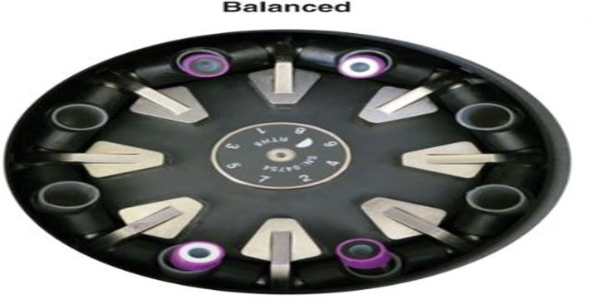
Using a Centrifuge
Balance the centrifuge
Set for correct speed
Close lid securely
Set timer for correct time
Wear face shield when removing tubes
Open lid slowly after centrifuge stops completely
©Lillian Mundt
Notes:
LO 11.2 Recognize criteria for special specimen handling.
Notes:
Centrifuges come in many different styles: refrigerated, floor models, and tabletop models. They are designed to spin blood specimens, separating the cells from the liquid portion. The cells are pushed to the bottom while the liquids remain on top. If a gel separator is used, the gel migrates to the middle and forms a barrier between the cell and liquid layers.
Non-additive tubes and serum separator tubes (SSTs) must be completely clotted prior to centrifugation.
Always be sure to balance the centrifuge by placing tubes of the same size and volume opposite each other. If you do not have an even number of tubes, you can fill a tube with water to balance the centrifuge. This is critical, because an unbalanced centrifuge can break the tubes and ruin laboratory specimens. It can also be dangerous for the user.
If a tube is broken in a centrifuge, the cup containing the tube must be completely emptied into a sharps container and disinfected.
Wait until the centrifuge comes to a complete stop before opening the lid. Wear a face shield to protect yourself from potentially harmful blood aerosols (mists that travel in the air).

Slide 30
Aliquoting Specimens
Take great care not to mix up specimens
Label transfer tube
Compare to specimen tube label
Use pipet to transfer serum or plasma
Store properly for delivery to lab
Mixing up patient specimens is one of the greatest concerns of all laboratory workers. Mistakes can have grave consequences.
Notes:
LO 11.2 Recognize criteria for special specimen handling.
Notes:
A pipet is a graduated tube with a suction bulb. It is used to draw some of the fluid from the specimen tube and place it into one or more transfer tubes. Never pour specimens from one tube to another.

Slide 31
Specimen Rejection
Learning Outcome 11.3

Slide 32
Pre-Examination Errors
Errors that occur before, during, or after blood collection
Patient identification errors
Specimen collection errors
Specimen handling errors
Notes:
LO 11.3 List the circumstances that would lead to re-collection or rejection of a patient sample.
Notes:
A pre-examination error is any error that occurs before the actual specimen analysis. This includes errors that occur before, during, or after blood collection.
Every step in the collection and transport of specimens is critical to providing an acceptable specimen to the laboratory and getting accurate results.

Slide 33
Specimen Recollection
Re-collection may be required if abnormalities are detected
Accurate test results depend on specimen quality
Errors may go unnoticed
Questionable results obtained
Notes:
LO 11.3 List the circumstances that would lead to re-collection or rejection of a patient sample.
Notes:
Lab personnel will see obvious characteristics of a poor specimen, such as hemolysis, clots, or underfilled tubes, and will request re-collection. However, less obvious characteristics may go unnoticed. Because these abnormalities may affect test results, it is important to follow all guidelines for correct collection and transportation of specimens.
There is nothing medical laboratory technicians and scientists can do to a specimen to obtain quality results from an inappropriately collected or handled specimen.

Slide 34
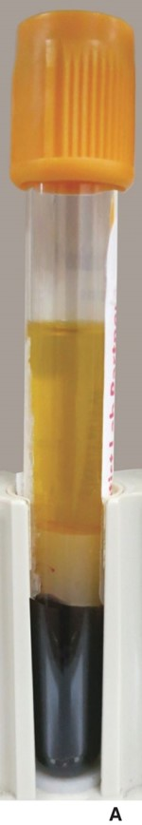
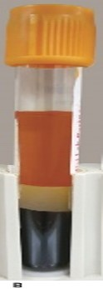
Hemolysis
Destruction of red blood cells
Can result from improper collection or handling
Normal Specimen
Hemolyzed Specimen
©Lillian Mundt
Notes:
LO 11.3 List the circumstances that would lead to re-collection or rejection of a patient sample.
Notes:
Common causes of hemolysis:
Not allowing the alcohol to dry prior to puncture
Continuing to draw blood during hematoma formation
Forcefully squeezing during dermal puncture
Vigorously mixing the collection tube
Forcing blood when using a syringe transfer procedure by pushing on the plunger
Handling the specimen roughly during transport
Freezing and thawing specimens in transit (uncontrolled environmental temperatures)

Slide 35
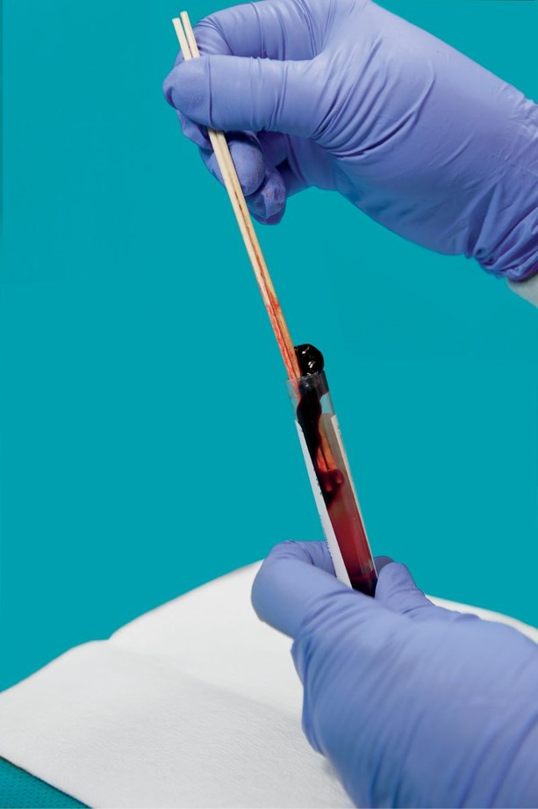
Clotted Anticoagulated Specimens
Some tests require unclotted specimens
Blood may clot even in tubes that contain anticoagulant
Often due to collection issues
©McGraw-Hill Education/Sandra Mesrine, photographer
Notes:
LO 11.3 List the circumstances that would lead to re-collection or rejection of a patient sample.
Notes:
Common causes of specimen clotting in anticoagulant tubes:
Incorrect order of draw
Failure to mix each tube as it is removed from the evacuated tube holder or to tap a microcollection container between each drop
Delay in transferring specimens from a syringe to an evacuated tube
Difficult blood draws in which the blood flows very slowly into the tube
Use of an expired tube

Slide 36
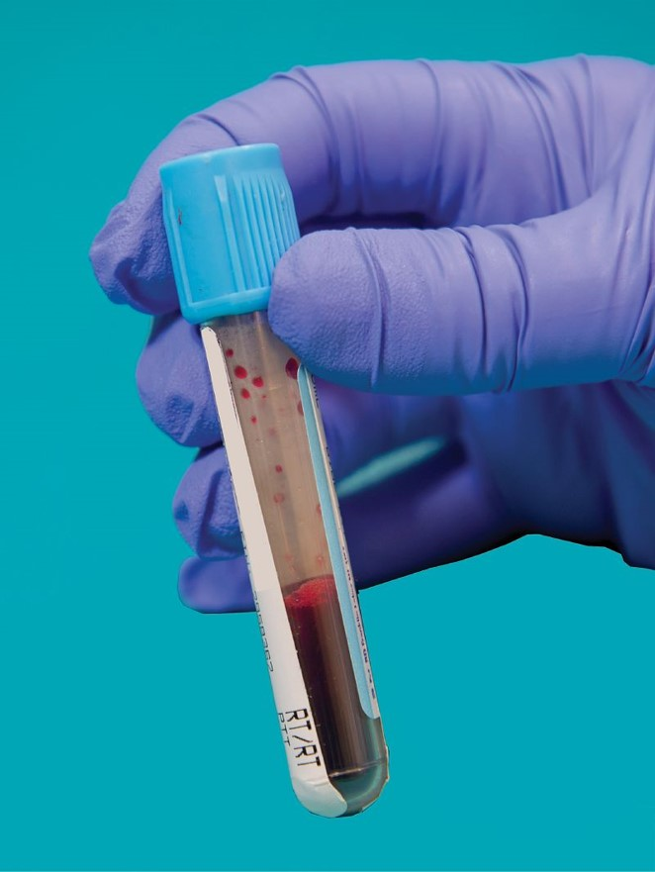
Incomplete Collection
May be rejected as “quantity not sufficient” (QNS)
Causes improper additive-to-blood ratio
©McGraw-Hill Education/Sandra Mesrine, photographer
Notes:
LO 11.3 List the circumstances that would lead to re-collection or rejection of a patient sample.
Notes:
Additive-to-blood ratio: The balance between the amount of additive or anticoagulant and the amount of blood
Common causes of incomplete collection:
Loss of vacuum during venipuncture
Loss of vacuum during shipping
Failure to purge air from butterfly needle tubing using a discard tube
Use of expired tubes
Removal of the tube before its fill level is reached
Veins collapsing during venipuncture
Dermal puncture site clotting before enough specimen is obtained

Slide 37
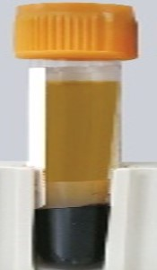
Other Causes for Rejection 1
Incorrect tube collected
Incorrect draw order
Hemoconcentration
Not easily detected
Results may be questioned if delta check fails
Icterus
Dark-yellow to greenish-yellow color
Caused by bilirubin
Icteric Specimen
©Lillian Mundt
Notes:
LO 11.3 List the circumstances that would lead to re-collection or rejection of a patient sample.
Notes:
Causes of incorrect tube collection:
Procedure manual not consulted or information was misinterpreted
Tube delivered to the wrong laboratory section (switch occurred)
Wrong tube collected by mistake
Misinterpretation of requisition
Causes of incorrect draw order:
Procedure manual not consulted or information was misinterpreted
Tubes collected in the wrong order by mistake
Hemoconcentration results from prolonged tourniquet application. Since the only effect is a greater concentration of cells, which can also be due to disease processes, this error is difficult to detect. Laboratory personnel may question the results if the results do not make sense or do not pass delta check.
Delta check: A comparison of the results with previous results on the same patient
Icterus: The abnormal color of icteric plasma interferes with some chemistry tests, such as creatinine.

Slide 38
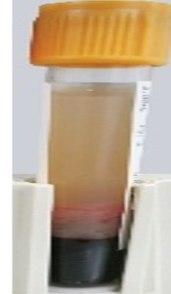
Other Causes for Rejection 2
Lipemia
Cloudy plasma
Caused by abnormal amount of fats
Special requirements not followed
Missing or inadequate documentation
Lipemic Specimen
©Lillian Mundt
Notes:
LO 11.3 List the circumstances that would lead to re-collection or rejection of a patient sample.
Notes:
Causes of incorrect tube collection:
Procedure manual not consulted or information was misinterpreted
Tube delivered to the wrong laboratory section (switch occurred)
Wrong tube collected by mistake
Misinterpretation of requisition
Causes of incorrect draw order:
Procedure manual not consulted or information was misinterpreted
Tubes collected in the wrong order by mistake
Hemoconcentration results from prolonged tourniquet application. Since the only effect is a greater concentration of cells, which can also be due to disease processes, this error is difficult to detect. Laboratory personnel may question the results if the results do not make sense or do not pass delta check.
Delta check: A comparison of the results with previous results on the same patient
Icterus: The abnormal color of icteric plasma interferes with some chemistry tests, such as creatinine.

Slide 39
Chapter Summary 1
Specimens must be transported to the laboratory in a timely manner.
Transport systems include hand delivery, pneumatic tube system, or automated or robotic transport systems.
Specimen packaging for transport by mail or express service must meet local, state, and federal safety standards.
Proper documentation of specimen collection and transport allows the specimen to be tracked.
Specimen handling for legal specimens must include chain-of-custody procedures.
For blood alcohol testing, written patient consent or a court order is required.
Notes:
11.1 Explain methods for transporting and processing blood specimens for routine and special testing and reference laboratories.
11.2 Recognize criteria for special specimen handling.

Slide 40
Chapter Summary 2
Forensic specimens are collected as evidence to help prove or disprove a link between an individual and objects, places, or other individuals.
Toxicology specimens are collected to detect poisons, drugs, and medications.
The phlebotomist may be required to process specimens, including centrifugation and aliquoting.
Pre-examination variables that affect laboratory results include temperature control, exposure to light, and special draw techniques.
Notes:
11.2 Recognize criteria for special specimen handling.
11.3 List the circumstances that would lead to re-collection or rejection of a patient sample.

Slide 41
Chapter Summary 3
Specimens may be rejected due to improper collection techniques or handling or processing errors.
Reasons for specimen rejection include hemolysis, clots, hemoconcentration, icterus, lipemia, contamination, incomplete collection, incorrect tube or draw order, inadequate documentation, or failure to follow special requirements.
Notes:
11.3 List the circumstances that would lead to re-collection or rejection of a patient sample.

Slide 42
Appendix Slides

Slide 43
Packaging Requirements for Shipping Specimens Appendix
Section view showing the inside of a shipping container. The secondary container is placed inside the shipping container. The ice pack is placed in the bottom of the secondary container. Absorbent material is placed on the ice pack, and the labeled specimen is placed in the absorbent material. The lid is placed on the secondary container, and the specimen documentation is placed on top of the lid of the secondary container.
Packaging Requirements for Shipping Specimens

