Slide 1
Quality Essentials
Chapter 12
©McGraw-Hill Education. All rights reserved. Authorized only for instructor use in the classroom. No reproduction or further distribution permitted without the prior written consent of McGraw-Hill Education.

Slide 2
Learning Outcomes
12.1 Identify policies and procedures used in phlebotomy and in the clinical laboratory to assure quality in obtaining blood specimens.
12.2 Carry out documentation of quality control.
12.3 Identify corrective actions for failures of quality control.
Notes:
Introduction
Quality—a state of excellence—is accomplished by adherence to a set of measurable standards. Phlebotomists must understand the need to perform and document quality control activities to ensure reliable laboratory results. Quality assessment and process improvement (QAPI) aims to discover and eliminate weaknesses in a process in order to improve the quality of patient care outcomes.

Slide 3
NAACLS Competencies
8.00 Demonstrate understanding of quality assurance in phlebotomy.
8.1 Describe the system for monitoring quality assurance in the collection of blood specimens.
8.2 Identify policies and procedures used in the clinical laboratory to assure quality in the obtaining of blood specimens.
8.2.3 Identify and report control results that do not meet predetermined criteria.

Slide 4
Key Terms 1
Accuracy
Audit
Calibration
Competency assessment
Continuous quality improvement (CQI)
Control material
Corrective action
Delta check
Evaluation
Incident forms
Indicators
Levey-Jennings chart
Parameters
Patient outcomes
Precision
Preventive action
Processes
Proficiency testing (PT)

Slide 5
Key Terms 2
Quality assessment and process improvement (QAPI)
Quality assurance (QA)
Quality control (QC)
Quality cost management (QCM)
Quality management system (QMS)
Random errors
Reliable
Shift
Standard operating procedure (SOP)
Standards
Systematic errors
Total quality management (TQM)
Training
Trend
Validation
Variances

Slide 6
Maintaining Quality
Learning Outcome 12.1

Slide 7
Quality
State of excellence
Free from defects or deficiencies
Accomplished by adhering to set of measurable standards
Ensures patient safety and customer satisfaction
Notes:
LO 12.1 Identify policies and procedures used in phlebotomy and in the clinical laboratory to assure quality in obtaining blood specimens.
Notes:
Using a set of measurable standards adopted by the healthcare industry helps ensure the quality of laboratory performance.

Slide 8
Quality in the Laboratory
Essential in all stages of laboratory processes
Proper completion of lab requisitions
Competent specimen collection
Correct specimen processing
Accurate performance of tests
Correct reporting of results
Notes:
LO 12.1 Identify policies and procedures used in phlebotomy and in the clinical laboratory to assure quality in obtaining blood specimens.
Notes:
Laboratory tests are a vital link in patient care that assists healthcare providers in identifying a patient’s medical diagnosis. Quality performance in the laboratory is therefore imperative to patient care.
The Clinical and Laboratory Standards Institute (CLSI) recognizes a hierarchy of processes that lead to the achievement of quality. Those processes and techniques are described in this presentation.

Slide 9
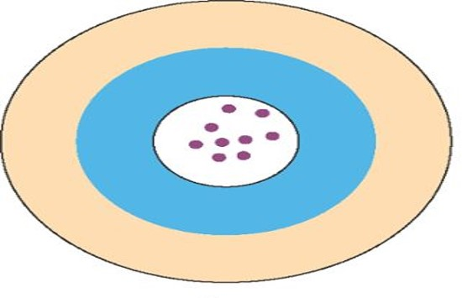
Accuracy and Precision
Actual glucose level: 125 mg/dL
Results both accurate and precise:
    122 mg/dL
    127 mg/dL
    125 mg/dL
    126 mg/dL
    122 mg/dL
    124 mg/dL
    125 mg/dL
    120 mg/dL
    127 mg/dL
Copyright © McGraw-Hill Education
Notes:
LO 12.1 Identify policies and procedures used in phlebotomy and in the clinical laboratory to assure quality in obtaining blood specimens.
Notes:
Accuracy: How close a result is to the actual value
Precision: Ability of a test to give nearly the same result when performed repeatedly

Slide 10
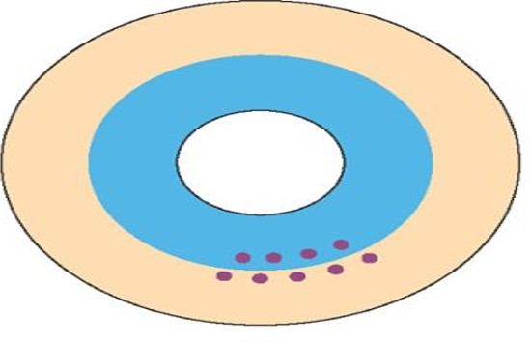
Precision without Accuracy
Actual glucose level: 125 mg/dL
Results precise but not accurate:
    100 mg/dL
    102 mg/dL
    90 mg/dL
    95 mg/dL
    101 mg/dL
    98 mg/dL
    95 mg/dL
    103 mg/dL
    100 mg/dL
Copyright © McGraw-Hill Education
Notes:
LO 12.1 Identify policies and procedures used in phlebotomy and in the clinical laboratory to assure quality in obtaining blood specimens.
Notes:
If test results are precise but not accurate, the results will be reproducible in repeated testing but also will be wrong.

Slide 11
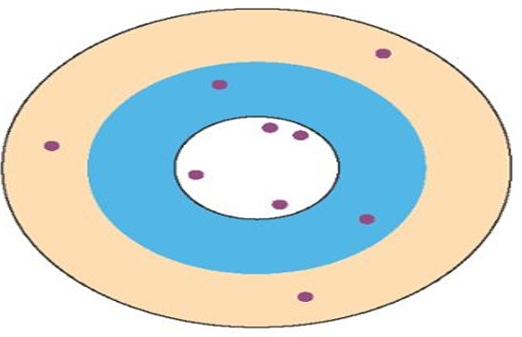
Neither Accuracy nor Precision
Actual glucose level: 125 mg/dL
Results neither accurate nor precise:
    162 mg/dL
    135 mg/dL
    126 mg/dL
    102 mg/dL
    124 mg/dL
    85 mg/dL
    150 mg/dL
    117 mg/dL
Copyright © McGraw-Hill Education
Notes:
LO 12.1 Identify policies and procedures used in phlebotomy and in the clinical laboratory to assure quality in obtaining blood specimens.
Notes:
If the results are neither accurate nor precise, the value is not consistent among repeated tests, and most of the values are wrong.

Slide 12
Total Quality Management (TQM)
Highest level of quality oversight
Managed at organizational level
Governs behavior of a set of individuals
Identifies organization’s customers
Designs operations to produce highest customer satisfaction
Not just accuracy of test results
Notes:
LO 12.1 Identify policies and procedures used in phlebotomy and in the clinical laboratory to assure quality in obtaining blood specimens.
Notes:
Total quality management (TQM): Identification of an organization’s internal and external customers in an effort to design operations that produce the highest customer satisfaction
In TQM, all members of the healthcare team work together to create quality processes to improve customer satisfaction.
Processes: Procedures performed on the patient

Slide 13
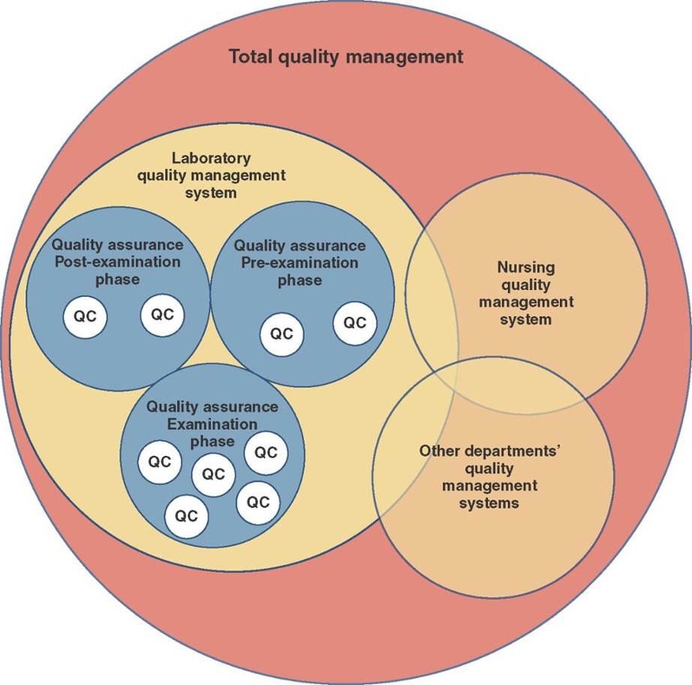
Total Quality Management Diagram
Total Quality Management Diagram Appendix
Copyright © McGraw-Hill Education
Notes:
LO 12.1 Identify policies and procedures used in phlebotomy and in the clinical laboratory to assure quality in obtaining blood specimens.
Notes:
Notice how some of the levels of quality management overlap. Total quality management is the overall management system that organizes and directs all of an organization’s quality endeavors.

Slide 14
Patient Satisfaction
General factors
How long they had to wait for the procedure
Presence or absence of bruising at the site
How many needlesticks were required
Perception of phlebotomist
Attitude
Appearance
Communication skills
Friendliness
Notes:
LO 12.1 Identify policies and procedures used in phlebotomy and in the clinical laboratory to assure quality in obtaining blood specimens.
Notes:
In addition to accuracy of test results, the total healthcare encounter is designed to improve patient perception of the laboratory:
Courteous, professional behavior
Clean, neat appearance
Ability to communicate clearly

Slide 15
Quality Cost Management (QCM)
System to measure and manage cost of quality
Cost of quality includes
Cost of procedure or product
Cost of repeating tests when results are questionable
Cost of correcting errors in a process
Cost of maintaining customer satisfaction
Notes:
LO 12.1 Identify policies and procedures used in phlebotomy and in the clinical laboratory to assure quality in obtaining blood specimens.
Notes:
Quality cost management (QCM): System to measure and manage the cost of quality
The cost of quality is not merely the cost of a procedure or product; it also includes the costs associated with delivering healthcare with the highest level of quality.
If a test result is questioned, the test must be repeated to ensure accuracy.
If errors are made at any point in the process, the errors must be corrected. This may involve expenses related to test materials as well as employee time, and if the patient must return to give another specimen, the cost may also include a decrease in customer satisfaction.

Slide 16
Quality Management System (QMS)
Establishment of:
Quality objectives
Methods to monitor achievement of objectives
Organizational structure of laboratory
Procedures, processes, and resources
Commonly included functions
Quality assurance
Quality control
Notes:
LO 12.1 Identify policies and procedures used in phlebotomy and in the clinical laboratory to assure quality in obtaining blood specimens.
Notes:
Quality management system (QMS): Establishment of quality objectives and the methods used to monitor the achievement of those objectives
A quality management system not only establishes objectives for quality in the laboratory but also defines the methods that will be used to monitor how well the objectives are met.

Slide 17
Quality Assurance (QA)
Examining process performance to confirm that:
Testing is performed correctly
Results are accurate
Mistakes are found and corrected
Standards put in place
Focuses on overall process to measure patient outcomes
Notes:
LO 12.1 Identify policies and procedures used in phlebotomy and in the clinical laboratory to assure quality in obtaining blood specimens.
Notes:
Quality assurance: System of planned activities that assess operational processes for the delivery of services or the quality of products provided to consumers, customers, or patients
Standards: Rules of practice that are defined by the QA team and should be followed to meet customer safety and satisfaction
Patient outcomes: Condition and length of hospital stay
Process to measure patient outcomes includes:
Error detection activities (double-checking information)
Corrective and preventive activities (documentation and training)
Activities to improve processes

Slide 18
Quality Assurance in the Laboratory
Ordering and requisitioning tests
Positive patient identification
Specimen collection processes
Integrity of specimen
Test analysis
Reporting of results
Turnaround time
Personnel training
Proficiency testing
Laboratory inspections
Documentation and follow-up on corrective action
Notes:
LO 12.1 Identify policies and procedures used in phlebotomy and in the clinical laboratory to assure quality in obtaining blood specimens.
Notes:
In the laboratory setting, QA should be applied to everything involved in producing a quality laboratory test result: pre-examination, examination, and post-examination phases.
Assessment requires the establishment of indicators (observable events used as evidence). Indicators should be:
Measurable
Specific
Well defined
Essential to the process
Indicators assess areas of care that tend to cause problems, or negative outcomes (results).
Evaluation: Examining evidence found when measuring the indicators
Evaluation determines the acceptability of both outcomes and processes.

Slide 19
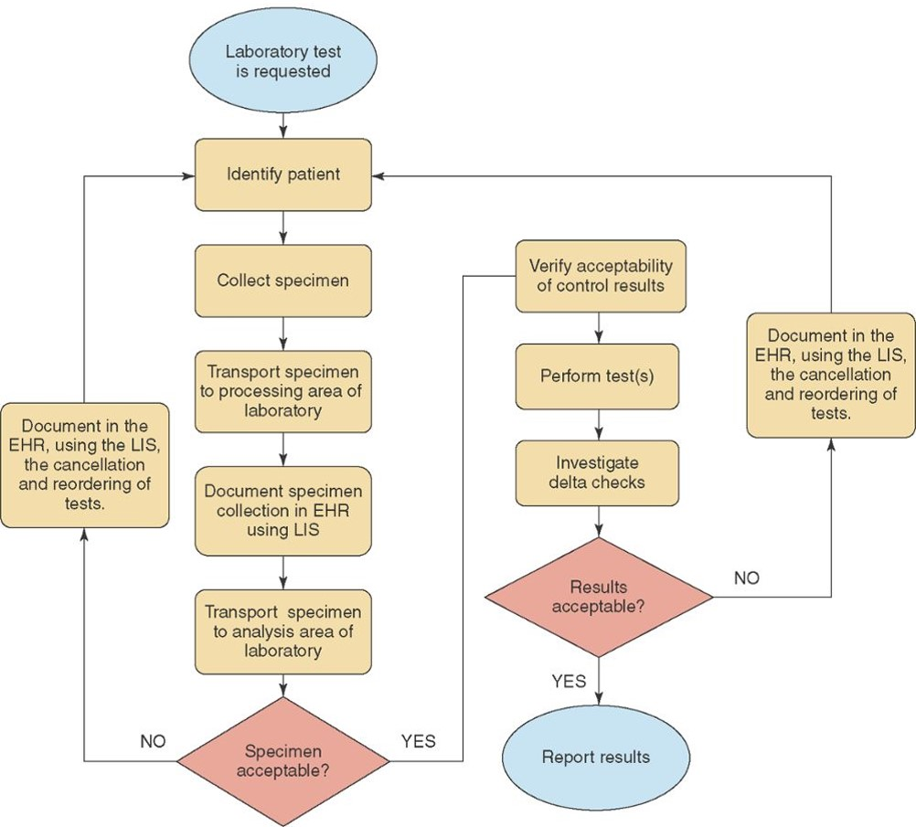
QA Flowchart for the Laboratory
QA Flowchart for the Laboratory Appendix
Copyright © McGraw-Hill Education
Notes:
LO 12.1 Identify policies and procedures used in phlebotomy and in the clinical laboratory to assure quality in obtaining blood specimens.

Slide 20
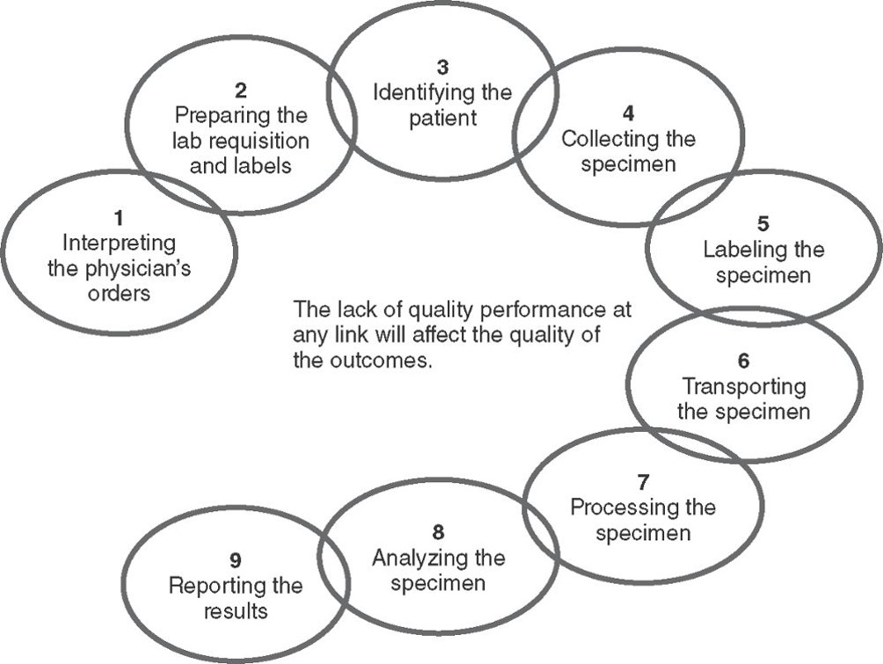
QA Chain of Accountability
QA Chain of Accountability Appendix
Copyright © McGraw-Hill Education
Notes:
LO 12.1 Identify policies and procedures used in phlebotomy and in the clinical laboratory to assure quality in obtaining blood specimens.
Notes:
The phlebotomist is responsible for links 3, 4, 5, and 6 in the chain of accountability. In some labs, the phlebotomist may be responsible for all nine links.

Slide 21
Quality Control (QC)
Evaluates each step of a procedure for accuracy
Each step must meet acceptable standards or parameters
Detects variances from standard operating procedure for procedures and tests
Notes:
LO 12.1 Identify policies and procedures used in phlebotomy and in the clinical laboratory to assure quality in obtaining blood specimens.
Notes:
Quality control: Activities that ensure that specific steps in a process meet acceptable standards
Parameters: Limitations
Variances: Deviations from the procedure
Standard operating procedure (SOP): Detailed explanation for each process or procedure:
Purpose
Specimen requirements
Step-by-step procedure
Limitations
Normal and critical values
Interpretation
SOP is developed using guidelines from:
The Joint Commission
Clinical and Laboratory Standards Institute
Food and Drug Administration
Other regulatory agencies

Slide 22
QC Activities
Tests performed on correct patient
Specimen collection procedures performed correctly and safely
Specimens handled, transported, and processed properly
Tests performed accurately
Reliable test results reported
Notes:
LO 12.1 Identify policies and procedures used in phlebotomy and in the clinical laboratory to assure quality in obtaining blood specimens.
Notes:
Reliable: Believable and dependable
QC includes step-by-step activities such as:
Verifying patient identity
Checking expiration dates on needles, evacuated tubes, etc.
Recording specimen storage temperatures
Calibrating centrifuges
Watch the video “Quality Control Procedures for Blood Specimen Collection” for more information about quality control activities.

Slide 23
Controls and Calibration
Performed on every type of test in laboratory, including point of care tests (POCT)
Control materials
Used for calibration and system checks
Check expiration dates on test strips and controls before using
Notes:
LO 12.1 Identify policies and procedures used in phlebotomy and in the clinical laboratory to assure quality in obtaining blood specimens.
Notes:
Control material: A liquid, serum, or freeze-dried material that has been prepared and tested by the manufacturer and has a known value of the substance being tested
Calibration: Procedure used to ensure that equipment is providing accurate results

Slide 24
Validation
Ensures accuracy and precision
Between two instruments performing the same method
Between two instruments performing tests by different methods
For tests that are new to the laboratory test menu
Notes:
LO 12.1 Identify policies and procedures used in phlebotomy and in the clinical laboratory to assure quality in obtaining blood specimens.
Notes:
Validation: Ensuring accuracy and precision; both accuracy and precision are required quality control checks of equipment to ensure reliable results

Slide 25
Delta Check
Comparison of patient’s previous results to current results
Significant delta must be investigated before reporting results
Unexplained deltas may require specimen re-collection
First-time patient tests are compared to normal ranges
Notes:
LO 12.1 Identify policies and procedures used in phlebotomy and in the clinical laboratory to assure quality in obtaining blood specimens.
Notes:
Delta check: Checking patient test results against previous results for the same patient
Delta: Change in value of test result

Slide 26
Documenting QC Activities
Learning Outcome 12.2

Slide 27
Required Documentation
QC tests for each analyte tested on each instrument
Temperatures for all incubators, water baths, refrigerators, freezers, and sometimes rooms
All actions taken to remedy variances
Each entry must be initialed by person performing QC
All forms must be reviewed and signed by supervisor
Notes:
LO 12.2 Carry out documentation of quality control.
Notes:
All quality control tests for each analyte tested on each instrument are documented in the quality control log sheets. The log may be either paper or electronic. Results are also graphed on Levey-Jennings charts that provide a visual assessment of the results.
The next two slides show examples of a quality control record and a Levey-Jennings chart.

Slide 28
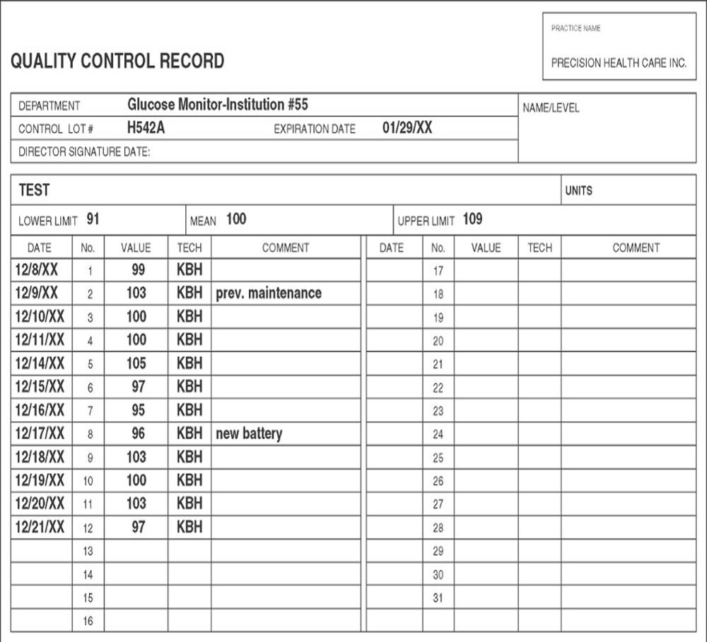
Quality Control Record
Copyright © McGraw-Hill Education
Notes:
LO 12.2 Carry out documentation of quality control.
Notes:
This example of a control record for a glucose monitor shows values obtained, the initials of the person who performed the testing, and notes about actions taken to remedy variances (installing a new battery).

Slide 29
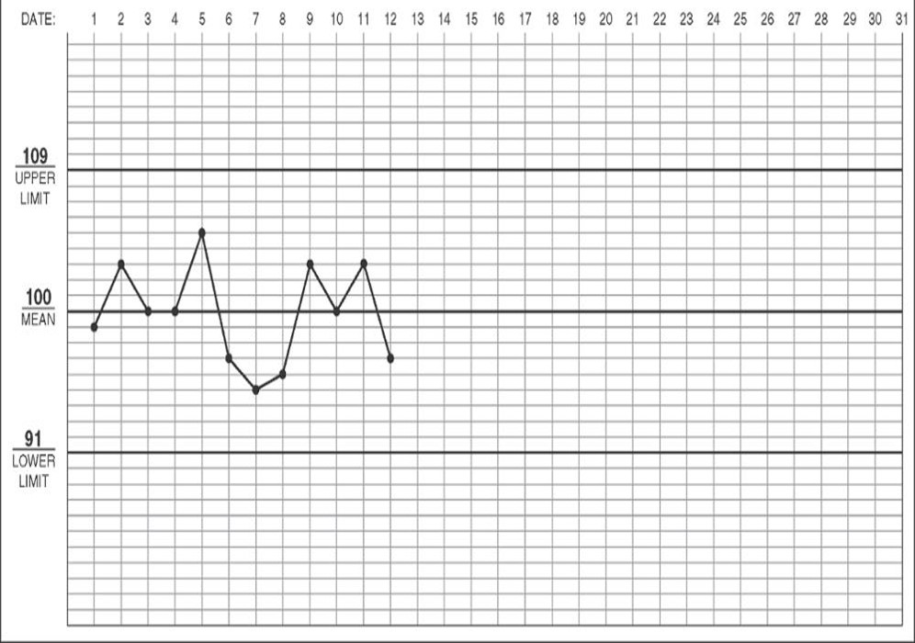
Levey-Jennings Chart
Copyright © McGraw-Hill Education
Notes:
LO 12.2 Carry out documentation of quality control.
Notes:
This example of a Levey-Jennings chart shows daily test values plotted on a graph. Notice that all values are well within the upper and lower limits for this device.

Slide 30
Quality Control Errors
Systematic errors
Trends
Shifts
Random errors
Operator procedural error
Equipment failure
Outdated reagents
Clerical errors
Notes:
LO 12.2 Carry out documentation of quality control.
Notes:
Systematic errors: Errors that can cause a shift or trend in test results
Trend: Results showing an upward or downward progression
Shift: Sudden jump in results that continues at a higher or lower level
Random errors: Errors that occur with no predictable pattern and may have several different causes

Slide 31
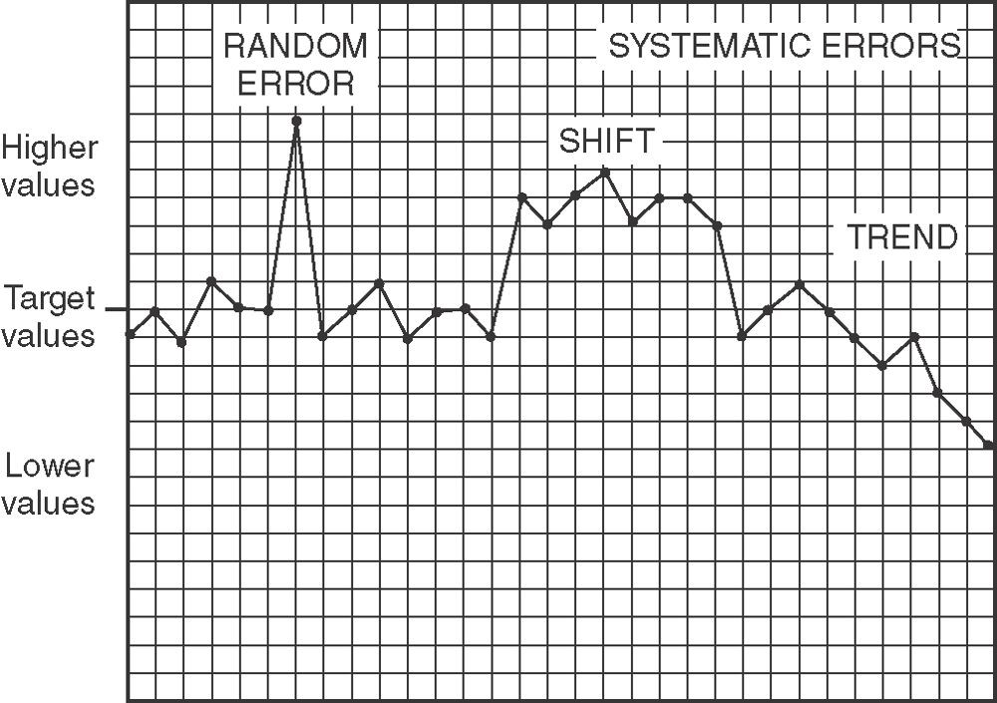
Random vs. Systematic Errors
Copyright © McGraw-Hill Education
Notes:
LO 12.2 Carry out documentation of quality control.
Notes:
This graph provides examples of a random error and both shift and trend systematic errors.

Slide 32
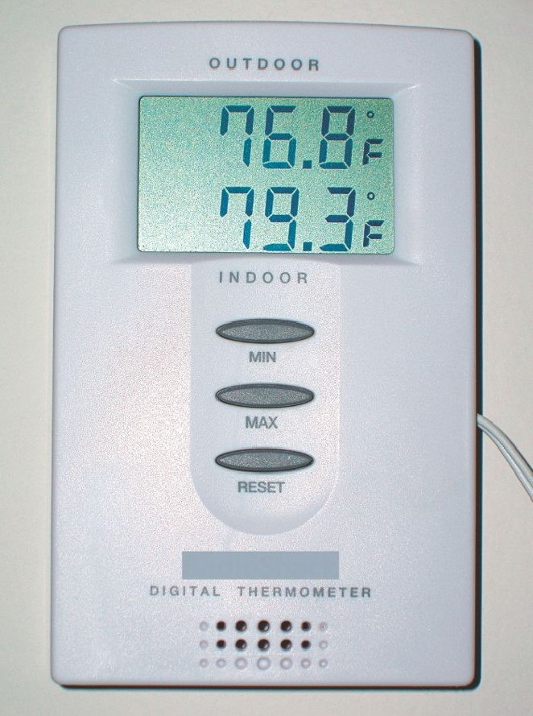
Temperature Requirements
Specific temperature requirements
Specimens and reagents
Refrigerators and freezers
Incubators and water baths
Testing procedures
Some laboratory rooms
Daily temperature logs
©Alamy RF
Notes:
LO 12.2 Carry out documentation of quality control.
Notes:
Daily temperature logs are also part of quality control documentation.
In some situations, a minimum/maximum thermometer, shown here, may be required. If the temperature falls outside the acceptable limits, corrective actions must be performed and documented.

Slide 33
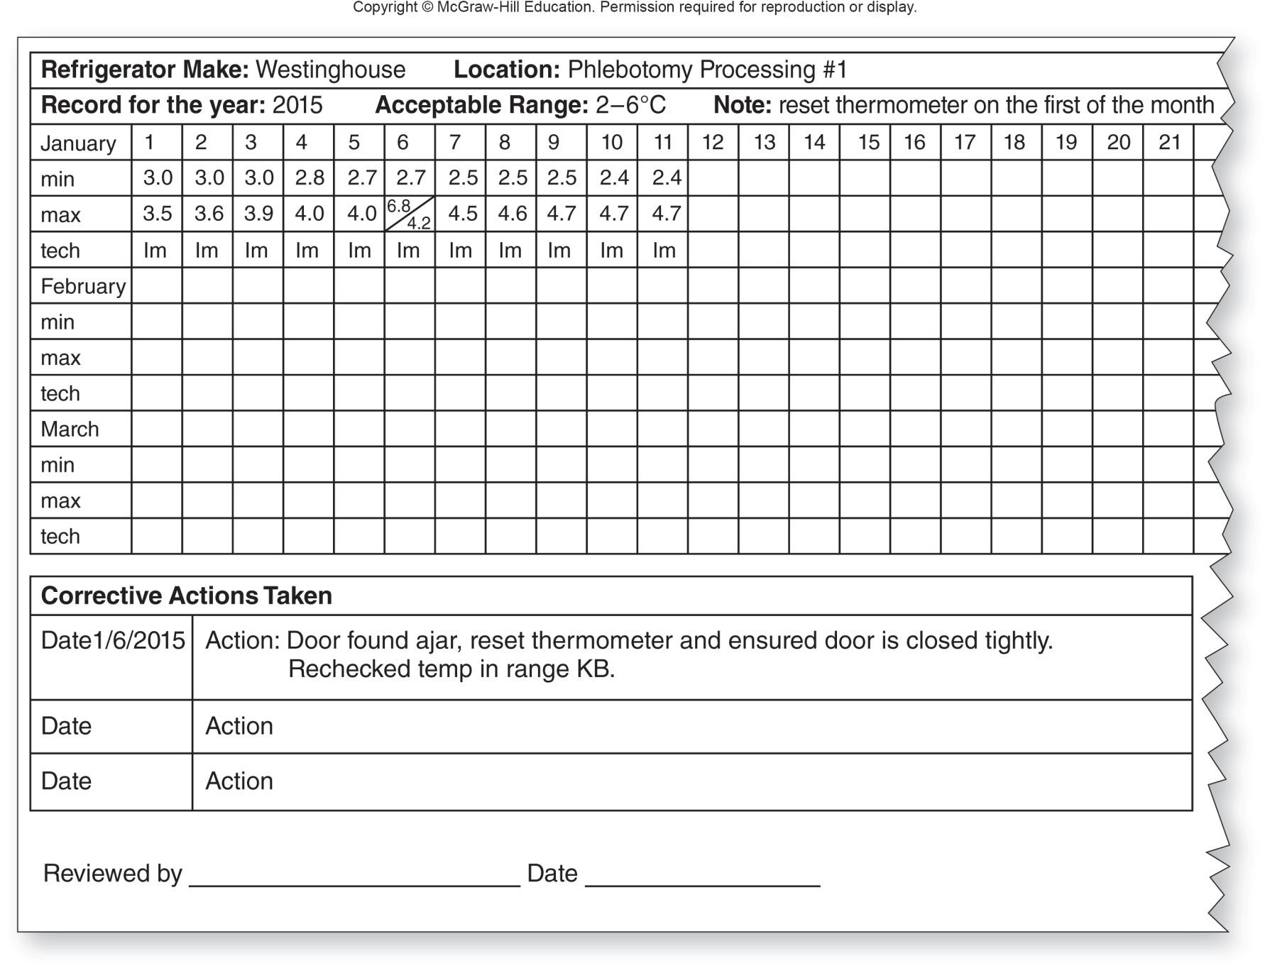
Temperature Control Log
Copyright © McGraw-Hill Education
Notes:
LO 12.2 Carry out documentation of quality control.
Notes:
This is an example of a temperature control log. Notice the error found on January 6 and the corrective action taken.

Slide 34
Quality Improvement Processes
Learning Outcome 12.3

Slide 35
Quality Assessment and
Process Improvement (QAPI)
QAPI committees
Review documentation to discover process weaknesses
Implement changes to eliminate weaknesses
Monitor effectiveness of changes
Notes:
LO 12.3 Identify corrective actions for failures of quality control.
Notes:
Quality Assessment and Process Improvement (QAPI): The review of documentation to discover and eliminate weaknesses in a process and improve the quality of patient outcomes; also called continuous quality improvement (CQI)
When a weakness is found, the process is revised, and then the results are monitored to see if the weakness or problem has been eliminated. If the problem still exists, another round of process revision and monitoring occur.

Slide 36
QAPI Tools
Audits
Review documentation to discover process weaknesses
Implement changes to eliminate weaknesses
Monitor effectiveness of changes
Incident forms
Document variances in quality care
Not intended to be punitive
Identify details such as personnel involved, actions needed, and effect on patient outcomes
Notes:
LO 12.3 Identify corrective actions for failures of quality control.
Notes:
Audit: Review of records before changes are made (to detect weaknesses), during change implementation (to see that the change is being followed correctly), and after the implementation (to monitor effectiveness)
Incident form: Document recording procedural or process errors

Slide 37
QAPI Corrective Activities
Corrective action
Helps eliminate cause of error or situation
Preventive action
Helps ensure that problem does not recur
Training
Providing staff with knowledge to perform their jobs correctly and accurately
May include observation
Notes:
LO 12.3 Identify corrective actions for failures of quality control.
Notes:
Corrective action: Activity that helps eliminate the cause of an error or undesirable situation
Preventive action: Activity that helps ensure that a problem does not occur or does not occur again
Training: A preventive action that provides staff with the knowledge to perform their job correctly and accurately

Slide 38
Competency
Ability to perform assigned tasks correctly
Competency assessment
Documents employee’s competency
Kept in employee files
May reveal need for training
Often required for inspections
Notes:
LO 12.3 Identify corrective actions for failures of quality control.
Notes:
Competence is the ability to perform assigned tasks correctly. Competency assessment is a means of documenting an employee’s competence to perform pre-examination, examination, and post-examination processes.

Slide 39
Proficiency Testing (PT)
Laboratory performance evaluation
Comparison with other, similar laboratories
Testing agencies
College of American Pathologists (CAP)
Department of Public Health (DPH)
Centers for Disease Control and Prevention (CDC)
Other agencies
Notes:
LO 12.3 Identify corrective actions for failures of quality control.
Notes:
Proficiency testing is performed by external agencies. The agency provides samples to be tested by the laboratory. The test results are sent to the agency, which analyzes them and returns comments, along with suggestions for improving performance if the results are out of range.
Continued errors on proficiency testing may result in revocation of license or accreditation.

Slide 40
Sources of Quality Improvement Tools
Health Resources and Services Administration
The Joint Commission
Root Cause Analysis (Six Sigma)
Failure Mode Effects Analysis (FMEA)
Notes:
LO 12.3 Identify corrective actions for failures of quality control.

Slide 41
Chapter Summary
Systems exist for monitoring the quality of laboratory procedures.
Quality assurance processes include assessment and evaluation of all steps in a procedure.
Quality control is the activity that ensures that specific steps in a procedure meet performance standards.
Accurate documentation of all quality assurance and quality control activities is essential for monitoring quality.
Quality assessment and process improvement (QAPI) provides a system for error detection and correction to ensure patient satisfaction, valid test results, and accurate reporting of results.
Notes:
12.1 Identify policies and procedures used in phlebotomy and in the clinical laboratory to assure quality in obtaining blood specimens.
12.2 Carry out documentation of quality control.
12.3 Identify corrective actions for failures of quality control.

Slide 42
Appendix Slides

Slide 43
Total Quality Management Diagram
Appendix
The largest circle represents all of total quality management. On the next level, circles for laboratory quality management system, nursing quality management system, and other departments’ quality management systems overlap slightly. Within the laboratory quality management system are three smaller circles that touch but do not overlap. These circles represent the quality assurance pre-examination phase, examination phase, and post-examination phase. Within each of these circles are several quality control circles.
Total Quality Management Diagram

Slide 44
QA Flowchart for the Laboratory Appendix
The first step in the flowchart is the request for the laboratory test. The healthcare worker then identifies the patient, collects the specimen, transports the specimen to the processing area of the laboratory, documents the specimen collection in EHR using the LIS, transports the specimen to the analysis area of the laboratory. If the specimen is not acceptable, the healthcare worker documents the cancellation and reordering the tests in the EHR using the LIS. The cycle begins again with identifying the patient.
If the specimen is acceptable, the worker verifies control results, performs the test(s), and does the delta checks. If the results are acceptable, the worker reports the results. If they are not acceptable, the worker documents the cancellation and reordering of tests. The cycle begins again with identifying the patient.
QA Flowchart for the Laboratory
Notes:
LO 12.1 Identify policies and procedures used in phlebotomy and in the clinical laboratory to assure quality in obtaining blood specimens.

Slide 45
QA Chain of Accountability Appendix
Link 1: Interpreting the physician’s orders
Link 2: Preparing the lab requisition and labels
Link 3: Identifying the patient
Link 4: Collecting the specimen
Link 5: Labeling the specimen
Link 6: Transporting the specimen
Link 7: Processing the specimen
Link 8: Analyzing the specimen
Link 9: Reporting the results
QA Chain of Accountability
Notes:
LO 12.1 Identify policies and procedures used in phlebotomy and in the clinical laboratory to assure quality in obtaining blood specimens.

