Slide 1
Special Phlebotomy Procedures
Chapter 13
©McGraw-Hill Education. All rights reserved. Authorized only for instructor use in the classroom. No reproduction or further distribution permitted without the prior written consent of McGraw-Hill Education.

Slide 2
Learning Outcomes 1
13.1 Describe special considerations and procedures needed to collect specimens for blood cultures.
13.2 Identify the various types of glucose tests and the indications and procedures for each.
13.3 List common neonatal screening tests and the conditions they are used to diagnose.
13.4 Explain the procedure for creating acceptable thin and thick blood smears.
13.5 Recognize the special requirements for carrying out blood collection for blood bank use
Notes:
Introduction
Phlebotomists may be required to perform special blood collection procedures such as blood cultures, state-required neonatal testing, and blood draws for type and cross-match. They may also be asked to perform glucose tolerance procedures or prepare blood smears. Some special procedures, such as arterial punctures and collecting units of blood from donors, are not in the phlebotomist’s scope of practice unless he or she has obtained additional training.

Slide 3
Learning Outcomes 2
13.6 Identify steps to competent and effective arterial puncture.
13.7 Classify venous access sites and their uses.

Slide 4
NAACLS Competencies 1
2.00 Demonstrate knowledge of infection control and safety.
4.00 Demonstrate understanding of the importance of specimen collection and specimen integrity in the delivery of patient care.
4.2 Describe the types of patient specimens that are analyzed in the clinical laboratory.
4.3 Define the phlebotomist’s role in collecting and/or transporting these specimens to the laboratory.
4.4 List the general criteria for suitability of a specimen for analysis, and the reasons for specimen rejection or re-collection.

Slide 5
NAACLS Competencies 2
4.5 Explain the importance of timed, fasting, and stat specimens, as related to specimen integrity and patient care.
5.00 Demonstrate knowledge of collection equipment, various types of additives used, special precautions necessary, and instances that can interfere in clinical analysis of blood constituents.
5.3 Describe the proper order of draw for specimen collections.
5.4 Describe substances that can interfere in clinical analysis of blood constituents and ways in which the phlebotomist can help avoid these occurrences.
6.00 Follow standard operating procedures to collect specimens.

Slide 6
NAACLS Competencies 3
6.2 Differentiate between sterile and antiseptic techniques.
6.3 Describe and demonstrate the steps in the preparation of a puncture site.
6.7 Describe the limitations and precautions of alternate collection sites for venipuncture and capillary (dermal) puncture.
7.00 Demonstrate understanding of requisitioning, specimen transport, and specimen processing.
7.3 Explain methods for transporting and processing blood specimens for routine and special testing.
9.7 Follow written and verbal instructions.

Slide 7
Key Terms 1
Aerobic
Anaerobic
Antibiotic removal device (ARD)
Arterial puncture
Autologous
Bacteremia
Biotinidase
Cannula
Congenital
Culture media
Cystic fibrosis
Diabetes mellitus
Differential
False-negative
False-positive
Fistula
Galactosemia
Gestational diabetes
Glycolysis
Hemochromatosis

Slide 8
Key Terms 2
Heparin lock
Hypothyroidism
Normal flora
Phenylketonuria (PKU)
Polycythemia vera
Saline lock
Septicemia
Sickle cell disease
Therapeutic phlebotomy

Slide 9
Blood Cultures
Learning Outcome 13.1

Slide 10
Introduction to Blood Cultures 1
Requested for patients with fever of unknown origin (FUO)
Isolate microorganisms for identification
Strict sterile technique is required
Containers for blood cultures contain culture media
Yellow-stoppered SPS tubes
Blood culture bottles
Some containers also have antibiotic removal device (ARD)
Notes:
LO 13.1 Describe special considerations and procedures needed to collect specimens for blood cultures.
Notes:
Blood culture bottles and tubes contain media that enhances the growth of the microorganisms.
Sterile technique is required because if the blood specimen is contaminated with organisms that did not originate in the blood, the test result may be a false-positive. Contamination may occur due to:
Inadequately cleaning the puncture site
Not allowing the cleaning agent to dry thoroughly
Using contaminated equipment or specimen containers
Touching the puncture site after it has been cleaned
If the patient is on antibiotics at the time of specimen collection, an antibiotic removal device (ARD) is included in the blood culture container to absorb any antibiotic found in the specimen. This provides for more accurate culture results.

Slide 11
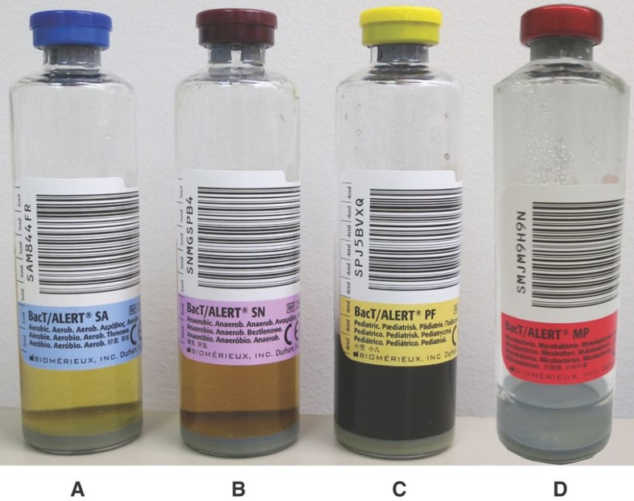
Introduction to Blood Cultures 2
Collected in pairs
Aerobic
Anaerobic
Other variations
Pediatric bottles
Mycobacterium bottles
©Lillian Mundt
Notes:
LO 13.1 Describe special considerations and procedures needed to collect specimens for blood cultures.
Notes:
Culture samples are collected in pairs of bottles: aerobic (with oxygen or air) and anaerobic (without oxygen or air). Each set is collected from different sites at different time intervals.
Blood is ordinarily sterile.
Bacteremia: Presence of microorganisms in the blood
Septicemia: Presence of pathogenic microorganisms in the blood with symptoms

Slide 12
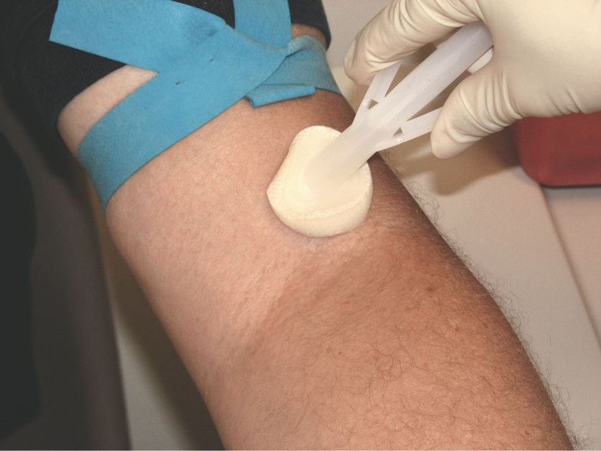
Site Cleaning for Blood Cultures
Reduces normal flora
Use sterile technique
First cleanse with alcohol prep pad
May repeat with 0.5% chlorhexidine gluconate, 2% iodine, Betadine, or benzalkonium chloride
©Total Care Programming, Inc.
Notes:
LO 13.1 Describe special considerations and procedures needed to collect specimens for blood cultures.
Notes:
The skin must be as clean as possible for collecting a specimen for blood culture. If normal flora (skin surface microorganisms, such as normal bacteria and fungi) is not removed, it may be introduced into the sample and interfere with the test results.
To cleanse the site, start in the middle of the puncture site and continue to spiral outward in concentric circles, using firm pressure. Do not allow the strokes to go back toward the center area. The cleansing process must be done with friction for at least 60 seconds.
Check the policy at your facility and current product directions to ensure that the site is cleaned properly. In many facilities, the tops of the blood culture bottles are also cleaned with alcohol.

Slide 13
Check Your Competency 13-1: Cleaning the Blood Culture Site 1
Cleanse the site with 70% to 90% alcohol prep, or other cleansing agents, such as 0.5% chlorhexidine gluconate, 2% iodine, Betadine, or benzalkonium chloride (Zephiran Chloride). Be aware that some products are not used on infants and children. Always check the manufacturer’s directions.
Start in the center of the puncture site and continue outward, in a spiral or circular motion, using firm pressure. Do not allow the strokes to go back toward the center area as this would bring contaminants toward the selected puncture site.
Notes:
LO 13.1 Describe special considerations and procedures needed to collect specimens for blood cultures.

Slide 14
Check Your Competency 13-1: Cleaning the Blood Culture Site 2
Clean the site with friction for at least 60 seconds to ensure that the normal flora and contaminants are removed from the area. Use a second cleansing pad if needed to prevent contamination.
Allow the site to air-dry so that the antiseptic has time to kill the germs.
When using alcohol, once the initial cleansing area has air-dried, a second cleansing step may be required. A circular cleansing pattern is used, this time with a swab or applicator containing 0.5% chlorhexidine gluconate, 2% iodine, Betadine, or benzalkonium chloride.
Notes:
LO 13.1 Describe special considerations and procedures needed to collect specimens for blood cultures.
Note:
Once the site has been cleaned, it must not be touched, even with a glove. If it is touched, it is considered contaminated, and the entire cleaning procedure must be repeated.

Slide 15
Check Your Competency 13-1: Cleaning the Blood Culture Site 3
NOTE: Follow the policy at your facility and current product directions to ensure that the site is cleansed properly.
Notes:
LO 13.1 Describe special considerations and procedures needed to collect specimens for blood cultures.

Slide 16
Blood Culture Volume and Collection
Volume is critical
Can impact test
Too little may cause false-negative test
Collection methods
Draw from appropriate sites
Draw in proper sequence
Notes:
LO 13.1 Describe special considerations and procedures needed to collect specimens for blood cultures.
Notes:
The volume of specimen collected for a blood culture is important because some organisms can cause disease even when they are present in very low numbers. Escherichia coli is an example of this. If the blood volume is too low, the bacteria are not seen in the culture, producing a false-negative result.
When the healthcare provider orders “blood cultures x 2,” the blood can be collected at the same time but from two different sites. If two sites cannot be used, the phlebotomist must wait a specified amount of time before collecting the second set of blood culture specimens from the same site. Blood cultures x 2 are often done to prevent a false-negative result.

Slide 17
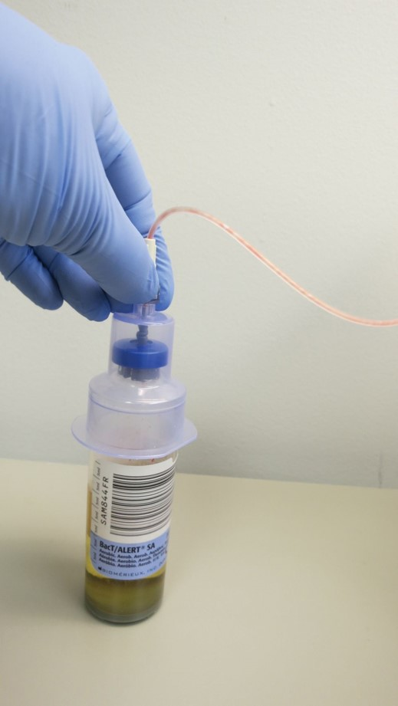
Collecting Blood Culture Specimens
Use evacuated tube system, syringe and transfer device, or butterfly assembly
Do not touch the site
Fill the anaerobic bottle first
Fill the aerobic bottle and any other tubes required
Label the culture containers carefully
©Lillian Mundt
Notes:
LO 13.1 Describe special considerations and procedures needed to collect specimens for blood cultures.
Notes:
After the skin has been cleaned, do not touch the site, even if you are wearing clean gloves. If you must, you can touch at least an inch above or below the site, but no closer. If you do accidentally touch within an inch radius of the site, you must clean the site again before proceeding.
When collecting more than one set, be sure to label the culture containers with the location of the draw and the order of draw.
If iodine was used to cleanse the site, remove it using a new alcohol prep pad to prevent absorption into the patient’s skin.
Watch the video “Special Blood Collection Procedures—Blood Culture Preparation and Collection” for more information about collecting blood cultures.

Slide 18
Check Your Competency 13-2: Blood Culture Collection Comparison of Procedures 1
Syringe Transfer Method
Butterfly Transfer Method
Greet the patient.
Properly identify the patient.
Explain the specimen collection procedure to the patient.
Wash your hands, put on gloves and other PPE, if needed, and prepare the equipment.
Greet the patient.
Properly identify the patient.
Explain the specimen collection procedure to the patient.
Wash your hands, put on gloves and other PPE, if needed, and prepare the equipment.
Notes:
LO 13.1 Describe special considerations and procedures needed to collect specimens for blood cultures.

Slide 19
Check Your Competency 13-2: Blood Culture Collection Comparison of Procedures 2
Syringe Transfer Method
Butterfly Transfer Method
Select the venipuncture site and release the tourniquet.
Cleanse the site using sterile technique and the appropriate antiseptic.
Allow the site to air-dry for 60 seconds.
Select the venipuncture site and release the tourniquet.
Cleanse the site using sterile technique and the appropriate antiseptic.
Allow the site to air-dry for 60 seconds.
Notes:
LO 13.1 Describe special considerations and procedures needed to collect specimens for blood cultures.

Slide 20
Check Your Competency 13-2: Blood Culture Collection Comparison of Procedures 3
Syringe Transfer Method
Butterfly Transfer Method
Cleanse the tops of the blood culture bottles (if required by facility policy).
Reapply the tourniquet.
Perform the venipuncture.
Fill syringe to the required volume.
Cleanse the tops of the blood culture bottles (if required by facility policy).
Reapply the tourniquet.
Perform the venipuncture.
Fill the aerobic bottle.
Notes:
LO 13.1 Describe special considerations and procedures needed to collect specimens for blood cultures.

Slide 21
Check Your Competency 13-2: Blood Culture Collection Comparison of Procedures 4
Syringe Transfer Method
Butterfly Transfer Method
Release the tourniquet, withdraw the needle, engage the safety device, and apply pressure to the site.
Safely remove the needle and attach the syringe to the transfer device.
Fill the anaerobic bottle.
Release the tourniquet, withdraw the needle, engage the safety device, and apply pressure to the site.
Notes:
LO 13.1 Describe special considerations and procedures needed to collect specimens for blood cultures.

Slide 22
Check Your Competency 13-2: Blood Culture Collection Comparison of Procedures 5
Syringe Transfer Method
Butterfly Transfer Method
Fill the anaerobic bottle.
Fill the aerobic bottle.
Safely dispose of the used needle and syringe.
Safely dispose of the used butterfly assembly.
Label the bottles with patient and collection information.
Complete post-puncture patient care.
Notes:
LO 13.1 Describe special considerations and procedures needed to collect specimens for blood cultures.

Slide 23
Check Your Competency 13-2: Blood Culture Collection Comparison of Procedures 6
Syringe Transfer Method
Butterfly Transfer Method
Label the bottles with patient and collection information.
Complete post-puncture patient care.
Thank the patient.
Thank the patient.
Notes:
LO 13.1 Describe special considerations and procedures needed to collect specimens for blood cultures.
Notes:
Post-procedure care:
Clean any remaining iodine or antiseptic from the site.
Ensure that bleeding has stopped.
Apply a bandage if necessary.
Thank the patient.
Transport specimens to the laboratory.

Slide 24
Glucose Testing
Learning Outcome 13.2

Slide 25
Glucose Tests
Ordered to diagnose carbohydrate metabolism disorders
Diabetes mellitus
Gestational diabetes
Hyperinsulinism
Notes:
LO 13.2 Identify the various types of glucose tests and the indications and procedures for each.
Notes:
Untreated diabetes mellitus can lead to blindness, kidney failure, and amputation due to problems in the lower limbs. Several tests may be ordered to determine the patient’s medical problem:
Glucose tolerance test
Insulin level
Hemoglobin A1C
Diabetes mellitus: Insufficient production of insulin
Gestational diabetes: High blood sugar during pregnancy
Hyperinsulinism: Increased levels of insulin, resulting in low blood sugar

Slide 26
Types of Glucose Tests 1
Fasting blood sugar
Random blood sugar
Two-hour postprandial glucose
Specimen obtained 2 hours after a meal
Collection timing is critical for accurate results
Glucose challenge
Specimen collected 1 or 2 hours after oral glucose dose
Notes:
LO 13.2 Identify the various types of glucose tests and the indications and procedures for each.
Notes:
Fasting blood sugar (glucose) is used to identify risk for diabetes. A single blood sample is taken after the patient has fasted for 8 to 12 hours.
Random blood sugar is used to identify risk for diabetes or hypoglycemia. It is collected randomly throughout the day.
Two-hour postprandial glucose: In a patient who does not have diabetes, glucose level will have returned to normal two hours after a meal. A glucose level of 200 or over two hours after a meal is a criterion for diagnosis of diabetes.
Glucose challenge:
Screens for gestational diabetes or polycystic ovary syndrome
Patient receives a dose of 50 grams or 75 grams of oral glucose in a sugary drink (Glucola).
Blood sample is drawn one hour later.
If this test is positive, a complete oral glucose tolerance test (OGTT) is done.

Slide 27
Types of Glucose Tests 2
Oral glucose tolerance test (OGTT)
Patient fasts for at least 12 hours
Fasting specimen is drawn
Patient receives a loading dose of glucose
Blood and urine specimens are collected at 30 minutes, 1 hour, 2 hours, and 3 hours
It is unsafe to give a patient with elevated glucose additional glucose for testing purposes. If the patient’s fasting blood glucose is 126 mg/dL or over, a GTT should not be performed. If the glucose level during the test exceeds 200 mg/dL, the test must be discontinued immediately.
Notes:
LO 13.2 Identify the various types of glucose tests and the indications and procedures for each.
Notes:
Oral glucose tolerance test:
Run the fasting specimen immediately. If the patient’s glucose level is more than 200 mg/dL, the test is over.
Watch the patient carefully during glucose administration to be sure that the patient drinks the entire solution within five minutes and does not vomit. If the patient vomits, the test is discontinued and the healthcare provider is notified.
The patient is not allowed to eat or drink anything because any food or liquid can affect the way the body metabolizes glucose. Smoking and chewing gum are also not allowed.
Use a gray-topped tube (sodium fluoride) to prevent glycolysis (breakdown of glucose into an acid).
Run both the blood and urine (if ordered) glucose level tests shortly after collection.

Slide 28
Check Your Competency 13-3: Glucose Testing 1
Identify the patient.
Explain the specimen collection procedure to the patient.
Ensure that the patient has been fasting for at least 12 hours.
Wash your hands, put on gloves, and prepare the equipment.
Collect a fasting blood specimen using proper venipuncture technique.
Perform a POCT glucose test or obtain a glucose level of the specimen from the chemistry department.
Verify that the screening blood glucose level is less than 200 mg/dL.
Notes:
LO 13.2 Identify the various types of glucose tests and the indications and procedures for each.

Slide 29
Check Your Competency 13-3: Glucose Testing 2
Prepare the glucose drink according to the requirements of the type of glucose test.
Observe the patient consume it within 5 minutes and confirm that no vomiting has occurred.
Collect blood at the specified time intervals.
Properly label each sample with both the time collected and the time interval.
Notes:
LO 13.2 Identify the various types of glucose tests and the indications and procedures for each.

Slide 30
Neonatal Screening
Learning Outcome 13.3

Slide 31
Biotinidase Deficiency and Cystic Fibrosis
Biotinidase deficiency
May cause neurological damage
May cause movement and balance problems
Treatable with biotin supplements
Cystic fibrosis
Accumulation of mucous secretions
Can be fatal
Notes:
LO 13.3 List common neonatal screening tests and the indications and procedures for each.
Notes:
Tests required by all states:
Cystic fibrosis
Galactosemia
Hypothyroidism
Phenylketonuria
Additional tests required by some states:
Biotinidase
Sickle cell disease
Toxoplasmosis
Human immunodeficiency virus
Biotinidase deficiency:
Biotin assists other enzymes in many functions, such as synthesis of fatty acids and breakdown of amino acids.
Deficiency of the biotinidase enzyme impairs the activities of these other enzymes.
Cystic fibrosis:
Chloride sweat test may be used as presumptive diagnosis of cystic fibrosis.
Treatments exist, and new treatments are currently under development.
If not treated, cystic fibrosis can be fatal at an early age.

Slide 32
Galactosemia and Hypothyroidism
Galactosemia
Body cannot use galactose as energy source
Can be life-threatening
Hypothyroidism
Acquired or congenital
Can delay normal growth
May cause intellectual disabilities
Notes:
LO 13.3 List common neonatal screening tests and the indications and procedures for each.
Notes:
Galactosemia:
Affects infants from birth
Failure to gain weight
Improper development
Liver damage and bleeding problems
A diet low in lactose may help minimize effects of galactosemia.
Hypothyroidism:
Partial or complete loss of thyroid function
The thyroid makes many iodine-containing hormones needed for growth, brain development, and regulation of metabolism.
Treated with oral dose of thyroxine (thyroid hormone)
May be congenital (existing at birth) or acquired

Slide 33
Phenylketonuria and Sickle Cell Disease
Phenylketonuria
Body is deficient in enzyme to break down phenylalanine
Sickle cell disease
Abnormal hemoglobin
Distorted cells block small blood vessels
Removal of affected cells causes anemia
Notes:
LO 13.3 List common neonatal screening tests and the indications and procedures for each.
Notes:
Phenylketonuria may cause:
Brain damage
Heart problems
Microcephaly (small head size)
Skin disorders, such as eczema
Treatment for sickle cell disease:
Closely monitoring symptoms
Staying well-hydrated
Avoiding exposure to low-oxygen environments, such as high altitudes and anesthesia

Slide 34
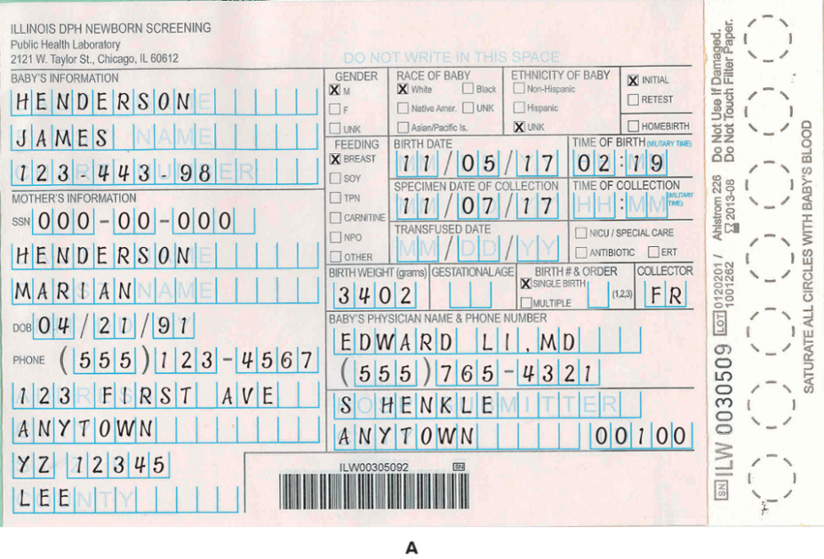
State Testing Specimen Collection
Special form required
Absorbent area for collecting specimens
Check expiration date before using
©Lillian Mundt
Notes:
LO 13.3 List common neonatal screening tests and the indications and procedures for each.
Notes:
Tips for collecting neonatal tests required by the state:
Each state has a specific form.
Follow the facility’s protocol for PPE.
Verify patient identity.
Select puncture site on infant’s heel.
Follow the collection procedure outlined on the state form.
Allow specimens to dry thoroughly as directed.
Specimens may be unsatisfactory if:
All circles are not completely filled.
A circle is oversaturated.
The specimen is not allowed to dry thoroughly.
The specimen is contaminated with a foreign substance.
An expired form is used.
The form is not received within 14 days of collection.

Slide 35
Check Your Competency 13.4: Dermal Puncture State Testing on Infants 1
Check the patient identification band (usually on the infant’s ankle) and verify the patient’s identity with nursing staff.
Wash your hands, put on gloves, and prepare the equipment.
Select the appropriate area for dermal puncture on the infant’s heel.
Sterilize and dry the skin.
Puncture the heel with a sterile lancet.
Allow a large blood droplet to form.
Notes:
LO 13.3 List common neonatal screening tests and the indications and procedures for each.

Slide 36
Check Your Competency 13.4: Dermal Puncture State Testing on Infants 2
Touch the filter paper to the blood and allow the blood to soak through completely in each circle. Total saturation of the circles must be evident when the paper is viewed on both sides. DO NOT APPLY BLOOD TO BOTH SIDES.
Allow blood spots to air-dry thoroughly for 3 hours at room temperature. Keep away from direct sunlight and heat. Never place one wet filter paper on top of another until both filter papers are thoroughly dry.
Notes:
LO 13.3 List common neonatal screening tests and the indications and procedures for each.

Slide 37
Peripheral Blood Smears
Learning Outcome 13.4

Slide 38
Blood Smears
Thin film of blood spread onto a glass slide
Used for microscopic examination of blood
Differential
Hematological disorders
Blood parasites
Notes:
LO 13.4 Explain the procedure for creating acceptable thin and thick blood smears.
Notes:
Blood smears can be made with either venous or capillary blood.
Differential: A hematology test performed using a stained blood smear in which the types of white blood cells are counted and abnormalities in cell size, shape, and color are noted
Many facilities use automated instruments to prepare blood smears, but in some situations, phlebotomists may be required to prepare blood smears.
Wedge method: Most common technique for making thin blood smears
Thick prep method: Produces blood smears used to screen for malaria

Slide 39
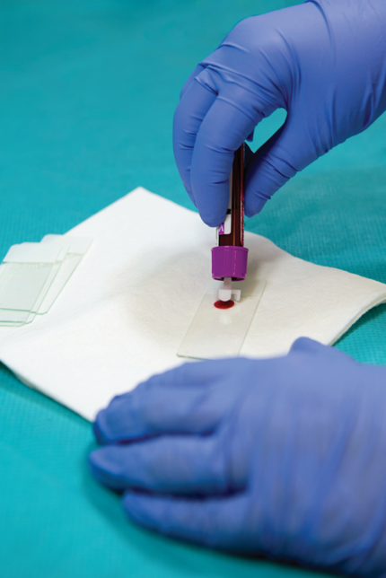
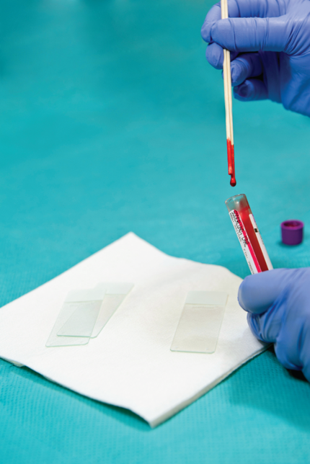
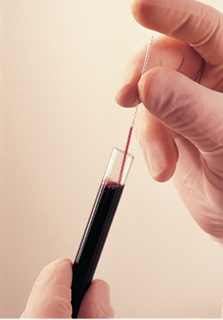
Thin Blood Smears
Safety device (preferred)
Wooden applicator
Capillary tube
Left and middle: ©McGraw-Hill Education/Sandra Mesrine, photographer; right: ©Terry Wild Studio
Notes:
LO 13.4 Explain the procedure for creating acceptable thin and thick blood smears.
Notes:
Wear appropriate PPE to perform this technique.
The first step after obtaining fresh, non-coagulated blood is to place the blood on a specimen slide.
If possible, use a safety device to place a drop of blood on the slide about ½ inch from the frosted edge.
Alternate methods of delivering a drop of blood to a slide include using a wooden applicator stick or a capillary tube. If you use one of these, uncap the blood under a safety shield. After transferring the blood, immediately place the applicator stick or capillary tube in the sharps container.

Slide 40
Check Your Competency 13-6: Thin Blood Smear 1
Wash your hands and put on gloves. Wear a face shield or work behind a tabletop shield.
Verify the identity of the specimen requiring a blood smear.
With the slide on the work surface, hold the capillary tube or applicator stick in one hand and the frosted end of the slide against the work surface with the other.
Apply a drop of blood to the slide about ½ inch from the frosted end.
Dispose of contaminated equipment in a biohazardous waste container. Capillary tubes must be placed in a sharps container.
Notes:
LO 13.4 Explain the procedure for creating acceptable thin and thick blood smears.
Notes:
Watch the video “Preparing a Blood Smear Slide” for more information about preparing blood smear slides.

Slide 41
Check Your Competency 13-6: Thin Blood Smear 2
Pick up the spreader slide with your dominant hand and hold it at a 30- to 35-degree angle.
Place the edge of the spreader slide on the smear slide close to the unfrosted end.
Pull or back up the spreader slide toward the frosted end until the spreader slide touches the blood drop. Capillary action will spread the droplet along the edge of the spreader slide.
Allow the blood drop to spread almost to the edges of the spreader slide.
Notes:
LO 13.4 Explain the procedure for creating acceptable thin and thick blood smears.

Slide 42
Check Your Competency 13-6: Thin Blood Smear 3
With one light, smooth, fluid motion, push the spreader slide toward the other, clear end of the slide until you come off the end, maintaining the 30- to 35-degree angle.
Immediately label the frosted end with two patient identifiers, the date, and the accession number of the specimen (if available).
Allow the smear to air-dry before staining.
Notes:
LO 13.4 Explain the procedure for creating acceptable thin and thick blood smears.

Slide 43
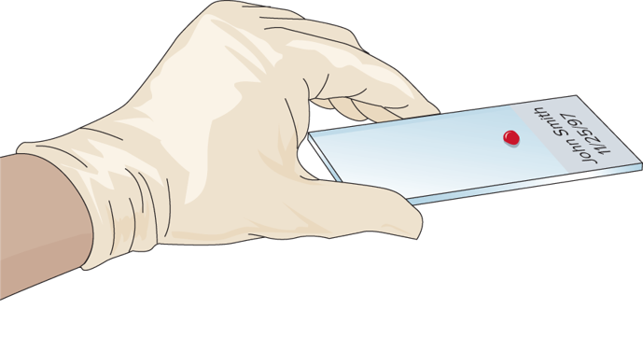
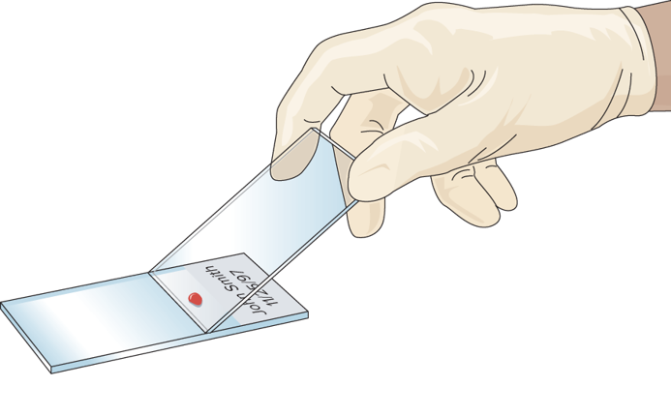
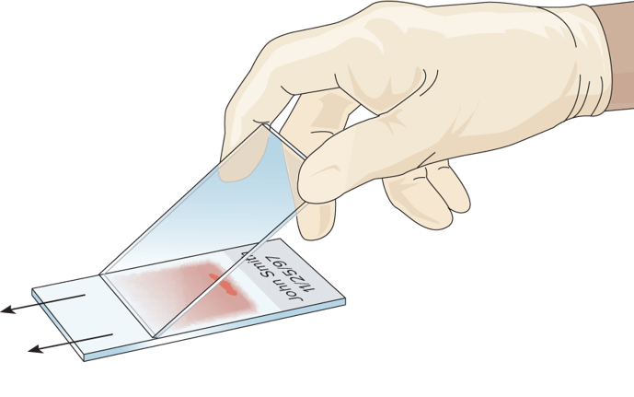
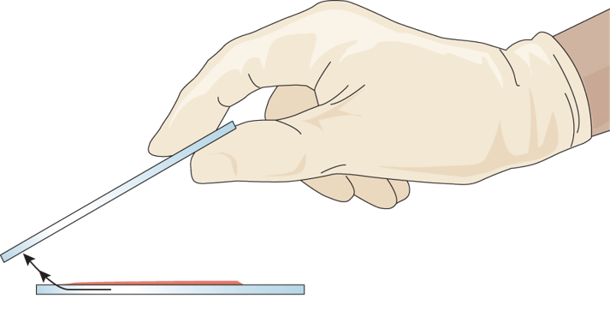
Obtaining a Good Wedge Smear
A
B
C
D
Copyright © McGraw-Hill Education
Notes:
LO 13.4 Explain the procedure for creating acceptable thin and thick blood smears.
Notes:
Two slides are needed to use the wedge method of creating a blood smear: the smear slide and the spreader slide.
After you have placed a drop of blood on the smear slide, follow these steps to create the smear:
Hold the spreader slide with your dominant hand at a 30- to 35-degree angle.
Pull the spreader slide toward the frosted end until it touches the drop of blood.
Allow the drop to flow along the edge of the spreader slide.
Push the spreader slide toward the unfrosted end of the smear slide.
Continue the steady motion past the edge of the smear slide and lift the spreader slide away from the smear slide, maintaining a 30- to 35-degree angle.
Allow the smear to air-dry before staining.

Slide 44
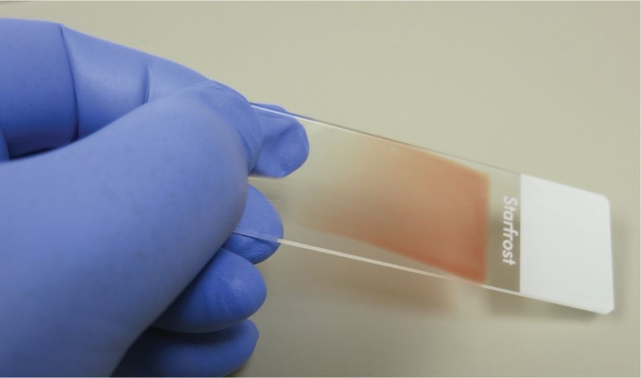
Factors Affecting Smear Quality
Angle of spreader slide
Size of blood drop
Speed of pushing the spreader slide
Patient’s hematocrit
©Total Care Programming, Inc.
Notes:
LO 13.4 Explain the procedure for creating acceptable thin and thick blood smears.
Notes:
The phlebotomist cannot do anything about the patient’s hematocrit, but he or she can control the other three factors that affect smear quality.
If blood smear is too long:
Use a smaller drop of blood.
Use a steeper angle on the spreader slide.
Increase the speed with which the spreader slide is pushed.
If blood smear is too short:
Use a larger drop of blood.
Use a shallower angle on the spreader slide.
Decrease the speed with which the spreader slide is pushed.

Slide 45
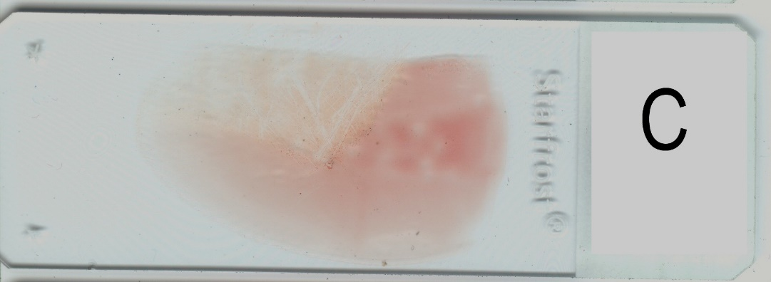
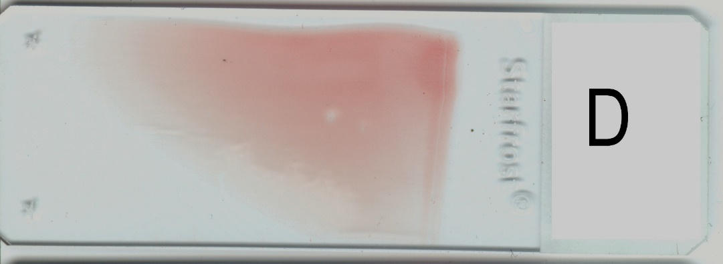
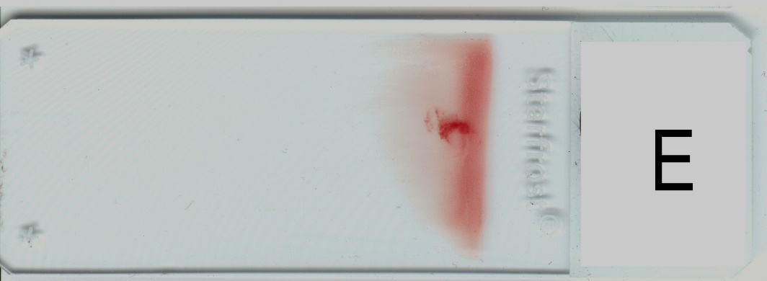
Improperly Made Smears 1
Too rounded
Sharp angle on one side
Too short
©Lillian Mundt
Notes:
LO 13.4 Explain the procedure for creating acceptable thin and thick blood smears.
Notes:
To avoid these errors:
Too rounded: Allow the drop of blood to spread along the edge of the spreader slide before pushing it.
Sharp angle on one side: Apply pressure evenly on the spreader slide while pushing it across the smear slide.
Too short: Reduce the angle of the spreader slide and/or decrease the speed of pushing.

Slide 46
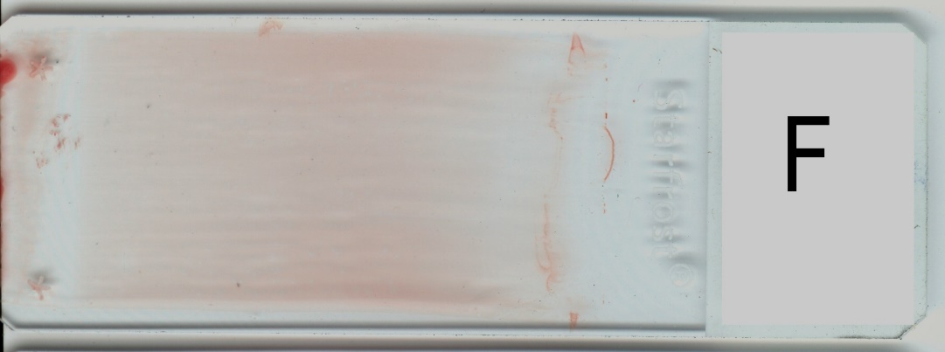
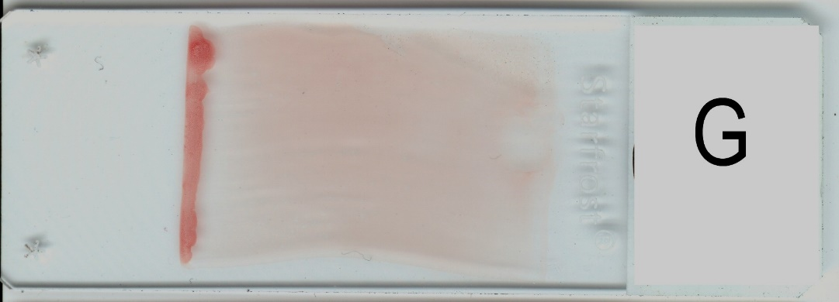
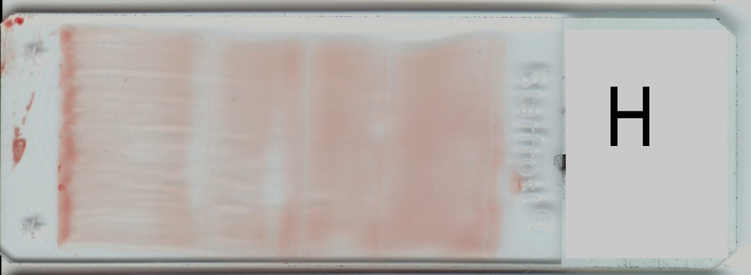
Improperly Made Smears 2
Too long
No critical area or feathered edge
Too long, with back-and-forth wavy appearance
©Lillian Mundt
Notes:
LO 13.4 Explain the procedure for creating acceptable thin and thick blood smears.
Notes:
To avoid these errors:
Too long: Push the spreader slide at a bigger angle or push it more quickly.
No critical area or feathered edge: Push the spread slide all the way off the bottom slide.
Too long, with back-and-forth wavy appearance: Use a smooth, uniform motion to push the spreader slide.

Slide 47
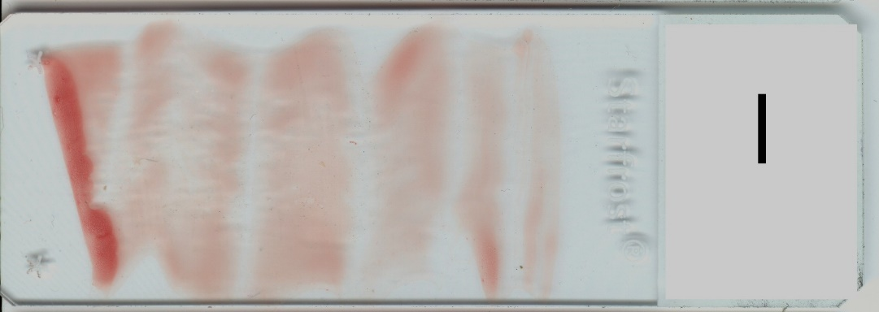
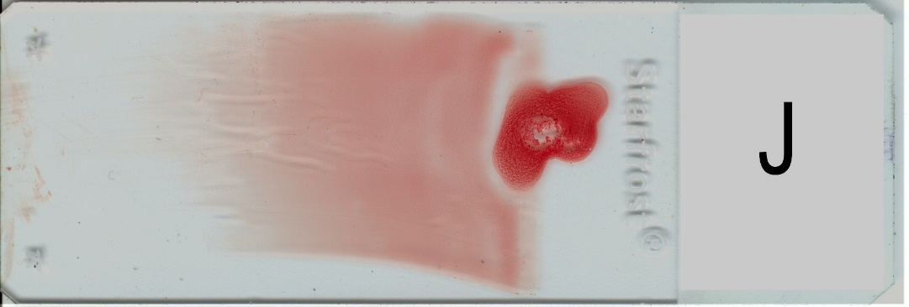
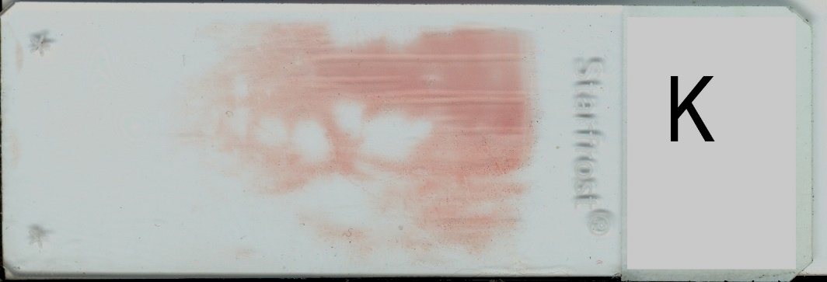
Improperly Made Smears 3
Areas of no blood on slide
Jagged edge and large amount of blood at head
Holes in smear
©Lillian Mundt
Notes:
LO 13.4 Explain the procedure for creating acceptable thin and thick blood smears.
Notes:
To avoid these errors:
Areas of no blood: Push the spreader slide smoothly and evenly across the smear slide.
Jagged edge and large amount of blood at head: Start with a clean slide and allow the entire drop of blood to flow along the edge of the spreader slide before pushing.
Holes in smear: Start with a clean slide and handle it only by the edges to avoid fingerprints.

Slide 48
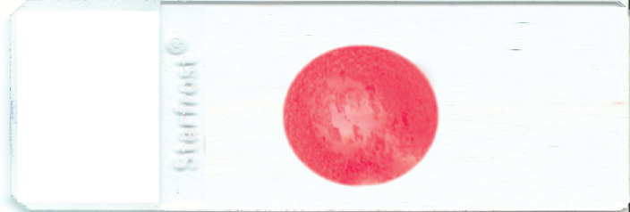
Thick Blood Smears
Screen for malaria
Prepared directly from capillary puncture
Requires one large drop of blood
Spiraled out from center of drop
©Lillian Mundt
Notes:
LO 13.4 Explain the procedure for creating acceptable thin and thick blood smears.
Notes:
Malarial parasites may be present in amounts too small to be detected easily on a routine blood smear examination. A thick blood smear is often used to screen for the presence of the parasite. If it is found, the blood can be examined further using a thin smear.
Procedure:
Collect one large drop of blood directly onto the center of a clean glass slide.
Place the corner of another glass slide or the tip of an applicator stick in the center of the drop.
Draw a spiral from the center outward, spreading the blood into a thick circle.
Allow the smear to air-dry for at least 30 minutes.
A well-prepared thick smear is dense but allows newsprint to be seen through it when still wet.
Thick smears prepared from an EDTA specimen should be prepared no more than one hour after collection.

Slide 49
Blood Collection for Blood Bank
Learning Outcome 13.5

Slide 50
Blood Collection for Blood Bank 2
Blood draw for:
Type and cross-match
Type and screen
Antibody screening
Blood donation
Therapeutic phlebotomy
Notes:
LO 13.5 Recognize the special requirements for carrying out blood collection for blood bank use.
Notes:
Type and cross-match: Typing of blood, screening for antibodies, and testing for compatibility with donor blood; donor units are then put on reserve for that specific patient
Type and screen: Typing of blood and screening for antibodies that may react with donor blood
Antibody screening: Cold agglutinins and anti-Rh tests
Therapeutic phlebotomy: The intentional removal of a large amount of blood to lower the red blood cell concentration
Watch the video “Special Blood Collection Procedures—Drawing Blood for Cross-Match” for more information about drawing blood for type and cross-matching.

Slide 51
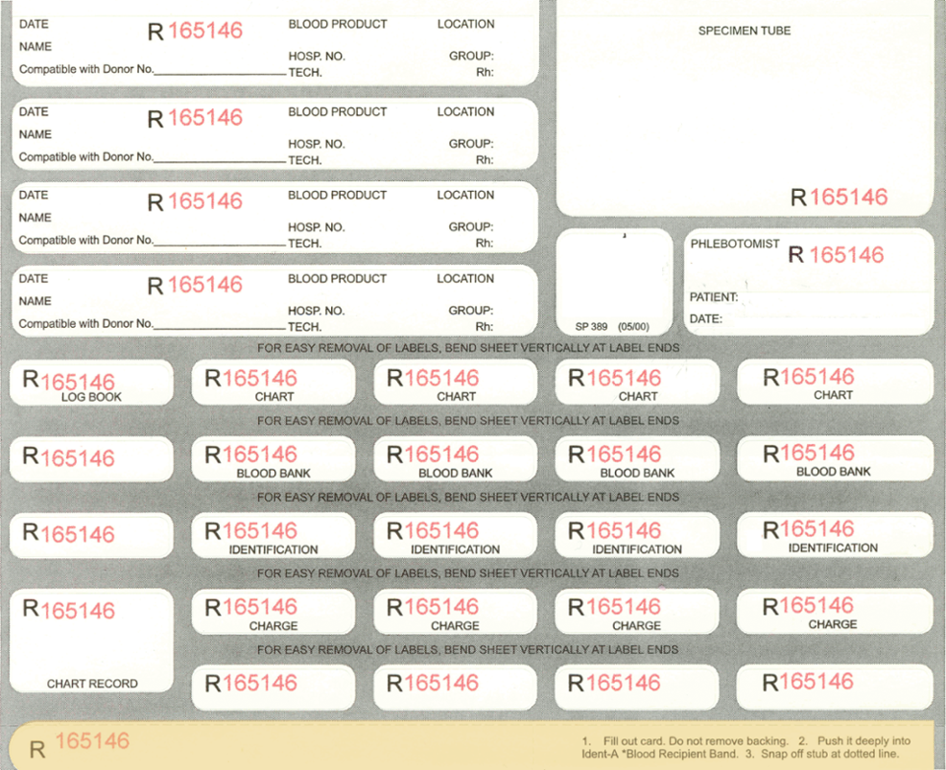
Type and Cross-Match/Type and Screen
Requires more complete identification and documentation
Identification wristband
Hospital admission band
Tube labeling system
©Lillian Mundt
Notes:
LO 13.5 Recognize the special requirements for carrying out blood collection for blood bank use.
Notes:
Identification systems vary by facility, so phlebotomists must become familiar with the system used by their facility.
In all cases, the special transfusion numbers must match on the patient wristband and the tubes.
Specimens drawn for type and cross-match or type and screen are usable for 72 hours only. After the specimen expires, a new specimen must be drawn if the patient requires additional products. In many facilities, a new transfusion number is assigned at that time.
Some hospital blood banks may also have a donor blood collection center. Phlebotomists may collect donor units only after additional training as a donor phlebotomist.

Slide 52
Check Your Competency 13-6: Type and Cross-Match 1
Identify the patient as you would for routine blood draws by asking the patient his or her name and date of birth, or use other acceptable forms of identification.
Compare this information with that on the blood bank requisition and labels.
Compare this information with that on the hospital wristband. If they are different, contact the patient’s nurse immediately for clarification of the patient’s identity. Discrepancies must be resolved before blood is drawn.
Notes:
LO 13.5 Recognize the special requirements for carrying out blood collection for blood bank use.
Notes:
Procedures vary from facility to facility, so always follow your facility’s policy. The general steps shown here and on the next slide will help ensure that the patient is adequately identified.
If you find any discrepancies in the patient’s identification, contact the patient’s nurse immediately. You must resolve discrepancies before drawing blood.

Slide 53
Check Your Competency 13-6: Type and Cross-Match 2
Attach the identification bracelet to the patient’s wrist above or below the hospital band.
Wash your hands, put on gloves, and prepare the equipment.
Perform the venipuncture procedure and collect the appropriate tubes (usually one or two pink-topped EDTA tubes).
Notes:
LO 13.5 Recognize the special requirements for carrying out blood collection for blood bank use.

Slide 54
Check Your Competency 13-6: Type and Cross-Match 3
Label the specimens with the special blood bank labels and recheck information by comparing the labels on the tubes with the blood bank identification band. Be sure to complete all of the information required on the blood bank labels.
Carry out postvenipuncture patient care.
Deliver the specimens and blood bank requisition to the blood bank or transfusion service at your facility.
Notes:
LO 13.5 Recognize the special requirements for carrying out blood collection for blood bank use.
Notes:
Type and cross-match/type and screens are almost always STAT procedures. Be sure to deliver the specimens promptly upon completion of the draw.

Slide 55
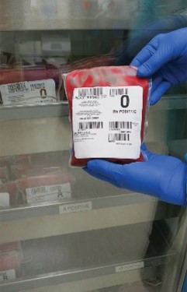
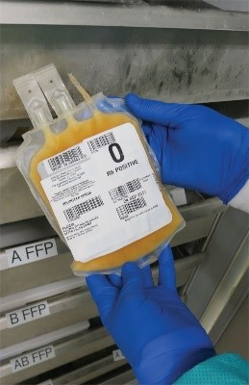
Donor Blood Collection
Products from donor collection
Red blood cells
Plasma
Platelets
© Lillian Mundt
Notes:
LO 13.5 Recognize the special requirements for carrying out blood collection for blood bank use.
Notes:
Blood products such as platelets, plasma, and granulocytes can be collected using apheresis techniques in which one or more of the products is removed during blood collection through a special apparatus. For example, plasmapheresis removes blood plasma.
Donors can give blood at:
Hospital blood banks
Commercial blood donation centers
Community blood drives

Slide 56
Qualifications for Blood Donors
Products from donor collection
Be at least 16 years old
Weigh at least 110 pounds
Be in good general health
Have eaten within 4 hours prior to donation
Have not donated blood in the past 8 weeks
Notes:
LO 13.5 Recognize the special requirements for carrying out blood collection for blood bank use.
Notes:
In addition, the donor’s temperature, blood pressure, and pulse are checked. The donor’s hematocrit or hemoglobin is also checked using a fingerstick technique.

Slide 57
Autologous Blood Collection
Patient donates blood for his or her own use
Must meet prerequisites
Blood must be used within certain amount of time
Cell Saver®
OrthoPAT®
Notes:
LO 13.5 Recognize the special requirements for carrying out blood collection for blood bank use.
Notes:
Autologous donation: Patients who know they will be undergoing surgery can donate blood for their own use if they meet certain prerequisites:
Written order from healthcare provider
Capable of regenerating red blood cells
Hemoglobin of at least 11 grams
Surgery must be scheduled more than 72 hours from time of donation
Other forms of autologous donation:
Cell Saver®: Patient’s blood is collected from body cavities during surgery into special reservoirs. The blood is cleaned and impurities are removed. Then, the blood is infused back into the patient.
OrthoPAT®: This is similar to Cell Saver but used primarily to collect blood loss during knee surgery.

Slide 58
Therapeutic Phlebotomy
Removal of blood for patient’s benefit
Treatment for several medical conditions
Polycythemia vera
Hemochromatosis
Patients require close monitoring
Not as healthy as other blood donors
Notes:
LO 13.5 Recognize the special requirements for carrying out blood collection for blood bank use.
Notes:
Polycythemia vera: Disease that causes an overproduction of red blood cells
Hemochromatosis: Disease in which the body stores iron in abnormal amounts

Slide 59
Arterial Blood Collection
Learning Outcome 13.6

Slide 60
Arterial Puncture
Arterial puncture is performed to test arterial blood gases (ABGs)
Measures ability of lungs to exchange oxygen and carbon dioxide (PO2 and PCO2)
Measure pH level
Special training is required
Notes:
LO 13.6 Identify steps to competent and effective arterial puncture.
Notes:
Arterial puncture: Procedure used to collect arterial blood
Conditions that require measurement of arterial blood gases:
Chronic obstructive pulmonary disease (COPD)
Respiratory failure
Severe shock
Lung cancer
Coronary bypass
Open-heart surgery
Respiratory distress syndrome
Arterial blood collection is not within a phlebotomist’s scope of practice unless additional training has been received.

Slide 61
Check Your Competency 13-7: Arterial Puncture 1
Identify the patient and perform the Allen test. If the Allen test is positive, proceed with the arterial puncture.
Wash your hands, put on gloves, and prepare the equipment.
Position the patient comfortably, with his or her arm resting on a flat surface, and hyperextend the wrist over a rolled towel or an armboard.
Select a site by palpating the path of the radial artery. Note that a tourniquet is not used.
Cleanse the site according to facility policy and procedure. Special cleansing may be required.
Notes:
LO 13.6 Identify steps to competent and effective arterial puncture.
Notes:
Allen test: Test to ensure that the blood supply to the wrist is adequate for the puncture

Slide 62
Check Your Competency 13-7: Arterial Puncture 2
Palpate the artery again using both the index and middle fingers separated by a space of approximately 2 to 4 cm. Leave fingers in place.
Hold the syringe near the needle hub end of the syringe barrel at a 45° angle or slightly steeper.
Puncture the artery midway between the fingers with a smooth, forward motion.
A flash of blood will appear in the hub of the needle when the artery is punctured. Do not advance the needle any farther.
Notes:
LO 13.6 Identify steps to competent and effective arterial puncture.

Slide 63
Check Your Competency 13-7: Arterial Puncture 3
Do not pull on the syringe plunger; the syringe will fill automatically in a pulsating fashion. Allow the syringe to fill to the required level.
Withdraw the needle and immediately apply pressure directly to the puncture site with a clean gauze pad. Direct pressure must be applied for a minimum of 5 minutes.
While still applying pressure, quickly complete the specimen handling procedure.
Follow the facility’s procedure for removing any air from the syringe, engaging the safety device, and capping the syringe, as needed.
Notes:
LO 13.6 Identify steps to competent and effective arterial puncture.

Slide 64
Check Your Competency 13-7: Arterial Puncture 4
Gently roll or invert the syringe to mix the blood with the heparin coating the syringe.
Label the syringe with the specimen label and place the syringe immediately into the ice bath.
After bleeding stops, cover the puncture site with a sterile bandage.
Before leaving the patient, label the syringe with any additional information required by the facility.
Thank the patient and transport the specimen to the laboratory immediately.
Notes:
LO 13.6 Identify steps to competent and effective arterial puncture.

Slide 65
Addressing Anxiety
Anxious patients may:
Hyperventilate
Grit their teeth
Hold their breath
These actions can alter blood gas values
Be calm and confident to reduce patient anxiety
Notes:
LO 13.6 Identify steps to competent and effective arterial puncture.

Slide 66
Venous Access Devices
Learning Outcome 13.7

Slide 67
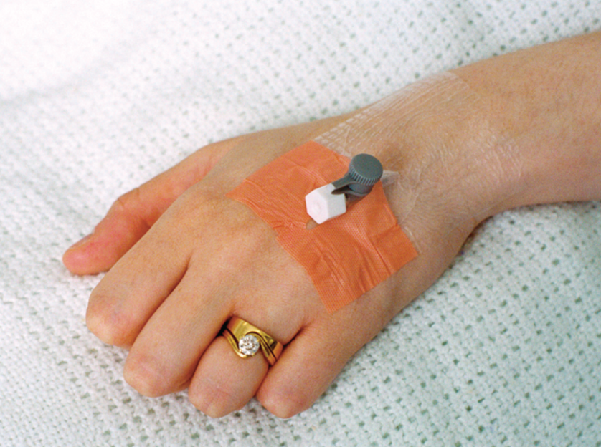
Types of Venous Access Devices
Cannula
Saline or heparin lock
Central venous access line
©Total Care Programming, Inc.
Notes:
LO 13.7 Classify venous access sites and their uses.
Notes:
Cannula: Hollow tube inserted and left in a vein
Heparin (saline) lock: Winged needle set that may remain in a patient’s vein for 8 to 72 hours and is flushed with heparin or saline; used when obtaining blood is difficult or when a patient must have multiple draws in a short period of time
Only specially trained personnel should draw blood from a heparin or saline lock.
Central venous therapy line: Cannula introduced into a vein other than a peripheral vein
Arterial venous fistula: Surgically inserted shunt (usually a U-shaped tube) containing an artery and a vein, usually in the forearm, to allow for hemodialysis; the shunt is used in patients with severe kidney disease and is connected to a machine that filters the blood
Phlebotomists should NEVER access a shunt or central venous line or collect blood from arms that have venous access devices installed.

Slide 68
Chapter Summary 1
Blood cultures must be drawn under strict aseptic technique to prevent false positives.
A set of blood cultures includes aerobic and anaerobic specimens.
Glucose tests include fasting blood glucose, random blood glucose, two-hour postprandial glucose, glucose challenge, and oral glucose tolerance tests.
All states require screening of newborns for cystic fibrosis, galactosemia, hypothyroidism, and phenylketonuria.
Some states also require screening of newborns for biotinidase deficiency and sickle cell disease.
Notes:
13.1 Describe special considerations and procedures needed to collect specimens for blood cultures.
13.2 Identify the various types of glucose tests and the indications and procedures for each.
13.3 List common neonatal screening tests and the conditions they are used to diagnose.

Slide 69
Chapter Summary 2
Thin smears are created by using a spreader slide to smear a single drop of blood across a smear slide.
Thick blood smears are used to screen for malaria.
Special patient identification procedures are required for type and cross-match and type and screen procedures.
Donors must meet strict criteria to be eligible to donate blood.
Patients may donate blood for their own use (autologous donation).
Therapeutic phlebotomy is the removal of blood for medical reasons.
Notes:
13.4 Explain the procedure for creating acceptable thin and thick blood smears.
13.5 Recognize the special requirements for carrying out blood collection for blood bank use.

Slide 70
Chapter Summary 32
Specially trained personnel may perform arterial punctures using the radial artery and specific arterial puncture procedures.
Other venous access devices include a heparin lock, saline lock, central venous therapy lines, and arterial venous fistulas.
Notes:
13.6 Identify steps to competent and effective arterial puncture.
13.7 Classify venous access sites and their uses.

