Slide 1
Collection of
Non-Blood Specimens
Chapter 14
©McGraw-Hill Education. All rights reserved. Authorized only for instructor use in the classroom. No reproduction or further distribution permitted without the prior written consent of McGraw-Hill Education.

Slide 2
Learning Outcomes
14.1 Distinguish among the procedures for collecting various types of swab specimens.
14.2 Explain the procedure for collecting a sputum specimen.
14.3 Describe the special handling and media that may be needed for stool specimens.
14.4 List patient instructions for providing a semen specimen.
14.5 Differentiate among the procedures for collecting various types of urine specimens.
14.6 List examples of other non-blood specimens and their uses.
Notes:
Introduction
Phlebotomists may be required to collect specimens other than blood, such as throat cultures, or to give instructions for collection of various body fluids. Laboratory tests and procedures are classified into categories based on complexity of the test and the training required to perform the test. Phlebotomists may be specially trained to perform laboratory testing that is classified as “waived.”

Slide 3
NAACLS Competencies 1
4.00 Demonstrate understanding of the importance of specimen collection and specimen integrity in the delivery of patient care.
4.2 Describe the types of patient specimens that are analyzed in the clinical laboratory.
4.3 Define the phlebotomist’s role in collecting and/or transporting these specimens to the laboratory.
4.5 Explain the importance of timed, fasting, and stat specimens, as related to specimen integrity and patient care.
5.4 Describe substances that can interfere in clinical analysis of blood constituents and ways in which the phlebotomist can help to avoid these occurrences.

Slide 4
NAACLS Competencies 2
7.00 Demonstrate understanding of requisitioning, specimen transport, and specimen processing.
7.2 Instruct patients in the proper collection and preservation of various samples, including blood, sputum, and stools.
7.6 Identify and report potential pre-analytical errors that may occur during specimen collection, labeling, transporting, and processing.

Slide 5
Key Terms
24-hour collection
Aspirate
Catheter
Clean-catch midstream specimen
Continence
Diabetes mellitus
Expectorate
First morning void
Legal specimens
Nasal swabs
Nasopharyngeal swabs
Semen
Sputum
Stool specimens
Suprapubic puncture
Throat swabs

Slide 6
Swab Specimens
Learning Outcome 14.1

Slide 7
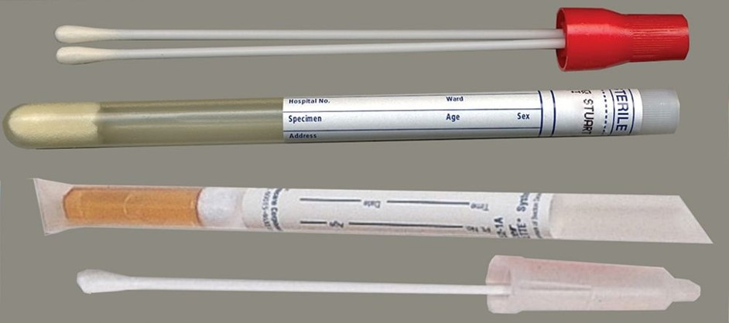
Throat Swabs
Sample taken from back of throat
Uses
Group A Streptococcus screening
Cultures of throat microorganisms
DO NOT use cotton-tipped swabs for throat cultures. The cotton may inhibit bacterial growth.
©Lillian Mundt
Notes:
LO 14.1 Distinguish among the procedures for collecting various types of swab specimens.
Notes:
Throat swabs are samples taken from the back of the throat.
They are used for Group A Streptococcus screening as well as for growing cultures to identify pathogens such as Haemophilus influenzae and Neisseria gonorrhoeae.

Slide 8
Competency Check 14-1:
Throat Swab Collection 1
Identify the patient.
Explain the procedure. Determine if the patient has used an antiseptic mouthwash to gargle recently or is taking antibiotics. These actions could affect the results of the test.
Put on PPE including gloves, mask, and eye protection.
Obtain a tongue depressor.
Remove the sterile swab from its container (do not set it down).
Have the patient tilt his or her head back and stick out the tongue.
Notes:
LO 14.1 Distinguish among the procedures for collecting various types of swab specimens.
Notes:
Before beginning the throat swab collection procedure, make sure that the room has sufficient lighting and all of the equipment you will need.
Gloves must always be worn when performing procedures on patients. When performing throat cultures, you should also wear a mask and eye protection since the patient may cough. Wearing all appropriate PPE is especially important to prevent the spread of pathogens.

Slide 9
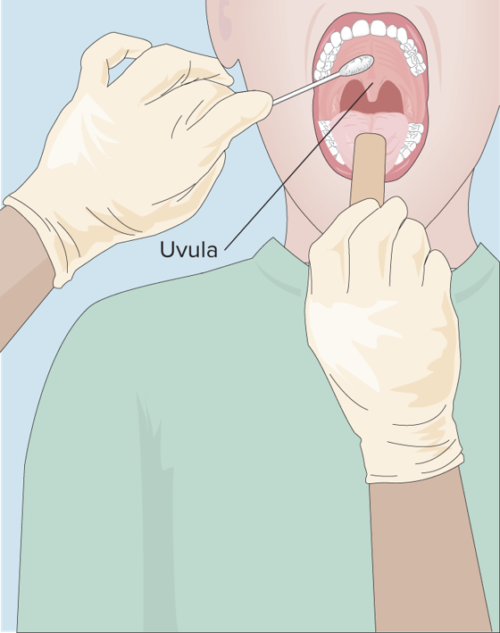
Competency Check 14-1:
Throat Swab Collection 2
Hold the tongue down with the tongue depressor.
Rub the back of the throat and each tonsil with the swab using a rolling action. To minimize the gag reflex, avoid touching the uvula (the tissue that hangs between the oral cavity and the throat). Do not touch the sides of the mouth or teeth because these contain bacteria normally present and can make interpreting culture results confusing.
Copyright © McGraw-Hill Education
Notes:
LO 14.1 Distinguish among the procedures for collecting various types of swab specimens.
Notes:
To help prevent gagging, instruct patients to breath through the nose. This will help minimize movement of the uvula and make it easier for you to collect the specimen quickly.
After removing the sterile swab from the container, do not set it down. Doing so would compromise the sterility of the swab, and you would need to start over with a new sterile swab.
Collect the sample using a rolling action. To minimize the gag reflex, avoid touching the uvula.
To avoid collecting bacteria that are normally present in the mouth, do not touch the swab to the sides of the mouth or teeth.
Most culture swabs have an ampule of growth medium. After the sample has been collected and the swab has been reinserted into the sterile container, the ampule must be crushed to release the growth medium. This helps ensure that any microorganism present remains viable.

Slide 10
Competency Check 14-1:
Throat Swab Collection 3
Withdraw the swab, then the tongue depressor.
Place the swab back into its sterile container and crush the media ampule, if applicable.
Discard the tongue depressor.
While the patient is still present, label the specimen with all required patient and collection information, which is the same as for blood specimens.
Remove your PPE and wash your hands.
Thank the patient.
Notes:
LO 14.1 Distinguish among the procedures for collecting various types of swab specimens.
Notes:
Most culture swabs have an ampule of growth medium. After the sample has been collected and the swab has been reinserted into the sterile container, the ampule must be crushed to release the growth medium. This helps ensure that any microorganism present remains viable.

Slide 11
Competency Check 14-2:
Nasal Swab Collection 1
Identify the patient.
Explain the procedure.
Put on PPE including gloves, mask, and eye protection.
Remove the sterile swab from its container (do not set it down).
While the patient is seated, have the patient tilt his or her head back. Support the back of the head by placing the hand without the swab against the back of the patient’s head. Patients have a tendency to pull away during this procedure.
Insert the swab approximately 2 cm (about ¾ inch) into
a naris.
Notes:
LO 14.1 Distinguish among the procedures for collecting various types of swab specimens.
Notes:
The nares are the cavities just inside the nasal opening.
Nasal swab: Used to collect a specimen from the cavities just inside the nose; also called the nares

Slide 12
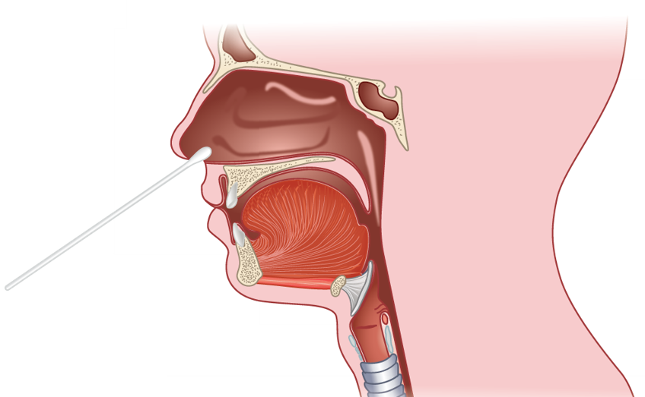
Competency Check 14-2:
Nasal Swab Collection 2
Rotate the swab against the anterior nasal mucosa for 3 seconds.
Using the same swab, repeat for other naris.
Place the swab back into the transport tube and crush the media ampule, if applicable.
Copyright © McGraw-Hill Education
Notes:
LO 14.1 Distinguish among the procedures for collecting various types of swab specimens.
Notes:
The transport tube keeps the microorganisms in the sample moist during transport.

Slide 13
Competency Check 14-2:
Nasal Swab Collection 3
Before leaving the patient, label the specimen with all required patient and collection information.
Remove PPE and wash your hands.
Thank the patient.
Notes:
LO 14.1 Distinguish among the procedures for collecting various types of swab specimens.

Slide 14
Competency Check 14-3:
Nasopharyngeal Swab Collection 1
Identify the patient.
Explain the procedure.
Put on PPE including gloves, mask, and eye protection.
Obtain nasopharyngeal swab, transport medium, and scissors.
Remove swab from its container (do not set it down).
While the patient is seated, have the patient tilt his or her head back. Support the back of the head by placing the hand without the swab against the back of the patient’s head. Patients have a tendency to pull away during this procedure.
Notes:
LO 14.1 Distinguish among the procedures for collecting various types of swab specimens.
Notes:
Nasopharyngeal swabs are samples taken from the nasopharynx (the upper part of the throat behind the nose). They are collected for detection of influenza and respiratory virus infections.
Swab requirements:
Dacron-tipped swabs on a very thin wire
Do not use cotton or calcium alginate
Must be kept moist in viral transport medium
Dry swabs are not acceptable

Slide 15
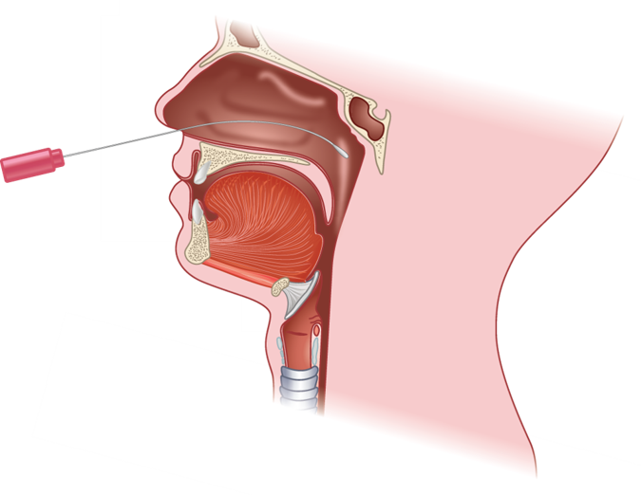
Competency Check 14-3:
Nasopharyngeal Swab Collection 2
Insert swab into one nostril straight back (not upwards) and continue along the floor of the nasal passage for several centimeters until reaching the nasopharynx (you will feel
a resistance). Do not force the swab if you encounter an obstruction before reaching the nasopharynx. Remove
the swab and try the other side.
Copyright © McGraw-Hill Education
Notes:
LO 14.1 Distinguish among the procedures for collecting various types of swab specimens.

Slide 16
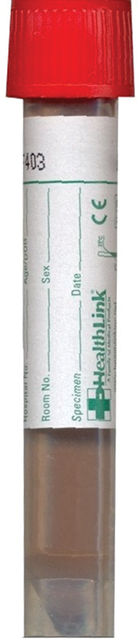
Competency Check 14-3:
Nasopharyngeal Swab Collection 3
Rotate the swab gently for 5−10 seconds to loosen cells from the epithelial lining.
Remove the swab, open the viral transport medium, and immediately place the swab into the container. Use scissors to cut the wire enough below the swab handle to fit the transport medium container. Reattach the cap securely.
Before leaving the patient, label the specimen with all required patient and collection information.
©Lillian Mundt
Notes:
LO 14.1 Distinguish among the procedures for collecting various types of swab specimens.
Notes:
Patients needing collection of a nasal swab or nasopharyngeal swab may have nasal discharge. Provide the patient with a non-scented tissue and ask him or her to attempt to clear the discharge by “blowing the nose” into the tissue. Children may need assistance with this.
Do not try to clear the nasal discharge with swabs. Attempting to do so might be excessively traumatic, especially for children.

Slide 17
Competency Check 14-3:
Nasopharyngeal Swab Collection 4
Remove PPE and wash your hands.
Thank the patient.
Transport to the laboratory immediately. If immediate transport is not possible, the specimen must be refrigerated and kept refrigerated during transport.
Notes:
LO 14.1 Distinguish among the procedures for collecting various types of swab specimens.

Slide 18
Other Swabs
Phlebotomists do not collect but may be asked to handle other types of swabs
Wound cultures
Vaginal cultures
Urethral cultures
Follow the protocols at your facility and your scope of practice
Notes:
LO 14.1 Distinguish among the procedures for collecting various types of swab specimens.

Slide 19
Sputum Specimens
Learning Outcome 14.2

Slide 20
Sputum Specimens2
Uses
Diagnose disorders of respiratory tract
Culture for pathogens
Collection
Rinse mouth with water
Ask patient to expectorate and spit into sterile container
Label specimen and deliver to laboratory
Notes:
LO 14.2 Explain the procedure for collecting a sputum specimen.
Notes:
Sputum: Mucus that collects in the air passages of the respiratory system
Expectorate: Generate a cough from deep within the lungs and bronchi
Having the patient rinse the mouth with water before collecting the specimen helps minimize contamination by bacteria in the mouth.

Slide 21
Stool Specimens
Learning Outcome 14.3

Slide 22
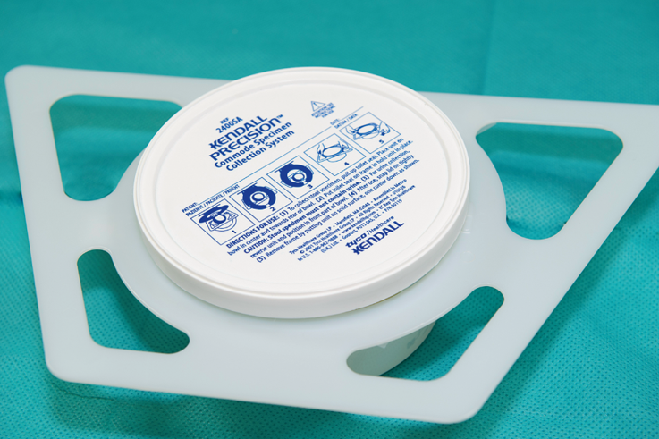
Stool Specimens2
Uses
Stool culture
Fecal fat analysis
Fecal hemoglobin screening
Ova and parasite identification
Collection
Clean, dry, sealable, leakproof container
Instruct patient on procedure
©McGraw-Hill Education/Sandra Mesrine, photographer
Notes:
LO 14.3 Describe the special handling and media that may be needed for stool specimens.
Notes:
Stool specimen: Fecal matter that is waste discharged from the digestive system
The phlebotomist should give clear, practical instructions for collection of the stool specimen:
Follow special diet (if prescribed)
Do not contaminate specimen with urine or water

Slide 23
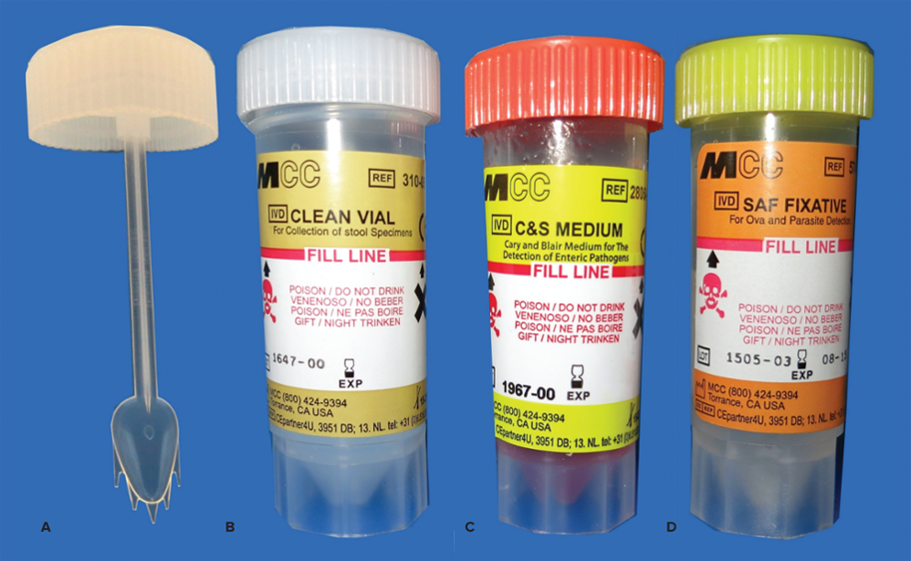
Stool Specimens for Specific Tests
Specimens need to be transferred to vials
All vials must be completely labeled
Types
Ova and parasites
Fecal occult blood
Ova and Parasites
©Lillian Mundt
Notes:
LO 14.3 Describe the special handling and media that may be needed for stool specimens.
Notes:
If the specimen is for the detection of occult blood or certain other tests, the phlebotomist may also need to instruct the patient on how to transfer a specimen to another container.

Slide 24
Semen Specimens
Learning Outcome 14.4

Slide 25
Semen Specimens2
Uses
Evaluate infertility problems
Verify vasectomy
Collection
Patient obtains by masturbation
Include entire ejaculate
Label the specimen
Deliver to lab quickly
DO NOT use condoms for collection of specimens. They may contain spermicidal compounds.
Notes:
LO 14.4 List patient instructions for providing a semen specimen.
Notes:
Semen: Fluid produced by the male reproductive system containing sperm and some substances necessary for fertilization
Have the patient collect the specimen into a clean, wide-mouthed glass or plastic jar with a secure lid. The patient should not use a condom for collection because many condoms contain chemicals (spermicides or lubricants) that may interfere with test results. The most accurate results are obtained on semen specimens collected after a 48- to 72-hour continence (abstinence from sexual activity).
Semen analysis results can be affected by delayed delivery, so encourage the patient to provide the sample in the facility, if possible. Most facilities provide a private room for this purpose. If the patient collects the sample at home, instruct him to keep the specimen near body temperature and deliver it to the lab within 30 minutes.

Slide 26
Urine Specimens
Learning Outcome 14.5

Slide 27
Types of Urine Specimens
Collection Type | Used For
First morning void | Overall screening
Random void | General or routine assessment
Clean-catch midstream | Urine cultures
24-hour collection | Quantitation of proteins and other substances
Legal specimens | Drug screening
Catheterization | Collection when patient is unable to void
Suprapubic puncture | Collection from bladder when patient is unable to void
Notes:
LO 14.5 Differentiate among the procedures for collecting various types of urine specimens.
Notes:
Urine must be refrigerated if it is not tested within one hour of collection. Changes that may occur if it is left at room temperature include:
Changes in urine color and clarity
Bacterial growth
Increase in pH and nitrites
Decomposition of casts and cellular elements
Decrease in substances such as glucose, bilirubin, ketones, and urobilinogen (if they were initially present)
First morning void: Urine that is produced during the night and collected in the morning at the first void
Random void: Collected at any time of the day, usually requiring no special preparation
Clean-catch midstream specimen: Urine collection procedure for culture, which requires skin cleansing and collection of the mid-portion of the urine stream
24-hour collection: Specimen collection procedure that requires patients to collect urine for a 24-hour period of time
Legal specimen: Specimen requiring special handling for criminal investigation
Catheter: A hollow tube inserted into the bladder; used for urine collection
Suprapubic puncture: Urine collection procedure requiring the insertion of a needle through the area just above the pubic bone and directly into the bladder

Slide 28
Reasons for Urine Testing
Screening
Glucose
Drugs or alcohol
General well-being
Measuring total amount of substances excreted in a 24-hour period
Assessment of urinary system
Screening for metabolic diseases
Notes:
LO 14.5 Differentiate among the procedures for collecting various types of urine specimens.
Notes:
Metabolic diseases that can be detected in the urine include:
Diabetes mellitus (a carbohydrate metabolism disorder)
Amino acid overflow
Proteinuria (the leakage of glucose, amino acids, and protein into the urine)

Slide 29
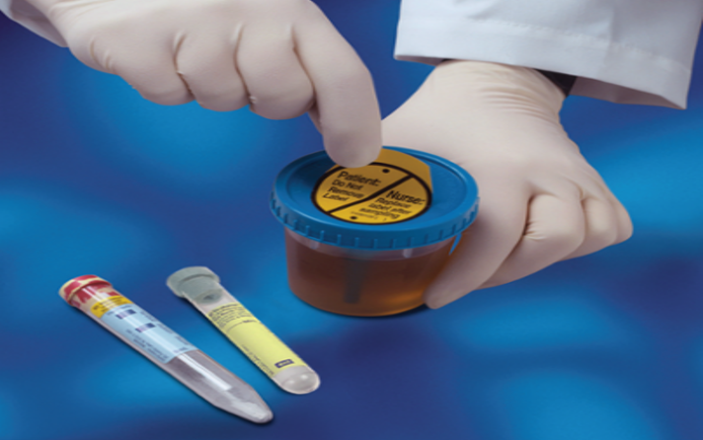
Urine Collection Containers
Routine collection cups
Sterile collection containers
Evacuated tubes with preservatives
Courtesy and ©Becton, Dickinson and Company
Notes:
LO 14.5 Differentiate among the procedures for collecting various types of urine specimens.
Notes:
Routine tests are performed on specimens in the original container (routine collection cup).
Urine for culture must be collected into a sterile cup and may need to be transferred into a tube that contains an additive. Some sterile container kits include towelettes for cleansing.
Urine preservative tube (yellow-topped)
Urine culture tube (gray-topped)
Care must be taken not to confuse the gray-topped urine tube with the gray-stoppered tubes containing sodium fluoride that are used for blood collection.

Slide 30
Competency Check 14-4: Female Clean-Catch Urine Specimen Collection 1
Instruct the patient to follow these steps to clean the perineum.
  Separate the skin folds (labia) and keep them separated throughout the cleaning and collection process. With one antiseptic towelette, wipe from front to back down one side of the skin folds and then discard the towelette.
  With a second towelette, wipe down the other side of the skin folds from front to back; discard the towelette.
  With a third towelette, wipe down the middle of the labia front to back and discard the towelette while keeping the skin folds open with the other hand.
Notes:
LO 14.5 Differentiate among the procedures for collecting various types of urine specimens.
Notes:
Watch the video “Collecting a Clean-Catch Midstream Urine Specimen” for more information about this topic.

Slide 31
Competency Check 14-4: Female Clean-Catch Urine Specimen Collection 2
Instruct the patient to follow these steps to obtain the specimen.
  Keeping the skin folds spread apart to avoid contamination, start to urinate into the toilet.
  Place the cup under the flow of urine after it has begun and remove the cup before it has finished. Do not collect the first or last part of the stream of urine. Instead, collect the urine at midstream; this is why the phrase “clean-catch midstream” is used.
Notes:
LO 14.5 Differentiate among the procedures for collecting various types of urine specimens.
Notes:
It is important not to collect the first or last part of the urine stream. Start the void, then place the cup under the flowing urine. Remove the cup before the urine flow stops.

Slide 32
Competency Check 14-4: Female Clean-Catch Urine Specimen Collection 3
Once the patient is finished, place the lid on the cup. Ideally, the cup should be about three-fourths full.
Label the specimen (name, date of collection). Remember, your facility might require other identification on the specimen, so check with your supervisor.
Notes:
LO 14.5 Differentiate among the procedures for collecting various types of urine specimens.

Slide 33
Competency Check 14-5: Male Clean-Catch Urine Specimen Collection 1
Instruct the patient to follow these steps to clean the penis.
  If uncircumcised, retract the foreskin before cleaning the penis. Use an antiseptic towelette to clean the head of the penis.
  Take a second towelette and wipe across the head of the penis.
Notes:
LO 14.5 Differentiate among the procedures for collecting various types of urine specimens.
Notes:
Watch the video “Collecting a Clean-Catch Midstream Urine Specimen” for more information about this topic.

Slide 34
Competency Check 14-5: Male Clean-Catch Urine Specimen Collection 2
Instruct the patient to follow these steps to obtain the specimen.
  If uncircumcised, keep the foreskin retracted and urinate into the toilet. Place the cup under the flow of urine after it has begun and remove the cup before it has finished. Do not collect the first or last part of the stream of urine. Instead, collect the urine at midstream.
Notes:
LO 14.5 Differentiate among the procedures for collecting various types of urine specimens.
Notes:
If the patient is uncircumcised, retract the foreskin before cleansing the penis and keep the foreskin retracted throughout the clean-catch procedure.

Slide 35
Competency Check 14-5: Male Clean-Catch Urine Specimen Collection 3
Once the patient is finished, place the lid on the cup. Ideally, the cup should be about three-fourths full.
Label the specimen (name, date of collection). Remember, your facility might require other identification on the specimen, so check with your supervisor or procedure manual for further instructions.
Notes:
LO 14.5 Differentiate among the procedures for collecting various types of urine specimens.

Slide 36
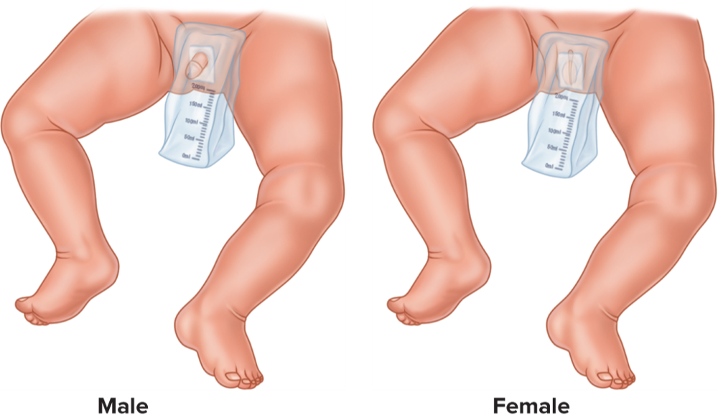
Infant Urine Collection
Use pediatric collection unit
May transfer to collection cup or tube
If for urine culture, leave in collection bag
Transport to laboratory immediately
Copyright © McGraw-Hill Education
Notes:
LO 14.5 Differentiate among the procedures for collecting various types of urine specimens.
Notes:
Urine collection from an infant or small child is performed using a pediatric collection kit, which consists of a sterile plastic bag that has an opening to fit around genitalia. The bag is secured with an adhesive backing.
Always use the established procedure at your facility for collecting urine from an infant.

Slide 37
Competency Check 14-6:
24-Hour Urine Specimen Collection 1
Upon waking the morning of the collection, empty the bladder. Do not collect this urine. Record the time at which this urination occurs.
Collect all urine voided throughout the next 24 hours directly into the preservative container or into a urine collection cup and add to the container.
Use caution when adding the urine to the container because it may contain an acid that may splash.
Be sure to add all the urine into the container; do not spill; do not contaminate the inside of the container.
Notes:
LO 14.5 Differentiate among the procedures for collecting various types of urine specimens.

Slide 38
Competency Check 14-6:
24-Hour Urine Specimen Collection 2
Refrigerate the container, or keep it on ice, for the entire time of collection, if required.
On the second morning, at exactly the same time as the previous day, collect a final void and add it to the container. Record this time.
Keep the specimen refrigerated or on ice, if necessary, until transported to the laboratory.
Notes:
LO 14.5 Differentiate among the procedures for collecting various types of urine specimens.

Slide 39
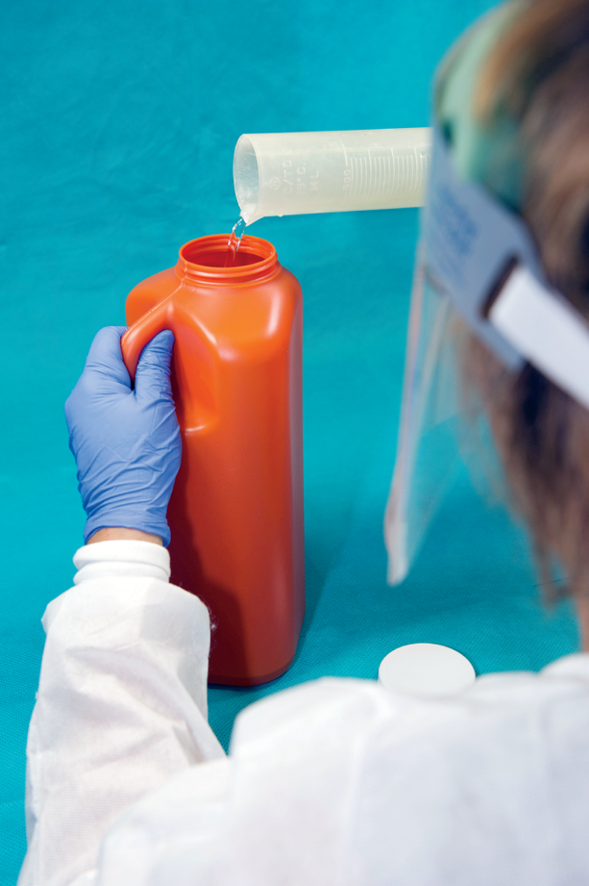
24-Hour Urine Specimen
Measures total amount of substances excreted in 24 hours
Protein
Sodium
Hormones
Some collections require preservatives
Caustic chemicals
Wear PPE
©McGraw-Hill Education/Sandra Mesrine, photographer
Notes:
LO 14.5 Differentiate among the procedures for collecting various types of urine specimens.
Notes:
Not all 24-hour urine collections require preservatives. For those that do, be aware that the chemicals may include strong acids or chloroform. Use a fume hood and wear appropriate PPE:
Gloves
Goggles
Rubber apron
Add acids slowly, and if water is also required, always add the acid to the water. Never add water to the acid.
Some specimens also require refrigeration or need to be placed on ice during the time of collection.

Slide 40
Other Non-Blood Specimens
Learning Outcome 14.6

Slide 41
Other Non-Blood Specimens 12
Specimen Type | How Collected | Reasons for Collection
Amniotic fluid | Amniocentesis (a procedure performed during an ultrasound in which a needle is inserted transabdominally into the amniotic sac and withdrawing a small portion of amniotic fluid). | Detection of fetal distress, genetic studies
Bronchoalveolar lavage (BAL) and bronchial washings | Specimens are collected during bronchoscopy (examination of the tracheobronchial tree). The bronchoscope may have suction catheters, brushes, or biopsy attachments for specimen collection. | Detection of obstructions, pneumonia, carcinoma, hemoptysis, foreign bodies, abscesses, or infectious agents in the lower respiratory tract
Bone marrow | Aspiration and biopsy of marrow, usually from the pelvic bone. | Diagnosis of hematopoietic disorders such as leukemia, lymphoma, and myeloma
Notes:
14.6 List examples of other non-blood specimens and their uses.

Slide 42
Other Non-Blood Specimens 2
Specimen Type | How Collected | Reasons for Collection
Cerebrospinal fluid (CSF) | Lumbar puncture is made into the intervertebral space between L3 and L4 or between L4 and L5. The needle is seated in the dura mater. CSF is collected and after checking CSF pressure. | Central nervous system malignancy, demyelinating diseases, meningeal infection, and subarachnoid hemorrhage
Ear effusion (fluid in the tympanic cavity) | Middle ear effusion specimens are collected using a suction cannula. | Otitis media caused by infections, allergic reactions, and Eustachian tube obstruction
Eye fluid (vitreous) | Vitrectomy, which involves infusing a salt solution while aspirating vitreous fluid from the eye. | Diabetic retinopathy, with retinal detachment, and detection of malignant infiltrates
Notes:
14.6 List examples of other non-blood specimens and their uses.

Slide 43
Other Non-Blood Specimens 3
Specimen Type | How Collected | Reasons for Collection
Gastric fluid | Nasogastric intubation, which involves careful insertion of a tube through the nasal passage, down the esophagus, and into the stomach. Fluid in the stomach is aspirated into a syringe. | Upper gastrointestinal bleeding and assessment of gastric acid output
Pericardial fluid | Pericardiocentesis, which involves inserting a needle through the chest wall into the sac surrounding the heart, with electrocardiographic monitoring. Excess fluid is aspirated into a syringe. | Pericarditis, malignancy
Notes:
14.6 List examples of other non-blood specimens and their uses.

Slide 44
Other Non-Blood Specimens 45
Specimen Type | How Collected | Reasons for Collection
Peritoneal fluid (ascites) | Abdominal paracentesis, which involves inserting a needle into the abdominal cavity and aspirating excess fluid into a syringe. | Chronic liver disease, cirrhosis, pancreatitis, hypoproteinemia, infections, malignancies, and trauma
Pleural fluid | Thoracentesis which involves inserting a needle between the ribs into the cavity surrounding the lungs and aspirating excess fluid into a syringe. | Venous obstruction, congestive heart failure, malignancies, pulmonary emboli or infarct, trauma
Saliva | Patient allows saliva to flow into a sterile collection tube. | Drug screening
Surgical specimens | Biopsies and excised tissues are removed by surgeons and placed into containers of fixative (preservative). | Tumors and other malignancies
Notes:
14.6 List examples of other non-blood specimens and their uses.

Slide 45
Other Non-Blood Specimens 5
Specimen Type | How Collected | Reasons for Collection
Sweat | Collected with the use of pilocarpine iontophoresis, which induces sweating at the site of electrode placement. | Sweat chloride levels to screen for cystic fibrosis
Synovial fluid | Arthrocentesis, which involves placing a needle into the capsule of an affected joint and aspirating fluid into a syringe. | Various types of arthritis: inﬂammatory, noninﬂammatory, hemorrhagic, septic, crystal induced
Notes:
14.6 List examples of other non-blood specimens and their uses.

Slide 46
Chapter Summary 1
Sterile swabs are used to collect several types of non-blood specimens, including throat, nasal, nasopharyngeal, wound, vaginal, and urethral specimens.
Sputum specimens are collected by asking the patient to expectorate and spit the mucus into a sterile container.
Stool specimens are used in tests including stool culture, fecal fat analysis, fecal hemoglobin screening, and ova and parasite identification.
The phlebotomist may need to instruct male patients on the procedure for providing a semen specimen.
Notes:
LO 14.1 Distinguish among the procedures for collecting various types of swab specimens.
LO 14.2 Explain the procedure for collecting a sputum specimen.
LO 14.3 Describe the special handling and media that may be needed for stool specimens.
LO 14.4 List patient instructions for providing a semen specimen.

Slide 47
Chapter Summary 2
Urine is used in many types of laboratory tests, including screening for glucose, drugs, alcohol, and general well-being.
Other non-blood specimens may be processed, but not collected, by the phlebotomist include amniotic fluid, bronchoalveolar and bronchial washings, bone marrow, cerebrospinal fluid (CSF), ear and eye fluids, gastric fluid, pericardial fluid, peritoneal fluid, plural fluid, saliva, surgical specimens, sweat, and synovial fluid.
Notes:
LO 14.5 Differentiate among the procedures for collecting various types of urine specimens.
LO 14.6 List examples of other non-blood specimens and their uses.

